Slide 1

State Taxation of Partnerships –
Status Report
July 28, 2026

Slide 2
Drafting Model State Tax Provisions is always hard
Model state tax provisions are almost never “plug-and-play.”
States adopting the models must often modify them to fit within existing statutes and regulations.
But model partnership sourcing rules raise additional challenges.

Slide 3
Partnerships pose even more challenges
The pass-through system is more complex than entity-level taxation.
    While states generally use similar sourcing approaches, the details vary.
      States may use different terminology for similar partnership or sourcing concepts.

Slide 4
Partnerships pose even more challenges
Existing partnership sourcing rules may:
    Have developed over time and not reflect changing precedents.
        Be generally worded or lack a detail or explicit basis.
            Be embedded in individual and corporate tax sections.

Slide 5
But . . .
Despite the challenges, model provisions can still serve as a useful “proof of concept,” demonstrating recommendations are workable and highlighting important elements that states should consider.
They can also incorporate approaches that states are currently using effectively and can promote uniformity for specific issues.

Slide 6
So here we go . . .
But before we start . . .
The model provisions address how state sourcing rules apply to partnership income. (That is – they apply existing general sourcing rules or principles.)
Some unique partnership issues may call for uniform sourcing rules. (Necessary to avoid duplicative taxation.)
Consistency in sourcing with entity level taxes is also essential.
Tax treatment—including sourcing—depends on the tax character of items. (Take, for example, sourcing non-apportionable items.)

Slide 7
So here we go . . .
But before we start . . .
Partnerships determine the tax character of partnership items. (Not the partner.)
The tax character of partnership items is attributed to the partners’ shares.
Attribution applies for state tax purposes, including when sourcing items. (This is consistent with withholding and PTE taxes.)
Tax attributes of the partner have a limited effect on sourcing. (BLENDING)

Slide 8
So here we go . . .
But before we start . . .
Application of the unitary business principle to partnerships is unclear. (Supreme Court has never opined on how it applies.)
Anti-abuse rules and limits are essential. (But it may be unclear how they apply for state purposes.)
Additional regulations will be needed to implement the provisions here. (These are drafted at the statutory level.)
As with partnership taxation generally, information reporting is essential.

Slide 9
Model Provisions begin with Definitions
    Partnership-related terms may have multiple sources of “definition”
      General state law governing partnerships
      Federal tax law – including Subchapter K
      State tax law
    Since the same terms may be defined and used differently, certain terms may need explicit definitions to avoid ambiguity.

Slide 10
Model Provisions begin with Definitions
    Also – definitions can help make explicit how the general framework of Subchapter K and the general state sourcing rules work together.

Slide 11
Definitions – Part I (Important Examples)
        (1) Allocate or allocation of distributive share income or items of income – A partnership’s determination of a partner’s share of partnership income or items of income under the partnership agreement as well as under any applicable state or federal tax law. See IRC § 704.
      This is to distinguish the term “allocate” when used for partnership distributive share versus when used for sourcing generally.

Slide 12
Definitions – Part I (Important Examples)
  (19) Specifically assign and rules of assignment – The method used to source or allocate corporate income to under [REFERENCE(S) TO STATE STATUTORY PROVISIONS FOR SOURCING NON-APPORTIONABLE OR “NONBUSINESS” ITEMS OF INCOME.]
    This may be a difficult thing for states to do—adopting a different term in the partnership context. And it may be sufficient to look to the context of the use of the term “allocate.”

Slide 13
Definitions – Part I (Important Examples)
  (5) Tax character of an item – The nature and classification of items for tax purposes which may affect their tax treatment as determined by a partnership applying general substantive federal or state tax law based on the activity giving rise to the item. . . .. The tax character of an item may include:
a. Type of receipts or expense – such as interest, royalties, dividends, gains (losses), etc.;
b. The type of transaction or activity giving rise to the income or expense – such as sales or purchases of property, leases of property, sales or purchases of services, depreciation of assets, borrowing of funds, etc.; and
c. The assets affected by the transaction or activity – such as real property, tangible or intangible property, inventory, etc.
This makes clear what “character” is and how it is determined generally.

Slide 14
Definitions – Part I (Important Examples)
        (3) Attribute (verb) or attribution of income or items – The way in which IRC Subchapter K and the pass-through system for partnerships which it creates assigns the tax character of partnership items, as determined by the partnership recognizing those items, to any direct or indirect partners who are allocated a share of those items. This includes the tax character of these items that may affect the sourcing of the items under [REFERENCE(S) TO THE STATE’S STATUTORY PROVISIONS FOR SOURCING INCOME OTHER THAN APPORTIONABLE INCOME]. See IRC §§ 702(b), 875, 897(c)(4)(B), and 958(a)(2).
This makes explicit that the partnership determines the character of income that affects sourcing and attributes that to the partners.

Slide 15
Definitions – Part I (Important Examples)
    (21) Taxpayer or partner attribute (noun) – An aspect of, or circumstance relating to a particular taxpayer that may affect the ultimate tax result for items recognized by or attributed to that taxpayer, which may include:
      (a) Whether the taxpayer or partner is a resident or nonresident individual or a corporation or other type of entity;
      (b) Whether the taxpayer or partner files a separate, joint, or combined/consolidated return;
      (c) The taxpayer’s marginal effective tax rate; and
      (d) The taxpayer’s participation or role in certain activities.
This distinguishes the use of “attribute” as a noun.

Slide 16
Conformity – Part II
  (A) [STATE] conforms to the federal tax law, including IRC Subchapter K, as provided in [REFERENCE(S) TO STATE LAW . . . ]. In conforming to Subchapter K, [STATE] is also conforming to the principle that partnerships determine certain tax character of items of income and then attribute that character of the items to partners who receive a distributive share of those items. This tax character as determined by the partnership may affect the state tax treatment of the items under the state tax rules, including the sourcing of those items under [REFERENCE(S) TO STATE LAW . . . ].
  (B) In addition, [STATE] conforms to certain anti-abuse rules under IRC Subchapter K as described further in Part V of this Section.

Slide 17
Information Reporting is critical
Partnership taxation depends entirely on proper reporting of information by the partnership to the partners (and up the chain by each tiered partnership partner).
Federal tax rules also depend upon, and require, information reporting and consistency in reporting by partners and partnerships.
Federal statutes provide that the IRS (Commissioner) has authority to require necessary reporting.

Slide 18
Obligations of Partnerships to File Information Returns and Report Information – PART III
(A) A partnership shall provide to its direct partners the information necessary for its direct and indirect partners to properly compute and report their [STATE] tax. Necessary information includes any information as described or provided for in regulations, forms, and instructions issued by the [STATE TAX AGENCY]. This requirement to provide information applies to:
  (1) Any partnership doing business in [STATE];
  (2) Any partnership that has a direct or indirect partner doing business in or resident in [STATE].
  (3) Any partnership that has a direct or indirect interest in a partnership doing business in [STATE].

Slide 19
Obligations of Partnerships to File Information Returns and Report Information – PART III
(B) A partnership shall provide to the [STATE TAX AGENCY] certain information as directed by the [STATE TAX AGENCY] necessary to verify the information required to be reported to partners under Subpart A, above and as provided in regulations, forms, and instructions issued by the [STATE TAX AGENCY].

Slide 20
Obligations of Partnerships to File Information Returns and Report Information – PART III
(C) The type of information that may be required to be reported to partners or to [STATE TAX AGENCY] under this Part II includes:
1. Federal tax-related information, including the tax character of partnership income and items recognized by the partnership or allocated to the partnership from lower-tier partnerships;
2. State tax-related information, including the tax character of partnership income and items recognized by the partnership or allocated to the partnership from lower-tier partnerships, as relevant to compliance with [REFERENCE TO STATE INCOME TAX RULES FOR CORPORATIONS AND INDIVIDUALS];

Slide 21
Obligations of Partnerships to File Information Returns and Report Information – PART III
    3. Information necessary for direct or indirect partners to properly determine the source of partnership income and items, as described further in this Section;
    4. Information from lower-tier partnerships or business entities in which the partnership holds an interest that is necessary for that partnership’s direct or indirect partners to properly determine the source of partnership income and items as described further in this Section; and
    5. Any other information the partnership may have or obtain that is necessary for direct or indirect partners to properly report their state tax on partnership income and items.

Slide 22
Applying state Sourcing rules to Partnership Income
The model provisions include two special rules for income of investment partnerships and for guaranteed payments for services paid to individual partners.
Those provisions have been reviewed in the past and we have responded to various comments on those provisions—which are closer to their final form.

Slide 23
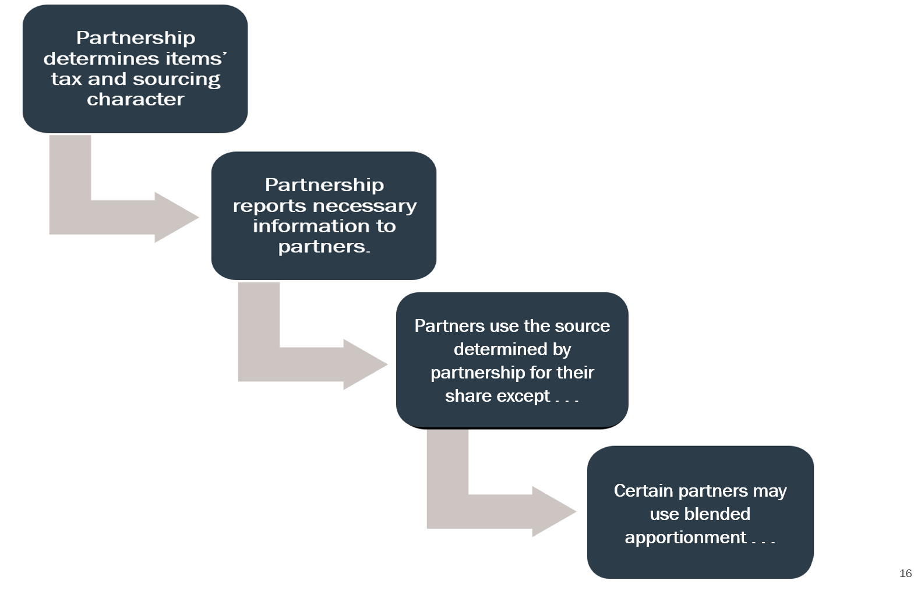

Slide 24
Sourcing Partnership Income and Items – Part IV
  (A) A partnership required to report information as described in Part III, must apply the applicable [STATE] and federal tax rules as required by Part II in determining that information.
  (B) Items Recognized Directly by a Partnership:
  Application of the rules for sourcing income under [REFERENCE TO STATE’S SOURCING RULES FOR INCOME OF BUSINESS ENTITIES, CORPORATIONS, OR NONRESIDENTS] to partnership income requires that a partnership determine the following with respect to the items of income, expense, gain, loss or other tax items that it recognizes directly from its activities:

Slide 25
Sourcing Partnership Income and Items – Part IV
  (1) Information as to the general tax character of those partnership items as it may be relevant to state tax treatment of the items, including:
  a. The tax character of the items for purposes of determining their federal tax treatment to which the state conforms;
  b. The tax character of the items for purposes of determining their state tax treatment, including any treatment that varies from the federal tax treatment; and
  c. The tax character of the items for purposes of applying the sourcing rules in [REFERENCE TO STATE’S SOURCING RULES . . . ].

Slide 26
Sourcing Partnership Income and Items – Part IV
  (2) Information as to whether any partnerships items would be non-apportionable as that term is defined by this Section and the rules provided in [REFERENCES TO STATE’S SOURCING RULES. . . ] if those rules were applied based on:
  a. The item’s particular tax character as determined by the partnership; and
  b. The relationship of the item to the business activity conducted by the partnership, alone or in conjunction with the activity conducted by one or more entities in which the partnership holds a direct or indirect interest.
  In determining this information, the partnership must determine whether its items of income have a sufficient unitary relationship to any business in which the partnership participates that also generates apportionable income, with the understanding that a partnership may engage in more than one unitary business.

Slide 27
Sourcing Partnership Income and Items – Part IV
  (3) Information necessary for sourcing all non-apportionable items determined under Paragraph 2 under [REFERENCE TO STATE’S SOURCING RULES—. . . ].
  (4) Information on the net apportionable income of the partnership as determined under [REFERENCE TO STATE’S SOURCING RULES— . . .] based on the particular business activities to which the items making up that net income have a sufficient unitary relationship, including business activity conducted by one or more entities in which the partnership holds a direct or indirect interest, with the understanding that a partnership may engage in more than one unitary business.

Slide 28
Sourcing Partnership Income and Items – Part IV
  (5) Information on the partnership’s apportionment factor attributes related to the items determined to be part of net apportionable income under Paragraph 4, applying [REFERENCE TO STATE’S SOURCING RULES—APPORTIONMENT FACTORS] to enable determination of those apportionment factors.

Slide 29
Now it gets complicated

Slide 30


Slide 31
Tiered and Corporate partners & Blending
The majority of states have rules that would use blended apportionment in some cases.
The MTC’s combined filing model statutes (Joyce and Finnigan) also use blended apportionment.
Of the states that specify – most use distributive share as the basis for determining the partner’s share of partnership apportionment factors.

Slide 32
What is Blended Apportionment
 | Partnership | Partner
Net apportionable income | $100,000 | $100,000
Partner’s distributive share | $50,000
Receipts – State A | $200,000 | $200,000
Receipts – Everywhere | $1,000,000 | $400,000
No Blending
Blending
Partner’s total income sourced to state A
$200,000 X $100,000 = $50,000
$400,000
+ $200,000 X $50,000 = $10,000
$1,000,000
Equals $60,000
Partner’s total income sourced to state A
$100,000 + $50,000 = $150,000
X (50% of $200,000) + $200,000 = 33.3%
(50% of $1,000,000) + $400,000
Equals $50,000

Slide 33
Sourcing – Part IV – Sections C and D
  A. Upper-Tier Partnership Treatment of Items Allocated from Lower-Tier Partnerships:
  Items of income, expense, gain, loss or other tax items that are allocated to an upper-tier partnership by a lower-tier partnership generally retain their tax character as determined in Subpart B. But the upper-tier partnership will also determine the following with respect to these items:

Slide 34
Sourcing – Part IV – Sections C and D
    1. Whether items determined by the lower-tier partnership to be non-apportionable under Subpart B.2, or apportionable under Subpart B.4, have a sufficient unitary relationship to any business activity generating apportionable income in which the upper-tier partnership is engaged directly or in conjunction with any entity in which the partnership owns a direct or indirect interest.

Slide 35
Sourcing – Part IV – Sections C and D
    2. If items determined to be non-apportionable by the lower-tier partnership are properly determined by the upper-tier partnership to have a sufficient unitary relationship to that partnership’s own business activity generating apportionable income, then the upper-tier partnership would include these items in the net apportionable income from that upper-tier partnership’s related business activities to be apportioned using the upper-tier partnership’s related factors when reporting information to that upper-tier partnership’s own partners.

Slide 36
Sourcing – Part IV – Sections C and D
    3. If items determined to be apportionable by the lower-tier partnership are also determined to have sufficient unitary relationship to the upper-tier partnership’s business activity generating apportionable income, the upper-tier partnership would include these items in the net apportionable income from that partnership’s related business activity and would also include a share of the lower-tier partnership’s in the upper-tier partnership’s apportionment factors to create a “blended apportionment” approach when reporting information on those items and related factors to the upper-tier partnership’s own partners.

Slide 37
Sourcing – Part IV – Sections C and D
    4. The share of the lower-tier partnership factors to be included under Paragraph 3 is determined using the upper-tier partnership’s total distributive share income from the lower-tier partnership as a percentage of that lower-tier partnership’s total income using the absolute value of the items making up that distributive share.

Slide 38
Sourcing – Part IV – Sections C and D
    5. In determining the blended apportionment factors, any factors included representing transactions between the partner and partnership would be eliminated to the extent of the partner’s share determined in Paragraph 4.
    Note that the rules for corporate partners (in Sec. D) are similar when describing the approach to blending.

Slide 39
Why the Absolute Value Method?
As we’ve tried to demonstrate – apportionment is not just about apportioning income (or the positive contributions to profit), it’s also about apportioning expense and loss.
Because partnerships may use “special allocations” – giving partners different shares of income or gain and expense or loss, simply using distributive share will sometimes lead to anomalous results (i.e., where the partner’s share of partnership factors would be negative).

Slide 40
Why the Absolute Value Method?
By giving the same weight to allocations of both income/gains (positive contributions to profit) and expense/loss (negative contributions to profit), the absolute value method reflects the partner’s economic results from its relationship to the partnership.

Slide 41
Speaking of that Relationship
Remember – blending is only used in certain circumstances.
Under the model – this is referred to as a “sufficient unitary relationship.”
The application of the unitary business principle to partnerships raises unique issues and – again – has not been specifically addressed by the Supreme Court.

Slide 42
Sufficient Unitary Relationship – Part VI.
The term “sufficient unitary relationship” as used in this section refers to the necessary relationship between items of income and the apportionment factors used to source that income, especially in the pass-through tax system used to impose tax on partners for their shares of partnership income. The term takes into account all the facts and circumstances relevant to the sourcing treatment of particular items of income including:

Slide 43
Sufficient Unitary Relationship – Part VI.
A. The relationship between the partnership that recognizes the income or items and the partners, including tiered partners, or other entities that are engaged in the related business activities generating other income or items, including:
1. The extent of actual common control, direct or indirect, held or exercised over the business activities, regardless of the share of partnership capital held;
2. The extent to which related activities are integrated or coordinated;
3. The extent to which resources and costs are shared; and
4. The extent of transactions or flows of value between the entities.

Slide 44
Sufficient Unitary Relationship – Part VI.
B. The extent of common use by the partnership and partners, including tiered partners, of assets held by the partnership or partners.
C. The nature of common use by the partnership and partners, including tiered partners, of assets held by the partnership or partners.
.

Slide 45
And Don’t Forget Anti-Abuse Rules
Subchapter K relies on anti-abuse rules.
There are generally two types –
  Explicit limitations or requirements that would affect both the federal and state tax result.
  Other rules that require the federal tax result to meet certain standards, including economic effect, but may not clearly apply to the state tax result if the federal result is not affected.
Part V. of the model addresses how these anti-abuse rules will apply to the state tax result.

Slide 47
Questions

