Slide 1

State Taxation of Partnerships –
Comments on Draft Model Provisions
(Continued)
July 15, 2026

Slide 2
How to Blend
How is the Partner’s share of factors determined?
New!
Episode 2: the Absolute Value Method

Slide 3
Recap of the last Episode!
New!
Information Reporting
Are the draft requirements reasonable?
When to Blend
Is the UBP the right standard and how does it apply?
How to Blend
How is the partner’s share of partnership’s “factor components” determined?

Slide 4
Recap of the last Episode!
New!
To answer the How?
  We started with the distributive share method to allocate factor components.
  The basic idea is to use the ratio of the partner’s distributive share of partnership net income over total partnership net income.
  But we saw that partnerships can make special allocations of distributive share items.

Slide 5
Recap of the last Episode!
New!
  Special allocations of profit and loss lead to absurd results of negative amount of factor components.
  With special allocations the equivalence “% interest = % distributive share = % factor components” no longer works.
  Special allocations also “break” the netting of items of income by specially allocating deductions.
  Losses are essentially excess deductions which means that deductions must have factor representation.

Slide 6
Blending: Special allocation of Partnership Items Demonstration
  When allocations are not uniform, meaning when at least one partnership item is allocated using a distinct ratio, net income or loss can no longer be used to distribute factor components.
  % net income (loss) ≠ % of factor component
  Why? Because net amounts derived from special allocations can represent a multitude of business realities, some representing very little business and others a large portion of activities.
  Compare:
    $200 – $100 = $100, with
    $1,000,000,000 – $999,999,900 = $100
  Could the same share of factor components be attributed to these two special allocations?
  Consider this example:
  P records $5 million of total receipts, including $2 million in State X
  P has a net income of $200k including:
    $100k of interest net of $3k of interest expense deduction, and
    $100k of ordinary business expense.
  P allocates $100k of ordinary business income to Partner A and $100k of interest to Corp.:
  Should Corp be allocated $2.5 million of receipts as factor component?

Slide 7
Blending: Special allocation of Partnership Items – ABS Method
  To give proper weight to distributive shares we must consider that $1 dollar of deductions has the same weight as $1 dollar of gross profits within each partnership separately stated item.
  In the example on the right, Corp would be attributed more receipts than Partner A to represent the larger weight that losses have over the gains. This is not a flaw. It is a feature.
  That weight can be mathematically represented by the absolute value of the allocation which is the distance a number is from zero on a number line, regardless of direction. Because distance cannot be negative, the absolute value of any number is always positive or zero.
  Consider this example:
  P records $5 million of total receipts, including $2 million in State X
  P has a net loss of ($3 million), meaning that P has $8 million of deductions.
  P allocates the partnership net income as follows:
    Partner A is allocated $5 million of gain.
    Corp is allocated ($8 million) of loss.
  Corp should receive 8/13 of the factor components.

Slide 8
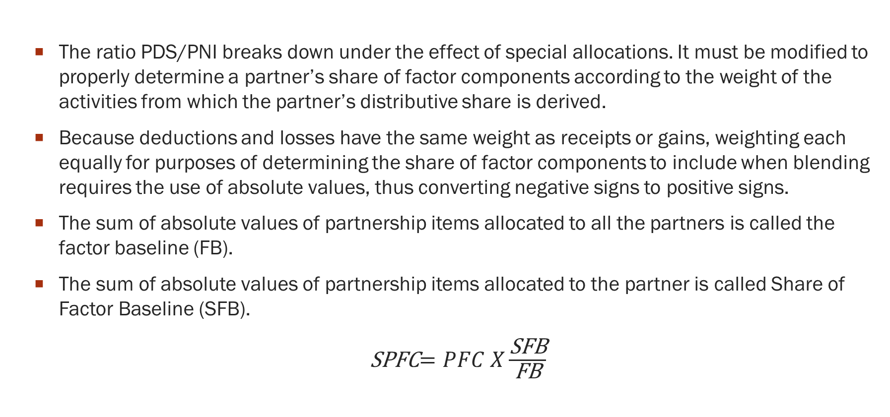
  Allocation of apportionment items: ABS Method
  The ratio PDS/PNI breaks down under the effect of special allocations. It must be modified to properly determine a partner’s share of factor components according to the weight of the activities from which the partner’s distributive share is derived.
  Because deductions and losses have the same weight as receipts or gains, weighting each equally for purposes of determining the share of factor components to include when blending requires the use of absolute values, thus converting negative signs to positive signs.
  The sum of absolute values of partnership items allocated to all the partners is called the factor baseline (FB).
  The sum of absolute values of partnership items allocated to the partner is called Share of Factor Baseline (SFB).
  SPFC$=PFC X\frac{\text{S}\text{FB}}{\text{FB}}$

Slide 9
  Allocation of apportionment items: ABS Method
  On a practical basis, the aggregation of gross receipts and deductions is derived from information reported on federal Form 1065, Schedules K-1 and state modifications.
  The sum of SFBs must equal the FB.
  Note that guaranteed payments and remedial allocations would end up being counted twice in the FB to account for them being at the same time a gain and a deduction.
  This is not a flaw because the same amount is at the same time a deduction and an item of income but for different partners.
  Depreciation deductions from IRC 743(b) basis adjustment are not deductions without tax consequences. They reduce net income in the same way other cost recovery of assets do. Therefore, they must receive as much weight as any other deduction.

Slide 10
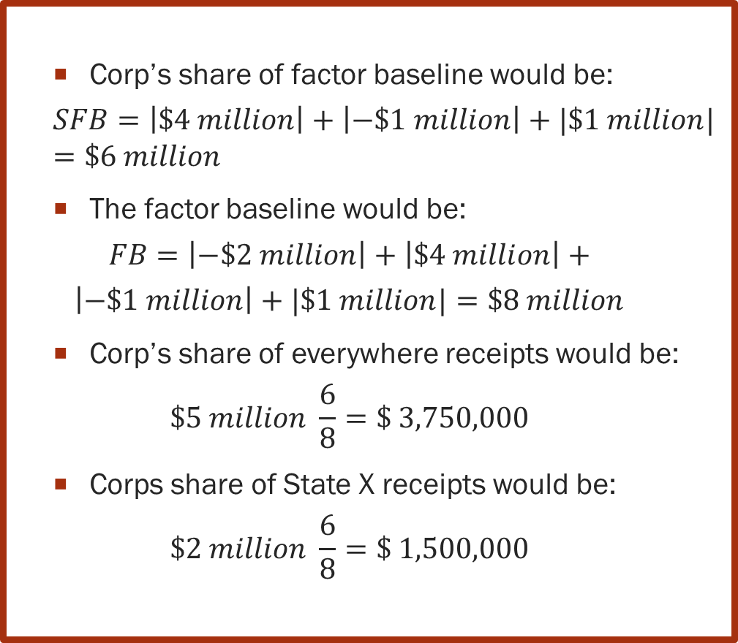
ABS Method: Gains
  P records $5 million of total receipts, including $2 million in State X
  P has a net gain of $2 million, meaning that P has ($3 million) of deductions.
  P’s income is allocated as follows:
    Partner A is allocated:
      ($2 million) of depreciation deduction
    Corp is allocated:
      $3 million of ordinary business income made of:
        $4 million of gross revenue
        $1 million of business deductions
      $1 million of Interest with which no associated expense.
  Corp’s share of factor baseline would be:
  $$SFB=\left|\$4 million\right|+\left|−\$1 million\right|+|\$1 million|=\$6 million$$
  The factor baseline would be:
  $$FB=\left|−\$2 million\right|+\left|\$4 million\right|+$$
  $$\left|−\$1 million\right|+|\$1 million|=\$8 million$$
  Corp’s share of everywhere receipts would be:
  $$\$5 million \frac{6}{8}=\$ 3,750,000$$
  Corps share of State X receipts would be:
  $$\$2 million \frac{6}{8}=\text{\$}\text{ 1,500,000}$$

Slide 11
ABS Method: Gains
  In addition to its share of P’s income and factors, Corp Group has:
  $10 million of total other receipts, including $2 million in State X
  Net income of $3 million
The factor is slightly more than with the 50% allocation (24%) reflecting the 6/8 attribution of apportionment factors.
The measures of business activity in state X has not been distorted using absolute value.

Slide 12
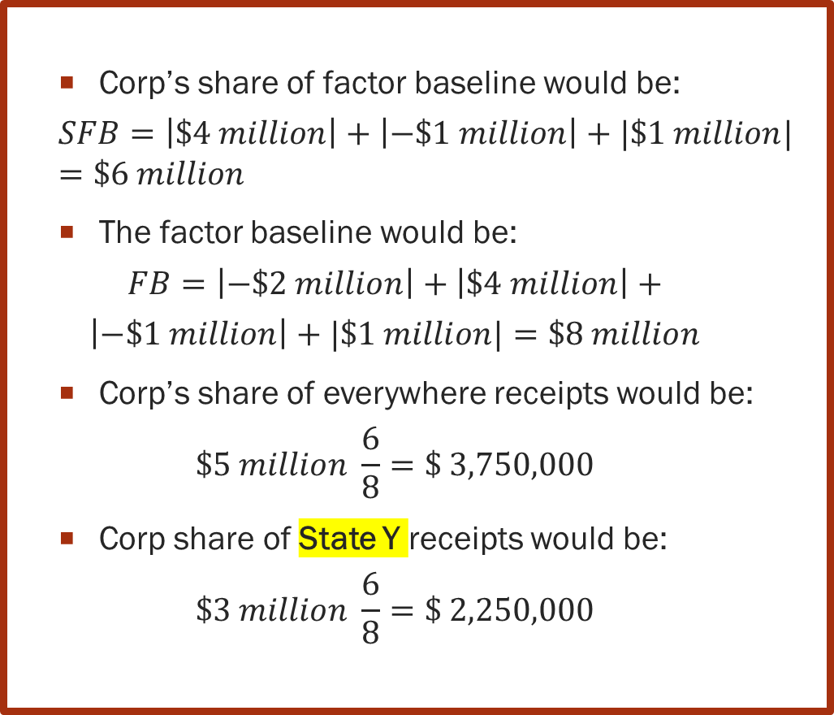
ABS Method: Gains
  P records $5 million of total receipts, including $3 million in State Y
  P has a net gain of $2 million, meaning that P has ($3 million) of deductions.
  P’s income is allocated as follows:
    Partner A is allocated:
      ($2 million) of depreciation deduction
    Corp is allocated:
      $3 million of ordinary business income made of:
        $4 million of gross revenue
        $1 million of business deductions
      $1 million of Interest with which no associated expense.
  Corp’s share of factor baseline would be:
  $$SFB=\left|\$4 million\right|+\left|−\$1 million\right|+|\$1 million|=\$6 million$$
  The factor baseline would be:
  $$FB=\left|−\$2 million\right|+\left|\$4 million\right|+$$
  $$\left|−\$1 million\right|+|\$1 million|=\$8 million$$
  Corp’s share of everywhere receipts would be:
  $$\$5 million \frac{6}{8}=\$ 3,750,000$$
  Corp share of State Y receipts would be:
  $$\$3 million \frac{6}{8}=\text{\$}\text{ 2,250,000}$$

Slide 13
ABS Method: Gains
Corp. Group does not have receipts in State Y. Only P does.
Because State Y also uses the absolute value method to determine the share of factor components, some of Corp. income is sourced to State Y representing the business activities conducted by P and in proportion of Corp distributive share.
In addition to its share of P’s income and factors, Corp Group has:
  $10 million of total other receipts, including $0 million in State Y
  Corp Group has a net income of $3 million

Slide 14
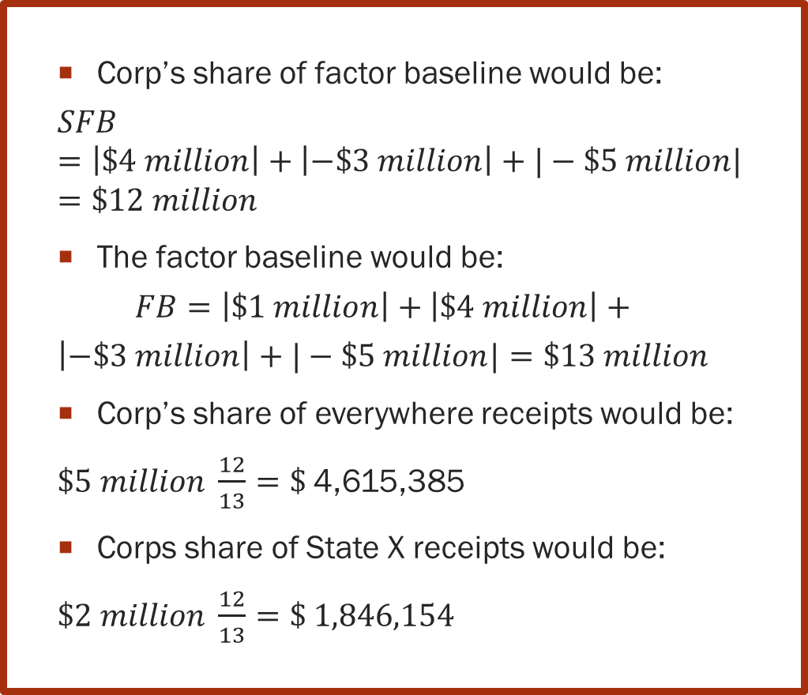
ABS Method: Losses
  P records $5 million of total receipts, including $2 million in State X
  P has a net loss of ($3 million), meaning that P has ($8 million) of deductions.
  P’s income is attributed as follows:
    Partner A is allocated:
      $1 million of interest
    Corp is allocated:
      ($4 million) of ordinary business loss
        $4 million of gross revenue
        ($3 million) of business expense
        ($5 million) of depreciation
  Corp’s share of factor baseline would be:
  $$SFB=\left|\$4 million\right|+\left|−\$3 million\right|+|−\$5 million|=\$12 million$$
  The factor baseline would be:
  $$FB=\left|\$1 million\right|+\left|\$4 million\right|+$$
  $$\left|−\$3 million\right|+|−\$5 million|=\$13 million$$
  Corp’s share of everywhere receipts would be:
  $\$5 million \frac{12}{13}=\$$4,615,385
  Corps share of State X receipts would be:
  $\$2 million \frac{12}{13}=\text{\$ }$1,846,154

Slide 15
Blending: Special allocation of Partnership Items
In addition to its share of P’s income and factors, Corp Group has:
  $10 million of total other receipts, including $2 million in State X
  Net income of $3 million
The factor (27%) is slightly more than with the 50% allocation of deduction (24%) and the 80% allocation (25.71429%).
This higher loss is consistent with the fact that Corp is allocated 12/13, or 92.3% of the partnership items.

Slide 16
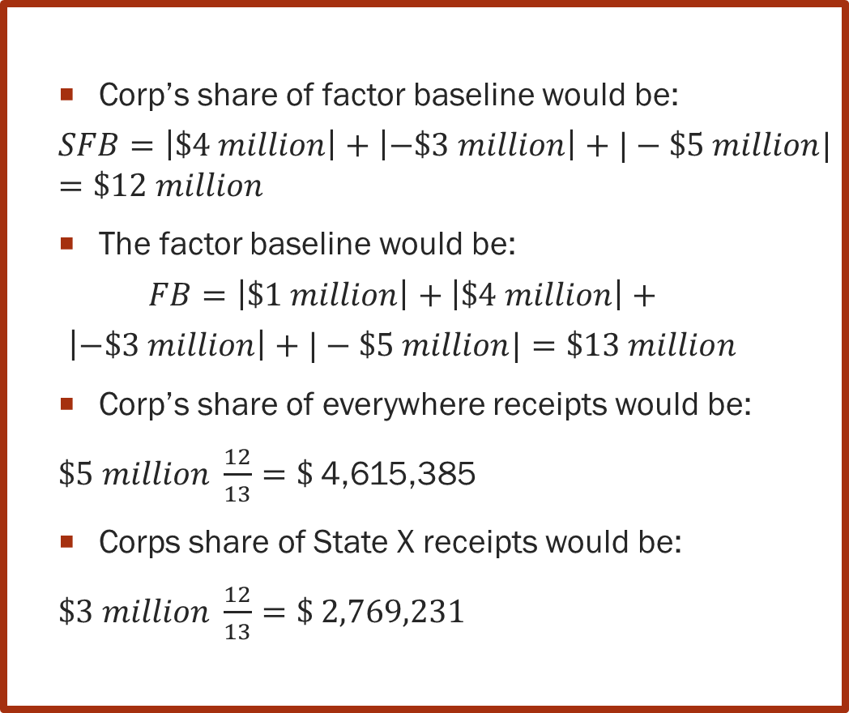
ABS Method: Losses
  P records $5 million of total receipts, including $3 million in State Y
  P has a net loss of ($3 million), meaning that P has ($8 million) of deductions.
  P’s income is allocated as follows:
    Partner A is allocated :
      $1 million of interest
    Corp is allocated :
      ($4 million) of ordinary business loss
        $4 million of gross revenue
        ($3 million) of business expense
        ($5 million) of depreciation
  Corp’s share of factor baseline would be:
  $$SFB=\left|\$4 million\right|+\left|−\$3 million\right|+|−\$5 million|=\$12 million$$
  The factor baseline would be:
  $$FB=\left|\$1 million\right|+\left|\$4 million\right|+$$
  $$\left|−\$3 million\right|+|−\$5 million|=\$13 million$$
  Corp’s share of everywhere receipts would be:
  $\$5 million \frac{12}{13}=\$$4,615,385
  Corps share of State X receipts would be:
  $\$3 million \frac{12}{13}=\text{\$ }$2,769,231

Slide 17
ABS Method: Losses
Corp. Group does not have receipts in State Y. Only P does.
Because State Y also uses the absolute value method to determine the share of factor components, some of Corp. loss is sourced to State Y. due to activities conducted in State Y by P.
In addition to its share of P’s income and factors, Corp Group has:
  $10 million of total other receipts, including $0 in State Y
  Net income of $3 million

Slide 18
  Absolute Value Method Conclusion
  The absolute value method resolves the mathematical impossibility of attributing negative receipts when one partner is allocated losses and another is allocated income.
  It is a mathematical way to eliminate the distortions resulting from the use of a uniform distribution factor when special allocations attribute the yield of activities in ways that are not uniform.
  No better system has been presented that would account for the weight of all partnership items allocated to partners.
  In addition, and quite importantly, it is a formula that can also be used when the allocations are uniform because the ratio SFB/FB would then be the same as the ratio PDS/PNI. And that formula can be integrated into a computerized system.

Slide 19
Blending: ABS Method – Guaranteed Payments
New!
  Guaranteed payments (GP) are made without regard to the income of the partnership.
  GP are sourced like distributive shares under the draft model.
  GPs are generally only business deductions to partnerships.
  Can GPs weight be captured in the ABS method?
  P records $5 million of total receipts, including $2 million in State X
  Corp is receiving a GP of $6 million.
  P has a loss of ($4 million), meaning that P has $9 million of deductions including GPs.
  Corp is allocated $4 million of gain including the GP and 50% of the loss.
  Comparing Corp allocations to the total weight of partnership items does not work because GPs are only recorded as deduction at the partnership level.
  To include the GP as income, Corp allocation must be compared to the total of items allocated to the partners.

Slide 20
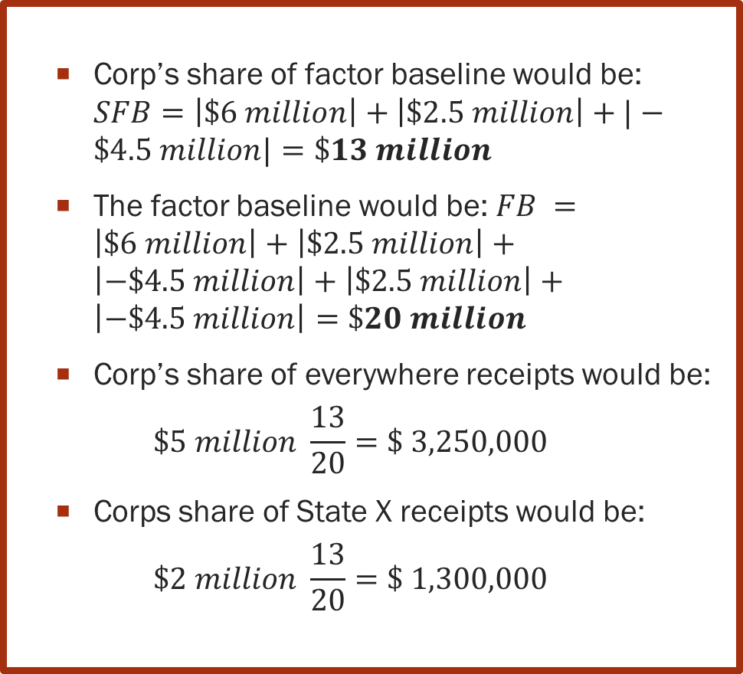
ABS Method: Guaranteed Payments
New!
  P records $5 million of total receipts, including $2 million in State X
  P has a loss of ($4 million), meaning that P has $9 million of deductions.
  P allocates the partnership net income 50/50 as follows:
    Partner A is allocated:
      $2.5 million of receipts.
      ($4.5 million of deductions)
    Corp is allocated:
      $6 million of GP.
      $2.5 million of receipts.
      ($4.5 million of deductions)
  Corp’s share of factor baseline would be: $SFB=\left|\$6 million\right|+\left|\$2.5 million\right|+|−\$4.5 million|=\$13 million$
  The factor baseline would be: $FB =\left|\$6 million\right|+\left|\$2.5 million\right|+\left|−\$4.5 million\right|+\left|\$2.5 million\right|+\left|−\$4.5 million\right|=\$20 million$
  Corp’s share of everywhere receipts would be:
  $$\$5 million \frac{13}{20}=\$ 3,250,000$$
  Corps share of State X receipts would be:
  $$\$2 million \frac{13}{20}=\text{\$}\text{ 1,300,000}$$

Slide 21
New!
ABS Method: Gains
  In addition to its share of P’s income and factors, Corp Group has:
  $10 million of total other receipts, including $2 million in State X
  Net income of $3 million
The factor is reflecting the 13/20 attribution of factor components.
The absolute value method succeeds in treating GPs as distributive share for sourcing purposes.

Slide 22
Possible edit to the model provisions
New!
Sections IV.C (4) and D (4) –
(Illustrated using the language for corporate partners) –
  The share of the partnership factors to be included under Paragraph 3 is determined using the corporate partner’s total distributive share income from the partnership, including guaranteed payments, as a percentage of the total of all the partners’ distributive share income, including guaranteed payments, for that partnership’s total income using the absolute value of the items making up that distributive share.

