Slide 1

Sales Taxation of Digital Products –
Status Report
July 28, 2026

Slide 2
Status report – White Paper

Slide 3
Work on the draft white paper
Drawing on the information from the work group process we are drafting sections of the white paper and publishing those.
Publishing those drafts on the project page along with links to other information from the work group, study groups, and staff research.

Slide 4
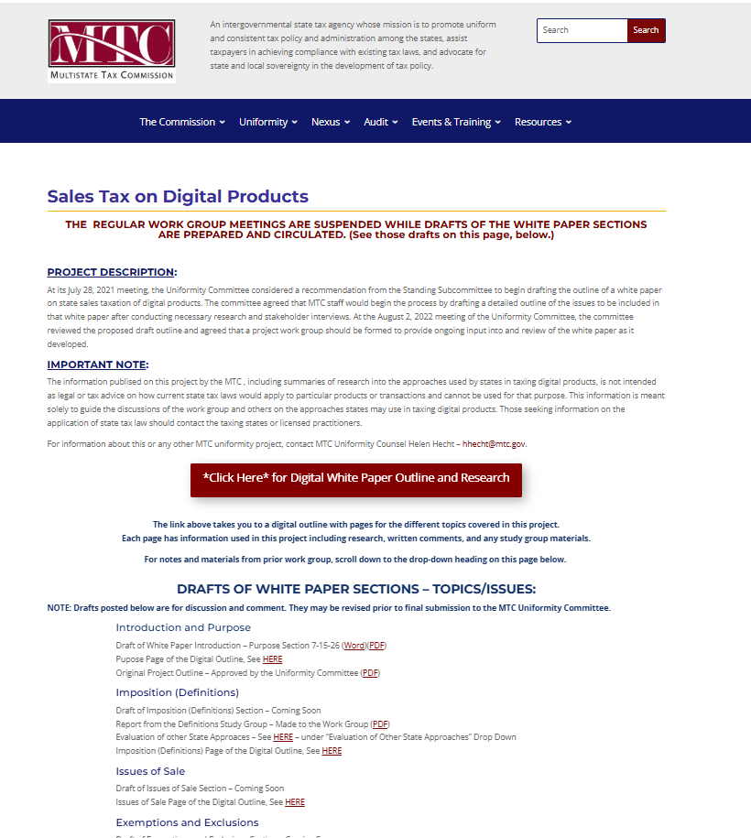

Slide 5
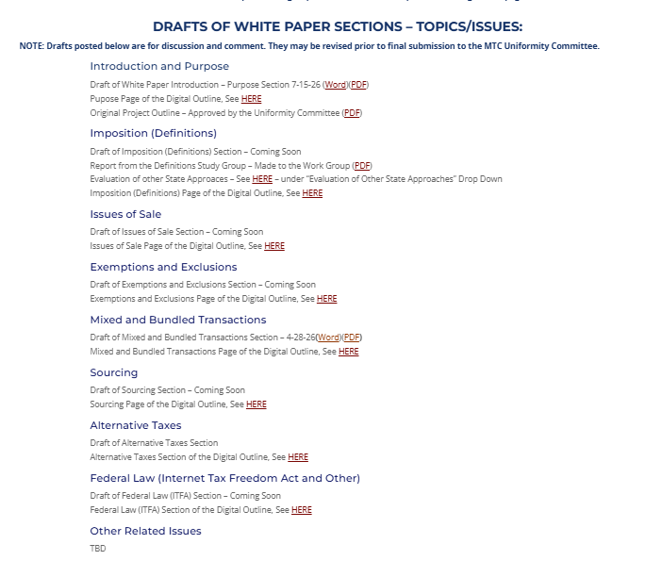

Slide 6


Slide 7
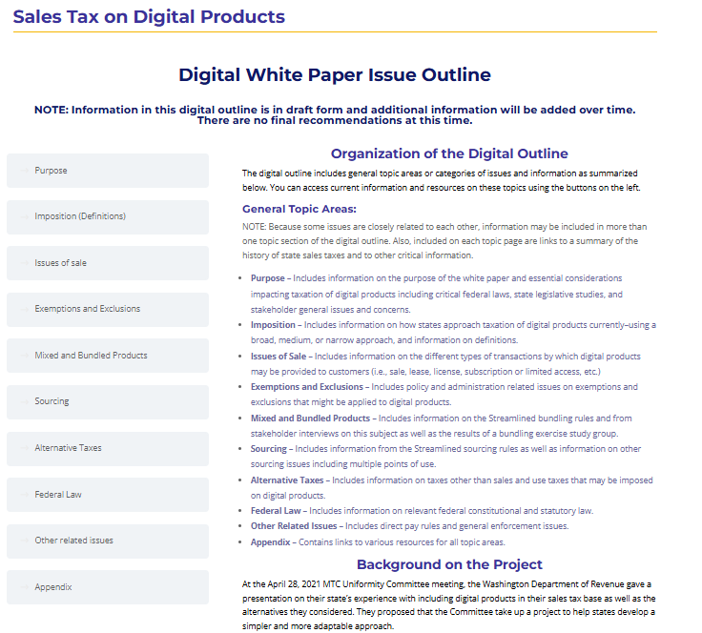

Slide 8
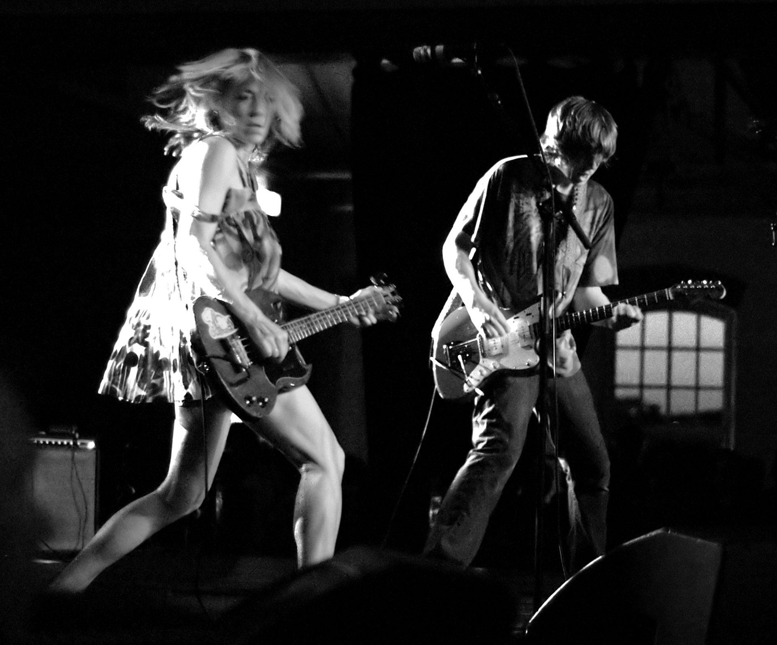

Alternative Taxes
This Photo by Unknown Author is licensed under CC BY-NC-ND
This Photo by Unknown Author is licensed under CC BY-NC-ND

Slide 9
lineup
  Jonathan will introduce the topic.
  Tim will discuss Washington’s imposition of tax on advertising.
  Brian will provide detail on various laws recently enacted by Chicago and Illinois.
  Encore/questions/discussion.

Slide 10
Major genres
  Advertising tax – measured by advertising revenues
  Data collection tax – measured by number of users who have their data collected (subgenre: measured by volume of data)
  Pure social media tax – imposed on social media companies and measured by gross revenue

Slide 11
New releases
  Digital Asset tax – a tax on the activity of dealing with crypo assets
  Prediction markets tax – similar to a wagering tax, per exchange wager

Slide 12
General genres
  Advertising tax – measured by advertising revenues
  Data collection tax – measured by number of users who have their data collected
  Pure social media tax – imposed on social media companies and measured by gross revenue
Important: there is significant substantive variation within genre; these are general categories!
Latest strains
  Digital Asset tax – a tax on the activity of dealing with crypo assets
  Prediction markets tax – similar to a wagering tax, per exchange wager

Slide 13
Behind the music
  Advertising – “programmatic” “targeted” “digital”
  Data collection – by a “commercial data collector” by a “social media platform business”
  Pure social media tax – a tax imposed on social media companies and measured by their gross revenues

Slide 14
Washington Sales Tax - Advertising
Historically, Washington has not imposed retail sales tax on advertising services.
Effective Oct. 1, 2025, sales of advertising became subject to sales tax.
“Advertising services" means all digital and nondigital services related to the creation, preparation, production, or dissemination of advertisements including, but not limited to:
  (A) Layout, art direction, graphic design, mechanical preparation, production supervision, placement, referrals, acquisition of advertising space, and rendering advice concerning the best methods of advertising products or services; and
  (B) Online referrals, search engine marketing and lead generation optimization, web campaign planning, the acquisition of advertising space in the internet media, and the monitoring and evaluation of website traffic for purposes of determining the effectiveness of an advertising campaign.

Slide 15
Washington Sales Tax - Advertising
Advertising services" do not include:
(A) Web hosting services and domain name registration;
(B) Services rendered in respect to the following:
  (I) "Newspapers" as defined in RCW 82.04.214;
  (II) Printing or publishing under RCW 82.04.280; and
  (III) "Radio and television broadcasting" within this state as defined in RCW 82.04.281; and
(C) Services rendered in respect to out-of-home advertising, including: Billboard advertising; street furniture advertising; transit advertising; place-based advertising, such as in-store display advertising or point-of-sale advertising; dynamic or static signage at live events; naming rights; and fixed signage advertising. Out-of-home advertising does not include direct mail;

Slide 16

Chicago and Illinois
Chicago Social Media Amusement Tax
Illinois Targeted Advertising Services Tax
Social Media Platform Fee
Extension of Sports Wagering Act to cover prediction markets
Illinois Digital Asset Tax Act (crypto tax)

Slide 17
Chicago Social Media Amusement Tax
Imposes tax at the rate of $0.50/per month per Chicago consumer on “the activity of social media amusement.”
Excludes the first 100K Chicago consumers.
The tax is imposed on “social media businesses” that collect consumer data on more than 100,000 Chicago consumers.

Slide 18
What is a Chicago consumer under the tax?
Rebuttable presumption: A Chicago consumer is a consumer whose information on record with, or available to, a social media business indicates:
(1) a Chicago home address,
(2) a Chicago mailing address, or
(3) an internet protocol address or other consumer data on primary usage location connected with a Chicago location.
For administrative ease, a social media business may create reasonable categorization standards to use in analyzing consumer data to determine if a consumer is a Chicago consumer.

Slide 19
What is Social Media under the tax?
“Social media” means websites, applications, products, and internet platforms that allows consumers to view, share, and otherwise engage with images, videos, and audio presented in types and formats including, but not limited to, performances, promotions, memes, augmented reality, artificial intelligence, and live streams. “Social media” does not include any bona fide news website, application, or platform.
“Amusement” means engagement with media content delivered through the use of social media for the substantial purpose of entertainment and enjoyment.
“Social media business” means a for-profit entity that: (a) provides individuals with access to social media and (b) collects, maintains, uses, processes, sells, or shares consumer data, other than consumer contact information, in support of the entity’s business activities.

Slide 20
4-156-1040 Rules of interpretation.
(a) The definition of “social media business” in this article shall not be construed to include:
(1) an Internet search provider;
(2) an Internet service provider;
(3) an email service;
(4) a streaming service, online video game, or website where the content is not user generated but includes interactive functions that enable chat, comments, reviews, or other interactive functionality that is incidental to, not directly related to or dependent upon providing the content;
(5) a communication service, including text, audio, or video communication technology, provided by a business to the business’s employees and clients for use in the course of business activities and not for public distribution, except that a social media business’s media access includes a communication service provided to consumers by a social media business;
(6) an advertising network with the sole function of delivering commercial content;
(7) a telecommunications carrier, as defined in United States Code, title 47, section 153;
(8) a broadband service, as defined in 220 ILCS 5/21-201(c);
(9) single-purpose community groups for education or public safety;
(10) teleconferencing or video-conferencing services that allow reception and transmission of audio and video signals for real-time communication, except that a social media business’s media access includes teleconferencing or video-conferencing services provided to consumers by a social media business;
(11) cloud computing services or other non-possessory computer leasing services, which may include cloud storage and shared document collaboration; or
(12) providing or obtaining technical support for a platform, product, or service.

Slide 21
Chicago Social Media Amusement Tax
The purpose of the tax is:
“revenue generation for the City of Chicago by taxing the activity of social media amusement based on a social media business’s monetization of consumer engagement and consumer data collected about Chicago users in conjunction with their social media use.”
Proceeds to be used to provide mental health services:
“The Budget Director and the Comptroller shall create and implement a special revenue fund for supports to the City’s mental and behavioral health operations and investments (the “Protecting Care Fund”) and other accounting measures to track the collection and spending of all proceeds, including penalties, resulting from the imposition of the tax under this chapter.”

Slide 22

Chicago Social Media Amusement Tax
NetChoice has challenged the tax in Cook County Circuit Court under:
Internet Tax Freedom Act
Illinois Constitution (limitation on home rule tax authority)
First Amendment
Commerce Clause

Slide 23
Illinois Social Media Platform Fee
Imposes a graduated system of fees on social media platforms that collect data from Illinois users:
10 cents per active user per month if the company has 100,000 to 500,000 Illinois users;
$40,000 plus 25 cents per user per month if the company has 500,001 to 1 million Illinois users; and
$165,000 plus 50 cents per user per month if the company has more than 1 million Illinois users.
No definition of Illinois user in the statute.

Slide 24
What is a Social Media Platform?
"Social media platform" means a website or internet medium that:
(1) permits a person to become a registered user, establish an account, or create a profile for the purpose of allowing users to create, share, and view user-generated content through that account or profile;
(2) enables one or more users to generate content that can be viewed by other users of the medium; and
(3) primarily serves as a medium for users to interact with content generated by other users of the medium.

Slide 25
Social Media Platform Fee
Administered by the Secretary of State (not the Department of Revenue)
Prohibits a platform from varying the cost of access, features, services, or in-app purchases for any user based on the geographic origin of the user for purposes of recouping the fee.
Fees to be deposited in the common school fund.

Slide 26
Illinois Targeted Advertising Services Tax
Imposes tax upon providers of “targeted advertising services” provided to Illinois user-consumers at the rate 10% of Illinois gross receipts.
Excludes providers with less than $1 million of annual gross receipts from targeted advertising services in Illinois.
Rebuttable presumption regarding Illinois consumers similar to the Chicago rebuttable presumption.

Slide 27
Illinois Targeted Advertising Services Tax
Differs from the Maryland Digital Advertising Tax which is currently being litigated:
The Illinois is a tax on targeted advertising services, rather than on digital advertising services.
"Targeted advertising services" means any programmatic written, oral, or graphic statement or representation conveyed through a digital interface or any other method of delivery, including, but not limited to, banner advertising, search engine advertising, interstitial advertising, and other comparable advertising services that use personal information about the people to whom the ads are being served. [Excludes news media sites.]

Slide 28
Illinois Targeted Advertising Services Tax
Findings and intent.
The General Assembly finds and declares the following: Many goods and services that traditionally have been subject to Illinois State and local use and occupation taxes have avoided taxation in the digital era. Many digital transactions are harder to bring into the sales tax base because, instead of paying a monetary fee, customers often barter their personal information for access to digital platforms. This personal information, in turn, is sold for use in targeted advertisements on digital platforms. . . .

Slide 29
Tax on (Certain) Prediction markets
Added to the Sports Wagering Act.
1.75% tax on each exchange wager up to 5 million wagers during a fiscal year; 3.5% tax on each additional wager.
"Exchange wager" includes an agreement, contract, transaction, or swap that is offered, traded, or executed on a prediction market or exchange tied to a sporting contest or sporting event.

Slide 30
Tax on (Certain) Prediction markets
Kalshi sued Illinois in federal district court challenging non-tax provisions of the bill that seek to regulate prediction markets.
The state agreed to halt enforcement of the tax until the lawsuit is resolved.
Kalshi claims that the Commodity Futures Trading Commission has exclusive jurisdiction over prediction markets under the federal Commodity Exchange Act

Slide 31
Illinois Digital Asset Tax Act
Imposes a transaction tax upon the “privilege of receiving any digital asset business activity by a customer in [Illinois].”
“Digital asset business activity” means exchanging, transferring, or storing a digital asset.
Rate: 0.2% of the value of the digital asset to which the digital asset business activity relates.
Industry claims that digital assets may include not only cryptocurrencies but also “tokenized” versions of stocks, bonds, commodities, and bank deposits.
Requires digital asset brokers, such as cryptocurrency exchanges and other parties that facilitate digital asset transactions on behalf of customers, to collect the tax and remit it to the state.

Slide 32
Illinois Digital Asset Tax Act
The Chamber of Digital Commerce has challenged the tax in Sangamon County Circuit Court under:
Uniformity Clause of the Illinois Constitution
Due process clause of the Illinois Constitution and the U.S. Constitution
Illinois Proportionment Penalties Clause of the Illinois Constitution
Commerce Clause
Internet Tax Freedom Act

Slide 33
Reference slide
  California – A.B. 796 (2026); proposed
  Illinois – S.B. 3019 (2026); enacted
  Maryland – H.B. 468 (2026); proposed
  Massachusetts – S.B. 3208; S.B. 3089 (2026); H.B. 3126; H.B. 3224; H.B. 3263; H.B. 3118 (2025); proposed
  Michigan – Governor’s FY2027 budget; H.B. 4142 (2025); proposed
  Minnesota – S.B. 5052; H.B. 5055 (2026); proposed
  Nebraska – L.B. 2025 (2026); proposed
  New Jersey – S. 4908 (2025); proposed
  New York – A.B. 1434 (2025); proposed
  North Carolina – S.B. 257 (2026); enacted
  Pennsylvania – H.B. 1678 (2026); proposed
  Rhode Island – S.B. 2028 (2026); proposed
  Tennessee – S.B. 2512 (2026); proposed
  Utah – S.B. 287 (2026); enacted
  Washington – S.B. 5814 (2025) (sales tax); enacted

Slide 34
Questions or Feedback

