Slide 1

State Taxation of Partnerships –
Comments on Draft Model Provisions
(Continued)
July 1, 2026

Slide 2
Comments on the Draft Model Provisions
From –
  AICPA
  Eversheds-Sutherland
  Energy Infrastructure Council
Also expecting comments from the ABA
Will be issuing a revised draft model with certain edits
For other comments we have an initial response (based on past discussions) but may need further discussion

Slide 3
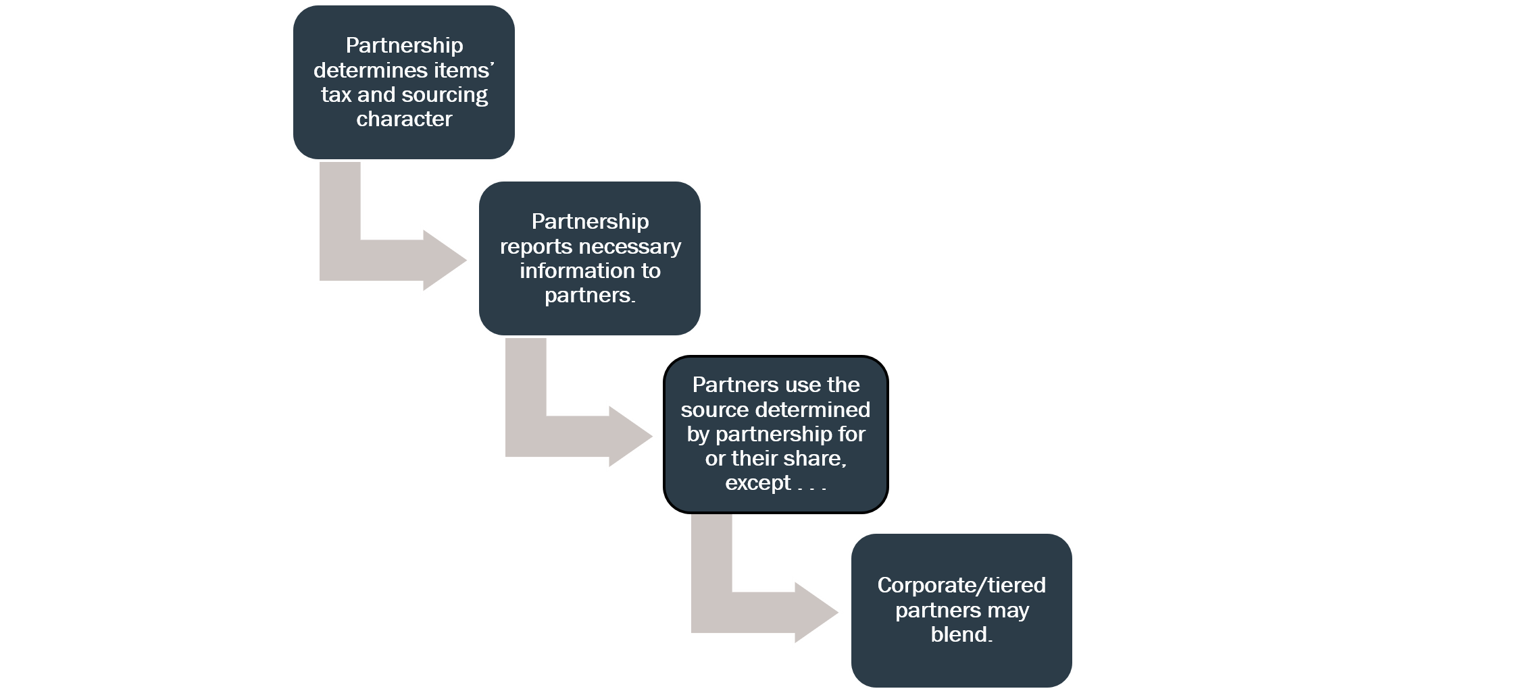
Partners use the source determined by partnership for their share except . . .

Slide 4
General Comments
Information Reporting
Are the draft requirements reasonable?
When to Blend
Is the UBP the right standard and how does it apply?
How to Blend
How is the partner’s share of partnership’s “factor components” determined?

Slide 5
Information Reporting
Are the Draft Requirements Reasonable?
Initial response – subject to further discussion

Slide 6
Summary from Last Call
General state law requirements –
  Partnerships must provide necessary or requested information to partners, including information partners request.
Federal tax requirements –
  Statute refers to information required by regulations, forms, instructions, etc.
Draft model provision requirements –
  Partnerships must give partners information needed to comply with state law
  Partnerships must provide state with information necessary to verify proper reporting
  Examples of information are also included

Slide 7
Critical Questions
What information should partners, especially indirect partners, be required to provide to partnerships that may not have activities in the partner’s state of residence?
  A statement of adjustments their resident state may require and the information needed?
  Can states design forms for that purpose –summarizing information that will be required?
When might penalties be imposed for failure to report?
  Not addressed in the draft model provisions.

Slide 8
Additional Question - Application of P.L. 86-272
As the white paper notes—the application of P.L. 86-272 to partnerships and partners raises questions of how to treat state throw-out and throw-back rules.
This, in turn, can raise information reporting questions.

Slide 9
When to Blend
Is the UBP the right Standard and how does it apply?
Initial response – subject to further discussion

Slide 10
Summary from the Last Call:
MTC combined filing models require blending.
Most states require blending for corporate partners and many also apply blending specifically to tiered partners.
States that address the “when” question generally refer to the unitary relationship between partner and partnership as the standard.
Only partners conducting their own business activities will blend and there is a special rule for investment partnerships.
States don’t have to blend, even when the partner and partnership are part of a unitary business.
States may also impose other limits on blending.

Slide 11
Comment concerning Sale of an Interest
Draft model provisions address the sourcing of partnership distributive share --
  Apply sourcing rules based on the character of the items making up the distributive share as determined at the partnership level.
  May also use blending where the partner and partnership have a sufficient unitary relationship.
Gain or loss from the sale of an interest is not distributive share.

Slide 12
Blending is about fair apportionment
  Assume a partner engages in the same income generating activity both directly and through a partnership. If the state would include both the direct and distributive share income from that activity in the apportionable base, then should the same types of that would otherwise be included also be used when apportioning that base?
  While the U.S. Supreme Court has never addressed factor representation per se, a few state courts have ruled supporting “factor representation” generally.
  UDITPA also contains Sec. 18 which allows variation in the approach used in order to “fairly represent the extent of the taxpayer’s business activity in this State.”

Slide 13
MTC Position on Blending
We have incorporated the concept of blending into our Joyce and Finnigan models for combined filing of corporations.
Those provisions would use distributive share to determine the share of factor components, but do not address how to apply that method in different circumstances.
We have not provided detail on how to apply the UBP to the question of when to blend.

Slide 14
Partnership Examples
Assume:
  Corp has a business renting property and provides services to those who lease the property in State X.
  Corp holds an interest in Partnership which owns similar property in State Y which Partnership leases.
  Corp provides the same types of services to those leasing the property of Partnership in State Y.
  Corp receives a share of Partnership’s rental income.
Questions:
  Should Corp include a share of the Partnership’s rental receipts sourced to State Y in its apportionment factor applied to its blended apportionable income from renting property in State X and providing services in States X and Y?
  Does it matter whether Corp is involved in a majority owner of Partnership?
  Does it matter whether Corp is involved in the management of Partnership?

Slide 15
Partnership Examples
Assume:
  Corp has a business in State X.
  Corp holds an interest in Partnership 1 (P1) which is involved in two businesses through Partnership 2 (P2) and Partnership 3 (P3), which operate entirely in State Y.
  Corp’s and P3’s businesses are closely related and Corp benefits from and participates in the activities of P3.
  Corp’s distributive share from P1 includes a distributive share from P3.
Questions:
  Should Corp include a share of P3’s factor components from State Y in its apportionment formula applied to the blended apportionable income from its own activities and its distributive share from P1 that is the income from P3?
  Does it matter whether Corp is an indirect partner in P3?

Slide 16
Partnership Examples
Assume:
  Corp has a business in State X which has no income tax.
  Corp holds a minority interest in Partnership which operates in State Y which has an income tax.
  Corp does not control Partnership.
  Corp has employees that perform certain operational tasks and has an exclusive contract with Partnership to provide Partnership those same operational services which are necessary for Partnership to serve its own customers.
  The transaction between Corp and Partnership is treated as a Sec. 707(a) transaction between unrelated parties.
Questions:
  Should Corp blend?
  Does it matter whether Corp’s income is effectively offset by its share of the related expense in its distributive share of Partnership’s income?

Slide 17
Partnership Examples
Assume:
  Corp has a business in State X which has no income tax.
  Corp holds a minority interest in Partnership which operates in State X and State Y which has an income tax.
  Corp controls Partnership.
  Corp receives a special allocation of Partnership income related only to activities in State X.
Questions:
  If Corp blends should it blend all of the factors from Partnership or only those related to the activities in State X.
  Does it matter whether Partnership’s activities in State X and State Y are unitary?

Slide 18
Proposed Draft Model Provisions – Part VI.
Sufficient Unitary Relationship
The term “sufficient unitary relationship” as used in this section refers to the necessary relationship between items of income and the apportionment factors used to source that income, especially in the pass-through tax system used to impose tax on partners for their shares of partnership income. The term takes into account all the facts and circumstances relevant to the sourcing treatment of particular items of income including:
A. The relationship between the partnership that recognizes the income or items and the partners, including tiered partners, or other entities that are engaged in the related business activities generating other income or items, including:
1. The extent of actual common control, direct or indirect, held or exercised over the business activities, regardless of the share of partnership capital held;
2. The extent to which related activities are integrated or coordinated;
3. The extent to which resources and costs are shared; and
4. The extent of transactions or flows of value between the entities.
B. The extent of common use by the partnership and partners, including tiered partners, of assets held by the partnership or partners.
C. The nature of common use by the partnership and partners, including tiered partners, of assets held by the partnership or partners.

Slide 19
Bottom Line Question
Can we say exactly how the UBP, as a standard for blending, will apply in every situation (which we do not attempt to do in the corporate context)—or is this sufficient, at least to the extent the UBP will be one part of any limitation on blending?

Slide 20
How to Blend
How is the Partner’s share of factors determined?
Initial response – subject to further discussion

Slide 21
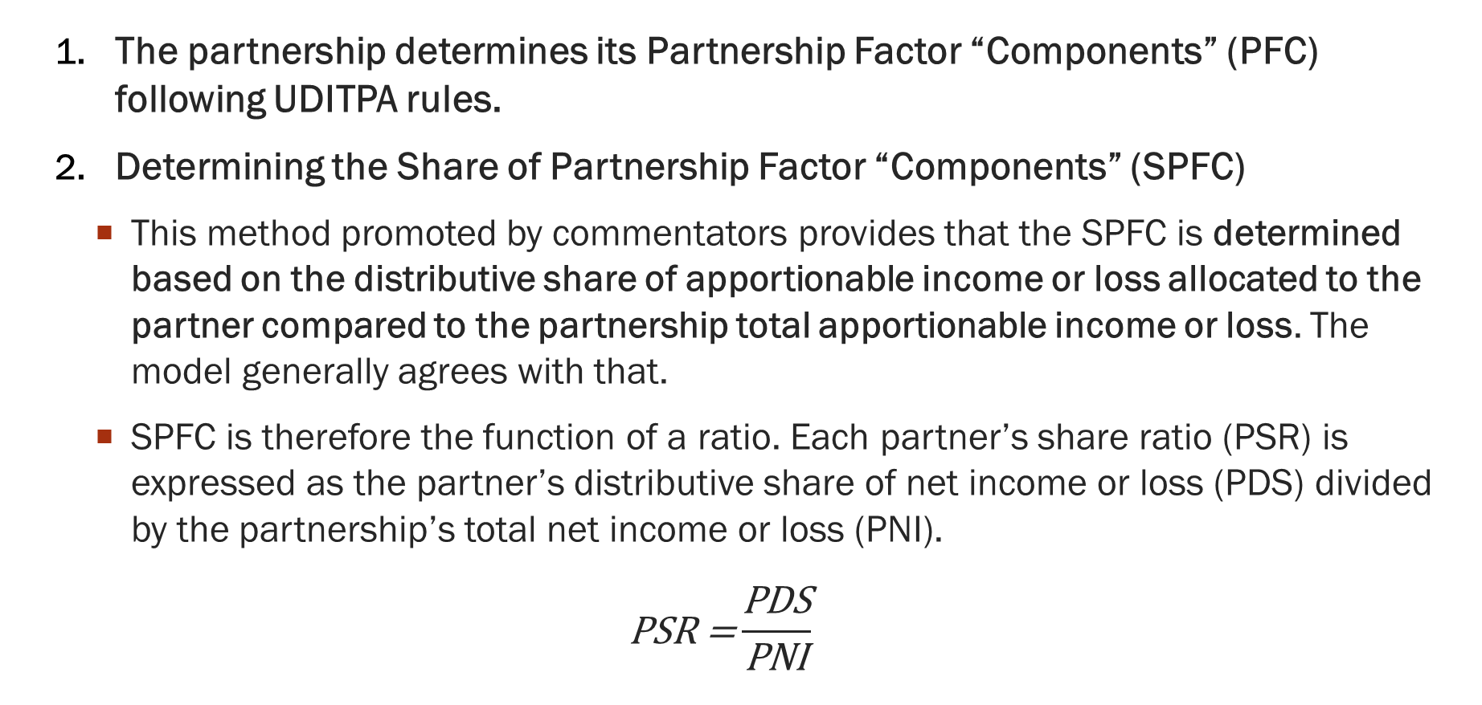
  Blending - Distributive Share Method
  The partnership determines its Partnership Factor “Components” (PFC) following UDITPA rules.
  Determining the Share of Partnership Factor “Components” (SPFC)
    This method promoted by commentators provides that the SPFC is determined based on the distributive share of apportionable income or loss allocated to the partner compared to the partnership total apportionable income or loss. The model generally agrees with that.
    SPFC is therefore the function of a ratio. Each partner’s share ratio (PSR) is expressed as the partner’s distributive share of net income or loss (PDS) divided by the partnership’s total net income or loss (PNI).
  $$\text{PSR}\text{ =}\frac{\text{PDS}}{\text{PNI}}$$

Slide 22
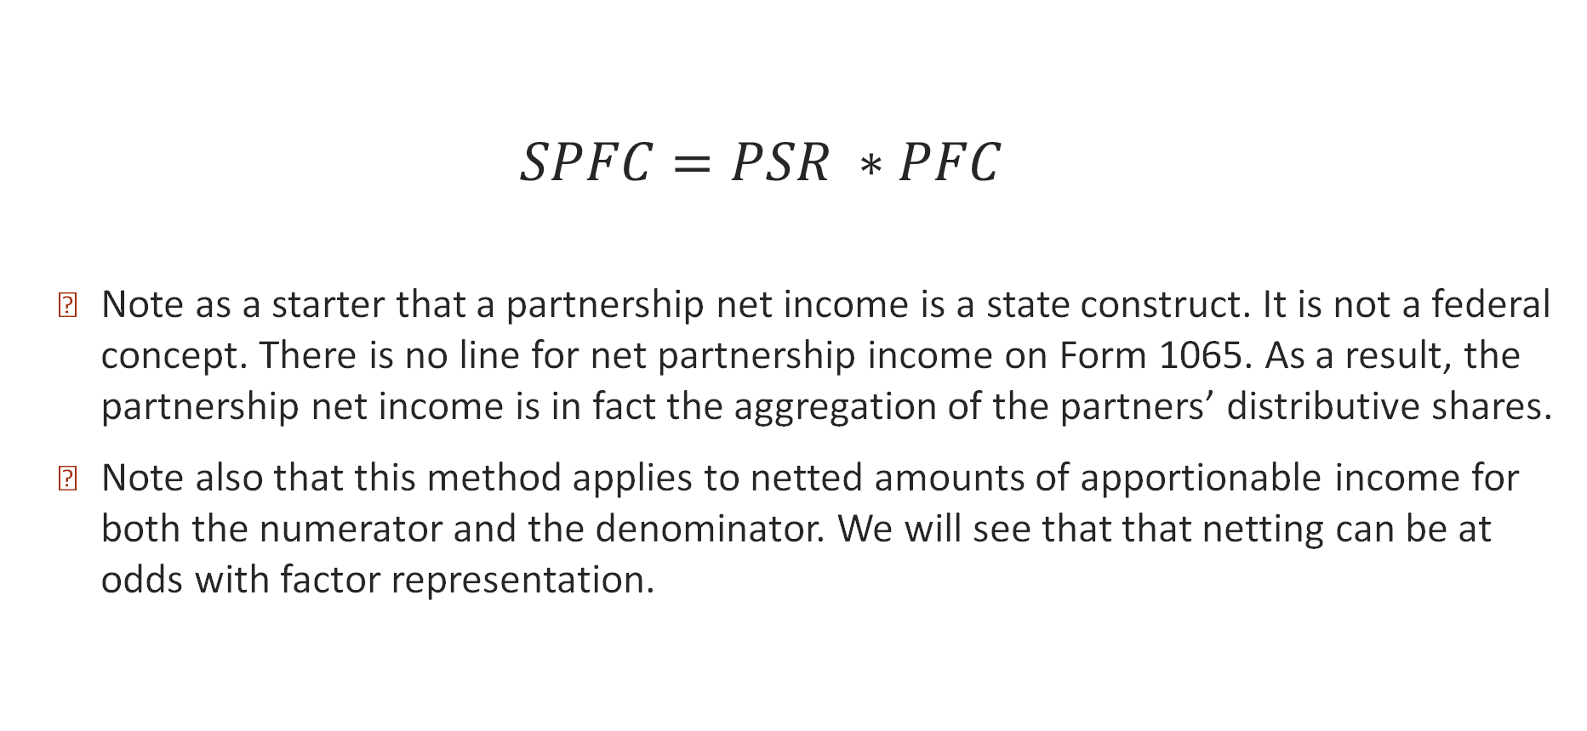
  Blending - Distributive Share Method
  $$SPFC=PSR ∗PFC$$
  Note as a starter that a partnership net income is a state construct. It is not a federal concept. There is no line for net partnership income on Form 1065. As a result, the partnership net income is in fact the aggregation of the partners’ distributive shares.
  Note also that this method applies to netted amounts of apportionable income for both the numerator and the denominator. We will see that that netting can be at odds with factor representation.

Slide 23
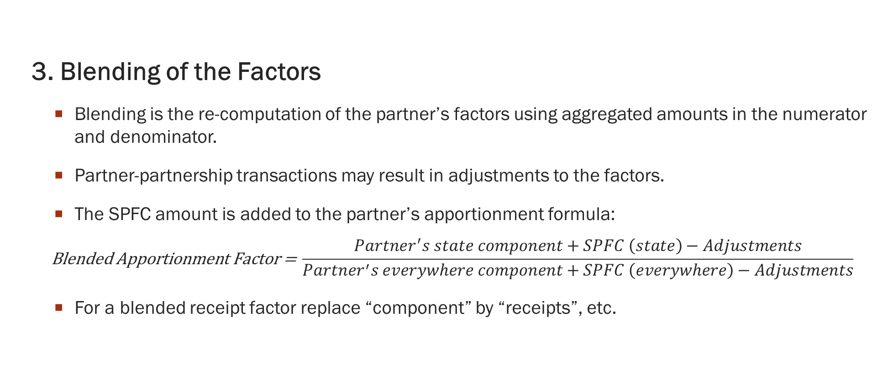
Blending – Distributive Share Method
  3. Blending of the Factors
    Blending is the re-computation of the partner’s factors using aggregated amounts in the numerator and denominator.
    Partner-partnership transactions may result in adjustments to the factors.
    The SPFC amount is added to the partner’s apportionment formula:
    $$\text{Blended} \text{Apportionment} \text{Factor}\text{ = }\frac{Partner^{′}s state component+SPFC \left(state\right)−Adjustments}{Partner^{′}s everywhere component+SPFC \left(everywhere\right)−Adjustments}$$
    For a blended receipt factor replace “component” by “receipts”, etc.

Slide 24
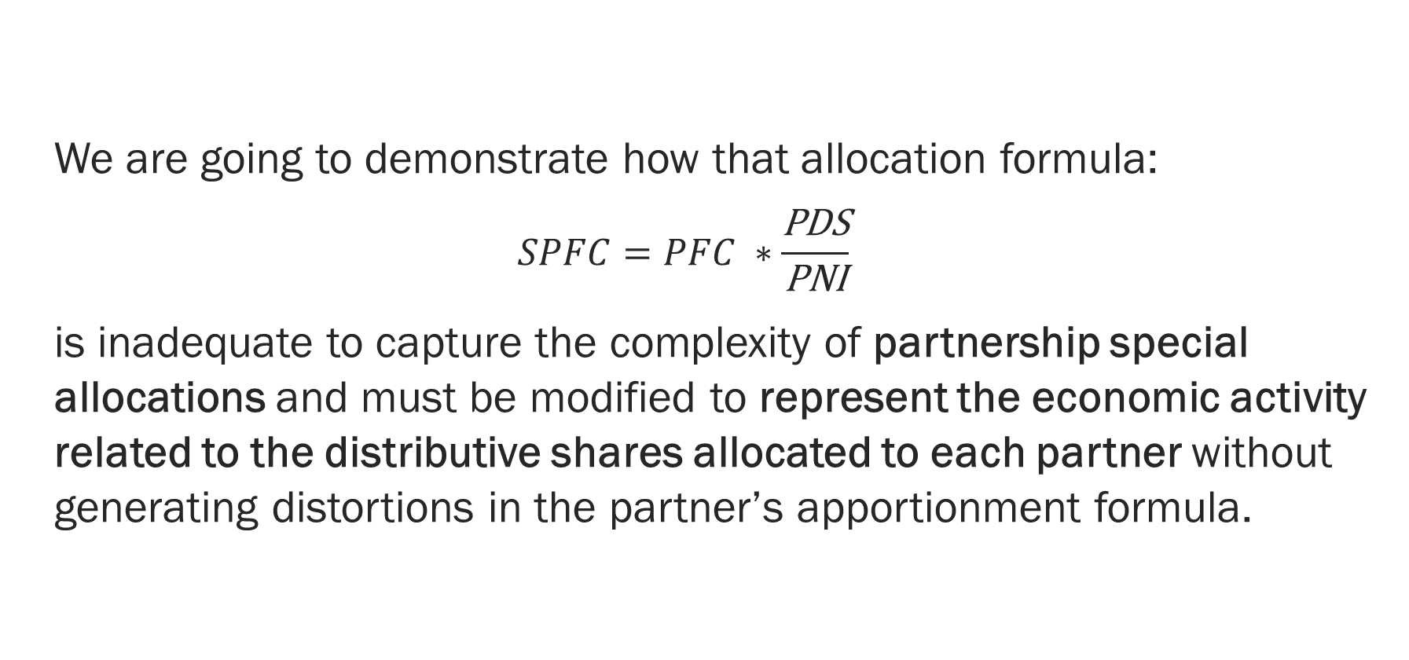
  Distributive Share Method
  We are going to demonstrate how that allocation formula:
  $$SPFC=PFC ∗\frac{\text{P}\text{DS}}{\text{PNI}}$$
  is inadequate to capture the complexity of partnership special allocations and must be modified to represent the economic activity related to the distributive shares allocated to each partner without generating distortions in the partner’s apportionment formula.

Slide 25
Distributive Share Method: Special Allocations
704(a) Effect Of Partnership Agreement — A partner's distributive share of income, gain, loss, deduction, or credit shall, except as otherwise provided in this chapter, be determined by the partnership agreement.
704(b) Determination Of Distributive Share — A partner's distributive share of income, gain, loss, deduction, or credit (or item thereof) shall be determined in accordance with the partner's interest in the partnership (determined by taking into account all facts and circumstances), if—
704(b)(1) — the partnership agreement does not provide as to the partner's distributive share of income, gain, loss, deduction, or credit (or item thereof), or
704(b)(2) — the allocation to a partner under the agreement of income, gain, loss, deduction, or credit (or item thereof) does not have substantial economic effect.

Slide 26
Distributive Share Method: Special Allocations
That means that as soon as the partnership allocates items of income, loss deduction or credit not in proportion of partnership interest there is a special allocation.
Special allocations occur at the separately stated item level: “(or item thereof)”.
They must have substantial economic effect. That means special allocations must:
    Be properly reflected in the partner’s capital accounts with an obligation to restore a negative balance;
    Not be done solely to affect the tax result, and
    Reflect the economic reality of the partnership agreement,
Regarding sourcing, the total allocation of factor components between partners must equal the total amount of factor components for the year.
More on that later

Slide 27
Special allocation – separately stated items
IRC 702(a) organizes partnership accounting in specific categories. Special allocations occur within these separately stated items, to give them federal tax effect. For example, when a partner is allocated ($3 million) of net partnership losses, such loss can be made of:
  $1 million of interest, plus ($4 million) of ordinary business losses due to a specially allocated depreciation.
  Or $0 of interest and ($3 million) of ordinary business income,
  etc…
Separately stated items can be themselves a net amount, which could be the result of a multitude of possible combinations. For the attribution of factor components to provide fair representation, the formula must be adapted to account for special allocations of items of gross income and deductions.

Slide 28
Blending: Example Sourcing income in State X
Corp 1
Corp 2
  P records $5 million of total receipts, including $2 million in State X
  P has a net income of $1 million, meaning that P reports $4 million of deductions.
  P attributes gain and loss not in proportion of partnership interest:
    $3 million of net gain to A
    ($1 million) of net loss to Corp 1
    ($1 million) of net loss to Corp 2
  Assume Corp 1 must blend.
A
20% interest
60% interest
20% interest
P

Slide 29
Sourcing P’s distributive shares
P’s Apportionment Factor | Everywhere | State X
Receipts | $ 5,000,000 | $2,000,000
Apportionment Factor |  | 40%
Partners’ K-1 | A | Corp 1 | Corp 2
Ordinary income | $3,000,000 | ($1,000,000) | ($1,000,000)
State X source income | $1,200,000 | ($400,000) | ($400,000)
Partner | Unitary Relationship | Sourcing Requirement
Corp 1 | Yes | must blend its distributive share of P’s income with the unitary group income
Corp 2 | No | will report ($400,000) of separately apportioned State X source income
Assume Corp 1 has no receipts in State X of its own. Should there be some factor representation for State X since Corp 1 has a unitary relationship with P and is allocated a loss sourced in State X by P?
Yes, otherwise Corp 1 unitary activity in State X would be ignored. What should it be?

Slide 30
  Distributive Share Method
  The problem is that when there are special allocations, the use of a formula using aggregated net income values leads to absurd results like negative ratios.
  In the prior example, the formula would lead to a ratio of -1/5 of factor components allocated to Corp 1, which would be a negative factor representation. A negative activity in a state makes literally no sense.
  But that is not all!
  The use of net amounts also distorts the weight of apportionment items in the formula.
  Let’s see how that happens by testing the limits of the formula.

Slide 31
Blending: Simple Example – no special allocation
  Information from P
  State X uses a single receipts factor formula
  A is an individual
  Corp. is a C corporation Group
    Corp. is unitary with P
    Corp. must use the blending method for sourcing purposes
  P records $5 million of total receipts, including $2 million in State X
  P has a net income of $1 million
  P allocates net income in proportion of interest in P per partnership agreement.
Corp.
A
20% interest
80% interest
P

Slide 32
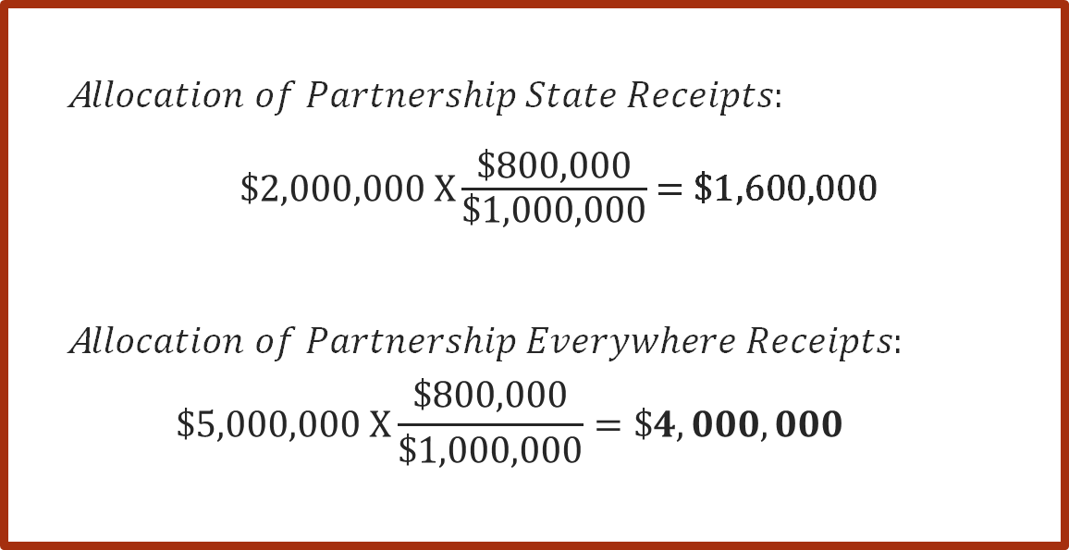
Blending: Simple Example – no special allocation
Share of Partnership Factor Components
When the distributive share matches each partner’s interest in a partnership, the allocation of factor components follows the income in the same proportion.
Corp is allocated 80% of the net apportionable income or loss and therefore is also attributed 80% of the factor components.
  A$llocation of Partnership State Receipts:$
  $\$2,000,000 X\frac{\text{\$}\text{800,000}}{\text{\$1,000,000}}$ = $1,600,000
  A$llocation of Partnership Everywhere Receipts:$
  $$\$5,000,000 X\frac{\text{\$800,000}}{\text{\$1,000,000}}=\$4,000,000$$

Slide 33
Blending: Simple Example – no special allocation
With separate apportionment, Corp would have been allocated a total of $1 million of State X source income [$400k from P, and $600k from the group]. The blending formula shows slightly less.
The allocation of partnership factor components did not distort the result. The activity occurring in State X is fairly represented.
In addition to its share of P’s income and factor components, Corp Group has:
  $10 million of total receipts, including $2 million in State X
  $3 million of income
80% of $1 million

Slide 34
Special allocation – Recap - 1
  When there are no special allocations, meaning all items of income, loss, deductions included in the distributive shares are allocated based on each partner’s interest in a partnership, the partner’s shares of factor components follow the same distribution:
  % of interest = % of net income = % of factor components
  However, the purpose of factor representation is not to reflect ownership. It is to reflect the economic activity occurring in each state.
  Once the allocation of net income is no longer a function of partnership interest the relationship between factor components and partnership interest (call it capital interest) no longer exists either.

Slide 35
Blending: Simple Special Allocation – % of Profit and Loss
  Information from P
  P records $5 million of total receipts, including $2 million in State X
  P has a net income of $1 million, meaning that P has $4 million of deductions.
  P allocates all the partnership items based on the partnership agreement on a 50/50 basis for that year.
Corp.
A
20% interest
80% interest
P

Slide 36
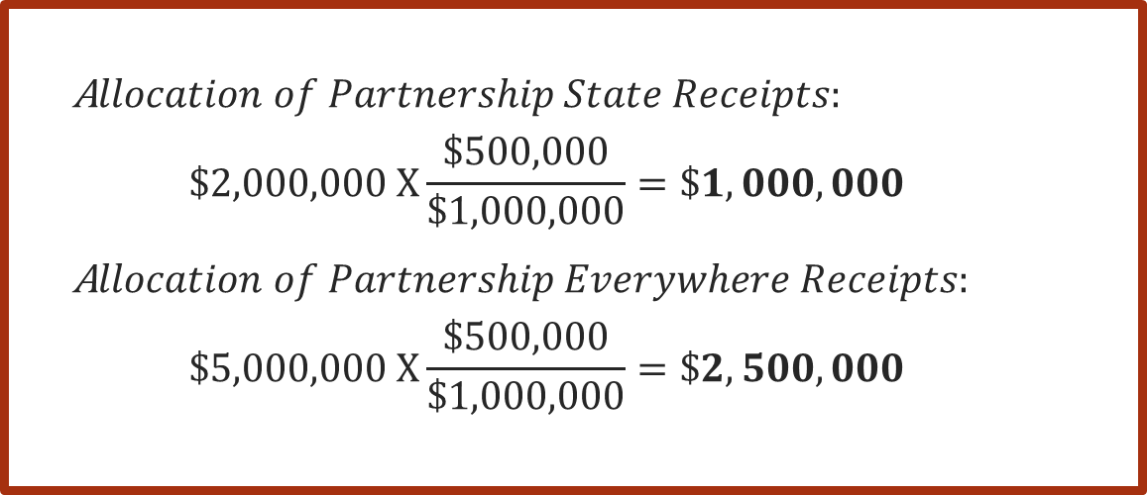
Blending: Simple Special Allocation – % of Profit and Loss
The allocation of income or loss no longer follows the interest in P.
The share of factor components is in proportion of the partner’s distributive share of net apportionable income.
Each partner receives 50% of the partnership receipts. The allocation has substantial economic effect.
With these facts, the distributive share method works without modifications because the special allocation affects all partnership items in the same proportion.
Share of Partnership Factor Components
  A$llocation of Partnership State Receipts:$
  $$\$2,000,000 X\frac{\text{\$}\text{500,000}}{\text{\$1,000,000}}=\$1,000,000$$
  A$llocation of Partnership Everywhere Receipts:$
  $$\$5,000,000 X\frac{\text{\$}\text{500,000}}{\text{\$1,000,000}}=\$2,500,000$$

Slide 37
Blending: Sourcing Corp. income in State X
The apportionment factor is a bit less than in the previous example because Corp. is receiving less receipts from P: 50% instead of 80%.
So far, the formula holds because allocating a percentage of the partnership net apportionable income or loss is the same as attributing a volume of business in proportion of the net apportionable income allocated.
  In addition to its share of P’s income and factors components, Corp Group has:
  $10 million of total other receipts, including $2 million in State X.
  Net income of $3 million.

Slide 38
Special allocation – Recap - 2
  A special allocation includes an agreement by the partners to share all items (that is the net partnership distributive share or profit and loss - "P&L") in some proportion other than by the partner’s interest in the partnership.
  As a result, to reflect the economic interest of each partner, and therefore to avoid disproportionate representation of partnership apportionment factors in a partner’s formula, the partner’s share of factor components must be a function of the P&L ratio, not a function of the partner’s interest.
  That method works if each partner’s P&L ratio applies to the partnership net apportionable income. But what happens when there is a special allocation of a particular partnership item?

Slide 39
Blending: Complex Special allocation
  P records $5 million of total receipts, including $2 million in State X
  P has a net income of $0.5 million, meaning that P has $4.5 million of deductions.
  P attributes the partnership item of gross revenue based on interest and 1/3 of the deduction items each.
  As a result:
    A’s distributive share is a net loss of:
      $1 million – $1.5 million = ($0.5 million)
    Corps’ distributive shares are a net gain of:
    $2 million – $1.5 million = $0.5 million.
Corp 1.
A
Corp 2
40% interest
20% interest
40% interest
P

Slide 40
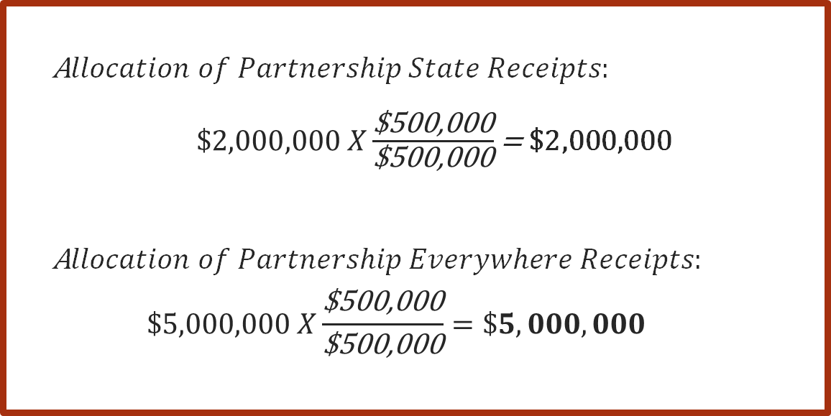
Blending: Complex Special Allocation
Share of Partnership Factor Components
When the partner’s distributive share is no longer in proportion to partnership net income the formula creates phantom allocation of factor components. It attributes all the receipts to Corp 1, and the same amount again to Corp 2!
The allocation of factor components is no longer a fair representation of the business activity, which generates distortions in the blended formula of the partner.
  A$llocation of Partnership State Receipts:$
  $\$2,000,000 X\frac{\text{\$500,000}}{\text{\$500,000}}$ = $2,000,000
  A$llocation of Partnership Everywhere Receipts:$
  $$\$5,000,000 X\frac{\text{\$}\text{500,000}}{\text{\$}\text{500,000}}=\$5,000,000$$
STOP

Slide 41
Special allocation – Recap - 3
  It seems intuitive that the share of receipts follows the allocation of net income.
  However, special allocations are NOT about allocation of net income. They are about the allocation of partnership separately stated items including gross income (receipts) and deductions.
  Special allocations may disconnect income and expenses attributing them to different partners. When this happens, partners are no longer allocated amounts that are a function of partnership net income.
  Subchapter K reconciles revenue and expenses for each item throughout the life of the partnership. But a future reconciliation of the capital accounts cannot be factored in the current determination of factor components.

Slide 42
Blending: Special allocation of Partnership Items
  For an allocation to have substantial economic effect it must:
    Be properly reflected in the partner’s capital accounts with an obligation to restore a negative balance;
    Not be done solely to affect the tax result, and
    Reflect the economic reality of the partnership agreement,
  Actions taken to ensure this requirement is met may not be reflected in the current year allocations. They may never result in corresponding future allocations.
  Because we have an annual reporting system, these changes may not have effect in the tax year.

Slide 43
Blending: Special allocation of Partnership Items Demonstration
  Assume this special allocation that has substantial economic effect.
  In this situation Corp is allocated no receipts as a component of its distributive share.
  What would it mean for the attribution of factor components to ignore special allocation of deductions or losses?
    Can Corp blend its distributive share of partnership deductions without any factor representation?
  P records $5 million of total receipts, including $2 million in State X
  P has a net loss of ($3 million), meaning that P has $8 million of deductions.
  P allocates the partnership net income and items as follows:
    $5 million of receipts to Partner A
    $8 million of deductions to Corp

Slide 44
Blending: Special allocation of Partnership Items Demonstration
In addition to its share of P’s income and factors, Corp Group has:
  $10 million of total other receipts, with no receipts in State X
  Other net income of $3 million
If deductions had no weight in the attribution of apportionment factors State X losses would have no factor representation, even though 40% of the partnership activity can be sourced to State X by measure of gross receipts, and the allocated loss reduces income everywhere else.
State X loss has been shifted to other states for lack of factor representation. This is distortion.

Slide 45
Blending: Special allocation of Partnership Items Demonstration
  In addition, net losses are normally sourced like net income.
  Net losses are essentially the excess of deductions over gross profit.
  So, when net losses are allocated what is allocated are deductions.
  Therefore, specially allocated deductions must also be associated with factor components to be sourced properly.
  Consider this example:
  P records $5 million of total receipts, including $2 million in State X
  P has a net loss of ($3 million), meaning that P has $8 million of deductions.
  P attributes the partnership net loss in proportion of partnership interests:
    Partner A is allocated ($600k).
    Corp is allocated ($2.4 million).
  In this case, Corp would be allocated 80% of the partnership factor components.

Slide 46
Blending: Special allocation of Partnership Items Demonstration
  When allocations are not uniform, meaning when at least one partnership item is allocated using a distinct ratio, net income or loss can no longer be used to distribute factor components.
  % net income (loss) ≠ % of factor component
  Why? Because net amounts derived from special allocations can represent a multitude of business realities, some representing very little business and others a large portion of activities.
  Compare:
    $200 – $100 = $100, with
    $1,000,000,000 – $999,999,900 = $100
  Could the same share of factor components be attributed to these two special allocations?
  Consider this example:
  P records $5 million of total receipts, including $2 million in State X
  P has a net income of $200k including:
    $100k of interest net of $3k of interest expense deduction, and
    $100k of ordinary business expense.
  P allocates $100k of ordinary business income to Partner A and $100k of interest to Corp.:
  Should Corp be allocated $2.5 million of receipts as factor component?

Slide 47
Blending: Special allocation of Partnership Items – ABS Method
  To give proper weight to distributive shares we must consider that $1 dollar of deductions has the same weight as $1 dollar of gross profits within each partnership separately stated item.
  In the example on the right, Corp would be attributed more receipts than Partner A to represent the larger weight that losses have over the gains. This is not a flaw. It is a feature.
  That weight can be mathematically represented by the absolute value of the allocation which is the distance a number is from zero on a number line, regardless of direction. Because distance cannot be negative, the absolute value of any number is always positive or zero.
  Consider this example:
  P records $5 million of total receipts, including $2 million in State X
  P has a net loss of ($3 million), meaning that P has $8 million of deductions.
  P allocates the partnership net income as follows:
    Partner A is allocated $5 million of gain.
    Corp is allocated ($8 million) of loss.
  Corp should receive 8/13 of the factor components.

Slide 48
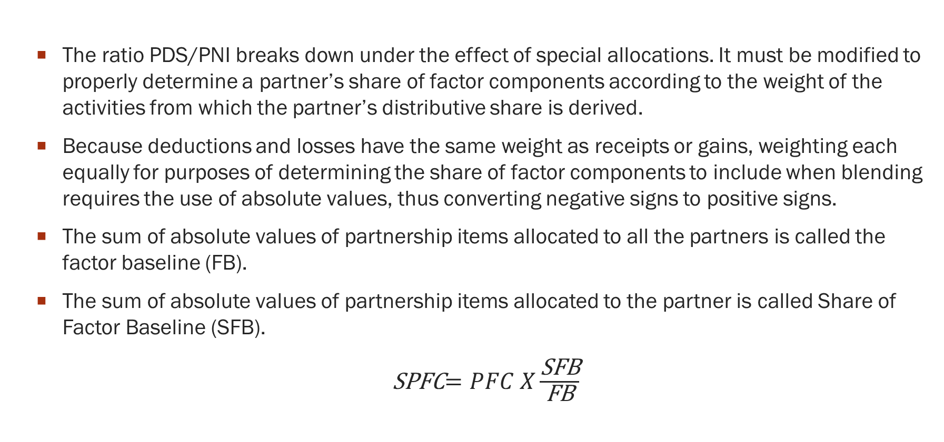
  Allocation of apportionment items: ABS Method
  The ratio PDS/PNI breaks down under the effect of special allocations. It must be modified to properly determine a partner’s share of factor components according to the weight of the activities from which the partner’s distributive share is derived.
  Because deductions and losses have the same weight as receipts or gains, weighting each equally for purposes of determining the share of factor components to include when blending requires the use of absolute values, thus converting negative signs to positive signs.
  The sum of absolute values of partnership items allocated to all the partners is called the factor baseline (FB).
  The sum of absolute values of partnership items allocated to the partner is called Share of Factor Baseline (SFB).
  SPFC$=PFC X\frac{\text{S}\text{FB}}{\text{FB}}$

Slide 49
  Allocation of apportionment items: ABS Method
  On a practical basis, the aggregation of gross receipts and deductions is derived from information reported on federal Form 1065, Schedules K-1 and state modifications.
  The sum of SFBs must equal the FB.
  Note that guaranteed payments and remedial allocations would end up being counted twice in the FB to account for them being at the same time a gain and a deduction.
  This is not a flaw because the same amount is at the same time a deduction and an item of income but for different partners.
  Depreciation deductions from IRC 743(b) basis adjustment are not deductions without tax consequences. They reduce net income in the same way other cost recovery of assets do. Therefore, they must receive as much weight as any other deduction.

Slide 50
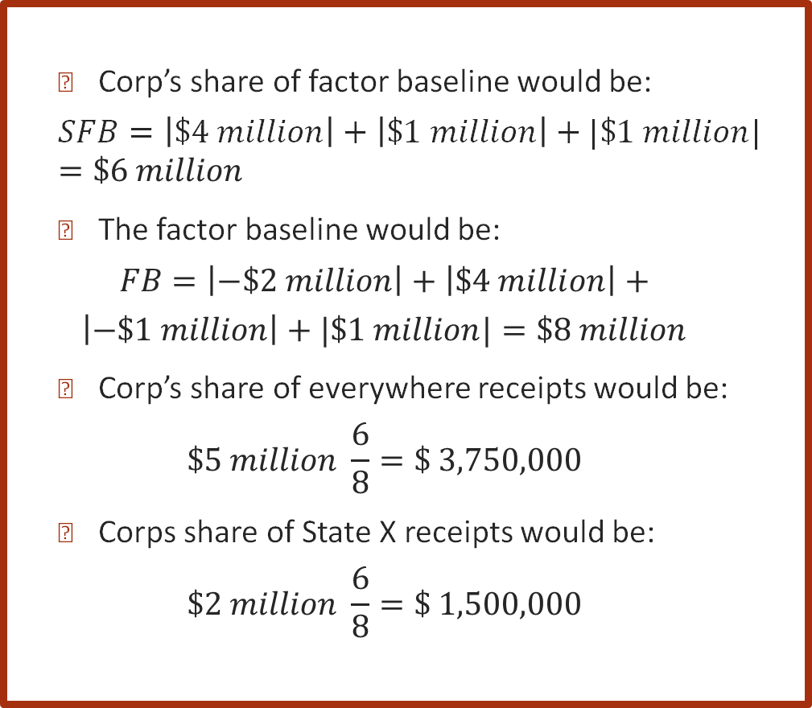
ABS Method: Gains
  P records $5 million of total receipts, including $2 million in State X
  P has a net gain of $2 million, meaning that P has ($3 million) of deductions.
  P’s income is allocated as follows:
    Partner A is allocated:
      ($2 million) of depreciation deduction
    Corp is allocated:
      $3 million of ordinary business income made of:
        $4 million of gross revenue
        $1 million of business deductions
      $1 million of Interest with which no associated expense.
  Corp’s share of factor baseline would be:
  $$SFB=\left|\$4 million\right|+\left|\$1 million\right|+|\$1 million|=\$6 million$$
  The factor baseline would be:
  $$FB=\left|−\$2 million\right|+\left|\$4 million\right|+$$
  $$\left|−\$1 million\right|+|\$1 million|=\$8 million$$
  Corp’s share of everywhere receipts would be:
  $$\$5 million \frac{6}{8}=\$ 3,750,000$$
  Corps share of State X receipts would be:
  $$\$2 million \frac{6}{8}=\text{\$}\text{ 1,500,000}$$

Slide 51
ABS Method: Gains
  In addition to its share of P’s income and factors, Corp Group has:
  $10 million of total other receipts, including $2 million in State X
  Net income of $3 million
The factor is slightly more than with the 50% allocation (24%) reflecting the 6/8 attribution of apportionment factors.
The measures of business activity in state X has not been distorted using absolute value.

Slide 52
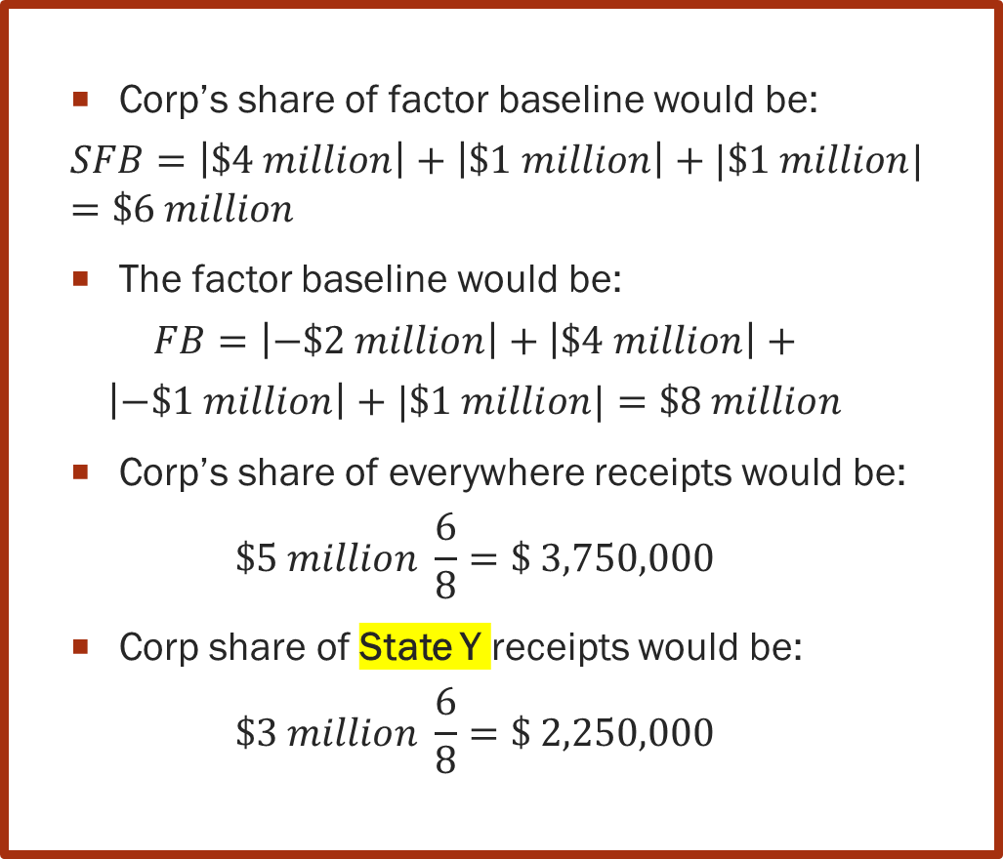
ABS Method: Gains
  P records $5 million of total receipts, including $3 million in State Y
  P has a net gain of $3 million, meaning that P has $2 million of deductions.
  P’s income is allocated as follows:
    Partner A is allocated:
      ($2 million) of depreciation deduction
    Corp is allocated:
      $3 million of ordinary business income made of:
        $4 million of gross revenue
        $1 million of business deductions
      $1 million of Interest with which no associated expense.
  Corp’s share of factor baseline would be:
  $$SFB=\left|\$4 million\right|+\left|\$1 million\right|+|\$1 million|=\$6 million$$
  The factor baseline would be:
  $$FB=\left|−\$2 million\right|+\left|\$4 million\right|+$$
  $$\left|−\$1 million\right|+|\$1 million|=\$8 million$$
  Corp’s share of everywhere receipts would be:
  $$\$5 million \frac{6}{8}=\$ 3,750,000$$
  Corp share of State Y receipts would be:
  $$\$3 million \frac{6}{8}=\text{\$}\text{ 2,250,000}$$

Slide 53
ABS Method: Gains
Corp. Group does not have receipts in State Y. Only P does.
Because State Y also uses the absolute value method to determine the share of factor components, some of Corp. income is sourced to State Y representing the business activities conducted by P and in proportion of Corp distributive share.
In addition to its share of P’s income and factors, Corp Group has:
  $10 million of total other receipts, including $0 million in State Y
  Corp Group has a net income of $3 million

Slide 54
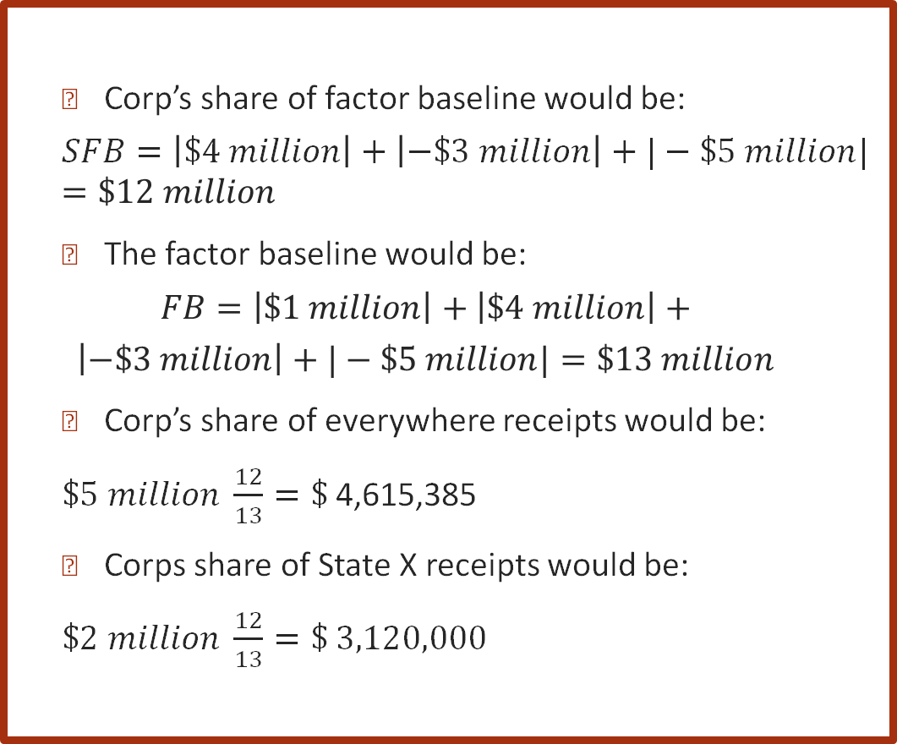
ABS Method: Losses
  P records $5 million of total receipts, including $2 million in State X
  P has a net loss of ($3 million), meaning that P has ($8 million) of deductions.
  P’s income is attributed as follows:
    Partner A is allocated:
      $1 million of interest
    Corp is allocated:
      ($4 million) of ordinary business loss
        $4 million of gross revenue
        ($3 million) of business expense
        ($5 million) of depreciation
  Corp’s share of factor baseline would be:
  $$SFB=\left|\$4 million\right|+\left|−\$3 million\right|+|−\$5 million|=\$12 million$$
  The factor baseline would be:
  $$FB=\left|\$1 million\right|+\left|\$4 million\right|+$$
  $$\left|−\$3 million\right|+|−\$5 million|=\$13 million$$
  Corp’s share of everywhere receipts would be:
  $\$5 million \frac{12}{13}=\$$4,615,385
  Corps share of State X receipts would be:
  $\$2 million \frac{12}{13}=\text{\$ }$3,120,000

Slide 55
Blending: Special allocation of Partnership Items
In addition to its share of P’s income and factors, Corp Group has:
  $10 million of total other receipts, including $2 million in State X
  Net income of $3 million
The factor (36%) is slightly more than with the 50% allocation of deduction (24%) and the 80% allocation (25.71429%).
This higher loss is consistent with the fact that Corp is allocated 12/13, or 92.3% of the partnership items.

Slide 56
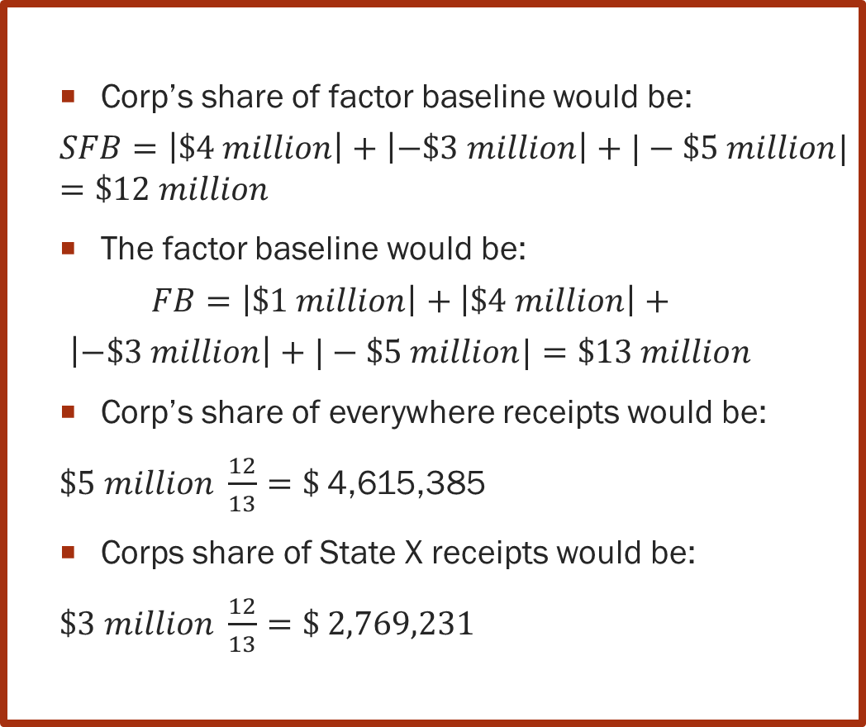
ABS Method: Losses
  P records $5 million of total receipts, including $3 million in State Y
  P has a net loss of ($3 million), meaning that P has ($8 million) of deductions.
  P’s income is allocated as follows:
    Partner A is allocated :
      $1 million of interest
    Corp is allocated :
      ($4 million) of ordinary business loss
        $4 million of gross revenue
        ($3 million) of business expense
        ($5 million) of depreciation
  Corp’s share of factor baseline would be:
  $$SFB=\left|\$4 million\right|+\left|−\$3 million\right|+|−\$5 million|=\$12 million$$
  The factor baseline would be:
  $$FB=\left|\$1 million\right|+\left|\$4 million\right|+$$
  $$\left|−\$3 million\right|+|−\$5 million|=\$13 million$$
  Corp’s share of everywhere receipts would be:
  $\$5 million \frac{12}{13}=\$$4,615,385
  Corps share of State X receipts would be:
  $\$3 million \frac{12}{13}=\text{\$ }$2,769,231

Slide 57
ABS Method: Losses
Corp. Group does not have receipts in State Y. Only P does.
Because State Y also uses the absolute value method to determine the share of factor components, some of Corp. loss is sourced to State Y. due to activities conducted in State Y by P.
In addition to its share of P’s income and factors, Corp Group has:
  $10 million of total other receipts, including $0 in State Y
  Net income of $3 million

Slide 58
  Absolute Value Method Conclusion
  The absolute value method resolves the mathematical impossibility of attributing negative receipts when one partner is allocated losses and another is allocated income.
  It is a mathematical way to eliminate the distortions resulting from the use of a uniform distribution factor when special allocations attribute the yield of activities in ways that are not uniform.
  No better system has been presented that would account for the weight of all partnership items allocated to partners.
  In addition, and quite importantly, it is a formula that can also be used when the allocations are uniform because the ratio SFB/FB would then be the same as the ratio PDS/PNI. And that formula can be integrated into a computerized system.

