Slide 1

State Taxation of Partnerships –
Comments on Draft Model Provisions
June 17, 2026

Slide 2
Comments on the Draft Model Provisions
From –
  AICPA
  Eversheds-Sutherland
  Energy Infrastructure Council
Aso expecting comments from the ABA
Will be issuing a revised draft model with certain edits
For other comments we have an initial response (based on past discussions) but may need further discussion

Slide 3
Before we get started . . .
Some essentials are worth noting

Slide 4
State Income Tax Essentials
Partnerships Generally
Also governed by their agreements.
Creatures of state law.
Any legal relief to partners is express.

Slide 5
Partnerships Generally
Partnerships often accommodate the specific legal obligations of their partners by providing for this in their agreements.

Slide 6
State Income Tax Essentials
Partnership structures
Some are large, complex, tiered structures.
Most are small and simple.
Large partnerships generate most income.

Slide 7
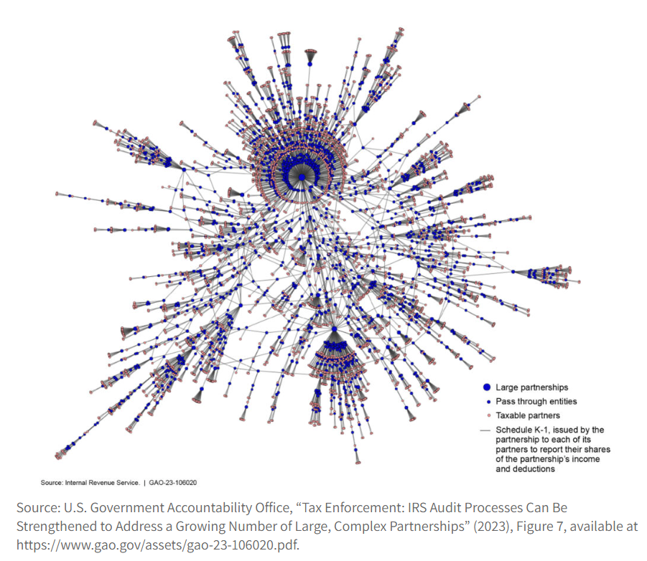
Partnerships Structures

Slide 8
State Income Tax Essentials
Annual reporting of net income
No perfect matching. Expenses create future income.
Sourcing can also vary from year to year.
Income allocations can also change capital accounts.

Slide 9
Annual Reporting of Net income
You would get a different result if you could look back over a longer period to compute and apportion income.

Slide 10
State Income Tax Essentials
Apportionment of net Income
Formula applies equally to all items.
Today 80% of states use a receipts factor.
Equitable apportionment may apply.

Slide 11
Apportionment to source income
States are NOT REQUIRED to use apportionment and often source items using different methods.

Slide 12
State Income Tax Essentials pass-through system conformity
Provides substantial benefits to businesses.
Partnerships must provide partners information.
Partnership determines tax character of items.

Slide 13
Pass-through system Conformity
Partners may also need partnerships to provide additional information so they can comply with state tax law.

Slide 14
State Income Tax Essentials attribution of sourcing info
Partnership activities also affect the income’s source.
Tax effects are determined by partnership activities and attributed to partners.
Partner activities /attributes may affect sourcing.

Slide 15
Attribution of Sourcing Info
Default – income is sourced based on character determined by partnership activities. Blending may apply to some partners.

Slide 16
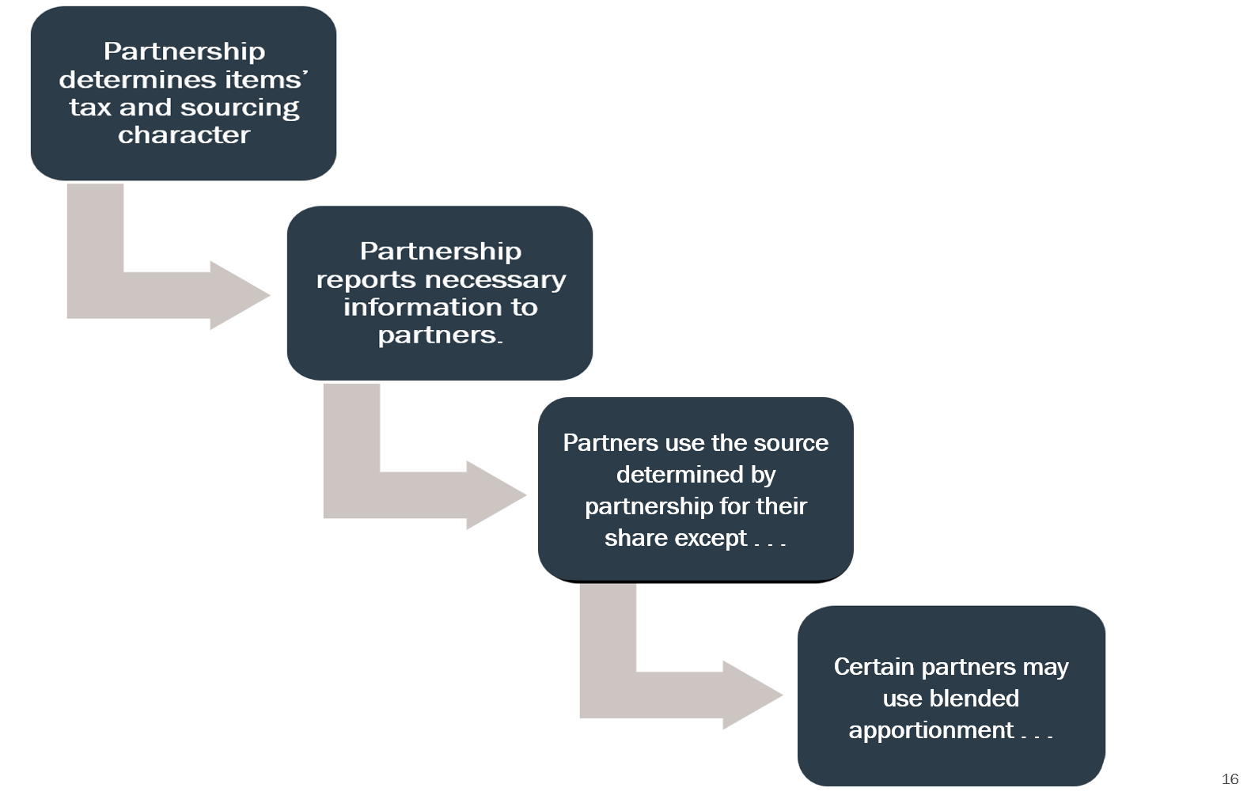

Slide 17
Model has a special rule for
investment partnerships.

Slide 18
General Comments
Information Reporting
Are the draft requirements reasonable?
When to Blend
Is the UBP the right standard and how does it apply?
How to Blend
How is the partner’s share of factors determined?

Slide 19
General Comments
Information Reporting
Are the draft requirements reasonable?
When to Blend
Is the UBP the right standard and how does it apply?
How to Blend
How is the partner’s share of factors determined?

Slide 20
Information Reporting
Are the draft requirements reasonable?
Initial response – subject to further discussion

Slide 21
Information Reporting Requirements – General State Law
Uniform Law Commission’s Model Acts – Versions Most Widely Adopted
Uniform Partnership Act-1997 (updated as of 2013)
SECTION 408. Rights to Information of Partners and Persons Dissociated as Partner.
available here: https://www.uniformlaws.org/viewdocument/final-act-98?CommunityKey=52456941-7883-47a5-91b6-d2f086d0bb44&tab=librarydocuments
Uniform Limited Liability Company Act (as updated 2013)
SECTION 410. Rights to Information of Member, Manager, and Person Dissociated as Member
Available here: https://www.uniformlaws.org/viewdocument/final-act-83?CommunityKey=bbea059c-6853-4f45-b69b-7ca2e49cf740&tab=librarydocuments

Slide 22
Information Reporting Requirements – General State Law
  Rules provide that:
    Partners may “inspect and copy” partnership records
    Certain information will be furnished without demand
    Certain information will be furnished upon demand
    This applies to past partners as well

Slide 23
Information Reporting Requirements – General State Law
  From the Comments Section in the UPA:
      Although the rights and duties stated in this section [to which information pertains] are extensive, they are not necessarily all-inclusive.
      . . .Subsection (a)—A general partnership is often a very informal organization. Accordingly, this subsection states a default-required location for any books and records a partnership may have but does not require that books and records be kept. Other law may so require, however—particularly tax law. This subsection applies to any books and records kept to satisfy other law.

Slide 24
Minimum information partnerships and partners Must have:
  Partnerships
    With respect to their partners –
      Direct partner identity and location
      Partner capital accounts
      Agreed upon shares of income and items
  Partners (including tiered partners)
    With respect to their direct partnerships –
      Business and transactional information
      Assets held by partnership (including partnership interests)

Slide 25
Federal partnership reporting Requirements
IRC § 6031 - Return of partnership income
(a) General rule
Every partnership . . . shall make a return . . . stating specifically the items of its gross income and the deductions allowable by subtitle A, and such other information . . . and shall include in the return the names and addresses of the individuals who would be entitled to share in the taxable income . . . and the amount of the distributive share of each individual.
(b) Copies to partners
Each partnership . . . shall . . . furnish to each person who is a partner . . . a copy of such information required to be shown on such return as may be required by regulations. . . .
. . .

Slide 26
Federal partnership reporting Requirements
26 CFR § 1.6031(a)-1 - Return of partnership income.
(a) Domestic partnerships—(1) Return required. . . . every domestic partnership must file a return of partnership income under section 6031 (partnership return) for each taxable year on the form prescribed . . .
(2) Content of return. The partnership return must contain the information required by the prescribed form and the accompanying instructions.
(3) Special rule.
(i) A partnership that has no income, deductions, or credits for federal income tax purposes for a taxable year is not required to file a partnership return for that year.
(ii) The Commissioner may, in guidance published in the Internal Revenue Bulletin (see § 601.601(d)(2)(ii)(b) of this chapter), provide for an exception to partnership reporting under section 6031 . . .
[More lengthy provisions related to foreign partnerships and partners.]

Slide 27
Federal partnership reporting Requirements
Federal Requirements
  Are becoming more detailed. (See the Partnership Return – IRS 1065 and all related schedules, including Schedule K, as well as information returns for partners – Schedule K-1.)
  Apply to tiered-partnership structures so that lower-tiered partnerships must report information to upper-tier partnerships and indirect taxpaying partners.
26 U.S. Code § 6222 - Partner’s return must be consistent with partnership return - otherwise an adjustment is treated as a mathematical or clerical error.

Slide 28
Proposed Draft Model Provisions – Part III
A. A partnership shall provide to its direct partners the information necessary for its direct and indirect partners to properly compute and report their [STATE] tax. Necessary information includes any information as described or provided for in regulations, forms, and instructions issued by the [STATE TAX AGENCY]. This requirement to provide information applies to:
1. Any partnership doing business in [STATE];
2. Any partnership that has a direct or indirect partner doing business in or resident in [STATE].
3. Any partnership that has a direct or indirect interest in a partnership doing business in [STATE].

Slide 29
Proposed Draft Model Provisions – Part III
B. A partnership shall provide to the [STATE TAX AGENCY] certain information as directed by the [STATE TAX AGENCY] necessary to verify the information required to be reported to partners under Subpart A, above and as provided in regulations, forms, and instructions issued by the [STATE TAX AGENCY].

Slide 30
Proposed Draft Model Provisions – Part III
C. The type of information that may be required to be reported to partners or to [STATE TAX AGENCY] under this Part III includes:
1. Federal tax-related information, including the tax character of partnership income and items recognized by the partnership or allocated to the partnership from lower-tier partnerships;
2. State tax-related information, including the tax character of partnership income and items recognized by the partnership or allocated to the partnership from lower-tier partnerships, as relevant to compliance with [REFERENCE TO STATE INCOME TAX RULES FOR CORPORATIONS AND INDIVIDUALS];

Slide 31
Proposed Draft Model Provisions – Part III
C. (Cont’d):
. . .
3. Information necessary for direct or indirect partners to properly determine the source of partnership income and items, as described further in this Section;
4. Information from lower-tier partnerships or business entities in which the partnership holds an interest that is necessary for that partnership’s direct or indirect partners to properly determine the source of partnership income and items as described further in this Section; and
5. Any other information the partnership may have or obtain that is necessary for direct or indirect partners to properly report their state tax on partnership income and items.

Slide 32
Kinds of Information Reporting
Partnerships to partners –
  Official forms required for filing tax returns.
  Other information as requested by the partners.
Partnerships to state –
  Official forms required for filing tax returns (or copies of those forms provided to partners)
  Other information as requested by the state or required to be kept in case requested.

Slide 33
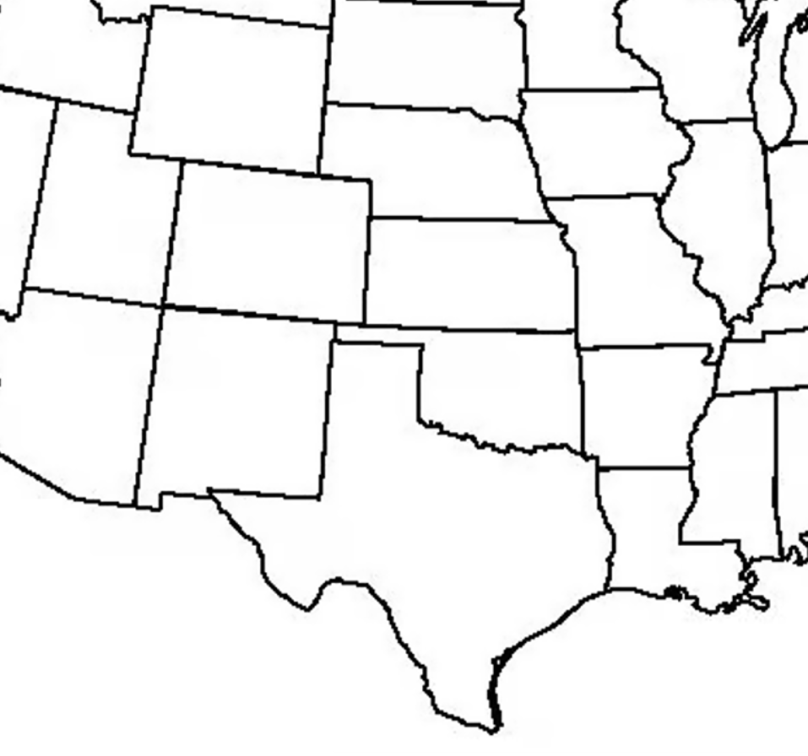
General Tax Information Reporting
What would partners Corp and Smith expect to know about their portion of P2 income and items that comes from P1:
It comes from P1
The share they agreed to allocate
Federal tax character of items making up the share
Whether state withholding or entity-level taxes applied (and how P1 sourced the income for that purpose)
Corp
Smith
P2
P1

Slide 34
State sourcing information Reporting – No blending
P1 determines whether income and items are:
Apportionable
If so – related factors for each state
If not – source based on state rules
P1 provides this information to P2
which then provides the information
to Corp and Smith so they can source their share of the P1 income and items.
Corp
Smith
P2
P1

Slide 35
State sourcing information – Blending
Assume Corp determines it should use blending to source the distributive share from P1 that passes through P2.
Corp will need to have information on:
P1 factors in each state
Information on distributive share
Corp
Smith
P2
P1

Slide 36
State Adjustment information
Assume Smith is in a state that has de-conformed to federal depreciation rules and P1’s distributive share allocated to P2 (and from P2 to Smith) includes depreciation expense.
P1 needs to know that it may need to provide information to Smith so that Smith can recompute the effect of the decoupling (depending on how the state applies the rule).
Corp
Smith
P2
P1

Slide 37

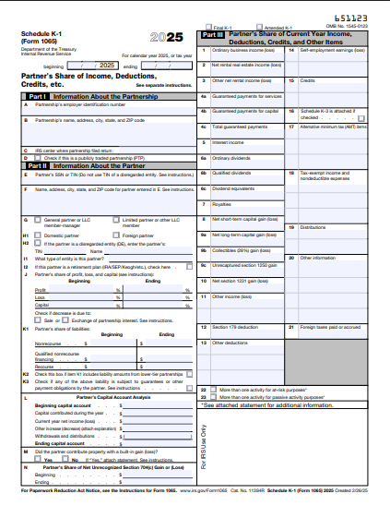
Information Reporting is Critical – But Rules come first
Adjustment information
  Rules are fairly clear
  Reporting requirements and process may not be sufficient
  One option – states could provide their residents with a form that indicates the kind of adjustments that will need to be made to partnership distributive share income so that this form can then be provided to their partnerships.

Slide 38
Information Reporting is Critical – But Rules come first
State sourcing information (no blending)
  The rules are fairly clear
  Reporting requirements may not be sufficient
  States may need to provide forms allowing different reporting for different types of partners

Slide 39
Information Reporting is Critical – But Rules come first
State sourcing information - blending
  The rules may need clarifying – especially with respect to computing the share of factors
  Reporting requirements may not be sufficient
  Information may vary where there are special or mandatory allocations

Slide 40
Critical Questions
What information should partners be required to provide to partnerships?
  Should partners in a state requiring adjustments be required to provide to their partnerships (for transmission to lower tiers) a statement that certain adjustment information is required?
  Can states design forms for that purpose – just summarizing the types of information that will be required.
  For example – state decoupling from depreciation would require resident partners to provide to the partnership a statement of information needed to make the adjustment.
Penalties and who is ultimately responsible.
  Should partnerships be penalized if a partner that should apply blending fails to do so? (It seems this would be inappropriate.)
  Should a partner be penalized if the partnership fails to provide information

Slide 41
Bottom Line Question
When the tax rules which apply to income or taxpayers effectively require that partners obtain certain information from a partnership which may be difficult in the case of a complex structure, do we come up with sufficient information-reporting systems, or do we simply waive the tax rules when it comes to that partnership income?

Slide 42
From the Tax Advisor Website
State compliance for multitiered partnerships: Planning, communication, and execution can avoid common mistakes
From Patrick Walsh, CPA, Fairlawn, Ohio
August 30, 2025
“A foundational step in managing state income tax compliance within a multitiered partnership structure is developing a comprehensive understanding of the entire structure and the specific needs of the stakeholders at each level. Without this clarity, the risk of inconsistencies, filing errors, or unintended changes in filing methodology increases significantly.”
“Equally important is the business activity conducted at each tier. A partnership that merely holds an interest in a lower–tier investment may have vastly different compliance considerations than one that also operates an active trade or business. Commingling these activities without clearly delineating them on a tax return can create confusion not only for the preparer but also for state tax agencies reviewing the filing.”

Slide 43
From the Tax Advisor Website
State compliance (Cont’d)
To mitigate these risks, communication must begin well in advance of any deadlines. Early discussions between the various tiers should address several key considerations:
Which states the lower-tier entity intends to file in for the current year;
Whether states will be added or exited in the current year due to changes in business activity or investments;
Preliminary apportionment data and state-sourced income estimates;
Character of income or losses (e.g., ordinary, capital, or guaranteed payments);
Understanding income allocations throughout the structure;
Anticipated state-level modifications;
Composite and nonresident withholding plans (to opt in or to opt out); and
Additional facts and circumstances that could impact filings (e.g., partner transactions or entity reorganizations).

Slide 44
General Comments
Information Reporting
Are the draft requirements reasonable?
When to Blend
Is the UBP the right standard and how does it apply?
How to Blend
How is the partner’s share of factors determined?

Slide 45
When to Blend
Is the UBP the right Standard and how does it apply?
Initial response – subject to further discussion

Slide 46
Basics:
Only certain partners may blend
  Not holding companies (no factors)
  Not individual partners acting in individual capacity (no factors)
  Not investment partnerships (see model)
Again note—the default method of sourcing partnership income is to source at the partnership level—including apportionment using partnership apportionment factors.
And states don’t have to blend. But most states require blending and some refer to the unitary relationship between partner and partnership as the standard.

Slide 47
NOTEs on USE of the Unitary Business Principle (UBP) as a standard for blending
As the white paper points out:
  States are not limited to using apportionment only when they combine the entire income from unitary business activities conducted by separate entities but may, instead, apportion that income separately.
  A single entity or taxpayer can have more than one unitary business activity from which income can be apportioned using separate factors.
The model refers to the application of the UBP and provides very generally for its application to limit blending, but other limitations might also apply.

Slide 48
The problem in using the UBP:
Where does the UBP come from?
  U.S. Supreme Court
Has the U.S. Supreme Court ever –
  Ruled the UBP is the appropriate standard for blending?
    No.
  Applied the UBP to sourcing a partner’s distributive share income?
    No.
  Used the term “factor representation?
    No.

Slide 49
So – how has the UBP been used?
Issues to which the UBP has been applied:
    State jurisdiction
    Aggregation (entity combination)
    Fair apportionment
These issues are often inter-connected.

Slide 50
Jurisdiction
  See ASARCO Inc. v. Idaho State Tax Com’n, where the Court, commenting on Mobil’s reference to the UBP as a “linchpin” said this:
    “The constitutionality of a state tax levied on extraterritorial business operations thus turns on whether the out-of-state business activity can be characterized as a separate business with no in-state contacts or whether instead it is a part of a unitary enterprise doing business in the State.”

Slide 51
  See U. S. Steel Corp. v. Multistate Tax Commission (1978), FN23,
  where the Court describes this as:
    The “unitary business” technique involves calculating a corporate taxpayer’s income on the basis of all phases of the operation of a single enterprise . . .. The portion of that income attributable to activities within the taxing State is then determined by means of an apportionment formula. . . .‘Combination of income’ involves applying the unitary business concept to separately incorporated entities engaged in a single enterprise.
See also Mobil Oil v. Vermont (1980) which talks about the “linchpin” of apportionability – CITING U.S. STEEL CORP V. MULTISTATE TAX COMM’N
But this aggregation is not constitutionally required.
Aggregation

Slide 52
Fair Apportionment
Container Corp. of Am. v. Franchise Tax Bd. later speaks to applying an apportionment to the income of a unitary business:
      “Such an apportionment formula must . . . be fair. . . .
      The first, and again obvious, component . . . is what might be called internal consistency . . .. The second and more difficult requirement is what might be called external consistency—the factor or factors used in the apportionment formula must actually reflect a reasonable sense of how income is generated. . ..
      [Citing Moorman] we will strike down the application of an apportionment formula if the taxpayer can prove “by ‘clear and cogent evidence’ that the income attributed to the State is in fact ‘out of all appropriate proportions to the business transacted in that State,’ . . ..”

Slide 53
Blending is not about jurisdiction
  States have jurisdiction to use “separate apportionment” (using the partnership factors) to source the partnership’s multistate income and to separately source the partners’ own income.

Slide 54
Blending is only partially about Aggregation
Partnerships don’t (can’t) just file a combined return.
Whenever there are partner-partnership transactions, the effects are offset to the extent the partner’s distributive share income is included with their own net income.
    Example: Corp Partner buys services from Partnership (properly treated as Sec. 707(a) transactions). Corp has expense and Partnership has income. Assuming there are no special allocations of these items, Corp’s expense from the purchases will be offset to the extent of its distributive share (which will include Partnership’s sales/income).

Slide 55
Blending Is only partially about Aggregation
But without blending, would intercompany receipts necessarily be excluded from the partnership’s receipts factor to the extent of the partner’s distributive share of the partnership’s related income?
Also, the effect of aggregation through the inclusion of distributive share is limited to the extent to which that distributive share, and the partner’s other income, are both sourced to a particular state.
    Example: Assume the same facts as the prior example except that Partnership sources its distributive share to State X (so that Corp’s share is also sourced to State X), but Corp sources its other income to State Y.

Slide 56
Blending is more about fair apportionment
Assume a partner engages in the same income generating activity both directly and through a partnership. If the state would include both the direct and distributive share income from that activity in the apportionable base, then should the same types of factors that would otherwise be included also be used when apportioning that base?
While the U.S. Supreme Court has never addressed factor representation per se, a few state courts have ruled supporting “factor representation” generally.
UDITPA also contains Sec. 18 which allows variation in the approach used in order to “fairly represent the extent of the taxpayer’s business activity in this State.”

Slide 57
MTC Model Allocation and Apportionment regulations
Current version available here: https://www.mtc.gov/uniformity/adopted-uniformity-recommendations/model-general-allocation-and-apportionment-regulations/
Notes the relationship of the UBP to UDITPA’s functional and transactional tests.
Provides that: “A single entity may have more than one unitary business” and in those cases “the apportionable income of each unitary business is then apportioned by a formula that takes into consideration the in-state and the out-of-state factors that relate to the respective unitary business . . ..”
Notes that ownership rules apply to determine when separate corporations are members of a commonly controlled group such that their income may be unitary.
In these regulations, the only mention of partnerships are in the determination of the ownership of the share of voting stock and the attribution of those voting rights in cases where stock is held by or through partnerships.

Slide 58
MTC Combined filing models
Speaking of combined filing . . . here are provisions from the MTC’s adopted combined filing models:
Joyce Model – here: https://mtc.gov/wp-content/uploads/2023/02/Combined-Reporting-FINAL-version.pdf
Section 1. Definitions.
  . . .
  C. “Corporation” means any corporation . . . which if it were doing business in this state would be a “taxpayer.” The business conducted by a partnership which is directly or indirectly held by a corporation shall be considered the business of the corporation to the extent of the corporation’s distributive share of the partnership income, inclusive of guaranteed payments to the extent prescribed by regulation.
  .

Slide 59
Combined filing models
Joyce Model – here: https://mtc.gov/wp-content/uploads/2023/02/Combined-Reporting-FINAL-version.pdf
Section 1. Definitions.
  . . .
  F. “Unitary business” means [a single economic enterprise that is made up either of separate parts of a single business entity or of a commonly controlled group of business entities that are sufficiently interdependent, integrated and interrelated through their activities so as to provide a synergy and mutual benefit that produces a sharing or exchange of value among them and a significant flow of value to the separate parts.]
  Drafter’s note: This portion of the definition is drafted to follow MTC Reg. IV(b), defining a “unitary business.” . . . Any business conducted by a partnership shall be treated as conducted by its partners, whether directly held or indirectly held through a series of partnerships, to the extent of the partner's distributive share of the partnership's income, regardless of the percentage of the partner's ownership interest or its distributive or any other share of partnership income. A business conducted directly or indirectly by one corporation is unitary with that portion of a business conducted by another corporation through its direct or indirect interest in a partnership if the conditions of the first sentence of this section 1.F. are satisfied, to wit: there is a synergy, and exchange and flow of value between the two parts of the business and the two corporations are members of the same commonly controlled group.

Slide 60
Combined filing models
Joyce Model
Section 3. Determination of taxable income or loss using combined report.
. . .
B. Determination of taxpayer’s share of the business income of a combined group apportionable to this State.
The taxpayer’s share of the business income apportionable to this State of each combined group of which it is a member shall be the product of:
i. the business income of the combined group, determined under Section 3.C., and
ii. the taxpayer member’s apportionment percentage, . . .The [property, payroll, and sales] of a partnership shall be included in the determination of the partner's apportionment percentage in proportion to a ratio the numerator of which is the amount of the partner's distributive share of partnership’s unitary income included in the income of the combined group in accordance with Section 3.C.ii.(c). and the denominator of which is the amount of the partnership’s total unitary income.

Slide 61
Combined filing models
Finnigan Model – here: https://mtc.gov/wp-content/uploads/2025/12/Final-finnigan-Model-1-correction-with-resolution-for-posting.pdf.
Section 3. Determination of combined group income subject to tax
B. Allocation and apportionment
. . .
  iv. If a member of the combined group holds a partnership interest from which it derives apportionable income, the share of the partnership’s apportionment factor[s] to be included in the apportionment factor[s] of the group is determined by multiplying the partnership’s factor[s] by a ratio the numerator of which is the amount of the partnership’s apportionable income properly included in the member’s income, whether received directly or indirectly, and including any guaranteed payments, and the denominator of which is the amount of the partnership’s total apportionable income. If a member of the combined group directly or indirectly receives an allocation of a partnership tax item, such as an item of loss or expense, so that it is not possible to determine the member’s share of apportionable income, the [Director] may provide rules for inclusion of particular partnership factors, or portions of factors, in the combined group’s factors.

Slide 62
Partnership Examples
Assume:
  Corp rents property and provides services to those who lease the property in State X.
  Corp holds an interest in Partnership which owns similar property in State Y which Partnership leases to customers.
  Corp provides the same types of services to Partnership’s customers leasing its property in State Y.
  Corp receives a share of Partnership’s rental income.
Questions:
  Should Corp include a share of the Partnership’s rental receipts sourced to State Y in Corp’s apportionment factor applied to its blended apportionable income including its share of Partnership income?
  Does it matter whether Corp is a majority owner of Partnership?
  Does it matter whether Corp is involved in the management of Partnership?

Slide 63
Partnership Examples
Assume:
  Corp has a business in State X.
  Corp holds an interest in Partnership 1 (P1) which is involved in two businesses through Partnership 2 (P2) and Partnership 3 (P3), which operate entirely in State Y.
  Corp’s and P3’s businesses are closely related and Corp benefits from and participates in the activities of P3.
  Corp’s distributive share from P1 includes a distributive share from P3.
Questions:
  Should Corp include a share of P3’s factors from State Y in its apportionment formula applied to the blended apportionable income from its own activities and its distributive share from P1 that is the income from P3?
  Does it matter whether Corp is an indirect partner in P3?

Slide 64
Partnership Examples
Assume:
  Corp has a business in State X which has no income tax.
  Corp holds a minority interest in Partnership which operates in State Y which has an income tax.
  Corp does not control Partnership.
  Corp has employees that perform certain operational tasks and has an exclusive contract with Partnership to provide Partnership those same operational services which are necessary for Partnership to serve its own customers.
  The transaction between Corp and Partnership is treated as a Sec. 707(a) transaction between unrelated parties.
Questions:
  Should Corp blend?
  Does it matter whether Corp’s income is effectively offset by its share of the related expense in its distributive share of Partnership’s income?

Slide 65
Partnership Examples
Assume:
  Corp has a business in State X which has no income tax.
  Corp holds a minority interest in Partnership which operates in State X and State Y which has an income tax.
  Corp controls Partnership.
  Corp receives a special allocation of Partnership income related only to activities in State X.
Questions:
  If Corp blends should it blend all of the factors from Partnership or only those related to the activities in State X?
  Does it matter whether Partnership’s activities in State X and State Y are unitary?

Slide 66
Proposed Draft Model Provisions – Part VI.
Sufficient Unitary Relationship
The term “sufficient unitary relationship” as used in this section refers to the necessary relationship between items of income and the apportionment factors used to source that income, especially in the pass-through tax system used to impose tax on partners for their shares of partnership income. The term takes into account all the facts and circumstances relevant to the sourcing treatment of particular items of income including:
A. The relationship between the partnership that recognizes the income or items and the partners, including tiered partners, or other entities that are engaged in the related business activities generating other income or items, including:
1. The extent of actual common control, direct or indirect, held or exercised over the business activities, regardless of the share of partnership capital held;
2. The extent to which related activities are integrated or coordinated;
3. The extent to which resources and costs are shared; and
4. The extent of transactions or flows of value between the entities.
B. The extent of common use by the partnership and partners, including tiered partners, of assets held by the partnership or partners.
C. The nature of common use by the partnership and partners, including tiered partners, of assets held by the partnership or partners.

Slide 67
Bottom Line Question
Is this sufficient as a general framework for states to use to create rules and other guidance for applying the UBP in the partnership pass-through tax context?
Is the UBP the right standard or are there other rules or limitations to be considered for purposes of blending?

Slide 68
Questions & Thoughts
To be continued . . .

