Slide 1

State Taxation of Partnerships –
Status Report
Report to the Uniformity Committee
April 21, 2026

Slide 2
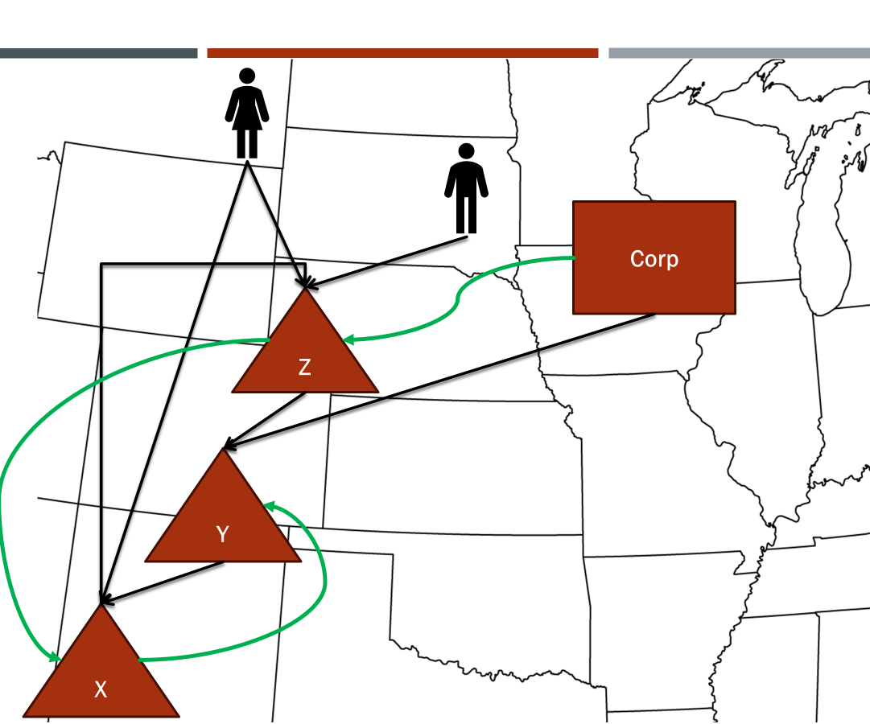
NOTE:
This presentation sets out information from the work group’s discussions, white paper draft, and multistate research, which are on the project webpage here: partnership project webpage. This information is presented to the Uniformity Committee for consideration and discussion. All input is welcomed.
*Our multistate research should not be relied on as tax advice. For specific questions, please contact your state department of revenue and/or tax advisor.

Slide 3
How the passthrough system works
INCOME ATTRIBUTES
Determined at the partnership level
PARTNER ATTRIBUTES
Determined at the partner level
TAX RESULT
Determined under the substantive tax rules

Slide 4
Combined Model Provisions
The Goals
  Applying state sourcing rules to partnership income
    This is NOT about special rules for sourcing partnership income
    Draft references the state’s existing rules
  Making the rules explicit
    Some states appear to follow the same approach but it’s not clear
    Explicit rules increase compliance
  Uniformity matters –
    It’s not just the partner’s home state but also where the partnership activities are
    Applying similar rules differently may lead to nowhere income or duplicative tax

Slide 5
Combined Model Provisions
The Challenges
  States generally do not have something like Subchapter K
  State rules use different terminology for similar concepts
  The basis for some state rules may not always be clear
  There are gaps in states rules that leave uncertainty in their application

Slide 6
Combined Model Provisions
The Approach
  Put the provisions together — at least so that they can be reviewed in context
  Include “fundamental” provisions (definitions, information reporting, etc.)
  Start with how the state sourcing rules apply generally to partnership income
    Tiered and corporate partners – blending
    Guaranteed payments for services
    Income of investment partnerships (exception)
  Lots of drafter’s notes

Slide 7
Combined Model Provisions – State Sourcing
Summary – General Rules
  Start at the partnership that first recognizes the income for tax purposes.
  Determine tax character of partnership items – including whether they are apportionable or non-apportionable based on the partnership’s information and activities.
  Determine related apportionment factors.
  Capture and report necessary information to all direct partners to allow them to comply with state sourcing rules applied to income of businesses.

Slide 8
Combined Model Provisions – State Sourcing
Summary – General Rules
  For tiered and corporate partners – determine if partnership items allocated directly from partnership are part of a unitary business in which the partner participates.
  If so, apply blending – using the distributive share to determine the share of partnership factors to include in the partner’s formula, and applying the absolute value method if necessary.
  Comply with all pass-through anti-abuse rules applied to prevent change in the character or source of income.

Slide 9
Combined Model Provisions – State Sourcing
Summary – Guaranteed Payments for Services
  Sourced in the same way as that partner’s distributive share would be sourced. (See the general rules.)
  Generous credit for taxes paid for residents taxed in another state on the same guaranteed payment based on location of services.

Slide 10
Combined Model Provisions – State Sourcing
Summary – Exception for Income of Investment Partnerships
  Applies only to nonresident individual partners (or persons taxed as nonresidents) who are not active in the investment partnership.
  The activities of the investment partnership (as defined) will not affect the sourcing of income from the investments.
  Rather, the partners will source the income from the investments as though they held the assets directly.

Slide 11
QIP Partner Jones
  General Assumptions:
  P – a business operating in State A
  Partner Smith – a nonresident of State A
  Corp – a business operating entirely outside State A
  QIP – a qualified investment partnership with offices inside and outside State A
  QIP Partner Jones – a partner in QIP but does not participate in the activities of QIP
  State A uses a single sales factor apportionment formula
Corp
Partner Smith
QIP
State A
P

Slide 12
QIP Partner Jones
  Example 1 – Simple Non-Resident Partner:
  P’s income is 100% apportionable
  P allocates $10,000 to Smith
  P has $100,000 of sales with $50,000 in State A
  Smith would have $5,000 of partnership income sourced to State A
Partner Smith
Corp
QIP
State A
P

Slide 13
Questions
Does it matter if Smith is a limited partner? (No)
Does it matter if Smith is an active partner? (No)
Does it matter if Smith has a controlling interest or role? (No)

Slide 14
QIP Partner Jones
  Example 2 – Simple Guaranteed Payment:
  P’s income is 100% apportionable
  P allocates $10,000 to Smith
  P also pays Smith a $2,000 guaranteed payment for services Smith performs outside of State A
  P has $100,000 of sales with $50,000 in State A
  Smith would have $6,000 of partnership income sourced to State A ($12,000 X $50,000/$100,000).
Partner Smith
Corp
QIP
State A
P

Slide 15
QIP Partner Jones
  Example 3 – Simple Apportionable / Non-Apportionable Income:
  P has:
    $100,000 in apportionable income
    $20,000 non-apportionable income sourced entirely to State A
  P allocates:
    $10,000 of its apportionable income to Smith
    $5,000 of its non-apportionable income to Smith
  P has $100,000 of total sales with $50,000 in State A
  Smith would have $10,000 of partnership income sourced to State A
    $10,000 X $50,000/$100,000 = $5,000 apportioned to State A
    Plus
    $5,000 allocated to State A
Partner Smith
Corp
QIP
State A
P

Slide 16
Questions
What would we call (at least one) of the allocations that Smith received?
  (Special allocation – since Smith’s share of apportionable income is 10% whereas the share of non-apportionable income is 25%.)
Do these different allocations have substantial economic effect?
  (Good question)
So . . . what if P has both apportionable and non-apportionable income AND Smith has a guaranteed payment?
  The rules assume that the guaranteed payment is sourced the same as apportionable income.

Slide 17
QIP Partner Jones
  Example 4 – Simple Corporate Partner:
  Corp’s and P’s businesses are not unitary
  Same facts as Examples 1 and 3 except the allocation is to Corp
  Same results as in Examples 1 and 3
    100% apportionable income = $5,000
    Apportionable and non-apportionable income (special allocations) = $10,000
Partner Smith
Corp
QIP
State A
P

Slide 18
Question
If Corp’s and P’s businesses are not unitary—why doesn’t Corp allocate its share of P income to Corp’s domicile as non-apportionable (nonbusiness) income?
  Character of partnership income is determined by the partnership and attributed to the partners – including whether it is apportionable or non-apportionable.
    Given that UDTIPA doesn’t address partnership distributive share income in its rules for allocating non-business income, the only alternative is to say that each item of income making up Corp’s share of P’s income has to be allocated separately (along with expenses) based on its character.

Slide 19
QIP Partner Jones
  Example 5 – Corp’s & P’s Businesses are Unitary:
  Corp’s own business is unitary with P’s business and State A uses blending
  Same facts as Example 1 except the allocation is to Corp
  For blending, we not only need to know the amount of partnership income allocated to Corp but also the share of the total partnership net income as well as Corp’s own income and factors.
Partner Smith
Corp
QIP
State A
P

Slide 20
QIP Partner Jones
  Example 5 – Corp and P’s Businesses are Unitary (cont’d):
  P allocates $10,000 of its net partnership income to Corp – which is 60% of P’s income ($16,666)
  Again, P has $100,000 of total sales with $50,000 in State A
  Corp has $100,000 of income with $400,000 of total sales and $0 sales in State A
  Corp’s blended apportionable income = $110,000
  Corp’s blended factor –
    Total sales = $400,000 (Corp’s) + 60% of $100,000 (P’s) = $460,000
    State A sales = $0 (Corp’s) + 60% of $50,000 = $30,000
    Sales factor = $30,000/$460,000 = 6.521%
  Corp’s State A source income = 6.521% X $110,000 = $7,173
Partner Smith
Corp
QIP
State A
P

Slide 21
Question
Why the difference in the result = $7,173 where Corp and P’s businesses are unitary versus where they are not unitary = $5,000?
  Corp’s business generated a higher rate of return on receipts (25%) versus P’s (16.6%) so that including both incomes in the apportionable base results in greater amount of income sourced to State A even though all of Corp’s factors are outside State A (making the factor lower).
  But it could also go the other way.

Slide 22
QIP Partner Jones
  Example 6 – Corp’s and P’s Businesses are Unitary – with Intercompany Transactions:
  Same facts as Example 5 except Corp has charged P a fee of $20,000 during the year. (Assume that fee is included in Corp’s separate sales amount—sourced outside State A.)
  Corp’s blended apportionable income =
    Total Corp income of $100,000
    Plus its P income of $10,000
    Equals $110,000
Partner Smith
Corp
QIP
State A
P

Slide 23
QIP Partner Jones
  Example 6 – Corp’s and P’s Businesses are Unitary – with Intercompany Transactions (cont’d):
  Corp’s blended factors –
    Total sales = $400,000 (Corp’s) – 60% of $20,000 = $388,000 + 60% of $100,000 (P’s) = $448,000
    State A sales = $0 (Corp’s) + 60% of $50,000 = $30,000
    Sales factor = $30,000/$448,000 = 6.7%
  Corp’s State A source income = 6.7% X $110,000 = $7,370
Partner Smith
Corp
QIP
State A
P

Slide 24
NOTE – Blending
Include apportionable partnership income in the partner’s own apportionable base –
  Eliminating the effect of intercompany transactions (that is the same share of the partner’s own income or expense as reflected in its partnership income)
Include a share of the partnership’s receipts or sales –
  Eliminating from that combined factor the effect of intercompany transactions (again, the same share as reflected by the partner’s partnership income).
Blending or not and how you do it makes a difference –
  Separate (partnership level) apportionment = $5,000
  Blending (no intercompany transactions or no elimination) = $7,173
  Blending (intercompany transactions with elimination) = $7,370

Slide 25
QIP Partner Jones
  Example 7 – QIP Partner Jones:
  P allocates $10,000 of its net partnership income to QIP
  QIP allocates $5,000 of P’s net partnership income to QIP Partner Jones
  P has $100,000 of total sales with $50,000 in State A
  Using P’s apportionment factor, Jones would have $2,500 of partnership income sourced to State A
Partner Smith
Corp
QIP
State A
P

Slide 26
QIP Partner Jones
  Example 8 – QIP – Separate Apportionment:
  QIP acquires an 80% interest in P2. P becomes P1.
  QIP is not unitary with P2 (otherwise it would not be a QIP)
  Same facts as example 7 between P1, QIP and Jones.
  P2 has a net loss of ($25,000) and allocates 80% ($20,000) of it to QIP.
  QIP allocates ($10,000) of its share of P2’s net partnership income to Jones
  P2 has $2,000,000 of total sales with $150,000 in State A
  P2 apportionment factor in State A is 7.5%
  Jones would have $1,750 of income sourced to State A including:
    $2,500 from partnership P1, and
    ($750) from partnership P2. [($10,000) x 7.5%]
Partner Smith
Corp
QIP
State A
P1
P2

Slide 27
QIP Partner Jones
  Example 8 – QIP – Separate Apportionment:
  QIP does not blend the two streams of source income from P1 and P2
  Each distributive share is apportioned separately based on the apportionment occurring at P1 and P2 levels
  Jones’ State A source income is the sum of his shares of the QIP shares of P1 and P2 partnership income separately apportioned by P1 and P2.
Partner Smith
Corp
QIP
State A
P1
P2

Slide 28
QIP Partner Jones
  Example 9 – Unitary group – Blending:
  Corp becomes a partner in QIP. QIP loses its investment partnership status and is now called P3
  Corp, P1, P2 and P3 are all engaged in the same unitary business.
  As a reminder, P3 distributive shares are:
    60% of P1’s net income and
    80% of P2’s net income
  P3 blends its distributive shares of P1 and P2 income because they are all engaged in the same unitary business
  P3’s blended apportionable income is ($10,000) which is the sum of $10,000 from P1 and ($20,000) loss from P2
Partner Smith
Corp
P3
State A
P1
P2

Slide 29
QIP Partner Jones
  Example 9 – Unitary group – Blending:
  P3’s apportionment factor is : 9.0361% calculated as follows:
  Total sales: $1,660,000, which is the sum of
      $60,000 (60% of P1 sales of $100,000), plus
      $1,600,000 (80% of P2 sales of $2,000,000)
    State A sales: $150,000, which is the sum of
      $30,000 (60% of P1 State A sales of $50,000), plus
      $120,000 (80% of P2 State A sales $150,000)
  P3 State A source loss is ($904), which is 9.0361% of ($10,000)
  P3 allocates 40% of that loss to Jones and 60% to Corp
  Jones has ($632) of State A loss
Partner Smith
Corp
P3
State A
P1
P2

Slide 30
QIP Partner Jones
  Example 9 – Unitary group – Blending:
  Corp’s blended apportionable income for its unitary business is $94,000: $100,000 + ($6,000) from P3
  Corp’s blended apportionment factor is 6.447% which includes 100% of its own factors and 60% of P3 factors, calculated as follows:
    Total sales: $1,396,000, which is the sum of
      $400,000 of Corp total sales, plus
      $996,000 (60% of P3 total blended sales of $1,660,000)
    State A sales: $90,000 (60% of P3 State A blended sales of $150,000)
  Corp has State A income of $6,060, which is 6.447% of $94,000
Partner Smith
Corp
P3
State A
P1
P2

Slide 31
QIP Partner Jones
  Example 9 – Unitary group – Blending:
  In Example 9 we see that the members of the unitary group blend their distributive shares as they are allocated up the ownership structure.
  Jones recognizes a State A loss of ($632) derived from the blending of distributive shares at P3 level.
  Corp recognizes a State A gain of $6,060 derived from the blending of P3 distributive shares with its own gain.
  Blending occurring at different level generates different results, as tiers add more gain or losses to the blended apportionable income.
  Notice that Smith is receiving a distributive share sourced using apportionment that is not blended. Both separate apportionment and blending co-exist necessarily within a partnership structure.
Partner Smith
Corp
P3
State A
P1
P2

Slide 32
QIP Partner Jones
  Example 10 – Unitary group – Blending – Special Allocations:
  Same as example 9, except that P3 allocates ($20,000) of losses to Corp and $10,000 of income to Jones.
  P3 blends P1 and P2 income and factors because they are all engaged in the same unitary business.
  P3 blended apportionable income is still ($10,000) and its factor is still 9.0361%
  P3 State A source income is still ($904)
  Yet Jones’ State A income is now $904 which is 9.0361% (P3’s State A factor) times $10,000
  Corp’s blended apportionable income for its unitary business is $80,000: $100,000 + ($20,000)
  Corp receives more loss than P3 net partnership loss, while Jones receives gain. Corp will use the absolute value method to calculate its share of P3 apportionment items.
Partner Smith
Corp
P3
State A
P1
P2

Slide 33
QIP Partner Jones
  Example 10 – Unitary group – Blending – Special Allocations:
  The absolute value method compares losses and income equally based on their absolute value to distribute the sales between partners.
  P3 factor baseline is the sum of gains and losses allocated $30,000 = $10,000 + $20,000.
  Corp’s share of factor baseline is $20,000
  Corp share of P3 sales is 66.66% which is $20,000/$30,000 using absolute value
  Corp’s includes $1,106,556 of P3’s total sales which is 66.66% times $1,660,000.
  Corp’s total sales is $1,506,556 which is the sum of Corp’s share of P3’s total sales and its own sales of $400,000.
  Corp’s includes $99,990 of P3’s State A sales which is 66.66% of $150,000.
  Corp’s apportionment factor is 6.637% which is $99,990 / $1,506,556
  Corp’s State A income is $5,309 which is 6.637% of $80,000
Partner Smith
Corp
P3
State A
P1
P2

Slide 34
QIP Partner Jones
  Example 10 – Unitary group – Blending – Special Allocations:
  Special allocations can pose a paradox for the assignment of apportionment items when distributive shares of opposite signs are allocated to different partners. That is P3 in our example.
  If the total partnership distributive share and the partner's own distributive share are both positive (income) or negative (loss), then the partner's share of factors is simply the proportion of that partner's distributive share to the total partnership distributive share. See example 9.
  Special allocations can result in a partner receiving positive distributive share while the total partnership distributive share is negative, or vice versa, where the partner receives a negative distributive share while the total partnership distributive share is positive. This means the share determined by dividing the partner's distributive share by the total distributive share will be a negative percentage. The absolute value method avoids this problem by converting all amounts to absolute values so that the share reflects the amplitude of the distribution.
  The absolute value method measures that amplitude and distributes apportionment items proportionally based on each partner’s share of that amplitude called “factor baseline”. Jones receiving 1/3 and Corp receiving 2/3 of the of the apportionment items.
Partner Smith
Corp
P3
State A
P1
P2
($20,000)
$0
$10,000
$30,000

