Slide 1
Federal and State Tax Developments to Watch
Presented at the Multistate Tax Commission’s
Uniformity Committee Meeting
Knoxville, TN
April 21, 2026
Carl Davis
Research Director
Institute on Taxation and Economic Policy
carl@itep.org

Slide 2
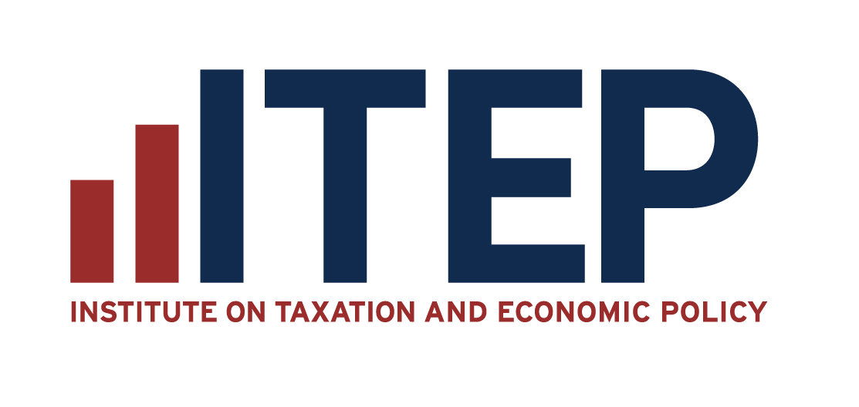
About ITEP
The Institute on Taxation and Economic Policy (ITEP) ​
Non-profit, non-partisan
Federal, state, and local tax policy issues​
Research and data focused​
ITEP Microsimulation Tax Model

Slide 3
Things to
Watch in
Tax Policy
10

Slide 4
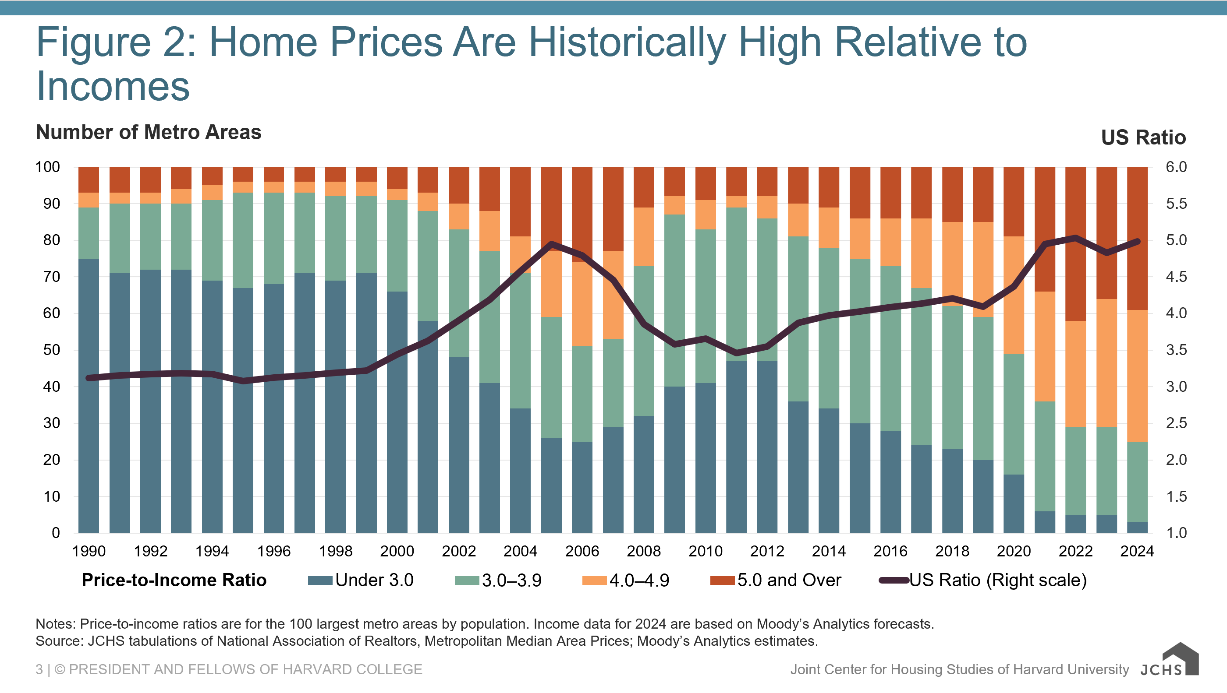
10. Housing Tax Breaks

Slide 5
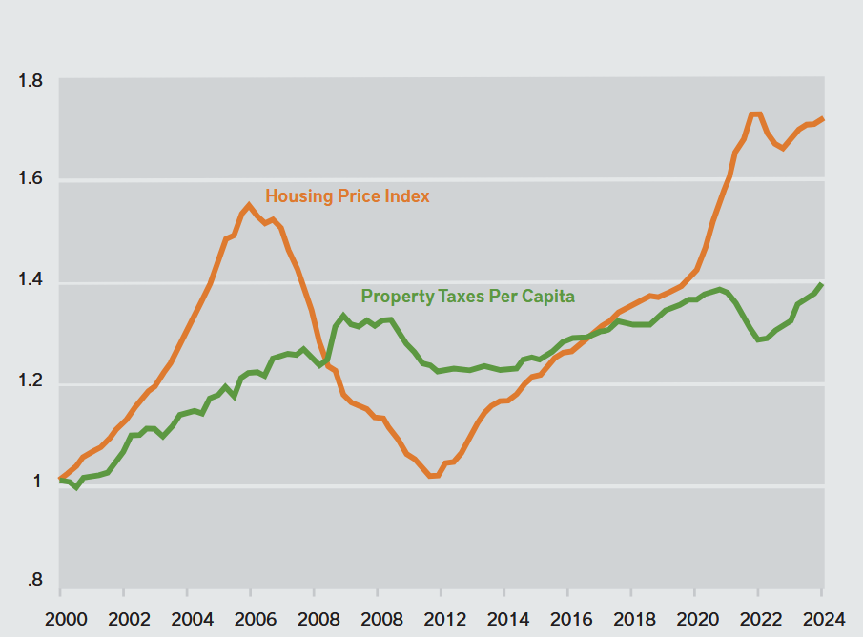
9. Property Tax Cuts
Source: Lincoln Institute of Land Policy

Slide 6
8. Tax Credit Restrictions for Non-Citizens
Targeting lawfully present immigrants with work-authorized SSNS, such as:
DACA recipients (Dreamers)
Asylum applicants
Survivors of serious crimes with U visas
People with Temporary Protected Status

Slide 7


7. State Gas Tax Holidays
Working-class and middle-class resident drivers
Motor fuel industry
Visitors / road trippers
Out-of-state trucking companies
High-income residents

Slide 8
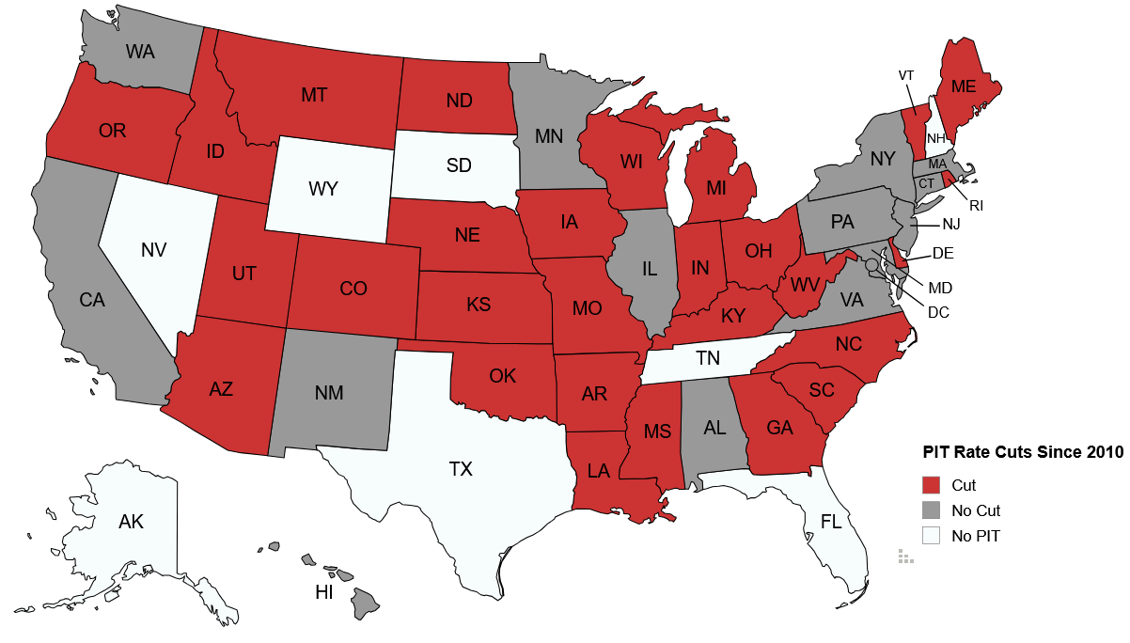
6. Income Tax Cuts, Elimination Plans

Slide 9
5. “Wealth Taxes”
Politics
58% support raising taxes on people with income above $400,000 income (Pew poll)
77% support raising taxes on billionaires (Impact Research poll)
Policy
26% federal income tax rate on top 1%, relative to AGI
11.5% rate relative to economic income (Gale & Sabelhaus study)

Slide 10
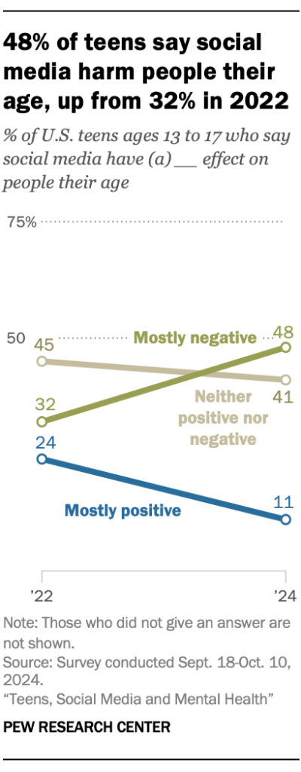
4. Tech Industry Taxes
78% of Americans say social media companies have too much power
64% of Americans say social media has a mostly negative effect on the country
Source: Pew Research Center

Slide 11
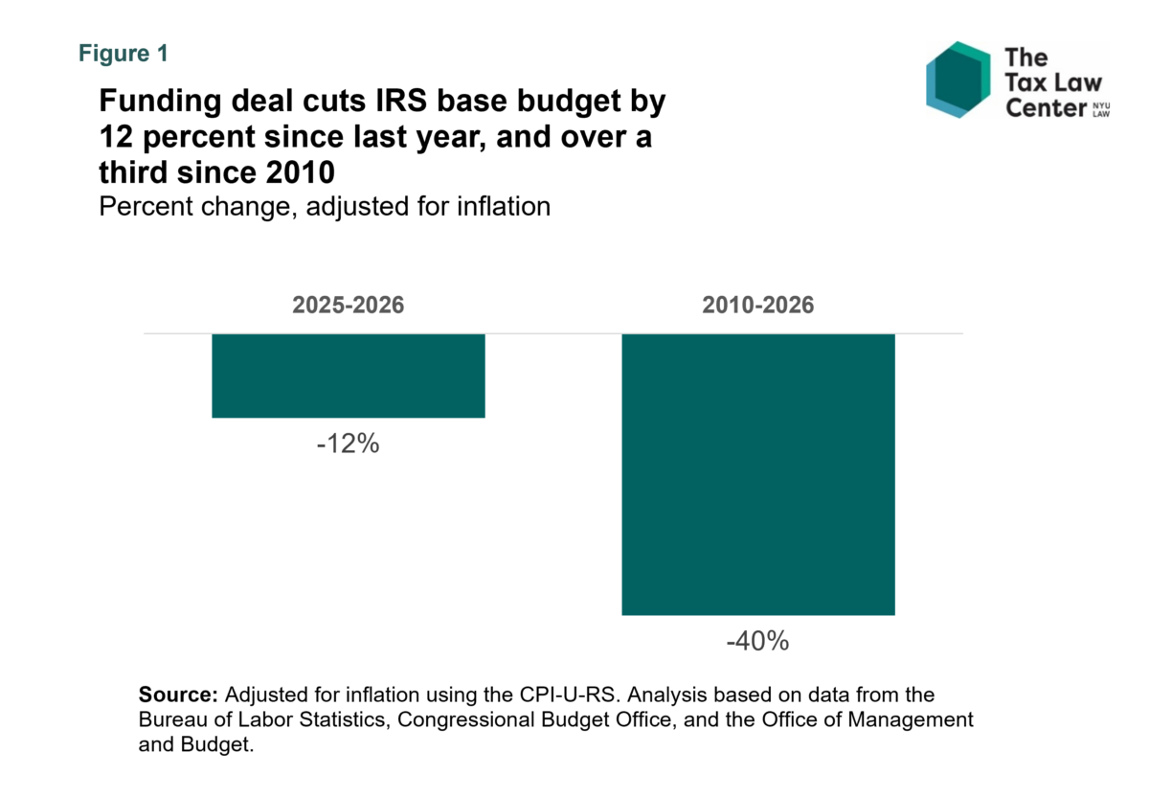
3. IRS Budget Cuts

Slide 12
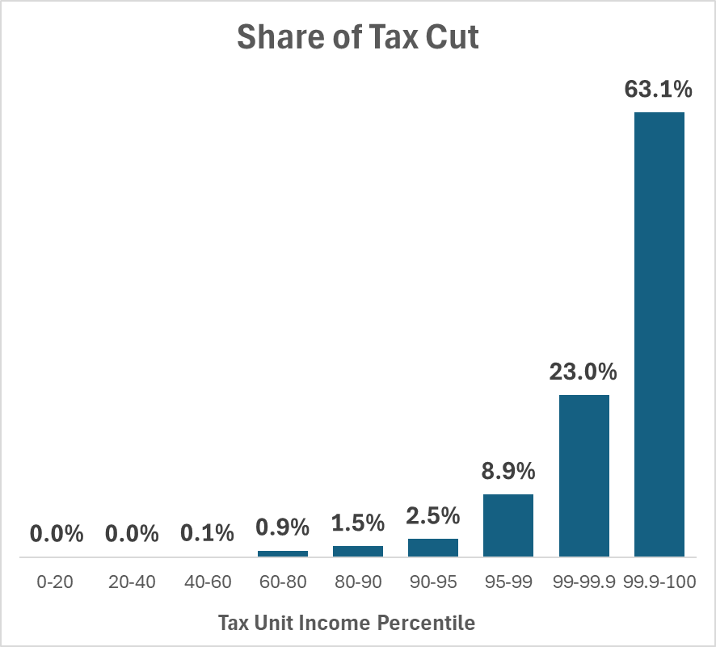
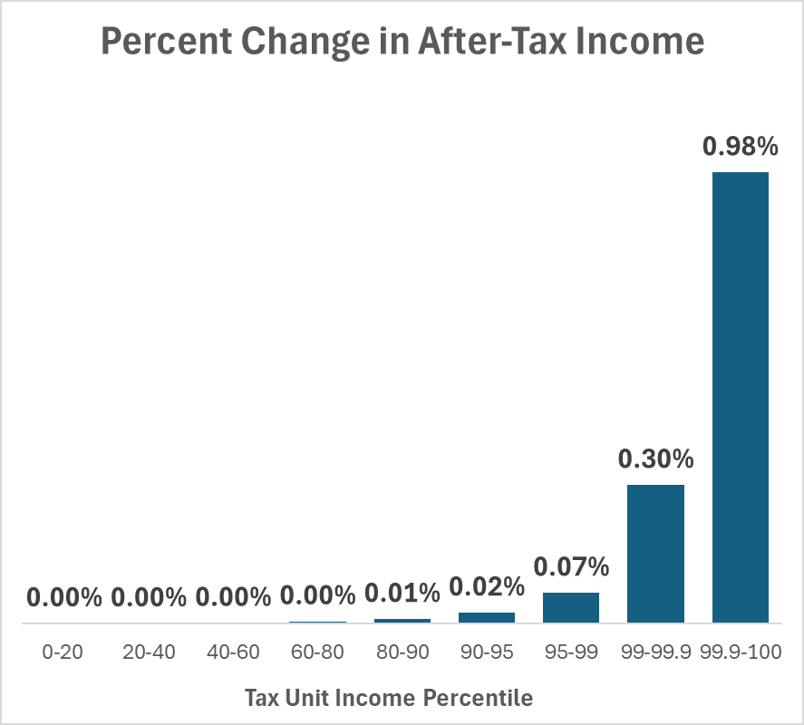
2. Capital Gains Indexing
Source: Penn Wharton Budget Model

Slide 13

1. Taxpayer-Favorable Administrative Deviations
“Treasury has clearly been enacting unlegislated tax cuts,” said Kyle Pomerleau, a tax economist at the American Enterprise Institute, a right-leaning think tank. “Congress determines tax law. Treasury undermines this constitutional principle when it asserts more authority over the structure of the tax code than Congress provides it.”

