Slide 1

Uniformity DEVELOPMENTS
Report to the MTC Uniformity Committee
April 21, 2026
Helen Hecht, MTC Uniformity Counsel

Slide 2
P.L. 86-272 –

Slide 3
P.L. 86-272 Litigation
In New York state and New Jersey American Catalog Mailers cases are still pending over rules similar to the MTC revised statement on P.L. 86-272
New York City and Massachusetts have also said they will adopt similar rules.

Slide 4
Definition of “sales” or “receipts” –

Slide 5
Can Some Receipts be Excluded
This has come up in the litigation between Florida and California
Florida argued that the MTC model regulations once excluded certain receipts not in the regular course of business or from certain other non-market related activity, but that we eliminated that exclusion when we adopted market-based sourcing
But the concepts in the regulations were incorporated into our revised model UDITPA (Art. IV of the Compact)—definition of receipts (by conforming receipts to the transactional test)
  (g) “Receipts” means all gross receipts of the taxpayer that are not allocated under paragraphs of this article, and that are received from transactions and activity in the regular course of the taxpayer’s trade or business; except that receipts of a taxpayer from hedging transactions and from the maturity, redemption, sale, exchange, loan or other disposition of cash or securities, shall be excluded.

Slide 6
Sourcing receipts (sales) –

Slide 7
Sourcing Sales of Tangibles
When do you “look-through” when sourcing tangibles?
Examples that have come up in recent litigation or controversies include:
  Sales where the purchaser’s use is entirely outside the state
  Sales where an intermediary takes temporary possession on behalf of the seller or purchaser and then delivers the items outside the state
  Sales delivered to a storage facility in which the purchaser has some agreement to allow the items to be stored and then shipped to their ultimate destination at the direction of the purchaser

Slide 8
Apportionment Formula –

Slide 9
Single Sales Factor
Lots of discussion still going on about whether states can use single sales factor to source multistate income – See the Smithfield case out of California
Arguments are generally not based on whether SSF is uniform (since most states currently use it)—but on some other theory that there is only one constitutional apportionment formula
These arguments contradict U.S. Supreme Court precedent – especially the leading case – Container

Slide 10
Partnership RAR Model –

Slide 11
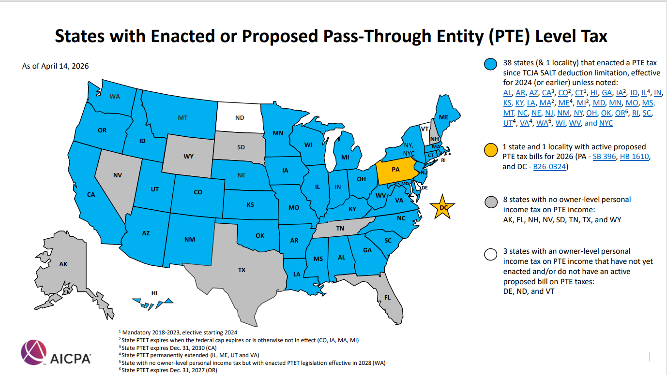

Slide 12
Partnership Audits –

Slide 13
Not happening
From the TIGTA Report - March 18, 2026
IRS provided data show that the number of returns filed by partnerships with at least $10 million in total assets increased from 140,577 returns for Tax Year (TY) 2011 to 334,686 returns for TY 2023.
However, the IRS also stated that the examination rate for these partnerships decreased from 2.7 percent to less than 0.1 percent during the same period.

