Slide 1
2026
Effects of Federal Policy and Economic Trends on State Taxes and Recent Legislative Trends
Scott Pattison
FTA
MTC UNIFORMITY COMMITTEE

Slide 2
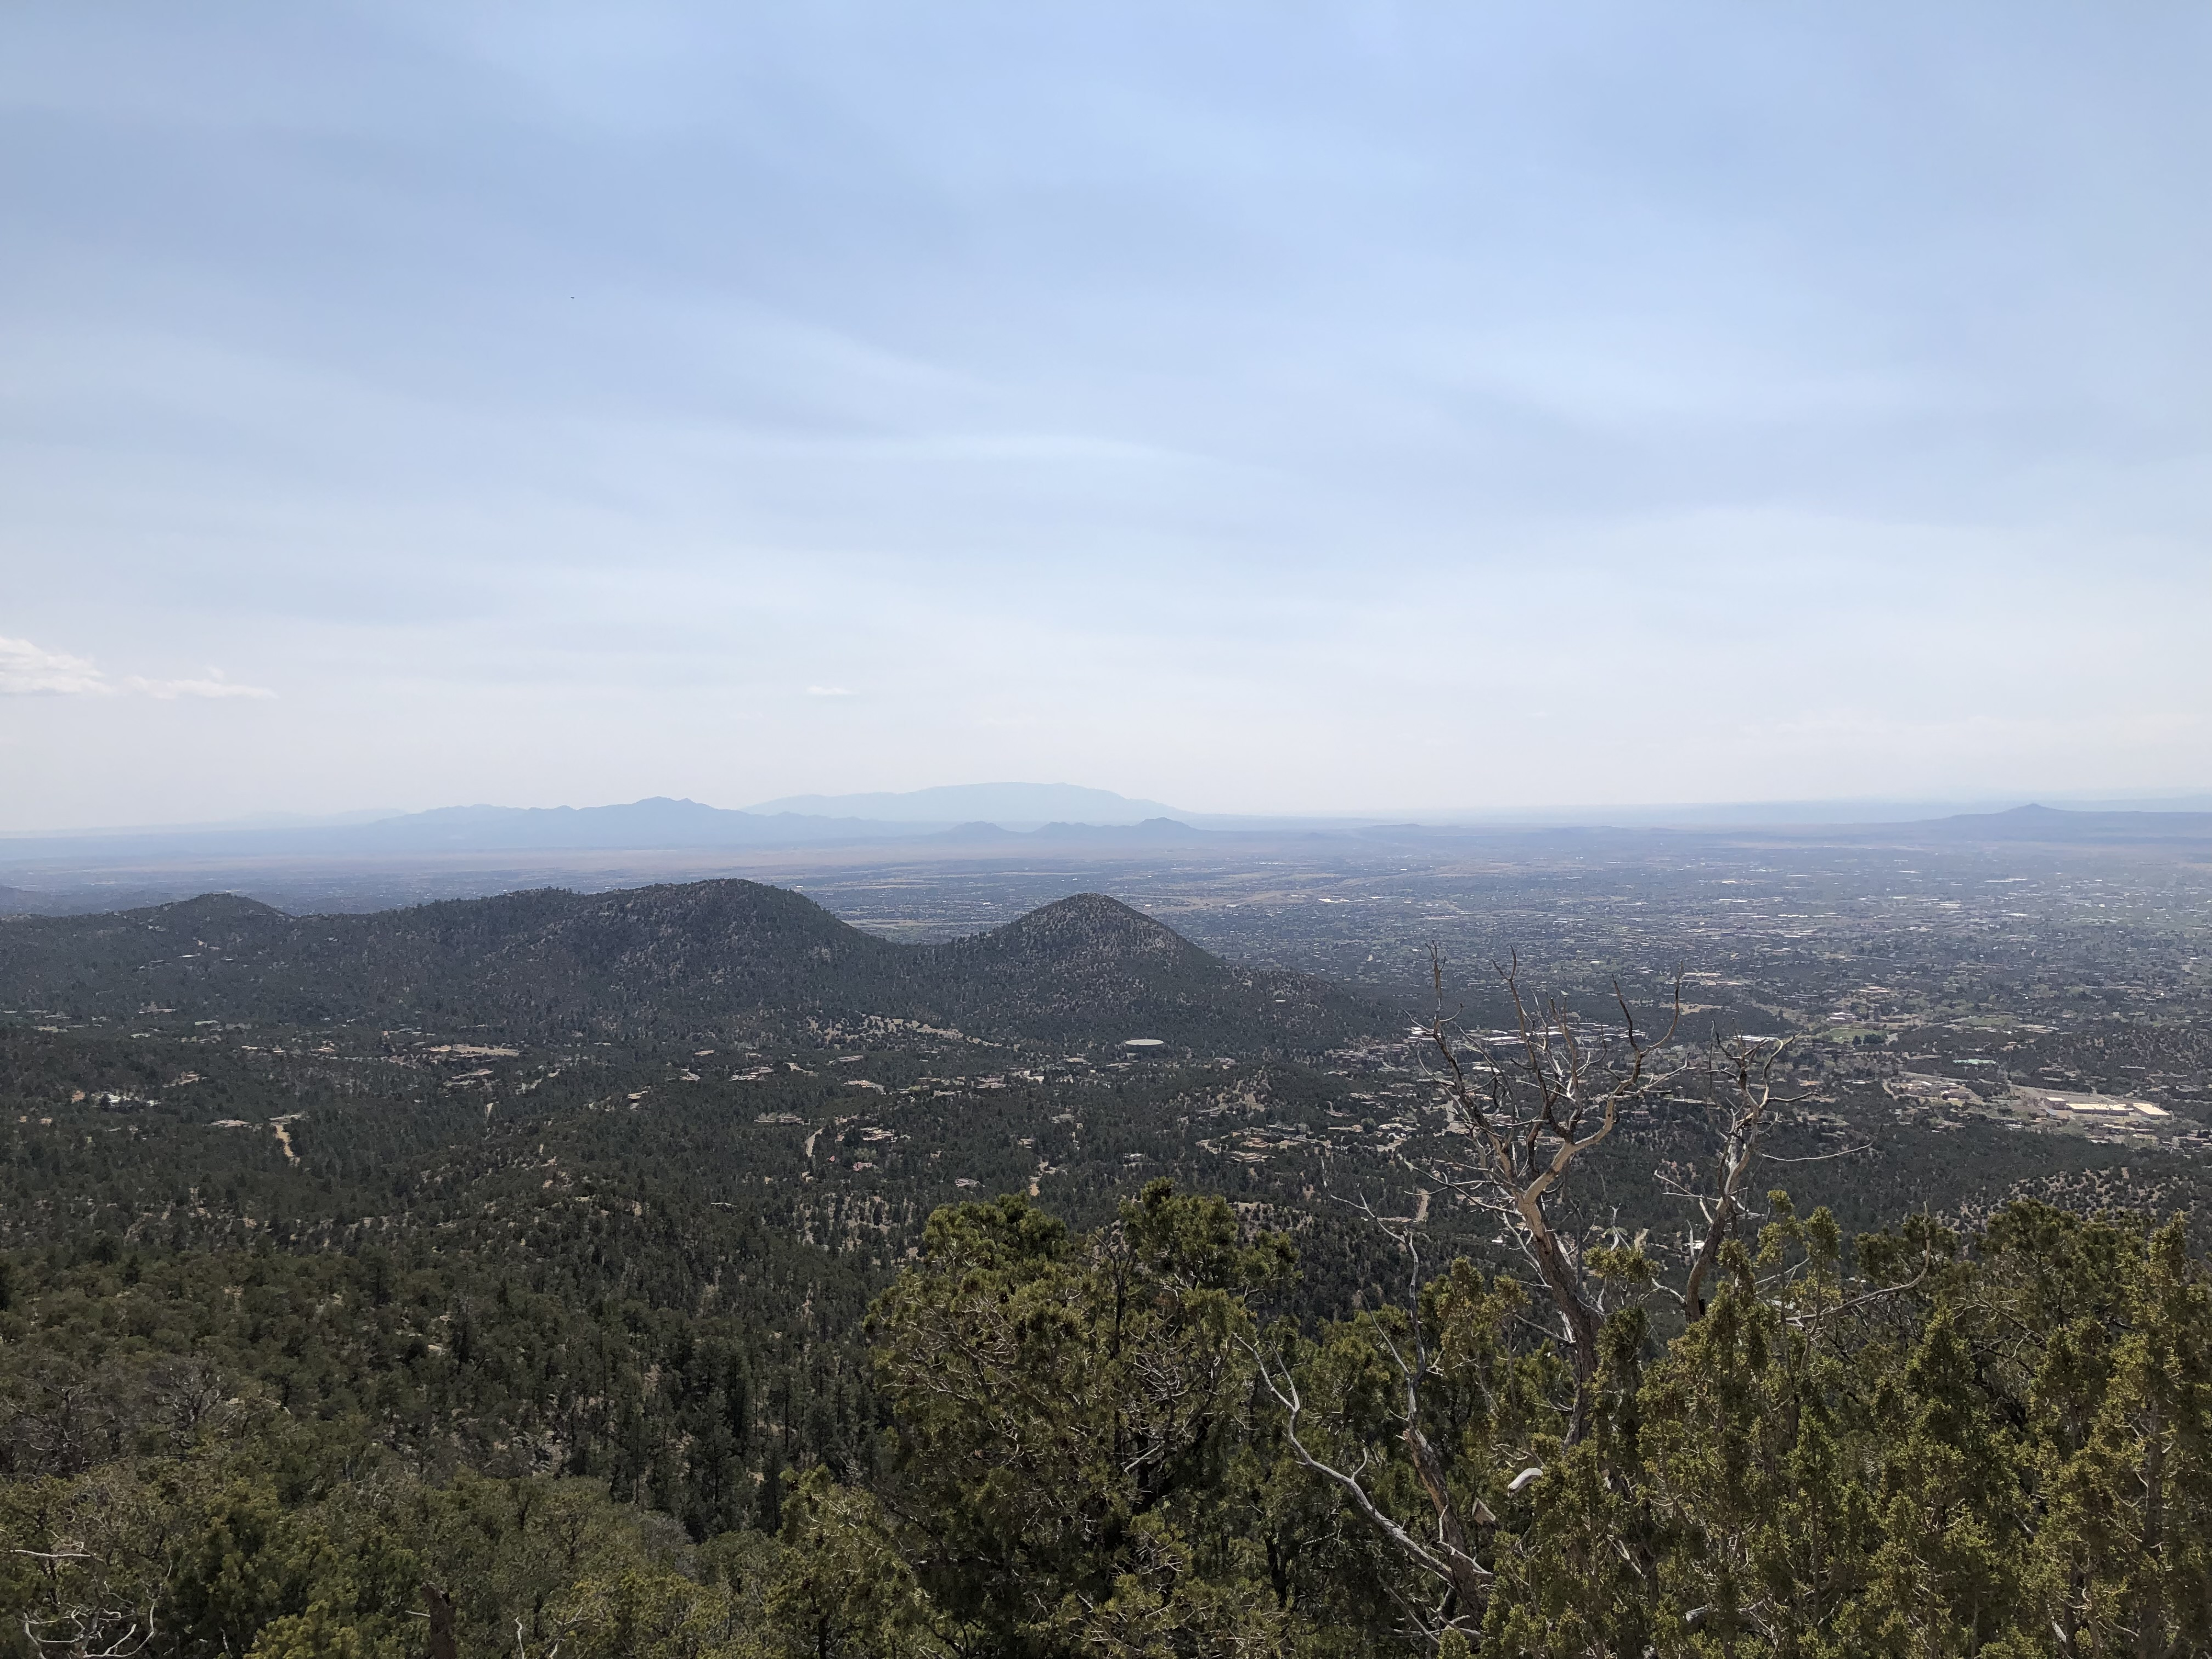
The views expressed in this presentation are my own

Slide 3

Uncertainty Conflicts/War Politics/Policy
Geopolitical Change, Rapid Tech Change

Slide 4
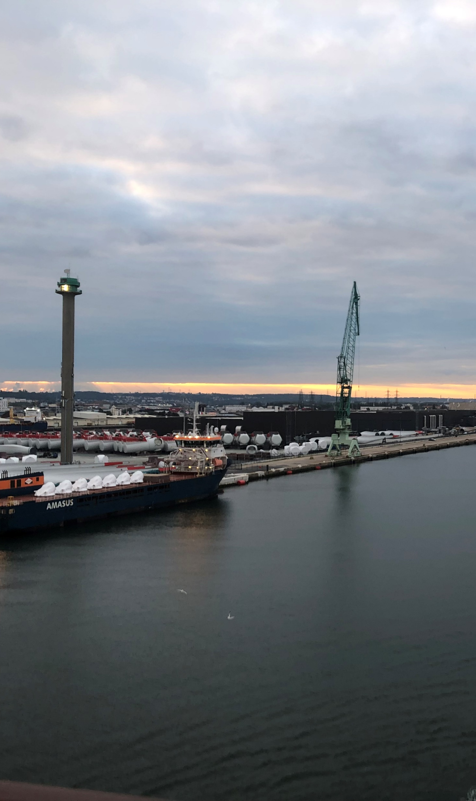
Intertwined World and Uncertainties
Weather
Shipping/Trade
  Strikes
  Port Closures
Conflicts/War
Energy

Slide 5
‘26 Impactful Issues
OBBBA
AI
Wealth Effect
Labor Force
Tariffs
War/Energy
Political Pressures

Slide 6
Expenditures Higher than Revenues
Fiscal 2026: projected 0.7% higher general fund revenues
For FY 2026 enacted budgets, state general fund spending is expected to increase by 1.3% after four consecutive years of at least 6% growth
23 states expecting year‑over‑year declines
Expenditures
Revenues

Slide 7
Pressures on State Revenues
Federal Decreases
Stimulus (Covid) Ending
Medicaid Cuts
Federal Cuts
No Assistance if Downturn
Lottery Revenues Decline
Corporate Volatile
Rainy Day Funds Stable
Sales Tax Lackluster

Slide 8
Federal Actions
Latest Budget FY 2027
Decreasing federal funding streams in grants etc.
IRS House Appropriations Committee: $10.2 billion in fiscal 2027 funding for the IRS, White House proposal: $9.8 billion
The Administration requests an increase of over 40% in budgetary resources for defense
Reductions in non-defense discretionary spending of 10%
OBBBA Medicaid cuts:
Estimated to fall by $911 billion over 10 years (about 14% of projected federal Medicaid expenditures)
7.6 million enrollment decline by 2034

Slide 9
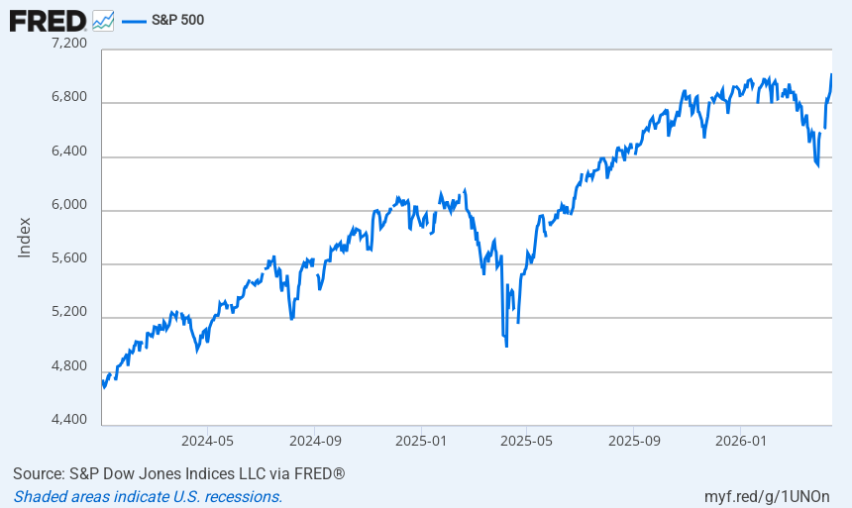
Markets – Income Tax Revenues
Market stats
  10% since ‘22
  16.8% through March
"Magnificent Seven" Apple, Amazon, Microsoft, Meta, Alphabet, Tesla and Nvidia

Slide 10
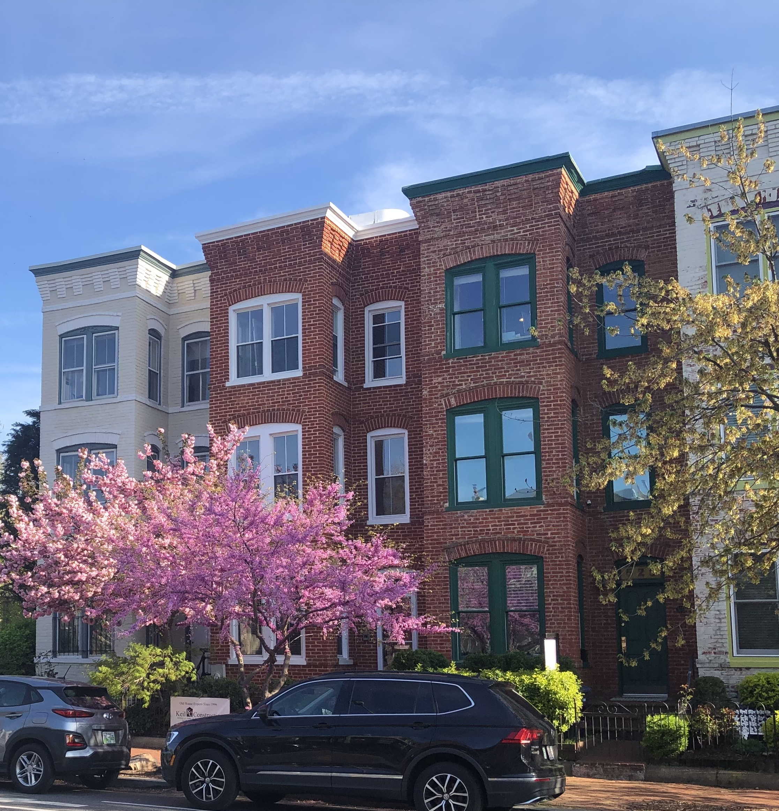
Interest Rates and Mortgages
3.5-3.75%
January Forecast: 3 quarter point cuts (June, Oct, December??)
Now: One in December ?
6.3-ish Mortgage Rates
Spring 2026 housing market more balanced for buyers and sellers

Slide 11
Labor Force
Participation Rate below 62%
Annual growth 1.4% - Now: Near Zero
  Productivity Growth Key
  WHY?
Low Birth Rate
Less Immigration
Aging

Slide 12
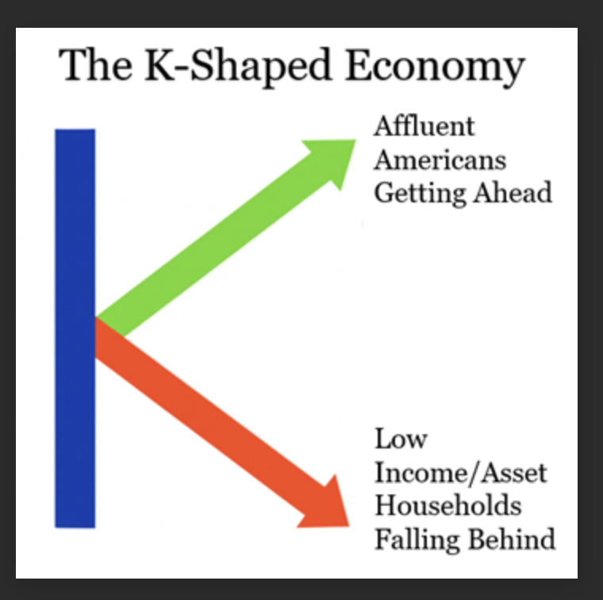
Consumers
Retail Sales Up 7% (excludes gasoline)
Tax Refunds Driving?
Consumer Sentiment Low
K shaped economy
10% of Americans account for 49% of all consumer spending, a record
10% of Americans contribute about one third of the GDP
Bottom 60% about one third

Slide 13

?
Optimistic/Pessimistic
Scott.Pattison@taxadmin.org

