Slide 1
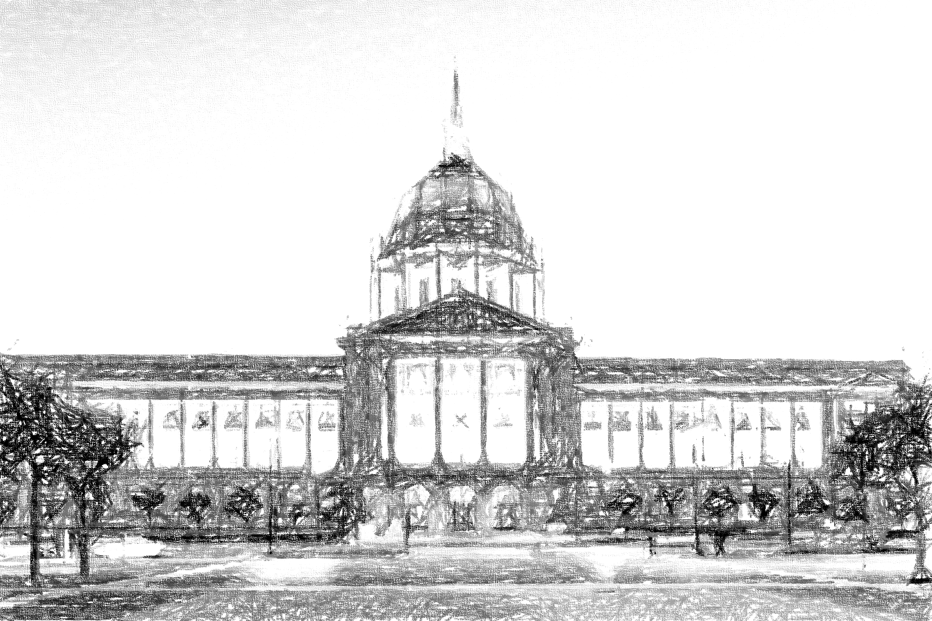
Federal Update part 1???
April 28, 2025
Slides prepared April 8, 2025

Slide 2
Disclaimer
We speak for ourselves.
Our comments do not necessarily represent the views of our employers.
Nothing in this presentation should be considered legal advice.

Slide 3
Why Budget Reconciliation?
Budget reconciliation is exempt from the Senate’s traditional rule allowing unlimited debate.
Unlimited debate allows the use of the filibuster, typically used to prevent votes on legislation. A filibuster can only be ended through cloture, which requires 60 votes.
Reconciliation allows the Senate to prevent a filibuster, allowing passage of legislation by a regular majority.

Slide 4
What is Budget Reconciliation?
Reconciliation is a budget procedure made available by the Congressional Budget Act of 1974, P.L. 93-344.
Congress adopts budget reconciliation instructions through a budget resolution. See H. Con. Res. 14 for a relevant example.
Congress the develops and passes legislation consistent with that resolution.
The Byrd Rule governs whether the legislation is consistent with the resolution.
The Byrd Rule is as important as budget reconciliation itself.

Slide 5
What is the Byrd Rule?
The Byrd Rule dates to 1985 and was made permanent in 1990.
The Byrd Rule allows Senators to offer amendments to, and raise points of order against, extraneous items.
Why?
To protect the effectiveness of the reconciliation process
To preserve the deliberative character of the Senate.

Slide 6
What is extraneous?
Extraneous items: provisions unrelated to achieving the goals of the reconciliation instructions. There is a list of six items.
Five of the six items paraphrased: produces no change in outlays or revenues or produces one that is either contrary to the reconciliation instructions, incidental, or outside the Committee’s jurisdiction; changes Social Security.
The big one: increases the deficit for a fiscal year beyond the “budget window” covered by the resolution.

Slide 7
What is the budget window?
The period covered by the budget resolution.
At a minimum it is the “budget year” (FY2026) and the four following years, the “outyears.”*
The budget resolution can cover the “current year” (FY2025) plus an additional five years after the “outyears” for a total of 11 years.**
For the current resolution, the window is 10 years. Fiscal years 2025 (current year) through fiscal year 2034.
* Section 301(a) of the Congressional Budget Act, as amended.
** Unsure of source.

Slide 8
Scoring – Determining How Much it Costs
Current policy – scoring based on current “policy” which is the current state of things regardless of expirations contained in the law.
Current law – scoring based on current law, which contains expirations for many provisions.
Under current policy scoring, extending the TCJA is free.
Under current law scoring, extending the TCJA ‘costs’ trillions.

Slide 9
Substance
Potential tax reductions:
Permanent TCJA
Increase SALT Cap
Exemption for tip income
Exemption for overtime
Exemption for Social Security benefits
Potential tax increases:
Disallowing PTE workarounds
Corporate SALT Cap
Carried Interest
Sports stadiums

Slide 10
Jonathan’s Bold Prediction
Current policy scoring
Permanent TCJA
$25,000/$50,000 individual SALT cap
Exemption for tip income
Exemption for overtime
Exemption for Social Security benefits
PTE workarounds remain allowed
No change to corporate SALT deduction
No change to carried interest
No change to sports stadiums

Slide 11
Jonathan White jwhite@mtc.gov
That’s It, That’s All
for now

