Slide 1
What the States are Watching
Discussion Presentation
MTC Uniformity Committee
April 29, 2025

Slide 2
Federal Tax Policy Developments
Thompson Reuters Institute, Midyear: Corporate tax departments grapple with possible key tax policy changes, Nadya Britton, Mar. 27, 2025 -
At the Tax Executives Institute 2025 Midyear Conference companies said they are watching.
  TCJA – expiring provisions
  Inflation Reduction Act – credits and related regulations
  US involvement in OECD efforts and DSTs
And, in their 2025 Corporate Tax Department Technology Report — more than 90% of respondents said they were optimistic about tax technology.

Slide 3
Federal Tax Policy Developments
How the TCJA Affected Legal Business Forms, Huaqun Li, Tax Foundation, June 19, 2024
Tracks the “sharp growth” of the pass-through sector since the 1980’s—from 25% of all net business income to 66% (including partnerships, S corporations, and proprietorships).
“The sharp growth in the pass-through sector since the 1980s was due in part to a significant improvement in their relative tax treatment.”

Slide 4
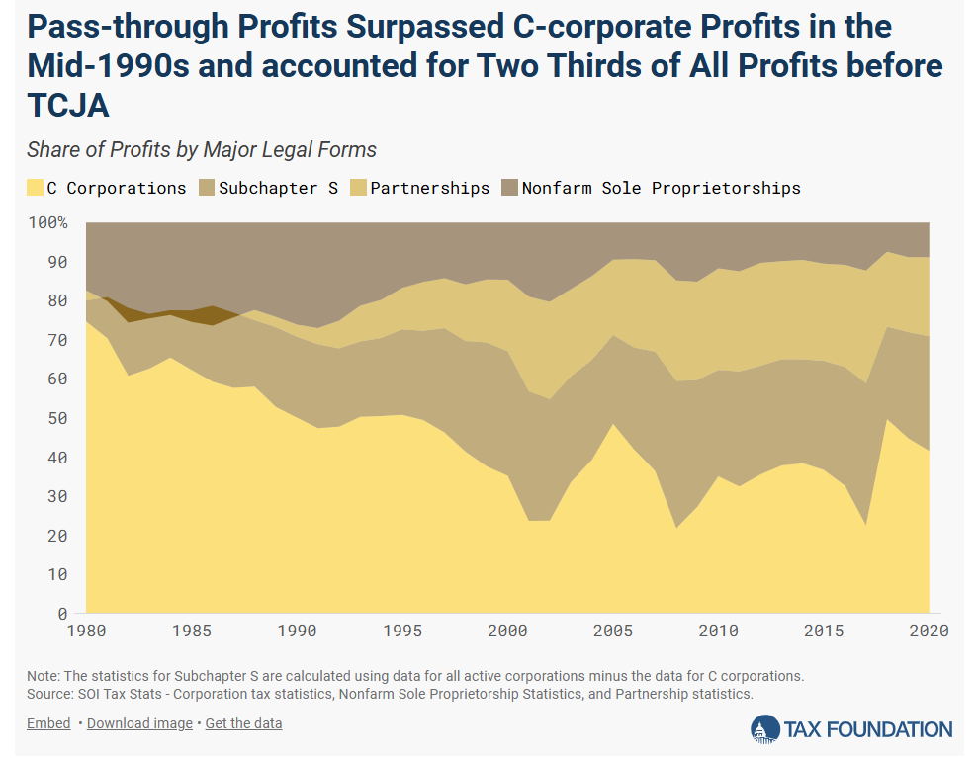

Slide 5
How the TCJA Affected Legal Business Forms, Huaqun Li, Tax Foundation, June 19, 2024
TCJA permanently reduced the corporate income tax rate to a flat rate of 21 percent, from a previous top rate of 35 percent.
TCJA reduced statutory individual income tax rates and enacted the Section 199A pass-through deduction which was created for “parity” but really just extends the pre-TCJA tax preference for pass-through income.

Slide 6
How the TCJA Affected Legal Business Forms, Huaqun Li, Tax Foundation, June 19, 2024
The number of C corporation tax returns has continued to decline since the TCJA.
The net income for C corporations shows a turbulent pattern between 2016 and 2020, dropping significantly in 2017 before increasing significantly in 2018.
But rather than indicating a real shift in C corporation business activity, the turbulence likely suggests that C corporations timed their income to benefit from the large rate cut, particularly through moving around deductions.

Slide 7
How the TCJA Affected Legal Business Forms, Huaqun Li, Tax Foundation, June 19, 2024
“Ideally, the choice of business form should not be influenced by tax considerations. The current tax treatment of businesses is far from ideal, as it applies two very different tax systems that are very difficult, if not impossible, to bring into parity. As lawmakers debate what to do about the expirations of the 2017 tax law, they should consider more fundamental reforms to integrate business taxation, such as moving to a distributed profits tax. Short of a fundamental reform, moving the tax code in the direction of simplicity, neutrality, and certainty should be the goal.”

Slide 8
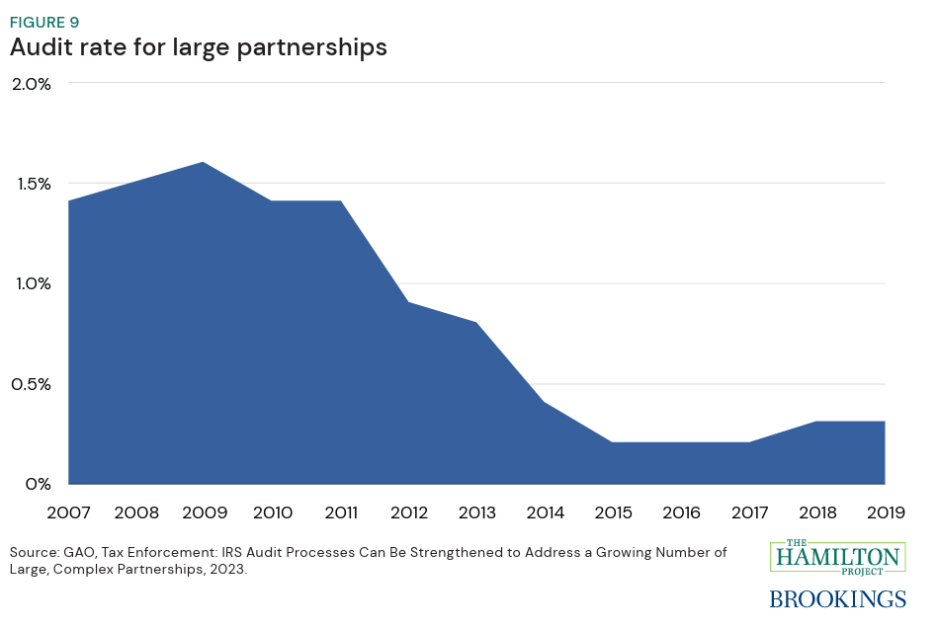
Federal Tax Administrative Developments

Slide 9
Tax Policy Center - Cuts in Spending and Staff Dim Hopes For Transformational Change At The IRS, Janet Holtzblatt, Apr. 2, 2025
The 2022 Inflation Reduction Act (IRA) provided the IRS with almost $80 billion in new funding over 10 years. Since 2023, Congress has rescinded $42 billion of that funding.
About $9 billion had been spent as of September 30, 2024, but of that amount, the IRS diverted $2 billion to pay for routine expenses because the annual Congressional appropriation was insufficient to keep up with inflation.

Slide 10
Tax Policy Center - Cuts in Spending and Staff Dim Hopes For Transformational Change At The IRS, Janet Holtzblatt, Apr. 2, 2025
Recently, 11 percent of the IRS workforce accepted buyouts or were laid off in February. (In response to an injunction, the laid-off workers were later reinstated but placed on administrative leave at least temporarily.) Planned staff cuts may be up to 18 percent.

Slide 11
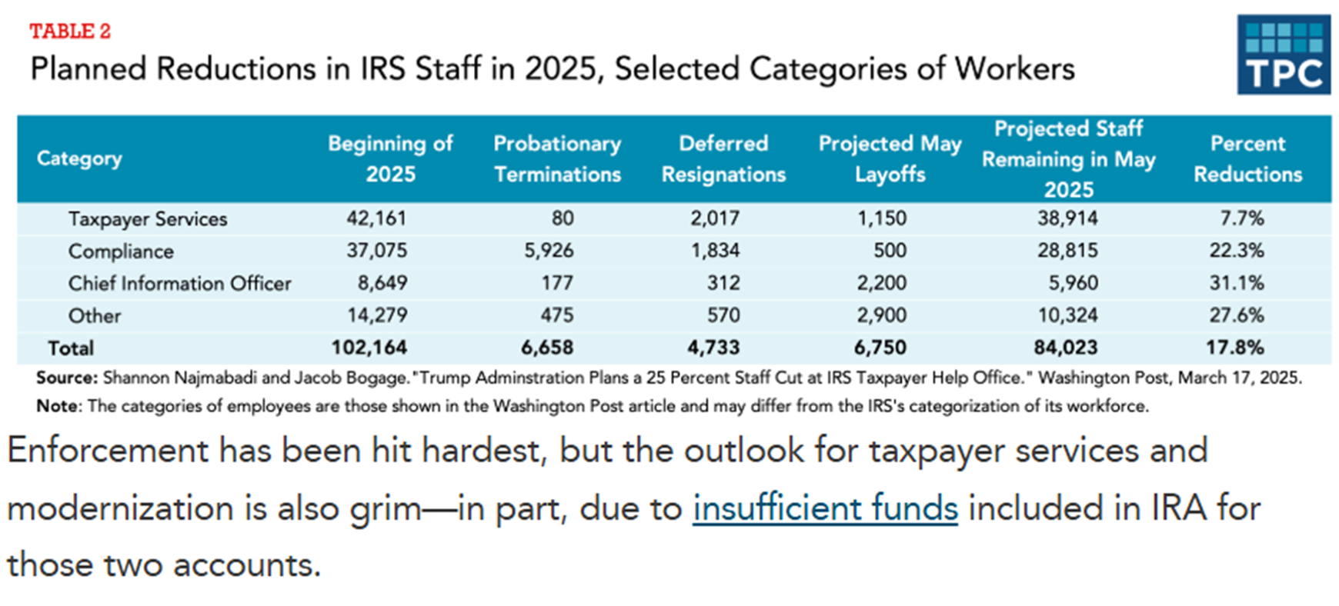
Tax Policy Center - Cuts in Spending and Staff Dim Hopes For Transformational Change At The IRS, Janet Holtzblatt, Apr. 2, 2025

Slide 12
Tax Policy Center - Cuts in Spending and Staff Dim Hopes For Transformational Change At The IRS, Janet Holtzblatt, Apr. 2, 2025
Spending was also constrained by hiring challenges. To increase compliance among high-income taxpayers and big businesses, the IRS sought skilled accountants and tax lawyers in a very competitive job market.
But, even though the agency received authority to expedite hiring to meet critical needs, it paused recruitment after the Office of Personnel and Management objected to some IRS promotion procedures. Delays also resulted from an understaffed human resource office, miscommunication, and prolonged security checks.
Thus, the IRS hired only 495 full-time equivalent employees to fill enforcement slots in 2023, while it brought in 10,500 for taxpayer services. The agency planned to hire about 3,600 new enforcement staff in 2024 and another 3,150 in 2025.

Slide 13
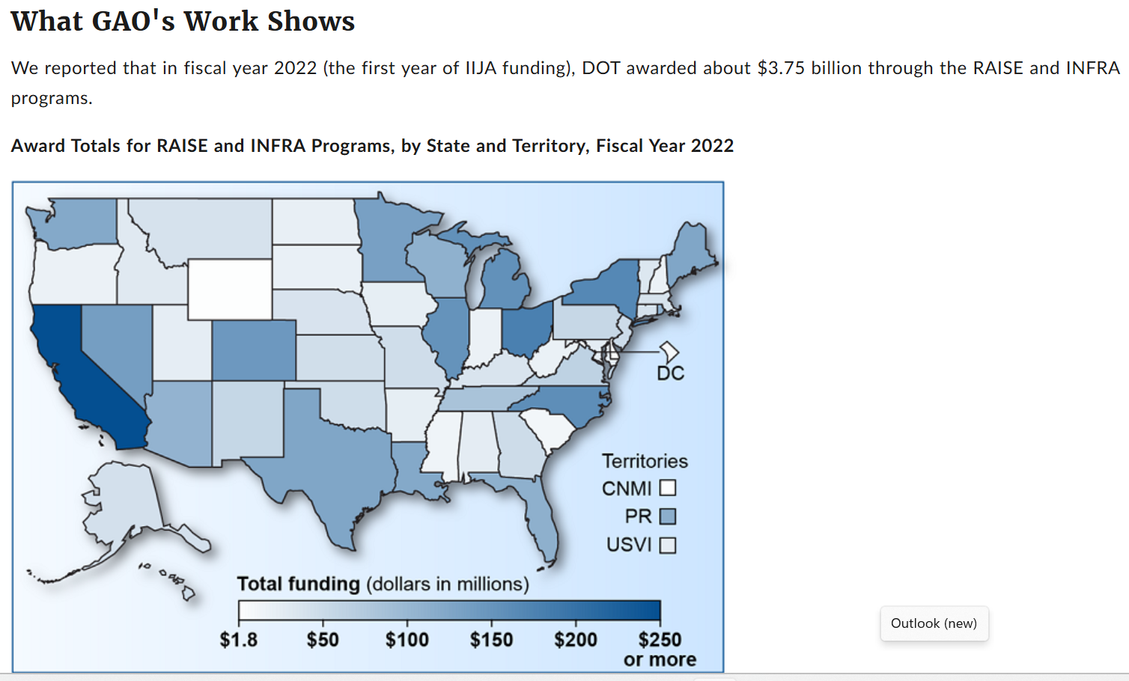
Federal Budget Developments
Discretionary Grants: DOT Should Improve Clarity and Transparency of Program Management, GAO-24-107264, Apr. 18, 2024.

Slide 14
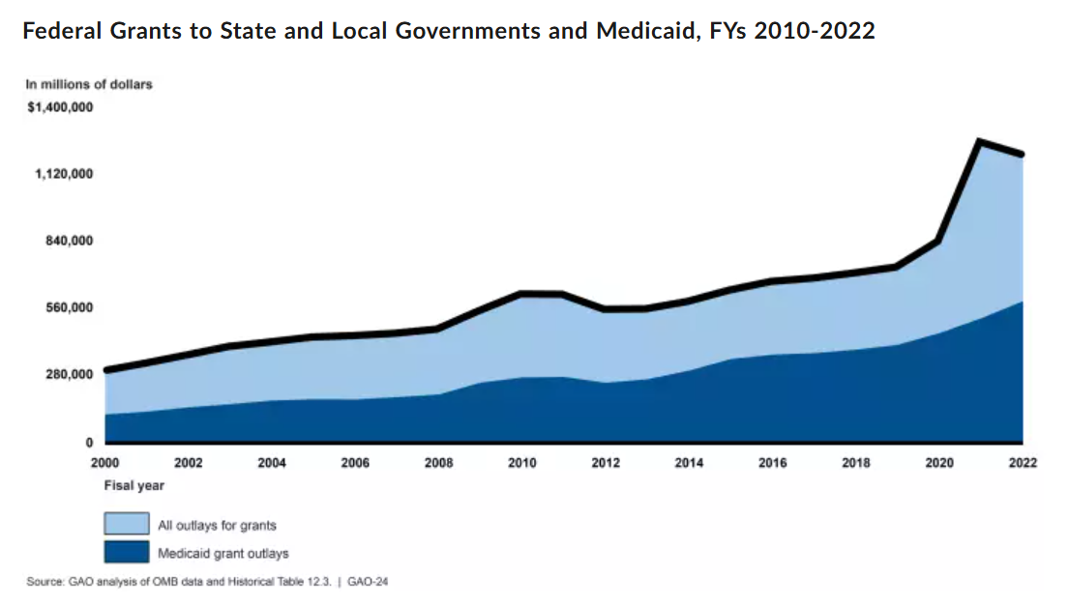
Economic Developments

Slide 15
Grants Management: Action Needed to Ensure Consistency and Usefulness of New Data Standards, GAO-24-106164, Released: Jan 25, 2024.
In 2022, federal aid to tribal, state, local, and territorial governments—primarily through grants—totaled roughly $1.2 trillion. Tracking federal grants spending can be difficult because data are sometimes not consistent government-wide. The GREAT Act seeks to strengthen management and oversight of federal grants through the establishment of governmentwide data standards.

Slide 16
The Tax Policy Center - What types of federal grants are made to state and local governments and how do they work?
The federal government directly transferred $988 billion to state governments and $133 billion to local governments in 2021. These funds accounted for 18 percent of the federal government’s budget in fiscal year 2021, and 27 percent of combined state and local governments’ general revenues. The total amount transferred directly to state governments was significantly higher than the amount transferred directly to local governments because the state total includes “pass-through” grants, which are federal dollars sent directly to states but ultimately intended for local governments.

Slide 17
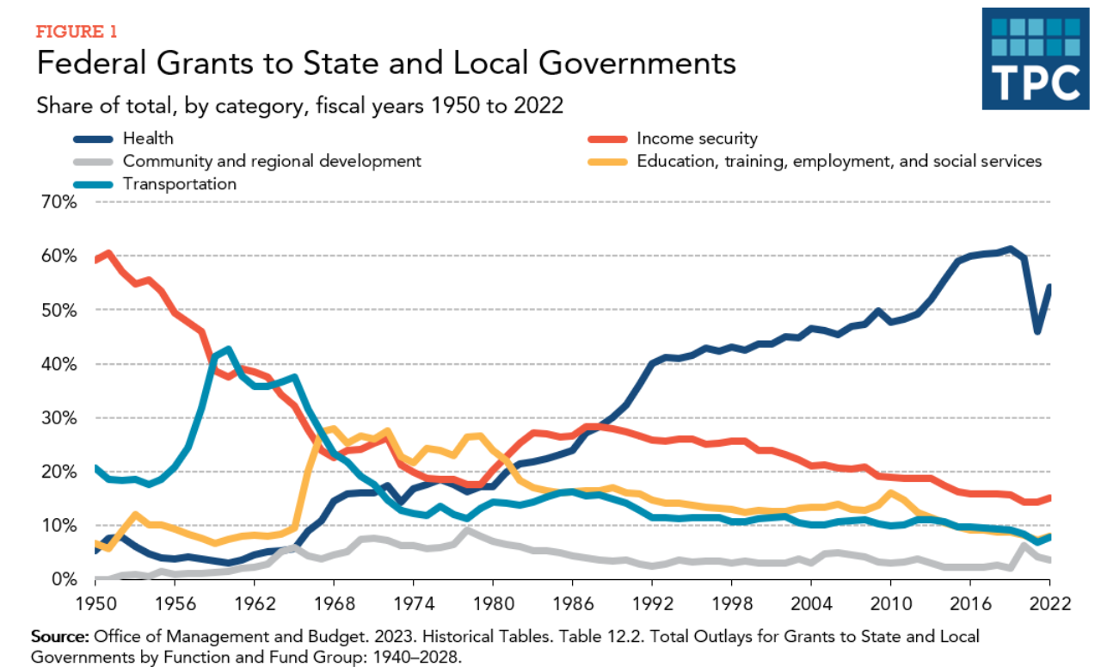
Federal Budget Developments
The Tax Policy Center - What types of federal grants are made to state and local governments and how do they work?

Slide 18
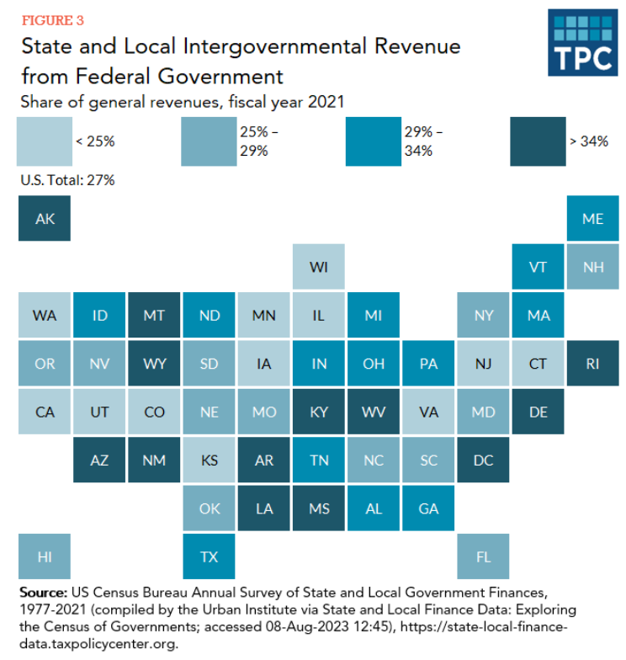
Federal Budget Developments
The Tax Policy Center - What types of federal grants are made to state and local governments and how do they work?

Slide 19
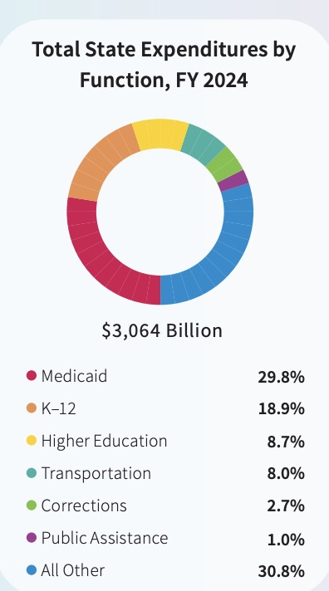
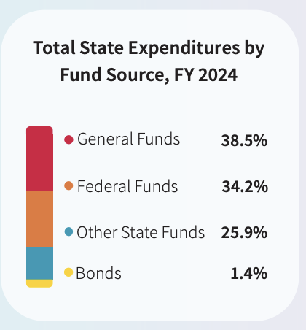
States and Federal Funds Decline

Slide 20
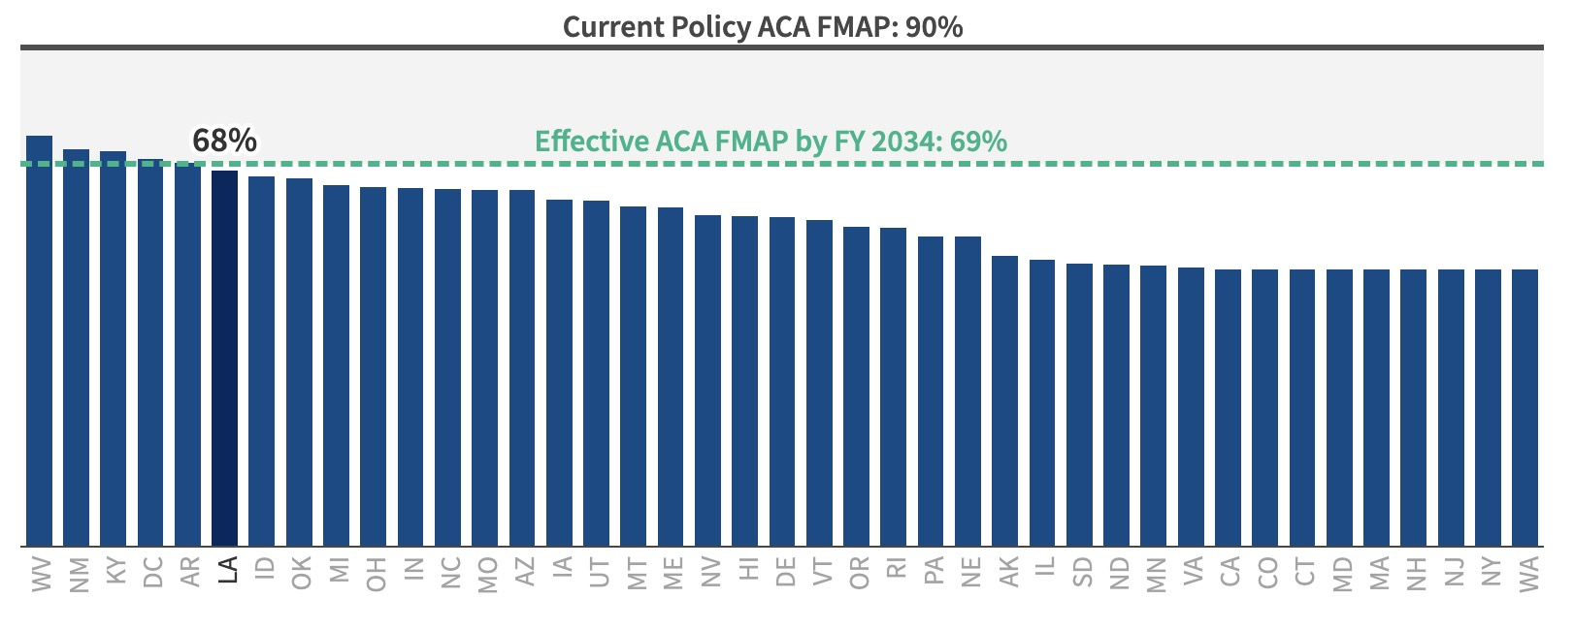
Medicaid $246 Billion Loss

Slide 21
State Revenue Forecasters Watching…
Impacts on State Revenues
Interest Rates/Inflation
Impact of Tariffs
Medicaid Cuts
Markets – Equities – Bonds
Munis
Dollar
Energy
Labor
Consumers

Slide 22
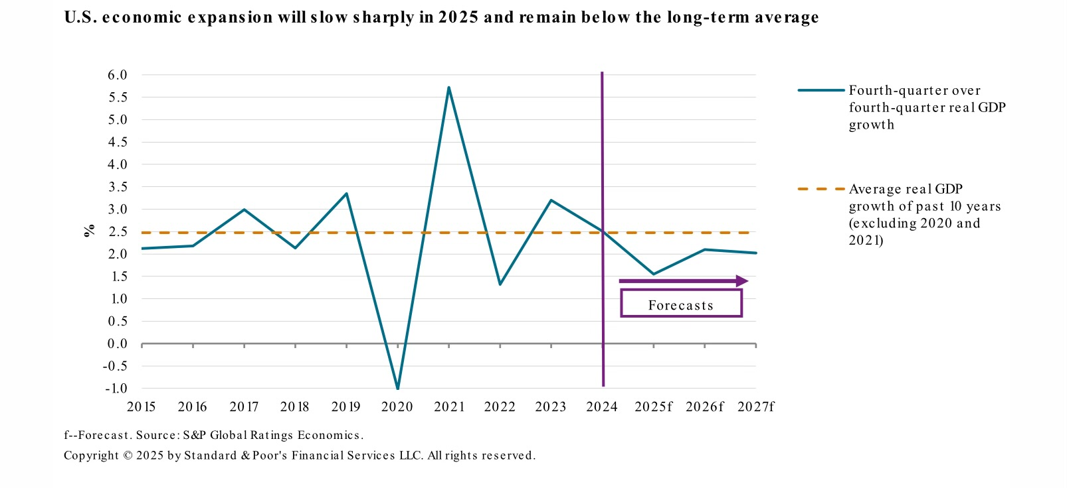
Economic Developments - Slowing Growth

Slide 23
Economic Developments
?

