Slide 1
Insights into the MTC
Uniformity Committee Meeting – Spokane, WA & Virtual
April 29, 2025
Hayes Holderness, Professor of Law, University of Richmond

Slide 2
Disclaimer
I speak for myself.
My comments do not necessarily represent the views of my employer.
Nothing in this presentation should be considered legal advice.

Slide 3
Overview and Agenda
Visiting Academician
A Brief History of the MTC
Uniformity
Establishing the MTC’s Place
Evaluating the Early MTC
State Sovereignty and Uniformity

Slide 4
Visiting Academician

Slide 5
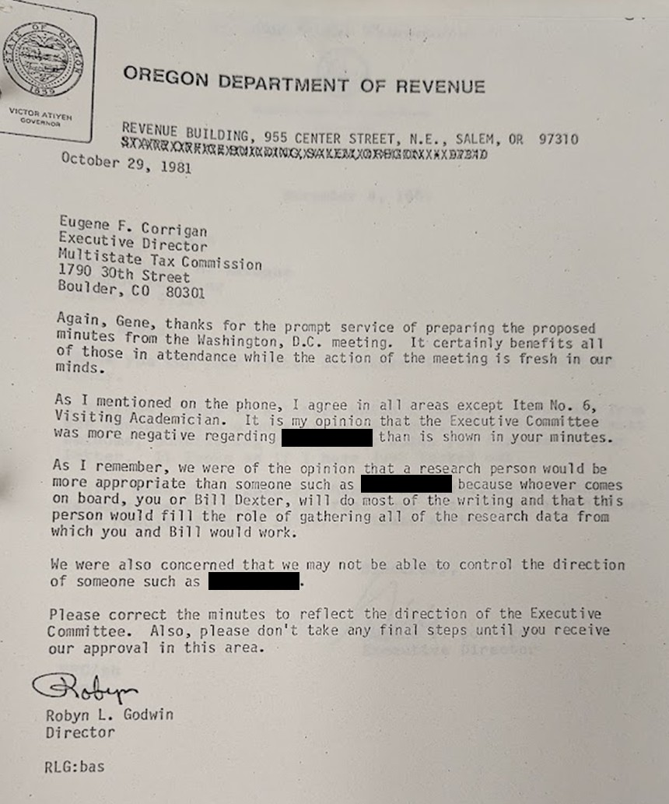
Visiting Academician

Slide 6
Visiting Academician
What makes for effective interstate compacts?
Coercive authority to force compliance with compact goals
A formative reason such as a federal initiative or crisis
Participation of the federal government
No “one state veto voting power”
A high degree of communication among member states
Elite constituencies
Flexibility
James Perry Hill, Managing the Nation’s Waters Without Washington: The Interstate Compact Experience (1992)

Slide 7
A Brief History of the MTC

Slide 8
MTC History
Northwestern States Portland Cement Co. v. Minnesota, 358 U.S. 450 (1959)
The Court held that solicitation of customers in a state was enough to establish nexus for taxation, upsetting the business community’s understandings.
Congressional response
P.L. 86-272
Willis Committee

Slide 9
MTC History
Multistate Tax Compact, Art. I
The purposes of this compact are to:
Facilitate proper determination of State and local tax liability of multistate taxpayers, including the equitable apportionment of tax bases and settlement of apportionment disputes.
Promote uniformity or compatibility in significant components of tax systems.
Facilitate taxpayer convenience and compliance in the filing of tax returns and in other phases of tax administration.
Avoid duplicative taxation.

Slide 10
Uniformity

Slide 11
Why Care About Uniformity?
Economic Benefits
No advantage to conducting activities in one state or another
Less complicated compliance burdens
Ease of developing reasonable expectations about taxation
Boon to economic activity, even if the substance of the law is not optimal

Slide 12
Why Care About Uniformity?
Governance Benefits
Eases enforcement costs
Curtails opportunities for tax evasion
Requires less legislative attention to tax laws
Equity Benefits
Puts interstate commerce on more equal footing with intrastate commerce
Treats interstate taxpayers the same regardless of geography

Slide 13
Why Care About Uniformity?
Foundational Principle
South Dakota v. Wayfair, Inc., 138 S. Ct. 2080 (2018)
“The Commerce Clause ‘reflect[s] a central concern of the Framers that was an immediate reason for calling the Constitutional Convention: the conviction that in order to succeed, the new Union would have to avoid the tendencies toward economic Balkanization that had plagued relations among the Colonies and later among the States under the Articles of Confederation.’”

Slide 14
Why Care About Uniformity?
Foundational Principle
The Federalist No. 7 (Alexander Hamilton)
“The spirit of enterprise, which characterizes the commercial part of America, has left no occasion of displaying itself unimproved. It is not at all probable that this unbridled spirit would pay much respect to those regulations of trade by which particular States might endeavor to secure exclusive benefits to their own citizens. The infractions of these regulations, on one side, the efforts to prevent and repel them, on the other, would naturally lead to outrages, and these to reprisals and wars.”

Slide 15
Achieving Uniformity
How to achieve uniformity in state taxation of interstate commerce?
Imposition
Congress
U.S. Supreme Court
Collaboration
Interstate Compacts

Slide 16
Achieving Uniformity
Uniformity by Imposition
Efficient, but
Comes at the cost of state sovereignty,
Can lock the states into methods of taxation that may not work
P.L. 86-272?
Political considerations
Moorman Manufacturing Co v. Bair, 437 U.S. 267 (1978)
“Although the adoption of a uniform code would undeniably advance the policies that underlie the Commerce Clause, it would require a policy decision based on political and economic considerations that vary from State to State.”

Slide 17
Achieving Uniformity
Mobil Oil Corporation v. Commissioner of Taxes of Vermont, 445 U.S. 425 (1980)
“We agree with Mobil that the constitutionality of a Vermont tax should not depend on the vagaries of New York tax policy.”
Container Corp. v. Franchise Tax Board, 463 U.S. 159 (1983)
“A final point that needs to be made about the unitary business concept is that it is not, so to speak, unitary: there are variations on the theme, and any number of them are logically consistent with the underlying principles motivating the approach.”

Slide 18
Achieving Uniformity
Uniformity by Collaboration
Allows for more state sovereignty and addresses some of the political issues of federal intervention, but
Reaching consensus or even a majority position can be difficult,
Requires buy-in from a significant number of states
Ad Hoc Committee proposal for federal legislation in response to the Willis Committee

Slide 19
Establishing the MTC’s Place

Slide 20
The MTC’s Purpose
Multistate Tax Compact, Art. I
The purposes of this compact are to:
Facilitate proper determination of State and local tax liability of multistate taxpayers, including the equitable apportionment of tax bases and settlement of apportionment disputes.
Promote uniformity or compatibility in significant components of tax systems.
Facilitate taxpayer convenience and compliance in the filing of tax returns and in other phases of tax administration.
Avoid duplicative taxation.

Slide 21
The MTC’s Purpose
Why is the “promotion of uniformity or compatibility in significant components of tax systems” a stated purpose of the Multistate Tax Compact?
Ease the flow of interstate commerce
Reduce enforcement costs for the states
Stave off federal action that would impair state sovereignty

Slide 22
Establishing the MTC’s Place
As the facilitator of the collaborative effort of the Multistate Tax Compact, how did the MTC establish itself?
Early years involved significant recruitment efforts to convince states to adopt the Multistate Tax Compact
Lobbied against federal uniformity legislation
Lobbied for federal consent bill
Established joint audit program and training programs
Established litigation and uniformity committees, among others
Recruited highly-qualified staff
Aggressively defended against efforts to diminish the MTC’s role

Slide 23
Establishing the MTC’s Place
The initial efforts of the MTC and states to adopt UDITPA and to lobby against federal action proved successful.
The joint audit program became a focus of attention within the MTC.
Tool to recruit more states by demonstrating the value that the MTC could provide.
Niche areas of taxation aside, less of a pressing need for substantive uniformity proposals?
Taxpayers used the program as the basis to challenge the constitutionality of the Multistate Tax Compact.

Slide 24
Evaluating The Early MTC

Slide 25
Evaluating the Early MTC
What makes for effective interstate compacts?
Coercive authority to force compliance with compact goals
A formative reason such as a federal initiative or crisis
Participation of the federal government
No “one state veto voting power”
A high degree of communication among member states
Elite constituencies
Flexibility
James Perry Hill, Managing the Nation’s Waters Without Washington: The Interstate Compact Experience (1992)

Slide 26
Evaluating the Early MTC
Coercive authority to force compliance with compact goals?
No, but the goal is the preservation of state sovereignty?
Soft power by recognizing and highlighting federal threats to act

Slide 27
Evaluating the Early MTC
A formative reason such as a federal initiative or crisis?
Northwestern States Portland Cement Case
P.L. 86-272
Willis Committee
Federal bills regarding state taxation

Slide 28
Evaluating the Early MTC
Participation of the federal government?
No, but the goal is the preservation of state sovereignty
Communication with federal lawmakers
Federal consent bills?
Supreme Court recognition in U.S. Steel Case

Slide 29
Evaluating the Early MTC
No “one state veto voting power”?
Collaborative effort between the member states
Not imposing laws/regulations on any state

Slide 30
Evaluating the Early MTC
A high degree of communication among member states?
Meetings
Communications regarding MTC’s work
Shared Expertise

Slide 31
Evaluating the Early MTC
Elite constituencies?
Recruitment of states to join the Compact

Slide 32
Evaluating the Early MTC
Flexibility?
Responsiveness to the desires of the states
Responsiveness to proposed federal action
Responsiveness to taxpayer input and pushback

Slide 33
State Sovereignty and Uniformity

Slide 34
Evaluating the MTC
Promoting uniformity while preserving state sovereignty can feel at odds
Goes to the core difficulty of the dormant Commerce Clause
Moorman Manufacturing Co v. Bair, 437 U.S. 267 (1978)
“While the freedom of the States to formulate independent policy in this area may have to yield to an overriding national interest in uniformity, the content of any uniform rules to which they must subscribe should be determined only after due consideration is given to the interests of all affected States.”
Perfect uniformity is not, or should not, be the goal

Slide 35
State Sovereignty and Uniformity
Trying to go to far in promoting uniformity at the expense of state sovereignty brings dangers
Invites challenges from taxpayer community
The joint audit program and the U.S. Steel litigation
Discourages states from joining the MTC’s efforts
Gillette litigation
Drains resources

Slide 36
State Sovereignty and Uniformity
The promotion of uniformity works best through the promotion of principles and common roots for state tax laws
Allows for states to enact tax laws suited for their jurisdiction
Also provides some degree of predictability to taxpayers
E.g. Combined reporting, UDITPA

Slide 37
State Sovereignty and Uniformity
Federal landscape
Congressional action to impose uniformity on state taxation of interstate commerce
Mobil Workforce Act
Internet Tax Freedom Act
Worldwide Combined Reporting?
Supreme Court
Dormant Commerce Clause
Pike Balancing

Slide 38
Questions & Discussion

Slide 39
Contact Information
Hayes Holderness
Professor of Law
University of Richmond
hrh@richmond.edu

