Slide 1
State Taxation of Partnerships – Status Report
April 29, 2025

Slide 2
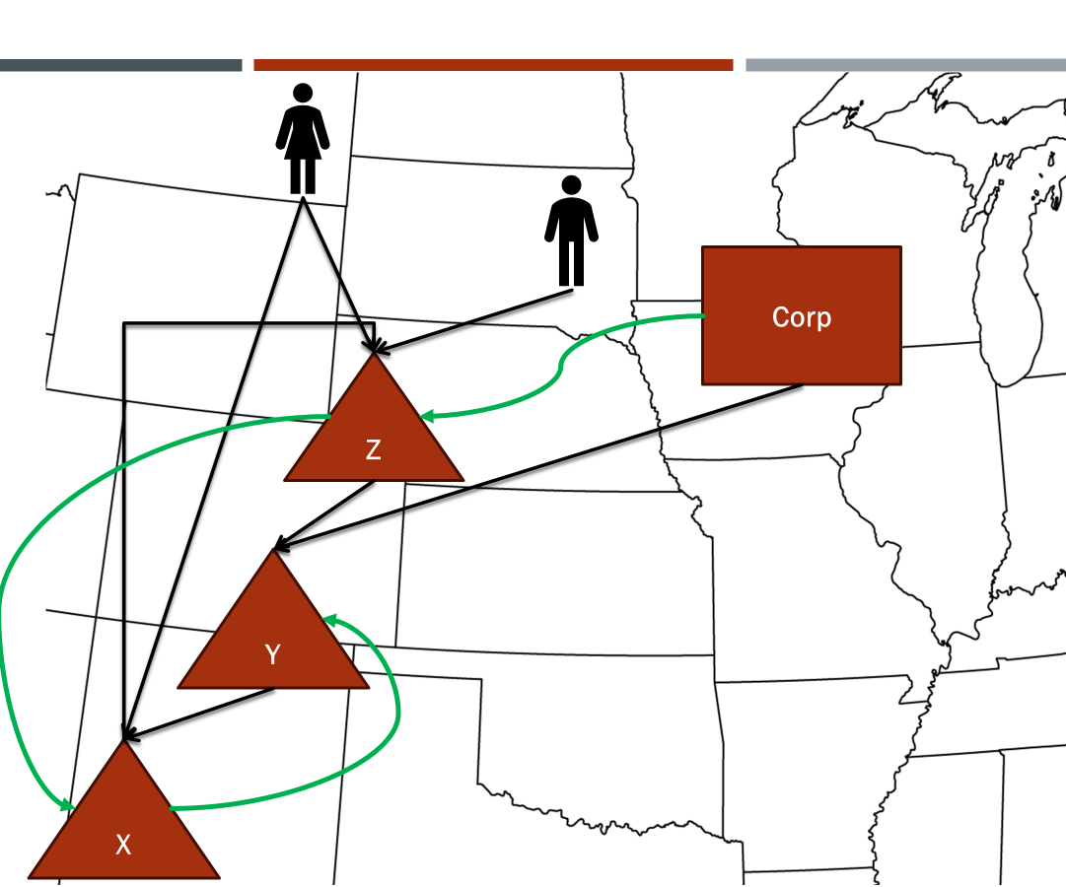
NOTE: This presentation sets out information from the work group’s discussions, white paper draft, and multistate research, which are on the project webpage here: partnership project webpage. This information is presented to the Uniformity Committee for consideration and discussion. All input is welcomed. *Our multistate research should not be relied on as tax advice. For specific questions, please contact your state department of revenue and/or tax advisor.

Slide 3
Work Group’s Approach
Identify critical issues
Research state treatment
Analyze different approaches
Draft white papers – findings and conclusions
Draft models
Defer finalizing to ensure models are consistent and workable

Slide 4
Partnership Project Progress To Date
Comprehensive Issue Outline
Sourcing Income of Investment Partnerships
White Paper
Draft Model
Sourcing Guaranteed Payments for Services
White Paper
Draft Model
Proposed General Framework – State Pass-Through Taxation of Partnerships
Sourcing in Complex Partnership Structures
Multistate Research
White Paper Draft - all input is welcome
These documents can be found on the project webpage HERE.

Slide 5
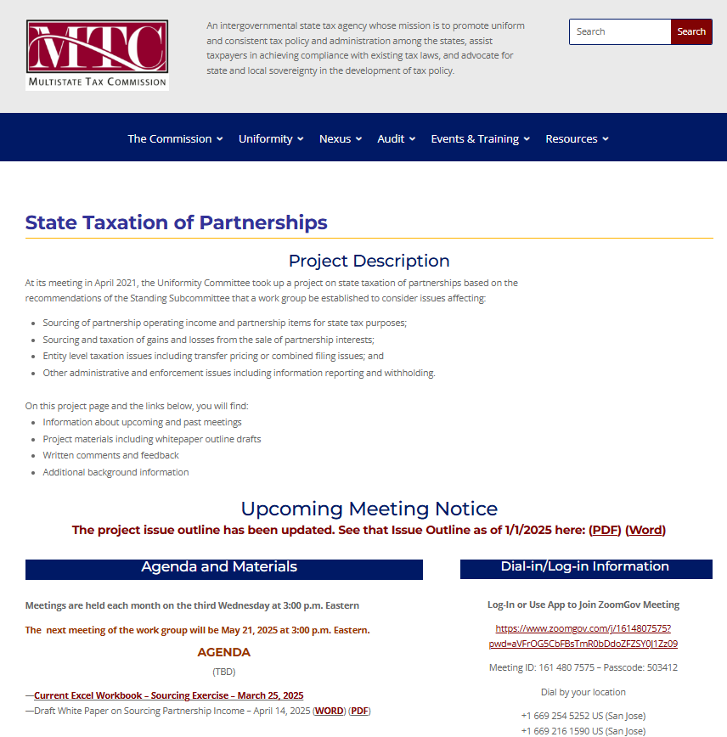
Staff has begun capturing the issues and approaches the work group and committee have reviewed and discussed in the form of a DRAFT white paper – on the project web page – here.

Slide 6
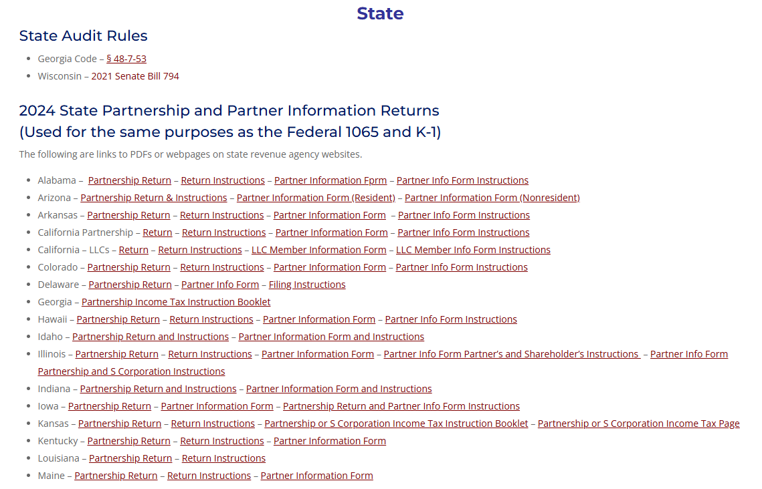

Slide 7
Steps in Sourcing Partnership Income - Corporate or Tiered Partners
Are partnership items of income apportionable to the partnership?

Slide 8
Steps in Sourcing Partnership Income - Corporate or Tiered Partners
Are partnership items of income apportionable to the partnership?
NO
Assign the items using state sourcing rules and attribute to partner.

Slide 9
Steps in Sourcing Partnership Income - Corporate or Tiered Partners
Are partnership items of income apportionable to the partnership?
NO
Assign the items using state sourcing rules and attribute to partner.
YES
Is the partnership distributive share apportionable income to the partner?

Slide 10
Steps in Sourcing Partnership Income - Corporate or Tiered Partners
Are partnership items of income apportionable to the partnership?
NO
Assign the items using state sourcing rules and attribute to partner.
YES
Is the partnership distributive share apportionable income to the partner?
NO
Apportion the items using state rules applied at the partnership level.

Slide 11
Steps in Sourcing Partnership Income - Corporate or Tiered Partners
Are partnership items of income apportionable to the partnership?
NO
Assign the items using state sourcing rules and attribute to partner.
YES
Is the partnership distributive share apportionable income to the partner?
NO
Apportion the items using state rules applied at the partnership level.
YES
Does the state provide for blended apportionment in this case?

Slide 12
Steps in Sourcing Partnership Income - Corporate or Tiered Partners
Are partnership items of income apportionable to the partnership?
NO
Assign the items using state sourcing rules and attribute to partner.
YES
Is the partnership distributive share apportionable income to the partner?
NO
Apportion the items using state rules applied at the partnership level.
YES
NO
Does the state provide for blended apportionment in this case?

Slide 13
Steps in Sourcing Partnership Income - Corporate or Tiered Partners
Are partnership items of income apportionable to the partnership?
NO
Assign the items using state sourcing rules and attribute to partner.
YES
Is the partnership distributive share apportionable income to the partner?
NO
Apportion the items using state rules applied at the partnership level.
YES
NO
Does the state provide for blended apportionment in this case?
YES
Use blended apportionment.

Slide 14
At the Last Uniformity Committee Meeting
We focused on the concept of blended apportionment.

Slide 15
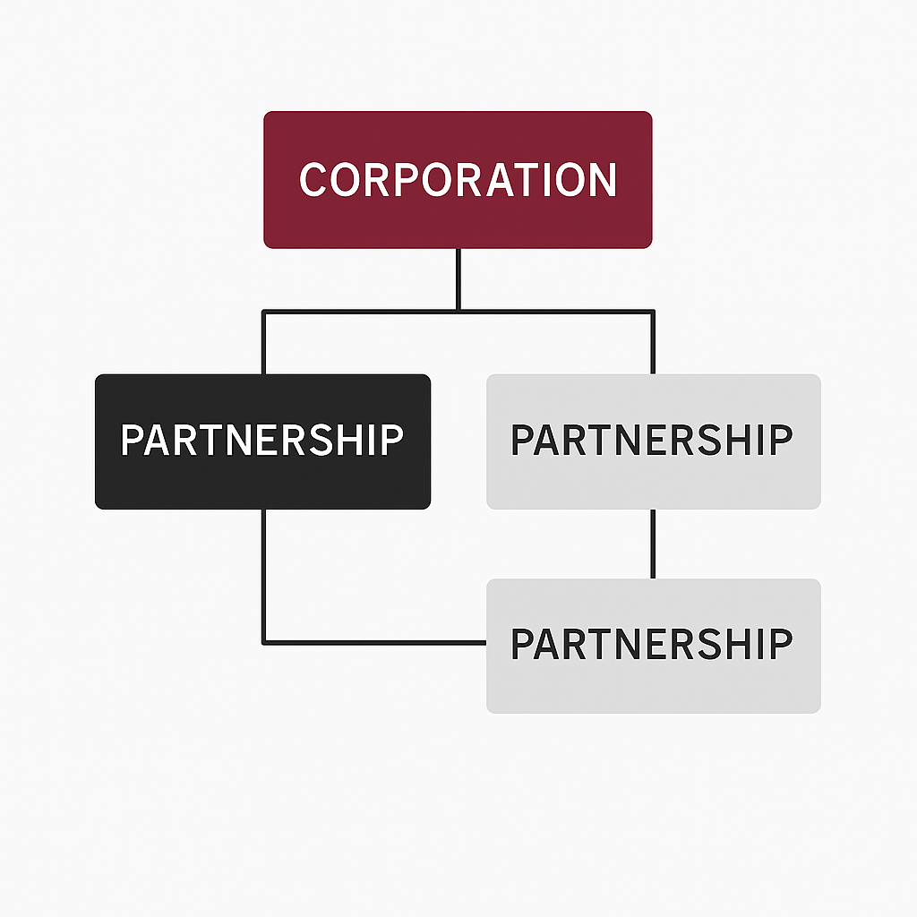
What is blended apportionment?
This concept applies when the partner is a corporation or another partnership.
It is sometimes referred to as “rolling up” the factors.
Under blended apportionment, the partner’s own apportionment factors are combined with its share of the partnership’s apportionment factors. The blended formula is then applied to the partner’s total apportionable income, including its share of the partnership’s apportionable income.
BLEND
BLEND
BLEND
Notes:
Note that there would be other partners where blending would not apply.

Slide 16
What is blended apportionment?
Note that this means not all partnership income will be sourced the same. There may be partners to which blending does not apply.
This reflects the nature of the pass-through system where both the character of the items and the attributes of the partner are taken into account.
BLEND
BLEND
BLEND
Notes:
Note that there would be other partners where blending would not apply.

Slide 17
Is Blended Apportionment Necessary?
Blended apportionment can create challenges in reporting tax-related information and calculating tax. However, similar to combined corporate reporting, it may help mitigate the distortive effects that separate-entity reporting can have on the sourcing of multistate income.

Slide 18
Determining the Share of Factors to include
Item - Based Approach: Directly attribute the receipts to particular partners based on the partnership items making up their distributive share.
Interest - Based Approach: Use a ratio of the partner’s “interest in the partnership” (same as federal rules under 704(b)).
Capital Share - Based Approach: Use a ratio of the partner’s share of capital.
Distributive Share - Based Approach: Use a ratio of the partner’s share of partnership net distributive share income.

Slide 19
Item – Based approach
This approach aligns with the attribution principle under IRC Sec. 702 and the requirement that partners treat items of partnership income as if they were realized directly.
Example – Partner receives 20% of ordinary income of Partnership earned by selling widgets—so 20% of the Partnership’s receipts are also attributed to the selling of widgets.
But it would be difficult to apply in practice.

Slide 20
Interest - Based Approach
The “partners interest in the partnership” is a concept tied to the substantial economic effect rules of Sec. 704(b)—which considers multiple facts and circumstances and may be difficult to apply where it is not applied at the federal level (to re-allocate distributive share income).

Slide 21
Capital Share - Based Approach
This will often not reflect the share of partnership income which the partner receives in a given year because of special allocations.

Slide 22
Distributive Share - Based Approach
This approach matches the partners’ shares of partnership income in a given year with the receipts of the partnership that would be used to apportion that income at the partnership level.
The main issue is that special allocations can create problems in computing the ratio—where a partner’s share is negative and the partnership distributive share net income is positive and the partner’s share is negative or vice versa.

Slide 23
Who is using blended apportionment?
The majority of states have explicitly adopted some form of blended apportionment for sourcing income when the partner is a corporation.
Alabama, Arizona, California, Connecticut, Delaware, the District of Columbia, Florida, Georgia, Hawaii, Indiana, Idaho, Illinois, Iowa, Kansas, Kentucky, Maine, Maryland, Massachusetts, Michigan, Minnesota, Montana, Nebraska, New Jersey, New York, North Carolina, North Dakota, Ohio, Oregon, Pennsylvania, Rhode Island, Tennessee, Utah, Vermont, Virginia, West Virginia, and Wisconsin.

Slide 24
Who is using blended apportionment?
When the partner is a partnership in another partnership, 12 of the 15 states with sourcing rules for multi-tiered partnerships have explicitly adopted some form of blended apportionment for sourcing income.
The twelve states are Arizona, California, Colorado, Florida, Illinois, Kentucky, Massachusetts, Ohio, Utah, Vermont, West Virginia, and Wisconsin.

Slide 25
“How” Issues for Applying
Blended Apportionment
(discussed in Santa Fe and in the White Paper with supporting calculations in the Excel Workbook on the Partnership Project Webpage)

Slide 26
“How” Issues with Blended Apportionment
How is the share of the factors to be combined with the partner’s own factors determined?
General tentative answer – based on the partner’s distributive share of partnership income.
What if the partner receives special allocations—including special allocations of partnership losses?
Use absolute values of the total amounts of income (loss) allocated to partners.
Are required allocations of gain or loss—e.g., built-in gain (loss) on contributed assets—sourced differently?

Slide 27
“How” Issues with Blended Apportionment
How are receipts from partner-partnership transactions treated?
In general—the states that have addressed this issue appear to eliminate those intercompany amounts.
Are there times when clear 482 or other add-back authority is needed?
Are there other general anti-abuse rules to consider?
Notes:
Lots more to do on the how questions.

Slide 28
“When” Issues for Applying
Blended Apportionment
Note: These issues were raised at the workgroup meeting on April 16, 2025, and are discussed in the White Paper. The work group is currently gathering input on these issues.
Notes:
History – development over time.

Slide 29
When are states using blended apportionment?
When the partner is a corporation – states vary
Most expressly limit blended apportionment
To situations involving a unitary relationship (California, Hawaii, Indiana, Illinois, Maryland, Massachusetts, Michigan, Minnesota, Montana, Nebraska, New Jersey, Vermont, West Virginia, Wisconsin); or
Where the income is apportionable (Idaho, North Carolina, North Dakota); or
Where the partnership is a business interest (Alabama – business interest; Arizona – business interest; Iowa – connection with the taxpayer’s regular trade or business operations; Oregon – part of the corporation's overall business operations).
The remaining blended apportionment states do not explicitly specify when blended apportionment applies.

Slide 30
When are states using blended apportionment?
When a partner is a partnership in another partnership:
7 of the 12 states with blended apportionment—California, Colorado, Illinois, Massachusetts, Vermont, West Virginia, and Wisconsin—expressly limit its application to situations involving a unitary relationship.
The remaining blended apportionment states do not explicitly specify when blended apportionment applies.

Slide 31
Examples of “Unitary” Limitations
Vermont Schedule BI-477 Instructions (2024)
For tiered pass-throughs, proportional shares of numerator and denominator factors from lower tiers should only be included if the unitary business principle is met.”

Slide 32
Examples of “Unitary” Limitations
Haw. Code R. § 18-235-29-04
(a) If a taxpayer is a partner in a partnership, and the partnership's activities and the taxpayer's activities constitute a unitary business:
(1) The taxpayer's share of the partnership's trade or business shall be combined with the taxpayer's trade or business;
(2) The property, payroll, and sales factors, or other applicable factors, of the taxpayer and the partnership shall be combined; and
(3) Intercompany items shall be eliminated, under the principles set forth in section 18-235-22-03.

Slide 33
What does “Unitary” Mean in the context of a partnership?
Some states do not provide guidance on the definition of “unitary” for purposes of application to partnerships and the use of blended apportionment.
In such cases, one might consider looking to applicable corporate definitions and tests from case law, such as functional integration, economies of scale, centralized management, contribution or dependency, and/or flow of value.

Slide 34
What does “Unitary” Mean in the context of a partnership?
Other states expressly cross-reference their “unitary” definition in their blended apportionment provisions.
Example: Minnesota Revenue Notice 08-03 (February 19, 2008) provides that “[p]artnership income is subject to apportionment as business income of the unitary business when a unitary business relationship exists between the corporation and the partnership. The determination of the existence of a unitary business must be made under Minnesota Statutes, section 290.17, subdivision 4, except that a corporation need not own more than 50% direct ownership in the partnership to be included in the unitary business. When a corporation and a partnership are engaged in a unitary business, the corporation must include its partnership income in its apportionable business income. The corporation must also include its pro-rata share of the partnership’s property, payroll, and sales/receipts located within and outside Minnesota in the corporation’s property, payroll, and sales/receipts numerator and denominator.”

Slide 35
What does “Unitary” Mean in the context of a partnership?
Minn. Stat. § 290.17
Subd 4(b) The term "unitary business" means business activities or operations which result in a flow of value between them. The term may be applied within a single legal entity or between multiple entities and without regard to whether each entity is a sole proprietorship, a corporation, a partnership or a trust.
Subd 4(c) Unity is presumed whenever there is unity of ownership, operation, and use, evidenced by centralized management or executive force, centralized purchasing, advertising, accounting, or other controlled interaction, but the absence of these centralized activities will not necessarily evidence a nonunitary business. Unity is also presumed when business activities or operations are of mutual benefit, dependent upon or contributory to one another, either individually or as a group.

Slide 36
What does “Unitary” Mean in the context of a partnership?
Some states provide additional, partnership-specific rules for the unitary analysis.
For example, many states have provisions disregarding ownership requirements when partnerships are involved.

Slide 37
Examples of Specific ownership rules for the unitary analysis
45 Ind. Admin. Code 3.1-1-153(b): if the corporate partner's activities and the partnership's activities constitute a unitary business under established standards, disregarding ownership requirements.
Cal. Code Regs. tit. 18, § 25137-1(f): if the partnership's activities and the taxpayer's activities constitute a unitary business under established standards, disregarding ownership requirements.

Slide 38
Examples of Specific ownership rules for the unitary analysis
Minnesota Revenue Notice 08-03 (February 19, 2008) states that the determination of the existence of a unitary business must be made under Minnesota Statutes, section 290.17, subdivision 4, except that a corporation need not own more than 50% direct ownership in the partnership to be included in the unitary business. Mont. Admin. R. 42.26.228 is similar.
316 Neb. Admin. Code § 24-315: When a partnership has sufficient contacts with a business entity to be considered unitary if it were a corporation, the partnership will be considered unitary with the business entity regardless of the ownership share of the business entity.

Slide 39
Examples of Specific ownership rules for the unitary analysis
Wis. Admin. Code Tax 2.62(8):
(a) For purposes of determining the scope of the unitary business, any business conducted by a pass-through entity that is controlled directly or indirectly by a corporation shall be treated as conducted by the corporation to the extent of the corporation's distributive share of the pass-through entity's income, regardless of the percentage of the corporation's ownership interest.
(b) any business conducted directly or indirectly by one corporation is unitary with that portion of a business conducted by another corporation through its direct or indirect interest in a pass-through entity if the requirements of s. 71.255(1) (n), Stats., are otherwise met with respect to the corporations' interests in the pass-through entity and the corporations are members of the same commonly controlled group.

Slide 40
Examples of Other Partnership Unitary Rules
N.J. Admin. Code § 18:7-7.6(g):
Facts that either singly or in combination may suggest that the corporation and partnership are part of a unitary business and hence that a flow through approach may be appropriate include, without limitation thereto:
i. Substantial intercompany-partnership transactions;
ii. The partnership interest is the only or the most substantial asset of the corporation;
iii. The partnership interest produces all or most of the income of the corporation;
iv. The corporation and the partnership are in the same line of business;
v. There is substantial overlapping of employees and offices; and/or
vi. There is sharing of operational facilities, technology, and/or know-how.

Slide 41
Examples of Other Partnership Unitary Rules
Michigan (Mich. Comp. Laws § 206.663(1))
A flow-through entity is unitary with a taxpayer when that taxpayer owns or controls, directly or indirectly, more than 50% of the ownership interests with voting rights or ownership interests that confer comparable rights to voting rights of the flow-through entity, and that has business activities or operations which result in a flow of value between the taxpayer and the flow-through entity, or between the flow-through entity and another flow-through entity unitary with the taxpayer, or has business activities or operations that are integrated with, are dependent upon, or contribute to each other.

Slide 42
Examples of Other Partnership Unitary Rules
Conn. Gen. Stat. § 12-213(a)(32):
“Unitary business” means a single economic enterprise that is made up either of separate parts of a single business entity or of a group of business entities under common ownership, which enterprise is sufficiently interdependent, integrated or inter-related through its activities so as to provide mutual benefit and produce a significant sharing or exchange of value among such entities, or a significant flow of value among the separate parts. For purposes of this chapter, (A) any business conducted by a pass-through entity shall be treated as conducted by its members, whether directly held or indirectly held through a series of pass-through entities, to the extent of the member's distributive share of the pass-through entity's income, regardless of the percentage of the member's ownership interest or its distributive or any other share of pass-through entity income . . .

Slide 43
Examples of Other Partnership Unitary Rules
Vermont Schedule BI-477 Instructions (2024)
The unitary business principle is satisfied if a single economic enterprise exists, which is made up either of separate parts of a single business entity or of a commonly controlled group of business entities that are sufficiently interdependent, integrated, and interrelated through their activities so as to provide a synergy and mutual benefit that produces a sharing or exchange of value among them and a significant flow of value to the separate parts. The unitary business principle can exist for a taxpayer as a result of the taxpayer’s interest in that partnership, whether the interest in that partnership is held directly or indirectly through a series of partnerships or other pass-through entities . . .
Each discrete business undertaken by a lower-tier pass-through is attributable to the filing passthrough. If no unitary business principle exists between these attributed (lower tier) activities and the activities of the filing pass-through entity, the sourcing of income will not change between levels. Income and factors should not be blended, but rather the net income/loss should be reported here.

Slide 44
Examples of Other Partnership Unitary Rules
California FTB Legal Ruling No. 2021-01:
Lastly, one must not forget that, as discussed above, traditional tests for unity are not an exact fit in the context of pass-through entity holding companies. The traditional unitary tests were concerned with the extent to which the income and factors of disparate corporate affiliates could be combined and used to apportion income. In the corporate context, all factors and income of unitary entities are combined. However, with pass-through interests, an entity is unitary only to the extent of its interest in the pass-through entity. Therefore if a partner is unitary with a partnership and holds a 25 interest, the partner and 25 percent of the partnerships income and factors are combined. Thus, since not all of the income and factors of a unitary holding company are includable, attributes normally considered insignificant become critical. Therefore, in instances where a pass-through entity holding company holds less than a controlling interest in an operating entity, the holding company can still be unitary with the operating entity, to the extent of its ownership interest in the entity. This is because pass-through entities need not hold more than fifty percent of an entity to be unitary with that entity. As long as unitary indicia, as discussed above, exist, a pass-through entity holding company can be unitary with an operating entity. If a pass-through entity holding company provides value and support to the operating business, it will be properly treated as unitary with that business

Slide 45
Challenges in applying Traditional unitary tests in the partnership context
A partner’s role in, or control of, the partnership is not necessarily tied to that partner’s ownership share.
Many partnership structures are so complex that identifying common control among related entities can be nearly impossible.
A partner might substantially use its interest in the partnership and the partnership’s intangible assets without the type of “functional integration” or “economies of scale” that were more typical in traditional businesses involving shared physical assets.

Slide 46
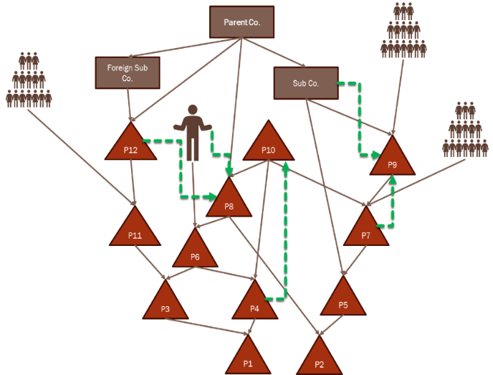
Can a partner be unitary with a partnership in which it owns an indirect interest?
Should the unitary analysis combine all members of a unitary corporate group that may have interests in the same partnership?
What about foreign subsidiaries that are part of a unitary group but do not file as part of the combined return?
What role do intercompany transactions play in the analysis?
What if the corporate partner is closely held and one of its owners is, separately, also a partner in the same partnership?

Slide 47
Do the unitary principle & attribution principle conflict?
As applied, the attribution principle essentially says: Assume every partner (direct and indirect, regardless of role) stands in the shoes of the partnership when determining the tax character of their share of the items of income.
The attribution principle applies to the character of items that may determine their foreign or domestic sourcing under federal rules.

Slide 48
Do the unitary principle & attribution principle conflict?
The attribution principle is essential to keep partnerships from being used to artificially change the character or treatment of items.
For example:
Income that is deferred for the partnership is deferred for the partners.
Income that is ordinary income to the partnership does not become capital gain for passive (investor) partners.

Slide 49
Do the unitary principle & attribution principle conflict?
States conform to this system and so they also conform to the attribution principle.
Does this mean that if the partnership is unitary with another business, the partners are also unitary with that other business?
Or – do partners’ attributes have to be taken into account as well (as they are when determining the ultimate treatment of some items for federal purposes)?

Slide 50
Other “WhEN” Issues to think about
Are there any additional limitations that should be considered when applying blended apportionment?
Would the “operational function” test be more effective in determining the relationship required for the application of blended apportionment?

Slide 51
Operational Function Test
Example:
Partnership is working on a new technology.
Corp decides to invest in Partnership because the technology may impact its own business.
Corp has a minority interest and does not control Partnership but benefits from the investment by diversifying its own investment in developing related technology.

Slide 52
Questions for the Committee
Can we proceed to build-out the “mechanics” of blended apportionment as a general recommendation to the states?
How much should we focus on the “when” questions (when should blended apportionment be applied)?

Slide 53
QUESTIONS?
Next work group meeting – May 21, 2025 – 3:00 PM Eastern

