Slide 1

Sales Tax on Digital Products
Status Report
April 29, 2025
Chair - Tim Jennrich, Washington
Vice Chair – Mia Strong, Louisiana
Definition Study Group Lead – Ray Langenberg, Texas

Slide 2
The Project
The Uniformity Committee established the work group on sales taxation of digital products to draft a white paper on the issues state tax policymakers should consider when deciding whether and how to include digital products in the sales tax base.
The work group, which is working in coordination with Streamlined and the FTA—has examined the current approach states take to taxing digital products, the treatment of business inputs, and the potential effects of the Internet Tax Freedom Act,
Recently, the work group, stakeholders, and staff have been studying the issue of bundled transactions—where a single price is charged for separate products, including digital products.

Slide 3
Regular Participants

Slide 4
Project Web Page
Digital Products Project

Slide 5
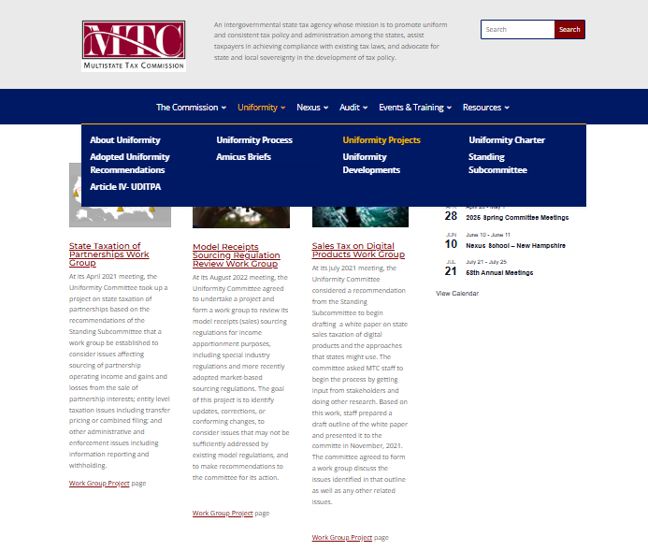
Project WebPage
Information on the project is on the project webpage on the MTC website – mtc.com – Uniformity – Uniformity Projects – Digital Products Work Group.

Slide 6
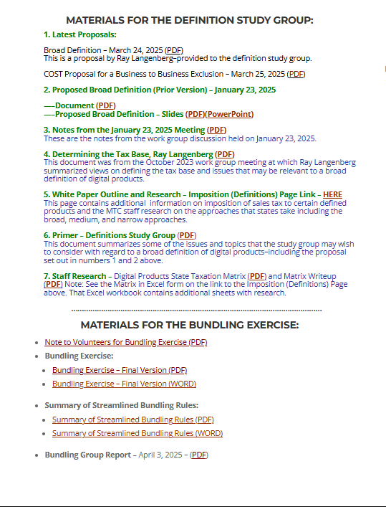
Project WebPage
On the home page, you will find information on the two study groups that we will be discussing.

Slide 7
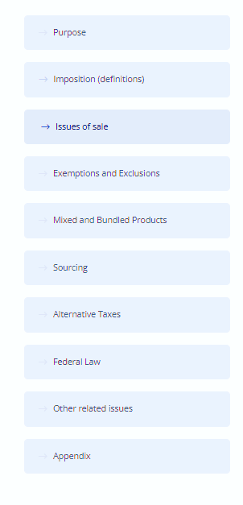
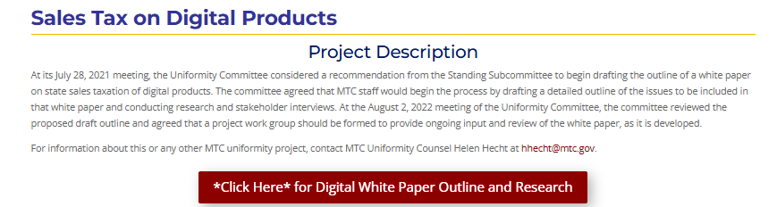
Project WebPage
That project page also contains a link to white paper subpages to which we are adding information over time.

Slide 8
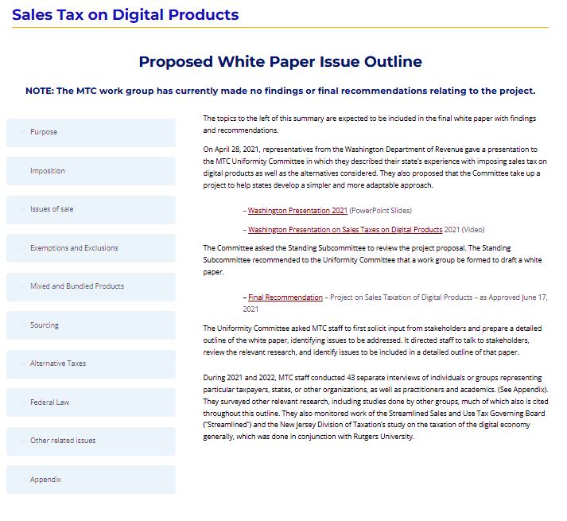
From that home page – you can get to the main page for the issue outline.
The headings/buttons on the left will then take you to those sections.

Slide 9
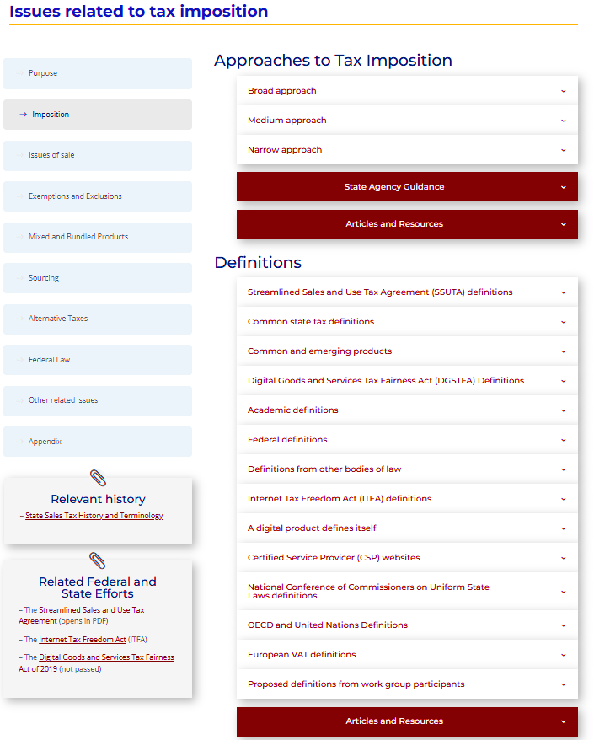
And this is the subsection page for issues related to tax imposition.
Here, for example, is information on definitions. And if you scroll down on these pages, you’ll see additional information under headings that help direct you to the information on that topic.

Slide 10
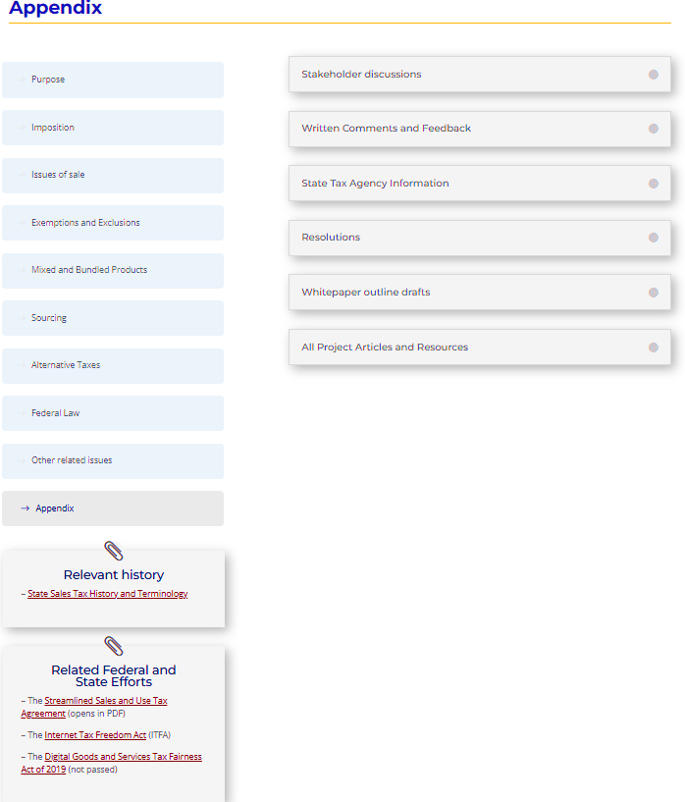
One important page is the appendix page. If you’re looking for materials, you may find them here as well as in other places in this outline.

Slide 11
UPDATE on the Bundling Study Group
Digital Products Project

Slide 12
Bundling Study Group
The goal was to determine if there were situations or details where the nature of digital products created issues for the Streamlined bundling rules.

Slide 13
Bundling Study Group
The bundling study group held four discussion sessions beginning in December, 2024.
Results were received from Colorado, the District of Columbia, Iowa, Kentucky, Louisiana, Nebraska, South Dakota, Texas, Utah, Vermont, Washington, and Wisconsin.
The group then agreed upon a report back to the work group which was discussed on the April 3, 2025 work group call.

Slide 14
Bundling Issue - Study Group Exercise
Summary of the Streamlined bundling rules.
Examples – that included digital products to which participants applied the bundling rules.
Asked state volunteers from the states to work through the examples and give input on their results and whether there were gaps or other problems applying the rules to transactions involving digital products.

Slide 15
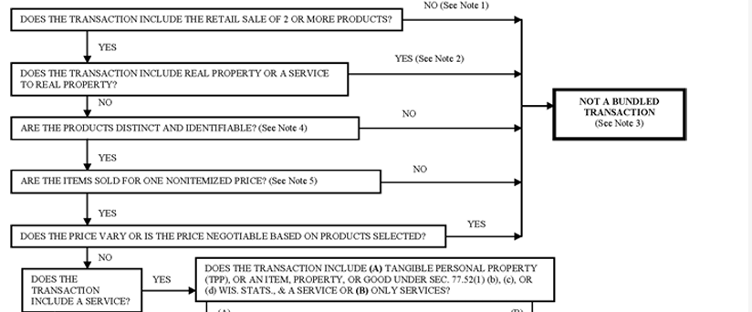
Streamlined Bundling Rules

Slide 16
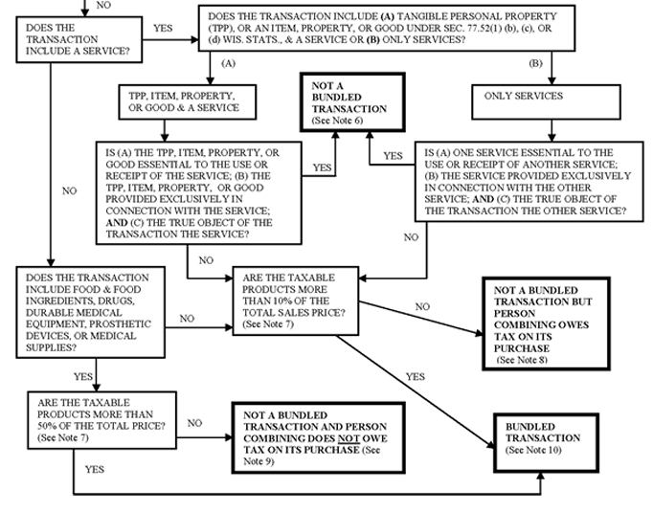
Streamlined Bundling Rules (cont’d)

Slide 17
Bundling Study Group – Report
Streamlined bundling rules work reasonably well and non-Streamlined states should consider them.
The group identified that for a given transaction, there are many ways out of the bundling rules, but only a narrow path to remain under the bundling rules.
The group was told that the Streamlined bundling rules were meant to be narrow, providing both an objective test for, and a set of subjective exclusions from, the bundling rules.
Due to this, a given transaction escaping treatment under the bundling rules should not be surprising and is not a bad thing.

Slide 18
Bundling Study Group – Report
Under the Streamlined Agreement, the determination of taxability is separate from the bundling determination.
The taxability of a bundled transaction is up to each state.
The point that the bundling rules are meant to be narrowly applicable was made and accepted.

Slide 19
Bundling Study Group – Report
The group questioned the best way to analyze digital products in general given –
  Many have no traditional, or analog, equivalent.
  They can be difficult to fit into the existing categories that are so important for sales tax.
  The tax base cannot be totally separated from the bundling question.

Slide 20
Bundling Study Group – Report
The ultimate worry is about taxability, not about bundling. Bundling analysis for its own sake is not the goal.
Deciding whether parts of a digital product can be separated, and how, is more important and more difficult for digital than for traditional physical items.
Members agreed that identifying distinct and identifiable products is more difficult with digital products than with physical products.
So with digital products, sellers have great latitude in asserting whether there are distinct and identifiable products involved.

Slide 21
Bundling Study Group – Report
Various members observed that the Streamlined rules are seller focused.
When the purchaser is responsible for paying use tax, the seller-focused nature of the rules might pose difficulties, especially where documentation focuses on the seller’s records.
For example, whether the seller has a catalog that lists the prices separately and that those prices add up to the total price the seller is charging may be critical documentation.

Slide 22
Bundling Study Group – Report
Streamlined rules - sale of two or more distinct and identifiable products is treated as a bundled transaction if no exception or exclusion applies.
Distinct and identifiable products do not include –
  packaging or similar items incidental or immaterial to the retail sale, or
  products provided free of charge with a required purchase.
Sellers may have broad ability to assert whether one or more distinct and identifiable digital products is offered.
The group recommends that the rules allow states to determine when digital components are a single product.

Slide 23
Bundling Study Group – Report
The members consistently raised issues with the one non-itemized price element,
The Streamlined language reads “separately identified by product on binding sales documents or other sales-related documents such as invoices, bills of sale, receipts, contracts, service agreements, and price lists made available to the purchaser in either paper or electronic form.” Question – how does this work in practice?
Members noted this is a more pressing problem with digital products than with traditional products.
The study group recommends any state considering this approach add detail to the one non-itemized price requirement and its exceptions. This could be in the form of a presumption or anti-abuse rules as well as more detailed rules for how to determine the price.

Slide 24
Bundling Study Group – Report
The de minimis exclusion excludes a transaction from the Streamlined bundling rules if the price of the taxable component is 10% or less of the total price.
Example – tax preparation software as a Service (SaaS) packaged with an application may raise the de minimis exclusion –
  For some, the application has little intrinsic value.
  But application of the de minimis exclusion may be problematic.
  How do you determine the value of the app?
Regarding whether the ten percent threshold of the de minimis rule is appropriate, the group identified the issue but did not discuss it.

Slide 25
Bundling Study Group – Report
Also while discussing the de minimis exclusion, the concept of breaking up digital products arose again.
  The bundling rules may encourage vendors to take one traditional product, break it down into several non-taxable components and justify the taxable parts being less than 10%
The suggestion made was to impose a threshold question of whether a transaction is composed of ‘integral’ components.
If the answer is yes, then the transaction is one product and should not be artificially separated to avoid taxation.

Slide 26
Bundling Study Group – Report
There were some challenges with application of the true object exclusions:
  Under the one involving tangible personal property and services, the tangible personal property must be essential to the use of the service, not the other way around. Additionally, the tangible personal property must be offered exclusively in connection with the service and the true object must be the service.
  The app question rises here also; are taxable applications essential to a non-taxable SaaS, or are they just helpful?
  Whether the service to service true object exclusion applies when there are more than two services.
An issue specifically created by digital products is the terminology used in the true object exclusion. Whether an item is “TPP, item, property, or good,” on the one hand, or a “service,” on the other.
These references do not include digital products or digital services.

Slide 27
Bundling Study Group – Report - Recommendations
Consider expanding the language used in the exclusions to bundling, including the true object exclusion, to apply to digital products.
Consider clarifying the applicability of the service-to-service true object exclusion to transactions involving more than two services.
Consider adding a third iteration of the true object exclusion for transactions involving digital products.

Slide 28
Bundling Study Group – Report - Recommendations
Consider clarifying the de minimis exclusion, including adding detail on valuation methods. The related question is who determines whether something is a single product or distinct and identifiable products.
Consider adding detail to the one non-itemized price element and its exceptions, particularly the role of a price list and the labeling and pricing of components.
Consider developing a threshold inquiry to determine whether a transaction is one product or a set of distinct and identifiable products.

Slide 29
Connecting to Streamlined
Streamlined states are also reviewing the exercise for possible input and action on the bundling rules.
Non-streamlined states may participate in those discussions.

Slide 30
UPDATE on the definitions Study Group
Digital Products Project

Slide 31
Bundling Study Group
Includes representatives from 26 different firms, groups, or states.
Group has held two discussion sessions so far.

Slide 32
Goal of the Chair
Articulate broad criteria for evaluation
Identify proposed and existing definitions for evaluation
Written evaluations
Finish before the MTC Annual Meeting

Slide 33
Broad Criteria
Clarity and ease of application
Revenue generation or stability
Compatibility with other elements of the tax structure
Pyramiding of taxes
Other considerations (catch-all)

Slide 34
Proposed and Existing Definitions for Evaluation
Langenberg Proposal
Washington
Utah/Maine
Ohio
South Dakota

Slide 35
Langenberg Proposal
“Automated digital product” - an item, including software or a service or a right to access or use the item regardless of duration, that is provided in a binary format and for which additional human intervention required to produce the same or a substantially similar item for additional customers is minimal.
Exemption: A product is exempt from taxation as an automated digital product if the product will be used predominantly for a trade or business.

Slide 36
Washington
Revised Code of Washington 82.04.192
Digital products definitions. ...
(3)(a) "Digital automated service," except as provided in (b) of this subsection (3), means any service transferred electronically that uses one or more software applications.
(b) "Digital automated service" does not include:
(i) Any service that primarily involves the application of human effort by the seller, and the human effort originated after the customer requested the service;
(ii) The loaning or transferring of money or the purchase, sale, or transfer of financial instruments.

Slide 37
Utah
Utah Code 59-12-101 (103)
(a) "Product transferred electronically" means a product transferred electronically that would be subject to a tax under this chapter if that product was transferred in a manner other than electronically.
(b) "Product transferred electronically" does not include:
(i) an ancillary service;
(ii) computer software; or
(iii) a telecommunications service.

Slide 38
Maine
Maine Rev. Stat. Title 36 §1811. Sales tax - 1. Tax imposed; rates. A tax is imposed on the value of all tangible personal property, products transferred electronically and taxable services sold at retail in this State. Value is measured by the sale price.
Maine Rev. Stat. Title 36 § 1752 (9-E). Product transferred electronically. “Product transferred electronically” means a digital product transferred to the purchaser electronically the sale of which in nondigital physical form would be subject to tax under this Part as a sale of tangible personal property.

Slide 39
Ohio
Ohio Revised Code Section 5739.01(B)(3)(e):
Automatic data processing, computer services, or electronic information services are or are to be provided for use in business when the true object of the transaction is the receipt by the consumer of automatic data processing, computer services, or electronic information services rather than the receipt of personal or professional services to which automatic data processing, computer services, or electronic information services are incidental or supplemental.

Slide 40
Ohio
Ohio Revised Code Section 5739.01(Y)(1)(c):
"Electronic information services” means providing access to computer equipment by means of telecommunications equipment for the purpose of either of the following:
(i) Examining or acquiring data stored in or accessible to the computer equipment;
(ii) Placing data into the computer equipment to be retrieved by designated recipients with access to the computer equipment.

Slide 41
South Dakota
South Dakota Codified Law 10-45-2.4 - There is hereby imposed a tax . . . upon the gross receipts of all sales, leases, or rentals of any product transferred electronically.
The tax is imposed if:
(1) The sale is to an end user;
(2) The sale is to a person who is not an end user, unless otherwise exempted by this chapter;
(3) The seller grants the right of permanent or less than permanent use of the products transferred electronically; or
(4) The sale is conditioned or not conditioned upon continued payment.
South Dakota Codified Law 10-46-1(8A) “Product transferred electronically,” any product obtained by the purchaser by means other than tangible storage media. A product transferred electronically does not include any intangible such as a patent, stock, bond, goodwill, trademark, franchise, or copyright.

Slide 42
COST Proposed B2B Exclusion
The sale of a “[Insert digital products definition (DP)]” to a qualified business that is the exclusive user of the [DP], including sharing the use of the [DP] with other qualified business users, is not subject to the [insert state SUT definition]; provided, however, that this exclusion shall not apply to non-business use of a [DP] by a qualified business unless the non-business use is inconsequential.
“Inconsequential” is based on consideration of the [DP] value and the frequency of which it is used for a non-business purpose, which is based on the non-business use being so small as to make accounting for that use unreasonable and/or impractical.
Qualified Business” means all for profit [and non-profit] entities including sole proprietorships, partnerships, LLCs, corporations and other similar entities.”

Slide 43
Questions – Discussion?

