Slide 1

State Taxation of Partnerships
Status Report
February 19, 2025

Slide 2
NOTE:
These slides Contain Information on the issues involved in sourcing partnership income in complex partnership structures. This information is for discussion purposes only.

Slide 3
Update on Project Issue Outline

Slide 4
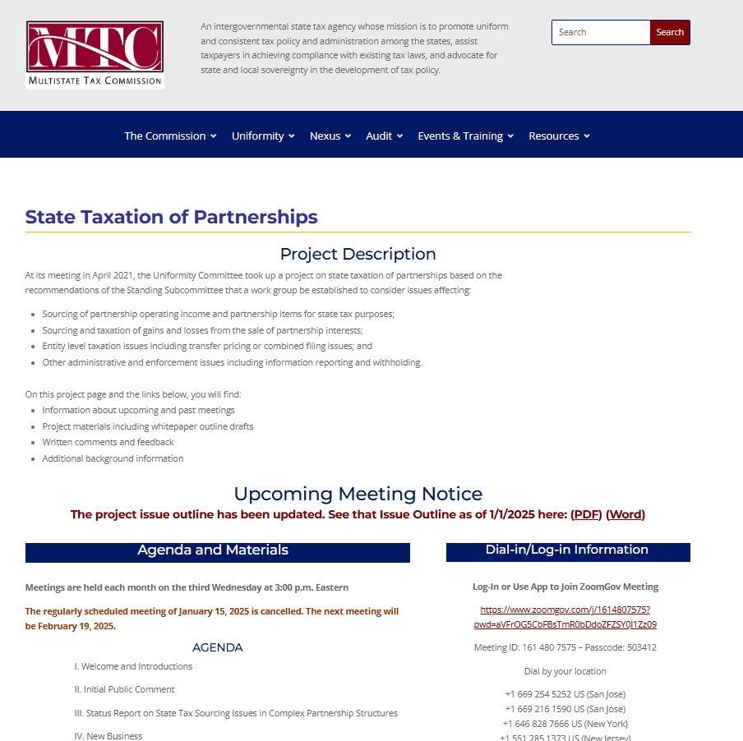
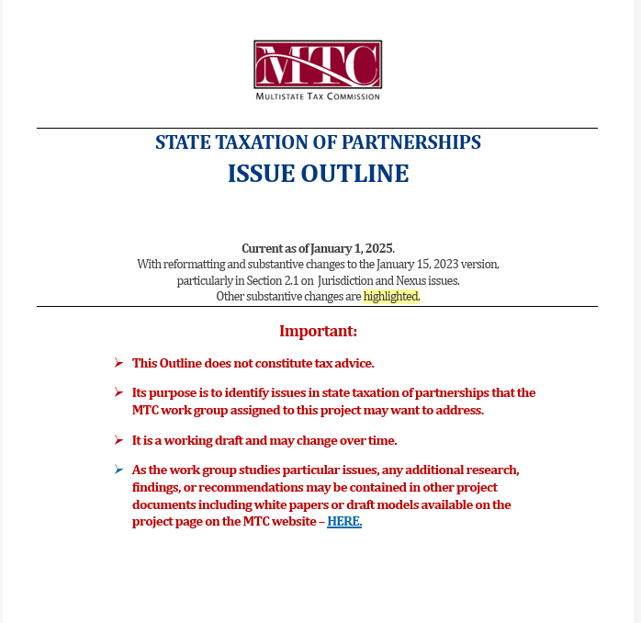

Slide 5
Partnership Training for States

Slide 6
Held on January 13-15
Total of 84 attendees from 24 states
Continuing to develop additional training – including for the MTC Learning Management System

Slide 7
Update on White Paper

Slide 8
Scope & Issues
Sourcing partnership income where:
  Partner is a corporation
  Partnership structure has –
      Tiers
      Intercompany transactions
      Special allocations

Slide 9
Drawing on multi-state Research
See the current research - HERE
States generally source partnership income using the same rules as for corporate and proprietorship businesses, including formulary apportionment.
A number use “blended” apportionment in some cases—combining the partner’s share of partnership factors with the partner’s own factors.
Blended apportionment raises issues not fully addressed—especially where there are special allocations and intercompany transactions.

Slide 10
outline
Scope
      The white paper would address sourcing where the partner is a corporation, the partnership is a tiered structure, or situations where there are intercompany transactions or special allocations. It would exclude investment partnerships but include guaranteed payments (sourced in the same way as distributive share).
Essential Terms
      (Drafted.)
Importance of the Attribution Principle
      (Drafted.)

Slide 11
Outline (cont’d)
Sourcing Non-Apportionable Partnership Income - Generally
    Determination of non-apportionable income (see slides below)
    Sourcing non-apportionable income (see slides below)
Sourcing Apportionable Partnership Income
    Corporate and tiered partners – need for blended apportionment
    How blended apportionment may be applied
      Share of partnership factors
      Effects of special allocations
      Effects of intercompany transactions
    When blended apportionment may be applied and legal and other limitations

Slide 12
Outline (cont’d)
Anti-Abuse Rules
    Special allocations and substantial economic effect
    Other – including equitable apportionment rules
Administrative Issues
    How information is reported by partnerships and partners
    How withholding may be affected
    How composite returns or PTE taxes may be affected
Summary of State Research
    (Drafted)
    Treatment of corporate and tiered partnerships
    Treatment of special allocations
    Anti-abuse rules

Slide 13
Sourcing Non-Apportionable Income - Generally

Slide 14
NOTE
First - non-apportionable income must be distinguished from apportionable income derived from separate lines of business where separate apportionment formulas might be used.
States generally apply the same rules applicable to corporations and businesses generally.

Slide 15
Treatment of Non-Apportionable Income/Items
General Rule # 1 – Entity-Level Non-Apportionable Income –
Determine whether any partnership items are non-apportionable to the entity that recognized or incurred the items.
If so—they are sourced at the entity level and that sourcing information flows through to direct and indirect partners.

Slide 16
Treatment of Non-Apportionable Income/Items
General Rule #2 – Partner-Level Non-Apportionable Income –
If the income or items are apportionable income to the partnership—then determine if the partner’s distributive share would, itself, be non-apportionable income to the partner.
If so, then the income or items are apportioned at the partnership level and that sourcing information flows through to direct and indirect partners.

Slide 17
3 Possible Outcomes
Income or Items Are: |  |  | Source:
Non-Apportionable to the Partnership | √ | √ | Apply general rules of assignment based on partnership-level information. Source is then attributed to the partner.
NOTE: - Income is also non-apportionable to the Partner.
Non-Apportionable to the Partnership |  | Apply formulary apportionment based on partnership-level information. Source is then attributed to the partner.
Apportionable to the Partnership | √
Non-Apportionable to the Partner | √
Non-Apportionable to the Partnership |  | States may use blended apportionment, especially for corporate partners.
Apportionable to the Partnership | √
Non-Apportionable to the Partner
Apportionable to the Partner | √

Slide 18
Sourcing Apportionable Income

Slide 19
generally
  States use formulary apportionment.
  Default Rule – Use the factors of the entity recognizing the income.
  Blended Apportionment – Some states, along with the MTC combined corporate filing model, require a combination of the taxpaying partner factors with its share of the partnership factors for corporate partners.

Slide 20
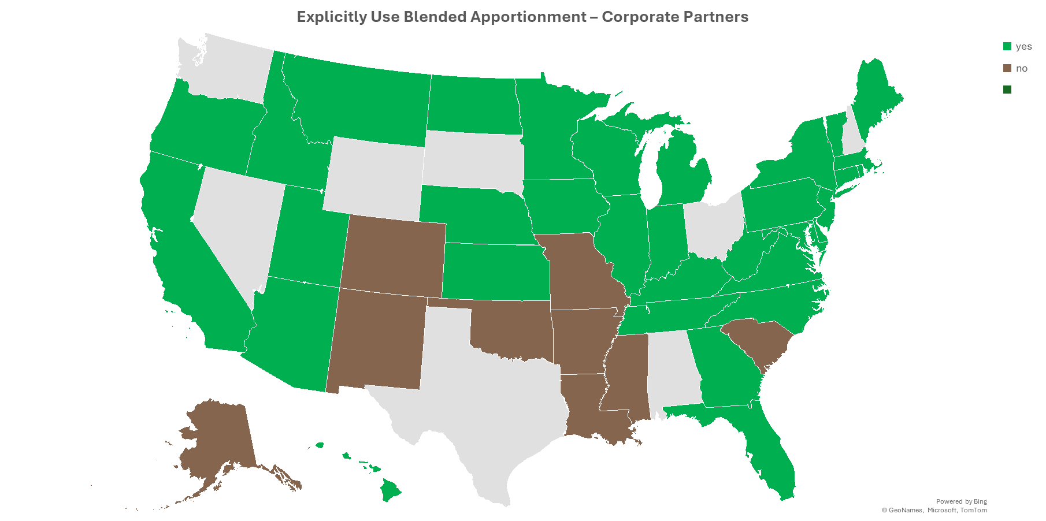
YES
NO

Slide 21
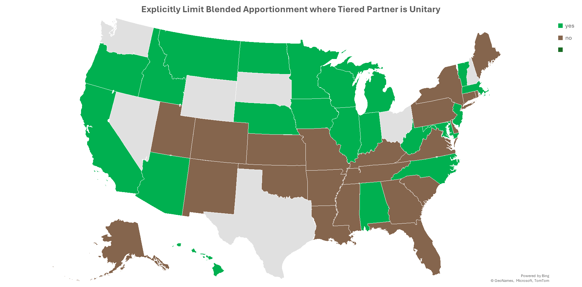
Explicitly Limit Blended Apportionment where Corporate Partner is Unitary
YES
NO

Slide 22
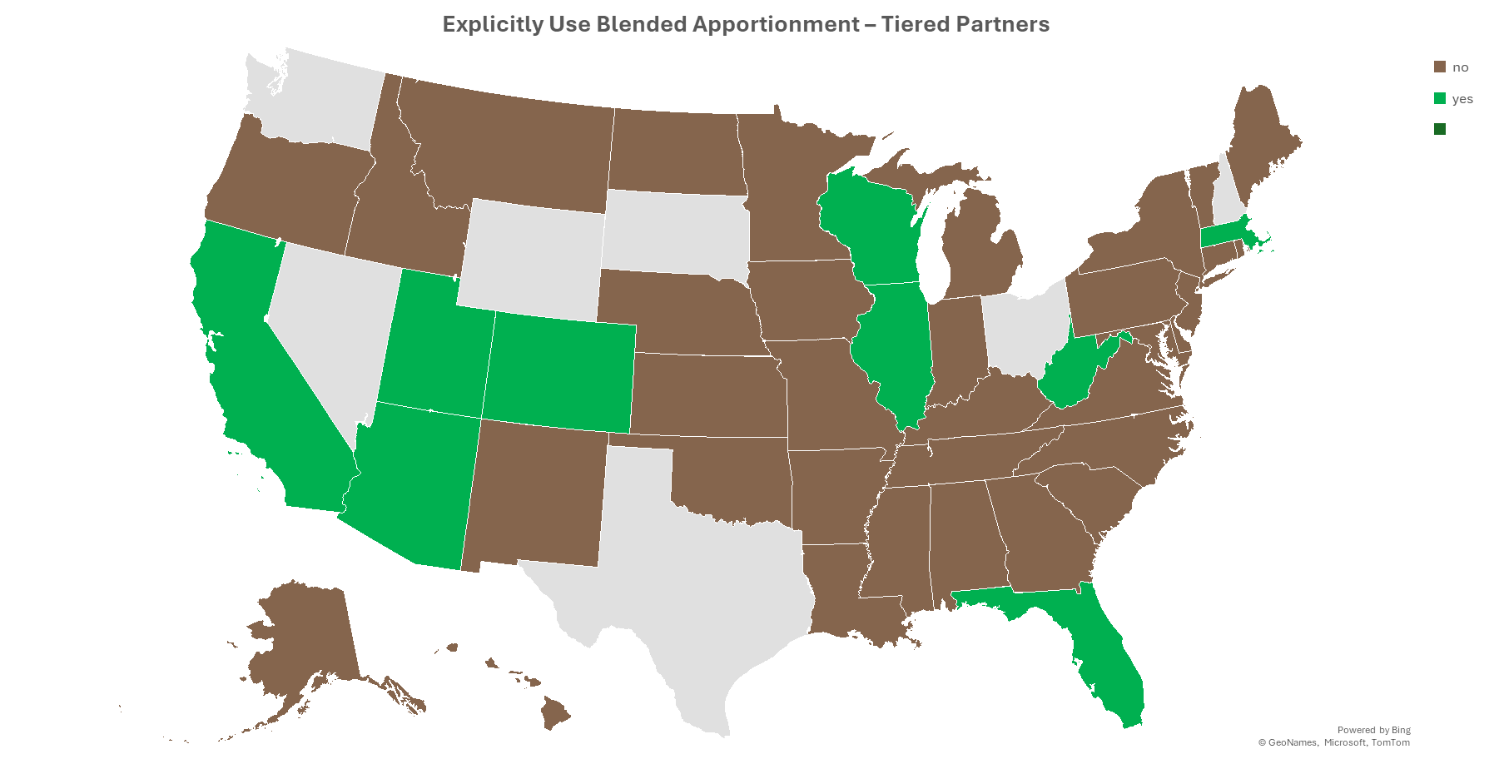
YES
NO

Slide 23
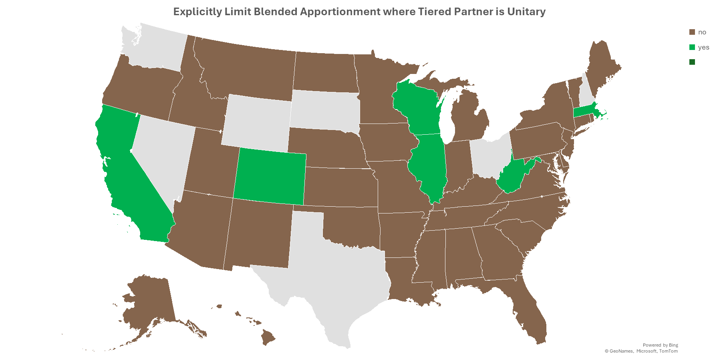
YES
NO

Slide 24
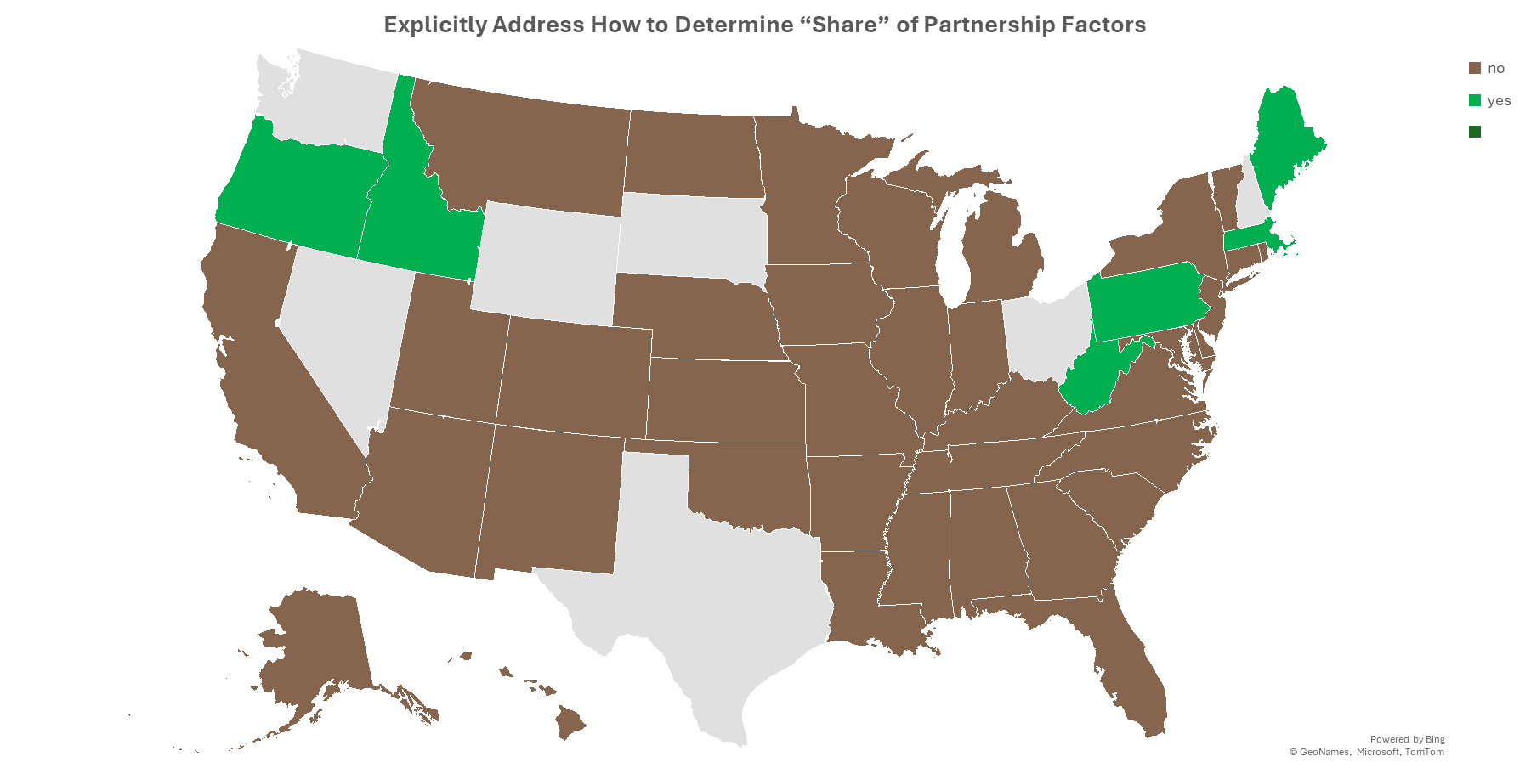
YES
NO

Slide 25
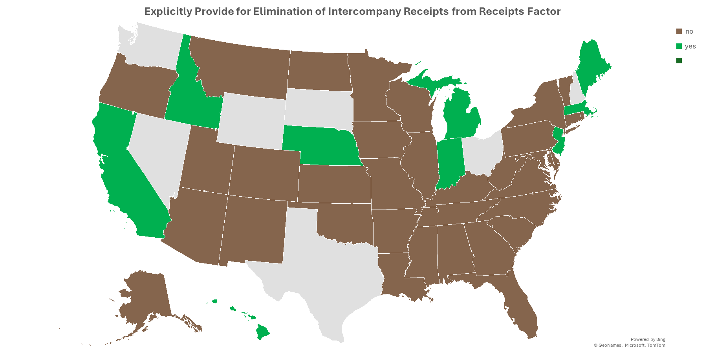
YES
NO

Slide 26
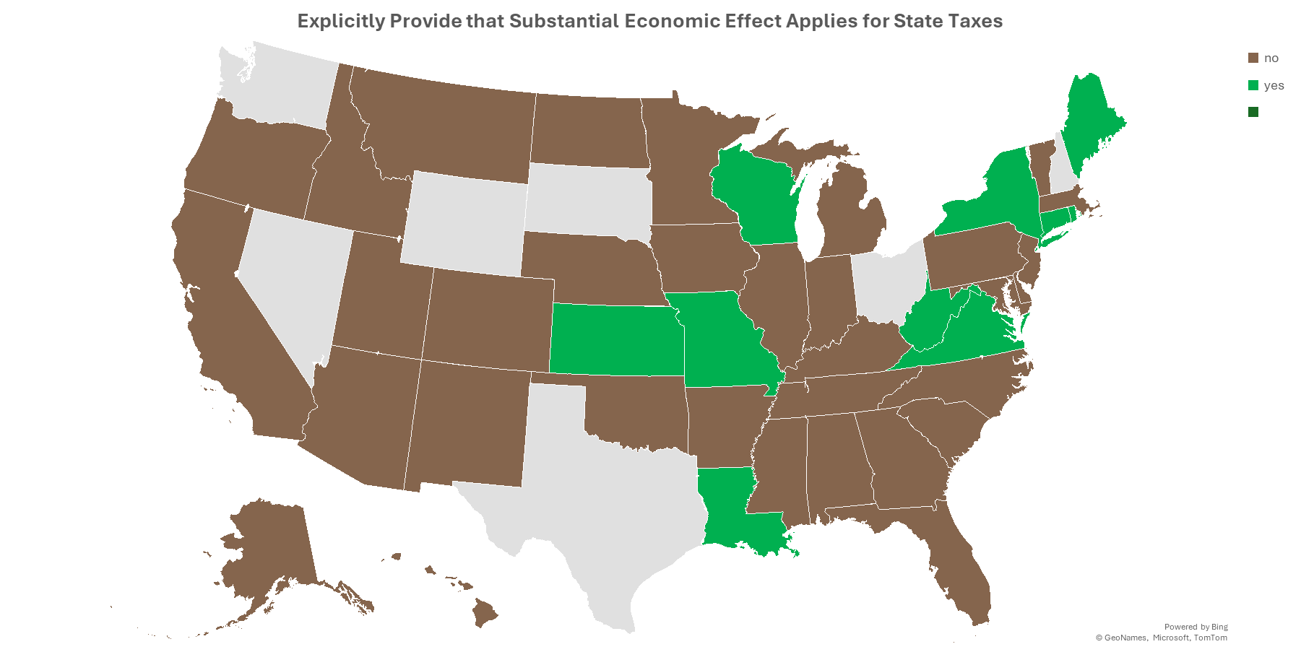
YES
NO

Slide 27
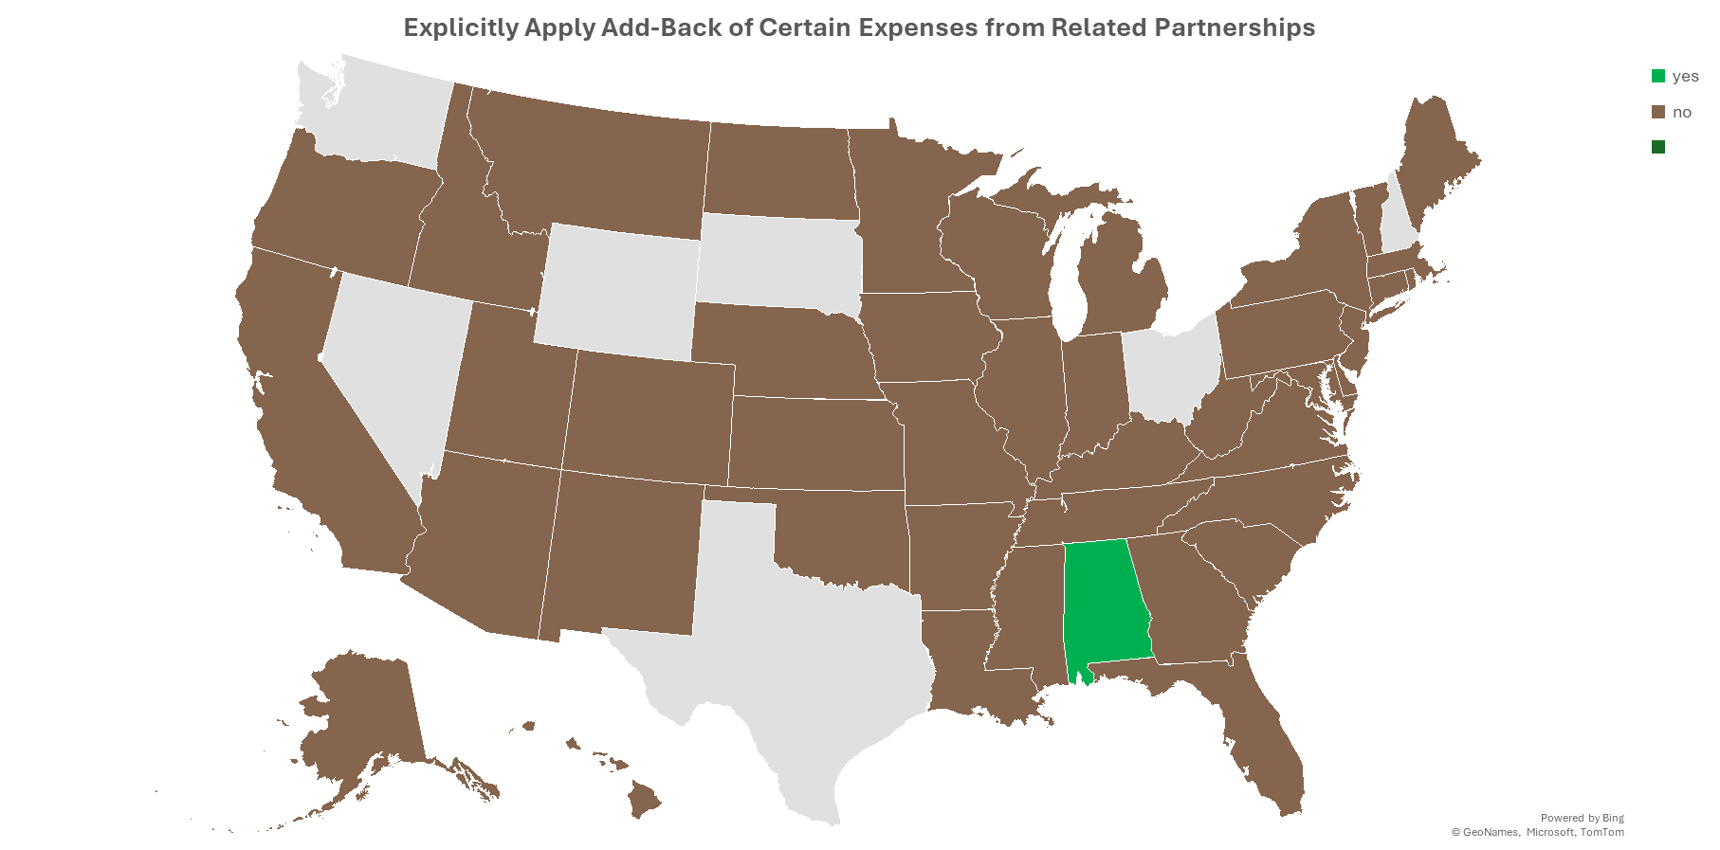
YES
NO

Slide 28
Big “How” Question:
How do partners determine share of partnership factors to include?
Directly attribute the receipts to particular partners based on the partnership items making up their distributive share.
Use a ratio of the partner’s “interest in the partnership” (same as federal rules under 704(b))
Use a ratio of the partner’s share of capital
Use a ratio of the partner’s share of partnership income (distributive share)

Slide 29
Big “How” Question:
The problem is what do you do with special allocations of expense or loss?
How do partners determine share of partnership factors to include?
Directly attribute the receipts to particular partners based on the partnership items making up their distributive share.
Use a ratio of the partner’s “interest in the partnership” (same as federal rules under 704(b))
Use a ratio of the partner’s share of capital
Use a ratio of the partner’s share of partnership income (distributive share)

Slide 30
Big “How” Question:
The problem is what do you do with special allocations of expense or loss?
How do partners determine share of partnership factors to include?
Directly attribute the receipts to particular partners based on the partnership items making up their distributive share.
Use a ratio of the partner’s “interest in the partnership” (same as federal rules under 704(b))
Use a ratio of the partner’s share of capital
Use a ratio of the partner’s share of partnership income (distributive share)
Too complicated and information may not be available.

Slide 31
Big “How” Question:
The problem is what do you do with special allocations of expense or loss?
How do partners determine share of partnership factors to include?
Directly attribute the receipts to particular partners based on the partnership items making up their distributive share.
Use a ratio of the partner’s “interest in the partnership” (same as federal rules under 704(b))
Use a ratio of the partner’s share of capital
Use a ratio of the partner’s share of partnership income (distributive share)
Too complicated and information may not be available.
Won’t necessarily match the share of income each year.

Slide 32

Big “How” Question:
The problem is what do you do with special allocations of expense or loss?
How do partners determine share of partnership factors to include?
Directly attribute the receipts to particular partners based on the partnership items making up their distributive share.
Use a ratio of the partner’s “interest in the partnership” (same as federal rules under 704(b))
Use a ratio of the partner’s share of capital
Use a ratio of the partner’s share of partnership income (distributive share)
Too complicated and information may not be available.
Won’t necessarily match the share of income each year.
How do we solve calculation problems?

Slide 33
Problem No. 2 with Special Allocations
Should the fact that a partner receives certain special allocations of partnership income affect which amounts go into the apportionment factor?
Example—
  Assume Partnership is engaged in two related activities – renovating commercial real property and performing engineering services.
  Corporate Partner provides support for renovation activities and is allocated 80% of the income (and expense) from those activities, but only 20% of the income (and expense) from engineering services.
  Should this affect the share of receipts from renovation activities versus engineering services that the corporate partner includes in the blended receipts factor?

Slide 34
Simple Excel workbook with different Sourcing Approaches
Comparing results of assignment, separate apportionment, and blended apportionment with certain variations—to determine if blended apportionment is workable.
Example in the workbook:
  Uses a single corporate partner
  Focuses on the receipts factor
  Use of an absolute value distributive share ratio for the blended apportionment approach
  Also illustrates how elimination if partnership-partner charges affects the result.

Slide 35
Informal study group to review the Model
Volunteers would:
  Review the Excel workbook.
  Try inputting different data to see how results of the different approaches vary.
  Consider tweaks or changes that may be needed to make an approach work.
  Provide input to staff for consideration so that the results can be included and used in the drafting of the white paper.
  Report out the results to the work group.

Slide 36
QUESTIONS???
And Feel Free to Reach OUt

Slide 37
Upcoming Meetings and Calls
Next Calls –
March 19, 2025
April 16, 2025
MTC Meetings – Spokane, WA – April 28 – May 1, 2025 (Uniformity Committee – April 29)

