Slide 1
State Taxation of Partnerships Status Report
February 19, 2025
Notes:
NOTES:
[Laurie McElhatton (California), work group chair, convened the meeting and also asked for any initial public comment. There was none.]
This is our first meeting of the work group since December. We’re going to provide an update on the project.

Slide 2
NOTE:
These slides Contain Information on the issues involved in sourcing partnership income in complex partnership structures. This information is for discussion purposes only.

Slide 3
Update on Project Issue Outline
Notes:
Helen Hecht, MTC Uniformity Counsel, gave the report on the status of the project.

Slide 4
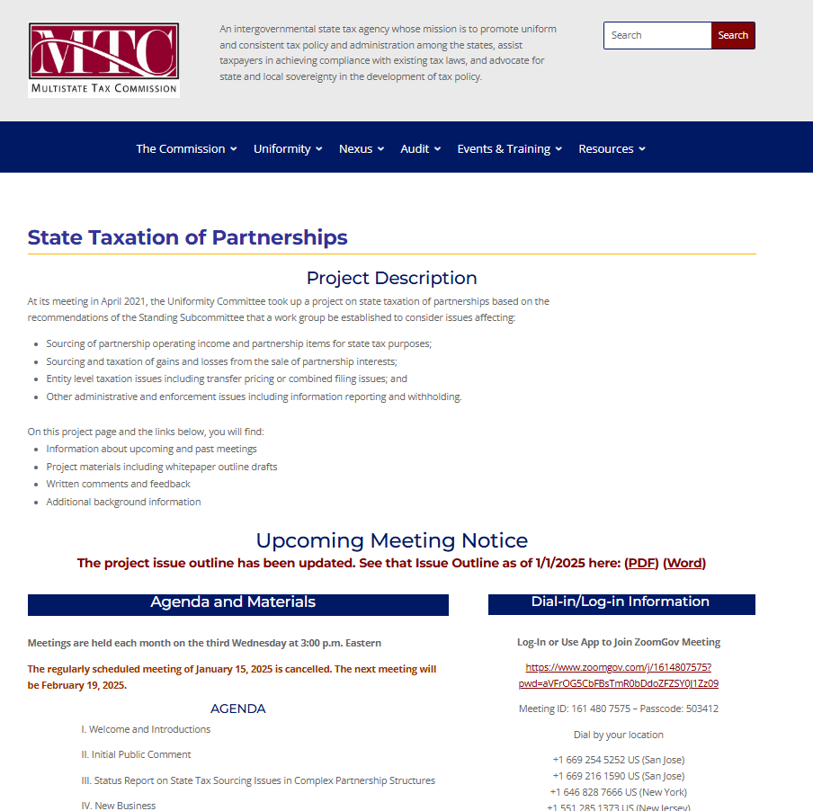
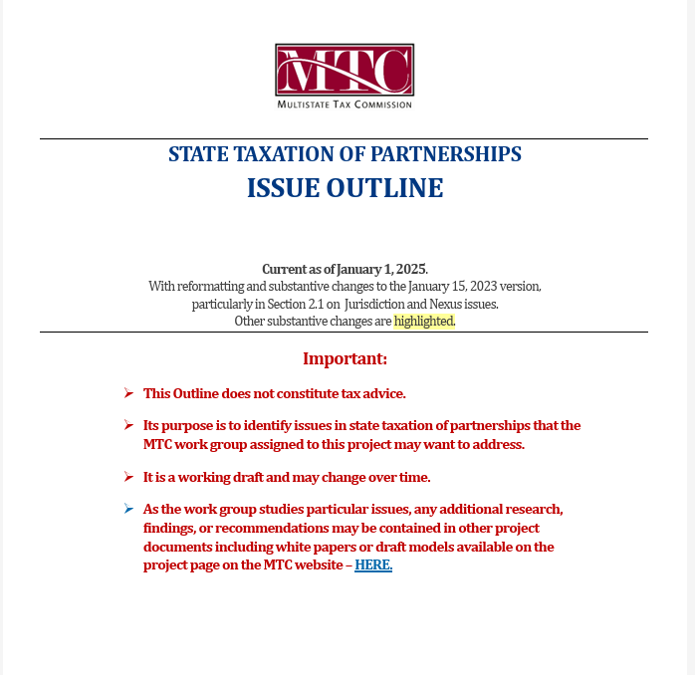
Notes:
Helen first noted that the project issue outline had been updated. She noted that the changes were mainly to clarify, especially terminology, and were highlighted in the current version posted on the project page.
Bruce Ely, Bradley Arant, mentioned that he appreciated the outline and had promoted it as an addition to the text book that Professor Richard Pomp publishes on state and local taxation.

Slide 5
Partnership Training for States
Notes:
Helen also mentioned that the MTC had conducted partnership training for the states in January.

Slide 6
Held on January 13-15
Total of 84 attendees from 24 states
Continuing to develop additional training – including for the MTC Learning Management System
Notes:
Helen mentioned that the training had 84 attendees from 24 states and provided information and exercise to help states think through the state treatment of partnership income under the federal pass-through system. She noted that the MTC is continuing to develop additional training and materials for states and will be using the new MTC learning management system, as well as in-person training, to provide this information to the states.

Slide 7
Update on White Paper
Notes:
Helen then provided an update on the white paper that the work group is currently drafting.

Slide 8
Scope & Issues
Sourcing partnership income where:
Partner is a corporation
Partnership structure has –
Tiers
Intercompany transactions
Special allocations
Notes:
Helen reminded the work group of the general scope of this white paper and the issues to be covered. The primary issue is the sourcing of partnership income, or distributive share, when the partnership has corporate partners or when the partnership structure has tiered partners, intercompany transactions, or special allocations.

Slide 9
Drawing on multi-state Research
See the current research - HERE
States generally source partnership income using the same rules as for corporate and proprietorship businesses, including formulary apportionment.
A number use “blended” apportionment in some cases—combining the partner’s share of partnership factors with the partner’s own factors.
Blended apportionment raises issues not fully addressed—especially where there are special allocations and intercompany transactions.
Notes:
Helen noted that the white paper will be based on research done by Jenn Stosberg, MTC counsel, and other information provided by the states. (That research is being updated as states review and provide input.) Helen also noted that this research shows that states generally use the same types of sourcing for partnership income as for other businesses – that is formulary apportionment and other business income sourcing rules.
She also noted that a number of states have explicitly provided for the use of blended apportionment where a share of the partnership factors is combined with the partner’s own factors. But blended apportionment raises issues that are not fully addressed and those issues can complicate the use of this approach, especially where there are special allocations and intercompany transactions between the partnership and partner.

Slide 10
outline
Scope
The white paper would address sourcing where the partner is a corporation, the partnership is a tiered structure, or situations where there are intercompany transactions or special allocations. It would exclude investment partnerships but include guaranteed payments (sourced in the same way as distributive share).
Essential Terms
(Drafted.)
Importance of the Attribution Principle
(Drafted.)
Notes:
Helen briefly reviewed the proposed outline of the white paper and the status of the various sections.

Slide 11
Outline (cont’d)
Sourcing Non-Apportionable Partnership Income - Generally
Determination of non-apportionable income (see slides below)
Sourcing non-apportionable income (see slides below)
Sourcing Apportionable Partnership Income
Corporate and tiered partners – need for blended apportionment
How blended apportionment may be applied
Share of partnership factors
Effects of special allocations
Effects of intercompany transactions
When blended apportionment may be applied and legal and other limitations
Notes:
Hele noted that the focus of discussion in recent months has been the application of blended apportionment and the questions raised by the use of that method. The discussion has focused on how blended apportionment may apply but the work group will also need to address when it should be applied.

Slide 12
Outline (cont’d)
Anti-Abuse Rules
Special allocations and substantial economic effect
Other – including equitable apportionment rules
Administrative Issues
How information is reported by partnerships and partners
How withholding may be affected
How composite returns or PTE taxes may be affected
Summary of State Research
(Drafted)
Treatment of corporate and tiered partnerships
Treatment of special allocations
Anti-abuse rules
Notes:
Helen mentioned that the white paper will also address anti-abuse rules and other related administrative issues and will include the research that has been circulated and is on the project page.

Slide 13
Sourcing Non-Apportionable Income - Generally
Notes:
Helen then noted that the work group had discussed the treatment of non-apportionable income and had received no indication that there was disagreement among the participating states on the approach to non-apportionable income set out here.

Slide 14
NOTE
First - non-apportionable income must be distinguished from apportionable income derived from separate lines of business where separate apportionment formulas might be used.
States generally apply the same rules applicable to corporations and businesses generally.
Notes:
Helen noted that the first step in sourcing partnership income is to determine what income is apportionable or non-apportionable. She noted that income may also be from a separate unitary business where separate apportionment formulas might be used. And she noted again that states generally apply the same sourcing rules to partnership income as to other businesses.

Slide 15
Treatment of Non-Apportionable Income/Items
General Rule # 1 – Entity-Level Non-Apportionable Income –
Determine whether any partnership items are non-apportionable to the entity that recognized or incurred the items.
If so—they are sourced at the entity level and that sourcing information flows through to direct and indirect partners.
Notes:
Helen then noted that if an item of income is determined to be non-apportionable at the partnership level, then it would be sourced by applying state rules to that income at the partnership level and this sourcing information would then flow through to the direct and indirect partners.

Slide 16
Treatment of Non-Apportionable Income/Items
General Rule #2 – Partner-Level Non-Apportionable Income –
If the income or items are apportionable income to the partnership—then determine if the partner’s distributive share would, itself, be non-apportionable income to the partner.
If so, then the income or items are apportioned at the partnership level and that sourcing information flows through to direct and indirect partners.
Notes:
Helen then noted that if the income or items are apportionable in the context of the partnership's own activities but would be non-apportionable income to the partner, then those items would be apportioned at the partnership level and that sourcing information would then flow through to the direct and indirect partners. So the income item would not be sourced separately at the partner level but would retain the sourcing treatment applied at the partnership level.

Slide 17
3 Possible Outcomes
Income or Items Are: |  |  | Source:
Non-Apportionable to the Partnership | √ | √ | Apply general rules of assignment based on partnership-level information. Source is then attributed to the partner.
NOTE: - Income is also non-apportionable to the Partner.
Non-Apportionable to the Partnership |  | Apply formulary apportionment based on partnership-level information. Source is then attributed to the partner.
Apportionable to the Partnership | √
Non-Apportionable to the Partner | √
Non-Apportionable to the Partnership |  | States may use blended apportionment, especially for corporate partners.
Apportionable to the Partnership | √
Non-Apportionable to the Partner
Apportionable to the Partner | √
Notes:
Helen then compared the three possible scenarios and their outcomes. Again for items that are non-apportionable, applying general state rules at the partnership level, would be sourced applying those rules to the partnership activities and to the items of income, and that sourcing would be retained as the items flow through to the partners.
Similarly, items that are apportionable at the partnership level but are non-apportionable income to the partner would be sourced by applying apportionment to those items at the partnership level and that sourcing would then be retained as the items flow through to the partners.
The third scenario Is where income or items are both apportionable to the partnership and apportionable to the partner, so that the rules for non-apportionable income would not apply and rather than apportioning solely at the partnership level, states might use a blended apportionment formula combining the partner's own factors with a share of the partnerships factors.

Slide 18
Sourcing Apportionable Income
Notes:
Helen then turn to a discussion of how states source apportionable income and the questions that raises in the context of complex partnership structures.

Slide 19
generally
States use formulary apportionment.
Default Rule – Use the factors of the entity recognizing the income.
Blended Apportionment – Some states, along with the MTC combined corporate filing model, require a combination of the taxpaying partner factors with its share of the partnership factors for corporate partners.
Notes:
Helen noted that states generally use formulary apportionment to source partnership income and default to using factors of the entity that recognized the items or the income. Sometimes this is referred to as separate apportionment or entity-level apportionment. But there are a number of states that also provide for what we call “blended apportionment.” This is also part of the MTC combined filing model for corporations. Under this approach states require the combination of the corporate partner’s own factors with its share of the partnership’s factors.

Slide 20
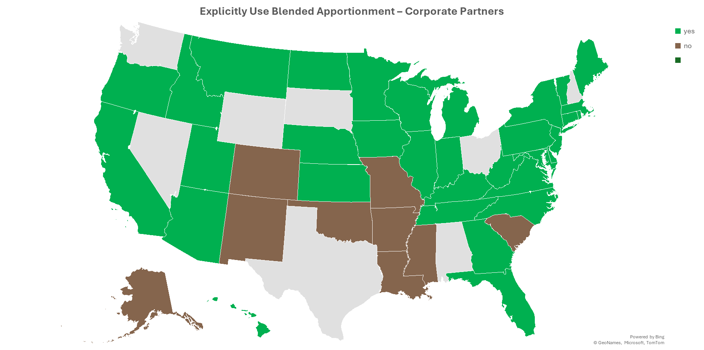
YES
NO
Notes:
Helen then walked through slides showing the number of states that have addressed the use of blended apportionment for partnership income. In the context of corporate partners, the majority of states that would tax corporate income have explicitly addressed use of blended apportionment.

Slide 21
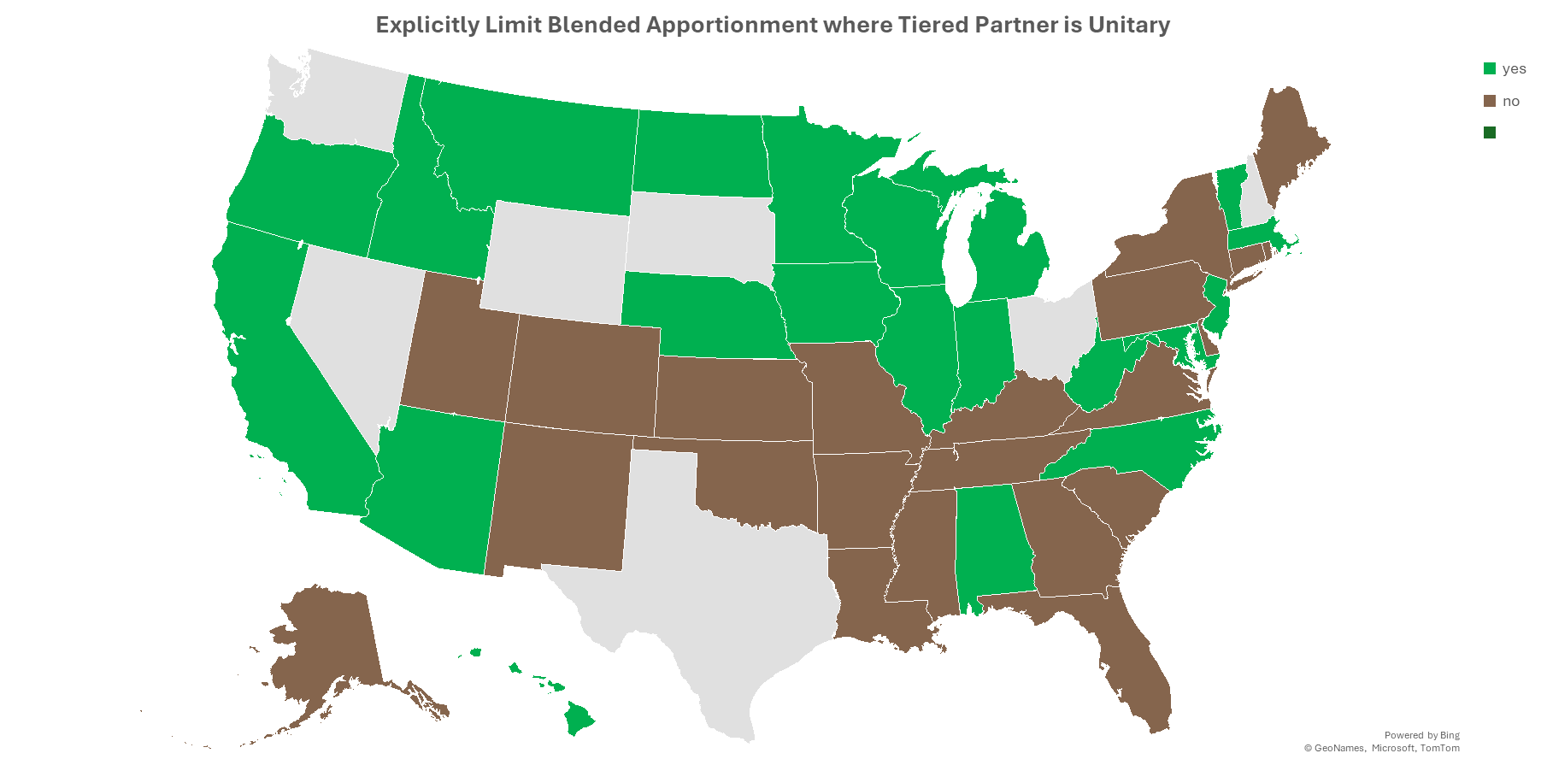
Explicitly Limit Blended Apportionment where Corporate Partner is Unitary
YES
NO
Notes:
As for states that have addressed when blended apportionment may be used, fewer states have addressed this issue explicitly. Those that have addressed the issue have generally limited the application of blended apportionment to situations where the corporate partner and the partnership have a unitary relationship.

Slide 22
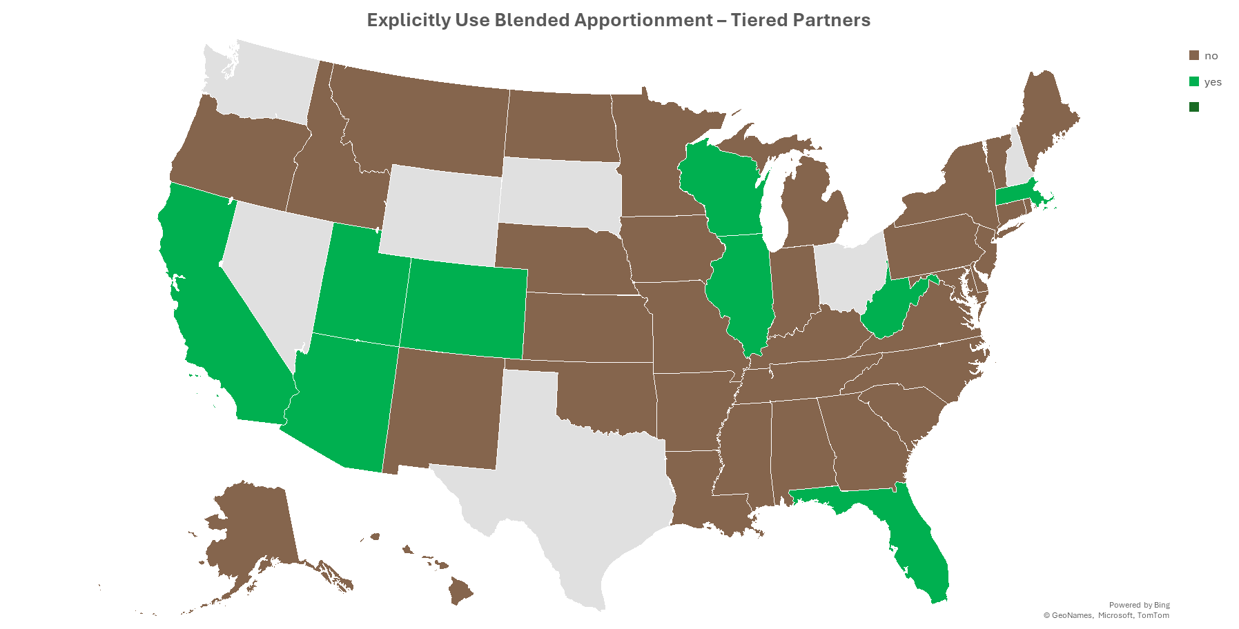
YES
NO
Notes:
Some states have also addressed the use of blended apportionment in the context of tiered partnerships, that is where one partnership holds an interest in another partnership. But fewer states have addressed this issue explicitly.

Slide 23
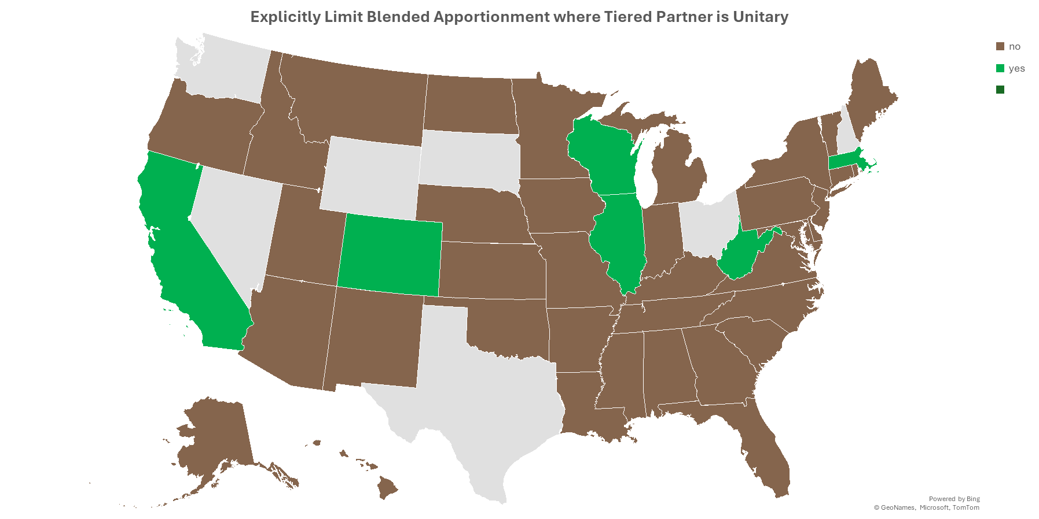
YES
NO
Notes:
And as for whether or not the application of blended apportionment in the context of tier partnerships is limited, only a handful of states have addressed this issue or said that blended apportionment would be used only in situations where the tiered partner and the partnership are unitary.

Slide 24
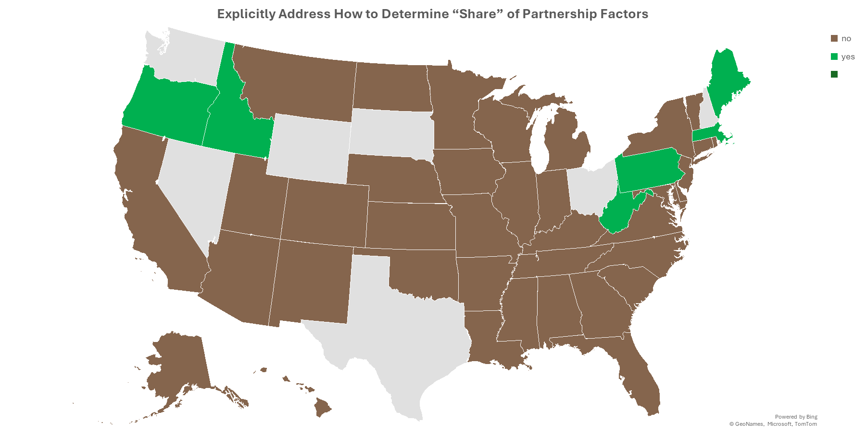
YES
NO
Notes:
When it comes to applying blended apportionment, one of the important questions is how the share of the partnership factors will be determined. This question has been explicitly addressed only by 5 states, shown here in green. Three of those states would generally treat the share as being determined based on the share of profit and loss or distributive share of the partner. This is an important question because a partner’s share of profit and loss or the partner’s distributive share of partnership items may vary from its interest in the partnership or its share of partnership capital.

Slide 25
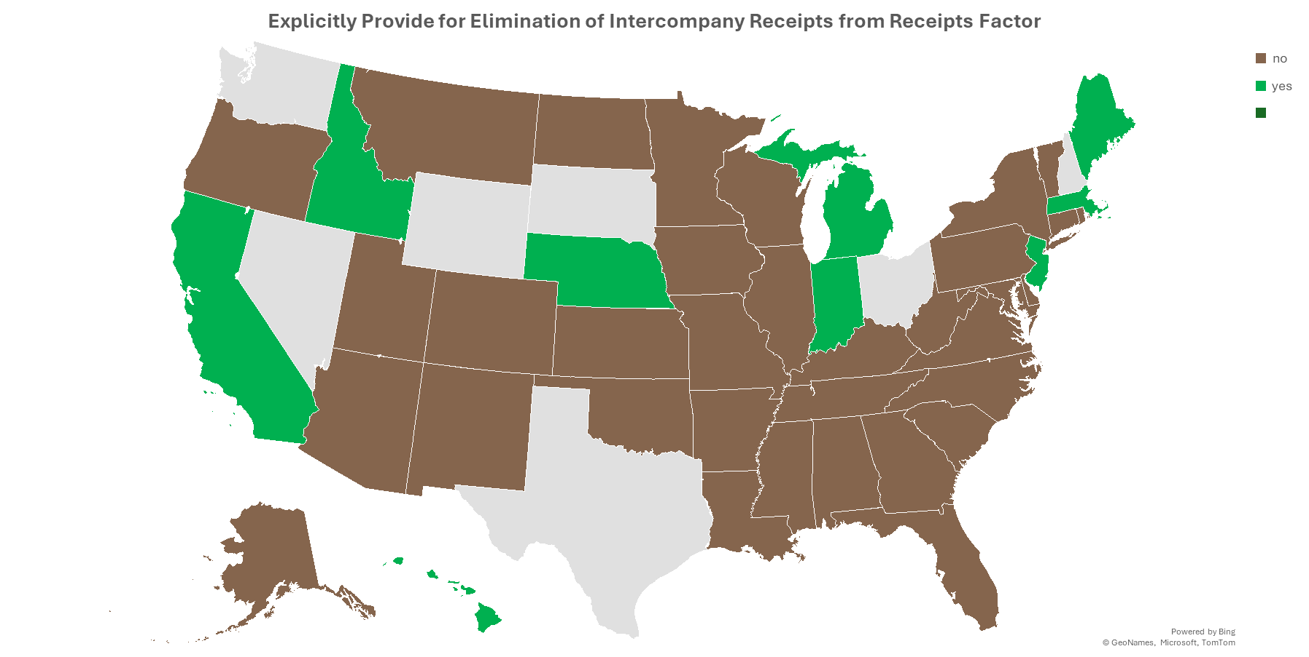
YES
NO
Notes:
Another question that may be raised in the context of apportioning a corporate or tiered partner’s share of partnership income is how to treat any transactions between the partnership and the partner. Some states have addressed this issue by explicitly requiring that any intercompany receipts from such transactions be eliminated from the receipts factor.

Slide 26
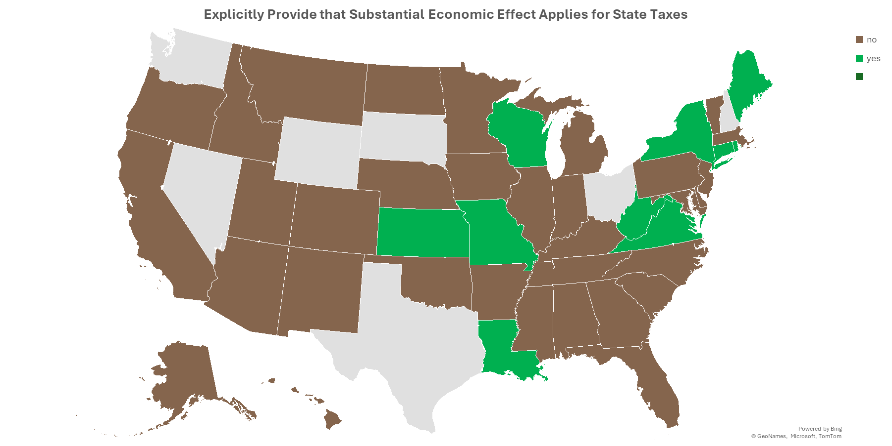
YES
NO
Notes:
Another issue that affects the apportionment of partnership income and the use of blended apportionment in particular is the effect that special allocations may have on the sourcing of the income. Special allocations of partnership income or items may result in a partner receiving a different share of particular items or a share that is different from that partner's interest in the partnership. Special allocations must have substantial economic effect in order to be respected for federal tax purposes. Some states have also made clear that these special allocations must have substantial economic effect when it comes to any state tax results as well.

Slide 27
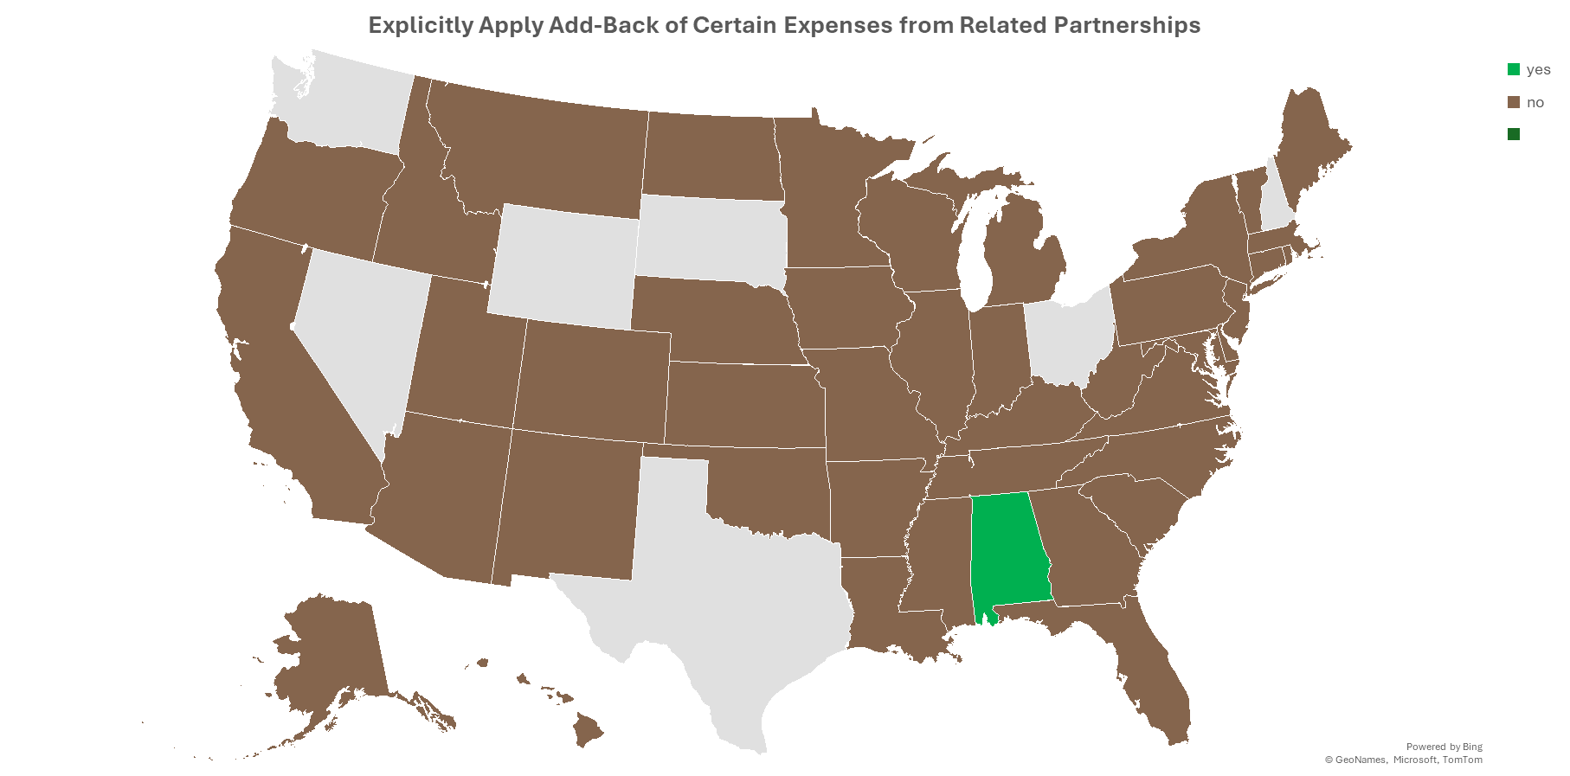
YES
NO
Notes:
Finally, states have used add-back requirements for some types of intercompany or related party transactions in order to prevent income shifting. As far as we can tell only one state would apply their add back statute in the context of partnerships.

Slide 28
Big “How” Question:
How do partners determine share of partnership factors to include?
Directly attribute the receipts to particular partners based on the partnership items making up their distributive share.
Use a ratio of the partner’s “interest in the partnership” (same as federal rules under 704(b))
Use a ratio of the partner’s share of capital
Use a ratio of the partner’s share of partnership income (distributive share)
Notes:
This is the issue that we are currently focusing on – that is – how to do the blended apportionment approach. These are the options.

Slide 29
Big “How” Question:
The problem is what do you do with special allocations of expense or loss?
How do partners determine share of partnership factors to include?
Directly attribute the receipts to particular partners based on the partnership items making up their distributive share.
Use a ratio of the partner’s “interest in the partnership” (same as federal rules under 704(b))
Use a ratio of the partner’s share of capital
Use a ratio of the partner’s share of partnership income (distributive share)
Notes:
There are problems with each of the options.
The first option is just to directly attribute the receipts associated with partnership items that are part of the distributive share allocated to that partner. So, for example, if the partner got 10% of the partnership’s ordinary income and 50% of its capital gains—then 10% of the receipts associated with the ordinary income and 50% of the receipts associated with the sale of capital assets would be included in the sales factor of the partner. But what if the partner receives special allocations of expenses or losses that are not directly associated with any receipts?

Slide 30
Big “How” Question:
The problem is what do you do with special allocations of expense or loss?
How do partners determine share of partnership factors to include?
Directly attribute the receipts to particular partners based on the partnership items making up their distributive share.
Use a ratio of the partner’s “interest in the partnership” (same as federal rules under 704(b))
Use a ratio of the partner’s share of capital
Use a ratio of the partner’s share of partnership income (distributive share)
Too complicated and information may not be available.
Notes:
The second option is to use the ratio of the partner’s “interest in the partnership” as that term is used in IRC Sec. 704(b). But as we’ve discussed, the partner’s interest in the partnership can be difficult to determine, given that it reflects not only the share of capital but other facts and circumstances—and this information may not be easy to obtain or analyze.

Slide 31
Big “How” Question:
The problem is what do you do with special allocations of expense or loss?
How do partners determine share of partnership factors to include?
Directly attribute the receipts to particular partners based on the partnership items making up their distributive share.
Use a ratio of the partner’s “interest in the partnership” (same as federal rules under 704(b))
Use a ratio of the partner’s share of capital
Use a ratio of the partner’s share of partnership income (distributive share)
Too complicated and information may not be available.
Won’t necessarily match the share of income each year.
Notes:
The ratio of a partners share of capital is easier to determine—but the main problem with this is that because of special allocations, the ratio of capital and the ratio of distributive share for a particular partner may be very different—so you would get a very different result in terms of factors included versus the amount of partnership income included in the partner’s calculation of state-sourced income.

Slide 32
Big “How” Question:
The problem is what do you do with special allocations of expense or loss?
How do partners determine share of partnership factors to include?
Directly attribute the receipts to particular partners based on the partnership items making up their distributive share.
Use a ratio of the partner’s “interest in the partnership” (same as federal rules under 704(b))
Use a ratio of the partner’s share of capital
Use a ratio of the partner’s share of partnership income (distributive share)
Too complicated and information may not be available.
Won’t necessarily match the share of income each year.
How do we solve calculation problems?
Notes:
So that brings us to the last option which is to use the partner’s share of partnership income (or distributive share) as the basis for determining the share of factors to include. And as we’ve discussed in the past, the potential problem with this method is that, because of special allocations, it’s possible for the total distributive share to be a net positive amount while the partner is allocated a net loss (so that you have to divide a negative number by a positive one), or for the total distributive share to be a net negative amount while the partner is allocated a net positive amount (which means you have to divide a positive number by a negative one).
But if this computational problem can be solved, then this method would seem to best fit the need to match the representation of partnership’s receipts with the income recognized by the partner.

Slide 33
Problem No. 2 with Special Allocations
Should the fact that a partner receives certain special allocations of partnership income affect which amounts go into the apportionment factor?
Example—
Assume Partnership is engaged in two related activities – renovating commercial real property and performing engineering services.
Corporate Partner provides support for renovation activities and is allocated 80% of the income (and expense) from those activities, but only 20% of the income (and expense) from engineering services.
Should this affect the share of receipts from renovation activities versus engineering services that the corporate partner includes in the blended receipts factor?
Notes:
But there may be a lingering question about whether special allocations of partnership items of income should drive the share of partnership receipts that a partner includes in its apportionment formula when using blended apportionment.
Here’s an example. Here the partnership is engaged in two related activities. Because the corporate partner primarily provides support for one of those activities, it receives a greater share of the income from that activity. So the question is whether this should affect the share of receipts from that activity—versus the other activity—that the partner would include in its receipts factor.
It may be that the answer to this question comes down to whether the two activities are unitary. If they are not, then perhaps separately apportioning those activities—that is, using separate receipts factors where the share of each is represented by the partner’s share of the income—would make sense.

Slide 34
Simple Excel workbook with different Sourcing Approaches
Comparing results of assignment, separate apportionment, and blended apportionment with certain variations—to determine if blended apportionment is workable.
Example in the workbook:
Uses a single corporate partner
Focuses on the receipts factor
Use of an absolute value distributive share ratio for the blended apportionment approach
Also illustrates how elimination if partnership-partner charges affects the result.
Notes:
But this brings us to the point where it may be useful to see these theories in action. So MTC staff have prepared an Excel workbook. It allows users to compare results of assignment, separate apportionment, and blended apportionment with certain variations—to determine if blended apportionment is workable.
The workbook uses a simple example—a single corporate partner and an apportionment formula that just uses a receipts factor. When doing the blended apportionment calculation—it uses the absolute value of items going into the distributive share ratio so that the calculation problem we discussed doesn’t cause a problem. And it varies the formulas used including to eliminate partnership-partner charges so you can see how this affects the result.

Slide 35
Informal study group to review the Model
Volunteers would:
Review the Excel workbook.
Try inputting different data to see how results of the different approaches vary.
Consider tweaks or changes that may be needed to make an approach work.
Provide input to staff for consideration so that the results can be included and used in the drafting of the white paper.
Report out the results to the work group.
Notes:
We’re proposing an informal study group. Volunteers for that group will review the Excel workbook and its calculations and will try inputting different data on the data page to see how results of the different approaches vary.
If volunteers see any issues that cause an approach to give an unexpected result or one they believe is different from the right result—we can tweak the approach or add to the workbook. And any input provided would then be used in our drafting of the rules for the approach that we would put in the white paper and would be reported out to the work group.

Slide 36
QUESTIONS???
And Feel Free to Reach OUt
Notes:
There were not questions.

Slide 37
Upcoming Meetings and Calls
Next Calls –
March 19, 2025
April 16, 2025
MTC Meetings – Spokane, WA – April 28 – May 1, 2025 (Uniformity Committee – April 29)
Notes:
Laurie mentioned that the next calls of the work group would be March 19 and April 16 and that the MTC meetings would be in Spokane, WA the week of April 28.

