Slide 1

State Taxation of Partnerships
Update on Partnership Tax Developments and
White Paper on Sourcing in Complex Structures
December 18, 2024

Slide 2
NOTE:
These slides Contain Information on the issues involved in sourcing partnership income in complex partnership structures. This information is for discussion purposes only.

Slide 3
Partnership Tax Developments
See also the Presentation to the Uniformity Committee from the November meeting - Here

Slide 4
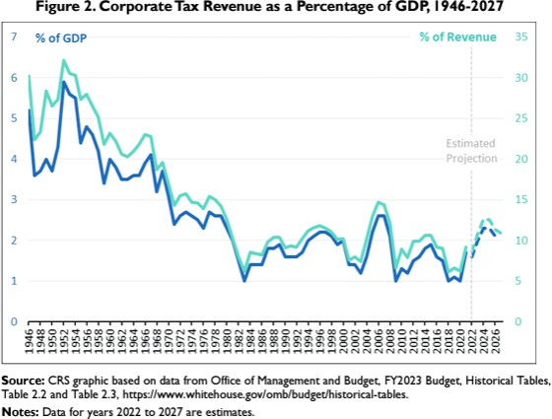
PUBLICLY TRADED CORPORATE INCOME TREND-LINES
FROM THE CONGRESSIONAL RESEARCH SERVICE –
APRIL 24, 2023
6

Slide 5
Possible CAUSES for Not going public
In order of size from smallest to largest:
Mergers
Fewer companies going public.
Investment in intangible assets.
From the Nat’l Bureau of Economic Research: “The Shrinking Universe of Public Firms: Facts, Causes, and Consequences” – July 2, 2018

Slide 6
Possible CAUSES for not going public
Effects of greater investments in intangibles:
  Under GAAP, unlike “hard” assets, spending on intangibles is expensed rather than capitalized.
    So financial statements show lower income or higher losses and less in terms of asset ownership.
    Such companies therefore appear to be more risky investments.
  And—if companies give too much detail about their intangible assets, which they could be forced to do by disclosure laws if public, their competitors can use the information.
From the Nat’l Bureau of Economic Research: “The Shrinking Universe of Public Firms: Facts, Causes, and Consequences” – July 2, 2018

Slide 7
IMPLICATIONS FOR TAXING BUSINESS INCOME
From Tax Notes:
Partnership Income,
and Calls for Partnership Reform, Keep Growing, Martin Sullivan, Oct. 21, 2024.
Private companies tend to be partnerships (LLCs).
Latest available annual data—2020 to 2021—shows that
in a single year, the total net income of partnerships nearly doubled — from $1.96 trillion to $3.89 trillion.
Total net income available for allocation to partners grew more than thirtyfold from its 1993 level of $106 billion.
“Is that a lot? You bet it is. Compare that with the growth of the overall U.S. economy: GDP over the same period merely tripled.”

Slide 8
IMPLICATIONS FOR TAXING BUSINESS INCOME
More from Tax Notes . . .
“But as rapid as this growth of real business has been, it pales in comparison with the growth of portfolio and other investment income flowing through partnerships.”
“Investment income of partnerships has grown from 1993 to 2024 at a rate nearly 20 times faster than GDP.”

Slide 9
IMPLICATIONS FOR TAXING BUSINESS INCOME
More from Tax Notes . . .
From 1993 to 2021 partnership income flowing to –
    Individual partners –
      Shrunk—from 63% to 25%
    Partners that are other partnerships –
      Grown—from 9% to 37%

Slide 10
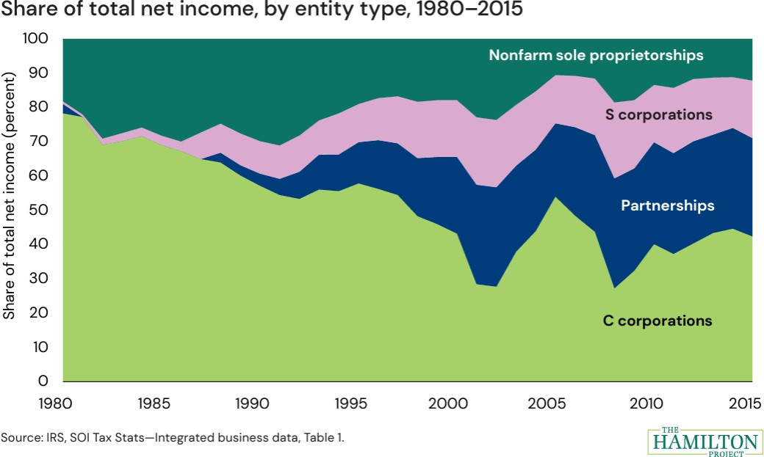
THE HAMILTON PROJECT

Slide 11
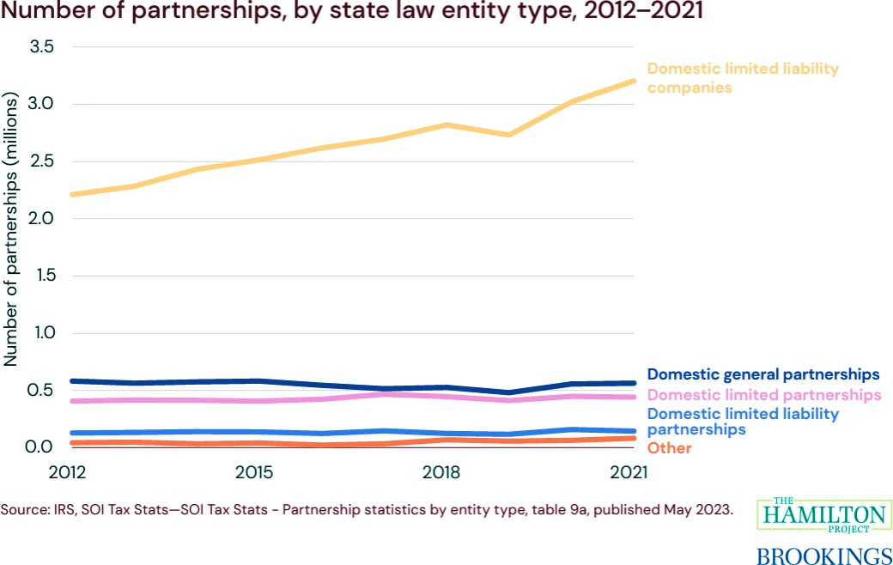
THE HAMILTON PROJECT

Slide 12
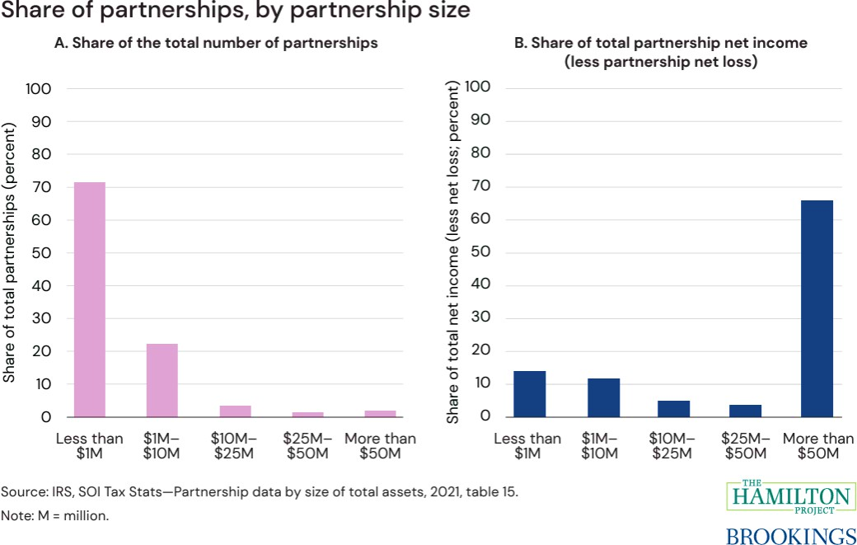
THE HAMILTON PROJECT

Slide 13
THE HAMILTON PROJECT
“From 2002 to 2019, the number of partnerships that qualify as “large” (i.e., $100 million or more in assets and 100 or more total partners) and “complex” (i.e.,
20 or more tiers of ownership) increased from 36 to more than 6,000.”

Slide 14
Status of IRS Large Partnership Audits
IRS announces launch of pass-through compliance unit in LB&I; new group brings together teams of specialists from across the agency to tackle large or complex exams – Oct. 22, 2024.
“. . . the new pass-through field operations unit announced last fall has officially started work in its Large Business and International (LB&I) division . . ..”
"By using Inflation Reduction Act funding and enhancing our expertise in
this area, we will be able to reverse our historically low audit rates for complex arrangements employed by certain high-wealth individuals and
large entities, while at the same time improving the taxpayer experience through a more tailored exam approach.”

Slide 15
Status of IRS Large Partnership Audits
IRS announces launch of pass-through compliance unit in LB&I; new group brings together teams of specialists from across the agency to tackle large or complex exams – Oct. 22, 2024.
The IRS launched examinations of 76 of the largest partnerships with average assets over $10 billion that includes hedge funds, real estate investment partnerships, publicly traded partnerships, large law firms and many other industries. These audits can take years depending on the size and complexity of the partnerships.
IRS Chief Counsel announced the creation of a new associate office that will focus exclusively on partnerships, S-corporations, trusts and estates. This office will be drawn from the current Passthroughs and Special Industries (PSI) Office.

Slide 16
What about the CTA?
Enacted in 2021, the CTA would require certain entities (that do not fall into a long list of exceptions) to disclose individual beneficial owners that have certain types of control or hold more than a 25% ownership share (direct or indirect).
But the entities and firms assisting them complain that their ownership structures make it exceedingly difficult to trace and determine ultimate beneficial owners and the structures and ownership shares can undergo continual change throughout a reporting year.

Slide 17
What about the CTA?
On December 3 – a federal court in Texas issued a nation-wide preliminary injunction against the enforcement of the CTA requirements. That decision is on appeal to the Fifth Circuit.
Cases have also been brought in other circuits and the decisions are split. There is also an appeal pending in the Eleventh Circuit.
  In that case, 22 states filed an amicus brief opposing enforcement of the CTA and arguing that:
    Congress is encroaching on state authority to oversee businesses formed in their states,
    The CTA’s burdens small businesses and state economies will, therefore, be impacted.
Issue is likely to end up at the U.S. Supreme Court.

Slide 18
RESOURCES
Hamilton Project on Modernizing Partnership Taxation - https://www.hamiltonproject.org/publication/policy- proposal/modernizing-partnership-taxation/
The Shrinking Universe of Public Firms: Facts, Causes, and Consequences - https://www.nber.org/reporter/2018number2/shrinking-universe-public-firms-facts-causes-and-consequences
Trends and Proposals for Corporate Tax Revenue - https://crsreports.congress.gov/product/pdf/IF/IF11809#:~:text=U.S.%20corporate%20tax%20revenues%20have
,to%20approximately%201.6%25%20in%202023
“International Tax Implications for Private Equity Investments,” Prof. Young Ran (Christine) Kim, Cardozo Legal Studies Research Paper No. 2024-42, Oct. 29, 2024 – https://papers.ssrn.com/sol3/papers.cfm?abstract_id=5004154

Slide 19
Update on White Paper

Slide 20
Scope & Issues
Sourcing partnership income where:
  Partner is a corporation
  Partnership structure has –
      Tiers
      Intercompany transactions
      Special allocations

Slide 21
Drawing on multi-state Research
See the current research - HERE
States generally source partnership income using the same rules as for corporate and proprietorship businesses, including formulary apportionment.
A number use “blended” apportionment in some cases—combining the partner’s share of partnership factors with the partner’s own factors.
Blended apportionment raises issues not fully addressed—especially where there are special allocations and intercompany transactions.

Slide 22
outline
Scope
      The white paper would address sourcing where the partner is a corporation, the partnership is a tiered structure, or situations where there are intercompany transactions or special allocations. It would exclude investment partnerships but include guaranteed payments (sourced in the same way as distributive share).
Essential Terms
      (Drafted.)
Importance of the Attribution Principle
      (Drafted.)

Slide 23
Outline (cont’d)
Sourcing Non-Apportionable Partnership Income - Generally
    Determination of non-apportionable income (see slides below)
    Sourcing non-apportionable income (see slides below)
Sourcing Apportionable Partnership Income
    Corporate and tiered partners – need for blended apportionment
    How blended apportionment may be applied
      Share of partnership factors
      Effects of special allocations
      Effects of intercompany transactions
    When blended apportionment may be applied and legal and other limitations

Slide 24
Outline (cont’d)
Anti-Abuse Rules
    Special allocations and substantial economic effect
    Other – including equitable apportionment rules
Administrative Issues
    How information is reported by partnerships and partners
    How withholding may be affected
    How composite returns or PTE taxes may be affected
Summary of State Research
    (Drafted)
    Treatment of corporate and tiered partnerships
    Treatment of special allocations
    Anti-abuse rules

Slide 25
Sourcing Non-Apportionable Income - Generally

Slide 26
NOTE
First - non-apportionable income must be distinguished from apportionable income derived from separate lines of business where separate apportionment formulas might be used.
States generally apply the same rules applicable to corporations and businesses generally.

Slide 27
Treatment of Non-Apportionable Income/Items
General Rule # 1 – Entity-Level Non-Apportionable Income –
Determine whether any partnership items are non-apportionable to the entity that recognized or incurred the items.
If so—they are sourced at the entity level and that sourcing information flows through to direct and indirect partners.

Slide 28
Treatment of Non-Apportionable Income/Items
General Rule #2 – Partner-Level Non-Apportionable Income –
If the income or items are apportionable income to the partnership—then determine if the partner’s distributive share would, itself, be non-apportionable income to the partner.
If so, then the income or items are apportioned at the partnership level and that sourcing information flows through to direct and indirect partners.

Slide 29
3 Possible Outcomes
Income or Items Are: |  |  | Source:
Non-Apportionable to the Partnership | √ | √ | Apply general rules of assignment based on partnership-level information. Source is then attributed to the partner.
NOTE: - Income is also non-apportionable to the Partner.
Non-Apportionable to the Partnership |  | Apply formulary apportionment based on partnership-level information. Source is then attributed to the partner.
Apportionable to the Partnership | √
Non-Apportionable to the Partner | √
Non-Apportionable to the Partnership |  | States may use blended apportionment, especially for corporate partners.
Apportionable to the Partnership | √
Non-Apportionable to the Partner
Apportionable to the Partner | √

Slide 30
Sourcing Apportionable Income

Slide 31
generally
  States use formulary apportionment.
  Default Rule – Use the factors of the entity recognizing the income.
  Blended Apportionment – Some states, along with the MTC combined corporate filing model, require a combination of the taxpaying partner factors with its share of the partnership factors for:
    Corporate partners
    Tiered structures

Slide 32
Is BLENDED APPORTIONMENT NECESSARY?
Simple Example - Assume –
  Corporation C forms Partnership X with another entity.
  C owns 50% and receives a 50% allocation X’s income.
  X performs important functions for C’s business.
  As separate entities:
    C has $2 million of income and $20 million in receipts—but no receipts in State 1.
    X has $1 million of income and all of its receipts--$20 million—are in State 1.

Slide 33
Is BLENDED APPORTIONMENT NECESSARY?
Partner-Level Apportionment
C includes its distributive share of X’s income in its apportionable income—but does not include any share of X’s factors. So it has no income apportioned to State 1, including none of the distributive share, because it has no receipts of its own in State 1.
RESULTS: $0 sourced to State 1.

Slide 34
Is BLENDED APPORTIONMENT NECESSARY?
Separate Partnership & Partner Apportionment -
Partnership X apportions its income at the entity level to State 1 and that sourcing result is attributed to C. Since all of X’s receipts are in State 1—all of X’s income, and C’s distributive share of that income, is sourced to State 1. But because C apportions its own income separately and has no receipts in State 1—it has no other income sourced to State 1.
RESULT: All of C’s distributive share - $500,000 is sourced to State 1.

Slide 35
Is BLENDED APPORTIONMENT NECESSARY?
Blended Apportionment -
C combines its own factors with its share of X’s factors and uses that combined formula to apportion all of its income.
 | State 1 Receipts | Total Receipts
C Corp Receipts | $ | $ 20,000,000
C Corp's Share of X's Receipts | $ 10,000,000 | $ 10,000,000
Total | $ 10,000,000 | $ 30,000,000
C's Blended Receipts Factor | 33.333%
C Corp Distributive Share | $ 2,500,000
C Corp Income Sourced to State 1 | $ 833,333

Slide 36
Is BLENDED APPORTIONMENT NECESSARY?
Income Soured to State Comparison:
  Partner-Level Apportionment - $0
  Separate Partnership & Partner Apportionment - $500,000
  Blended Apportionment - $833,333

Slide 37
Big “How” Question:
How do partners determine share of partnership factors to include?
Directly attribute the receipts to particular partners based on the partnership items making up their distributive share.
Use a ratio of the partner’s “interest in the partnership” (same as federal rules under 704(b))
Use a ratio of the partner’s share of capital
Use a ratio of the partner’s share of partnership income (distributive share)

Slide 38
Big “How” Question:
The problem is what do you do with special allocations of expense or loss?
How do partners determine share of partnership factors to include?
Directly attribute the receipts to particular partners based on the partnership items making up their distributive share.
Use a ratio of the partner’s “interest in the partnership” (same as federal rules under 704(b))
Use a ratio of the partner’s share of capital
Use a ratio of the partner’s share of partnership income (distributive share)

Slide 39
Big “How” Question:
The problem is what do you do with special allocations of expense or loss?
How do partners determine share of partnership factors to include?
Directly attribute the receipts to particular partners based on the partnership items making up their distributive share.
Use a ratio of the partner’s “interest in the partnership” (same as federal rules under 704(b))
Use a ratio of the partner’s share of capital
Use a ratio of the partner’s share of partnership income (distributive share)
Too complicated and information may not be available.

Slide 40
Big “How” Question:
The problem is what do you do with special allocations of expense or loss?
How do partners determine share of partnership factors to include?
Directly attribute the receipts to particular partners based on the partnership items making up their distributive share.
Use a ratio of the partner’s “interest in the partnership” (same as federal rules under 704(b))
Use a ratio of the partner’s share of capital
Use a ratio of the partner’s share of partnership income (distributive share)
Too complicated and information may not be available.
Won’t necessarily match the share of income each year.

Slide 41

Big “How” Question:
The problem is what do you do with special allocations of expense or loss?
How do partners determine share of partnership factors to include?
Directly attribute the receipts to particular partners based on the partnership items making up their distributive share.
Use a ratio of the partner’s “interest in the partnership” (same as federal rules under 704(b))
Use a ratio of the partner’s share of capital
Use a ratio of the partner’s share of partnership income (distributive share)
Too complicated and information may not be available.
Won’t necessarily match the share of income each year.
How do we solve calculation problems?

Slide 42
Example:
Partnership has two corporate partners – A and B – which have their own separate businesses and receipts.
The partnership conducts two primary types of activities as part of a unitary business and has $100,000 of receipts in State 1 and $100,000 of receipts in State 2.
In the tax year, the partnership has also invested in developing additional businesses (“investment” expense) and has sold property.

Slide 43
Assume that A and B agree to share partnership income (and all partnership items) 50/50. So this is easy. Take each partner’s amount of distributive share of partnership income, divide by total partnership income.
Then the ratio for each partner is multiplied by the partnership receipts in State 1 and in State 2 to determine the partner’s share of partnership receipts in those states.

Slide 44
But the partners don’t have to share partnership items in the same proportions. So what if the partnership items were shared as shown below—where Partner A is now is allocated all of the other investment expense and none of the net gain.
In that case, Partner A would have $0 net distributive share. That means Partner A’s distributive share ratio is 0% and it would therefore include none of the partnership receipts in its receipts factor—whereas Partner B would include 100%. Does that make sense?

Slide 45
You can also have a situation in which the special allocations of partnership items to the partners result in one partner having a negative amount of net distributive share and the other partner has a distributive share amount greater than the partnership’s net income. This is illustrated below.
Does it really make sense for Partner A to have a “negative” amount of partnership receipts included in its receipts factor, or for Partner B to have 150%?

Slide 46
And then – you can have a situation in which the partnership has a net loss overall, but because of special allocations, one partner has a positive amount of net distributive share and the other partner has a negative amount greater than the partnership’s net loss. Same problem – you have a negative distributive share ratio for one partner and a distributive share ratio for the other partner that exceeds 100%.

Slide 47
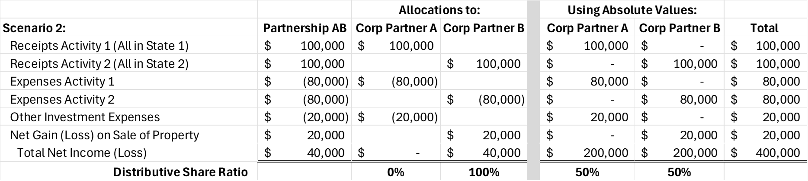
Possible fix – use absolute values for partnership items and calculate the ratio of distributive share based on these values.

Slide 48
Possible fix – use absolute values for partnership items and calculate the ratio of distributive share based on these values.

Slide 49

Possible fix – use absolute values for partnership items and calculate the ratio of distributive share based on these values.

Slide 50
Working on Excel Model Showing different Sourcing Approaches
Comparing results of using blended apportionment to other sourcing approaches under different circumstances.
Possible Assumptions for Blended Apportionment:
  Application to both corporate and tiered partners
  Focus on the receipts factor
  Use of an absolute value distributive share ratio for the blended apportionment approach
  Elimination from receipts factor the receipts from charges by the partnership to the partner or by the partner to the partnership.
Looking at need for anti-abuse rules.

Slide 51
Possible use of a study group to review the Model
Volunteers would:
  Agree to take the Excel workbook and review the formulas and assumptions.
  Use different data to see how the results of the different approaches.
  Consider tweaks or changes that may be needed to make an approach work.
  Meet to discuss and give input to staff for revisions to the model or issues to bring back to the work group.
  Report out the results to the work group along with any proposals.

Slide 52
QUESTIONS???
And Feel Free to Reach OUt

Slide 53
Upcoming Meetings and Calls
Partnership Training – Week of January 13, 2025 in New Orleans
(Note that this creates a conflict with our next regularly scheduled meeting – so that meeting will be cancelled.)

