Slide 1
BUSINESS INCOME
AND WHERE IT COMES FROM (NOW)
MULTISTATE TAX COMMISSION UNIFORMITY MEETING – NOVEMBER 19, 2024

Slide 2
PRESENTERS
SCOTT PATTISON, FEDERATION OF TAX ADMINISTRATORS (FTA) HELEN HECHT, MULTISTATE TAX COMMISSION (MTC)
2

Slide 3
DISCLAIMER
This slide presentation provides information for consideration by the MTC Uniformity Committee and does not necessarily represent the official views of the MTC or its member states.
3

Slide 4
PUBLICLY TRADED CORPORATE INCOME TREND-LINES
According to Forbes – June, 2023:
“The count of publicly listed companies traded on US exchanges has fallen substantially from its peak in 1996.”
“Back then, the number exceeded 8,000 companies. Today that count has dropped by more than 50% to just 3700.”
“It’s not that America has half as many companies as 30 years ago – it’s that companies are increasingly staying private, largely outside the scrutiny of the public eye.”
4

Slide 5
PUBLICLY TRADED CORPORATE INCOME TREND-LINES
According to Forbes – June, 2023:
“In 2022 the US IPO [initial public offering] market fell 94.8% to
$8 billion, a 32-year low.”
“That downturn has continued; the total capitalization of new stock in the first quarter of 2023 declined by 60% relative to last year.”
“A story of private equity: There are now about five times as many private equity-backed firms in the US as there are publicly held companies, said economists at Wells Fargo on Thursday.”
5

Slide 6
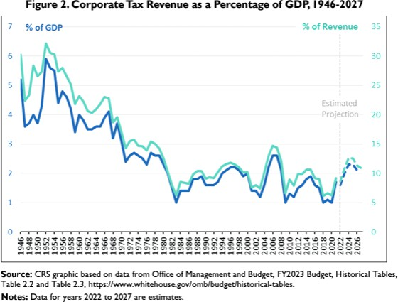
PUBLICLY TRADED CORPORATE INCOME TREND-LINES
FROM THE CONGRESSIONAL RESEARCH SERVICE –
APRIL 24, 2023
6

Slide 7
PUBLICLY TRADED CORPORATE INCOME TREND-LINES
FROM FORTUNE - MAY 28, 2024
Jamie Dimon is right—The number of U.S. public companies is plummeting—and that’s bad news for the democratic component of the economy.
By Eric Hippeau
“Several factors have precipitated this decline:
mergers and acquisitions among public companies,
increased regulatory hurdles and compliance costs, and
the availability of more capital to allow companies to stay private for longer and avoid the pressure to deliver short-term results that comes with being public.”
7

Slide 8
PUBLICLY TRADED CORPORATE INCOME TREND-LINES
According to the Atlantic – “The Secretive Industry Devouring the U.S. Economy” – Oct. 30, 2023
“In 2000, private-equity firms managed about 4% of total U.S. corporate equity.”
“By 2021, that number was closer to 20%. In other words, private equity has been growing nearly five times faster than the U.S. economy as a whole.”
“Meanwhile, private equity has matured into a multitrillion-dollar industry, devoted to making short-term profits from highly leveraged transactions, operating with almost no regulatory or public scrutiny.”
8

Slide 9
CAUSES
From the Nat’l Bureau of Economic Research: “The Shrinking Universe of Public Firms: Facts, Causes, and Consequences” – July 2, 2018
One cause in shrinkage of number of public firms – mergers.
Bigger cause is fewer companies going public.
But – “most importantly” – the nature of investment has changed for
U.S. firms, as they invest much more in intangible assets.

Slide 10
CAUSES
From the Nat’l Bureau of Economic Research: “The Shrinking Universe of Public Firms: Facts, Causes, and Consequences” – July 2, 2018
The increase in the role of intangible assets has important effects.
Under GAAP, those investments are expensed rather than capitalized, which makes it harder to gauge the value of a company based on its assets and so investing in or lending to that company is more risky. It also means young companies don’t go public.
And if companies give too much detail about their investment in intangibles, which they could be forced to do by disclosure laws if public, their competitors can use the information. If they give too little detail, investors will pay little for their shares.

Slide 11
IMPLICATIONS FOR TAXING BUSINESS INCOME
From Tax Notes:
Partnership Income,
and Calls for Partnership Reform, Keep Growing, Martin Sullivan, Oct. 21, 2024.
One implication – private companies are more likely to be formed as partnerships (LLCs).
“From 2020 to 2021 (the latest year of available data),
the total net income of partnerships nearly doubled — from
$1.96 trillion to an astounding $3.89 trillion.”
“. . . . total net income available for allocation to partners grew more than thirtyfold from its 1993 level of $106 billion.”
“Is that a lot? You bet it is. Compare that with the growth of the overall U.S. economy: GDP over the same period merely tripled.”

Slide 12
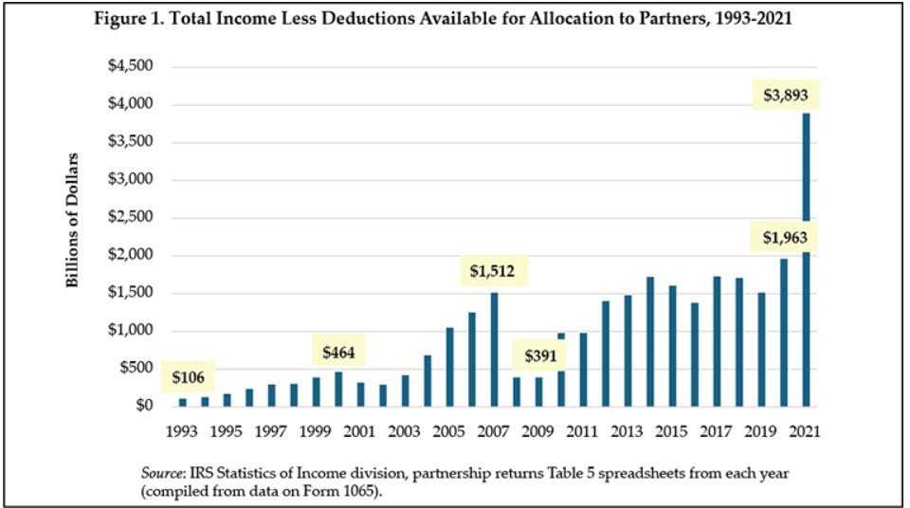
IMPLICATIONS FOR TAXING BUSINESS INCOME
From Tax Notes:
Partnership Income,
and Calls for Partnership Reform, Keep Growing, Martin Sullivan, Oct. 21, 2024.

Slide 13
IMPLICATIONS FOR TAXING BUSINESS INCOME
More from Tax Notes . . .
“But as rapid as this growth of real business has been, it pales in comparison with the growth of portfolio and other investment income flowing through partnerships.”
“. . . partners’ total distributive share of income less ordinary business income . . . was equal to $3.23 trillion in 2021.”
“Investment income of partnerships has grown from 1993 to 2024 at a rate nearly 20 times faster than GDP.”

Slide 14
IMPLICATIONS FOR TAXING BUSINESS INCOME
More from Tax Notes . . .
“Total partnership income (including trade or business income) is divided into four categories. Two trends stand out. First, there is the reduction in the percentage of partnerships accruing directly to individual partners — from 63 percent in 1993 to 25 percent in 2021. And then there is the increase in partnerships that are themselves partners — from 9 percent in 1993 to 37 percent in 2021.”

Slide 15
THE HAMILTON PROJECT
Modernizing Partnership Taxation – September 2024
“Partnership tax reform should be a key part of the current and upcoming tax policy debate, with large parts of 2017’s Tax Cuts and Jobs Act (TCJA) set to expire at the end of 2025. Partnerships are a large and growing slice of the economy and now represent almost 30% of all business income in the United States— more than double the share in the 1980s—while other similar pass-through entities represent another 30% of business income.”
“Yet the tax treatment of partnerships has not attracted attention proportionate to their growing prevalence—partnership tax rules have been revised around the edges since 1954 but have not been the subject of larger changes.”

Slide 16
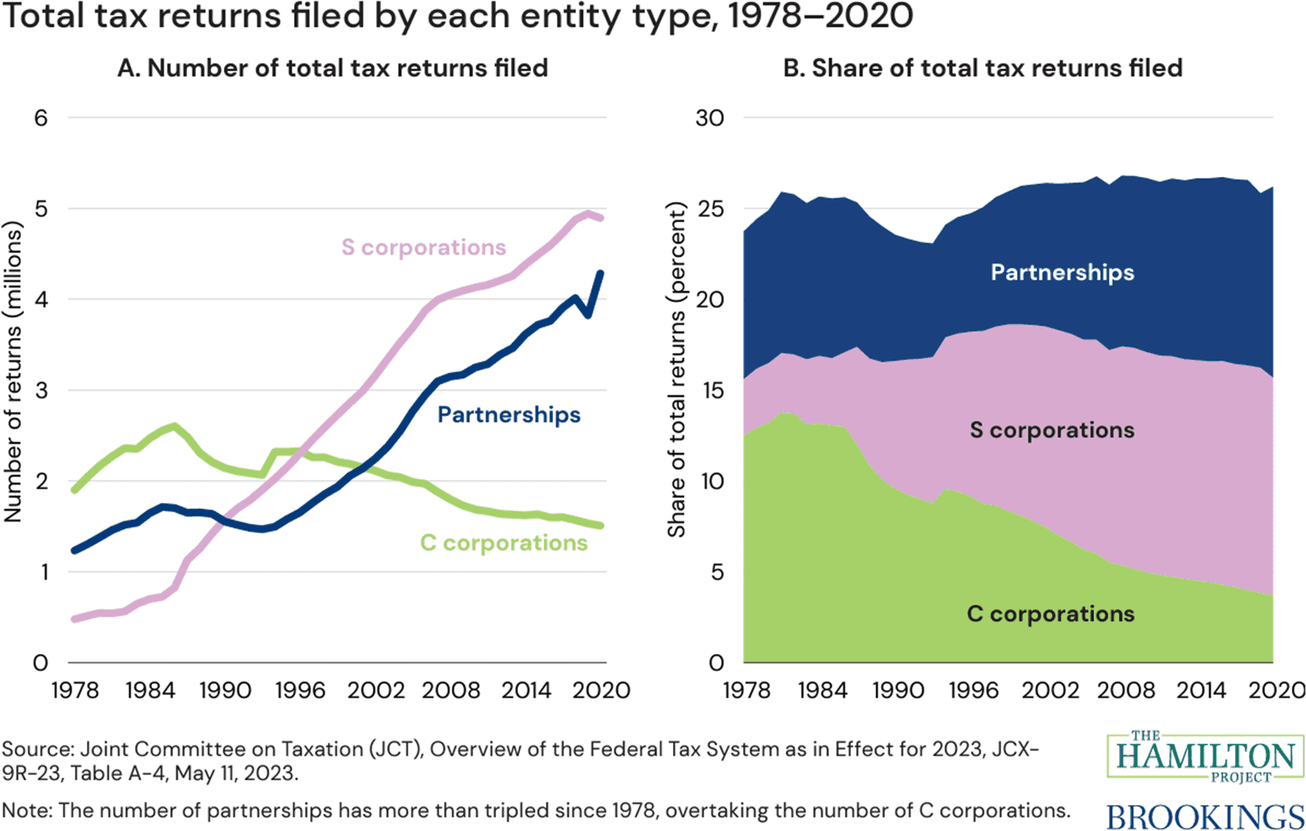
THE HAMILTON PROJECT

Slide 17
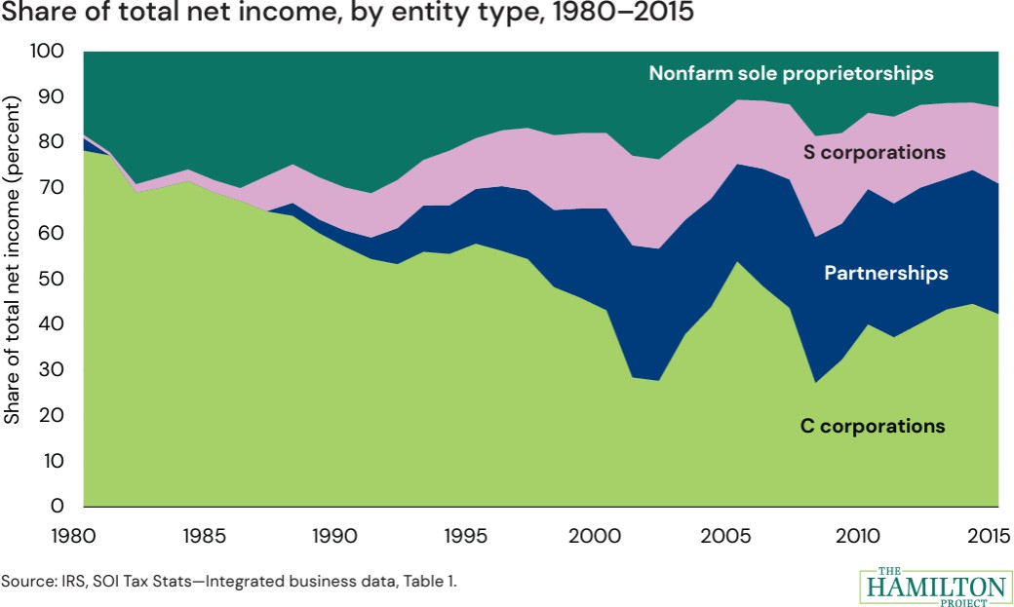
THE HAMILTON PROJECT

Slide 18
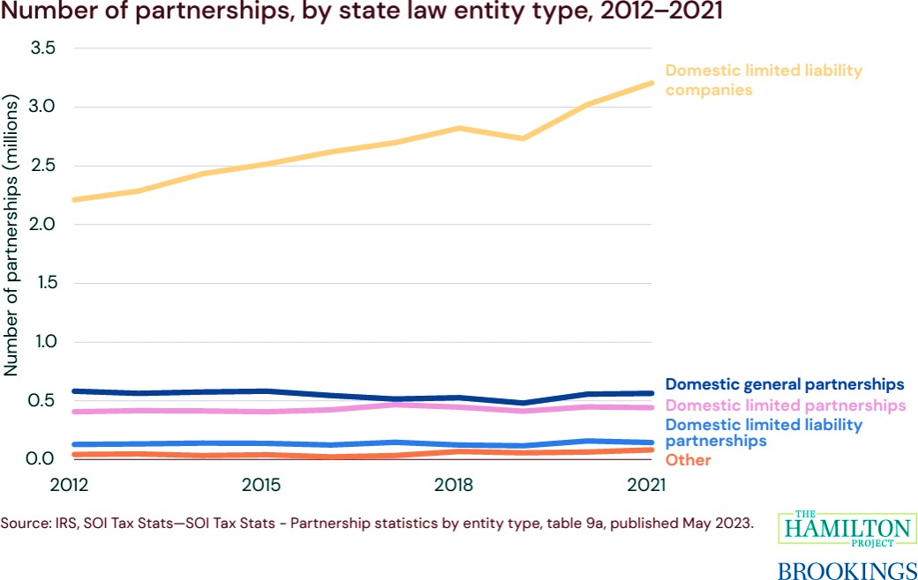
THE HAMILTON PROJECT

Slide 19
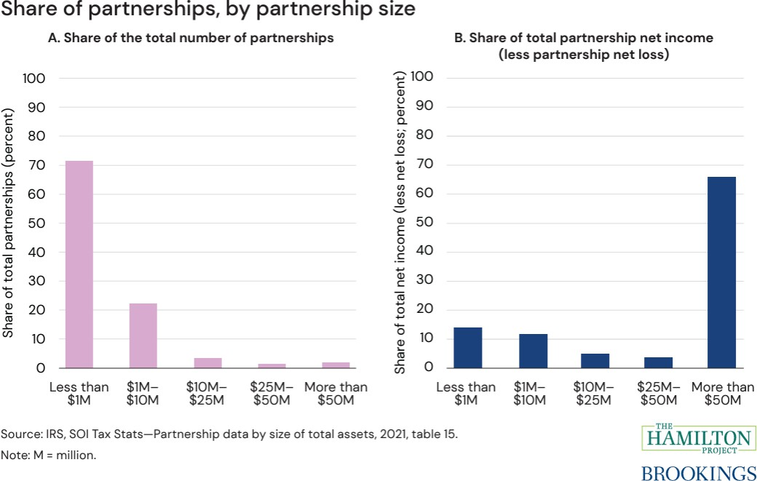
THE HAMILTON PROJECT
Most partnerships – around 70% are small entities – with less than
$1 million in total partnership assets.

Slide 20
THE HAMILTON PROJECT
But that’s not where the income comes from.
Most of the income – about 68% - comes from the small number of large partnerships.

Slide 21
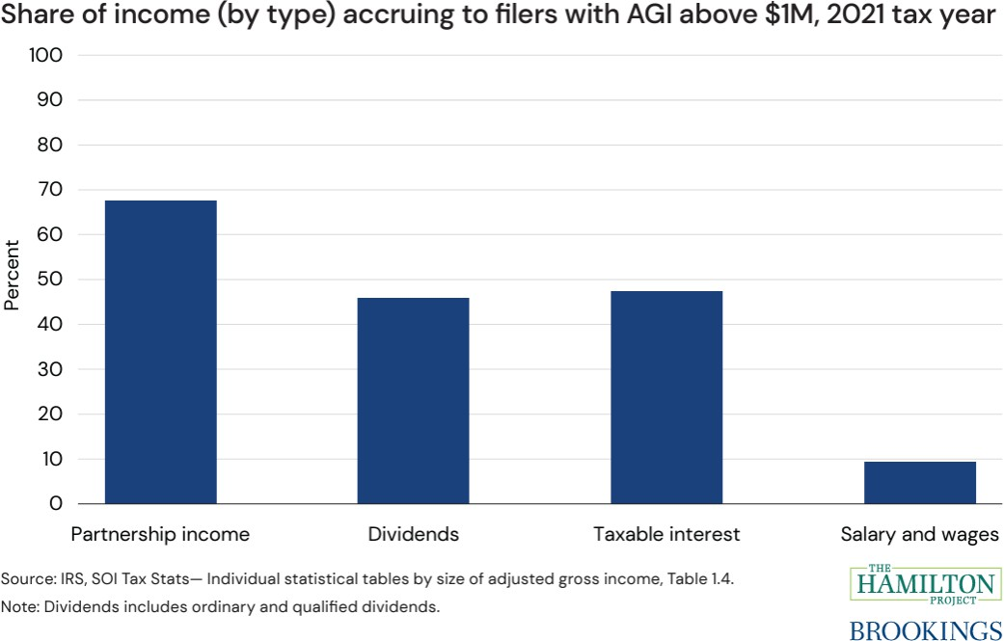
THE HAMILTON PROJECT
As this graph shows— individual taxpayers reporting AGI above
$1 Million – get a substantial share – around 68% – of their income from partnerships.

Slide 22
THE HAMILTON PROJECT
“Partnership tax rules today have some critical weaknesses that generate wasteful planning, undermine equity, and reduce revenue. Tax benefits for partnerships plus opportunities for noncompliance result in significant reductions in federal revenue at a time when the nation faces long-term fiscal and federal investment deficits.”

Slide 23
THE HAMILTON PROJECT
“This paper focuses on ways to modernize the current partnership tax system within the core of partnership tax rules, particularly ways that might be feasible as part of the 2025 tax debate. However, larger and more fundamental reforms that change the nature of pass-through taxation should also be considered and are discussed briefly.”

Slide 24
THE HAMILTON PROJECT
“Some 85 percent of partnership structures are simple—a single partnership owned directly by individuals—but many of the others are exceedingly complex.”
“Complex structures can involve partnerships owned by chains of other entities (including other partnerships) and could even include circular ownership, where one entity owns a stake in another, which then owns the first entity, creating an ownership loop. . . .”
“From 2002 to 2019, the number of partnerships that qualify as “large” (i.e.,
$100 million or more in assets and 100 or more total partners) and “complex” (i.e., 20 or more tiers of ownership) increased from 36 to more than 6,000.”

Slide 25
THE HAMILTON PROJECT
“Some filers use partnerships to conceal ownership and tax liability. For example, in one high-profile case a high net-worth individual organized a complicated network of offshore entities that included LLCs, trusts, and other pass-through entities to own various investments and conceal the income from those investments.”

Slide 26
The CTA requires disclosure of beneficial ownership of certain entities (many are excluded)including corporations, LLCs and limited partnerships.
WHAT ABOUT THE FEDERAL CORPORATE TRANSPARENCY ACT? 31 U.S.C. 5336 (Beneficial ownership information reporting requirements)
Passed in 2021, the CTA is currently the subject of ongoing litigation.
The federal government argues the information is essential to the oversight, regulation, and taxation of these entities.
Opponents claims that it exceeds the authority of Congress, in part, because it is not tied to any particular authority.

Slide 27
WHAT ABOUT INTERNATIONAL TAX?
From “International Tax Implications for Private Equity Investments,” Prof. Young Ran (Christine) Kim, Cardozo Legal Studies Research Paper No. 2024-42, Oct. 29, 2024.
“Private equity funds (PEFs) have continuously grown over the last couple of decades, making up a ‘quarter of global M&A activity and as much as half of the leveraged loan issues in the capital markets’ (Talmor and Vasvari, 2011, 3). Its popularity is due to the fact that it allows access to capital not available on the public markets. However, discourse on private equity tax is still limited to domestic matters. There is scant research analyzing international tax aspects of PEFs’ cross-border investment, despite the dramatic increase in international capital flows.”

Slide 28
WHAT ABOUT INTERNATIONAL TAX?
From “International Tax Implications for Private Equity Investments,” Prof. Young Ran (Christine) Kim, Cardozo Legal Studies Research Paper No. 2024-42, Oct. 29, 2024.
“Policy alternatives that capture PEF’s hybrid nature would lead to strengthening source-based taxation because the investors’ income would be treated as active income. If treated as active income, then it would be taxed primarily by the country of source. To justify source-based taxation for GPs income, there is the argument that GPs [general partners] are culpable for eroding source-based taxation in international tax. . . .”

Slide 29
WHAT ABOUT INTERNATIONAL TAX?
From “International Tax Implications for Private Equity Investments,” Prof. Young Ran (Christine) Kim, Cardozo Legal Studies Research Paper No. 2024-42, Oct. 29, 2024.
“. . . By recognizing PEF as ToB [trade or business], the U.S. could raise its revenue as a source country in the case of inbound investment. In contrast, the revenue could decrease in outbound investment cases, where the U.S. would be a residence country. However, the U.S. is the largest destination market of private equity investment, absorbing more than 40% of private equity investment worldwide. Unlike the traditional notion that the U.S. is a country of residence, it is more likely a country of source in PEF investments. Thus, the policy alternative of treating PEF as ToB could raise U.S. revenue in the aggregate.”

Slide 30
RESOURCES
Hamilton Project on Modernizing Partnership Taxation - https://www.hamiltonproject.org/publication/policy- proposal/modernizing-partnership-taxation/
The Shrinking Universe of Public Firms: Facts, Causes, and Consequences - https://www.nber.org/reporter/2018number2/shrinking-universe-public-firms-facts-causes-and-consequences
Trends and Proposals for Corporate Tax Revenue - https://crsreports.congress.gov/product/pdf/IF/IF11809#:~:text=U.S.%20corporate%20tax%20revenues%20have
,to%20approximately%201.6%25%20in%202023
“International Tax Implications for Private Equity Investments,” Prof. Young Ran (Christine) Kim, Cardozo Legal Studies Research Paper No. 2024-42, Oct. 29, 2024 – https://papers.ssrn.com/sol3/papers.cfm?abstract_id=5004154

Slide 31
QUESTIONS???
THANK YOU!
31

