Slide 1

State Taxation of Partnerships –
Status Report –
Sourcing in Complex Structures
November 19, 2024

Slide 2
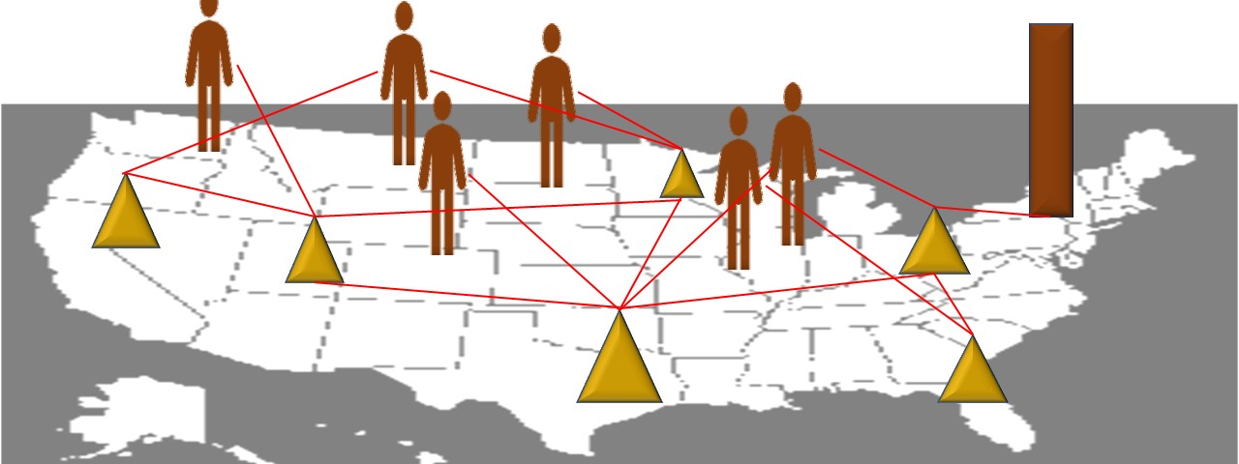
NOTE:
This presentation sets out some proposed findings from the work group’s discussions and from
multistate research, summaries of which are on the project webpage here: Partnership Project Webpage.
This information is presented to the committee for consideration and discussion. All input is welcomed.

Slide 3
Building on what We’ve Done
(Short-Term)
Available on the project web page - HERE
  Comprehensive Issue Outline
  (Sourcing Income of Investment Partnerships
    White Paper
    Draft Model
  Sourcing Guaranteed Payments for Services
    White Paper
    Draft Model
  Proposed General Framework –
  State Pass-Through Taxation of Partnerships
  Multistate Research on Tiered Partnership Sourcing

Slide 4
Building on what We’ve Done
(Long-Term)
Sourcing business income:
  To where the business is domiciled or owner is resident?
  OR
  To where the income is derived?

Slide 5



Building on what We’ve Done
(Long-Term)
Sourcing Business Income
  To where the business is domiciled or owner is resident?
  OR
  To where the income is derived?

Slide 6
Work Group Activity
Considered some of the “essential elements” or principles necessary to make it possible to source partnership income to where it is derived. See General Framework – HERE.
Did research confirming that existing state guidance generally agrees with these principles—at least to an extent.

Slide 7
Recent Activity
Work group met September 18, 2024 to discuss approach to blended apportionment and the complexity caused by tiered structures, special allocations, and related-party transactions. (See slides with the agenda for this meeting - HERE.) Focusing on the “how” not the “when”.
Since then—we have worked on answering the question raised – how do you apply blended apportionment where there are special allocations of partnership items.
But we’ve also received informal feedback questioning principles.

Slide 8

Question: Can income from complex partnership Structures be sourced to where it is derived?

Slide 9
10,000 Foot View
Can income from complex partnership Structures be sourced to where it is derived?

Slide 10
Fundamental Elements of the System
Limits on Size and Complexity of Partnership Structures
Federal: | State:
Few if any limitations. | Same.
Determination of Partnership Tax-Related Information
Federal: | State:
Done at the partnership level. | Same.
Tax Reported and Paid
Federal: | State:
By partners. | Same. (But see PTE tax options.)

Slide 11
Fundamental Elements of the System
Limits on Special Allocations
Federal: | State:
Special allocations (where partnership income or items are allocated to partners other than according to their ownership of capital) are allowed provided the allocations have substantial economic effect. | Same. HOWEVER, it’s not clear to what extent the limit requiring allocations have substantial economic effect would apply to allocations made which affect state rather than federal tax.

Slide 12
Fundamental Elements of the System
Limits on Special Allocations
Federal: | State:
Partners may agree that items of partnership income, expense, gain, loss, etc. may be allocated to partners in any way that they choose, regardless of their ownership share, and these allocations may change over time—but these special allocations must have substantial economic effect. | Same. HOWEVER, it’s not clear to what extent the limit on allocations that do not have substantial economic effect would apply to allocations made which affect state rather than federal tax.
Some states have adopted specific anti-abuse rules that make clear this substantial economic effect limitation applies when the tax affected by the special allocation is state tax.

Slide 13
Fundamental Elements of the System
Application of the Attribution Principle
Federal: | State:
Partnership tax-related information, including federal sourcing information, is generally attributed to the partners regardless of the ownership share or the role that the partners play in the partnership (although these factors may affect that partner’s treatment of the partnership income). | Same. HOWEVER, the extent to which this attribution principle applies to state tax information—including nexus and state sourcing—is subject to ongoing debate.

Slide 14
On that question – See, for example:
Alaska Form 6900 Instructions from 2022 Sourcing –
  “A partnership is required to file Form 6900, even if the partnership itself does not conduct business in the state, but owns a partnership interest in a lower-tier partnership doing business in the state, because of the attribution rule . . . If the foreign partnership has an ownership interest in a foreign corporation, the ownership is attributed to the upper- tier partnership, including all tax attributes such as apportionment factor . . . If you answered yes to question 1c on page 1 of Form 6900, then the amounts in Schedule A, column A must include amounts attributed to the partnership from lower-tier partnerships.”
Colo. Code Regs. § 39-22-109(3)(c) Sourcing -
  (ii) Character of Income. The activities of a Pass-through entity are attributable to its Members. Therefore, a Member is engaged in a Business in Colorado to the extent the Pass-through entity is engaged in Business in Colorado. The character of the item of income, loss, deduction or credit included in the Member's distributive share is determined as if the item was realized or incurred directly by the Member from the source from which the item was realized by the Pass-through entity or incurred in the same manner as the Pass-through entity. The principles of this paragraph apply in the case of an ownership chain that runs through multiple Pass-through entities.

Slide 15
On that question – See, for example:
Fla. Admin. Code Ann. r. 12C-1.015(10) Sourcing –
  “Partnerships. The amounts of the property, payroll, and sales of a partnership are attributable to the partners or members of the joint venture. A corporation that is a State Tax Sourcing of Tiered Partnerships – partner in a partnership must add its share of the property, payroll, and sales to its own apportionment factors, regardless of whether the partnerships are Florida partnerships. Form F-1065 is used in part to distribute to each partner subject to the tax its share of the apportionment factors of the partnership or joint venture.”
Florida TAA # 11C1-001(February 2, 2011) Sourcing –
  “The Florida statutes and rules are clear that the activities of a partnership flow through the partnership to its partners.“

Slide 16
On that question – See, for example:
Ind. Code § 6-3-2-2(a) Sourcing –
  “Income from a pass through entity shall be characterized in a manner consistent with the income's characterization for federal income tax purposes and shall be considered Indiana source income as if the person, corporation, or pass through entity that received the income had directly engaged in the income producing activity. Income that is derived from one (1) pass through entity and is considered to pass through to another pass through entity does not change these characteristics or attribution provisions.”
Massachusetts Department of Revenue Tax Guide for Pass-Through Entity Tax Withholding Withholding/Return –
  “The activities of a pass-through entity are attributed to its members. An upper-tier entity is therefore engaged in the activities of the lower-tier entity. This is true regardless of the number of tiers of pass-through entities between the lowest tier of the entity structure and the highest tier. “

Slide 17
Fundamental Elements of the System
Sourcing of Business Income (or Items)
Federal: | State:
To where the income is derived. The federal government uses separate accounting, applying specific rules to source each item of income (and some expenses) based on the nature of the transactions giving rise to those items (and then allocating overhead expenses). | Same HOWEVER, states use formulary apportionment which raises two questions: To what extent should “blended apportionment” be used? How does the unitary business principle apply in the partnership context?

Slide 18
Fundamental Elements of the System
Sourcing of Business Income (or Items)
Federal: | State:
To where the income is derived. The federal government uses separate accounting, applying specific rules to source each item of income (and some expenses) based on the nature of the transactions giving rise to those items (and then allocating overhead expenses). | Same HOWEVER, states use formulary apportionment which raises two questions: To what extent should “blended apportionment” be used How does the unitary business principle apply in the partnership context?
States may provide that blended apportionment is used whenever the entities are unitary (without regard to ownership share) OR when the partnership income is business (apportionable) income to the partner.

Slide 19
Fundamental Elements of the System
Effects of Related-Party Transactions
Federal: | State:
IRC Sec. 482 allows the IRS to distribute, apportion, or allocate gross income, deductions, credits, or allowances between or among certain related businesses—including partnerships—if such distribution, apportionment, or allocation is necessary in order to prevent evasion of taxes or clearly to reflect the income of any of such organizations, trades, or businesses. | There have been questions over the extent to which states may use Sec. 482 to redistribute items that are used to evade or that fail to clearly reflect state tax. Some states have adopted add-back statutes that may apply where the related entity is a partnership.

Slide 20
100 Foot View
Can income from complex partnership Structures be sourced to where it is derived?

Slide 21
Application of the Attribution Principle
Can a state attribute nexus over partnership activities giving rise to taxable income in the state to the partners of that partnership?
  What about minority partners?
  What about passive partners?
  What about indirect partners?

Slide 22
Application of the Attribution Principle
Can a state attribute partnership-level sourcing information to the partners?
  What about minority partners?
  What about passive partners?
  What about indirect partners?
  What if the income is “nonbusiness” income to the partner?

Slide 23

Example 1:
Smith lives in State A.
Smith is a partner in Partnership 1 (P1).
P1 is a partner in Partnership 2 (P2).
P2 generates $1 million of business income entirely in State B.
Does State B’s nexus over Partnership 2 provide nexus over Smith?
1
State B
2

Slide 24
Example 1:
Or does it matter whether:
Smith has a majority capital ownership interest in P1? OR
  Has control over P1?
  Has some management involvement in P1?
  Is active in P1’s business?
P1 has a majority capital ownership interest in P2? OR
  Has control over P2?
  Has some management involvement in P2?
  Is active in P2’s business?
P1 and P2 are engaged in a unitary business?
How much income of P2 is allocated to P1?
How much income of P1 is allocated to Smith?
1
State B
2

Slide 25
Example 2:
None of Corp’s own business operations is in State B.
Pship has apportionable business income 100% apportioned to State B
Corp’s share of Pship’s income is nonbusiness income to Corp.
Can State B tax Corp on its share of Pship’s income? That is, can State B attribute the sourcing of Pship’s income (sourced at the entity level) to Corp?
Corp
State B
Pship

Slide 26
Down in the weeds
Can income from complex partnership Structures be sourced to where it is derived?

Slide 27
Working on the “how” of blended apportionment
How is the share of the factors to be combined with the partner’s own factors determined?
  General tentative answer – based on the partner’s distributive share of partnership income.
    What if the partner receives special allocations—including special allocations of partnership losses?
      Use absolute values of the total amounts of income (loss) allocated to partners.
Are required allocations of gain or loss—e.g., built-in gain (loss) on contributed assets—sourced differently?
How are receipts from partner-partnership transactions treated?
  In general—the states that have addressed this issue appear to eliminate those intercompany amounts.
    Are there times when an add-back statute is needed?
Are there other general anti-abuse rules to consider?

Slide 28
And on a related note

Slide 29
Partnership Training for the States
January 13-15, 2024 – New Orleans, LA
For more information reach out to Helen Hecht – hhecht@mtc.gov or Chris Barber – cbarber@mtc.gov.

Slide 30
Questions or Comments

