Slide 1
Sales Tax on Digital Products Status Report Bundling Issue
November 19, 2024
Chair - Tim Jennrich, Washington
Vice Chair – Mia Strong, Louisiana

Slide 2
The Project
The Uniformity Committee established the work group on sales taxation of digital products to draft a white paper on the issues state tax policymakers should consider when deciding whether and how to include digital products in the sales tax base.
The work group, which is working in coordination with Streamlined and the FTA—has examined the current approach states take to taxing digital products, the treatment of business inputs, and the potential effects of the Internet Tax Freedom Act,
Recently, the work group, stakeholders, and staff have been studying the issue of bundled transactions—where a single price is charged for separate products, including digital products.

Slide 3
Regular Participants
Chair: Tim Jennrich – Washington
• Vice Chair: Mia Strong - Louisiana
• Josh Pens – Colorado
• Olufemi Obikoyai – DC
• Jordan Heller – Kansas
• Richard Dobson – Kentucky
• Ben Grossman – Maryland
• Michael Fox – Maryland
• Michael Fatale – Massachusetts
• John Haidamous – Michigan
• Mark Chaiken – New Mexico
• Charles Dendy – North Dakota
• Victoria Johnson - Oregon
• Alison Jares – South Dakota
• Shannon Brandt – Texas
• Ray Langenberg – Texas
• Frank Hales - Utah
• Shelley Robinson – Utah
• Emily Cramer – West Virginia
• Michael Hardtke - Wisconsin
• Tracey Mueller – Wisconsin
• Ex officio members: Craig Johnson and Christie Comanita, SST Staff

Slide 4
UPDATE on the Project Web Page
Digital Products Project

Slide 5
Because of the size of this project and the materials associated with the development of the white paper—the project web page was expanded from a single page to a series of pages organized in a way that is similar to the outline for the paper.
The home page contains the meeting information and past meeting materials (which may also be included in other pages).

Slide 6
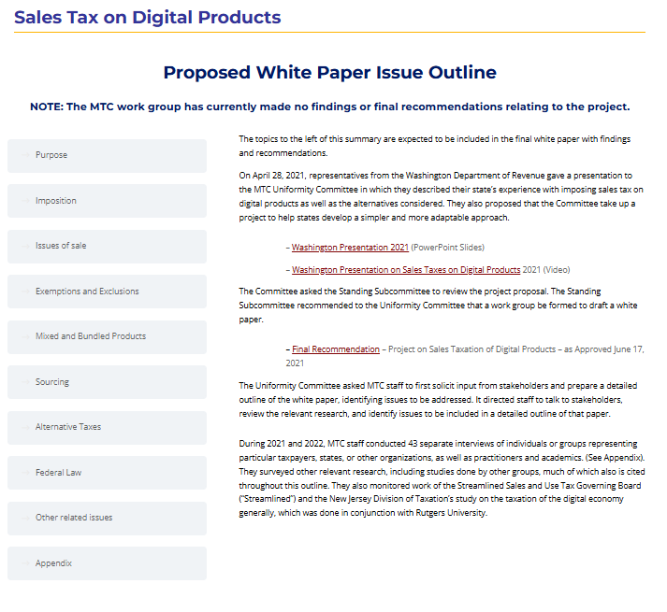
From that home page – you can get to the main page for the issue outline.
The headings/buttons on the left will then take you to those sections.

Slide 7
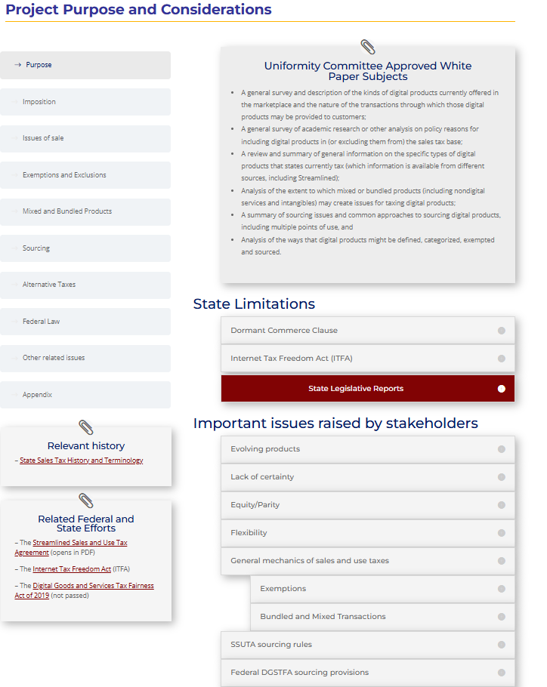
For example – here is the page on the project’s purpose and the considerations that the work group has focused on, as well as those raised by stakeholders.

Slide 8
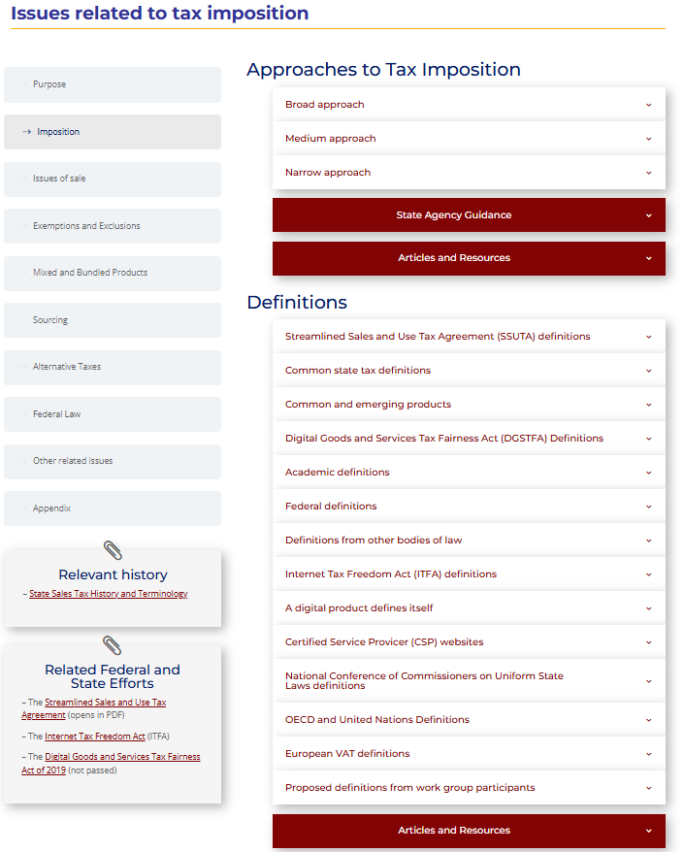
And this is the subsection page for issues related to tax imposition.
Here, for example, is information on definitions. And if you scroll down on these pages, you’ll see additional information under headings that help direct you to the information on that topic.

Slide 9
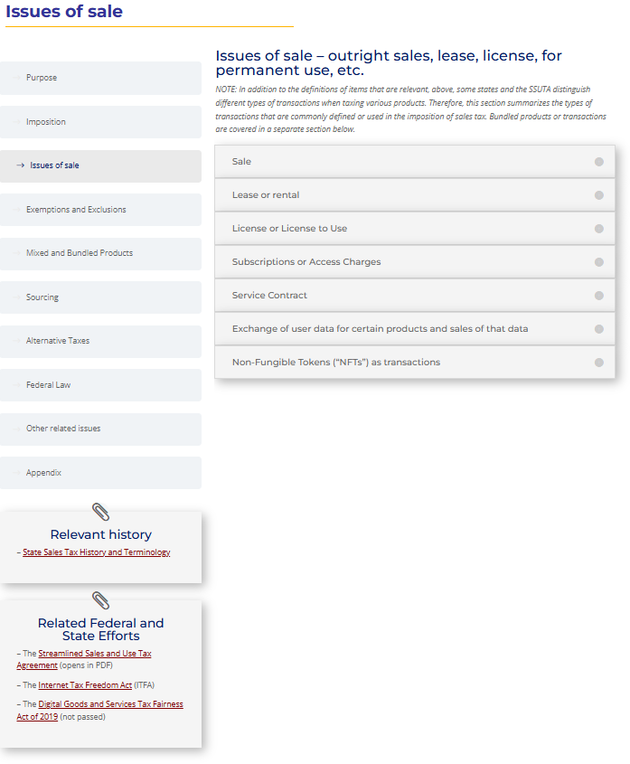
Here’s another section on issues of sale. This section has been set up to capture information which the work group has not yet addressed—but may be addressed in the future. So, there may be topics which do not yet have materials.

Slide 10
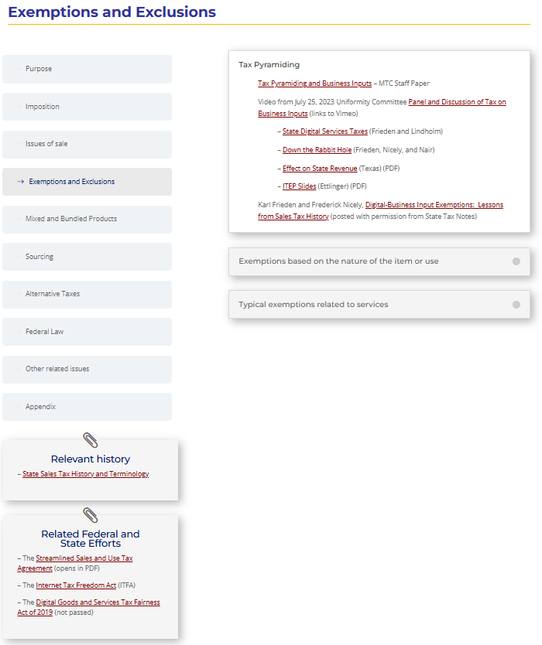
Under the section on exemptions and exclusions there is information about the question of how to treat sales of business inputs—including information from the panel presentation at the 2023 MTC annual meeting in Austin.

Slide 11
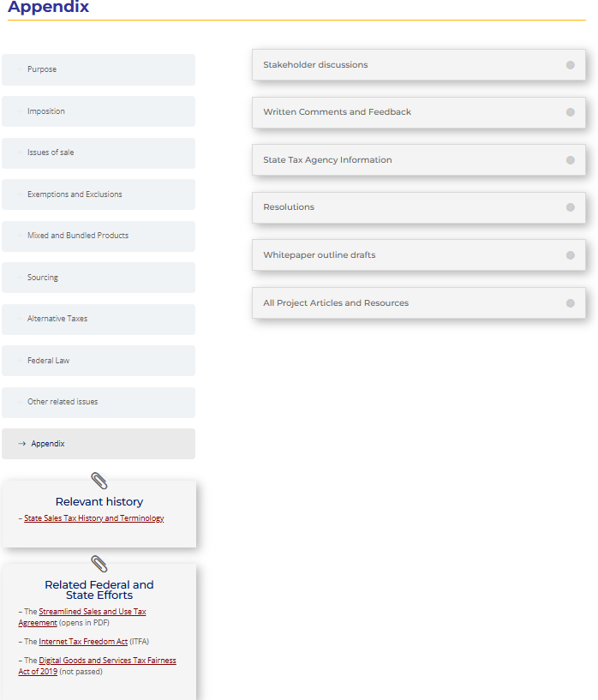
One important page is the appendix page. If you’re looking for materials, you may find them here as well as in other places in this outline.

Slide 12
UPDATE on the Bundling Issue
Digital Products Project

Slide 13
Bundling Issue – Draft Section of White Paper
Draft Section of the White Paper – with research on Streamlined and other rules as well as a summary of stakeholder input. – HERE
Covers:
Why and how states have developed bundling rules.
Results of staff research into current state practices on bundling.
Streamlined States - Basics
Streamlined Exclusions
True object exclusions
De minimis exclusion
Food, drug, and medical equipment exclusion
Other States Rules
Not Bundling
True Object Test and Mixed Transactions
Stakeholder Input
Federal Law
Comparison of Different Approaches

Slide 14
Bundling Issue - Study Group Exercise
Summary of the Streamlined bundling rules.
Examples – that include digital products to which participants will apply the bundling rules.
Asking state volunteers from the states to work through the examples and give input on their results and if there are gaps or other problems applying the rules to transactions involving digital products.

Slide 15
Bundling Issue - Study Group Exercise
Results expected by the meeting in January – will be provided to the work group and used in completing the summary on bundling for the white paper.
If the results highlight issues or questions that may need to be addressed, this information will be provided to Streamlined for their consideration.

Slide 16
Possible Next Study group - Definitions
Based on staff research and work group discussions, we have focused on three approaches to defining digital products for inclusion in the tax base which we’ve termed “broad,” “medium,” and narrow.
The work group has discussed forming a study group to consider the broad approach.
The study group might also wish to take business inputs into account when discussing the definitions.
Streamlined is also considering definitions of products, in addition to those it already has adopted, following the narrow approach.

Slide 17
Questions – Discussion?

