Slide 1
Uniformity Committee – Developments Report
Helen Hecht, Uniformity Counsel, MTC

Slide 2
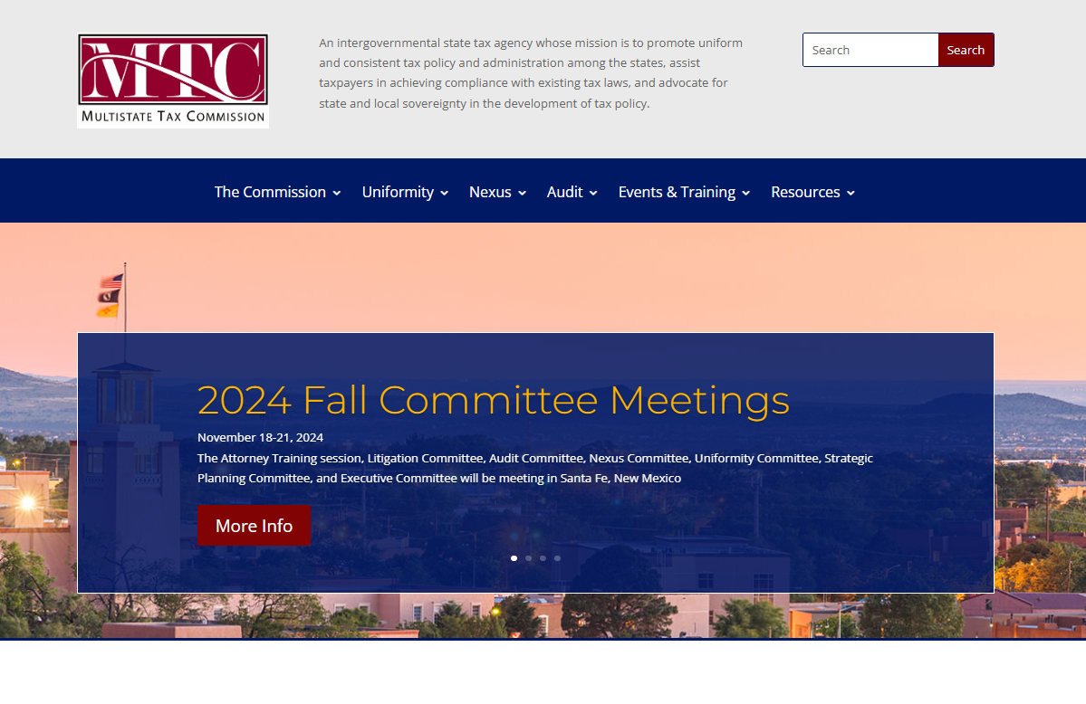
Some Website Additions/Changes

Slide 3
An addition to the MTC website is here under the Uniformity Tab and has to do with the Uniformity Process.

Slide 4
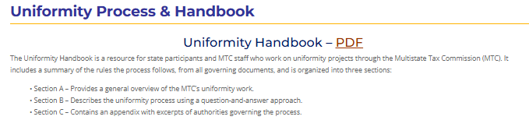
Posted there is a Uniformity Handbook which summarizes the rules governing the uniformity process.

Slide 5
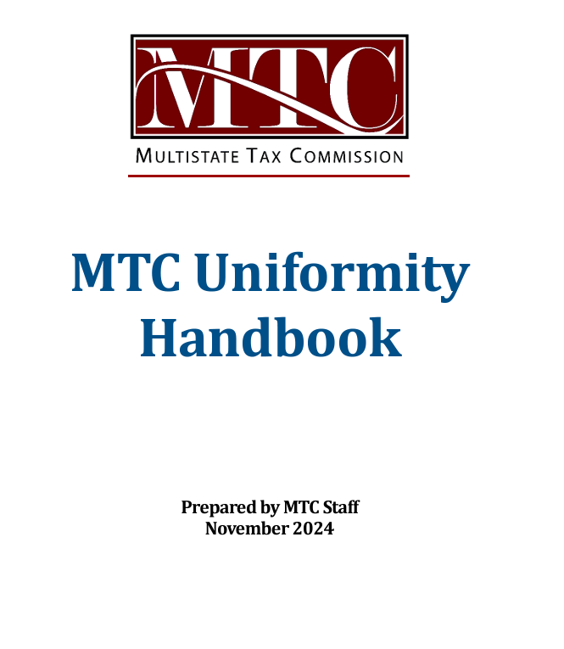
The link takes you to the document (PDF) which has excerpts from all the authorities and rules governing the uniformity process generally.

Slide 6
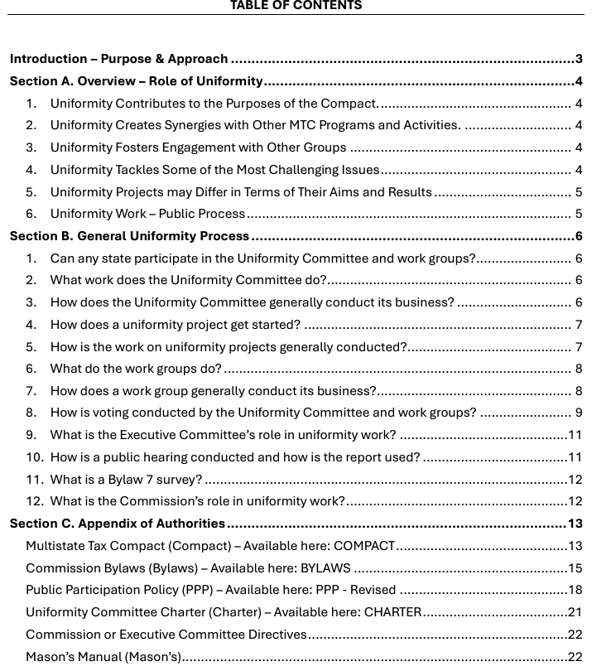
The rules for conducting the uniformity business of the committee and the commission are summarized according to the steps in the process and the relevant excerpts from those rules are also included in an appendix.

Slide 7
But also note Section A.
The goal of this handbook is not only to summarize the rules generally used in our uniformity process—but also to discuss how our uniformity work fits within the overarching purpose of the MTC, the other important work we do—audit, nexus, training, etc.—and our relationships to other organizations that may also be focusing on these issues.

Slide 8
Note on Two types of Projects
First Type - Uniform or Model Rules:
The issue to be addressed is fairly clear.
Result is actual text of proposed models along with other information.

Slide 9
Note on Two types of Projects
The goals may differ slightly:
Goal of Uniform Rules: Have states use the same approach so as to avoid duplicative taxation.
Goal of Model Rules: Provide states that want to tax something a workable way to do it if they choose.

Slide 10
Note on Two types of Projects
Second Type - Research or White Papers: Other projects involve significant research or study of emerging or complex tax issues and produce information, research, and white papers for use by state policymakers.

Slide 11
Note on Two types of Projects
Goals of Research or White Papers:
Strong educational and informational component.
Sharing of state experiences is also key—for example, the digital project is based on Washington’s experience.
May, but does not necessarily have to, produce uniform or model rules.

Slide 12
Bottom line
Handbook sets out the general rules used in the uniformity process.
Those rules are flexible enough to accommodate both types of projects.
The particular uniformity process may differ based on the nature of the project.
In addition - educational and informational sessions, stakeholder interviews and discussions, study groups, or working with other organizations (AICPA, ABA, FTA, Streamlined, etc.) may be useful.
See:
MTC Whitepaper on Wayfair Implementation
Work with FTA on the Universal POA
Work with various groups on the model for assessing state tax on federal partnership adjustments

Slide 13
And a change to the MTC website is here under the Uniformity Tab and has to do the Adopted Uniformity Recommendations.

Slide 14
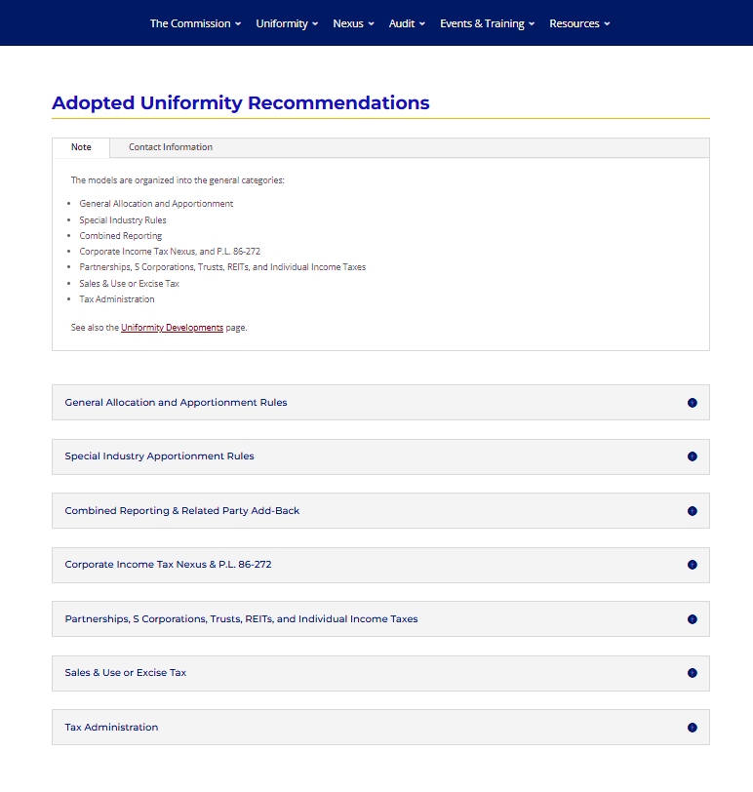
The Adopted Uniformity Recommendations page has been modified with drop-down sub-headings. The models are organized by sub-heading.

Slide 15
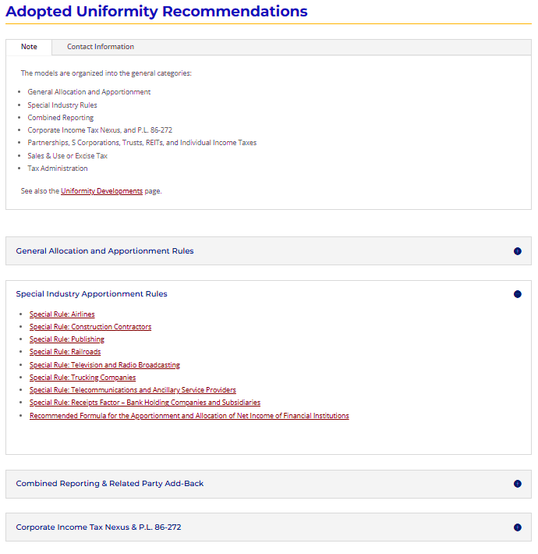
So clicking on the sub-heading will take you to a drop-down, and the models under that sub-heading.

Slide 16
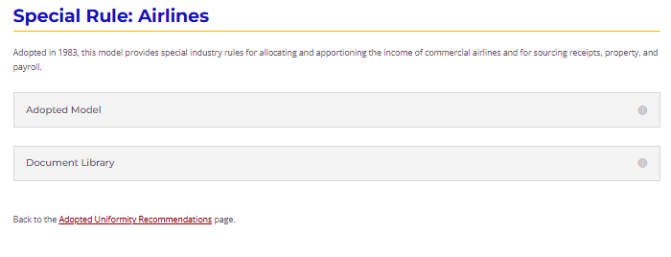
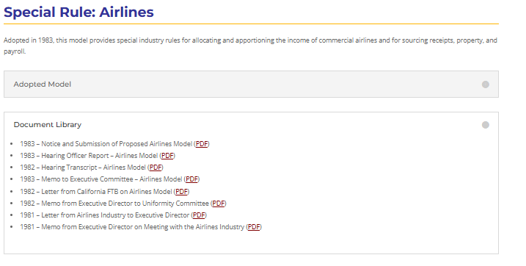
Clicking on the name of the model will then bring up that model page and will provide you with the model itself and any other documents archived there.

Slide 17
Other Uniformity Developments
MTC Statement on P.L. 86-272
The MTC Statement on P.L. 86-272 continues to get attention and is even mentioned in a recent U.S. Supreme Court petition, although its not at issue in that case.
Digital Project
The press is closely following the digital project.
A similar project has been undertaken by NCSL.
We will present on this project at FTA.
We continue to work closely with Streamlined and will be giving them the results of our bundling exercise to use.

Slide 18
Other Uniformity Developments
Partnership Project
Staff have been working on crunching numbers—along with others—to test how blended apportionment can work in apportioning distributive share where there are corporate and tiered partners.
Also following other developments—for example—a recent case out of the Virginia Court of Appeals, FJ Management, Inc., where blended apportionment was found not to apply because there was no showing that the interest held by the corporate partner was unitary.
Also working on training for state tax administrators on partnership taxation – to be held in New Orleans, January 13-15.

Slide 19
Other Uniformity Developments
The work on apportionment regulations is getting attention. (Note: Summary of the work on the ground transportation is on the project page – here:

Slide 20
Questions?

