Slide 1
Commercial Domicile: the Crumbing Pillar of Business Income Taxation
Brian Hamer
Multistate Tax Commission
November 19, 2024

Slide 2
Disclaimer
The information in this slide deck is intended for discussion purposes only. Unless otherwise indicated, it does not reflect the official position of the MTC or any of its member states.

Slide 3
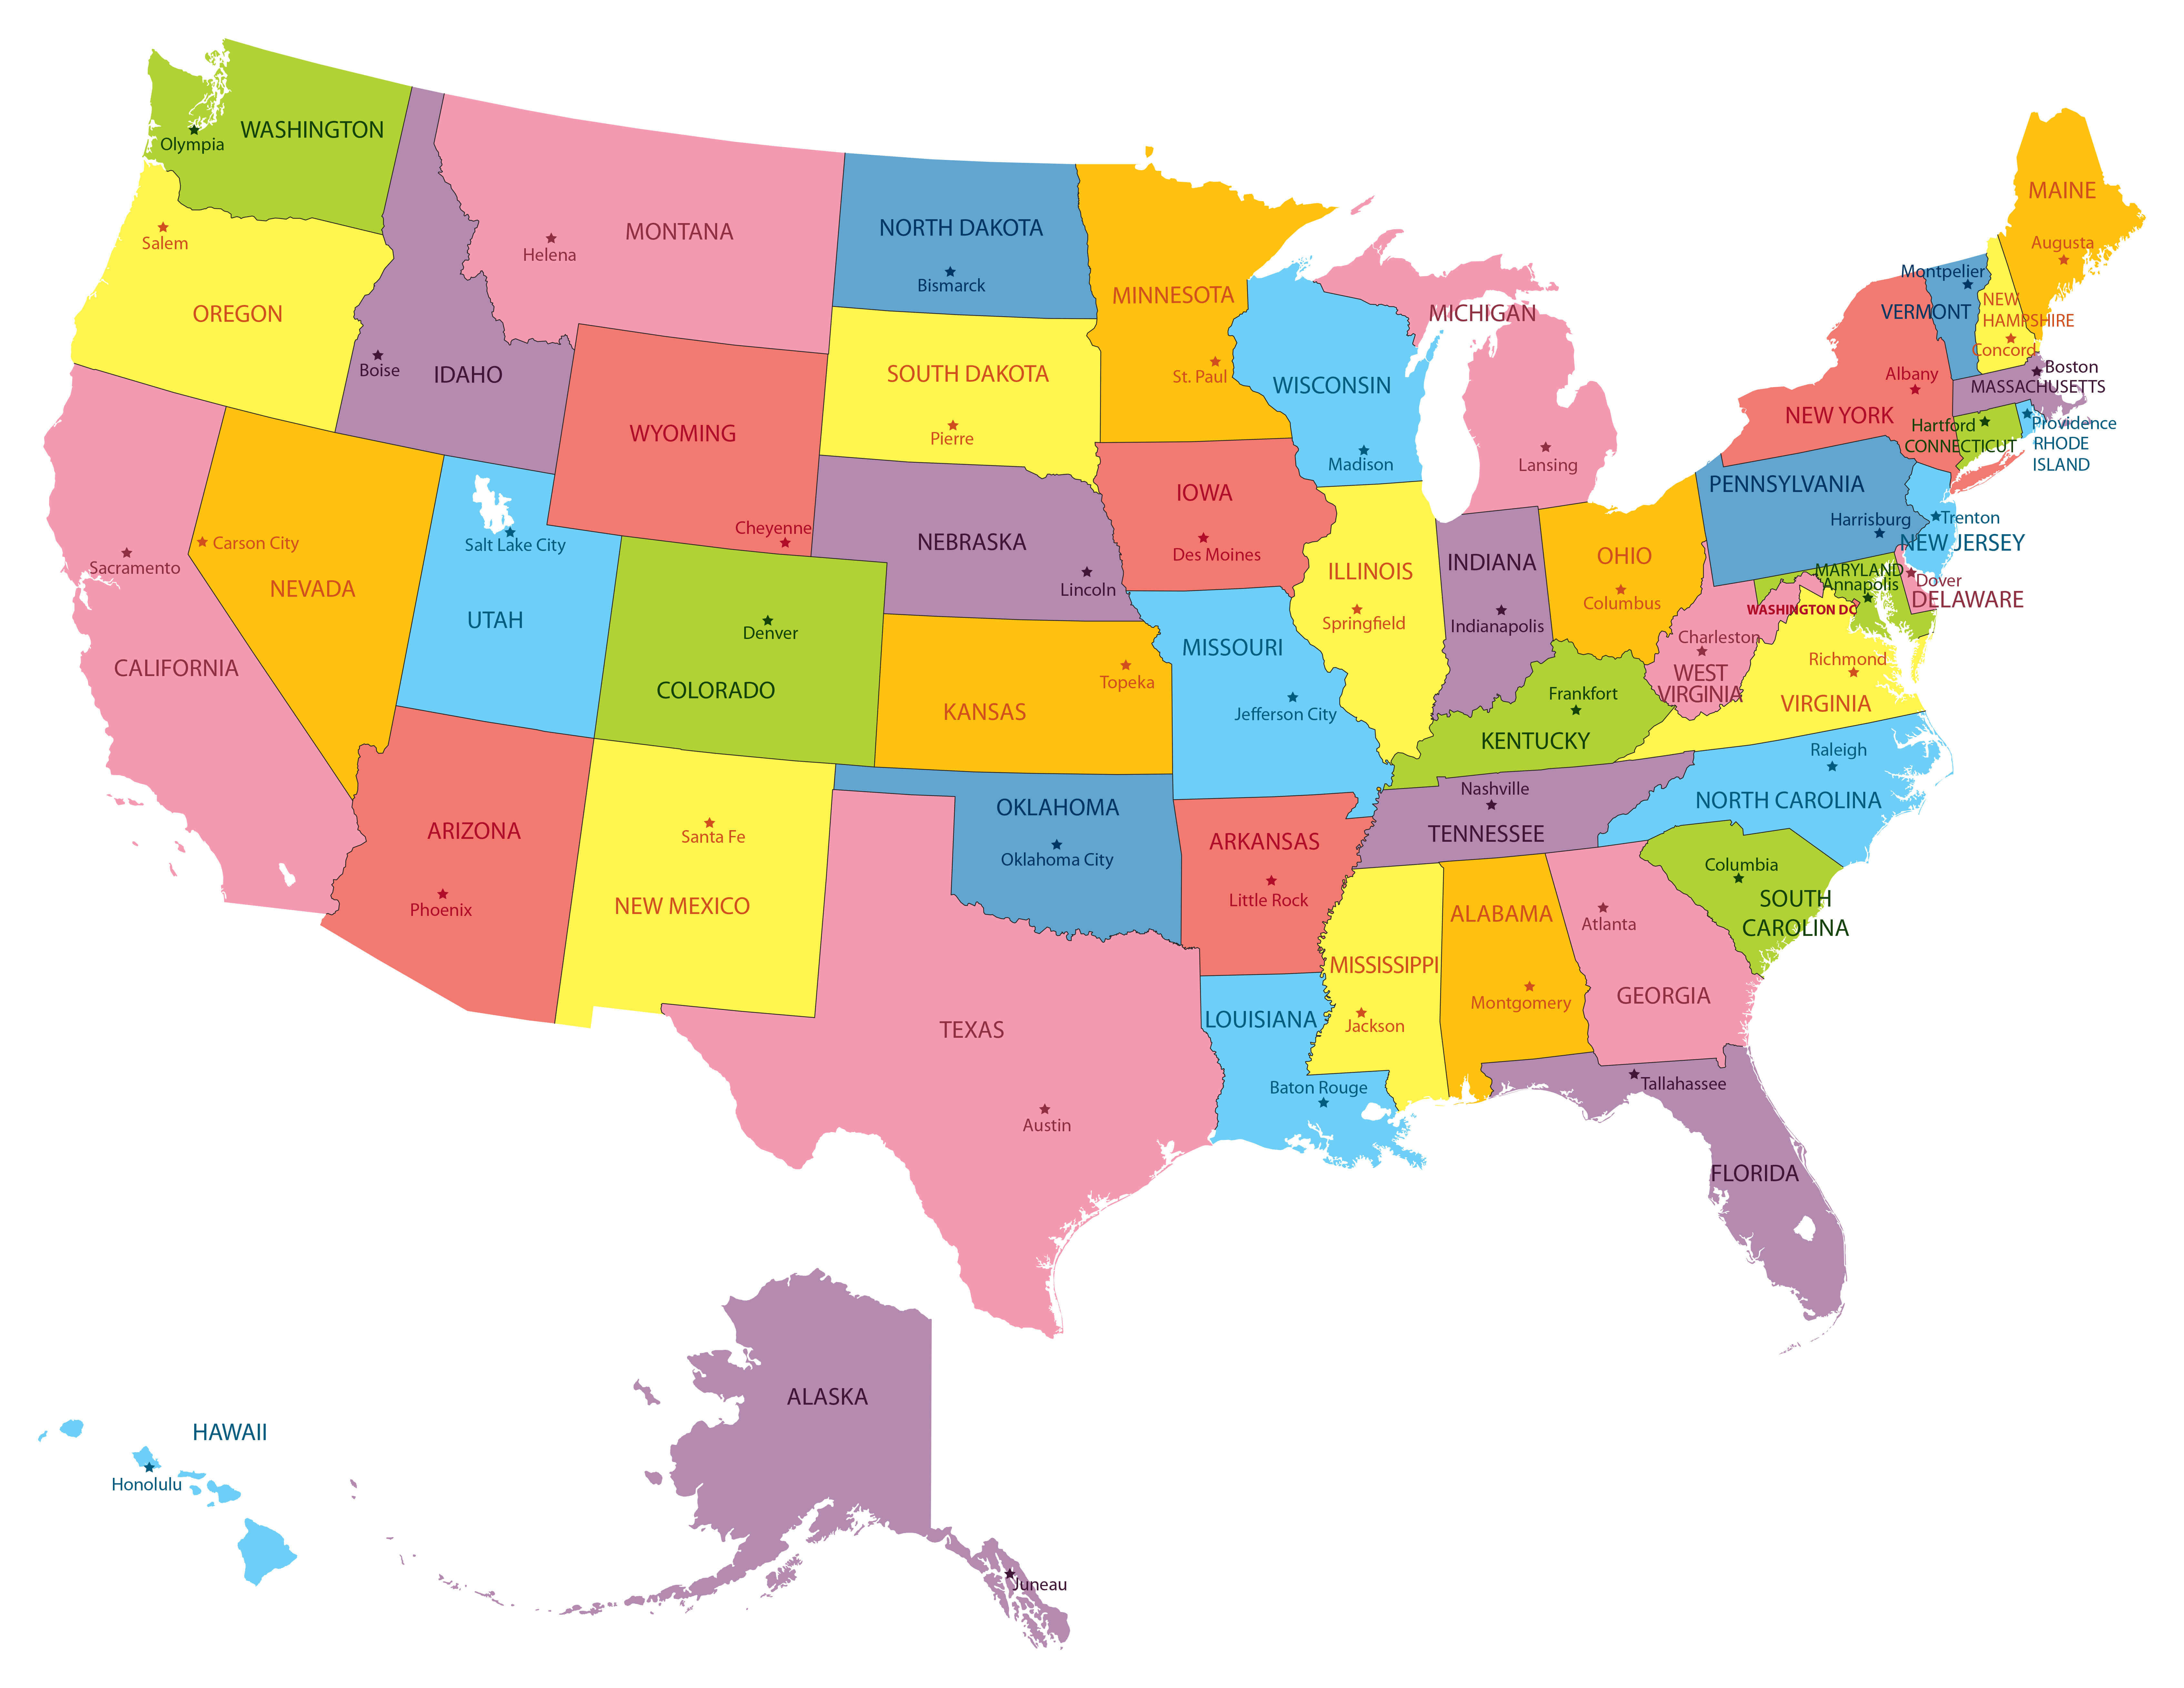
Courts and legislatures have long assigned the right to tax certain “nonbusiness income” to a multistate enterprise’s state of commercial domicile.
Given modern realities--for both practical and principled reasons—this reliance on commercial domicile needs to be rethought.

Slide 4
The Role that Commercial Domicile has Played in Determining Taxing Rights
First principles: Both the due process clause and the commerce clause prevent states from taxing “value” earned outside of their borders unless there is “some definite link, some minimum connection between a state and the person, property or transaction it seeks to tax.”
See, e.g., MeadWestvaco v. Illinois Dep’t of Revenue, 553 U.S. 16, 19 (2008) (“The Due Process and Commerce Clauses forbid the States to tax ‘extraterritorial values.’”).
And as a consequence:

Slide 5
Caselaw
Courts have held:
Income from intangible property not used in a company’s business and any gain from the sale of such intangible property may be taxed only by the state where the property has acquired a business situs or by the company’s state of commercial domicile.
Certain other nonbusiness income, such as dividends and interest received from a non-unitary payor, may be taxed only by the state where the company receiving the income is domiciled.

Slide 6
UDITPA
Certain* non-apportionable (nonbusiness) income is allocable only to the taxpayer’s state of commercial domicile, including non-apportionable interest, dividends, and capital gains realized from sales of intangible property.
*Under UDITPA, not every type of non-apportionable income is allocable to commercial domicile. In particular, patent and copyright royalties are generally allocable to the state or states where the patent or copyright is utilized by the payor.

Slide 7
What is the basis for assigning taxing rights to the state of domicile?
The Supreme Court has explained that the state where a corporation is domiciled may impose tax because it is where the corporation receives the benefits provided by government:
“[E]njoyment by the resident of a state of the protection of its laws is inseparable from responsibility for sharing the costs of its government.” First Bank Stock Corp. v. Minnesota, 301 U.S. 234 (1937)(Harlan Stone, J).
To support this point, the Court in First Bank Stock Corp. cited a prior case which in turn quoted Justice Oliver Wendell Holmes’ immortal line: “Taxes are what we pay for civilized society.”

Slide 8
Where is a business domiciled?
To answer this question, the Supreme Court has looked to a company’s “center of authority.” Wheeling Steel Corp. v. Fox, 298 U.S. 193 (1936)
In Wheeling Steel, the Court looked at such activities as:
Where the company’s officers conducted the affairs of the Corporation
Where the company maintained its general business offices and kept its books and accounting records
Where its board of directors held its meetings.

Slide 9
State courts have followed the Supreme Court’s lead, often quoting Wheeling Steel. They have considered such factors as:
Where the day-to-day affairs of the business are managed
Where the CEO’s office is located
Where most employees work
Where management meetings are held
Where orders are received and fulfilled
Where the business’s books and bank accounts are kept
Where tax returns are prepared
Where the board of directors meets.

Slide 10
UDITPA
UDITPA has taken a similar approach:
§1(b). Commercial domicile means ”the principal place from which the trade or business of the taxpayer is directed or managed.”
Numerous states have adopted this language, sometimes with a bit of embellishment.

Slide 11
And many states have provided further guidance by promulgating regulations. These regulations utilize a wide array of terms and often provide a good deal of wiggle room. For example--
Illinois: “In general, this is the place at which the offices of the principal executives are located. Where executive authority is scattered, the place of daily operational decision making controls. Such determinations must be made on the basis of all the facts and circumstances.”
Indiana: sets forth 12 factors to be considered while also stating that this list is not exclusive.

Slide 12

So, what is the problem?

Slide 13
Problem #1: As a factual matter, it is becoming increasingly difficult to identify the singular state of domicile of many far-flung businesses
Boeing Corporation
Amazon
Subway
Advocate Aurora Health (major hospital system in Chicago area)
What ChatGPT has to say

Slide 14
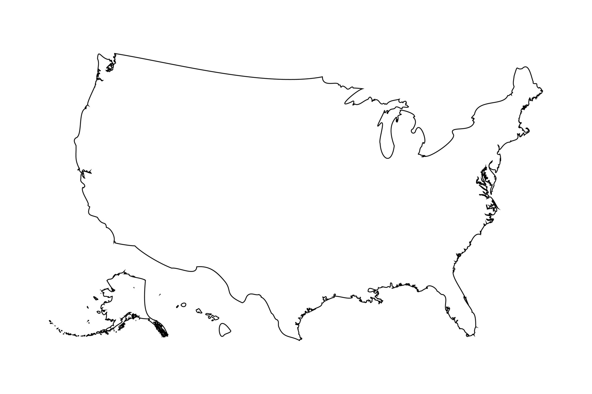







Th
The Future

Slide 15
Problem #2: There is arguably no principled basis for assigning all taxing rights to one state when corporate activity and decision making is so dispersed.

Slide 16
For more details, see B. Hamer, “Commercial Domicile: the Crumbing Pillar of Corporate Income Taxation,” Tax Notes State, vol. 113, p. 263 (Aug. 5, 2024).

