Slide 1

State Taxation of Partnerships
Update on Developments and White Paper on
Sourcing in Complex Structures
September 18, 2024

Slide 2
NOTE:
These slides Contain Information on the issues involved in sourcing partnership income in complex partnership structures. This information is for discussion purposes only.

Slide 3
Partnership Tax Developments

Slide 4
IRS Developments
BASIS SHIFTING
IRS News Release – June 17, 2024 –
IRS announces new steps to combat abusive use of partnerships; agency’s focus intensifies as new guidance closes loopholes worth tens of billions
https://www.irs.gov/newsroom/irs-announces-new-steps-to-combat-abusive-use-of-partnerships-agencys-focus-intensifies-as-new-guidance-closes-loopholes-worth-tens-of-billions
  Explains the need for regulatory guidance for partnerships addressing when basis-adjustments will be allowed in transactions between related parties under IRC §§ 732 and 734. (See Notice 2024-54.)
  “The new guidance is designed to stop the use of “basis shifting” transactions that use related-party partnerships to avoid taxes.”

Slide 5
IRS Developments
BASIS SHIFTING
IRS News Release – June 17, 2024 (cont’d)
  “. . . basis shifting amounts to a shell game where sophisticated tax maneuvers take place by shifting the basis of assets between closely related entities, ultimately allowing these complex partnership arrangements to hide from a tax bill,” Commissioner Werfel said. ‘These complicated maneuvers take time and resources for the IRS to uncover. The new guidance is aimed at telling promoters that the IRS considers these transactions inappropriate, and we are bringing new Inflation Reduction Act resources into play to beef up our compliance work in the overlooked partnerships and pass-throughs area.’”
But then . . . on June 28, 2024, the Supreme Court issued Loper Bright.

Slide 6
IRS Developments
BASIS SHIFTING
July 17, 2024 – Nat’l Ass’n of Manufacturers filed letter opposing the new rules
  The letter states: “Notice 2024-54 cites as authority for the forthcoming proposed regulations sections 482, 732, 734(b), 743(b), 755, and 7805. While certain of those statutory provisions do contemplate the exercise of a degree of agency discretion in issuing regulations, the forthcoming proposed regulations far exceed it. As the Supreme Court explained in Loper Bright, even where statutes provide an express grant of regulatory authority, courts must still “independently interpret the statute and effectuate the intent of Congress subject to constitutional limits.”

Slide 7
Other
Loper-Bright Developments
Tribune Media Co. v. Commissioner – Pending at the Seventh Circuit
  In 2009, Tribune transferred ownership of the Chicago Cubs using a partnership structure.
  As described by the Tax Court: “Tribune sought to arrange its transaction as to minimize its taxes.” (Citing Judge Hand’s ruling in the Gregory v. Helving case in the Second Circuit.) The way in which it did this was to take advantage of rules that allow a partner to increase the basis in a partnership interest to the extent of partnership liabilities attributed to the partner. (TC Memo 2021-122)
  IRS determined this attribution of debt was artificial and the transfer was a “disguised sale.” It imputed gain to the Tribune and assessed $181,662,000 in tax, relying on the general partnership anti-abuse regulation – Treas. Reg. 1.701-2.
  The Tax Court ruled for the IRS but only in part, finding that a portion of the transaction was not taxable under IRC Sec. 707(a)(2)(B) and reduced the tax owed by over half. The case is now on appeal to the Seventh Circuit.
  Question – Can the IRS rely on the general partnership anti-abuse regulation
  (Reg. 1.701-2).

Slide 8
Other
Loper-Bright Developments
IRS Position (Tribune Media – before the Seventh Circuit) –
  The IRS argues: “. . . the partnership anti-abuse rule targeted by petitioners is rooted in well-established caselaw combating tax abuse. Nearly 60 years before §1.701-2 was promulgated, the Supreme Court upheld the Commissioner's determination that a corporate reorganization, which met technical statutory requirements, nonetheless “was without substance and must be disregarded” for federal tax purposes. Gregory v. Helvering, 293 U.S. 465, 467-70 (1935). The §1.701-2 anti-abuse rule is directly traceable to Gregory and its progeny. And the business-purpose requirement in §1.701-2(a)(1), on which the Commissioner's appeal focuses, also is consistent with Congress's more recent codification of the judicial economic-substance doctrine, I.R.C. §7701(o).

Slide 9
Other Litigation
Rawat v. Commissioner, 108 F.4th 891 (D.C. Cir. 2024)
“Aggregate sourcing” – what is it?
  First - it differs from the attribution principle which says that the character of partnership income, expense, gain, and loss—including their sourcing—is determined at the partnership level and then attributed to the partners who receive a share of those items.
  The aggregate theory treats partners as having joint ownership of partnership assets. So aggregate sourcing generally refers to the treatment of gains from the sale of a partnership—realized directly by the partner—and looks through to the assets of the partnership to determine the sourcing of any gain (loss).
  The IRS long applied this approach to sourcing gains on the sale of the partnership interests by foreign partners, effectively treating the gain as if it were attributed to a sale of each of the assets.

Slide 10
Other Litigation
Rawat v. Commissioner, 108 F.4th 891 (D.C. Cir. 2024)
In Grecian Magnesite Mining, Indus. & Shipping Co., SA v. Comm'r, 926 F.3d 819 (D.C. Cir. 2019), the court ruled that the IRS could not source gains of foreign partners from sales of domestic partnership interests using an “aggregate” approach--looking through to the location of the assets.
In 2017, TCJA amended IRC Sec. 864 to specify that gains are sourced using an aggregate approach—looking through to the location of the assets of the partnership.

Slide 11
Other Litigation
Rawat v. Commissioner, 108 F.4th 891 (D.C. Cir. 2024)
In Rawat, the IRS argued that even prior to TCJA, gains from the sale of a partnership interest that are attributed to the partnership’s “hot assets” (e.g., inventory and accounts receivable) should be sourced on an aggregate basis, because IRC Sec.s 741 and 751 provide an exception that treats that portion of gain as “ordinary income.”
The D.C. Circuit ruled IRC Sec. 751 does not change the sourcing of that portion of the gain, holding in part that IRC Sec. 741 first provides that gains from sales of partnership interests are taxed as gains from sale of a capital asset except for Sec. 751. Since the exception does not apply to the sourcing of the gain, specifically, it is limited to treating the portion of the gain from hot assets as ordinary income.

Slide 12
Other Developments
Deferring Income with Tiered and Circular Partnerships
Chris William Sanchirico, Reed Shuldiner, University of Pennsylvania, Institute For Law and Economics, Research Paper 24-28, Aug. 25, 2024
“. . . partnerships can have different taxable years from their partners and that this can result in deferral of taxes. Thus, when at the close of its taxable year a partnership passes income to its partners, some partners’ taxable years may just be getting underway. Those partners will not owe tax on their distributive share until after their own taxable year ends months later.
“This opportunity for deferral is ostensibly limited by rules that restrict the partnership’s choice of taxable year based on a formulaic aggregation of partners’ taxable years. But how effective are these rules? How much deferral do they allow?
“We find that existing restrictions on partnerships’ taxable years are far less effective than they may at first appear.”

Slide 13
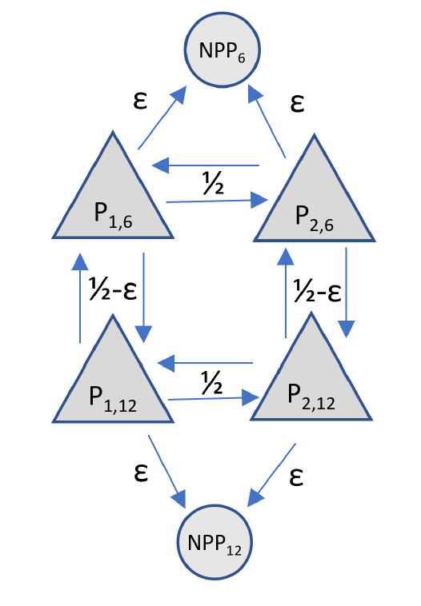
“By carefully phasing taxable years in tiered and circular partnership structures, taxpayers can indefinitely defer tax with minimum complexity and friction. Existing rules that restrict partnerships’ taxable years are ill-adapted to handle tiering and circularity. Even strengthening such rules to look through tiers of partnerships would do little to temper the deferral opportunity.”

Slide 14
Other Developments
“The past, present, and future of the BBA partnership audit regime”
By Jonathan Williamson, CPA, MT, Cleveland, The Tax Adviser, August 1, 2024
“Partnership complexities are compounded by evolving allocation and liquidation methodologies, tiered structures, and ever-increasing reporting requirements . . . Partnership adjustments are problematic due to the cascading nature of partnerships. A change in income or loss may change how all items of a partnership are allocated to its partners, which may result in changes to upper-tier entities, and so on.”

Slide 15
Other Developments
“Artificial Intelligence May Help IRS Close the Tax Gap”
Government Accountability Office, WatchBlog: Following the Federal Dollar, June 6, 2024 (Here: https://www.gao.gov/blog/artificial-intelligence-may-help-irs-close-tax-gap)
“Partnership audits. . . .The number of large partnerships has increased substantially in recent years (by nearly 600% between 2002 and 2019). This shift has made it more difficult for the IRS to identify taxable income and catch potential tax cheats.
“IRS audits few large partnerships’ tax returns because they are complex. And when IRS does audit them, the result is often no change to the audited return. IRS currently uses two AI models to help prioritize partnership returns for audit. The models are intended to help select the highest risk large partnership returns for audit. But we think more could be done to address design weaknesses that may limit these models’ ability to objectively identify the most high-risk returns and improve audit selection over time.”

Slide 16
What does A Generative AI (OpenAI ChatGPT 4o) think of sourcing in Complex partnerships?
DISCLAIMER: Just for fun (not to rely)

Slide 17
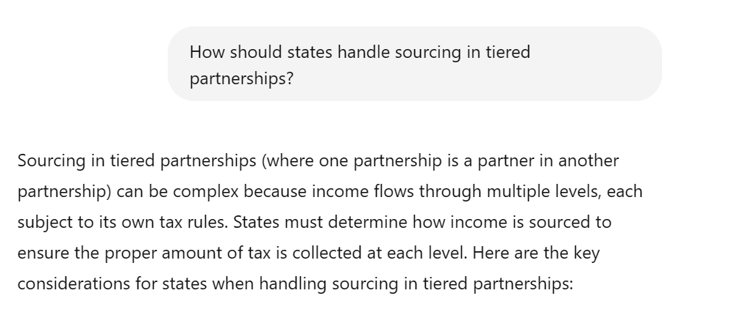
What does AI think of sourcing in Complex partnerships? – DISCLAIMER: Just for fun (not to rely)

Slide 18
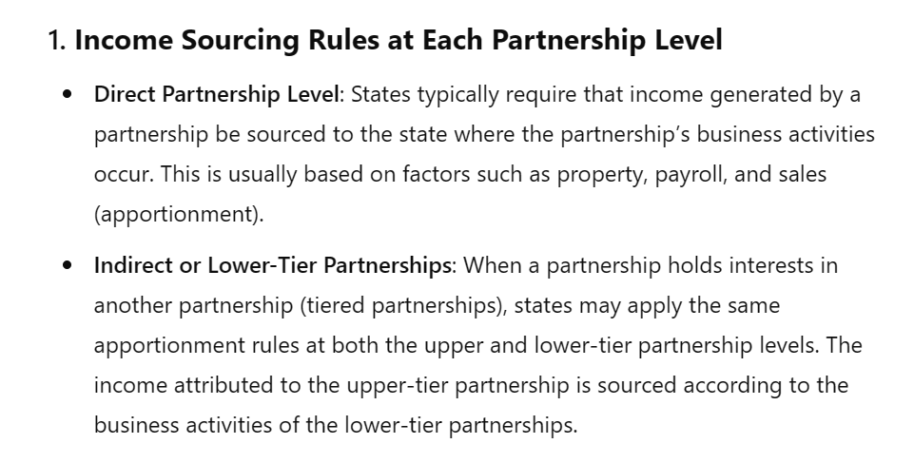
What does AI think of sourcing in Complex partnerships? – DISCLAIMER: Just for fun (not to rely)

Slide 19
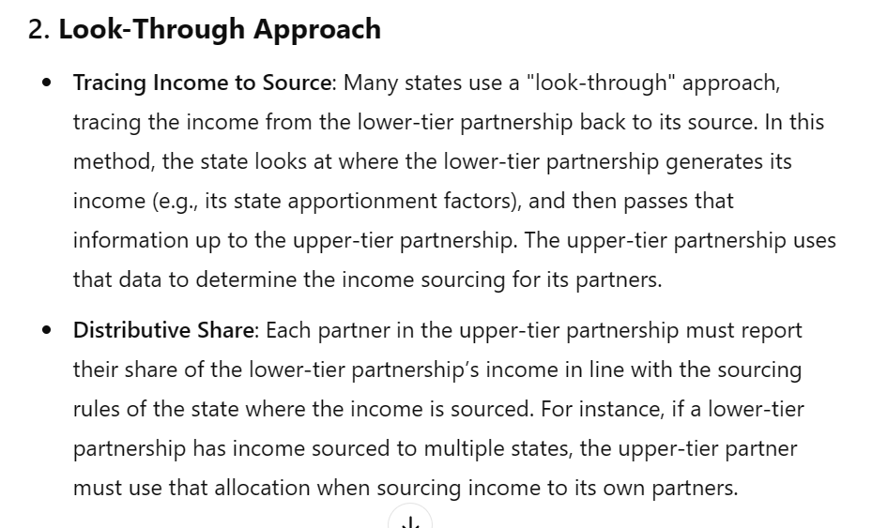
What does AI think of sourcing in Complex partnerships? – DISCLAIMER: Just for fun (not to rely)

Slide 20
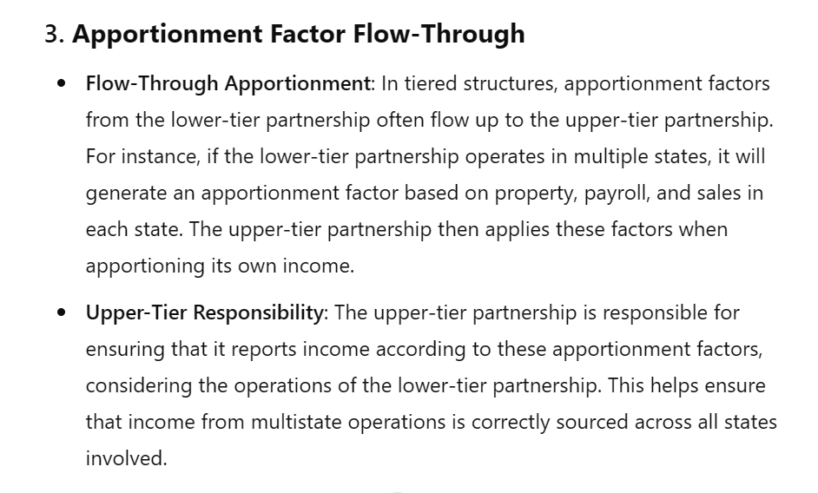
What does AI think of sourcing in Complex partnerships? – DISCLAIMER: Just for fun (not to rely)

Slide 21
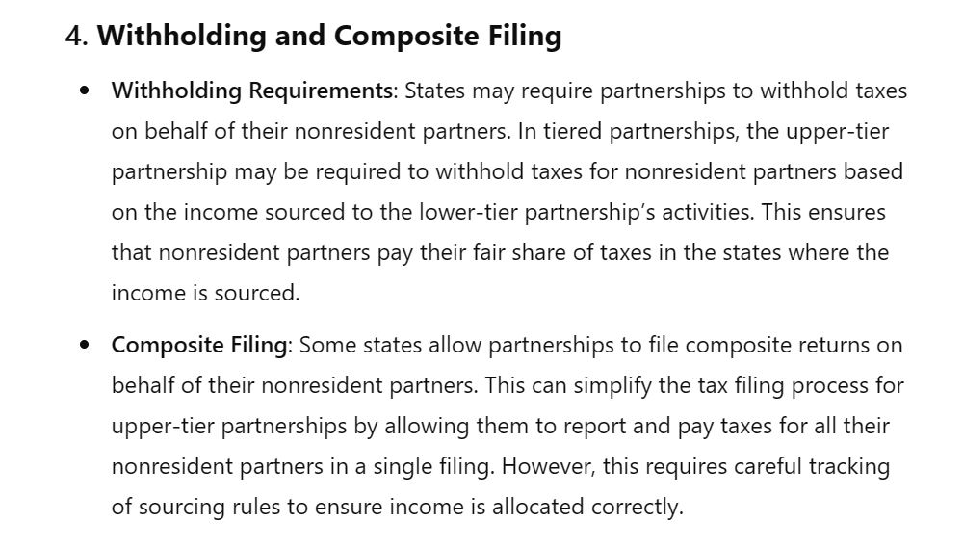
What does AI think of sourcing in Complex partnerships? – DISCLAIMER: Just for fun (not to rely)

Slide 22
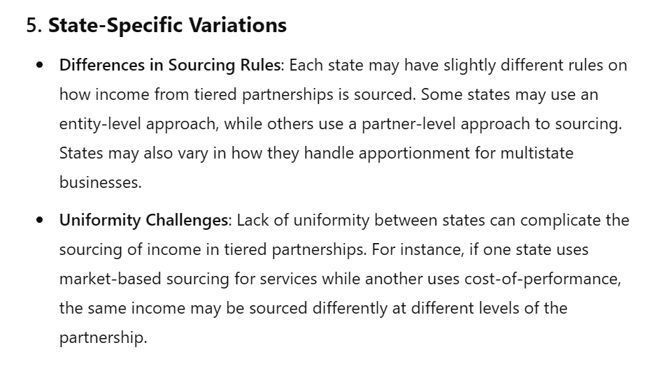
What does AI think of sourcing in Complex partnerships? – DISCLAIMER: Just for fun (not to rely)

Slide 23
What does AI think of sourcing in Complex partnerships? – DISCLAIMER: Just for fun (not to rely)
Follow-Up Questions
1. How do withholding requirements vary for upper-tier partnerships across
different states?
2. What are the challenges of apportioning income when a tiered partnership
operates in multiple states with conflicting sourcing rules?
3. Can a lower-tier partnership's business activities create a tax nexus for
partners in the upper-tier partnership?
4. What do you need to improve your latest answer based on the information
you have provided?

Slide 24
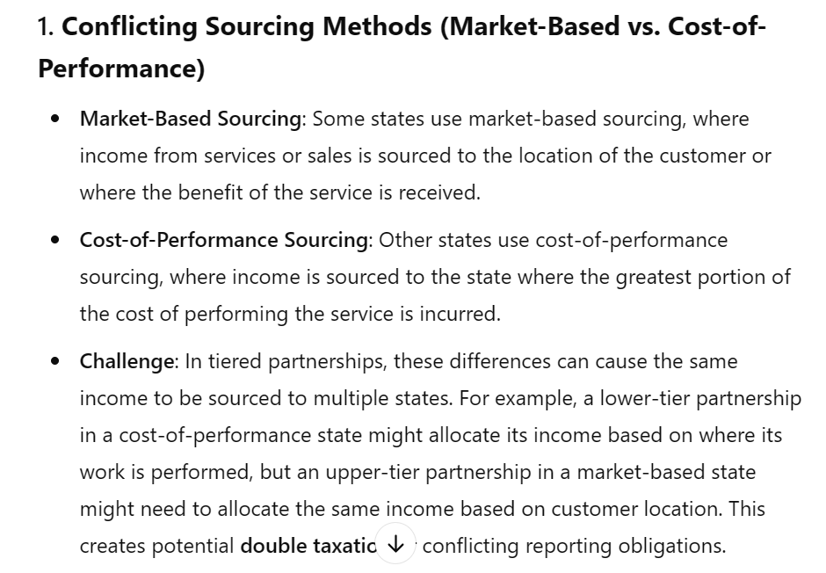
What does AI think of sourcing in Complex partnerships? – DISCLAIMER: Just for fun (not to rely)

Slide 25
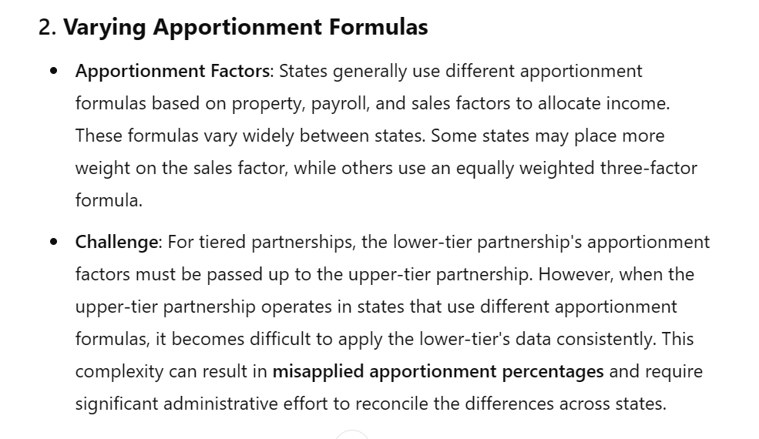
What does AI think of sourcing in Complex partnerships? – DISCLAIMER: Just for fun (not to rely)

Slide 26
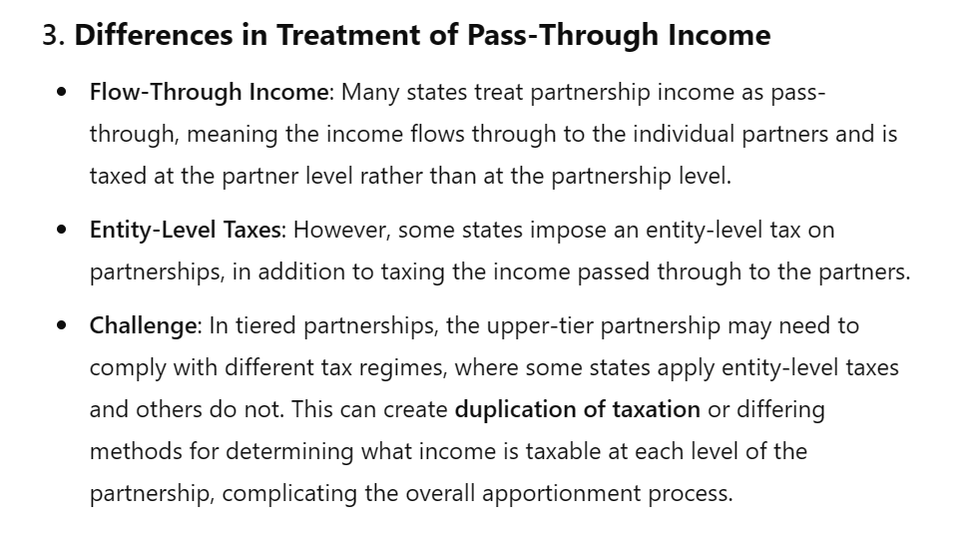
What does AI think of sourcing in Complex partnerships? – DISCLAIMER: Just for fun (not to rely)

Slide 27
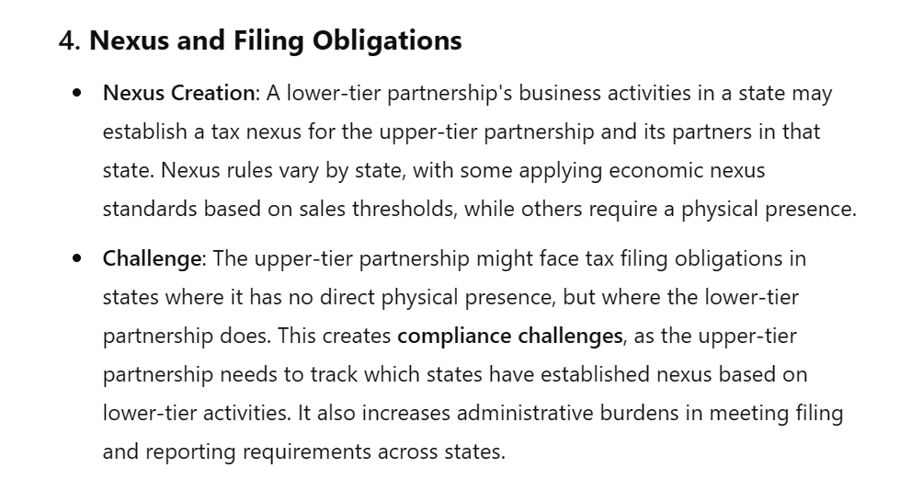
What does AI think of sourcing in Complex partnerships? – DISCLAIMER: Just for fun (not to rely)

Slide 28
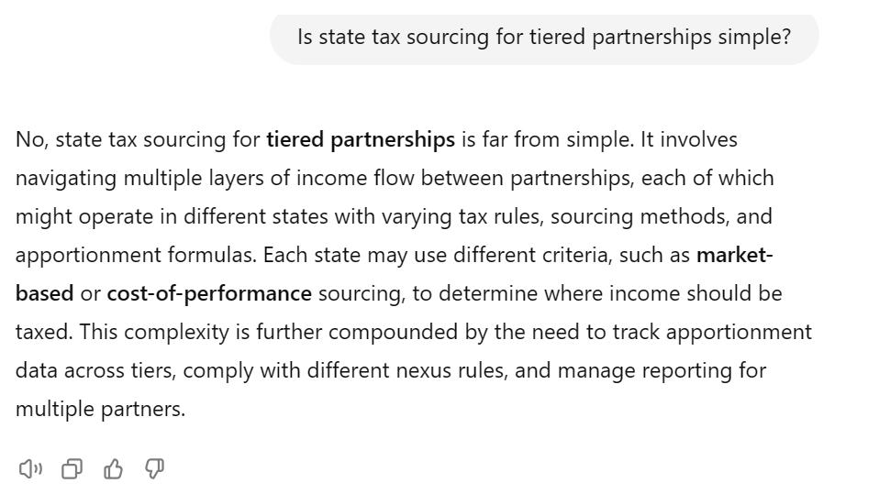
What does AI think of sourcing in Complex partnerships? – DISCLAIMER: Just for fun (not to rely)

Slide 29
Update on White Paper

Slide 30
See ALSO the Slides from July 17, 2024 Meeting
Those July 27th slides provide a general outline of the white paper, including:
  Scope –
    Corporate and Tiered Partners
    Special Allocations
    Related-Party Transactions
  Terminology and Concepts
  Attribution Principle
All this draws on multistate research.

Slide 31
“How” Issues
Comparing Three Methods to Determine Share of Factors
  No Blending
  Share of Capital
  Share of Income
Special Allocations
  Different Capital and Income Shares
  Special Allocations of Particular Items
  How to Treat Items of Losses-to-Income and Items of Income-to-Loss
Guaranteed Payments and Intercompany Transactions
  Eliminated from Factors?
  Eliminated from Income?
Necessary Exceptions or Anti-Abuse Rules

Slide 32
Treatment of Non-Apportionable Income/Items
Step 1 – Entity-Level Non-Apportionable Income –
Determine whether any partnership items are non-apportionable to the entity that recognized or incurred the items.
If so—they are sourced at the entity level and that sourcing information flows through to direct and indirect partners.
Step 2 – Partner-Level Non-Apportionable Income –
If the answer to Step 1 is no—that is, the income or items are apportionable income to the partnership—then determine if the partner’s distributive share would, itself, be non-apportionable income to the partner.
If so, then the income or items are apportioned at the partnership level and that sourcing information flows through to direct and indirect partners.

Slide 33
Blended Apportionment
  States use formulary apportionment.
  Default Rule – Use the factors of the entity recognizing the income.
  Blended Apportionment – Some states require a combination of the taxpaying partner factors with a share or the partnership factors for:
    Corporate partners
    Tiered structures
    But there are lots of “how” questions.

Slide 34
Blended Apportionment – Simple Example
Corporate Partner
Partnership

Slide 35
Blended Apportionment – Simple Example
State A uses a single sales factor.
Partnership has:
  $100,000 of apportionable net income
  $500,000 of sales in State A
  $ 1 million of sales everywhere
Corporate Partner has:
  $100,000 of apportionable net income
  $200,000 of sales in State A.
  $2 million of sales everywhere
Corporate Partner
Partnership

Slide 36
Blended Apportionment – Simple Example
Assume:
  Corporate Partner has an 80% share of Partnership capital
  Corporate Partner receives 80% of Partnership’s items of income, expense, gain, and loss.
Corporate Partner
Partnership

Slide 37
Blended Apportionment – Simple Example
State A uses a single sales factor.
Partnership has:
  $100,000 of apportionable net income
  $500,000 of sales in State A
  $ 1 million of sales everywhere
Corporate Partner has:
  $100,000 of apportionable net income
  $200,000 of sales in State A.
  $2 million of sales everywhere
Assume:
  Corporate Partner has an 80% share of Partnership capital
  Corporate Partner receives 80% of Partnership’s items of income, expense, gain, and loss.
Sourcing Approach - No Blending
Partnership Income Sourced to State A at Partnership Level (50% x $100,000) | $ 50,000
Corporate Partner's Share of State A Income (80% of $50,000) | $ 40,000
Corporate Partner's Own Income Sourced to State A (10% of $100,000) | $ 10,000
Total Corporate Partner Income Sourced to State A | $ 50,000

Slide 38
Blended Apportionment – Simple Example
State A uses a single sales factor.
Partnership has:
  $100,000 of apportionable net income
  $500,000 of sales in State A
  $ 1 million of sales everywhere
Corporate Partner has:
  $100,000 of apportionable net income
  $200,000 of sales in State A.
  $2 million of sales everywhere
Assume:
  Corporate Partner has an 80% share of Partnership capital
  Corporate Partner receives 80% of Partnership’s items of income, expense, gain, and loss.
Sourcing Approach – Using Share of Partnership Capital to Determine Share of Factors
Corporate Partner's Share of Total Partnership Income (80% of $100,000) | $ 80,000
Corporate Partner's Income | $ 100,000
Total Corporate Apportionable Income | $ 180,000 | State A | Everywhere | Ratio
Corporate Partner's Share of Partnership Factors (using 80% capital share) |  | $ 400,000 | $ 800,000
Corporate Partner's Own Factors |  | $ 200,000 | $ 2,000,000
Total Corporate Partner's Sales Factor |  | $ 600,000 | $ 2,800,000 | 21%
Corporate Partner's Total Income Sourced to State A | $ 38,571

Slide 39
Blended Apportionment – Simple Example
State A uses a single sales factor.
Partnership has:
  $100,000 of apportionable net income
  $500,000 of sales in State A
  $ 1 million of sales everywhere
Corporate Partner has:
  $100,000 of apportionable net income
  $200,000 of sales in State A.
  $2 million of sales everywhere
Assume:
  Corporate Partner has an 80% share of Partnership capital
  Corporate Partner receives 80% of Partnership’s items of income, expense, gain, and loss.
Sourcing Approach – Using Share of Partnership Income to Determine Share of Factors
Corporate Partner's Share of Total Partnership Income (80% of $100,000) | $ 80,000
Corporate Partner's Income | $ 100,000
Total Corporate Apportionable Income | $ 180,000 | State A | Everywhere | Ratio
Corporate Partner's Share of Partnership Factors (using 80% income share) |  | $ 400,000 | $ 800,000
Corporate Partner's Own Factors |  | $ 200,000 | $ 2,000,000
Total Corporate Partner's Sales Factor |  | $ 600,000 | $ 2,800,000 | 21%
Corporate Partner's Total Income Sourced to State A | $ 38,571

Slide 40
Comparison:
No Blended - $50,000
Using Share of Capital - $38,571
Using Share of Income - $38,571

Slide 41
Blended Apportionment – Simple Example
State A uses a single sales factor.
Partnership has:
  $100,000 of apportionable net loss
  $500,000 of sales in State A
  $ 1 million of sales everywhere
Corporate Partner has:
  $100,000 of apportionable net income
  $200,000 of sales in State A.
  $2 million of sales everywhere
Corporate Partner
Partnership

Slide 42
Blended Apportionment – Simple Example
Assume:
  Corporate Partner has an 80% share of Partnership capital
  Corporate Partner receives 80% of Partnership’s items of income, expense, gain, and loss.
Corporate Partner
Partnership

Slide 43
Blended Apportionment – Simple Example
State A uses a single sales factor.
Partnership has:
  $100,000 of apportionable net loss
  $500,000 of sales in State A
  $ 1 million of sales everywhere
Corporate Partner has:
  $100,000 of apportionable net income
  $200,000 of sales in State A.
  $2 million of sales everywhere
Assume:
  Corporate Partner has an 80% share of Partnership capital
  Corporate Partner receives 80% of Partnership’s items of income, expense, gain, and loss.
Sourcing Approach - No Blending
Share of Partnership Loss Sourced to State A (50% X -$100,000) | $ (50,000)
Corporate Partner's Share of State A Income (80% of the loss) | $ (40,000)
Corporate Partner's Own Income Sourced to State A (10% of $100,000) | $ 10,000
Total Corporate Partner Income Sourced to State A | $ (30,000)

Slide 44
Blended Apportionment – Simple Example
State A uses a single sales factor.
Partnership has:
  $100,000 of apportionable net loss
  $500,000 of sales in State A
  $ 1 million of sales everywhere
Corporate Partner has:
  $100,000 of apportionable income
  $200,000 of sales in State A.
  $2 million of sales everywhere
Assume:
  Corporate Partner has an 80% share of Partnership capital
  Corporate Partner receives 80% of Partnership’s items of income, expense, gain, and loss.
Sourcing Approach – Using Share of Partnership Capital to Determine Share of Factors
Corporate Partner's Share of Loss | $ (80,000)
Corporate Partner's Income | $ 100,000
Total Apportionable Income of Corporate Partner | $ 20,000 | State A | Everywhere | Ratio
Corporate Partner's Share of Partnership Factors (80%) |  | $ 400,000 | $ 800,000
Corporate Partner's Own Factors |  | $ 100,000 | $ 1,000,000
Total Corporate Partner's Sales Factor |  | $ 500,000 | $ 1,800,000 | 28%
Corporate Partner's Total Income Sourced to State A | $ 5,556

Slide 45
Blended Apportionment – Simple Example
State A uses a single sales factor.
Partnership has:
  $100,000 of apportionable net loss
  $500,000 of sales in State A
  $ 1 million of sales everywhere
Corporate Partner has:
  $100,000 of apportionable income
  $200,000 of sales in State A.
  $2 million of sales everywhere
Assume:
  Corporate Partner has an 80% share of Partnership capital
  Corporate Partner receives 80% of Partnership’s items of income, expense, gain, and loss.
Sourcing Approach – Using Share of Partnership Income to Determine Share of Factors
Corporate Partner's Share of Loss | $ (80,000)
Corporate Partner's Income | $ 100,000
Total Corporate Apportionable Income of Corporate Partner | $ 20,000 | State A | Everywhere | Ratio
Corporate Partner's Share of Partnership Factors (80%) |  | $ 400,000 | $ 800,000
Corporate Partner's Own Factors |  | $ 100,000 | $ 1,000,000
Total Corporate Partner's Sales Factor |  | $ 500,000 | $ 1,800,000 | 28%
 | $ 5,556

Slide 46
Comparison:
No Blended - ($30,000)
Using Share of Capital - $5,556
Using Share of Income - $5,556

Slide 47
Blended Apportionment – Simple Example
State A uses a single sales factor.
Partnership has:
  $100,000 of apportionable net income
  $500,000 of sales in State A
  $ 1 million of sales everywhere
Corporate Partner has:
  $100,000 of apportionable net income
  $200,000 of sales in State A.
  $2 million of sales everywhere
Corporate Partner
Partnership

Slide 48
Blended Apportionment – Simple Example
Assume:
  Corporate Partner has an 80% share of Partnership capital
  Corporate Partner receives only 20% of Partnership’s items of income, expense, gain, and loss.
Corporate Partner
Partnership

Slide 49
Blended Apportionment – Simple Example
State A uses a single sales factor.
Partnership has:
  $100,000 of apportionable net income
  $500,000 of sales in State A
  $ 1 million of sales everywhere
Corporate Partner has:
  $100,000 of apportionable net income
  $200,000 of sales in State A.
  $2 million of sales everywhere
Assume:
  Corporate Partner has an 80% share of Partnership capital
  Corporate Partner receives only 20% of Partnership’s items of income, expense, gain, and loss.
Sourcing Approach - No Blending
Partnership Income Sourced to State A (50% of $100,000) | $ 50,000
Corporate Partner's Share of State A Income (20% of $50,000) | $ 10,000
Corporate Partner's Own Income Sourced to State A (10% of $100,000) | $ 10,000
Total Corporate Partner Income Sourced to State A | $ 20,000

Slide 50
Blended Apportionment – Simple Example
State A uses a single sales factor.
Partnership has:
  $100,000 of apportionable net income
  $500,000 of sales in State A
  $ 1 million of sales everywhere
Corporate Partner has:
  $100,000 of apportionable net income
  $200,000 of sales in State A.
  $2 million of sales everywhere
Assume:
  Corporate Partner has an 80% share of Partnership capital
  Corporate Partner receives only 20% of Partnership’s items of income, expense, gain, and loss.
Sourcing Approach – Using Share of Partnership Capital to Determine Share of Factors
Corporate Partner's Share of Total Partnership Income (20% of $100,000) | $ 20,000
Corporate Partner's Own Income | $ 100,000
Total Apportionable Income of Corporate Partner | $ 120,000 | State A | Everywhere | Ratio
Corporate Partner's Share of Partnership Factors (using 80% of capital) |  | $ 400,000 | $ 800,000
Corporate Partner's Own Factors |  | $ 200,000 | $ 2,000,000
Total Corporate Partner's Sales Factor |  | $ 600,000 | $ 2,800,000 | 21%
Corporate Partner's Total Income Sourced to State A | $ 25,714

Slide 51
Blended Apportionment – Simple Example
State A uses a single sales factor.
Partnership has:
  $100,000 of apportionable net income
  $500,000 of sales in State A
  $ 1 million of sales everywhere
Corporate Partner has:
  $100,000 of apportionable net income
  $200,000 of sales in State A.
  $2 million of sales everywhere
Assume:
  Corporate Partner has an 80% share of Partnership capital
  Corporate Partner receives only 20% of Partnership’s items of income, expense, gain, and loss.
Sourcing Approach – Using Share of Partnership Income to Determine Share of Factors
Corporate Partner's Share of Total Partnership Income (20% of $100,000) | $ 20,000
Corporate Partner's Own Income | $ 100,000
Total Apportionable Income of Corporate Partner | $ 120,000 | State A | Everywhere | Ratio
Corporate Partner's Share of Partnership Factors (using 20% of income) |  | $ 100,000 | $ 200,000
Corporate Partner's Own Factors |  | $ 200,000 | $ 2,000,000
Total Corporate Partner's Sales Factor |  | $ 300,000 | $ 2,200,000 | 14%
Corporate Partner's Total Income Sourced to State A | $ 16,364

Slide 52
Comparison:
No Blended - $20,000
Using Share of Capital - $25,714
Using Share of Income - $16,364

Slide 53
Blended Apportionment – Simple Example
State A uses a single sales factor.
Partnership has:
  $100,000 of apportionable net income
  $500,000 of sales in State A
  $ 1 million of sales everywhere
Corporate Partner has:
  $50,000 of apportionable net income
  $200,000 of sales in State A.
  $2 million of sales everywhere
Corporate Partner
Partnership

Slide 54
Blended Apportionment – Simple Example
Assume:
  Corporate Partner has an 80% share of Partnership capital
  Corporate Partner receives only a special allocation of a single item – a $200,000 partnership capital loss. (That is – even though the partnership has net income – it also has a $200,000 capital loss offset by other income.)
Corporate Partner
Partnership

Slide 55
Blended Apportionment – Simple Example
State A uses a single sales factor.
Partnership has:
  $100,000 of apportionable net income
  $500,000 of sales in State A
  $ 1 million of sales everywhere
Corporate Partner has:
  $50,000 of apportionable net income
  $200,000 of sales in State A.
  $2 million of sales everywhere
Assume:
  Assume:
  Corporate Partner has an 80% share of Partnership capital
  Corporate Partner receives only a special allocation of a single item – a $200,000 partnership capital loss.
Sourcing Approach - No Blending
Share of Partnership Capital Loss Sourced to State A (50% of -$200,000) | $ (100,000)
Corporate Partner's Share of State A Income (100% of the loss) | $ (100,000)
Corporate Partner's Own Income Sourced to State A (10% of $50,000) | $ 5,000
Total Corporate Partner Income Sourced to State A | $ (95,000)

Slide 56
Blended Apportionment – Simple Example
State A uses a single sales factor.
Partnership has:
  $100,000 of apportionable net income
  $500,000 of sales in State A
  $ 1 million of sales everywhere
Corporate Partner has:
  $50,000 of apportionable net income
  $200,000 of sales in State A.
  $2 million of sales everywhere
Assume:
  Assume:
  Corporate Partner has an 80% share of Partnership capital
  Corporate Partner receives only a special allocation of a single item – a $200,000 partnership capital loss.
Sourcing Approach – Using Share of Partnership Capital to Determine Share of Factors
Corporate Partner's Special Allocation of Partnership Capital Loss | $ (200,000)
Corporate Partner's Income | $ 50,000
Total Apportionable Income of Corporate Partner | $ (150,000) | State A | Everywhere | Ratio
Corporate Partner's Share of Partnership Factors (using 80% capital share) |  | $ 400,000 | $ 800,000
Corporate Partner's Own Factors |  | $ 100,000 | $ 1,000,000
Total Corporate Partner's Sales Factor |  | $ 500,000 | $ 1,800,000 | 28%
Corporate Partner's Total Income Sourced to State A | $ (41,667)

Slide 57
Blended Apportionment – Simple Example
State A uses a single sales factor.
Partnership has:
  $50,000 of apportionable net income
  $500,000 of sales in State A
  $ 1 million of sales everywhere
Corporate Partner has:
  $50,000 of apportionable net income
  $200,000 of sales in State A.
  $2 million of sales everywhere
Assume:
  Assume:
  Corporate Partner has an 80% share of Partnership capital
  Corporate Partner receives only a special allocation of a single item – a $200,000 partnership capital loss.
Sourcing Approach – Using Share of Partnership Income to Determine Share of Factors
Corporate Partner's Special Allocation of Partnership Capital Loss | $ (200,000)
Corporate Partner's Income | $ 50,000
Total Corporate Apportionable Income of Corporate Partner | $ (150,000) | State A | Everywhere | Ratio
Corporate Partner's Share of Partnership Factors (using ($200,000)÷$100,000 = -200%) |  | $ (1,000,000) | $ (2,000,000)
Corporate Partner's Own Factors |  | $ 100,000 | $ 1,000,000
Total Corporate Partner's Sales Factor |  | $ (900,000) | $ (1,000,000) | 90%
Corporate Partner's Total Income Sourced to State A | $ (135,000)

Slide 58
Comparison:
No Blended - ($95,000)
Using Share of Capital - ($41,667)
Using Share of Income - ($135,000)

Slide 59
Blended Apportionment – Simple Example
State A uses a single sales factor.
Partnership has:
  $100,000 of apportionable income
  $500,000 of sales in State A
  $ 1 million of sales everywhere
Corporate Partner has:
  $100,000 of apportionable income
  $200,000 of sales in State A.
  $2 million of sales everywhere
Corporate Partner
Partnership

Slide 60
Blended Apportionment – Simple Example
Assume:
  Corporate Partner has an 80% share of Partnership capital
  Corporate Partner receives 80% of Partnership’s items of income, expense, gain, and loss.
  Corporate Partner receives a guaranteed payment of $40,000 for services done for the partnership.
Corporate Partner
Partnership

Slide 61
Blended Apportionment – Simple Example
Sourcing Approach - No Blending
Share of Partnership Loss Sourced to State A (50% of $100,000) | $ 50,000
Share of Guaranteed Payment Sourced to State A (50% of $40,000) |  | $ 20,000
Corporate Partner's Share - Items Sourced to State A | $ 40,000 | $ 20,000
Total Corporate Partner Income Sourced to State A |  | $ 60,000
Sourcing Approach – Using Share of Partnership Capital to Determine Share of Factors
Corporate Partner's Share of Partnership Factors (using 80% capital share) | $ 80,000
Guaranteed Payment | $ 40,000
Corporate Partner's Own Income | $ 100,000
Total Apportionable Income of Corporate Partner | $ 220,000 | State A | Everywhere | Ratio
Corporate Partner's Share of Partnership Factors (using 80% capital share) |  | $ 400,000 | $ 800,000
Corporate Partner's Own Factors |  | $ 100,000 | $ 1,000,000
Less Guaranteed Payment (Assuming All Sourced Outside State A) |  | $ - | $ (40,000)
Total Corporate Partner's Sales Factor |  | $ 500,000 | $ 1,760,000 | 28.41%
Corporate Partner's Total Income Sourced to State A | $ 62,500

Slide 62
Blended Apportionment – Simple Example
Sourcing Approach - Share of Partnership Income
Corporate Partner's Share of Partnership Income | $ 80,000
Corporate Partner's Guaranteed Payment | $ 40,000
Corporate Partner's Own Income | $ 100,000
Total Apportionable Income of Corporate Partner | $ 220,000 | State A | Everywhere | Ratio
Corporate Partner's Share of Partnership Factors (using (80% X $100,000)+$40,000 / (100,000 + 40,000)=83%) |  | $ 428,550 | $ 857,100
Corporate Partner's Own Factors (Less Guranteed Payment) |  | $ 100,000 | $ 960,000
Total Corporate Partner's Sales Factor |  | $ 528,550 | $ 1,817,100 | 29.09%
Corporate Partner's Total Income Sourced to State A | $ 63,993
Comparison:
  No Blended - $60,000
  Using Share of Capital - $62,500
  Using Share of Income - $63,993

Slide 63
Plan For the Next Call
Continue working on examples and calculating results while adding complexity to determine how the different approaches may work in practice.
Consider the information needed for each approach.
Begin to consider the type of anti-abuse rules that may be necessary.

Slide 64
QUESTIONS???
And Feel Free to Reach OUt

Slide 65
Upcoming Meetings and Calls
The Uniformity committee’s in-Person meeting is Tuesday, November 19, 2024 in Santa Fe, NM
The next Work Group Meeting will be Wednesday, October 16, 2024
Partnership Training – Week of January 13, 2025 in New Orleans

