Slide 1
State Taxation of Partnerships – Status Report & Look Ahead
July 30, 2024

Slide 2
NOTE:
This presentation sets out some proposed findings from the work group’s discussions and from multistate research, summaries of which are on the project webpage here: Partnership Project Webpage. This information is presented to the committee for consideration and discussion. All input is welcomed.

Slide 3
Looking to the Coming Year
MTC State Taxation of Partnerships Project

Slide 4
Building on what We’ve Done
Comprehensive Issue Outline (PDF Here)
Sourcing Income of Investment Partnerships
White Paper - (PDF Here)
Draft Model – (PDF Here)
Sourcing Guaranteed Payments for Services
White Paper (PDF Here)
Draft Model (PDF Here)
Proposed General Framework – State Pass-Through Taxation of Partnerships (PDF Here)
Multistate Research on Tiered Partnership Sourcing (PDF Here)

Slide 5
Sourcing Partnership income: Tiered Structures & special Allocations
MTC State Taxation of Partnerships Project

Slide 6
Attribution Principle
Fundamental to the pass-through system. See IRC Sec. 702.
Information about items that would affect their tax treatment (“character”) is determined at the level of the partnership that first recognizes those items and is then attributed to the partners’ own distributive share of those partnership items.
Based on all our research so far – attribution would also apply to state sourcing information unless states provide otherwise.

Slide 7
Sourcing Question #1 – Apportionable vs non-apportionable
Two-Step Process –
Question 1: Relationship of Items to the Partnership Ask - would items of income that are earned or incurred directly by a partnership be considered non-apportionable to that partnership under general state rules? If not—go to question 2.

Slide 8
Sourcing Question #1 – Apportionable vs non-apportionable
Two-Step Process –
Question 1: Relationship of Items to the Partnership Ask - would items of income that are earned or incurred directly by a partnership be considered non-apportionable to that partnership under general state rules? If not—go to question 2.
Question 2: Relationship of Distributive Share to the Partner If the items would be considered apportionable income to the partnership then ask – would the distributive share be considered apportionable or non-apportionable to the partner?

Slide 9
Possible Outcomes and answers
1. What if the item is non-apportionable to the partnership?
Short Answer: Items that are non-apportionable to the partnership are non-apportionable to the partners.
Longer Answer: Under the attribution principle, the tax character of items of partnership income, including whether they are apportionable or non-apportionable, is determined at the partnership level. This information is then attributed to the distributive share of those items allocated to partners. The role of the partner or the relation of the partner’s distributive share to that partner does not affect sourcing of these non-apportionable items.

Slide 10
Possible Outcomes and answers
Example – Items Non-Apportionable to the Partnership –
Assume:
Corp Partner is a controlling GP in Partnership so that Corp Partner’s distributive share would generally be apportionable to that partner.
Partnership owns real property located in State X that is not a part of the partnership’s business.
Under state rules, Partnership would treat any rents from the real property as non-apportionable rents and source them to State X.
That character as non-apportionable rents and their sourcing is attributed to the partner’s distributive share of those rents—which would cause them to be sourced to State X.

Slide 11
Possible Outcomes and answers
2. What if the item is apportionable to the partnership but the distributive share would be non-apportionable to the partner?
Short Answer: The item would be sourced using apportionment at the partnership level and this sourcing would be attributed to the partner’s distributive share.
Longer Answer: The character of the item as apportionable, determined at the partnership level, would also determine the source of that item. This sourcing information would then be attributed to the partner’s distributive share of that income or item. This sourcing determination would not be affected by whether the relationship of the distributive share to the partner is non-apportionable income.

Slide 12
Possible Outcomes and answers
Example – Apportionable to the Partnership but Non-Apportionable to the Partner
The partnership has apportionable income, 50% of which would be sourced to State X under that state’s apportionment rules.
The distributive share of that income is non-apportionable income to the partner.
The source of the income, determined by the partnership, would be attributed to the distributive share so that the partner would report 50% of that distributive share to State X.
Note: This is consistent with the draft model for sourcing investment partnership income.

Slide 13
Possible Outcomes and answers
3. What if the item is apportionable to the partnership and the distributive share is also apportionable to the partner?
Answer: There are two ways states may source these items of income:
See the answer to 2 above (sourced at the partnership level), or
States may use “blended apportionment” in some circumstances.

Slide 14
Blended Apportionment
What is it?
If a partner is a corporation or other business, including another partnership, that sources income using apportionment, then –
The partner includes its distributive share of the partnership income in its own apportionable income and also includes a share of the partnership factors in its apportionment factors when apportioning that income.

Slide 15
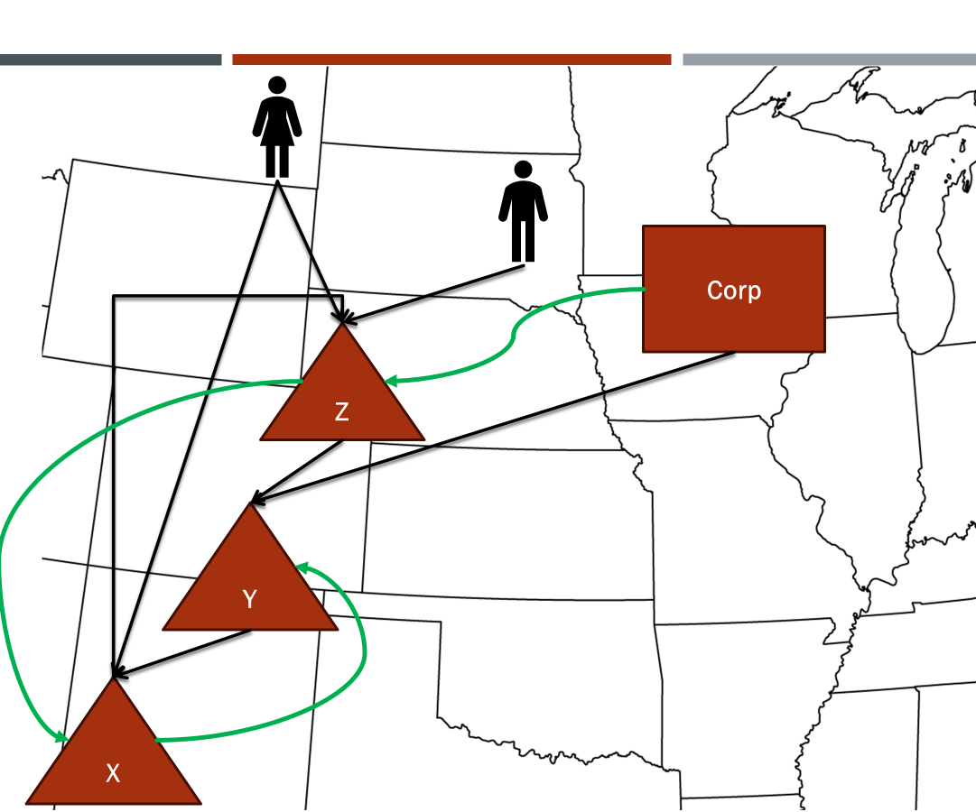
But of course It’s more complicated than that

Slide 16
How?
When?
KINDS OF QUESTIONS POSED BY BLENDED APPORTIONMENT

Slide 17
But First . . . Why?
Simple Example:
Assume:
State A has no income tax. State B has an income tax and requires combined filing.
Parent Corp and Sub-1 (a subsidiary) are domiciled in State A.
Parent Corp forms Sub-2 – also domiciled in State A.
Parent Corp and Sub-2 form a Partnership.
Partnership does business in State A and State B but all of its receipts - $10 million – are sourced to State B.
Partnership also pays an “administrative fee” to Sub-1 – reducing its income to $0 and creating receipts for Sub-1 that are sourced to State A.

Slide 18
Parent
$
Sub -1
Sub -2
Partnership
$
State B
State A

Slide 19
Results – No Blended Apportionment
Parent, Sub-1, and Sub-2 file a group return combining income and receipts.
Since Partnership has $0 income, the distributive share to Parent and Sub-2 is $0.
Sub-1 would include the administrative fee from Partnership in its income and receipts – but those receipts would be sourced to State A.
Assume the Group has $1 million in combined income and $10 million in receipts – all sourced to State A
Group would report $0 income to State B.

Slide 20
Results – WiTH Blended Apportionment
Parent, Sub-1, and Sub-2 file a group return combining income and receipts.
Since Partnership has $0 income, the distributive share to Parent and Sub-2 is $0.
Sub-1 would include the administrative fee from Partnership in its income and receipts – but those receipts would be sourced to State A.
Assume the Group has $1 million in combined income and $10 million in receipts – all sourced to State A.
BUT – the group would also include the partners’ share of Partnership receipts - $10 million – sourced to State B

Slide 21
Results – WITH Blended Apportionment (Cont’d)
Group’s Share of Partnership Factors Sourced to State B $10,000,000
Group’s Total Factors (including Partnership factors) $20,000,000
Apportionment Factor for State B 50%
Group’s Own Income $1,000,000
Group’s Income Apportioned to State B $500,000
So the group would report $500,000 in income to State B.
(But see also “Other How Questions” below.)

Slide 22
Is Blended apportionment the Answer?
Short Answer – We’re still in the early stages of evaluating that.
Longer Answer – There are a number of how and when questions. We believe that it will also be necessary to have anti-abuse rules and other detailed rules to support the sourcing of income in complex structures.

Slide 23
How Question Example
What is a partner’s “share” of partnership factors?
Use of blended apportionment requires that there be a rule for how partners determine their shares of the partnership factors.
In examining this issue—we also need to remember that a partner’s distributive share may include special allocations.

Slide 24
How do you Determine the Share of Factors?
Option 1: Ratio = Partner’s “Interest in the Partnership.”
IRS regulations under IRC Sec. 704(b) provide for the determination of a partner’s “interest in the partnership”
But this is a complex concept, does not necessarily equate with a partner’s share of capital, may be difficult to determine, and may also be subject to dispute.
Often there is not enough reported information on returns to make this determination.

Slide 25
How do you Determine the Share of Factors?
And what if –
A partner’s interest in the partnership is determined to be 10%.
The partner contributes property with a built-in gain and the partnership later sells the property recognizing that gain.
If, under Subchapter K rules, that built-in gain is required to be allocated 100% to the contributing partner, then should that partner’s share of factors somehow reflect this?

Slide 26
How Do you Determine the Share Of Factors?
Option 2: Ratio = Partner’s Capital to Total Partnership Capital
Following the determination of capital accounts under IRC Subchapter K and as reported on returns.
Note that capital accounts must be properly maintained and there are complex rules for doing so.

Slide 27
How do you Determine the Share Of Factors?
Example–
Corp Partner’s capital account is 50% of the partnership total capital.
Partnership has $10 million of receipts, 50% of which – or $5 million – are sourced to State X.
Corp Partner would include 50% of these State X receipts – or $2.5 million – in its State X receipts factor, along with its own State X receipts.

Slide 28
How do you Determine the Share Of Factors?
But what if–
While Corp Partner’s capital account is 50% of partnership capital, it has agreed with its partners that it will be allocated 80% of the partnership income.
In that case, does it make sense to only include 50% of the factors giving rise to that income?
Also – this approach has the same issue as Option 1 above.

Slide 29
How do you Determine the Share of Factors?
Option 3: Ratio = Partner’s Amount of Distributive Share to Total Partnership Income
Determine the partner’s distributive share from the partnership and compute the ratio to total partnership distributive share.
Will need to address how guaranteed payments may affect this calculation.

Slide 30
How do you Determine the Share of Factors?
Assume the same facts as in the what-if under Option 2 above –
Corp Partner is allocated 80% of partnership income.
Partnership has $10 million of receipts, 50% of which – or $5 million – are sourced to State X.
Corp Partner would include 80% of these State X receipts – or $4 million – in its State X receipts factor, along with its own State X receipts.

Slide 31
How do you Determine the Share Of Factors?
But what if–
Corp Partner has agreed with its partners that it will receive a special allocation of a particular type of loss.
In the tax year in which that loss occurs, the partnership has net income, but Corp Partner’s distributive share is a net loss.
Question—How do you determine the ratio of a negative number to a positive number?

Slide 32
How do you Determine the Share Of Factors?
Option 4: Ratio is Determined Using the Distributive Share Approach on a Per-Item Basis
The receipts from which the partner’s distributive share of an item is derived are attributed to the partner based on the distributive share of the related item.
So, in the example under Option 3 above, you would look through to the proceeds from the sale that resulted in the loss specially allocated to the partner and include those receipts in Corp Partner’s receipts factor.
Problem—doesn’t work great for property or payroll factors.

Slide 33
How do you Determine the Share Of Factors?
Option 5: Some Combination of the Other Options
Use a simpler approach in certain circumstances.
Use more complicated approaches when necessary.
For states that still use property and payroll factors—there may need to be special rules for those factors.

Slide 34
Other “How” Questions
What do you do with related party transactions?
Is there a need for state anti-abuse rules?
Example – special allocations that have no economic effect beyond changing the collective state tax that would otherwise be owed.
Example – intercompany transactions between tiered partners and partnerships or corporate partners in a corporate group that may shift income.
Example – using partnerships to shift the sourcing of built-in gains from one state to another.
How do these sourcing rules impact withholding, composite returns, and PTE taxes?

Slide 35
And then the When Questions
When should blended apportionment be applied?
Are there limits on the use of blended apportionment?

Slide 36
Coming “soon”
in-person partnership training – January 13-15, 2025 in New Orleans
We will be asking for input on issues to be covered

