Slide 1
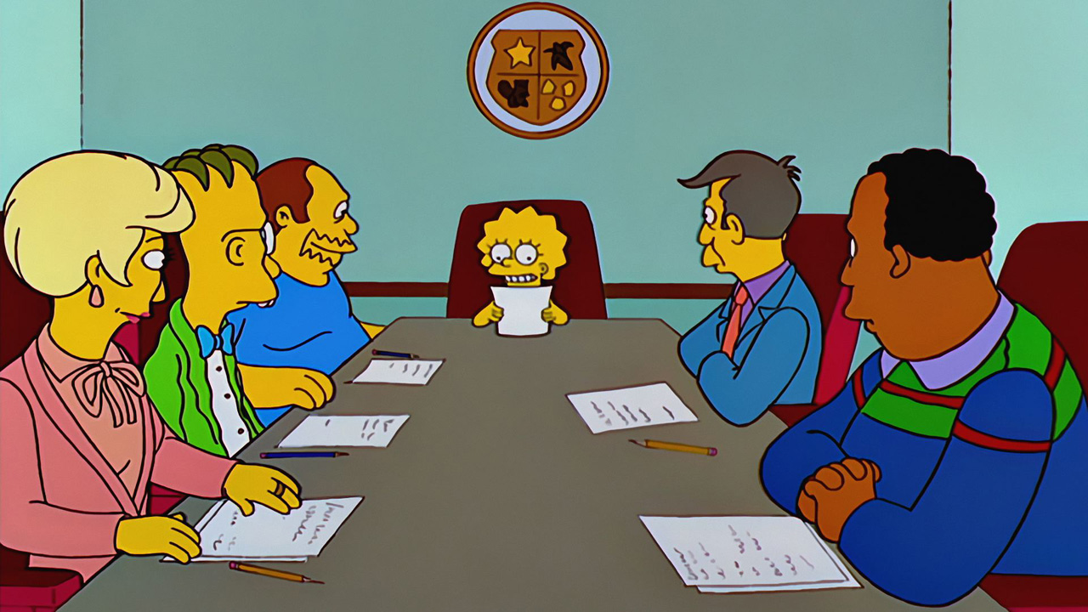
Making the Most of Meetings
Ray Langenberg, Special Counsel for Tax Litigation, Texas Comptroller

Slide 2
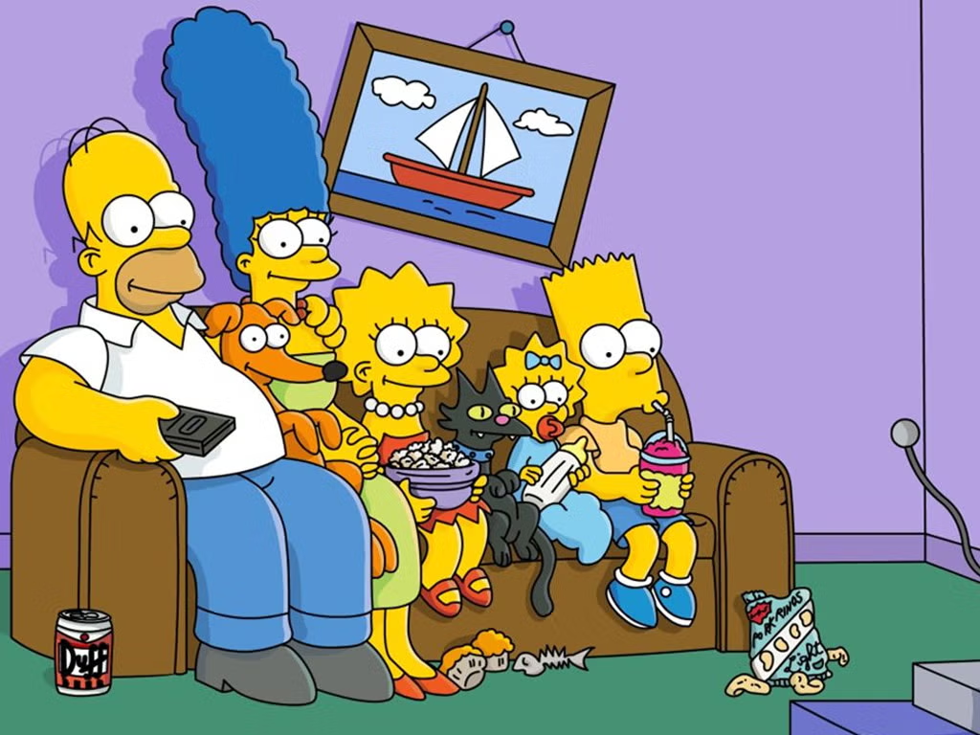
Tips for Leaders
1. Develop a reputation for punctuality.

Slide 3
Tips for Leaders
2. Develop a reputation for a one-hour time limit.

Slide 4
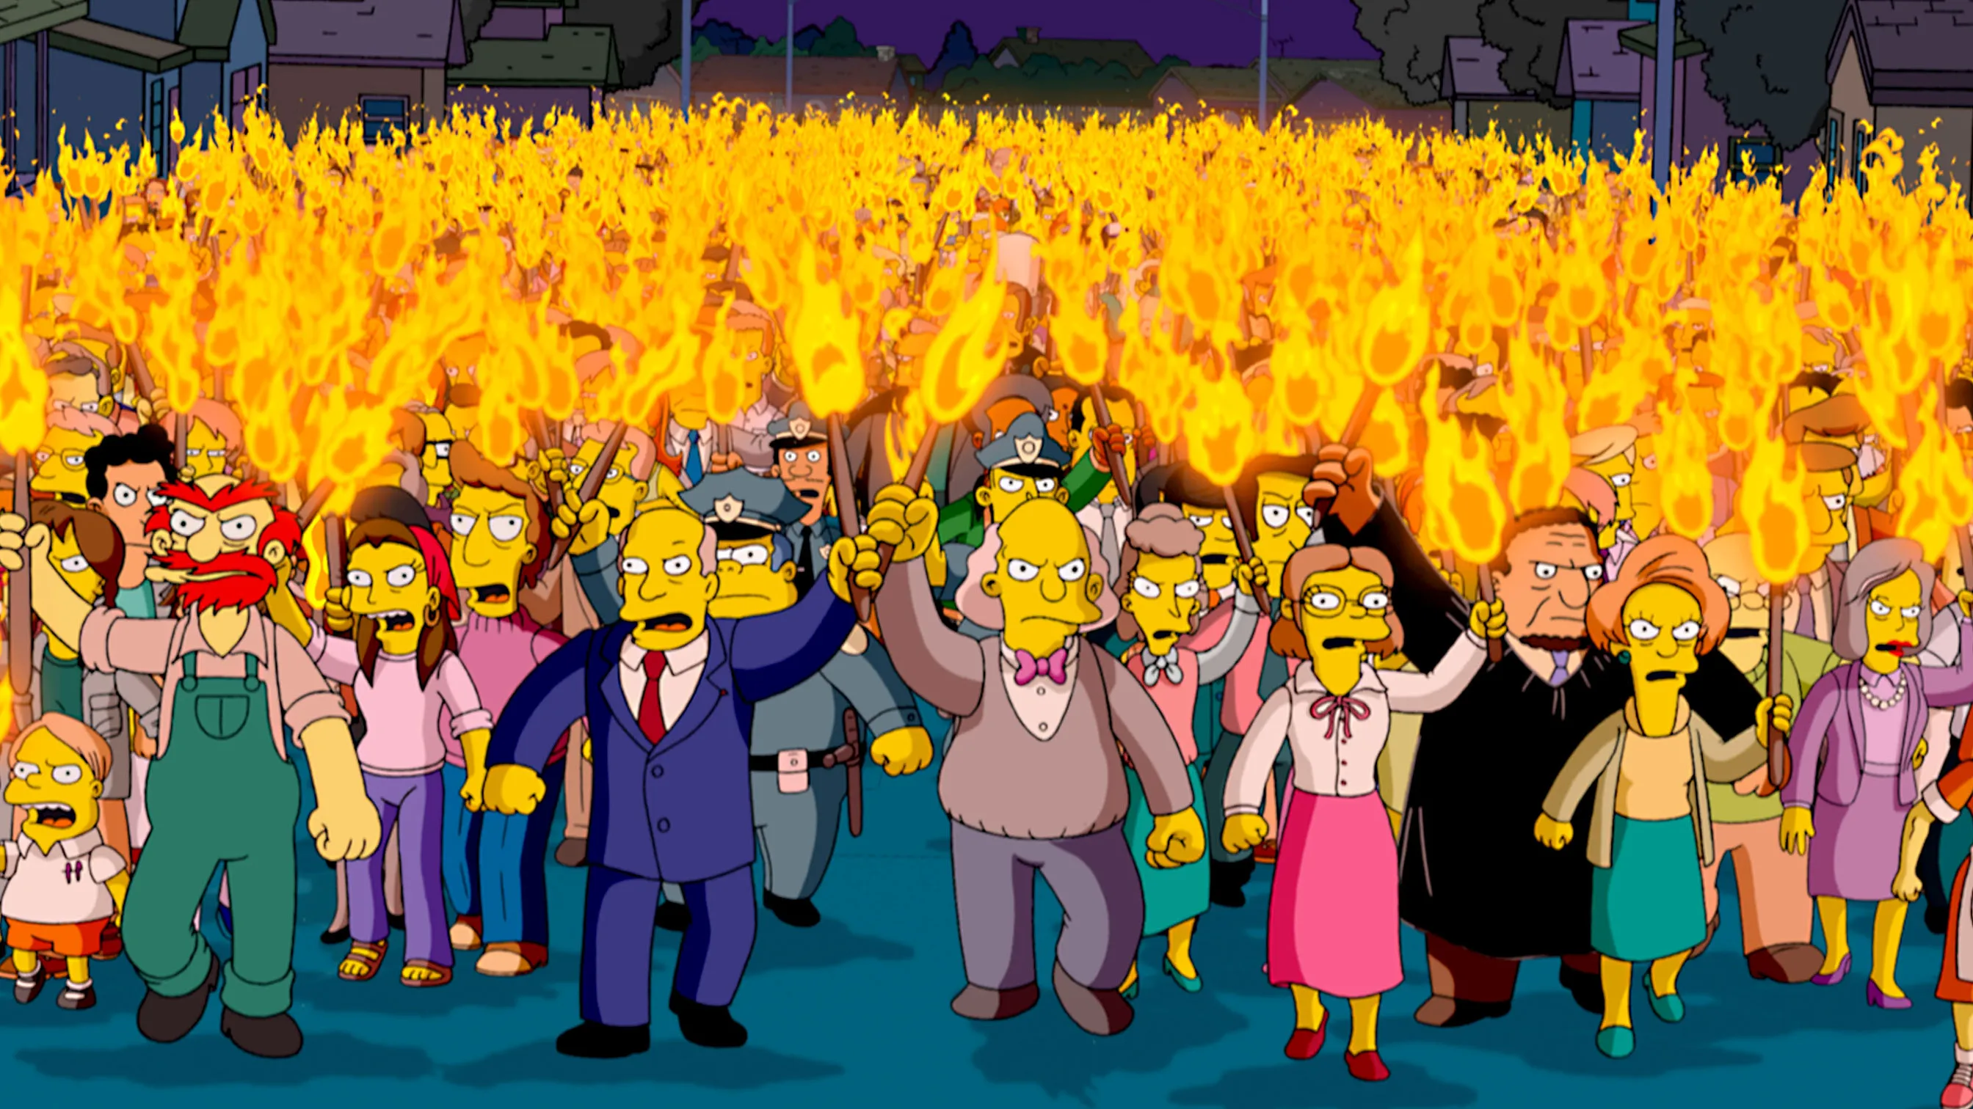
Tips for Leaders
3. Engage everyone if you can.

Slide 5
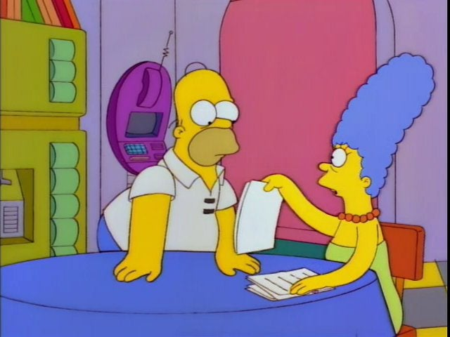
Tips for Leaders
4. End with momentum –
decisions, next steps, assignments.

Slide 6
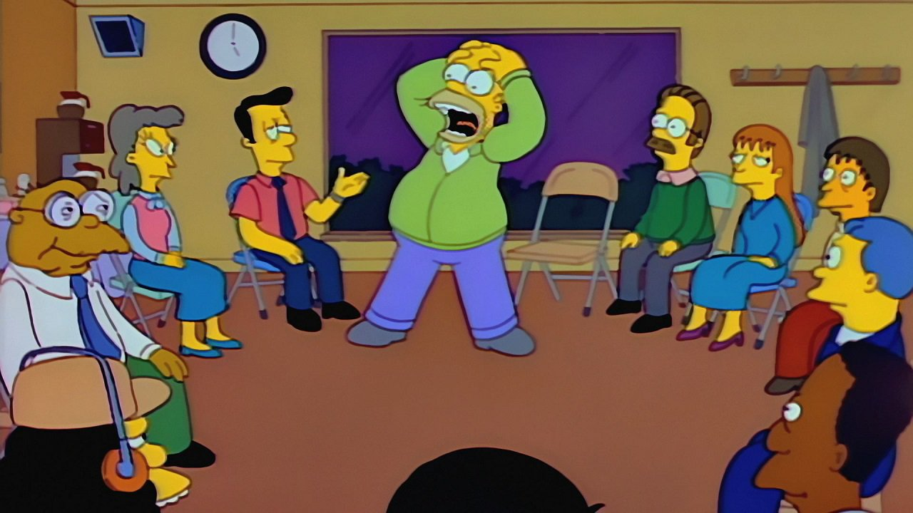
Tips for Participants
1. Start the meeting before the meeting.

Slide 7
Tips for Participants
2. WWID – What would I do?

Slide 8
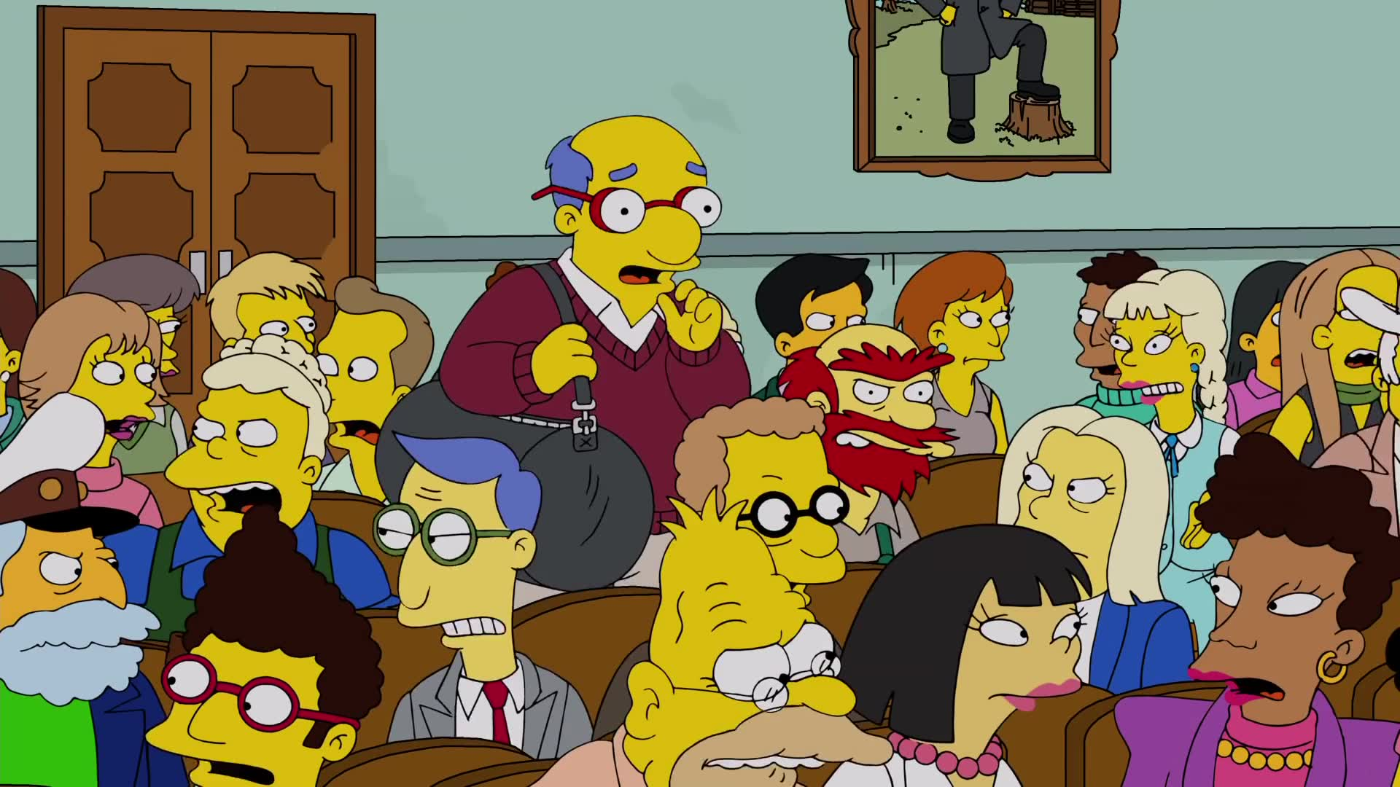
Tips for Participants
3. Nobody cares about what you think
unless they care about what you think.

Slide 9
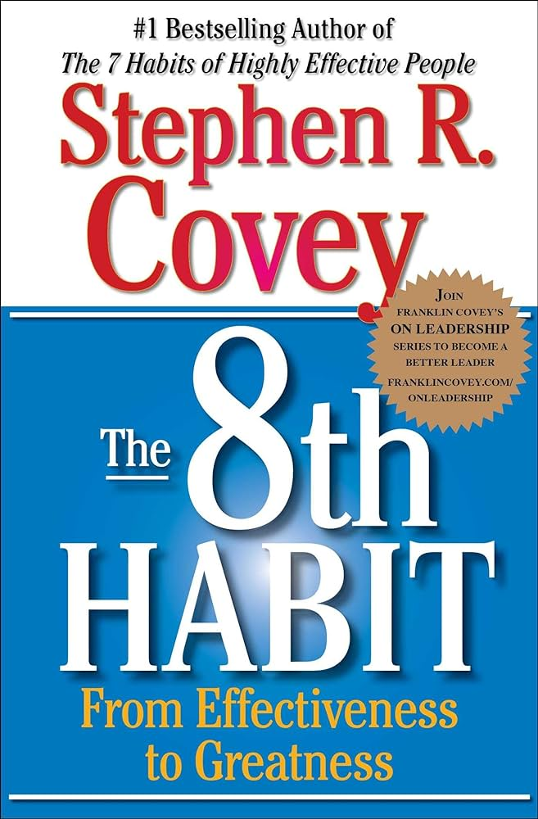
Tips for Participants
Nobody cares about what you think
unless they care about what you think.
Be proactive.
Begin with the end in mind.
Put first things first.
Think win/win.
Seek first to understand, then to be understood.
Synergize.
Sharpen the saw.
Find your voice and inspire others to find their voice.

Slide 10
Tips for Participants
4. Read Chapter 7 – The Voice of Influence
Ethos – Exceed expectations
Pathos – Seek first to understand
Logos – Then to be understood

Slide 11
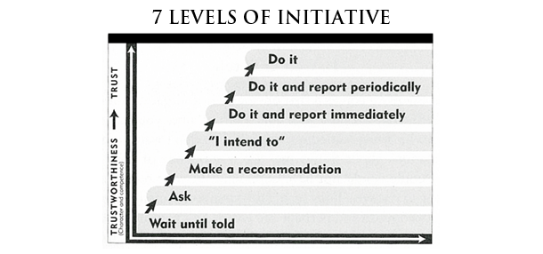
Tips for Participants
4. Read Chapter 7 – The Voice of Influence

Slide 12
Tip for Leaders and Participants
Try to find joy in your endeavors.

