Slide 1

Uniformity Committee Meeting
April 30, 2024
Kansas City, Missouri

Slide 2


Join at slido.com
#1493195
ⓘ Start presenting to display the joining instructions on this slide.

Slide 3
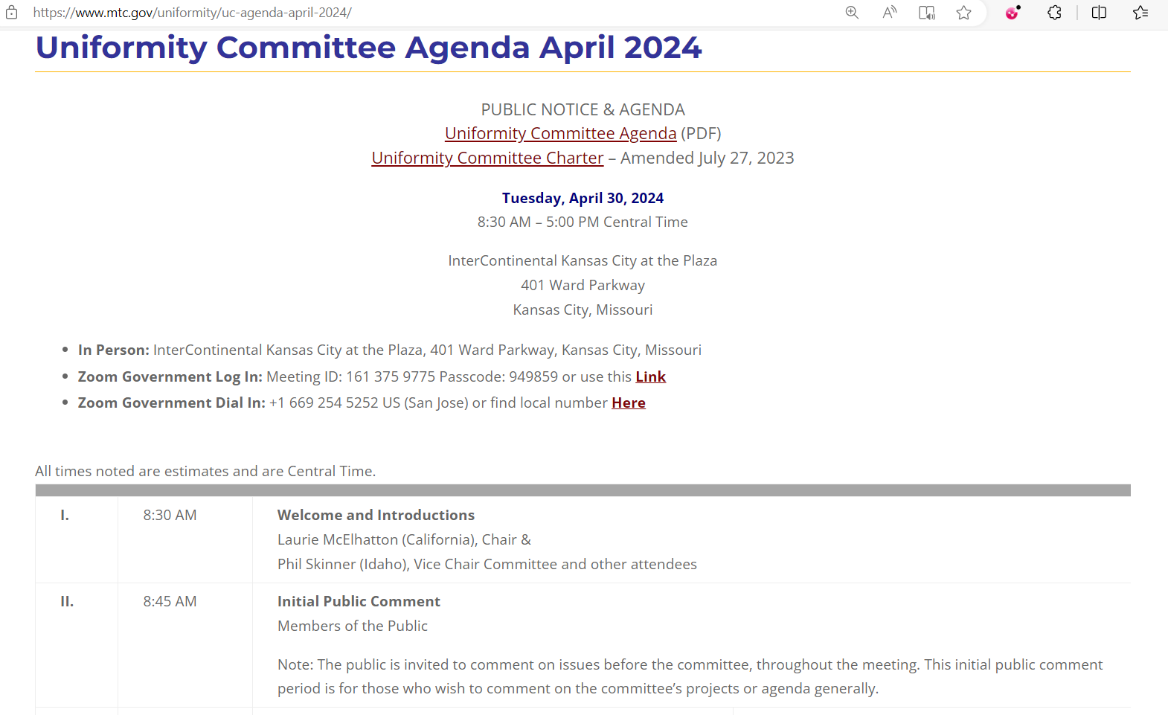

Slide 4
Welcome & Introductions
Laurie McElhatton (California) – Chair
Phil Skinner (Idaho) – Vice Chair

Slide 5
Polling Question
Which category best fits you?
  This is my first MTC Uniformity Committee meeting.
  I’ve been to a few recent Uniformity Committee meetings.
  I’ve been coming to most Uniformity Committee meetings for several years.
  I’ve been to at least 50 Uniformity Committee meetings.

Slide 6

Which category best fits you?
ⓘ Start presenting to display the poll results on this slide.

Slide 7
Our Process - Generally
The committee was established to work on issues involving uniform or compatible state tax laws for taxpayers with multistate income or activities.
MTC Website has more information on the Uniformity Tab.
The committee uses work groups to study issues and make draft proposals—which the committee reviews.

Slide 8
Our Process - Generally
This initial study and drafting process is fairly informal.
We appreciate input from the public and no one is required to disclose whether they are representing themselves or particular clients.
During this process, state participants speak for themselves, unless they indicate otherwise, and not officially for their states.

Slide 9
Our Process - Generally
Before the committee makes any recommendation to the Executive Committee, there will be a more formal review, discussion, and vote.
Before the Executive Committee recommends any proposal to the Commission, there will be additional review, a formal hearing, and additional votes—as well as a poll of the states.
Our process is also about information sharing and education of administrators and policymakers.

Slide 10
Initial Public Comment
Note: The public is invited to comment
on issues before the committee
throughout the meeting.
This initial public comment period
is for those who wish to comment on the
committee’s projects or agenda generally.

Slide 11
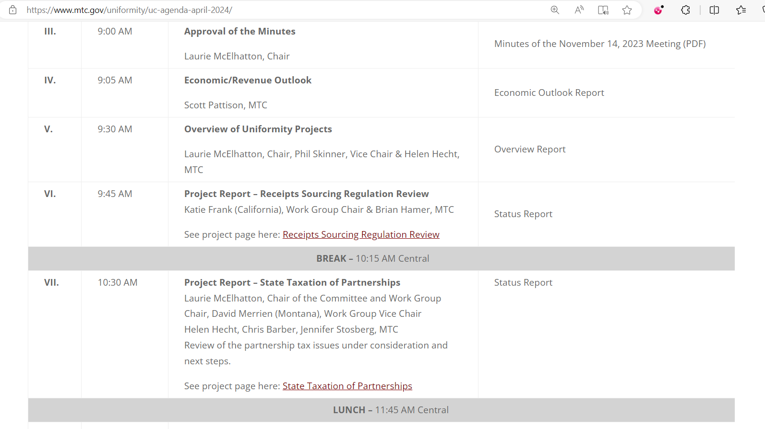

Slide 12
Approval of the Minutes

Slide 13
Approval of the Minutes

Slide 14
Approval of the Minutes
State Roundtable
States were asked to give brief updates on developments in their state that might be of interest to others.
New Business
There was no new business.
Adjourn
Attendees – In Person and Remote
Daniel Anolik
Phillip Ashley
William Barber
Carol Bell
Beth Berniker
Karolyn Bishop
Paul Blascovich
Michael Bologna
Krystal Bolton
Shannon Brandt
Michael Branton
Gil Brewer
Derrick Coleman
Holly Coon
Richard Cram
Charles Dendy
Lila Disque
Nikki Dobay
James Douglas
Jessie Eisenmenger
Cathy Felix
John Ficara
Bruce Fort
Katie Frank
Karl Frieden
Jeff Friedman
Kelsey Gallacher
Vicki Gardino
Stacey Greaud
John Grochala
Frank Hales
Brian Hamer
Amy Hamilton
Greg Harris
Helen Hecht
Eileen Henderson
Amber Herman
Angie Hillas
Debra Houck
Craig Johnson
Hal Jones
Bryan Kelly
Robert Kindred
Kurt Konek
Olga Kourdova
Jorie Krumpfer
Ray Langenberg
Matthew Largent
Elizabeth Lipari-Walsh
Katie Lolley
Michelle Lombardi
Michael Lucas
Anne Mangiardi
Angela Matelski
Laurie McElhatton
Julio Mendoza-Quiroz
David Merrien
Teresa Miller
John Mollenkamp
Kathy Mui
Patrick Nana-Adjei
Valerie Newson
Argi O'Leary
Brian Oliner
Amber Ortiz
maryanna paolinie
Scott Pattison
Josh Pens
Matthew Peyerl
Janee Pousson Garcia
Nancy Prosser
Amy Quam Skinner
Scott Reed
Brendon Reese
Nicholas Reich
Will Rice
Shelley Robinson
Joseph Royston
John Sagaser
Timothy Sanders
Miranda Scroggins
Tom Shaner
Allison Sheppard
larry shinder
Kristen Shogren
Jeffrey Silver
Marc Simonetti
Kasey Skidmore
Brian Smith
Mitchell Smith
Kathy Smith
Nicholas Souza
Jenn Stosberg
Delinda Tamagni
Craig Toncic
Rebecca Turner
Esther van Mourik
Deborah Van Wyke
John Vecchiarelli
Mark Wainwright
Donnita Wald
Jonathan White
Ted Wiatr
Paul Williams
Michael Williams
Steve Yang

Slide 15
Polling Question
Predictions for 2025 –
  How do you rank the following global or national tax-related issues in terms of their importance for policymakers in 2025?
  [5 = very important to 1 = not important]
    The OECD Pillar 2 minimum tax proposal
    The Provisions of TCJA that will expire (including the SALT cap)
    The need for the federal government to increase revenues
    Growing use of digital ad taxes globally

Slide 16

How do you rank the following global or national tax-related issues in terms of their importance for policymakers in 2025? [5 = very important to 1 = not important]
ⓘ Start presenting to display the poll results on this slide.

Slide 17
Economic / Revenue Outlook
Scott Pattison
Deputy Executive Director, MTC

Slide 18
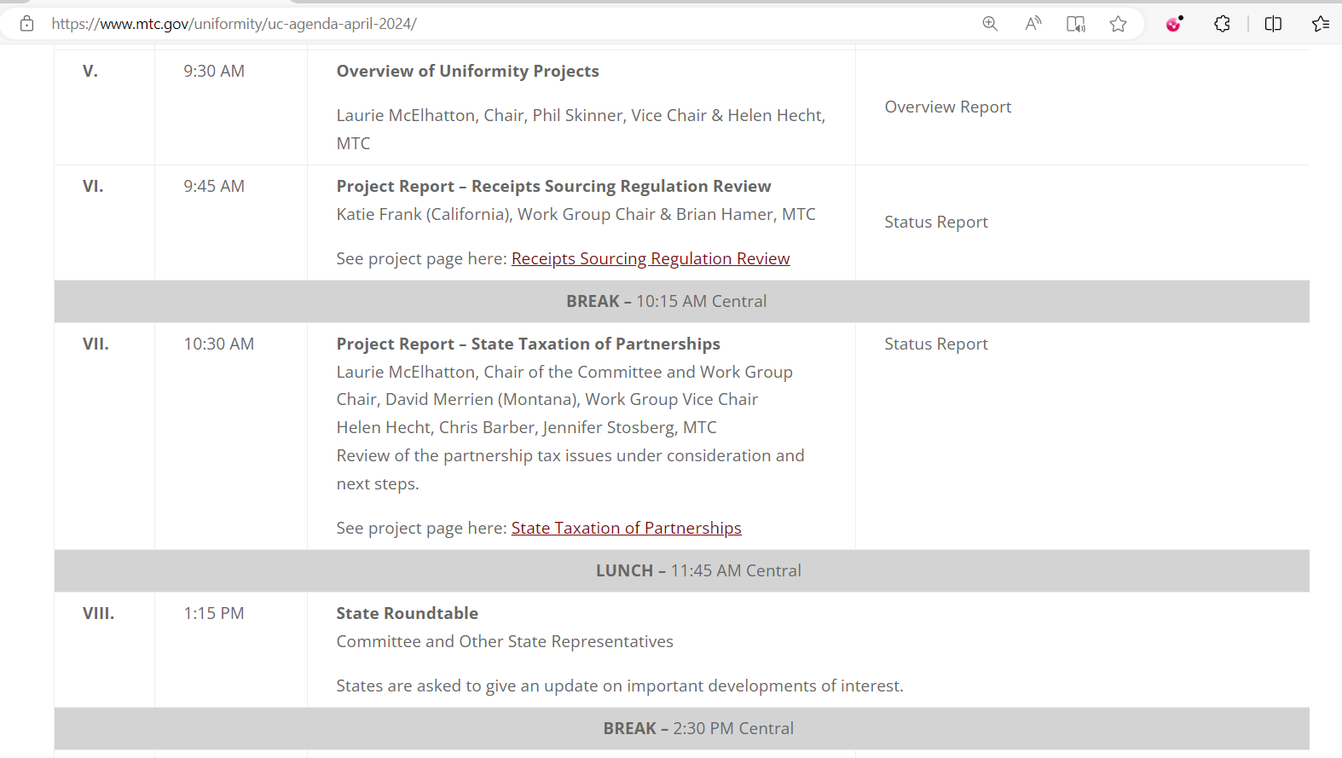

Slide 19
Overview of Uniformity Projects
Laurie McElhatton, Chair
Phil Skinner, Vice Chair
Helen Hecht, MTC

Slide 20
Overview of Uniformity Projects
Three big projects:
  Review Receipts Sourcing Regulations
  Sales Taxation of Digital Products
  Taxation of Partnerships

Slide 21
Overview of Uniformity Projects
Challenges:
  Capturing the research, analysis, and discussion as the project goes along and making that information available so states can use it.
  Handling the complexity—dealing with the issues at the right level and helping participants better understand those issues.
  Making sure we’re spending our time on the right things.

Slide 22
Overview of Uniformity Projects
Looking for Input:
  How the process could be improved—work groups, committee meetings, etc.
  What additional information might be useful.
  What’s most important or needs to be addressed first.

Slide 23
Polling Question
The current projects require setting the right balance between research and study versus crafting specific recommendations or proposals. Give us your general sense (if you have one) of whether we’re finding the right balance on each project.
[1 = too much research and study (moving too slow),
2 = not enough research and study (moving too fast), or
3 = good balance generally.]

Slide 24
State Taxation of Partnerships
ⓘ Start presenting to display the poll results on this slide.

Slide 25
Model Receipts Sourcing Regulation Review Work Group
ⓘ Start presenting to display the poll results on this slide.

Slide 26
State Tax on Digital Products
ⓘ Start presenting to display the poll results on this slide.

Slide 27
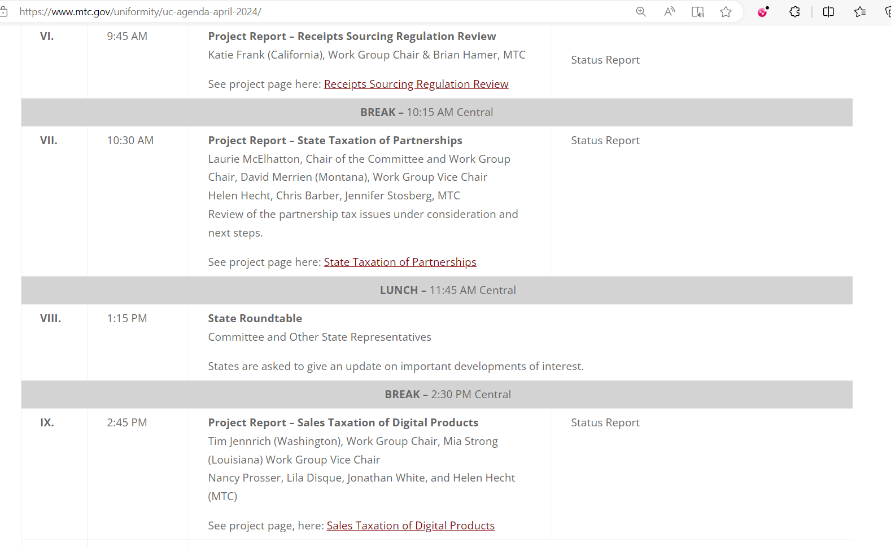

Slide 28
Project Reports & Agenda Items

Slide 29
New Business
During this portion of the committee agenda, we take comments on possible new projects or other topics for discussion.

Slide 30
Wrap-Up
Before we break for the day – a couple reminders.
  MTC website contains much more information on the projects – on the project pages as well as other information.

Slide 31
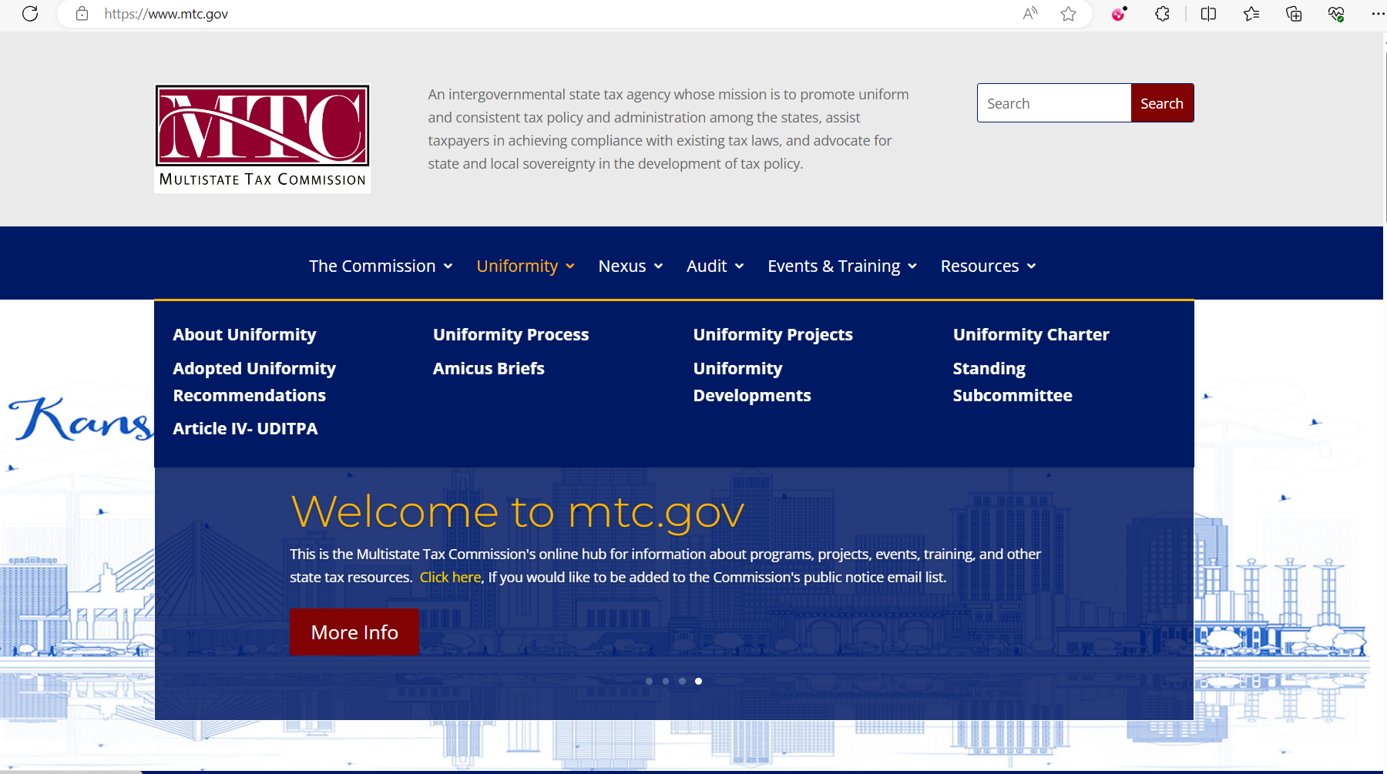

Slide 32
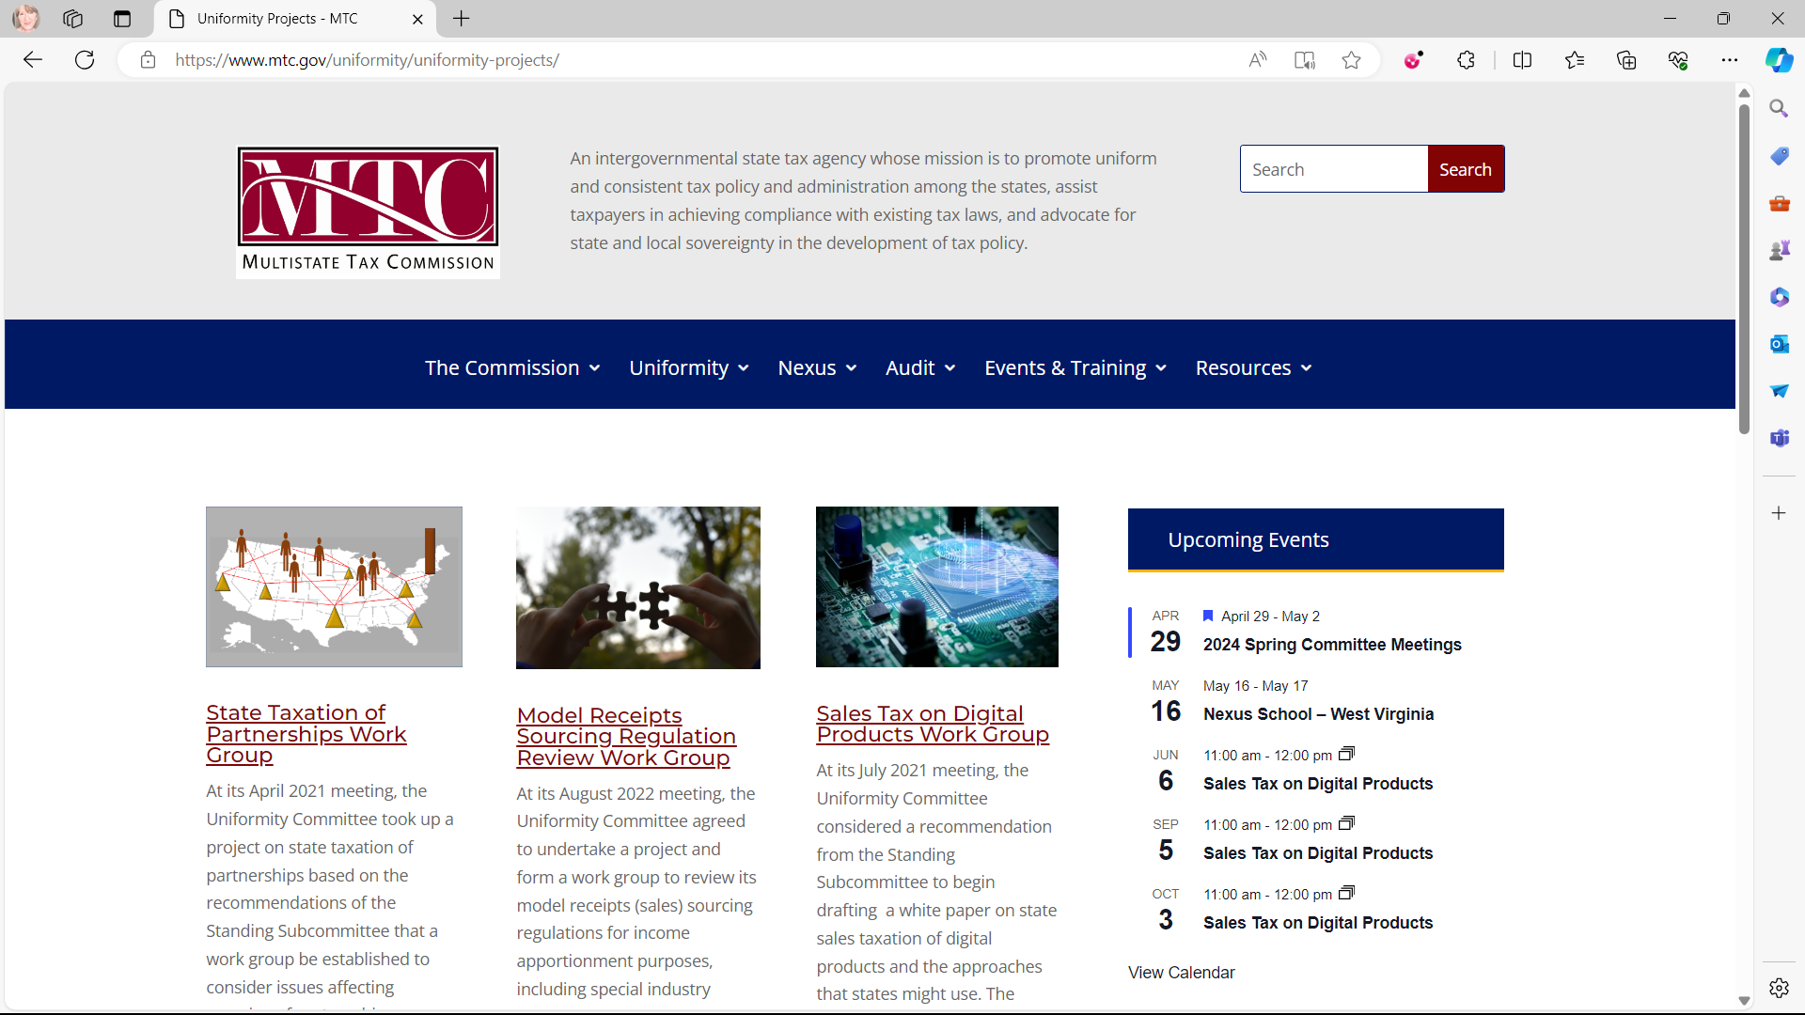

Slide 33
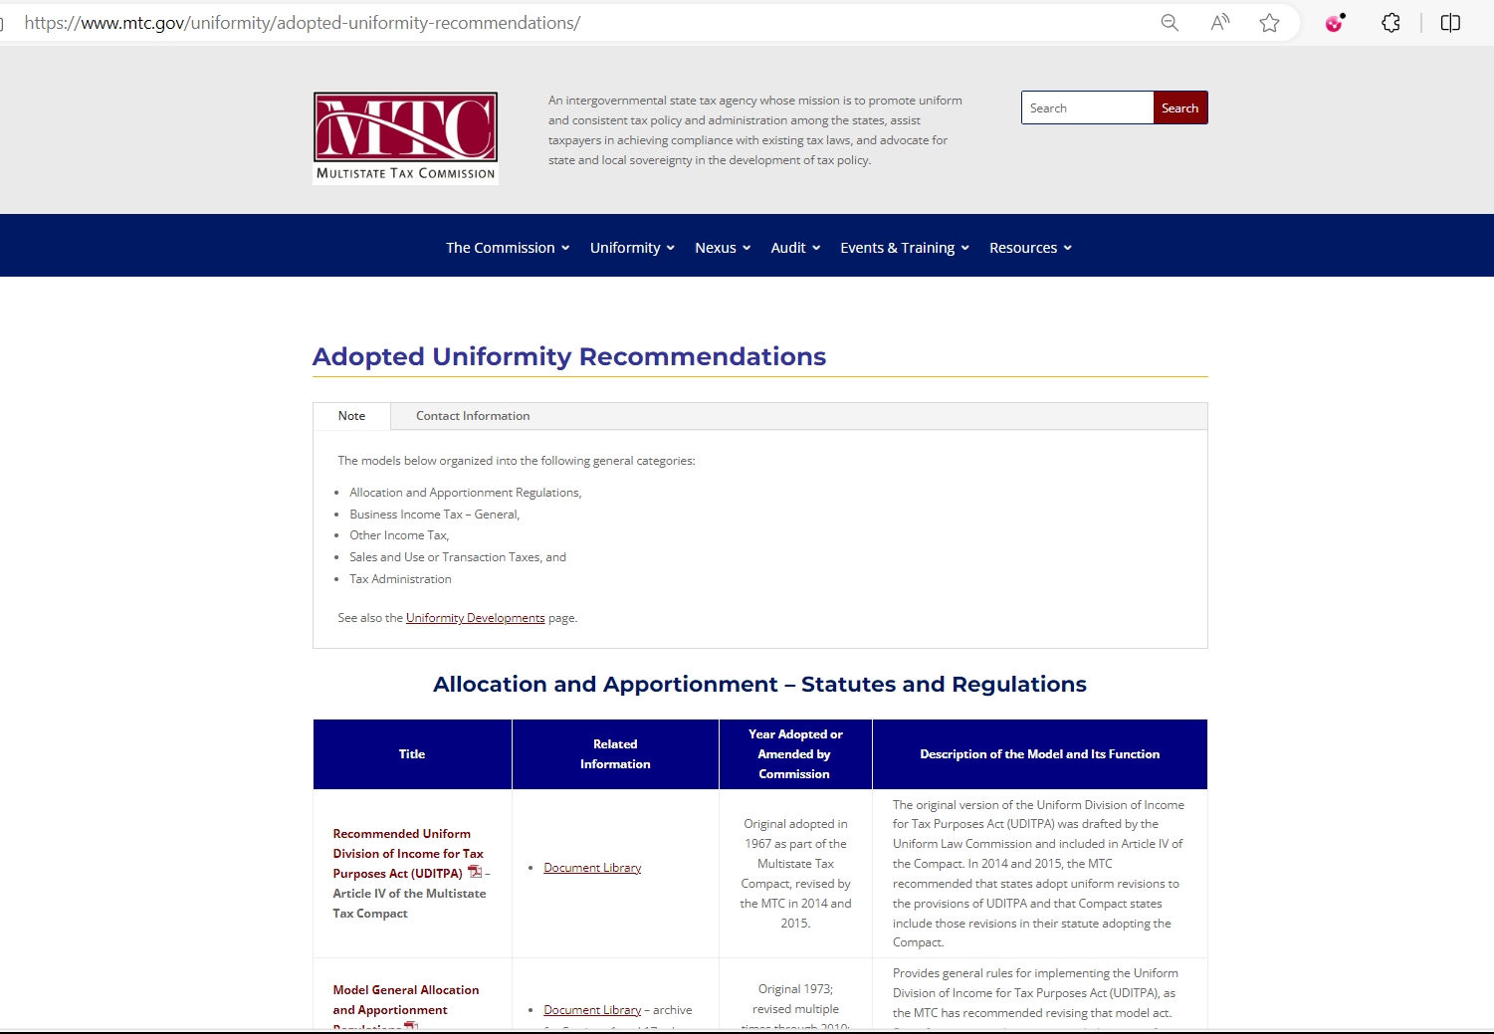

Slide 34
Wrap-Up
Also –
  Next in-person meetings will be:
    Annual MTC Commission and Committee Meetings
    July 29 - August 1, 2024, Denver, CO
    Fall MTC Committee Meetings
    November 18-23, 2024, Sante Fe, NM
  If you want to make sure you get information on the committee and its work groups – contact Helen Hecht at hhecht@MTC.gov.

Slide 35
Adjourn
And thank you for all you do.

