Slide 1
Sales Tax on Digital Products Uniformity Project
Tim Jennrich, Wa, Work Group Chair
Mia Strong, La, Work Group Vice-Chair
Report to the Uniformity Committee
April 30, 2024

Slide 2
Join at slido.com #1493195
ⓘ Start presenting to display the joining instructions on this slide.

Slide 3
Agenda
Introductory remarks from the work group Chair and Vice-Chair (Polling Question 1)
Webpage resources & whitepaper outline
Project scope recap & guiding principles (PQ 2 and 3)
Working with the Streamlined states, FTA, and NCSL (PQ 4)
What we have studied and achieved so far – refresh on business inputs research (PQ 5)
Current project updates (PQ 6 and 7)
Trends and developments in the taxation of digital products (PQ 8)
Final thoughts for the uniformity committee or work group (PQ 9)
Appendix materials

Slide 4
Thanks to our Regular Work Group Members
Chair: Tim Jennrich – Washington Vice Chair: Mia Strong – Louisiana Josh Pens – Colorado Olufemi Obikoyai – DC Jordan Heller – Kansas Richard Dobson – Kentucky Ben Grossman – Maryland Michael Fox – Maryland Michael Fatale – Massachusetts John Haidamous – Michigan Mark Chaiken – New Mexico | Charles Dendy – North Dakota Victoria Johnson – Oregon Alison Jares – South Dakota Shannon Brandt – Texas Ray Langenberg – Texas Frank Hales – Utah Shelley Robinson – Utah Emily Cramer – West Virginia Michael Hardtke – Wisconsin Tracey Mueller – Wisconsin
Ex officio members: Craig Johnson and Christie Comanita, SST Staff

Slide 5
What best describes your profession?
ⓘ Start presenting to display the poll results on this slide.

Slide 6
Update on webpage and whitepaper outline
New Webpage Layout and Functionality
Outline updates:
Addition of business inputs summary
Addition of ITFA materials

Slide 7
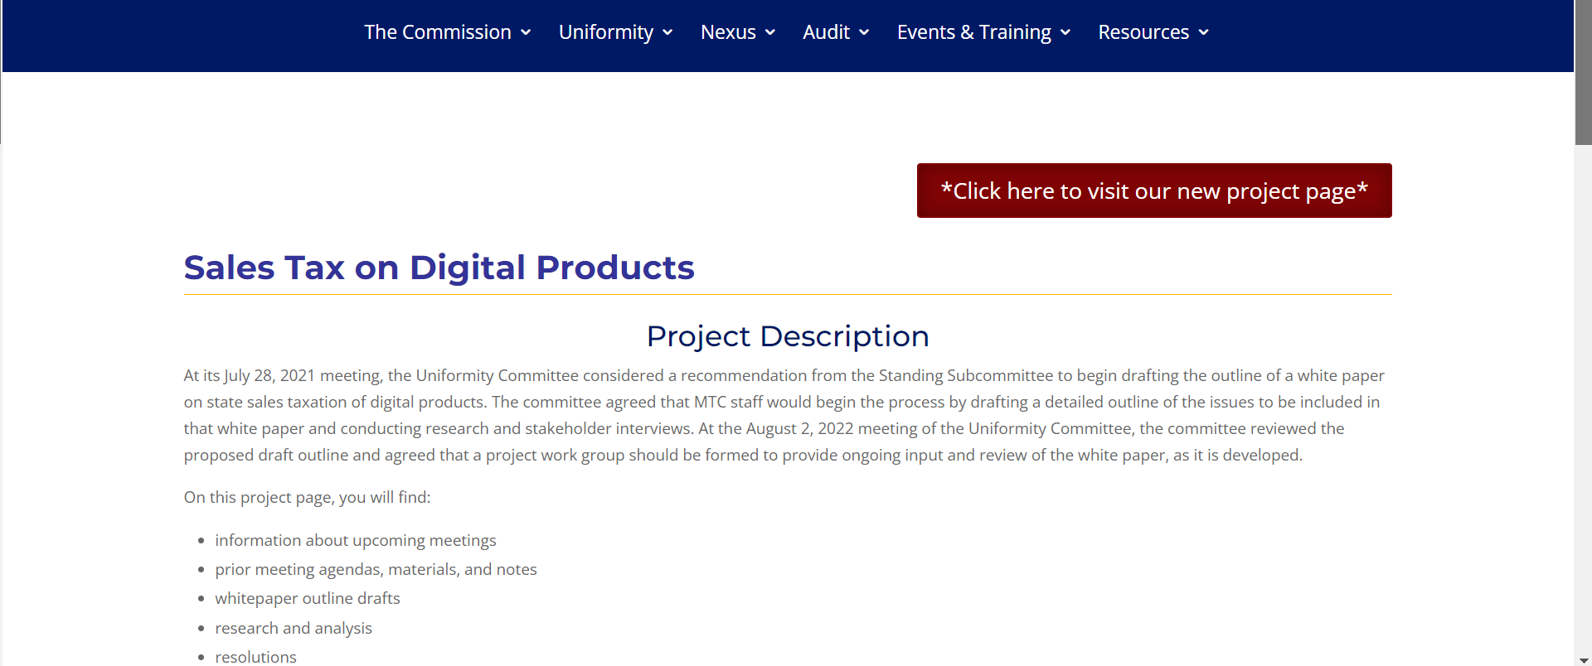
New Webpage

Slide 8
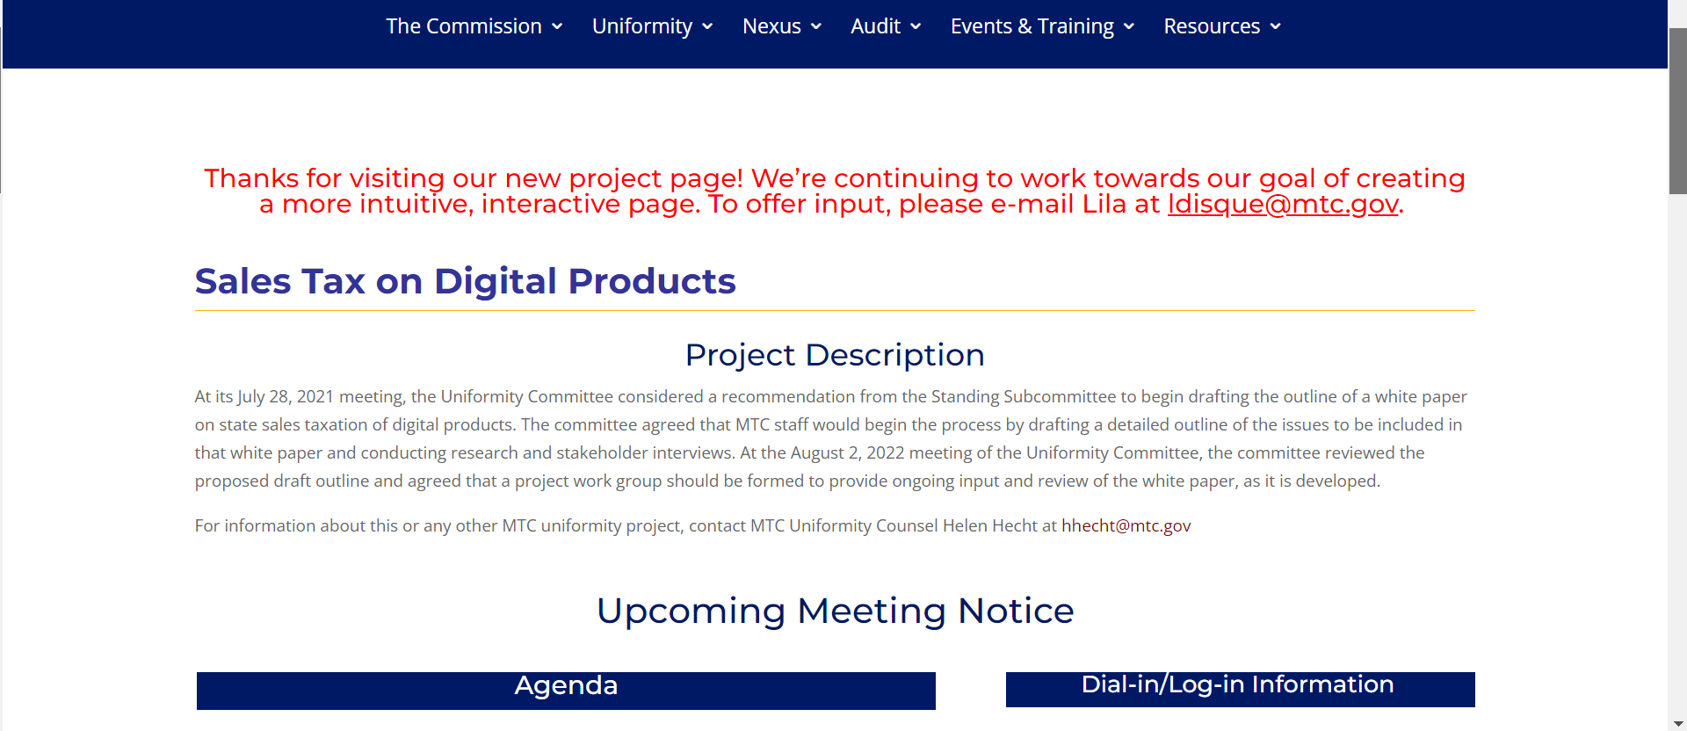
New Webpage

Slide 9
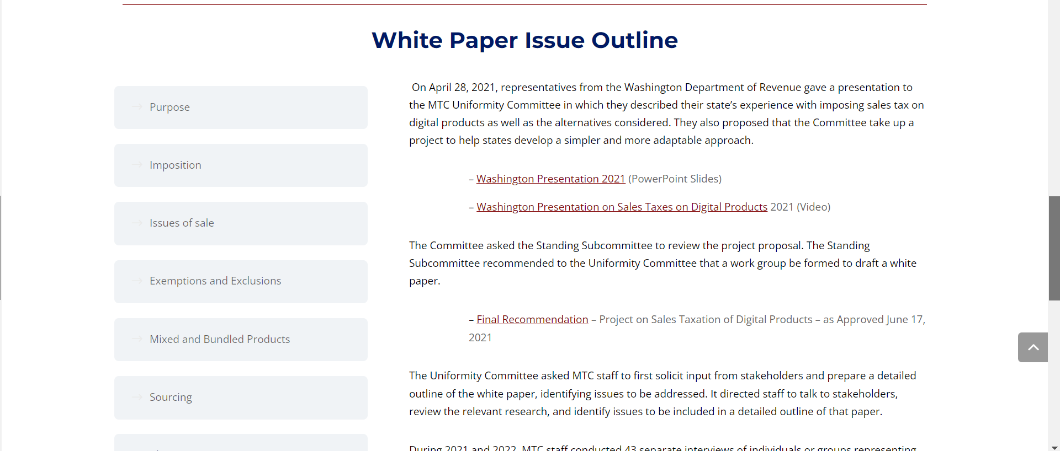
Update on webpage and whitepaper outline
New Webpage

Slide 10
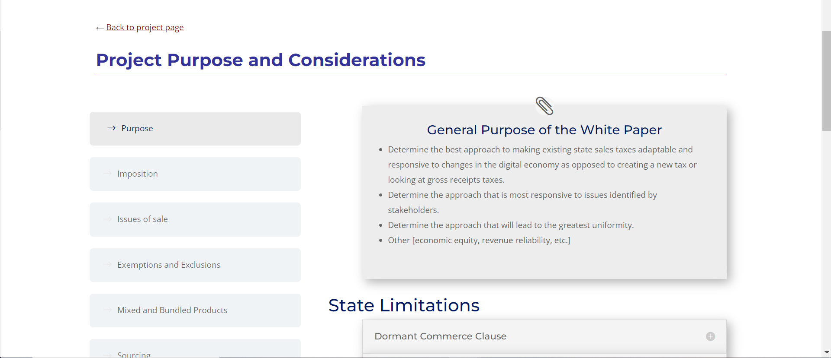
Update on webpage and whitepaper outline
New Webpage

Slide 11
Update on webpage and whitepaper outline
New Webpage

Slide 12
Project Scope
The MTC Uniformity Committee Requested a Whitepaper with this Information:
A general survey and description of the kinds of digital products currently offered in the marketplace and the nature of the transactions through which those digital products may be provided to customers;
A general survey of academic research or other analysis on policy reasons for including digital products in (or excluding them from) the sales tax base;
A review and summary of general information on the specific types of digital products that states currently tax (which information is available from different sources, including Streamlined);
Analysis of the extent to which mixed or bundled products (including nondigital services and intangibles) may create issues for taxing digital products;
A summary of sourcing issues and common approaches to sourcing digital products, including multiple points of use; and
Analysis of the ways that digital products might be defined, categorized, exempted, and sourced.

Slide 13
Is the project scope still appropriate? If not, what should change?
ⓘ Start presenting to display the poll results on this slide.

Slide 14
Possible Guiding Principles
Tax all retail sales by default.
Encourage a system that is simple, easy to administer, and transparent.
Favor either clear and specific definitions or broad definitions with clear and specific exemptions, when appropriate.
Do not treat digital products as tangible personal property.
Avoid distinguishing products based on the manner they are transferred.
Distinguish products based on how they are produced and what is produced.
Source digital products based on where the products are used/their destination.
Exempt business inputs.
Exempt products based on who they are sold to, e.g., sold to nonprofits, sold to businesses.

Slide 15
Are these guiding principles appropriate? If not, what should change or what are we missing?
ⓘ Start presenting to display the poll results on this slide.

Slide 16
Working with Streamlined States, FTA, and NCSL
SST and MTC adopted a joint resolution in 2023
Federation of Tax Administrators adopted related 2023 resolution
MTC is a “friend” of the NCSL SALT Task Force

Slide 17
Any thoughts about how the MTC could work more collaboratively with the Streamlined states, FTA, and NCSL?
ⓘ Start presenting to display the poll results on this slide.

Slide 18
What We Have Studied And Achieved So Far
Definitions
Items that exist in the marketplace
Review of the Streamlined Agreement
Analysis of business inputs
Survey of digital products taxed by states
Analysis of approaches states use to tax digital products
Internet Tax Freedom Act
Bundling

Slide 19
Summary of Business Inputs (Pyramiding) Research
Experts are split: “avoid pyramiding at all costs” to “it costs too much revenue not to pyramid tax on some items,” and suggestions for a middle ground.
The severity of pyramiding depends on the facts and circumstances.
Taxing digital business inputs can impose tax on industries that have historically been tax favored.
Exempting digital business inputs will be costly if done after the tax base includes them.
Consider pyramiding issues when expanding the tax base to include digital products.
Exempting business inputs via legislation can be complicated or simple.
Anti-pyramiding efforts should be weighed against tax administration pros and cons.

Slide 20
Is the MTC missing anything with respect to the taxation of business inputs and digital products? If so, what else needs to be studied?
ⓘ Start presenting to display the poll results on this slide.

Slide 21
Current Project: Digital tax base spreadsheet
It’s not the “how” but what the states tax now (i.e., the tax base)
What products have states deemed appropriate for sales taxation
Updates: ongoing as staff track developments
Expansion: on hold, see bundling

Slide 22
What does the spreadsheet cover?
ⓘ Start presenting to display the poll results on this slide.

Slide 23
Current Project: Three Approaches Matrix
This is the “how”
Not the tax base
The Matrix addresses three approaches to developing a sales tax base and the interaction of those three approaches with various aspects of tax administration
Content – based on the best efforts of MTC staff as well as the input of many work group members
Conversion – conversion to prose for communication to work group members and potential white paper entry

Slide 24
What does the matrix cover?
ⓘ Start presenting to display the poll results on this slide.

Slide 25
Current Project: Internet Tax Freedom Act (ITFA)
Research ongoing but nearing the end of the road
Staff are prepared for when work group determines to address ITFA
Annotated ITFA – staff are creating an annotated ITFA statute using the research that has been done

Slide 26
Current Project: Bundling
State-by-state research on bundling and true object test
Deep and detailed scope
Large scale assignment, no substantive update at this time
Stakeholder sessions with non-tax agency staff have started

Slide 27
Trends and developments in the Taxation of Digital Products
Internationally there is a trend to adopt digital services taxes or DSTs.
This trend has been delayed in response to Pillar 1, which would use formulary apportionment to tax certain excess income of large companies deemed to be from digital services.
The federal government is considering how Pillar 1, versus DSTs, will affect the domestic economy and tax revenues.
States are . . .
Considering expansion of the sales tax bases.
Considering stand-alone DSTs including digital ad taxes.

Slide 28
Related Developments -International-
OECD – Pillar 1 and DSTs
Goals:
Address the use of digital and intangible assets to shift income.
Avoid adoption of digital services taxes – or DSTs.
Approach:
Determine excess profits for certain large multinationals.
Apportion using a single receipts factor & market-based sourcing.
Coordinate this with all the other international tax rules.
Status:
The OECD efforts have been delayed.
Other countries are considering digital taxes.
The U.S. is now studying the effect on the domestic economy and tax revenues.

Slide 29
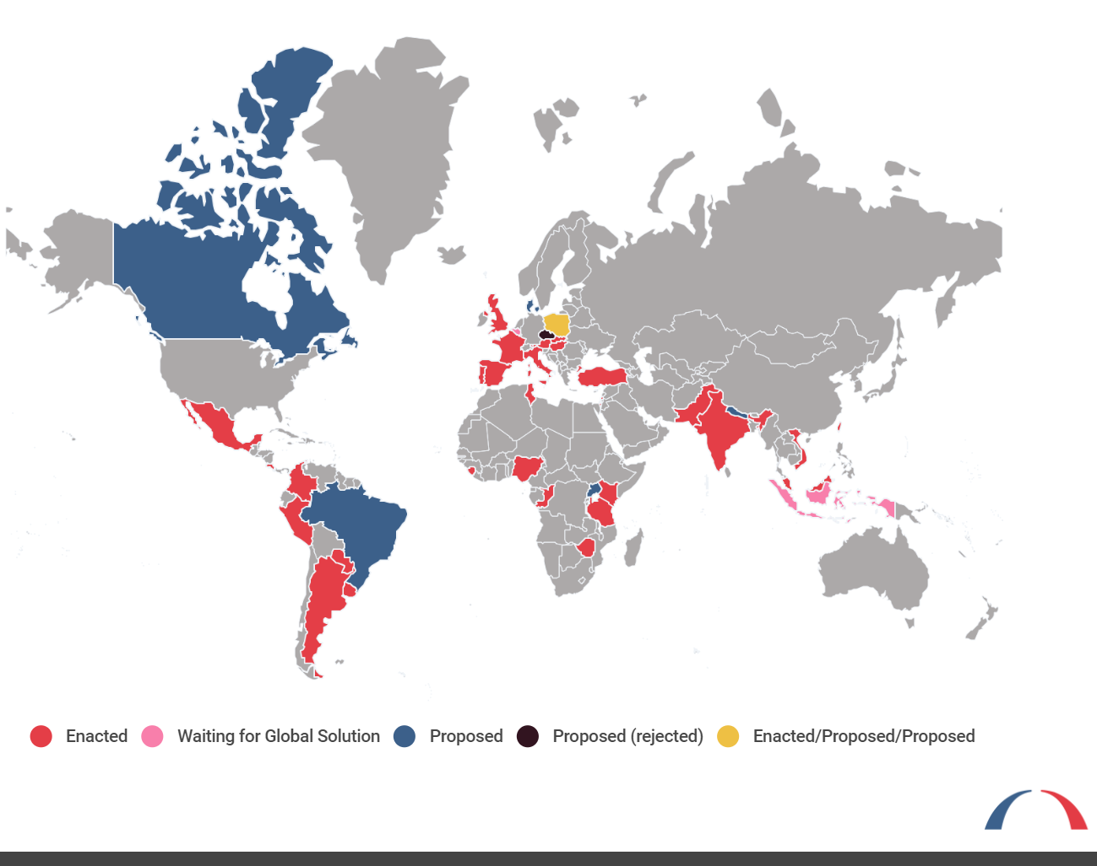
Related Developments -international-
Other Countries - DSTs
The Bi-Partisan Policy Center:
Tracking the enactment or proposal of DSTs – some of which may take effect if Pillar 1 fails, and others would be withdrawn if it succeeds.

Slide 30
Related Developments -International-
Other Resources on International Developments
Report of the International Monetary Fund - Exploring the Adoption of Selected Digital Technologies in Tax Administration: A Cross-Country Perspective (Dec, 2023), https://www.elibrary.imf.org/view/journals/068/2023/008/article-A001-en.xml
Report to the UK House of Commons – Digital Services Tax, https://commonslibrary.parliament.uk/research-briefings/cbp-8719/
Big 4 Accounting Firms:
KPMG – Taxation of the Digital Economy - https://kpmg.com/us/en/home/insights/2019/06/tnf-digital-economy0.html
PWC – Digital Services Taxes and Global Profit Reallocation - https://thesuite.pwc.com/specialist-areas/digital-services-tax-es-and-global-profit-reallocation
EY - Digital services taxes and other taxes on the digital economy (November 2023), https://www.elibrary.imf.org/view/journals/068/2023/008/article-A001-en.xml
Deloitte – Digital Tax Atlas - https://www.deloitte.com/global/en/services/tax/services/gx-tax-atlas-digital-services-tax.html.

Slide 31
Related Developments -Federal-
U.S. Treasury and Congress – Pillar 1 & DSTs
Treasury Discussions:
In October 2023, Treasury asked for input from the public on Pillar 1.
That information was due to be submitted in December 2023.
House Ways and Means Committee:
In March – the Ways and Means Committee held hearings.
Opponents expressed fear U.S. companies were being targeted for foreign tax.
Another concern is the effect on U.S. tax revenue.

Slide 32
Related Developments -Federal-
U.S. Treasury and Congress – Pillar 1 & DSTs
Joint Committee:
Issued a report on March 5, 2024 on Pillar 1.
Estimates the effect would have been a $1.4 billion revenue loss had Pillar 1 applied in 2021.
Congressional Research Service:
Issued a report by Jane Gravelle on April 1, 2024 on the effects of Pillar 1,
Report compares domestic effects of Pillar 1 to DSTs.
Report summarized the current Pillar 1 draft and the history of DSTs.
Found that DSTs would mostly be borne by consumers.

Slide 33
Related Developments -State-
State Legislation – Digital Ad Taxes
California –
A.B. 2829 - Would impose a 5% tax on annual gross revenues from digital advertising services for certain large providers.
Connecticut –
H.B. 5147 – Would impose a 10% tax on gross revenues of companies with more than $10 billion in revenue from digital advertising services.
District of Columbia –
District’s Tax Revision Commission proposed data mining tax (modeled on New York proposed legislation).
Maryland –
H.B. 1372 – Would impose a social media gross revenues tax at graduated rates on platforms with more than 1 million active monthly users nationwide and more than $500 million in annual gross revenues that allow users to share content with certain other users.

Slide 34
Other Related Developments -State-
State Legislation – Digital Ad Taxes (cont’d)
Massachusetts –
H.D. 1683 – Would impose a tax on the sale of digital advertising, sourced using the IP address of the consumer’s device.
H.D. 3052 - (A different version of the tax on the sale of digital advertising .)
Nebraska – [session ended]
L.B. 388, L.B. 1354, and L.B. 1310 – Would impose a tax on digital ads for companies with more than $1 billion in revenue.
New York –
S.B. 1845 – Would impose a 5% tax on the gross income of a corporation that derives income from data individuals have shared with the corporation.
Tennessee –
S.B. 1891, H.B. 2234, and S.B. 2065 – Would create a data transaction privilege tax at the rate of 9.5% on gross revenues derived from data transactions from digital advertising services if the gross revenues are over $50 million.

Slide 35
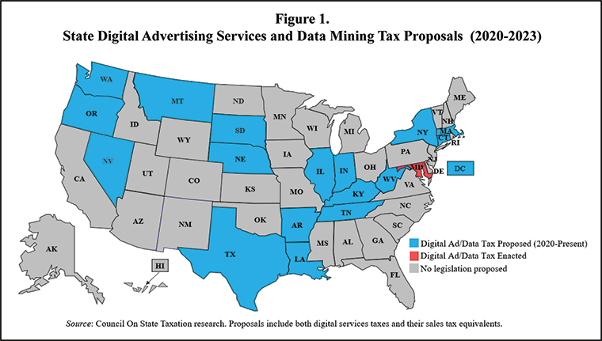
From the Council on State Taxation

Slide 36
Other Related Developments -State-
State Legislation – Tax on Digital Products
Kansas –
H.B. 2584 – Would impose sales and use tax on digital property and subscription services. Defines digital property as media or products encoded in machine-readable formats and includes streaming services related to digital property.
Illinois –
S.B. 2307 - Creates a Commercial Data Collector Tax, an excise tax on the collection of consumer data by commercial data collectors. A commercial data collector is a for-profit entity that collects, maintains, uses, processes, sells, or shares consumer data in support of its business activities and collects consumer data, other than contact information, on more than 1 million Illinois individuals in a month. The tax rate is based on the number of consumers the entity collects data from.
Massachusetts –
H.D. 74 – Would establish a 5% tax on the annual gross revenue of streaming operators from the sale of streaming entertainment services.

Slide 37
Other Related Developments -State-
State Legislation – Tax on Digital Products (cont’d)
Missouri –
H.J.R. 111 - Proposes a constitutional amendment that would add licenses for digital products and online purchases of tangible personal property to the sales tax base (and a commensurate reduction to the income tax rate).
S.J.R. 50 - Proposes a constitutional amendment that would reverse the state constitution's ban on taxing sales of subscriptions and licenses for digital products services that aren't already subject to tax.
South Dakota [signed by the governor]
H.B. – 1019 - Would expand the definition of "seller" in statutes governing sales and use tax to include any person making sales, leases or rentals of any product transferred electronically.
Vermont –
S. 181 - Would levy a 5% tax on the gross receipts of video streaming service providers that earn more than $250,000 a year from such services from Vermont residents. Video streaming service is the distribution or broadcasting of video programming displayed by the viewer for a fee on a subscription basis, and does not include cable service.

Slide 38
Other Related Developments -State-
State Legislation – Tax on Digital Products (cont’d)
Virginia –
Session has adjourned and will reconvene for a special session on May 13.
During the session, bills were considered that would expand the sales tax base to include digital products.
H.B. 30 (Budget Bill) – Would ad digital personal property to the definition of tangible personal property.
S.B. 703 – Would tax streaming services.

Slide 39
Other Related Developments -State-
Other State Developments
Maryland –
The states digital ad tax continues to face various challenges in court.

Slide 40
Other Related Developments -State-
Other Resources on State Digital Tax Developments
CSPs –
Vertex - 2023 Sales Tax Trends: Digital Taxes Take Off - https://www.vertexinc.com/resources/resource-library/2023-sales-tax-trends-digital-taxes-take
Avalara – State-by-state guide to the taxability of digital products – https://www.avalara.com/blog/en/north-america/2019/02/state-by-state-guide-to-digital-products-and-sales-tax.html/
State Digital Services Taxes: A Good and Permissible Idea (Despite What You Might Have Heard), Young Ran (Christine) Kim & Darien Shanske, https://ndlawreview.org/2023/01/state-digital-services-taxes-a-good-and-permissible-idea-despite-what-you-might-have-heard/

Slide 41
Are there any trends or developments that we are missing? Any other thoughts to share on state activities and taxation of digital products?
ⓘ Start presenting to display the poll results on this slide.

Slide 42
Wrap Up & Final Thoughts
Final Polling Question

Slide 43
Any other thoughts for the Uniformity Committee or work group on this project?
ⓘ Start presenting to display the poll results on this slide.

Slide 44
Appendix
Additional and more detailed slides relating to this project update

Slide 45
Working with Streamlined States, FTA, and NCSL
SST staff serve as ex officio members of the MTC work group.
MTC and SST staff attend each other’s meetings and regularly consult.
MTC staff monitor the related SST projects:
Sourcing of sales without need for physical addresses.
Updating the SST Agreement relating to digital codes.
SST and MTC adopted a joint resolution in 2023 titled: Joint Resolution Supporting State Efforts to Promote Uniformity in the Taxation of Digital Products.
Federation of Tax Administrators adopted related Resolution 2023-1: Supporting State Efforts to Promote Transparency, Certainty, and Clarity of State Tax Policies.
MTC is a “friend” of the NCSL SALT Task Force and attends meetings; next meeting in May

Slide 46
What We Have Studied And Achieved So Far
Definitions for digital products.
Identification of what items exist in the marketplace, including a presentation by SST certified service provider Avalara representatives.
Presentation by Streamlined representatives (watch via the MTC project page).
Survey of state treatment of digital products (website has spreadsheet and details)
Panel discussion on digital products and business inputs at July 2023 Uniformity Committee meeting (watch via the MTC project page).
Developing a matrix with “three approaches” to taxing digital products used by the states today and possible guiding principles for policy makers.
Internet Tax Freedom Act – presentation on what states and taxpayers need to know about definitions and the anti-discrimination provision at the Nov. 14, 2023 Uniformity Committee (audio and transcript posted to the website).

Slide 47
Summary of Business Inputs (Pyramiding) Research
Some advocate that pyramiding should always be avoided, while others advocate that there are multiple policy considerations that affect the extent to which pyramiding exists in a sales and use tax base.
The severity of pyramiding depends on the facts and circumstances, including whether the eventual retail sale will be exempt from tax and the incidence of the tax.
Taxing digital business inputs can impose tax on industries, such as agriculture, that have historically been tax favored.
Exempting digital business inputs will be costly if done after the tax base is expanded to include digital business inputs.
Exempting business inputs should be considered in tandem with any proposed expansion of the tax base to include digital products.
Exempting business inputs can be complicated or simple. A simple version would rely on the identity of the purchaser as a commercial entity, such as the current Iowa statute.
Exempting business inputs, or any other anti-pyramiding effort, should be weighed against tax administration pros and cons, including the ability for exemptions to keep pace with the tax base.

Slide 48
Project Background and Steps to Date - 1
April 2021 –Washington State presentation to the Uniformity Committee (UC) to consider an MTC project to examine sales taxes on digital products.
July 2021 – UC approves recommendation to begin work on a project studying the application of sales tax to digital products — starting with a whitepaper — and asks MTC staff to begin a detailed outline of that whitepaper.
November 2021 and April 2022 – MTC staff reports to the Committee, including a recap of stakeholder interviews. Stakeholders included taxpayers and their representatives, states, academics, and industry and association representatives – over 40 in total.

Slide 49
Project Background and Steps to Date - 2
August 2022 - UC approves work group (WG) formation. WG chair selected and work group members solicited. SST staff included as ex officio members.
September 2022 – WG meetings begin the first Thursday of each month at 11:00 a.m. Eastern. Public is welcome at all meetings.
October 2022 – WG directs MTC staff to research definitions for digital products.
November 2022–March 2023 – WG and stakeholders discuss various definitions for digital products and digital products in the marketplace.

Slide 50
Project Background and Steps to Date - 3
April 2023 – WG hears results of anonymous survey of WG members to solicit input on various aspects of the project.
April 2023 - UC meets to discuss next steps. Hears presentations on the Streamlined experience with digital products and the results of MTC staff research about current treatment of digital products by the states.
August 2023 UC Meeting – Panel discussion on the taxation of digital products and business inputs.
Fall 2023 – Staff research into state treatment of digital products and development of “three approaches” matrix; identification of trends.

Slide 51
Project Background and Steps to Date - 4
November 2023 – Panel discussion at UC meeting on the basics of the Internet Tax Freedom Act.
January 2024 – Farewell to Chair Gil Brewer (WA); WG committee votes in new chair Tim Jennrich (WA).
March 2024 – WG votes to have Mia Strong (LA) serve as vice-chair and begin studying bundling issues.

Slide 52
LOOKING OUT FOR POTHOLES (Gil Brewer’s thoughts as of April 2023)
Potential challenges
Perception as “the largest tax increase in history.”
Political inertia.
Legislative vs. administrative change.
The potential product/transactional variety in the digital world is infinite, and the pace of change is daunting.
Simply imposing a traditional sales tax regime on the digital world may well be impossible.
Is it possible to maintain parity between taxation/exemption of traditional products and digital products?
Desire for a broad B2B exemption.
ITFA preemption limitations.
International complications.
The sheer/scope size of the undertaking.

