Slide 1
Economic/Revenue Update Uniformity Committee Scott Pattison, MTC April 30, 2024
Kansas City

Slide 2
The views expressed in this presentation are my own.

Slide 3
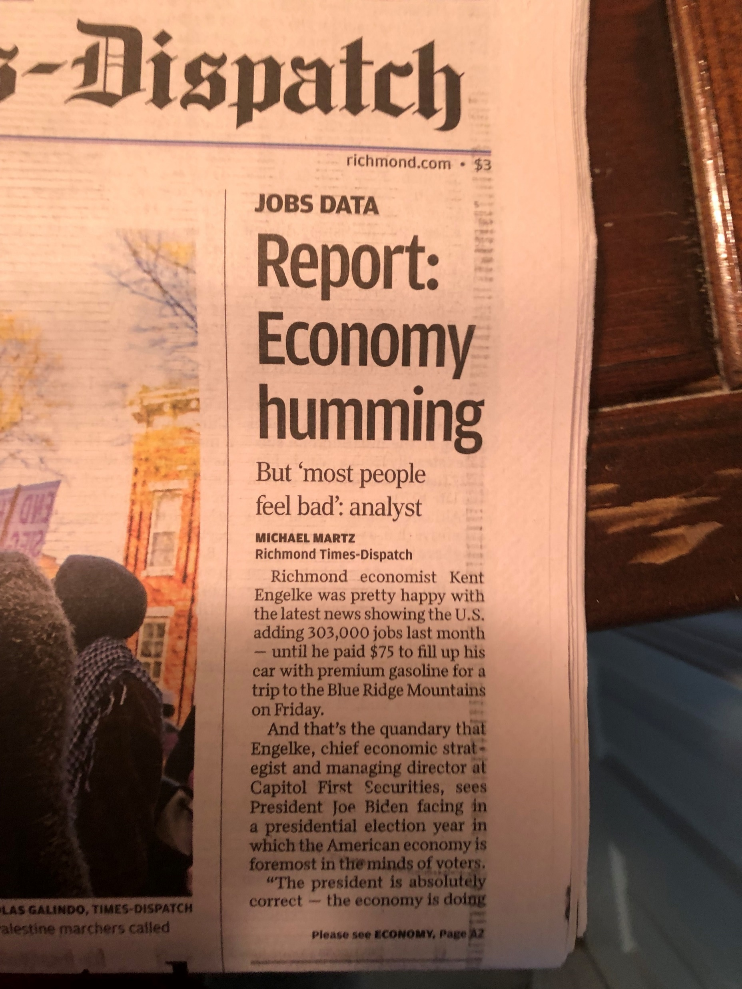
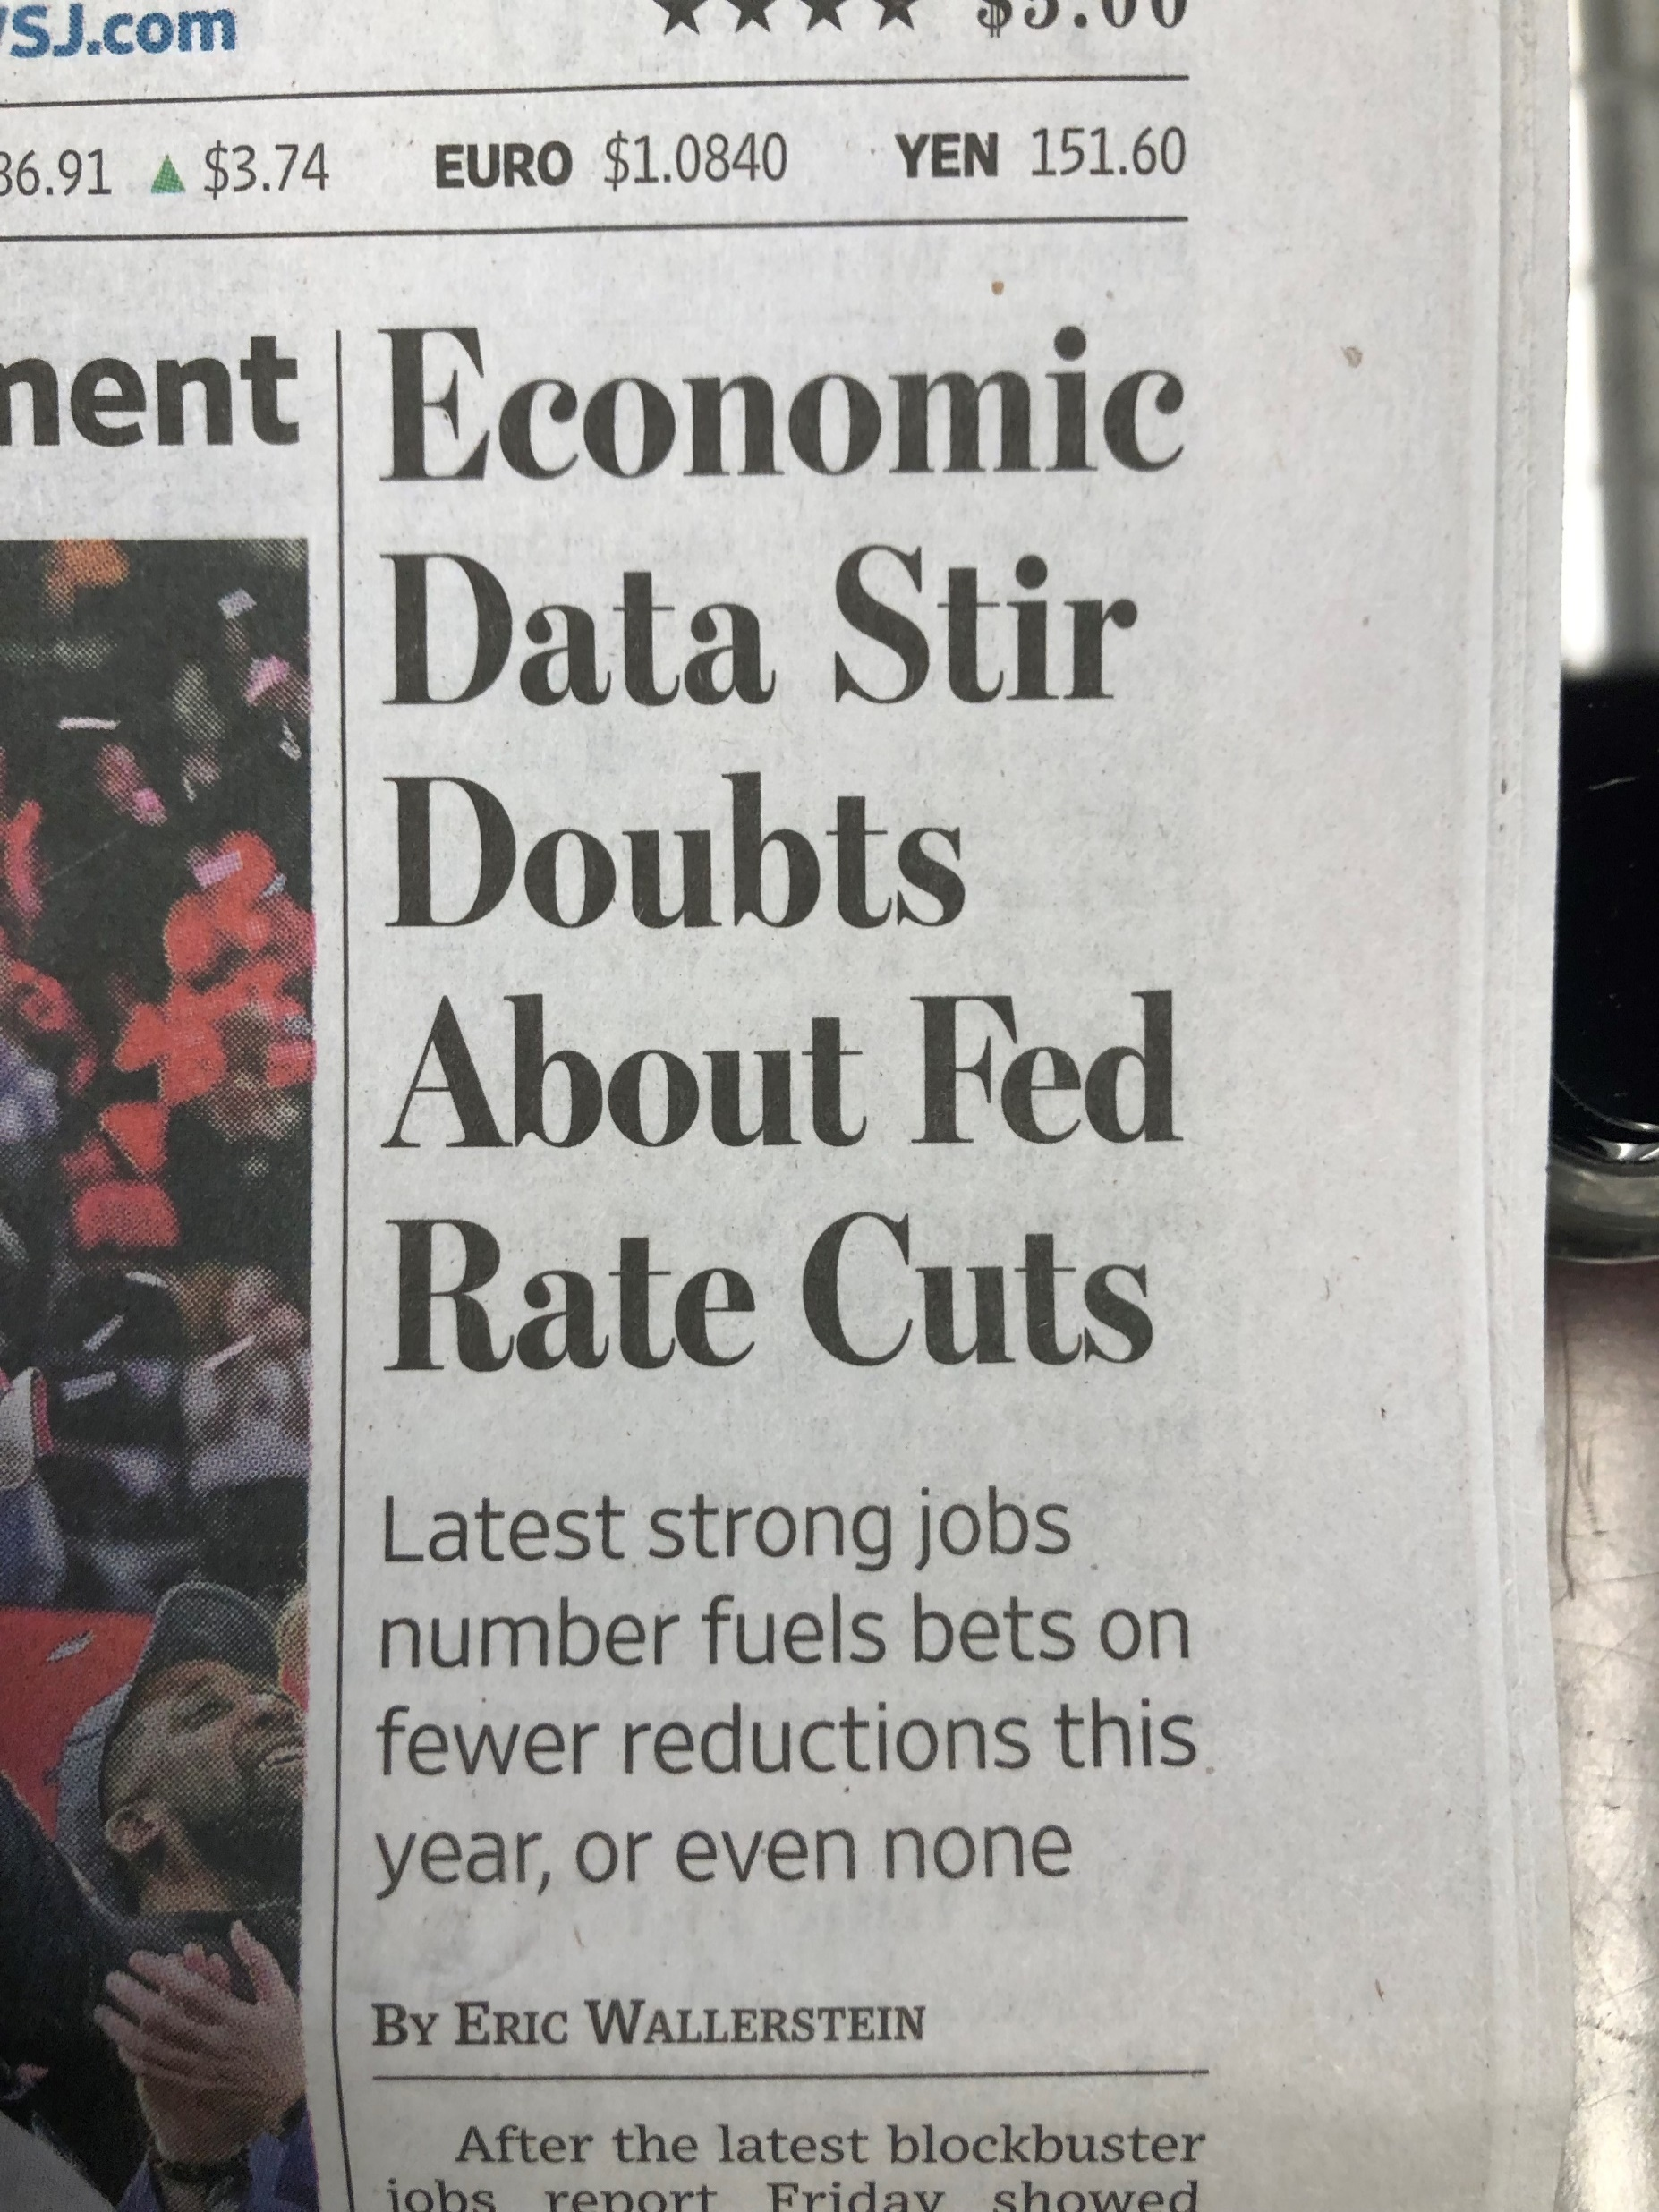
Uncertainty and Concerns

Slide 4
Overall Relatively Good Situation, Early ‘24
Inflation moderating
Big Companies Borrowing
Stock market strong 1Q
Consumer spending decent
Jobs/Wage Growth/No interest rate increases
Chip shortage has eased

Slide 5
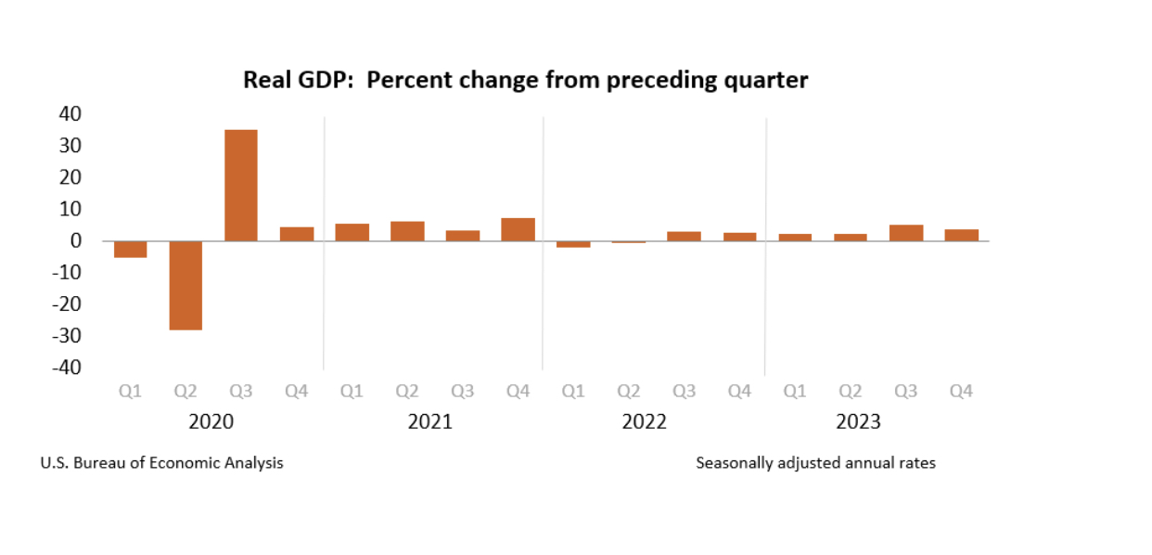
GDP
Real gross domestic product increased at an annual rate of 1.6 percent in the first quarter of 2024, according to the “advance” estimate (2.5% estimates)
In the fourth quarter of 2023, real GDP increased 3.4 percent

Slide 6
Fed Projections
FOMC March 19–20, 2024, participants submitted their projections for the most likely outcomes of the U.S. economy. Key projections for real gross domestic product (GDP) growth, the unemployment rate, and inflation:
Change in Real GDP:
Median projection for 2024: 2.1%
Median projection for 2025: 2.0%
Median projection for 2026: 2.0%
Longer-run median projection: 1.8%.
The range of projections varies, but the central tendency suggests moderate growth

Slide 7
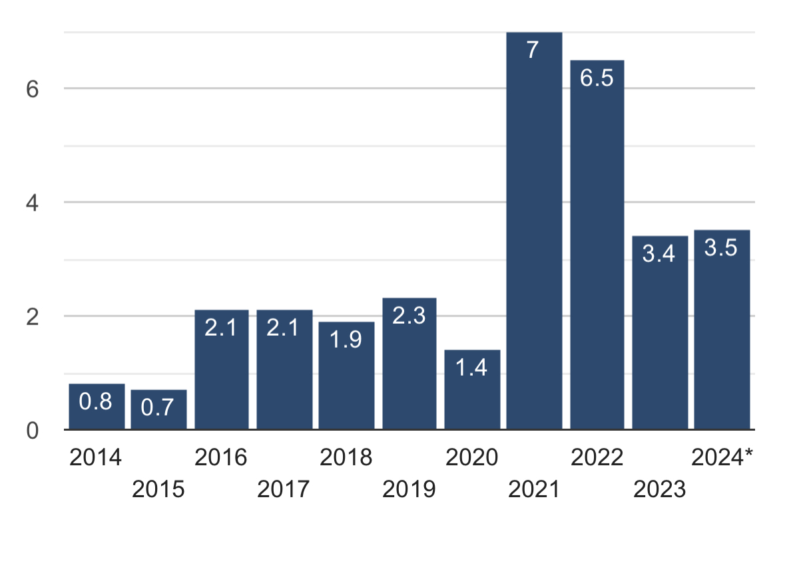
Inflation
In March 2024, the annual inflation rate in the United States rose to 3.5%, up from 3.2% in February.

Slide 8
Interest Rates
Unusual level of uncertainty as the landscape surrounding the financial system continues to shift
Nine straight rate hikes
5.25% - highest level since September 2007

Slide 9
Housing
Prices Rising
Unaffordable for many
Tight Supply
High Mortgage Rates, may decline
“I don’t expect to see a meaningful increase in the supply of existing homes for sale until mortgage rates are back down in the low 5% range, so probably not in 2024,” says Rick Sharga, founder and CEO of CJ Patrick Company, a market intelligence and business advisory firm.

Slide 10
State Revenue
Tax Changes (half the states, tax cuts)
Stimulus
2023 Revenues – Market Impact
NCSL April
30 states expect to meet their fiscal year 2024 general fund revenue estimates
10 states and anticipate exceeding revenue estimates
2 states, California and Nebraska, general fund revenues will likely fall short of estimates.
California faces a significant shortfall and the problem could grow if revenue performance continues to deteriorate. In Nebraska, general fund revenue collections were up substantially, but they enacted a pass-through entity tax that will result in refunds.

Slide 11
Challenges
Inflation and Interest Rates
Governance
Domestic
International
Energy
Debt
Consumers
Government
Housing
Pessimism
Supply Chains
Commercial Real Estate

Slide 12
Thank You
Scott Pattison
Spattison@mtc.gov

