Slide 1
State Taxation of Partnerships – Status Report and Next Steps
April 30, 2024

Slide 2
Join at slido.com #1493195
ⓘ Start presenting to display the joining instructions on this slide.

Slide 3
The Process
MTC Taxation of Partnerships Project

Slide 4
Identify Potential Issues & Relationships
Issue Outline
Background & Training
Expanding Project Page
Select Issue & Develop Practices or Position
White Papers & Draft Models
General Work Group Process
Litigation & Legislation
Agree on a Set of Practices & Positions
Proposed Drafts & Other Guidance
REPEAT or PROCEED
WORK GROUP APPROVAL
UNIFORMITY COMMITTEE APPROVAL
EXECUTIVE COMMITTEE PUBLIC HEARING
COMMISSION APPROVAL

Slide 5
The Work to Date
MTC Taxation of Partnerships Project

Slide 6
Work To date
Issue Outline
Comprehensive list of the state tax issues raised by the pass-through tax system that states must address including:
Nexus
Tax base .
Sourcing
Administrative
Etc.
Sourcing of Income from Investment Partnerships
White Paper and Draft Model –
If the partnership meets the definition of an investment partnership,
Then nonresident partners not involved in the partnership activities would source that partnership’s income by looking through to the underlying assets and activities.
Sourcing of Guaranteed Payments for Services
White Paper and Draft Model –
Guaranteed payments for services are sourced in the same way as distributive share.
A credit for tax paid is provided if a resident is subject to tax in another state on the basis of where services are performed.

Slide 7
Work To date
Issue Outline
Comprehensive list of the state tax issues raised by the pass-through tax system that states must address including:
Nexus
Tax base .
Sourcing
Administrative
Etc.
Sourcing of Income from Investment Partnerships
White Paper and Draft Model –
If the partnership meets the definition of an investment partnership,
Then nonresident partners not involved in the partnership activities would source that partnership’s income by looking through to the underlying assets and activities.
Sourcing of Guaranteed Payments for Services
White Paper and Draft Model –
Guaranteed payments for services are sourced in the same way as distributive share.
A credit for tax paid is provided if a resident is subject to tax in another state on the basis of where services are performed.

Slide 8
Work To date
Issue Outline
Comprehensive list of the state tax issues raised by the pass-through tax system that states must address including:
Nexus
Tax base .
Sourcing
Administrative
Etc.
Sourcing of Income from Investment Partnerships
White Paper and Draft Model –
If the partnership meets the definition of an investment partnership,
Then nonresident partners not involved in the partnership activities would source that partnership’s income by looking through to the underlying assets and activities.
Sourcing of Guaranteed Payments for Services
White Paper and Draft Model –
Guaranteed payments for services are sourced in the same way as distributive share.
A credit for tax paid is provided if a resident is subject to tax in another state on the basis of where services are performed.

Slide 9
Information is on the Project page on the MTC Website

Slide 10
Information is on the Project page on the MTC Website

Slide 11
Information is on the Project page on the MTC Website

Slide 12
Sourcing in Tiered Structures
MTC Taxation of Partnerships Project

Slide 13
Overview of State Tax Guidance on
Sourcing in Tiered Partnership Structures
We researched to see what states have done to address the sourcing of partnership income in tiered structures generally.
We looked in state tax statutes, regulations, guidance, tax form instructions, and case law.
We compiled this research into a draft document containing examples of state tax sourcing rules, pass-through entity tax rules, and withholding/composite return tax rules relevant to tiered partnerships.
If we have missed anything in our research, please contact Jenn Stosberg at jstosberg@mtc.gov
*Our research should not be relied on as tax advice. For specific questions, please contact your
state department of revenue and/or tax advisor.

Slide 14
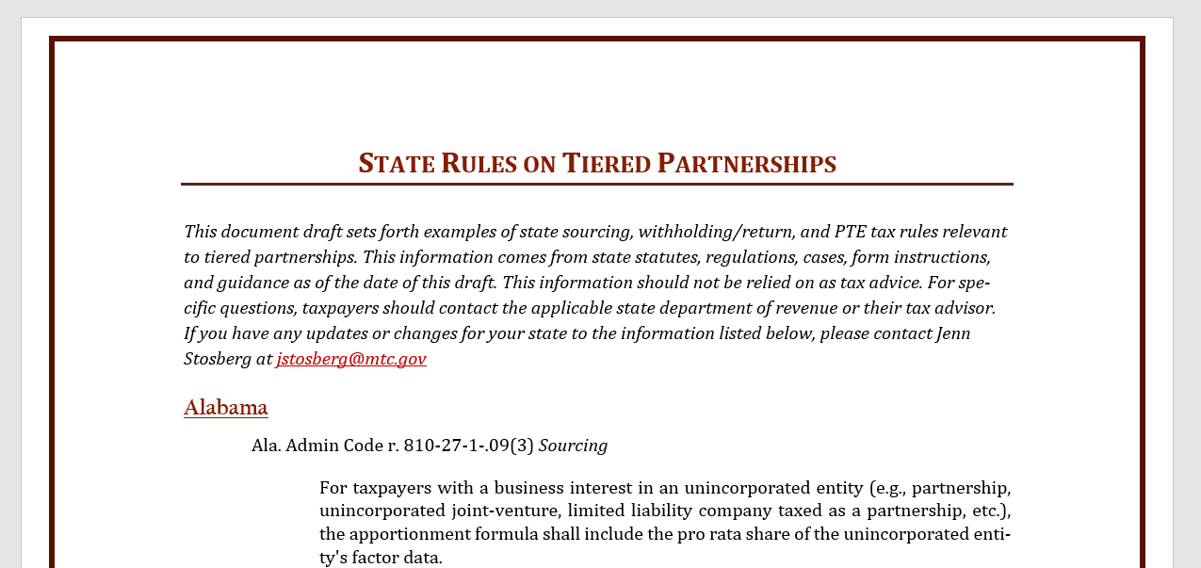

Slide 15
What IS THE Research SHOWING?
Most states have explicit rules for the sourcing of partnership income for nonresident individual partners and corporate partners.
Several states also have general provisions attributing partnership activities to the partners.
However, only a minority of states have explicit rules for the sourcing of partnership income in tiered structures.
States do not always use consistent terminology in state tax partnership sourcing rules.

Slide 16
Corporate Partners
When a corporation owns an interest in a partnership, most states have specifically addressed how the corporation should source the partnership income.
The majority of states blend the apportionment factors of the corporation with the corporation’s pro rata share of the apportionment factors of the partnership.

Slide 17
Corporate Partners
However, in many of the blended apportionment states, the partnership’s apportionment factors only roll up to the corporation if there is a unitary relationship involved.
For non-unitary partnerships in these states, the income is generally sourced at the partnership level and that sourcing is retained as it flows up without reapportionment.

Slide 18
Examples of corporate partner sourcing rules
Alabama: Ala. Admin Code r. 810-27-1-.09(3)
For taxpayers with a business interest in an unincorporated entity (e.g., partnership, unincorporated joint-venture, limited liability company taxed as a partnership, etc.), the apportionment formula shall include the pro rata share of the unincorporated entity's factor data.

Slide 19
Examples of corporate partner sourcing rules
California: Cal. Code Regs. tit. 18, § 25137-1
If the partnership’s activities and the taxpayer's activities constitute a unitary business under established standards, disregarding ownership requirements, the business income of such single trade or business attributable to this state shall be determined by an apportionment formula, pursuant to either Section 25128, Section 25128.5 or Section 25128.7, Revenue and Taxation Code, whichever is applicable, of the taxpayer and its share of the partnership's factors for any partnership taxable year ending within or with the taxpayer's taxable year . . . When the activities of the partnership and the taxpayer do not constitute a unitary business under established standards, disregarding ownership requirements, the taxpayer's share of the partnership's trade or business shall be treated as a separate trade or business of the taxpayer.

Slide 20
Examples of corporate partner sourcing rules
Hawaii: Haw. Code R. § 18-235-29-04
(a) If a taxpayer is a partner in a partnership, and the partnership's activities and the taxpayer's activities constitute a unitary business:
(1) The taxpayer's share of the partnership's trade or business shall be combined with the taxpayer's trade or business;
(2) The property, payroll, and sales factors, or other applicable factors, of the taxpayer and the partnership shall be combined; and
(3) Intercompany items shall be eliminated, under the principles set forth in section 18-235-22-03.
(b) If a taxpayer is a partner in a partnership, and the partnership's activities and the taxpayer's activities do not constitute a unitary business, the partnership shall allocate and apportion its income at the partnership level. The taxpayer's distributive share of the partnership's income allocated or apportioned to this State shall not be subject to further apportionment by the taxpayer.
Example: Corporation A's distributive share of income in partnership P is 20 per cent. Corporation A manufactures and sells toys in the seven western states. Partnership P operates farms within and without this State. Both corporation A and partnership P earn exclusively business income, except for distributions from Partnership P. Corporation A's business income for the year is $1,000,000 and partnership P's income is $800,000 for the same year. Because corporation A and partnership P are engaged in two different trades or businesses, corporation A shall apportion its $1,000,000 income on the basis of its own apportionment formula. Partnership P shall apportion its business income of $800,000 on the basis of its own apportionment formula. Corporation A's apportionment factors are determined without regard to Partnership P's apportionment factors, and vice versa. Assume that corporation A's apportionment percentage determined under section 18-235-29-01 is 35 per cent, and that partner-ship P's apportionment percentage is 10 per cent. Partnership P's Hawaii income is 10 per cent of the income from its farming business ($80,000 = 10 per cent × $800,000). Corporation A is taxable in this State upon 35 per cent of the income from its toy manufacturing business ($350,000 = 35 per cent × $1,000,000) plus its full distributive share of the partnership income attributed to this State ($16,000 = 20 per cent × $80,000), or $366,000.

Slide 21
Variations in Corporate Partner Rules
State rules vary on whether they indicate if a unitary relationship is required to blend the factors of a partnership with a corporation.
There are variations on how unitary is defined in the partnership context and on whether ownership requirements are disregarded.
States vary on whether they specifically define a pro rata or proportionate share of partnership factors.
States vary on whether intercompany transactions between the corporation and partnership must be excluded from the apportionment factors.

Slide 22
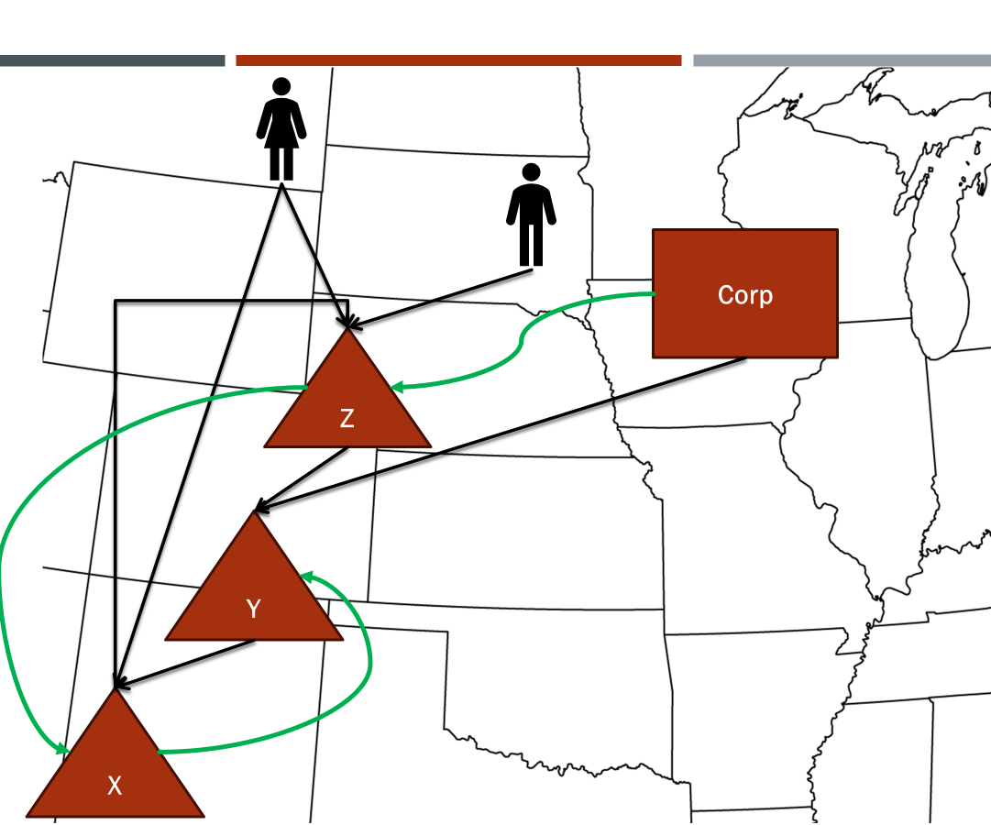
Explicit Tiered Partnership Sourcing Rules

Slide 23
Examples of tiered partnership sourcing rules
Colorado: Colo. Code Regs. § 39-22-109(3)(c) (continued)
In the case of a Nonresident who is a Member of a partnership ("first partnership"), which partnership is a partner in another partnership ("second partnership"), the following rules apply:
(A) Unitary Partnerships. In the case of unitary partnerships, the election made by the second partnership is irrelevant to the treatment of income of the first partnership.
(I) If the first partnership makes the election to apportion its income pursuant to § 39-22-303.6, C.R.S. (including the special apportionment rules adopted thereunder), and is unitary with the second partnership as determined by general unitary theory, then the Nonresident member of the first partnership's share of Colorado source income is the Member's pro rata share of the partnership's Colorado-source income as determined by § 39-22-303.6, C.R.S. The first and second partnerships are treated as a single entity for purposes of calculating apportionment under § 39-22-303.6, C.R.S.
(II) If the first partnership makes the election not to apportion its income pursuant to § 39-22-303.6, C.R.S., and is unitary with the second partnership, then the partnerships are treated as one partnership and the income is sourced in accordance with this rule.
(B) Non-Unitary Partnerships. In the case of non-unitary partnerships, the election made by the first partnership is irrelevant to the treatment of income of the second partnership.
(I) If the two partnerships are non-unitary, then regardless of the election made by the first partnership, the first partnership's pro-rata share of the second partnership's Colorado-source income is directly allocated by the first partnership to Colorado and is not apportioned. The pro-rata share of such income passes through to the Nonresident Member as Colorado-source income.

Slide 24
Examples of tiered partnership sourcing rules
New York: New York Instructions for Form IT-204 (2023)
Tiered partnerships (Regulation section 137.6) If your partnership is a partner in another partnership (hereinafter referred to as the lower tier partnership), the source and character of the distributive share of each item of your partnership to any partner of your partnership that is attributable to the lower tier partnership retains the source and character determined at the level of the lower tier partnership. Such source and character are not changed by reason of the fact that any such item flows through your partnership to such partner.
Example: Partnership A was a partner in another partnership, B. A is referred to as the upper tier partnership while B is referred to as the lower tier partnership. P was a nonresident individual partner of A. Partnership A was not engaged in a trade or business in New York but partnership B was. Even though partnership A was not carrying on business in New York, it had New York source income from the distributive shares it received from partnership B. The source and character of each item that partnership A received from partnership B retains the source and character determined at the level of partnership B. For instance, if P was a partner of A, and A was a partner of B, nonresident individual partner P would allocate its share of the NY income from B at B’s business allocation percentage. Further, if A was engaged in a trade or business in NY, then P would allocate its share of A’s income using A’s business allocation percentage and P would allocate its share of B’s income (which flows to A) at B’s business allocation percentage. This allocation method should be reflected on Forms IT-204 and IT-204-IP.

Slide 25
Examples of tiered partnership sourcing rules
West Virginia: West Virginia Form PTE-100 Instructions (2023)
Pass through entity owners of pass through entities should allocate income received from a Pass Through Entity unless such entities are engaged in a unitary business. If a unitary relationship exists, a Pass Through Entity owner of a pass through entity may reapportion its WV income, including the appropriate factors of the subsidiary.

Slide 26
Considerations: Should tiered partners have different sourcing rules than corporate and nonresident individual partners? What method is best for sourcing partnership income in tiered partnerships – lower-tier pass-through sourcing, upper-tier sourcing, BLENDED sourcing, something else? Let us know what you think.

Slide 27
Special allocations
MTC Taxation of Partnerships Project

Slide 28
Overview of the Partnership Lifecycle
Choose Form
Contributions
Acquiring Property
Income & Distributive Share
Changes in Partners
Agreement
Obtaining Credit
Partner Transactions & Guaranteed Payments
Distributions
Liquidation

Slide 29
Why are they called special allocations?
ⓘ Start presenting to display the poll results on this slide.

Slide 30
IRC § 704. Partner’s Distributive Share
(a) Effect of partnership agreement. A partner’s distributive share of income, gain, loss, deduction, or credit shall, except as otherwise provided in this chapter, be determined by the partnership agreement.
(b) Determination of distributive share. A partner’s distributive share of income, gain, loss, deduction, or credit (or item thereof) shall be determined in accordance with the partner’s interest in the partnership (determined by taking into account all facts and circumstances), if—
(1) the partnership agreement does not provide as to the partner’s distributive share of income, gain, loss, deduction, or credit (or item thereof), or
(2) the allocation to a partner under the agreement of income, gain, loss, deduction, or credit (or item thereof) does not have substantial economic effect.

Slide 31
If partnership allocations are based on the partnership agreement, then can the partnership allocate items however it wants?
ⓘ Start presenting to display the poll results on this slide.

Slide 32
Substantial economic effect
Treas. Reg. § 1.704-1(b)(2)(ii) Economic Effect
Treas. Reg. § 1.704-1(b)(2)(iii) Substantiality
Under the 704(b) regs, an allocation will be respected if
the partnership properly maintains capital accounts
liquidating distributions are made according to positive capital account balances, and
if, after liquidation any partner has a deficit in their capital account, that partner has to restore the deficit.
An allocation is substantial if there is a reasonable possibility that the allocation (or allocations) will affect substantially the dollar amounts to be received by the partners from the partnership, independent of tax consequences.

Slide 33
If the allocation does not have substantial economic effect, the partnership allocates income based on the partners' capital accounts.
ⓘ Start presenting to display the poll results on this slide.

Slide 34
Partner’s interest in the partnership
Treas. Reg. § 1.704-1(b)(3) Partner's Interest In The Partnership--
In General. — References in section 704(b) and this paragraph to a partner's interest in the partnership, or to the partners' interests in the partnership, signify the manner in which the partners have agreed to share the economic benefit or burden (if any) corresponding to the income, gain, loss, deduction, or credit (or item thereof) that is allocated.
Factors Considered. — In determining a partner's interest in the partnership, the following factors are among those that will be considered:
The partners' relative contributions to the partnership,
The interests of the partners in economic profits and losses (if different than that in taxable income or loss),
The interests of the partners in cash flow and other non-liquidating distributions, and
The rights of the partners to distributions of capital upon liquidation.

Slide 35
Built-in gains
Sec. 704(c) addresses situations in which a partner contributes an asset to a partnership that has a built-in gain or loss and provides how any eventual gain or loss recognized by the partnership—as well as related deductions like depreciation—will be allocated

Slide 36
What Have States Done?
New York:
(c) Whether the principal purpose of a special allocation of an item is the avoidance or evasion of New York State personal income tax depends on all the surrounding facts and circumstances. Among the relevant circumstances to be considered are the following: whether the partnership or a partner individually has a business purpose for the allocation; whether the allocation has “substantial economic effect,” that is, whether the allocation may actually effect the dollar amount of the partners’ shares of the total partnership income or loss independently of New York State personal income tax consequences; whether related items of income, gain, loss or deduction from the same source are subject to the same allocation; whether the allocation was made without recognition of normal business factors and only after the amount of the specially allocated item could reasonably be estimated; the duration of the allocation; and the overall New York State personal income tax consequences of the allocation.
NY State Tax Regulations, PART 117. RESIDENT PARTNERS

Slide 37
What Have States Done?
West Virginia:
17.4. West Virginia Tax Avoidance Or Evasion Through Partnership Form Of Business.
17.4.2. . . . a provision for special allocation does not have as its principal purpose the avoidance or evasion of federal income tax, but has as its principal purpose the avoidance or evasion of West Virginia income tax. In such an instance, any such provision shall be disregarded and each partner's share of the pertinent item of partnership-income, gain, loss or deduction shall be determined in accordance with his share of the partnership's ordinary income or loss.
17.4.3. Whether the principal purpose of a special allocation of an item is the avoidance or evasion of West Virginia income tax depends upon all surrounding facts and circumstances . . . and any other factors from Treasury Regulation 1.704-1.
West Virginia Code of State Rules 2019, W. Va. C.S.R. § 110-21-17[2019], Resident Partners

Slide 38
Special Allocations: What do the Experts Say?
“The allocation rules are complex, burdensome, and prone to abuse.”
“This article joins the chorus of those who have argued that special allocations generally should be disallowed.”
Hasen, David (2023) "Partnership Special Allocations Revisited," Florida Tax Review: Vol. 13, Article 8. Available at: https://scholarship.law.ufl.edu/ftr/vol13/iss1/8

Slide 39
Special Allocations: What do the Experts Say?
The immensely complicated tax rules governing partnership allocations—the notorious section 704(b) regulations—have been the subject of criticism ever since their promulgation nearly 30 years ago. Yet, one particular problem with those rules has thus far escaped significant scrutiny. The problem involves partnership allocations that are shared by partners who are related to one another. Because the section 704(b) regulations are premised on the assumption that partners deal with each other at arm’s length, they are ill-suited to deal with related-partner allocations. As a result, these regulations can easily be abused by related partners.
Cauble, Emily and Polsky, Gregg D. (2023) "The Problem of Abusive Related-Partner Allocations," Florida Tax Review: Vol. 16, Article 9. Available at: https://scholarship.law.ufl.edu/ftr/vol16/iss1/9

Slide 40
Special Allocations: What do the Experts Say?
Special allocations shouldn’t be permitted, and section 704(b) should be amended to say so. All allocations should be made based on the proportionate capital interests of the partners in the partnership. An exception to this proportionate capital treatment could be allocations related to preferred interests in the partnership. This is because the preferred interest would be given priority regarding distributions under the partnership agreement and local nontax law. As a corollary rule, all partnership allocations in form to service partners should be treated as the payment of compensation by the partnership to the partners for all federal income tax purposes,²³ including for employment tax purposes. Appropriate transition rules should be provided.
Monte A. Jackel, “Special Report: Is It (Finally) Time? Reforming Subchapter K,” Tax Notes, Mar. 29, 2021, https://www.taxnotes.com/special-reports/partnerships-and-other-passthrough-entities/it-finally-time-reforming-subchapter-k/2021/03/26/3k6c2

Slide 41
Does this work?
ⓘ Start presenting to display the poll results on this slide.

Slide 42
Partnership audits
MTC Taxation of Partnerships Project

Slide 43
Federal Partnership audits under the bba
Bipartisan Budget Act effective for taxable years beginning Jan. 1, 2018.
Budget estimated at $1 billion in new revenue over the first 10 years.
Large majority of 2016-19 partnership audits were closed without changes.
IRS promised to add enforcement capacity for reviewing complex partnership returns
Partnership Audit Goal of 8,852 opened cases for 2023 and 5,253 opened cases for 2024.

Slide 44
Partnership representative
Federal Centralized Partnership Audit Regime
MTC Model Statute
Under the BBA, the federal centralized audit is conducted entirely at the partnership level.
The partnership is required to designate a partnership representative that has the sole au
The actions of the partnership representative are binding on the partnership and all of the partners.
The MTC model also requires the partnership to appoint a state partnership representative that will handle matters involving state reporting of federal centralized partnership audit adjustments.
If the partnership does not appoint anyone, the federal partnership representative will also serve as the state partnership representative.

Slide 45
Centralized Audit Adjustments – Federal “Imputed Underpayment”
The audit takes place at the partnership level and an imputed underpayment is calculated by netting all partnership adjustments for the reviewed year and applying the highest rate of tax to the net amount.
If reallocation adjustments do not result in an imputed underpayment, the adjustments flow through and be reported by the partners in the adjustment year.

Slide 46
Modification Period
Federal Centralized Partnership Audit Regime
MTC Model Statute
At the end of the audit process, and before the final imputed underpayment is determined, the IRS issues a notice of proposed partnership adjustment that details the audit adjustments as well as the proposed imputed underpayment.
Once the notice is issued the partnership had 270 days in which the imputed underpayment may be modified.
During this period, the partners may choose to file amended returns reporting their share of audit adjustments and paying taxes due, or the partnership can use something called the “pull-in” process to pay tax on adjustments on a partner-by-partner basis without the filing of amended returns.
To the extent portions of the proposed federal adjustments are taken into account through the filing of amended returns by the partners, or through the “pull-in” process, then the partners would also be required to file amended state returns.

Slide 47
Final Partnership Adjustment
Federal Centralized Audit Regime
MTC Model Statute
Submitted to the partnership with the revised imputed underpayment after modifications
Partnership may make push-out election (within 45 days of FPA) –
Must take all steps to provide partners (and the IRS) with information necessary to compute tax that should have been paid in reviewed year
Partners will report this additional tax as “other tax” on adjustment year tax returns
Partnership is relieved of any liability
If partnership pays the imputed underpayment –
Partners will see no adjustment whatsoever
Partnership must provide notice to the state
Default – partnership and the partners file amended state returns reporting the effects of the adjustments
Alternative – partnership elects to compute and pays tax at the partnership level, in lieu of taxes owed by partners (with some exceptions)

Slide 48
Partnership audit progress

Slide 49
More on the MTC Model RAR/Partnership adjustment Model here: https://www.mtc.gov/uniformity/partnership-or-rar-work-group/

Slide 50
Partnership Training for State administrators
MTC Training & New LMS

Slide 51
It’s not just you - Other people think this is hard
Partnership tax is “ripe for reform.”
The “tax treatment of partnership interest redemptions [is] …schizophrenic”
Michelle M. Jewett, A Model of Complexity and Uncertainty: Redemptions of Partnerships and Interests, 72 TAX LAW. 337 (2018).
“partnership taxation [is] one of the most complex areas in all of taxation”
“lawyers without expertise in partnership taxation who form LLC’s need to have a feel for the core issues, if for no other reason than to avoid wandering inadvertently into a partnership taxation blackhole”
Schwidetzky, quoting a 1986 article, deems “partnership-allocation Treasury Regulations” to be “a creation of prodigious complexity . . . essentially impenetrable to all but those with the time, talent, and determination to become thoroughly prepared experts on the subject.” [Walter Schwidetzky, Partnership Tax Allocations: The Basics, 46 COLO. LAW. 39 (2017).

Slide 52
So does this person
“crippling complexity” of partnership tax law
“perplexing, mazelike regulatory scheme”
“partnership tax often befuddles even IRS auditors”
Lawson explains that partnership “rules are highly complex and needlessly saddle small, simple businesses with increased compliance costs and potentially excessive tax liability” while simultaneously “leav[ing] loopholes for sophisticated organizations [who are] able to exploit them.” [Andrew L. Lawson, Simple Audits for Simple Tax Partnerships, 88 TENN. L. REV. 117 (2020).]

Slide 53
And this one
Past partnership “tax reform and simplification typically have led to increased complexity and confusion.”
Fear that in the future, partnership tax “will become more difficult, more uncertain, and more complex.”
Complexity has been a big part of tax lawyers migrating to accounting firms.
The IRS is “underfunded, underpaid, underappreciated, underqualified” and “overwhelmed with work.” The staff ”may not understand partnership law” and have “very limited audit resources for partnerships or any other audits.”
Terence Floyd Cuff, Remarks to the 2016 Midyear Meeting: The Tax Ghosts of Christmas Past, Christmas Present, and Christmas Yet to Come, 35 ABA TAX TIMES 5 (2016).]

Slide 54
And These people think so, too
Present condition of Subchapter K is “too complicated for taxpayers to apply or for the IRS to administer.”
“burden of enormous complexity”
“the rules involve needless complexity”
“[A]lmost insurmountable complexity is found in the interaction” of certain partnership code sections.
Roscow and Hughes assert that “Subchapter K needs to be fixed.” [Stuart L. Rosow & Rachel A. Hughes, Reforming Subchapter K: The Partnership Tax Simplification Act of 20, 94 TAXES 361 (2016).]

Slide 55
Partnership Training update
MTC is investing in a new Learning Management System (LMS) and is beginning to post past training for state tax administrators.
The Basics of Subchapter K that we created a couple years ago is posted there and people can still sign up.
We will be creating new content.
We are also planning in person training – building on the 2023 Partnership Summit.
We received a lot of feedback from states saying they would be interested in sending people or even hosting.
We are working on timing and logistics.

