Slide 1
State Taxation of Partnerships – Report to the Work Group
FEBRUARY 21, 2024

Slide 2
Process Notes
Vice Chair
Planning of Related Partnership Training
Other

Slide 3
Identify Potential Issues & Relationships
Issue Outline
Background & Training
Expanding Project Page
Select Issue & Develop Practices or Position
White Papers & Draft Models
General Work Group Process
Litigation & Legislation
Agree on a Set of Practices & Positions
Proposed Drafts & Other Guidance
REPEAT or PROCEED
WORK GROUP APPROVAL
UNIFORMITY COMMITTEE APPROVAL
EXECUTIVE COMMITTEE PUBLIC HEARING
COMMISSION APPROVAL

Slide 4
Status - Overview
Last meeting – January 17, 2024
Status update on state tax issues related to investment partnerships and guaranteed payments:
Investment Partnership Whitepaper and Draft Model
Guaranteed Payments Whitepaper and Draft Model
Discussion of what is next for the MTC Partnership Project:
Sourcing of income in tiered structures:
Application of general state sourcing rules—including formulary apportionment, unitary business principle, etc.
Treatment of related-entity transactions
Treatment of complex special allocations

Slide 5
Overview of State Tax Guidance on
Sourcing in Tiered Partnership Structures
We researched to see what states have done to address the sourcing of partnership income in tiered structures generally.
We looked in state tax statutes, regulations, guidance, tax form instructions, and case law.
We compiled this research into a draft document containing examples of state tax sourcing rules, pass-through entity tax rules, and withholding/composite return tax rules relevant to tiered partnerships.
If we have missed anything in our research, please contact Jenn Stosberg at jstosberg@mtc.gov
*Our research should not be relied on as tax advice. For specific questions, please contact your
state department of revenue and/or tax advisor.

Slide 6
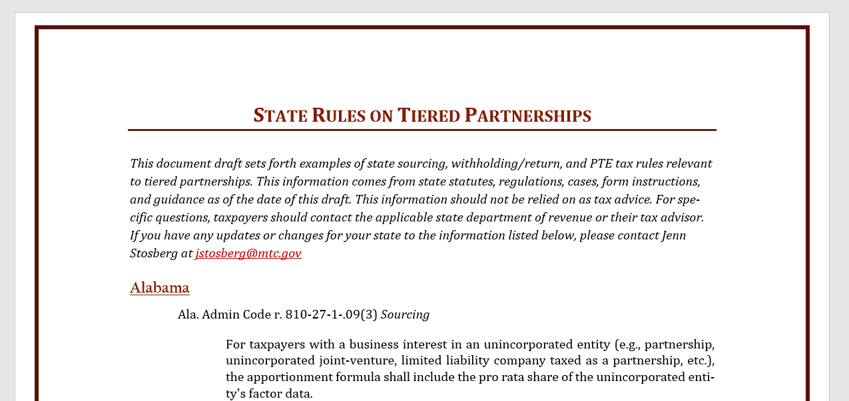

Slide 7
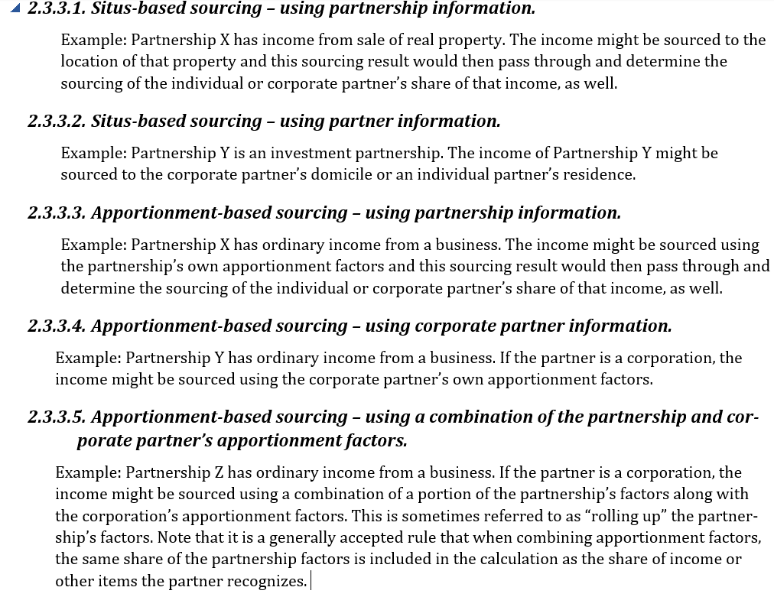
Five Methods of Sourcing Partnership Income - Generally
Methods of Sourcing Partnership Income (from the MTC Partnership Outline):
Partner
Partnership

Slide 8
What IS THE Research SHOWING?
Most states have explicit rules for the sourcing of partnership income for nonresident individual partners and corporate partners.
Several states also have general provisions attributing partnership activities to the partners.
However, only a minority of states have explicit rules for the sourcing of partnership income in tiered structures.
States do not always use consistent terminology in state tax partnership sourcing rules.

Slide 9
Examples of General Provisions Attributing Partnership Activities to The Partners
Cal. Code Regs. tit. 18, § 25137-1 - The determination of whether an item of income is apportionable business income or allocable nonbusiness income is made at the partnership level based on the trade or business of the partnership.
Del. Code Ann. tit. 30, § 1622 - Where federal income tax rules and principles are not determinative of the character or of the source of an item of income, gain, loss or deduction for purposes of this title, such item shall have the same character or source for a member of the pass-through entity as if the item were realized directly by such member from the source from which realized by the pass-through entity or incurred in the same manner as incurred by the pass-through entity.
N.Y. Comp. Codes R. & Regs. tit. 20, § 9-2.3 - Where a corporation is a partner in an upper tier partnership that is a partner in a lower tier partnership, the source and character of such corporation's distributive share or proportionate part, as the case may be, of each partnership item of receipts, income, gain, loss, deduction, asset, liability, and activity of the upper tier partnership that is attributable to the lower tier partnership retains the source and character determined at the level of the lower tier partnership. Such source and character are not changed by reason of the fact that such item flows through the upper tier partnership to such partner . . .

Slide 10
Corporate Partners
When a corporation owns an interest in a partnership, most states have specifically addressed how the corporation should source the partnership income.
The majority of states combine the apportionment factors of the corporation with the corporation’s pro rata share of the apportionment factors of the partnership.

Slide 11
Corporate Partners
However, in many of the combined apportionment states, the partnership’s apportionment factors only roll up to the corporation if there is a unitary relationship involved.
For non-unitary partnerships in these states, the income is generally sourced at the partnership level and that sourcing is retained as it flows up without reapportionment.

Slide 12
Examples of corporate partner sourcing rules
Alabama: Ala. Admin Code r. 810-27-1-.09(3)
For taxpayers with a business interest in an unincorporated entity (e.g., partnership, unincorporated joint-venture, limited liability company taxed as a partnership, etc.), the apportionment formula shall include the pro rata share of the unincorporated entity's factor data.
Arkansas: Ark. Corp. Inc. Tax Regs. 1.26-51-802(b)
Any taxpayer with an interest in a partnership which has gross income from sources within Arkansas must directly allocate the partnership's Arkansas income to Arkansas, rather than include partnership income and apportionment factors in the taxpayer's apportionment formula.

Slide 13
Examples of corporate partner sourcing rules
California: Cal. Code Regs. tit. 18, § 25137-1
If the partnership’s activities and the taxpayer's activities constitute a unitary business under established standards, disregarding ownership requirements, the business income of such single trade or business attributable to this state shall be determined by an apportionment formula, pursuant to either Section 25128, Section 25128.5 or Section 25128.7, Revenue and Taxation Code, whichever is applicable, of the taxpayer and its share of the partnership's factors for any partnership taxable year ending within or with the taxpayer's taxable year . . . When the activities of the partnership and the taxpayer do not constitute a unitary business under established standards, disregarding ownership requirements, the taxpayer's share of the partnership's trade or business shall be treated as a separate trade or business of the taxpayer.

Slide 14
Examples of corporate partner sourcing rules
Delaware: Del. Code Ann. tit. 30, § 1623
The 3 ratios described in such § 1903(b)(6) of this title of such corporation shall be determined by including in each such ratio such corporation’s distributive share of each relevant item of such pass-through entity.
Florida: Fla. Admin. Code Ann. r. 12C-1.015(10)
The amounts of the property, payroll, and sales of a partnership are attributable to the partners or members of the joint venture. A corporation that is a partner in a partnership must add its share of the property, payroll, and sales to its own apportionment factors, regardless of whether the partnerships are Florida partnerships.

Slide 15
Examples of corporate partner sourcing rules
Hawaii: Haw. Code R. § 18-235-29-04
(a) If a taxpayer is a partner in a partnership, and the partnership's activities and the taxpayer's activities constitute a unitary business:
(1) The taxpayer's share of the partnership's trade or business shall be combined with the taxpayer's trade or business;
(2) The property, payroll, and sales factors, or other applicable factors, of the taxpayer and the partnership shall be combined; and
(3) Intercompany items shall be eliminated, under the principles set forth in section 18-235-22-03.
(b) If a taxpayer is a partner in a partnership, and the partnership's activities and the taxpayer's activities do not constitute a unitary business, the partnership shall allocate and apportion its income at the partnership level. The taxpayer's distributive share of the partnership's income allocated or apportioned to this State shall not be subject to further apportionment by the taxpayer.
Example: Corporation A's distributive share of income in partnership P is 20 per cent. Corporation A manufactures and sells toys in the seven western states. Partnership P operates farms within and without this State. Both corporation A and partnership P earn exclusively business income, except for distributions from Partnership P. Corporation A's business income for the year is $1,000,000 and partnership P's income is $800,000 for the same year. Because corporation A and partnership P are engaged in two different trades or businesses, corporation A shall apportion its $1,000,000 income on the basis of its own apportionment formula. Partnership P shall apportion its business income of $800,000 on the basis of its own apportionment formula. Corporation A's apportionment factors are determined without regard to Partnership P's apportionment factors, and vice versa. Assume that corporation A's apportionment percentage determined under section 18-235-29-01 is 35 per cent, and that partner-ship P's apportionment percentage is 10 per cent. Partnership P's Hawaii income is 10 per cent of the income from its farming business ($80,000 = 10 per cent × $800,000). Corporation A is taxable in this State upon 35 per cent of the income from its toy manufacturing business ($350,000 = 35 per cent × $1,000,000) plus its full distributive share of the partnership income attributed to this State ($16,000 = 20 per cent × $80,000), or $366,000.

Slide 16
Examples of corporate partner sourcing rules
Indiana: 45 Ind. Admin. Code 3.1-1-153
If the corporate partner's activities and the partnership's activities constitute a unitary business under established standards, disregarding ownership requirements, the business income of the unitary business attributable to Indiana shall be determined by a three (3) factor formula consisting of property, payroll, and sales of the corporate partner and its share of the partnership's factors for any partnership year ending within or with the corporate partner's income year, with the following modifications:
(b)(1) The value of property which is rented or leased by the corporate partner to the partnership or vice versa shall, with respect to the corporate partner, be excluded from the property factor of the partnership or eliminated to the extent of the corporate partner's interest in the partnership, whichever the case may be,in order to avoid duplication.
(b)(2) Intercompany sales between the corporate partner and the partnership shall be eliminated from the corporate partner's sales factor as follows:
(b)(2)(A) Sales by the corporate partner to the partnership to the extent of the corporate partner's interest in the partnership.
(b)(2)(B) Sales by the partnership to the corporate partner not to exceed the corporate partner's interest in all partnership sales.
(c) If the corporate partner's activities and the partnership's activities do not constitute a unitary business under established standards, disregarding ownership requirements, the corporate partner's share of the partnership income attributable to Indiana shall be determined as follows:
(c)(1) If the partnership derives business income from sources within and without Indiana, the business income derived from sources within Indiana shall be determined by a three (3) factor formula consisting of property, payroll, and sales of the partnership.
(c)(2) If the partnership derives business income from sources entirely within Indiana, or entirely without Indiana, such income shall not be subject to formula apportionment.
(e) After determining the amount of business income attributable to Indiana under subsection (c), the corporate partner's distributive share of such income shall be added to the corporate partner's other business income apportioned to Indiana and its nonbusiness income, if any, allocable to Indiana, in determining the corporate partner's total taxable income.

Slide 17
Examples of corporate partner sourcing rules
Maine: 18-125 Me. Code R. 801 § 7
In determining the denominator of its sales factor, a corporate partner, shareholder or member must include its pro rata share of the passthrough entity's total sales during the pass-through entity's taxable year. In determining the numerator of its sales factor, a corporate partner, shareholder or member must include its pro rata share of such sales in Maine. To avoid duplication, however, the following sales must be eliminated from both the numerator and denominator of the sales factor:
(a) Sales by the corporation to the pass-through entity in an amount equal to the total of such sales multiplied by the corporation's interest in the passthrough entity; and
(b) Sales by the pass-through entity to the corporation in an amount not to exceed the total of all sales made by the pass-through entity multiplied by the corporation's interest in the pass-through entity.

Slide 18
Examples of corporate partner sourcing rules
Minnesota: Minnesota Revenue Notice 08-03 (February 19, 2008)
Partnership income is subject to apportionment as business income of the unitary business when a unitary business relationship exists between the corporation and the partnership. The determination of the existence of a unitary business must be made under Minnesota Statutes, section 290.17, subdivision 4, except that a corporation need not own more than 50% direct ownership in the partnership to be included in the unitary business. When a corporation and a partnership are engaged in a unitary business, the corporation must include its partnership income in its apportionable business income. The corporation must also include its pro-rata share of the partnership’s property, payroll, and sales/receipts located within and outside Minnesota in the corporation’s property, payroll, and sales/receipts numerator and denominator.
If the corporation and partnership are not engaged in a unitary business, the corporation must report its partnership income or loss as separately stated income or loss. If the partnership’s business is conducted wholly within Minnesota, the corporate partner’s share of partnership income or loss must be assigned entirely to Minnesota by the corporate partner. If the partnership business is conducted wholly outside Minnesota, the corporate partner’s share of partnership income or loss must be assigned entirely outside Minnesota. If the partnership conducts its business both within and without Minnesota, the corporate partner’s share of partnership income or loss is assigned to Minnesota based on the partnership’s property, payroll, and sales/receipts apportionment factors.

Slide 19
Examples of corporate partner sourcing rules
New Jersey: N.J. Admin. Code § 18:7-7.6
For purposes of apportionment (allocation) of corporate income, where the subject corporation and the partnership are not part of a single unitary business, including a business carried on directly by the foreign corporate partner, separate accounting apportionment should be used to arrive at corporate income. If the New Jersey business of the partnership is part of a single unitary business including a business carried on directly by the foreign corporate partner, flow through accounting apportionment should be used with respect to the incomes of the two entities.
(1) Separate accounting apportionment, for purposes of this subsection only, means use of the following method: The corporation's distributive share of the partnership's business income would be apportioned to New Jersey by computing the applicable N.J.S.A. 54:10A-6 apportionment factor for that business by only taking into account the corporate partner's share of the receipts of the business that the partnership carries on directly. Second, the corporation's entire net income, excluding its distributive share of the partnership's income is apportioned to New Jersey by computing the applicable N.J.S.A. 54:10A-6 apportionment factor for that business by only taking into account the receipts (excluding receipts from the partnership namely, receipts from intercompany transactions) of the business that the corporation carries on directly. Third, these two amounts would be added together to arrive at the corporation's entire net income apportioned to New Jersey.
(2) “Flow through accounting apportionment,” for the purpose of this section only, means use of the following method: Taxpayer shall separately compute the receipts fractions attributable to the partnership activity, The taxpayer next computes the receipts fractions attributable to the corporate activity. An allocation factor combining the factors of the corporation and the partnership is then applied to the corporation’s entire net income including its distributive share of the partnership's income.

Slide 20
Variations in Corporate Partner Rules
State rules vary on whether they indicate if a unitary relationship is required to combine the factors of a partnership with a corporation.

Slide 21
Variations in Corporate Partner Rules
There are also variations on how unitary is defined in the partnership context.
For example, California and Indiana disregard ownership requirements in the unitary analysis.
Minnesota Revenue Notice 08-03 (February 19, 2008) states that the determination of the existence of a unitary business must be made under Minnesota Statutes, section 290.17, subdivision 4, except that a corporation need not own more than 50% direct ownership in the partnership to be included in the unitary business. Mont. Admin. R. 42.26.228 is similar.
316 Neb. Admin. Code § 24-315: When a partnership has sufficient contacts with a business entity to be considered unitary if it were a corporation, the partnership will be considered unitary with the business entity regardless of the ownership share of the business entity.

Slide 22
Variations in Corporate Partner Rules
More examples of unitary variations:
In Michigan (Mich. Comp. Laws § 206.663), a flow-through entity is unitary with a taxpayer when that taxpayer owns or controls, directly or indirectly, more than 50% of the ownership interests with voting rights or ownership interests that confer comparable rights to voting rights of the flow-through entity, and that has business activities or operations which result in a flow of value between the taxpayer and the flow-through entity, or between the flow-through entity and another flow-through entity unitary with the taxpayer, or has business activities or operations that are integrated with, are dependent upon, or contribute to each other.

Slide 23
Variations in Corporate Partner Rules
More examples of unitary variations:
N.J. Admin. Code § 18:7-7.6: Facts that either singly or in combination may suggest that the corporation and partnership are part of a unitary business and hence that a flow through approach may be appropriate include, without limitation thereto:
i. Substantial intercompany-partnership transactions;
ii. The partnership interest is the only or the most substantial asset of the corporation;
iii. The partnership interest produces all or most of the income of the corporation;
iv. The corporation and the partnership are in the same line of business;
v. There is substantial overlapping of employees and offices; and/or
vi. There is sharing of operational facilities, technology, and/or know-how.

Slide 24
Variations in Corporate Partner Rules
More examples of unitary variations:
Wis. Admin. Code Tax 2.62 : A passive holding company that is in a commonly controlled economic enterprise and holds intangible assets that are used by the enterprise in a unitary business shall be deemed to be engaged in the unitary business, even if the holding company's activities are primarily passive.
A passive parent holding company that directly or indirectly controls one or more operating company subsidiaries engaged in a unitary business shall be deemed to be engaged in a unitary business with the subsidiary or subsidiaries, even if the holding company's activities are primarily passive.
For purposes of determining the scope of the unitary business, any business conducted by a pass-through entity that is controlled directly or indirectly by a corporation shall be treated as conducted by the corporation to the extent of the corporation's distributive share of the pass-through entity's income, regardless of the percentage of the corporation's ownership interest.
Any business conducted directly or indirectly by one corporation is unitary with that portion of a business conducted by another corporation through its direct or indirect interest in a pass-through entity if the requirements of s. 71.255(1) (n), Stats., are otherwise met with respect to the corporations' interests in the pass-through entity and the corporations are members of the same commonly controlled group.

Slide 25
Variations in Corporate Partner Rules
States also vary on whether they specifically define a pro rata or proportionate share of partnership factors.
Example from Maine (18-125 Me. Code R. 801 § 7): a corporate partner's, shareholder's or member's pro rata share of a pass-through entity's sales shall be its percentage interest in pass-through entity profit or loss for the taxable year, as stated on the partner's, shareholder's or member's Schedule K-1. However, if, under the pass-through entity agreement, a partner's, shareholder's or member's share of gain or loss from the sale of particular pass-through entity assets is different from its profit or loss ratio stated on Schedule K-1, gross receipts from sales of such assets shall be attributed to its sales factor in the same proportion as the partner's, shareholder's or member's interest in gain or loss from the sale. In the event of a termination or other change in a partner's, shareholder's or member's interest during the taxable year, the partner's, shareholder's or member's pro rata share of sales must be modified to reflect pass-through entity sales during the actual period that the partner, shareholder or member held its interest.

Slide 26
Variations in Corporate Partner Rules
More examples of definitions for a share of partnership factors:
Or. Admin. R. 150-314-0385: The corporation's share of the related entity's property, payroll, and sales are based on its percentage of interest in the related entity that is equal to the ratio of its capital account plus its share of the related entity's debt to the total of the capital accounts of all members of the related entity plus total related entity debt. The capital accounts of the members must reflect the average of the accounts for the period of the tax return. The average of the capital accounts may be computed by averaging the beginning and ending balances or monthly balances. Capital accounts of a related entity must be adjusted to reflect a member's adjusted basis in contributed property, rather than fair market value. The corporation's share of a related entity's debt is determined under IRC 752(a) and 752(b) and the regulations thereunder, irrespective of whether or not the related entity is a true partnership.

Slide 27
Variations in Corporate Partner Rules
More examples of definitions for a share of partnership factors:
61 Pa. Code § 153.29: A taxpayer's partnership interest for the purpose of computing the portion of the partnership's property, payroll and sales to be included in the taxpayer's property, payroll and sales factors shall be determined under the partnership agreement and in accordance with the IRC.

Slide 28
Variations in Corporate Partner Rules
States vary on whether intercompany transactions between the corporation and partnership must be excluded from the apportionment factors.
Examples of states where certain intercompany sales are excluded: California, Hawaii, Idaho, Indiana, Maine, Massachusetts, Michigan, Nebraska, New Jersey, and Oregon

Slide 29
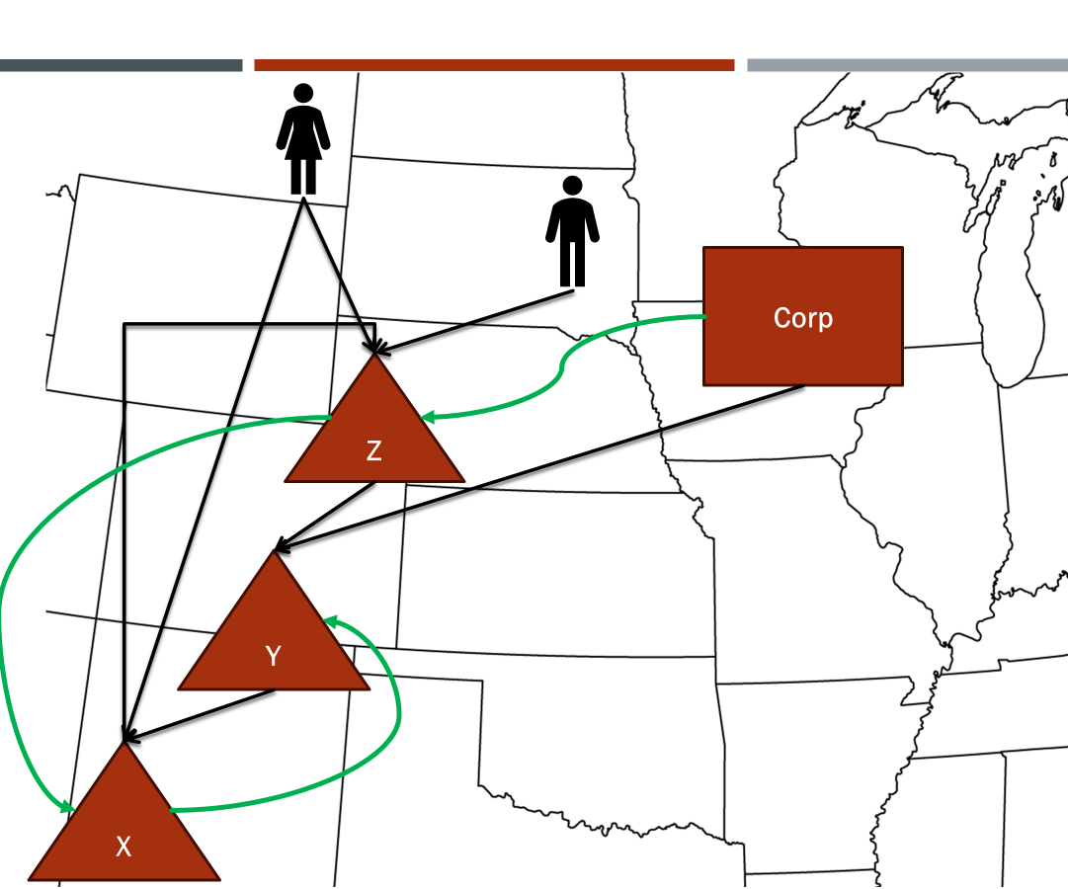
Explicit Tiered Partnership Sourcing Rules

Slide 30
Examples of tiered partnership sourcing rules
Arizona: Arizona Corporate Tax Ruling No. 93-10 (04/30/1993)
A multistate corporation that has business activities within and without Arizona must apportion its income from such activities in addition to the apportionment or allocation of its ultimate distributive share of the tiered partnership's income or loss from Arizona activities. If the corporation's interest in the tiered partnership is
business, the numerator and denominator of the corporation's apportionment factors in the Arizona tax return would include the corporation's distributive share of the tiered partnership's factors. The allocation of a tiered nonbusiness partnership's income or loss in the corporation's Arizona tax return would reflect the corporation's ultimate distributive share of the tiered partnership's Arizona activities.

Slide 31
Examples of tiered partnership sourcing rules
California:
Cal. Code Regs. tit. 18, § 25137-1
The taxpayer in computing net income for its taxable year shall include its distributive share of partnership items referred to above for any partnership year ending within or with the taxpayer's taxable year. The same principle applies when a taxpayer has an interest in a partnership that itself owns an interest, directly or indirectly, in one or more other partnerships . . . The determination of whether an item of income is apportionable business income or allocable nonbusiness income is made at the partnership level.
California FTB Legal Ruling No. 2021-01
In the corporate context, all factors and income of unitary entities are combined. However, with pass-through interests, an entity is unitary only to the extent of its interest in the pass-through entity. Therefore if a partner is unitary with a partnership and holds a 25 interest, the partner and 25 percent of the partnerships income and factors are combined. Thus, since not all of the income and factors of a unitary holding company are includable, attributes normally considered insignificant become critical. Therefore, in instances where a pass-through entity holding company holds less than a controlling interest in an operating entity, the holding company can still be unitary with the operating entity, to the extent of its ownership interest in the entity. This is because pass-through entities need not hold more than fifty percent of an entity to be unitary with that entity. As long as unitary indicia, as discussed above, exist, a pass-through entity holding company can be unitary with an operating entity.

Slide 32
Examples of tiered partnership sourcing rules
Colorado: Colo. Code Regs. § 39-22-109(3)(c)
These rules apply to all Members of a Pass-through entity regardless of the type of the entity (e.g., limited liability company, limited liability partnership, limited liability limited partnership) or the status of the Member (e.g., limited or general) . . . The activities of a Pass-through entity are attributable to its Members. Therefore, a Member is engaged in a Business in Colorado to the extent the Pass-through entity is engaged in Business in Colorado. The character of the item of income, loss, deduction or credit included in the Member's distributive share is determined as if the item was realized or incurred directly by the Member from the source from which the item was realized by the Pass-through entity or incurred in the same manner as the Pass-through entity. The principles of this paragraph apply in the case of an ownership chain that runs through multiple Pass-through entities . . .

Slide 33
Examples of tiered partnership sourcing rules
Colorado: Colo. Code Regs. § 39-22-109(3)(c) (continued)
In the case of a Nonresident who is a Member of a partnership ("first partnership"), which partnership is a partner in another partnership ("second partnership"), the following rules apply:
(A) Unitary Partnerships. In the case of unitary partnerships, the election made by the second partnership is irrelevant to the treatment of income of the first partnership.
(I) If the first partnership makes the election to apportion its income pursuant to § 39-22-303.6, C.R.S. (including the special apportionment rules adopted thereunder), and is unitary with the second partnership as determined by general unitary theory, then the Nonresident member of the first partnership's share of Colorado source income is the Member's pro rata share of the partnership's Colorado-source income as determined by § 39-22-303.6, C.R.S. The first and second partnerships are treated as a single entity for purposes of calculating apportionment under § 39-22-303.6, C.R.S.
(II) If the first partnership makes the election not to apportion its income pursuant to § 39-22-303.6, C.R.S., and is unitary with the second partnership, then the partnerships are treated as one partnership and the income is sourced in accordance with this rule.
(B) Non-Unitary Partnerships. In the case of non-unitary partnerships, the election made by the first partnership is irrelevant to the treatment of income of the second partnership.
(I) If the two partnerships are non-unitary, then regardless of the election made by the first partnership, the first partnership's pro-rata share of the second partnership's Colorado-source income is directly allocated by the first partnership to Colorado and is not apportioned. The pro-rata share of such income passes through to the Nonresident Member as Colorado-source income.

Slide 34
Examples of tiered partnership sourcing rules
District of Columbia: D.C. Code § 47-1801.4(55)(B)
For the purposes of this chapter, any business conducted by a partnership within the meaning of § 47-1808.06 shall be treated as conducted by its partners, whether directly held or indirectly held through a series of partnerships, to the extent of the partner's distributive share of the partnership's income, regardless of the percentage of the partner's ownership interest or its distributive or any other share of partnership income.

Slide 35
Examples of tiered partnership sourcing rules
Florida: Florida TAA # 11C1-001(February 2, 2011)
Whether the taxpayer's sales, payroll, and property factors of the apportionment formula should include the taxpayer's interest in various partnerships . . .
The Florida statutes and rules are clear that the activities of a partnership flow through the partnership to its partners. In its letter dated XXX, the taxpayer states that the partnerships it invests in contain multiple layers of ownership, and the lower tiered and middle tiered partnerships do not report apportionment information to the top tiered partnership because they are not required to do so in the states where they are located. Therefore, the upper tiered partnerships do not have any way to report the apportionment information from the middle and lower tiered partnerships to the corporate partner (in this case the taxpayer).
This rule provides that a corporation that is a partner in a partnership must add its share of the partnership's property, payroll, and sales to its own apportionment factor. Based on the foregoing, the partnerships' property, payroll, and sales should be combined with the taxpayer's property, payroll, and sales, for purposes of determining the taxpayer's apportionment factor

Slide 36
Examples of tiered partnership sourcing rules
Indiana: Ind. Code § 6-3-2-2(a)
Income from a pass through entity shall be characterized in a manner consistent with the income's characterization for federal income tax purposes and shall be considered Indiana source income as if the person, corporation, or pass through entity that received the income had directly engaged in the income producing activity. Income that is derived from one (1) pass through entity and is considered to pass through to another pass through entity does not change these characteristics or attribution provisions.

Slide 37
Examples of tiered partnership sourcing rules
Illinois: Ill. Admin. Code tit. 86, § 100.3500(d)
In the case of a partnership that is itself a partner in a second partnership, a partner in the first partnership shall include in net income its partnership share of the first partnership's share of the items of business income of the second partnership, as apportioned to Illinois by that second partnership. If the second partnership is itself a partner in a third partnership, a partner in the first partnership shall include in net income its partnership share of the first partnership's share of the items of business income of the third partnership as determined under the preceding sentence, and so on through all partnerships that are themselves partners in other partnerships.
Illinois: Ill. Admin. Code tit. 86, § 100.3380(d)
If a partnership and one of its partners are engaged in a unitary business and the partnership is itself a partner in a second partnership:
i) If the partner is not engaged in a unitary business with the second partnership, the partner's share of the first partnership's share of the business income and apportionment factors of the second partnership shall not be included in the partner's business income and apportionment factors. Instead, the partner's share of the first partnership's share of the base income apportioned to Illinois by the second partnership shall be included in the partner's Illinois net income.
ii) If the partner is engaged in a unitary business with the second partnership, the partner's share of the first partnership's share of the business income and apportionment factors of the second partnership shall be included in the partner's business income and apportionment factors.

Slide 38
Examples of tiered partnership sourcing rules
Kentucky: KRS 141.206
For purposes of determining an apportionment fraction under paragraph (a) of this subsection, if the pass-through entity is: 1. Doing business both within and without this state; and 2. A partner or member in another pass-through entity; then the pass-through entity shall be deemed to own the pro rata share of the property owned or leased by the other pass-through entity, and shall also include its pro rata share of the other pass-through entity's payroll and sales.
(c) The phrases "a partner or member in another pass-through entity" and "doing business both within and without this state" shall extend to each level of multiple-tiered pass-through entities.
(d) The attribution to the pass-through entity of the pro rata share of property, payroll and sales from its role as a partner or member in another pass-through entity will also apply when determining the pass-through entity's ultimate apportionment factor for property, payroll and sales as required under subsection (11) of this section.

Slide 39
Examples of tiered partnership sourcing rules
Massachusetts: 830 Mass. Code Regs. 62.5A.1
The income of a pass-through entity that derives from or is effectively connected with the conduct of a trade or business or the ownership of real or tangible personal property in Massachusetts retains its character as it passes through a tiered structure of pass-through entities before becoming income to the non-resident. Thus, income that is derived from a trade or business does not convert to non-business-related income as it passes through a series of entities. Similarly, Massachusetts source income of any pass-through entities engaged in a unitary business that conducts a trade or business in Massachusetts is taxable to a non-resident member to the extent it would be taxable if received directly by the non-resident . . .

Slide 40
Examples of tiered partnership sourcing rules
Massachusetts: 830 Mass. Code Regs. 62.5A.1 (continued)
Tiered Structure, a pass-through entity that has a pass-through entity as a member. As between two entities, the pass-through entity that is a member is the upper-tier entity, and the entity of which it is a member is the lower-tier entity. A tiered pass-through entity arrangement may have two or more tiers; in such cases, a single entity can be both a lower-tier and an upper-tier entity . . .
The activities of a pass-through entity are attributed to its individual members. A non-resident member of a pass-through entity is therefore engaged in the conduct of the trade or business of the pass-through entity of which it is a member, and thus is taxable on the Massachusetts source income of the entity. The character of any item of income, loss, deduction or credit included in the member's distributive share is determined as if it were realized directly by the member from the source from which realized by the pass-through entity, or incurred in the same manner as incurred by the pass-through entity. The principles in this paragraph shall apply in the case of an ownership chain that runs through multiple pass-through entities. For example, if a non-resident individual is a member of a pass-through entity that, in turn, is a member of a lower-tier pass-through entity that is engaged in a trade or business in Massachusetts, then the non-resident will be taxable on its share of the Massachusetts source income derived from the trade or business conducted by the lower-tier entity . . .

Slide 41
Examples of tiered partnership sourcing rules
Massachusetts: 830 Mass. Code Regs. 62.5A.1 (continued)
In the case of multiple pass-through entities that are not engaged in a unitary business, the pass-through entities must identify the Massachusetts income or loss, reporting that amount to its members, allocated or apportioned as appropriate pursuant to 830 CMR 62.5A.1(6). That income must retain its identity as Massachusetts source income, and be reported as such to members as it passes through multiple pass-through entities, without further apportionment . . .
In the case of multiple pass-through entities that are engaged in a unitary business, the income of any entity in the structure that derives from or is effectively connected with the conduct of a trade or business or the ownership of real or tangible personal property in Massachusetts retains its character as it passes through the structure. Thus, business income of a pass-through entity does not convert to non-business income as it passes through a series of pass-through entities engaged in related business activities, as that term is defined in 830 CMR 62.5A.1(2), and is further explained in 830 CMR 62.5A.1(6) . . .

Slide 42
Examples of tiered partnership sourcing rules
Massachusetts: 830 Mass. Code Regs. 62.5A.1 (continued)
If a passthrough entity has Massachusetts source income and is related to one or more other pass-through entities in a unitary business, including non-Massachusetts businesses that are in a unitary relationship, the entire income derived from the related activities of the members of the unitary business is subject to Massachusetts apportionment. The method of apportionment is to take the pro rata share of the factors of each entity in the unitary structure, and to aggregate the result for the entire group, according to the method in the following example. The non-resident members will report as Massachusetts source income their apportioned share of income of the entire unitary business . . .

Slide 43
Examples of tiered partnership sourcing rules
Massachusetts: 830 Mass. Code Regs. 62.5A.1 (continued)
Massachusetts Example: General Partnership (General) has a 50% interest in Subsidiary Partnership (Subsidiary); the entities are engaged in a unitary business. General has the following apportionment factors attributable to Massachusetts, presented as a fraction of Massachusetts activity divided by activity everywhere: Property, 25/100; Payroll, 50/100; Sales, 1000/10,000. General has income of $1,000. Subsidiary has the following apportionment factors, presented as a fraction of Massachusetts activity divided by activity everywhere: Property, 10/100; Payroll, 50/100; Sales, 1000/10,000. Subsidiary has a loss of $500. The Massachusetts income of the unitary group is calculated as follows: Income = $1,000 (General's income) - $250 (representing half the loss of Subsidiary; half because General has a 50% interest in Subsidiary) = $750. The $750 income figure must be multiplied by the blended apportionment factors. The blended factors are determined by adding the full factor of General to half the value of Subsidiary's factors (again, because of the 50% ownership). Thus the blended property factor is (25 + 5)/(100 + 50) = 30/150; the blended payroll factor is (50 + 25)/(100 + 50) = 75/150; the blended sales factor (to be counted twice according to the double weighted sales factor rule) is [(1000 + 500)/(10,000 + 5,000)] = 1,500/15,000; the sum of these factors is then divided by four to yield the following result:.2 +.5 +.1 +.1 =.9 / 4 =.225.

Slide 44
Examples of tiered partnership sourcing rules
Montana : Mont. Admin. R. 42.9.107
(1) A pass-through entity may have, in addition to income from its own operations or activities, income from one or more other pass-through entities. This rule describes how the pass-through entity must classify its income from its own operations or activities as apportionable or nonapportionable income and how it must report its income from other pass-through entities. For purposes of this rule, "operations income" means the income of a pass-through entity from its own operations or activities and "flow-through income" means its separately and nonseparately stated distributable share of income from other pass-through entities.
(2) Except as provided in (5), each pass-through entity has to separately determine whether its operations income is apportionable or nonapportionable income as those terms are defined in ARM 42.26.206. Once a pass-through entity determines the apportionable or nonapportionable character of its operations income, the entity must then determine what part of this apportionable and/or nonapportionable income is Montana source income. Except as provided in (5) and (6), the operations income retains its character as apportionable or nonapportionable income and as Montana source income regardless of how many other tiers of pass-through entities through which the income is passed.
(3) Except as provided in (5) and (6), flow-through income of a pass-through entity, determined as provided in (1), retains its character as apportionable and/or nonapportionable income and its character as Montana source income.
(4) An entity in a multi-tiered pass-through entity structure may have flow-through income sourced to Montana under the subsections of the definition of "Montana source income" in 15-30-2101, MCA, that address partnership or S corporation income derived from Montana activity or property, reportable on Montana Schedule K-1, and also operations income sourced to Montana as a result of its own business activity under other subsections of that definition of "Montana source income," such as net income from a business, profession, or farming activities carried on in the state. If this occurs the entity must allocate to Montana the flow-through income sourced to Montana and the entity must determine the portion of its operations income that is sourced to Montana as provided in (1) and allocate or apportion that Montana source income under the provisions of ARM 42.9.112.
(5) This rule does not apply to a partnership or disregarded entity whose operations are unitary with the business operations of a corporate partner or disregarded entity owner that is a C corporation whose apportionment factors are included in the computation of the C corporation's apportionment factors as provided in ARM 42.26.228.

Slide 45
Examples of tiered partnership sourcing rules
New Jersey: N.J. Admin. Code § 18:35-1.3(d)(6)
A tiered partnership shall take into account its distributive share of partnership income from any partnership of which it is a member. Once income has been allocated by a partnership, it shall not be reallocated by the partners.

Slide 46
Examples of tiered partnership sourcing rules
New York: New York Instructions for Form IT-204 (2023)
Tiered partnerships (Regulation section 137.6) If your partnership is a partner in another partnership (hereinafter referred to as the lower tier partnership), the source and character of the distributive share of each item of your partnership to any partner of your partnership that is attributable to the lower tier partnership retains the source and character determined at the level of the lower tier partnership. Such source and character are not changed by reason of the fact that any such item flows through your partnership to such partner.
Example: Partnership A was a partner in another partnership, B. A is referred to as the upper tier partnership while B is referred to as the lower tier partnership. P was a nonresident individual partner of A. Partnership A was not engaged in a trade or business in New York but partnership B was. Even though partnership A was not carrying on business in New York, it had New York source income from the distributive shares it received from partnership B. The source and character of each item that partnership A received from partnership B retains the source and character determined at the level of partnership B. For instance, if P was a partner of A, and A was a partner of B, nonresident individual partner P would allocate its share of the NY income from B at B’s business allocation percentage. Further, if A was engaged in a trade or business in NY, then P would allocate its share of A’s income using A’s business allocation percentage and P would allocate its share of B’s income (which flows to A) at B’s business allocation percentage. This allocation method should be reflected on Forms IT-204 and IT-204-IP.

Slide 47
Examples of tiered partnership sourcing rules
Utah : Form TC-65 Utah Instructions (2023)
If a corporation holds direct and indirect ownership interests in tiered pass-through entities, it must include its pro rata share of the apportionment factors (property, payroll and sales) of the pass-through entities, applying the respective ownership percentages. For example, a corporation that holds 50 percent interest in Partnership A that in turn holds 20 percent interest in Partnership B would include 50 percent of the factors of Partnership A, and 10 percent (50 percent of 20 percent) of the factors of Partnership B.
Virginia: Virginia Ruling of the Commissioner PD 07-50 (April 26, 2007)
Thus, if a partnership operates a business in Virginia, any item of partnership income, gain, loss, deduction, or credit will retain its Virginia source character no matter how many partnerships it passes through. The pass through of Virginia source income will continue to occur from partnership to partner until the income is passed through to a partner that is a taxable entity.

Slide 48
Examples of tiered partnership sourcing rules
West Virginia: West Virginia Form PTE-100 Instructions (2023)
Pass through entity owners of pass through entities should allocate income received from a Pass Through Entity unless such entities are engaged in a unitary business. If a unitary relationship exists, a Pass Through Entity owner of a pass through entity may reapportion its WV income, including the appropriate factors of the subsidiary.
Wisconsin: Wisconsin Tax Bulletin No. 197 (April 2017)
Partnership or Tax-Option (S) Corporation: A partner that is a partnership or tax-option (S) corporation reports its share of income, before apportionment, from the partnership. The partnership reports this amount in column (d), “Amount under Wis. law”, of Schedule 3K-1. The partnership must also report the partner's share of the partnership's apportionment factors in Part IV of Schedule 3K-1, Partner's Share of Apportionment Factors. The partnership or tax-option (S) corporation partner com-bines the amounts from Part IV with its own apportionment factors on its Form A-1 or Form A-2.

Slide 49
Considerations: Should tiered partners have different sourcing rules than corporate and nonresident individual partners? What Method is best for sourcing Partnership income in tiered partnerships – Lower-tier Pass-through Sourcing, Upper-Tier sourcing, Combination sourcing, something else?

Slide 50
Keep in mind

Slide 51
Why Do Large partnerships Continue to be a challenge
Pass-through system splits the reporting of tax information between entities and all the owners
Complex opaque structures can have hundreds of entities and thousands of partners
Items of income, expense, gain, and loss can be “specially allocated” to the owners
There is a lack of non-tax financial or regulatory information
Financing can be obtained without public offerings or third-party financial institutions
But what about the new centralized partnership audit regime?

Slide 52
Example: Recent IRS Audit initiative - Sports Partnerships
IRS is reported to be focusing on sports teams, which often use partnership entities in their ownership structures.
Reason given for this audit focus - These partnerships often “throw off” losses.
Those losses may be used by owners, typically high-income individuals, to offset other income.
However, the losses must pass the substantive loss-limitation rules—which look to how the activities creating the income and loss are related, the character of the income and loss, and the role of the partner in the partnership.
So how will the centralized partnership audit regime be able to handle this?

Slide 53
What does this have to do with State Tax Sourcing?
It’s easy to separate activities giving rise to losses and activities giving rise to income—or to combine them—using partnership structures.
The same partners (or different) partners may share in income and losses from related activities differently.
When divided into separate entities, the income and losses may be sourced to different states than they would be if combined.
All this provides a potential means to structure the tax result in certain cases.

Slide 54
THOUGHTS – Questions - comments?

