Slide 1

State Taxation of Partnerships –
Work Group Report to the Uniformity Committee
November 14, 2023

Slide 2
Process

Slide 3
Identify Potential
Issues & Relationships

Slide 4
Identify Potential
Issues & Relationships
Issue Outline

Slide 5
Identify Potential
Issues & Relationships
Issue Outline
Jurisdiction & Nexus Issues
  Jurisdiction to require filing of reports
  Nexus over the partnership and partners, including limited, passive, and indirect
Tax Base & Conformity Issues – State Adjustments
  Adjustments to the base at the partnership level
  Adjustments to the base at the partner level
Sourcing – Operating Income & Gains from Interest Sales
  Simple sourcing – partnership level
  Issues – investment partnerships and other
  Tiered sourcing and related party transactions
PTE & Related Issues
Administration & Enforcement
  Withholding, etc.

Slide 6
Identify Potential
Issues & Relationships
Issue Outline
Select Issue & Develop Practices or Position

Slide 7
Identify Potential
Issues & Relationships
Issue Outline
Sourcing –
  Investment Partnerships
    White Paper
    Draft Model
  Guaranteed Payments for Services
    White Paper
    Draft Model
Select Issue & Develop Practices or Position
White Papers & Draft Models

Slide 8
Identify Potential
Issues & Relationships
Issue Outline
Select Issue & Develop Practices or Position
White Papers & Draft Models
Agree on a Set of Practices & Positions
Proposed Drafts & Other Guidance

Slide 9
Identify Potential
Issues & Relationships
Issue Outline
Select Issue & Develop Practices or Position
White Papers & Draft Models
Agree on a Set of Practices & Positions
Proposed Drafts & Other Guidance
REPEAT or PROCEED

Slide 10
Identify Potential
Issues & Relationships
Issue Outline
Select Issue & Develop Practices or Position
White Papers & Draft Models
Agree on a Set of Practices & Positions
Proposed Drafts & Other Guidance
REPEAT or PROCEED
WORK GROUP APPROVAL

Slide 11
Identify Potential
Issues & Relationships
Issue Outline
Select Issue & Develop Practices or Position
White Papers & Draft Models
Agree on a Set of Practices & Positions
Proposed Drafts & Other Guidance
REPEAT or PROCEED
WORK GROUP APPROVAL
UNIFORMITY COMMITTEE APPROVAL

Slide 12
Identify Potential
Issues & Relationships
Issue Outline
Select Issue & Develop Practices or Position
White Papers & Draft Models
Agree on a Set of Practices & Positions
Proposed Drafts & Other Guidance
REPEAT or PROCEED
WORK GROUP APPROVAL
UNIFORMITY COMMITTEE APPROVAL
EXECUTIVE COMMITTEE PUBLIC HEARING

Slide 13
Identify Potential
Issues & Relationships
Issue Outline
Select Issue & Develop Practices or Position
White Papers & Draft Models
Agree on a Set of Practices & Positions
Proposed Drafts & Other Guidance
REPEAT or PROCEED
COMMISSION APPROVAL
WORK GROUP APPROVAL
UNIFORMITY COMMITTEE APPROVAL
EXECUTIVE COMMITTEE PUBLIC HEARING

Slide 14
Identify Potential
Issues & Relationships
Issue Outline
Background & Training
Select Issue & Develop Practices or Position
White Papers & Draft Models
Agree on a Set of Practices & Positions
Proposed Drafts & Other Guidance
REPEAT or PROCEED
COMMISSION APPROVAL
WORK GROUP APPROVAL
UNIFORMITY COMMITTEE APPROVAL
EXECUTIVE COMMITTEE PUBLIC HEARING

Slide 15
Identify Potential
Issues & Relationships
Issue Outline
Background & Training
Litigation & Legislation
Select Issue & Develop Practices or Position
White Papers & Draft Models
Agree on a Set of Practices & Positions
Proposed Drafts & Other Guidance
REPEAT or PROCEED
COMMISSION APPROVAL
WORK GROUP APPROVAL
UNIFORMITY COMMITTEE APPROVAL
EXECUTIVE COMMITTEE PUBLIC HEARING

Slide 16
Identify Potential
Issues & Relationships
Issue Outline
Background & Training
Litigation & Legislation
Select Issue & Develop Practices or Position
White Papers & Draft Models
Expanding Project Page
Agree on a Set of Practices & Positions
Proposed Drafts & Other Guidance
REPEAT or PROCEED
COMMISSION APPROVAL
WORK GROUP APPROVAL
UNIFORMITY COMMITTEE APPROVAL
EXECUTIVE COMMITTEE PUBLIC HEARING

Slide 17
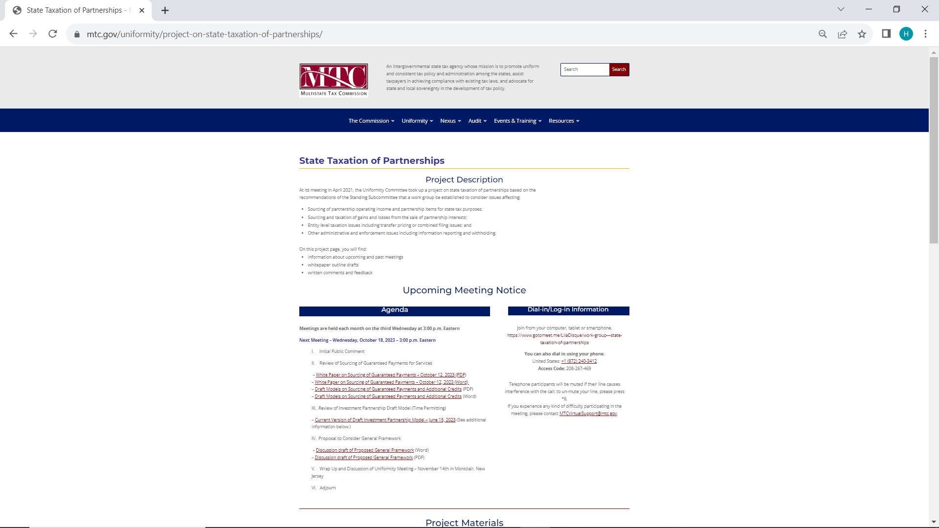


Slide 18
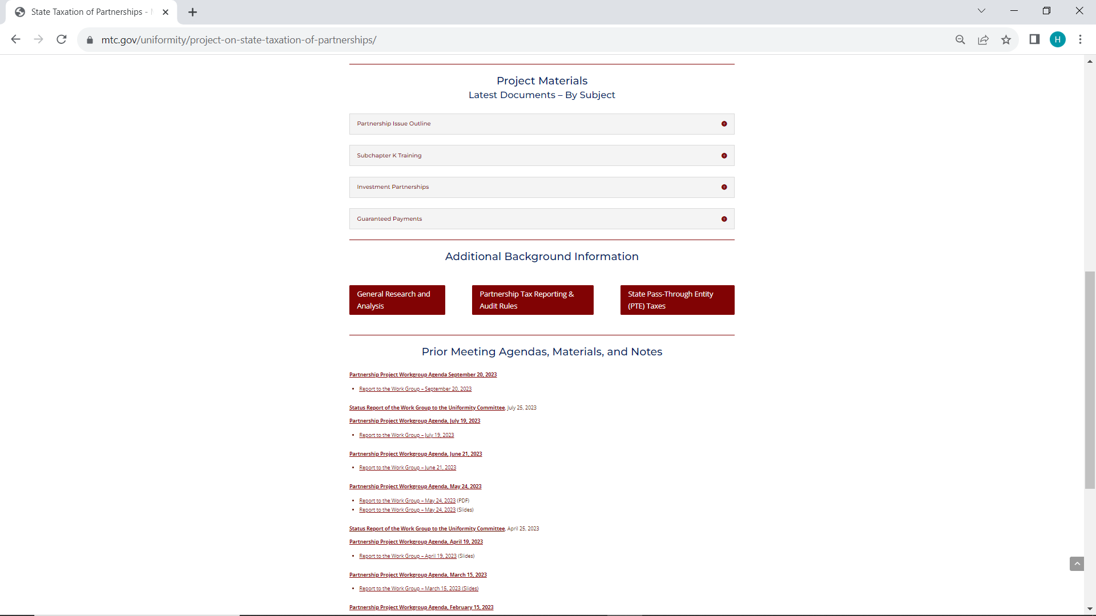


Slide 19
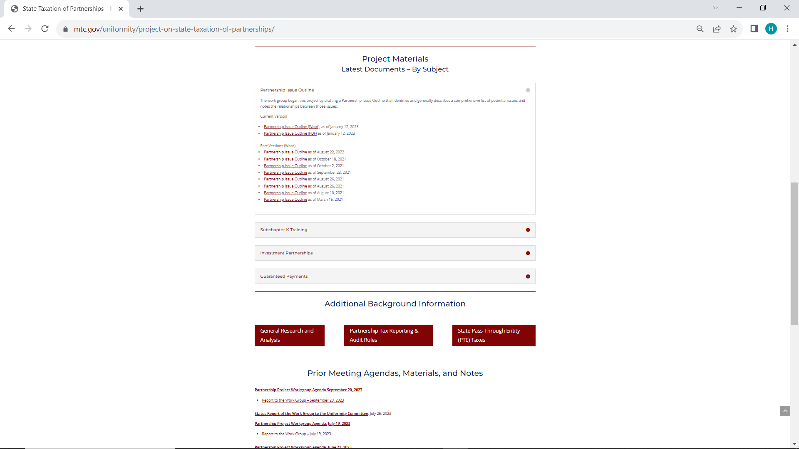


Slide 20
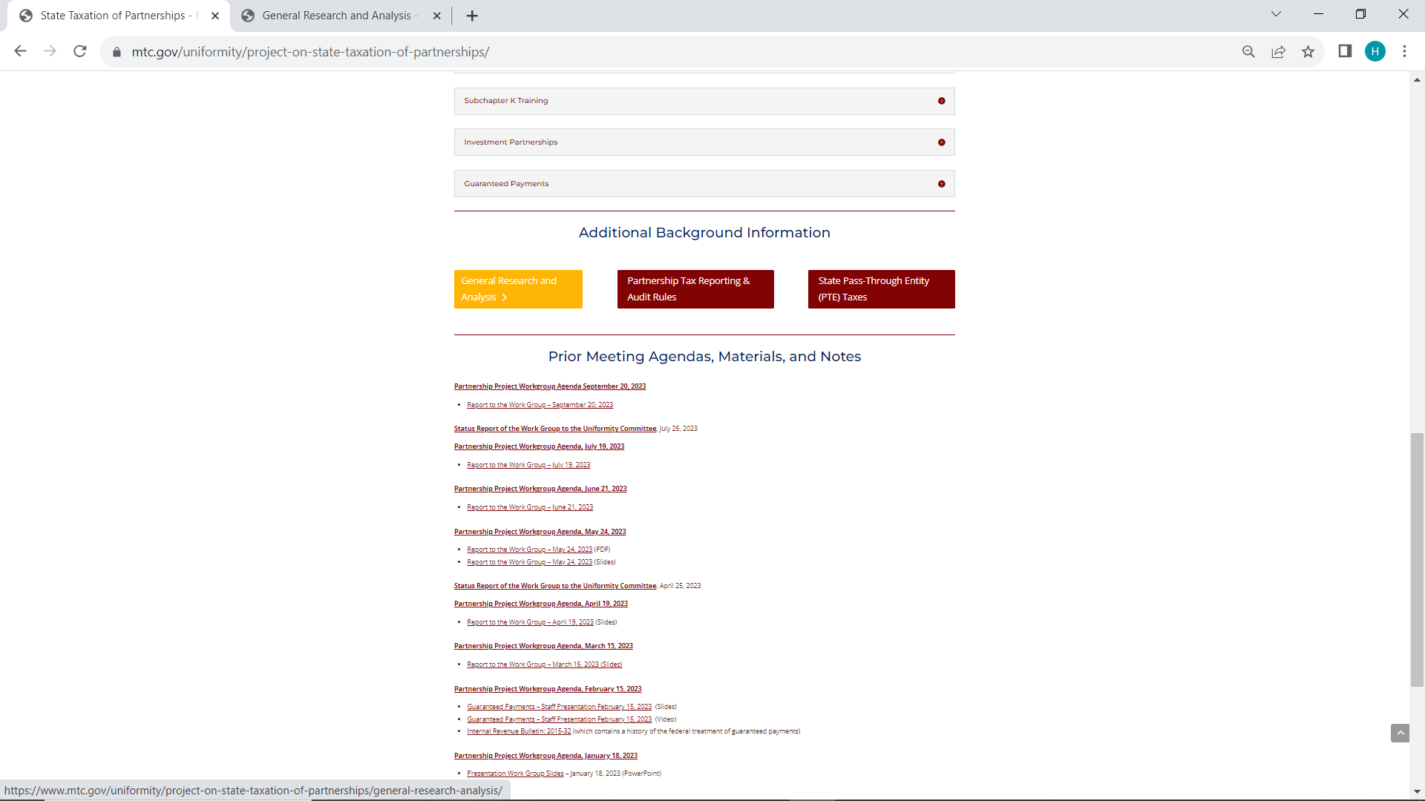


Slide 21
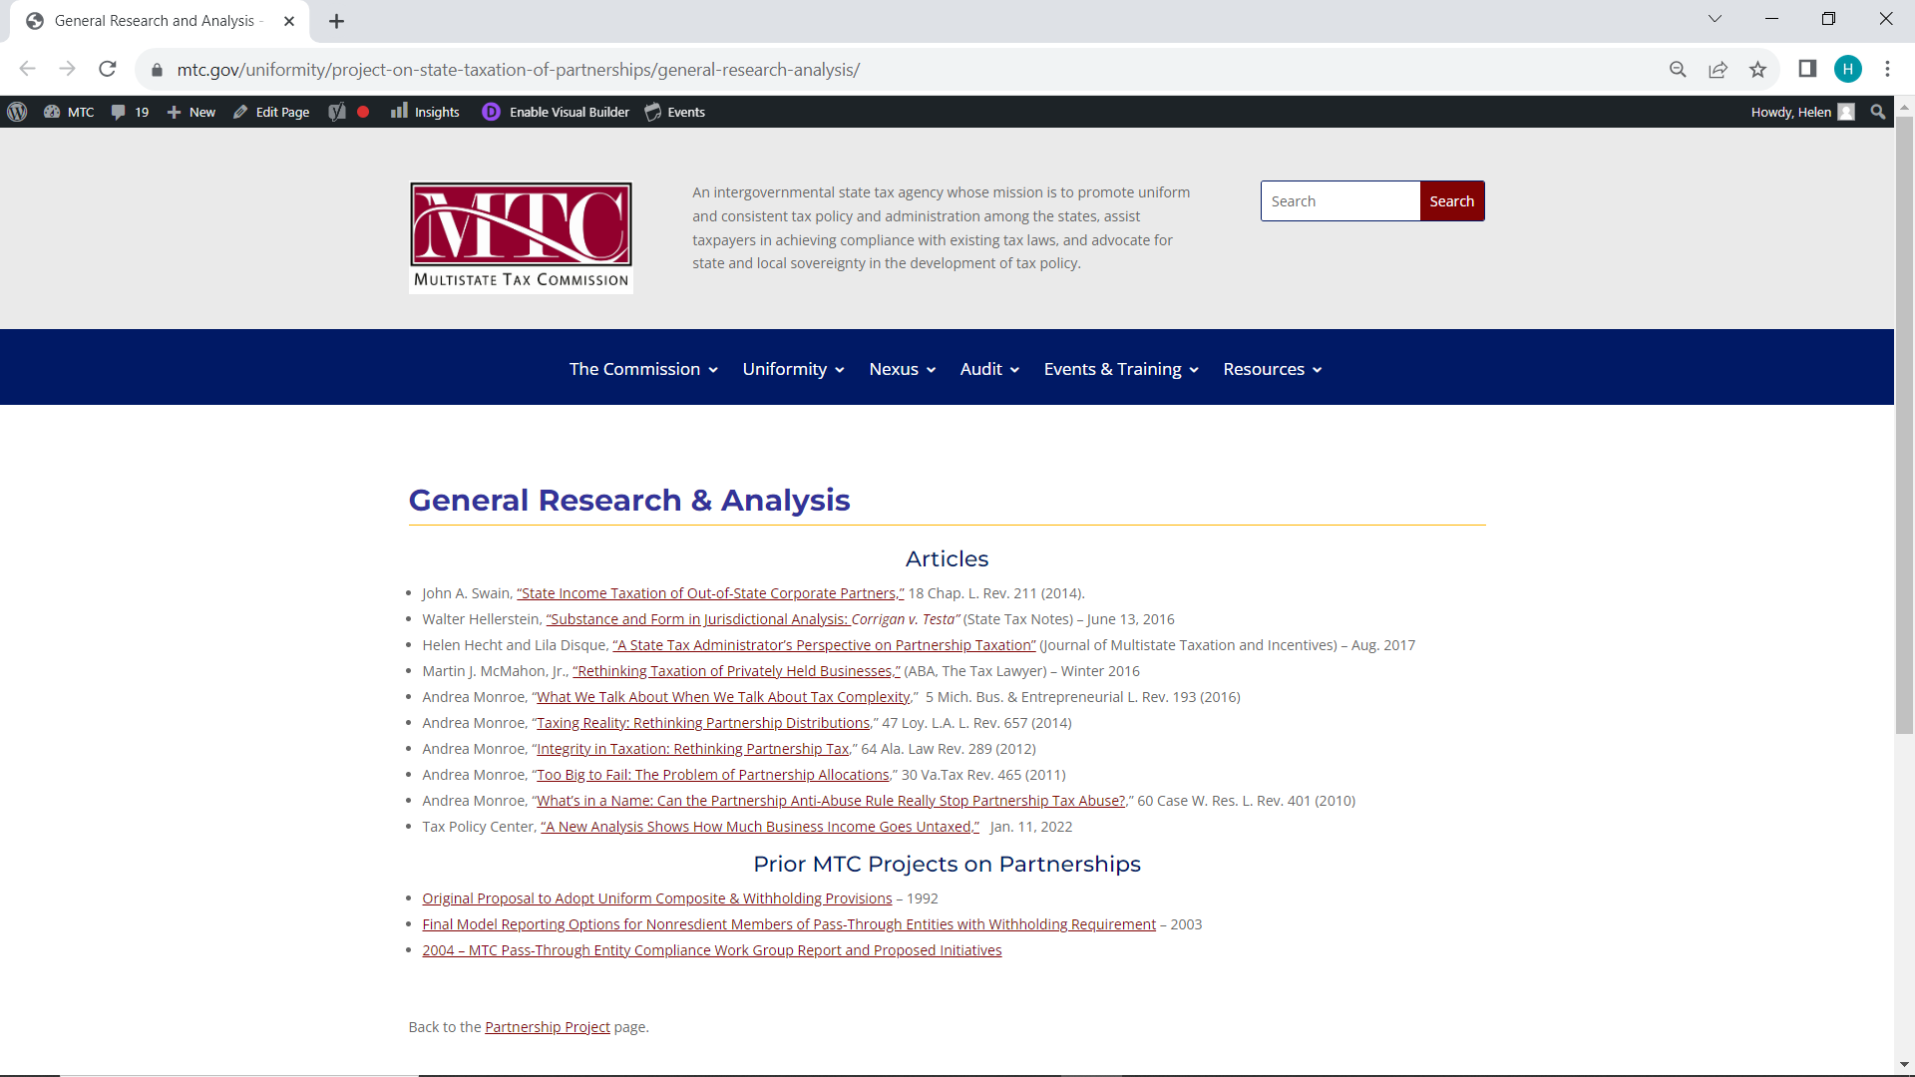


Slide 22
Sourcing – Income of Investment Partnerships

Slide 23
Sourcing – Income of Investment Partnerships
Sourcing Issue:
Partnership income is generally sourced at the partnership level and that sourcing flows through to the partners. Should income of partnerships engaging primarily in investment activities be sourced differently, and if so, how?
Example: Partnership X holds stock, interests in other partnerships, and certain real property as investments for its partners and the partnership does not take an active role in the management of the underlying businesses or use the assets in a business of its own.
About half of the states have specifically addressed the issue—generally sourcing certain income to the partner’s state of residence.
Some appear to have treated it as a nexus or doing business issue, others appear to have treated it as nonbusiness or non-apportionable income.

Slide 24
Sourcing – Income of Investment Partnerships
Work Group Process to Date:
Conducted discussions on the issue – starting in January, 2022 and ongoing.
Issued a draft white paper analyzing the treatment – published in May, 2022.
Circulated a draft model rule (statutory form) – in August, 2022.
Took comments on model rule – summarized in April, 2023.
Issued proposed revisions in response to comments – April, 2023
Revised model rule into the form of a regulation – June, 2023.

Slide 25
Sourcing – Income of Investment Partnerships
Draft Model is Based on Certain Principles:
States conform to Subchapter K’s conduit approach.
States do not apply the federal sourcing rules to partnership items in the interstate context.
States generally source partnership income using an entity approach.
BUT - States source direct nonbusiness investment income of nonresidents using specific rules based on the type of income or asset.

Slide 26
Sourcing – Income of Investment Partnerships
Sourcing Based on the Asset Rather than the Partnership Applies If:
The partner:
  Is a nonresident individual (or taxed as a nonresident individual).
  Does not engage in managing the investment partnership.
  Is not a dealer in investments.
  Does not hold the interest as part of the business of the partner.
The investment partnership is not unitary with any other business.

Slide 27
Sourcing – Income of Investment Partnerships
Approach:
The rule is NOT that a partners source all qualified investment partnership income to residence.
The definition of “Qualified investment partnership” includes:
  A general definition, and
  A safe harbor – using the asset test.
Examples are used to illustrate application.

Slide 28
Sourcing – Income of Investment Partnerships
General Definition:
(c) “Qualified Investment Partnership.”
A qualified investment partnership, as used in this regulation, means a partnership that:
(1) does not act as a dealer under 26 U.S.C. § 475(c);
(2) does not act as a financial institution as defined by [reference to state law]; and
(3) holds assets solely for investment purposes and:
(i) does not materially participate or otherwise actively engage in the activities of the businesses in which it holds interests;
(ii) is not unitary with a business in which it holds interests; and
(iii) does not use or employ assets in any way other than for investment.

Slide 29
Sourcing – Income of Investment Partnerships
Safe Harbor:
(d) . . . no less than 90 percent of the cost of the partnership’s total assets consists of the following:
(1) Common stock . . . and preferred stock, including debt securities convertible into preferred stock;
(2) Bonds, debentures, and other debt securities . . .;
(3) Deposits and any other obligations of banks and other financial institutions . . . and cash and cash equivalents, including foreign currencies;
(4) Corporate stock and bond index securities, future contracts, derivative securities, warrants or options on securities, and other similar financial securities and instruments available for sale or trade through public markets;
(5) Interests in partnerships or other pass-through entities but only if those partnerships or entities would meet the requirements of this safe harbor;
(6) Other similar or related financial or investments contracts, instruments, or securities; and
(7) Office facilities and other tangible and intangible personal property reasonably necessary to carry on its investment activities, including accounts receivable.

Slide 30
Sourcing – Income of Investment Partnerships
Examples:
General Assumptions: In each of the examples below, assume Smith is a nonresident partner that holds an interest in Partnership X which has offices and activities in this state.
(1) Simple Example:
• Smith meets the criteria of Section (b) of this regulation.
• X meets the safe harbor of Section (d) of this regulation.
• X has dividends from corporate stock.
The activities of X in this state do not determine how Smith’s distributive share of the dividends are sourced. Rather, under state statutes and regulations, such dividends from investment in corporate stock recognized by an individual would be sourced to the individual’s state of residence. [Insert reference to statutes and regulations.] Therefore, Smith’s distributive share of the dividend income of X is not sourced to this state.

Slide 31
Sourcing – Income of Investment Partnerships
Examples:
(2) Partnership X Meets General Criteria but not Safe Harbor:
Smith meets the criteria of Section (b) of this regulation [nonresident and not active in any partnership management activities].
X does not meet the safe harbor of Section (d) of this regulation, but otherwise meets the definition of a qualified investment partnership under Section (c).
X has dividends from corporate stock.
The fact that X is not presumed to be a qualified investment partnership does not prevent it from being treated as one. The activities of X in this state do not determine how Smith’s distributive share of the dividends are sourced. Rather, under state statutes and regulations, such dividends from corporate stock recognized by an individual would be sourced to the individual’s state of residence. [Insert reference to statutes and regulations.] Therefore, Smith’s distributive share of the dividend income of X is not sourced to this state.

Slide 32
Sourcing – Income of Investment Partnerships
Examples:
(3) Partnership X has Gain from Sale of Real Property in this State:
Partner Smith owns an interest in Partnership X.
Smith meets the criteria of Section (b) of this regulation.
X does not meet the safe harbor of Section (d) of this regulation, but otherwise meets the definition of a qualified investment partnership under Section (c).
X has a capital gain from the sale of real property in this state.
. . . under state statutes and regulations, such capital gains from real property in the state that are recognized by an individual would be sourced to this state. [Insert reference to statutes and regulations.] Therefore, Smith’s distributive share of the capital gains is sourced to this state.

Slide 33
Sourcing – Income of Investment Partnerships
Examples:
If X were found not to meet the definition of a qualified investment partnership under Section (c), then X’s activities in the state might affect the sourcing of the gain from the sale of real property. If the gain were determined to be part of X’s unitary business, then the gain would be apportioned as part of X’s business income using [reference to state’s apportionment rules applied to partnerships]. If the gain were determined to be nonbusiness [or non-apportionable] income of X, then the gain would be allocated under [reference to state’s rules for sourcing nonbusiness income].

Slide 34
Sourcing – Income of Investment Partnerships
Examples:
(4) Partnership has in Distributive Share Income from Another Partnership:
Smith meets the criteria of Section (b) of this regulation.
X does not meet the safe harbor of Section (d) of this regulation, but otherwise meets the definition of a qualified investment partnership under Section (c).
X has distributive share income from an interest in Partnership Y, doing business in this state.
. . . under state statutes and regulations, such distributive share income recognized by an individual would be sourced to this state based on the activities of Partnership Y. [Insert reference to statutes and regulations.] Therefore, Smith’s distributive share of the income of Partnership Y, flowing through Partnership X, is sourced to this state based on the activities of Partnership Y.

Slide 35
Sourcing – Income of Investment Partnerships
Status:
Awaiting any further comments – but also – will address other general sourcing issues before moving on to recommend the model to the uniformity committee.

Slide 36
Sourcing – guaranteed payments for services

Slide 37
Sourcing – guaranteed Payments for Services
Sourcing Issue:
Should states source an individual partner’s guaranteed payments for services as distributive share or as compensation?
About half the states have explicitly addressed the issue.
Of those, the majority would source the guaranteed payments the same as other distributive share income. Other states would source as compensation, with certain limits.

Slide 38
Sourcing – guaranteed Payments for Services
Work Group Process to Date:
Began discussions in February, 2023.
Published first draft of white paper in April, 2023.
Published draft white paper with findings and recommendations in August, 2023.
Drafted model using the same method as sourcing distributive share – October, 2023 – and including a credit provision to address multiple sourcing.

Slide 39
Sourcing – guaranteed Payments for Services
Factors Favoring Sourcing the Same as Compensation:
More consistent with the entity approach used under Subchapter K to account for and tax these payments.
More consistent with the sourcing of payments to partners who perform services not acting in the capacity of partners.
Generally consistent with the federal sourcing of such payments when partners perform services overseas.
Since federal tax law gives these payments less favorable treatment than distributive share/distributions generally, this means that the risk that they would be used merely to alter the state sourcing result is somewhat reduced.

Slide 40
Sourcing – guaranteed Payments for Services
Factors Favoring Sourcing the Same as Distributive Share:
Guaranteed payments are simply a matter of agreement between partners and, in some cases, can lead to the same economic result for the partners as distributive share.
Sourcing guaranteed payments for services as compensation requires distinguishing these them from special allocations and from payments for the use of capital.
Sourcing the same as distributive share treats partners the same as owners of proprietorships who take draws.
States that have PTE taxes and include guaranteed payments in the base will generally source that base using entity-level apportionment or allocation.
Sourcing guaranteed payments differently than distributive share may also add administrative complexity.
Sourcing guaranteed payments as distributive share is the approach used by the majority of states that have specifically addressed the issue.

Slide 41
Sourcing – guaranteed Payments for Services
Draft Models are Based on Certain Principles:
States conform to Subchapter K’s conduit approach.
States do not apply the federal sourcing rules to partnership items in the interstate context.
States generally source partnership income using an entity approach.
State sourcing of partnership income is attributed to the partners.
Multiple taxation should be reduced if possible.

Slide 42
Sourcing – guaranteed Payments for Services
Approach:
Model is drafted in part as a statute and in part as a regulation with examples.
The model statute addresses the treatment of guaranteed payments to foreign partners and to domestic partners working abroad, where the federal sourcing treatment is based on location of performance.
Addresses guaranteed payments to retired partners which states are preempted from taxing unless the partner is a resident.
The additional credit recognizes that a minority of states have chosen to tax guaranteed payments for services to the location of the performance. The credit is drafted as a statute to be adopted by residency states that source guaranteed payments in the same way as distributive share.

Slide 43
Sourcing – guaranteed Payments for Services
Status:
The work group is taking comments and input on the draft model as part of their discussions.

Slide 44
What’s next?

Slide 45
Complex sourcing Issues
Complex Tiered and Related Entity Structures
Complex Special Allocations

Slide 46

Simple Example
X

Slide 47

Simple Example
Ownership
Y
X

Slide 48
Simple Example
Corp
Z
Ownership
Y
X

Slide 49

Simple Example
Corp
Z
Ownership
Y
X

Slide 50
Simple Example
Corp
Z
Ownership
Y
X

Slide 51
Simple Example
Corp
Z
Ownership
Transactions
Y
X

Slide 52
Simple Example
Do the activities of Partnership Z affect the sourcing of Bob’s distributive share from Partnership Y?
Ownership
Corp
Transactions
Z
Y
X

Slide 53
Simple Example
Do the activities of Partnership Z affect the sourcing of Bob’s distributive share from Partnership Y?
Assume Partnerships Z and Y are part of a unitary business and Partner Bob is a majority, active partner in Partnership Z.
Ownership
Corp
Transactions
Z
Y
X

Slide 54
Simple Example
Do the activities of Partnership Z affect the sourcing Corp’s distributive share from Partnership Y?
Ownership
Corp
Transactions
Z
Y
X

Slide 55
Simple Example
Do the activities of Partnership Z affect the sourcing Corp’s distributive share from Partnership Y?
Assume Partnership Z and Partnership Y are part of a unitary business and Corp is a minority, passive partner in Partnership Y.
Ownership
Corp
Transactions
Z
Y
X

Slide 56
Simple Example
Assume Partnership Y and Partnership X are part of a unitary business.
How does this affect the sourcing of Partner Ann’s partnership income?
Does it matter whether Ann is active in the business?
Ownership
Corp
Transactions
Z
Y
X

Slide 57




Simple Example
Assume Partnership Y and Partnership X are part of a unitary business.
How does this affect the sourcing of Partner Ann’s partnership income?
Does it matter whether Ann is active in the business?
Ownership
Corp
Transactions
Z
Y
X

Slide 58
Simple Example
Assume Partner Ann receives a special allocation of income from Partnership X which is nonbusiness/ non-apportionable income to Partnership X.
Ownership
Corp
Transactions
Z
Y
X

Slide 59
Identify Potential
Issues & Relationships
Issue Outline
Complexity
Background & Training
Litigation & Legislation
Select Issue & Develop Practices or Position
White Papers & Draft Models
Expanding Project Page
Agree on a Set of Practices & Positions
Proposed Drafts & Other Guidance
REPEAT or PROCEED
COMMISSION APPROVAL
WORK GROUP APPROVAL
UNIFORMITY COMMITTEE APPROVAL
EXECUTIVE COMMITTEE PUBLIC HEARING

Slide 60
Research
Identify Potential
Issues & Relationships
Issue Outline
Background & Training
Litigation & Legislation
Select Issue & Develop Practices or Position
White Papers & Draft Models
Expanding Project Page
Agree on a Set of Practices & Positions
Proposed Drafts & Other Guidance
REPEAT or PROCEED
COMMISSION APPROVAL
WORK GROUP APPROVAL
UNIFORMITY COMMITTEE APPROVAL
EXECUTIVE COMMITTEE PUBLIC HEARING

Slide 61
General Framework
Identify Potential
Issues & Relationships
Issue Outline
Background & Training
Litigation & Legislation
Select Issue & Develop Practices or Position
White Papers & Draft Models
Expanding Project Page
Agree on a Set of Practices & Positions
Proposed Drafts & Other Guidance
REPEAT or PROCEED
COMMISSION APPROVAL
WORK GROUP APPROVAL
UNIFORMITY COMMITTEE APPROVAL
EXECUTIVE COMMITTEE PUBLIC HEARING

Slide 62

General Framework
General –
1. State law governs the formation of different types of partnerships and the basic rights of partners, including any rights to:
a. Divest or transfer their interests;
b. Receive liquidating distributions; and
c. Alter certain legal and economic rights and relationships by agreement.
2. States allow entities formed in other jurisdictions to operate in the state, provided they comply with state regulatory requirements.
3. State income taxes generally conform to applicable federal substantive tax provisions for computing and characterizing items of income for individuals and corporations, and follow the IRS interpretation of those provisions.

Slide 63
General Framework
General (cont’d) –
4. State pass-through tax systems generally conform to the provisions of IRC Subchapter K and follow IRS interpretations of those provisions. The critical elements of Subchapter K include:
a. Partnership income is taxed when earned (IRC § 702 & 703).
b. Partners are required to report and pay tax on their shares of partnership items of income, expense, gain or loss, regardless of whether they receive any actual distribution (IRC § 704).
c. Distributions are not taxable to the extent they represent contributions by or income already recognized by the partner (IRC § 731).
d. Partners may agree to vary their shares of partnership items and change those shares over time and the tax result will reflect their agreement provided the allocations of items have substantial economic effect. (IRC § 704(b)).

Slide 64
General Framework
General (cont’d) –
5. The IRS has adopted certain anti-abuse rules deemed essential for the federal pass-through system to function properly but the application at the state level may be unclear.
6. Both general state law and Subchapter K allow partnerships to have partners that are corporations (whether taxed as C corporations or S corporations), individuals, trusts, and other partnerships.
7. Most states that impose tax on partnership income on a pass-through basis have also adopted elective pass-through entity taxes under which partnerships can report income and pay tax at the entity level in lieu of the tax on partners.

Slide 65
General Framework
General Regulatory Jurisdiction –
8. Over the Entity: If a partnership has assets or activities with a sufficient connection to a state, the state may exercise general regulatory jurisdiction over that partnership, including:
a. Requirements to register;
b. Requirements to report activities in the state; and
c. Requirements to provide certain information about the partners regardless of a partner’s control of or role in the partnership.
9. Over the Partners: If a state has general regulatory jurisdiction over the partnership, that jurisdiction generally extends to the partners in matters involving activities of the partnership, although there remains some uncertainty as to whether it extends to passive or indirect partners in all cases.

Slide 66
General Framework
Constitutional Tax Nexus and State Doing Business Standards –
10. A business’s choice of entity—sole proprietorship, partnership, corporation, etc.—does not affect constitutional limits on the state taxation of the business’s income.
11. States have due process nexus to impose tax on the income of a business, including a partnership, to the extent there is a sufficient connection between the assets or activities giving rise to that income and the state.
12. States have commerce clause nexus to impose tax on the income of a business, including a partnership, to the extent the income or a share of it is fairly sourced (or “apportioned,” as that term is used generally in Supreme Court precedent), the tax does not discriminate against interstate commerce, and the tax does not impose an undue burden on interstate commerce.

Slide 67
General Framework
Constitutional Tax Nexus and State Doing Business Standards (cont’d) –
13. States that have due process and commerce clause nexus over the income of a partnership taxed on a pass-through basis also have due process and commerce clause nexus to apply the tax to partners generally. And while there have been some conflicting opinions in the past, this nexus extends to both direct and indirect partners and applies regardless of whether the partner is active or passive, holds a majority share of partnership capital, or controls or does not control the partnership, provided the state takes reasonable steps so as not to burden interstate commerce.
14. States’ doing business or tax imposition statutes, as applied to partnerships, should be consistent with other businesses and may apply a factor-presence nexus standard or threshold at the entity level.
15. As with nexus, if a partnership exceeds any doing business standard or threshold, then states should make clear that the standard or threshold is also met by any direct or indirect partner, regardless of whether the partner is active or passive, holds a majority share of partnership capital, or controls or does not control the partnership.

Slide 68
General Framework
Sourcing –
16. States generally conform to the federal rules for domestic sourcing of multinational income, but do not apply these federal rules to the sourcing of domestic income between the states.
17. States generally apply formulary apportionment and specific rules of assignment to source income of multistate businesses.
18. Under the dormant commerce clause, apportionable income is limited to income that has a sufficient connection to the apportionment formula and factors in the state, and it may include income that is part of a unitary business to which the factors relate.
19. Non-apportionable income can be sourced using state rules of assignment provided there is a sufficient connection between the basis for the rule and the income to be sourced.

Slide 69
General Framework
Sourcing (cont’d) –
20. Formulary apportionment and state rules of assignment can be properly applied to the partnership income or items at the entity level, based on the activities and assets of the partnership.
21. The sourcing of partnership income or items at the entity level can be attributed to any direct or indirect partner that receives a share of that income or items, regardless of whether the partner is active or passive, holds a majority share of partnership capital, or controls or does not control the partnership, unless the partner is separately engaged in a business and –
a. That business is unitary with the business conducted by the partnership, or
b. That partnership interest held by the partner serves a unitary purpose in that business.
In that case, the factors related to the partner’s business may also be taken into account in sourcing the partner’s share of the partnership income or items.

Slide 70
General Framework
Withholding/Composite/PTE Tax –
22. States that tax partnership income on a pass-through basis may impose a requirement on partnerships to withhold tax on their partners distributive shares of that income, regardless of whether the partners receive any distributions.
23. States that allow partnerships to file a composite or PTE return and pay tax attributable to the shares of income or items of partners, and that also exempt partners with no other income in the state from requirements to file and report tax on that partnership income or items, have sufficiently reduced the burden that the tax might otherwise impose on interstate commerce.

Slide 71
Questions - comments

