Slide 1

B2B and Digital Products
(in Texas)
MTC Uniformity Committee
July, 25 2023

Slide 2
Obligatory Disclaimer
The views expressed in this presentation are those of the presenter and should not be attributed to the Comptroller of Public Accounts or the State of Texas.

Slide 3


B2B Exemptions in Texas
B2B?
Not 2B

Slide 4
So, how do we avoid pyramiding?
1. Sale-for-Resale
  A taxable item acquired for the purpose of reselling it may be purchased tax-free.
  Sellers are allowed a good-faith reliance on properly completed resale certificates.
    Tex. Tax Code §151.006 and 34 Tex. Admin. Code 3.285

Slide 5


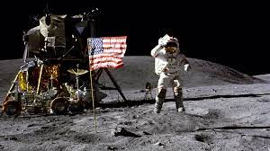
So, how do we avoid pyramiding?
Pyramid fun fact: Did you know that Cleopatra’s reign was closer in time to the moon landing than the construction of the Great Pyramid at Giza?
2,500 years
2,000 years

Slide 6

So, how do we avoid pyramiding?
2. Manufacturing Exemption. Exemption includes:
  TPP that will become a part of TPP for ultimate sale or that is consumed in manufacturing,
  Equipment used in manufacturing (that makes a chemical or physical change)
  TPP used in quality and environmental control,
  Wrapping and packaging,
  And so much more!
    2023: $10,709,800,000
    Tex. Tax Code §151.318
    and 34 Tex. Admin. Code 3.300

Slide 7
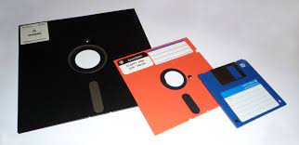
Digital Taxation in Texas
Computer Programs (151.0031)
The electronic form of taxable TPP (151.010)
  Books, movies, movies, etc.

Slide 8
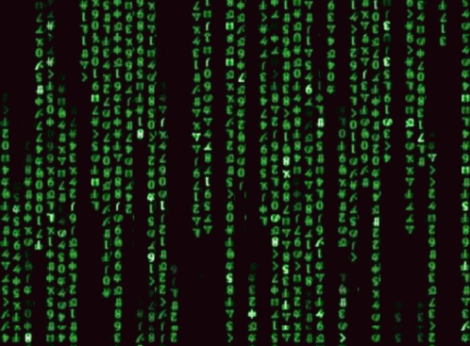
Digital Taxation in Texas
Data Processing Tex. Tax Code §151.003
What it is:
  Data entry, word processing, payroll and business accounting,
  Computerized data and information storage or manipulation
What it is not:
  Medical transcription,
  Payment processing.

Slide 9
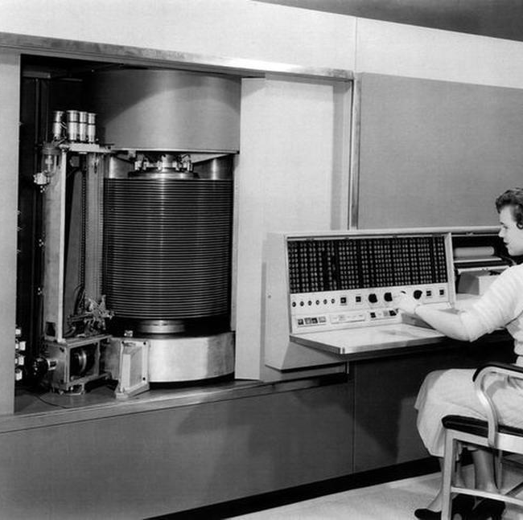
Digital Taxation in Texas
Fun fact about digital storage
This is the 305 RAMAC. It was the first computer with magnetic disc storage. It was released by IBM in 1956. It weighed over a ton, leased for $3,200 a month and stored 5MB of data.
(that’s $35,895.18 in today’s dollars)

Slide 10
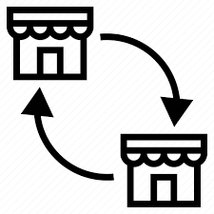
How much are we talking?
B2B Software Transactions:
  2022: $1,294,000,000.00
  2023: $1,369,000,000.00

Slide 11
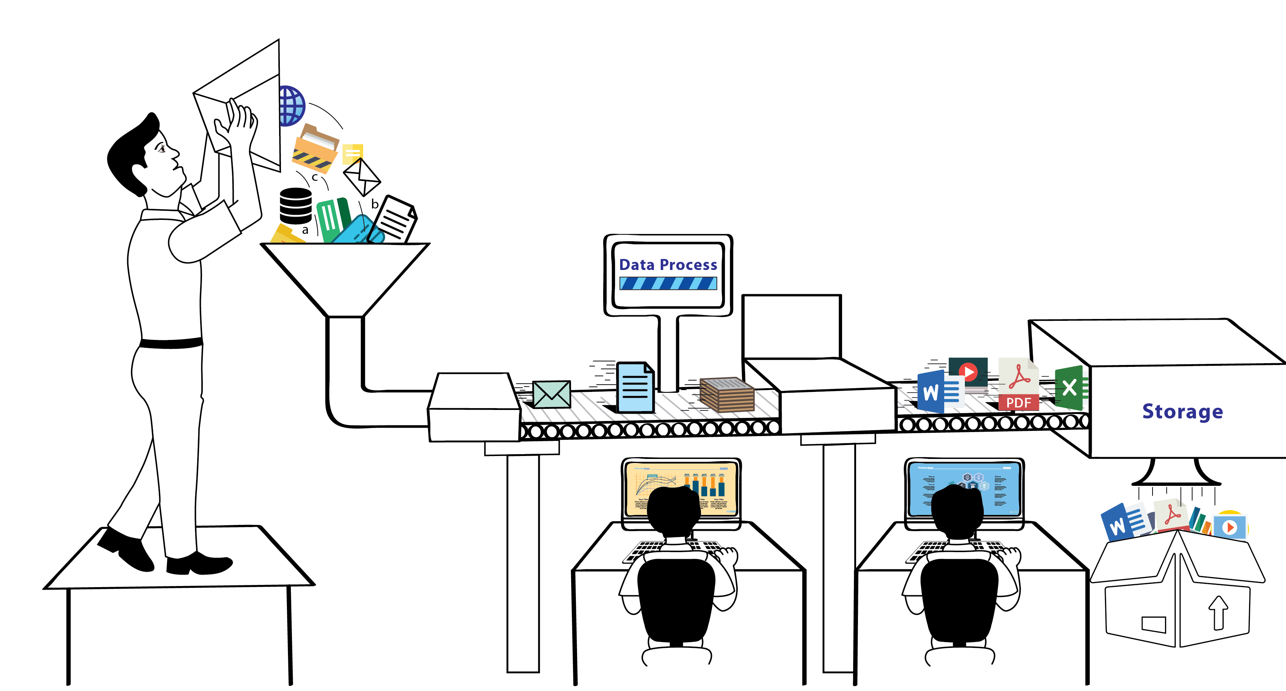
How much are we talking?
Data Processing:
  2022: $360,000,000.00
  2023: $392,000,000.00

Slide 12
How much are we talking?
During the legislative session, HB 5070 was filed which would remove the services provided by a marketplace provider from the definition of data processing.
  These types of transactions are almost all B2B.
  The fiscal note on the bill was $47,700,000.00 for the 2024-25 biennium.

Slide 13

When you ask Chat GPT for a joke
Why did the data scientist go broke?
Because they used up all their cache!

