Slide 1
Sales Tax on Digital Goods & Services Uniformity Project
Work Group Survey Results
April 6, 2023

Slide 2
Recap of Previous Meetings and discussion of “digital products”
Oct. 27, 2022 Work Group (WG) Meeting – WG requests staff to focus on types of digital items in the marketplace and definitions. Research begins in November.
Dec. 2022, Jan., Feb., and Mar. 2023 WG Meetings – Continued study and discussion of definitions for digital products in the marketplace and existing state laws and other guidance relating to the taxation of digital products.
March 2023 survey of WG members authorized by Chair Gil Brewer to solicit views on the project and ideas for moving forward.

Slide 3
Summary of the Survey
Anonymous Survey
17 Questions
26 Work Group Members Representing 17 States and the Streamlined Board Surveyed
14 Responses

Slide 4
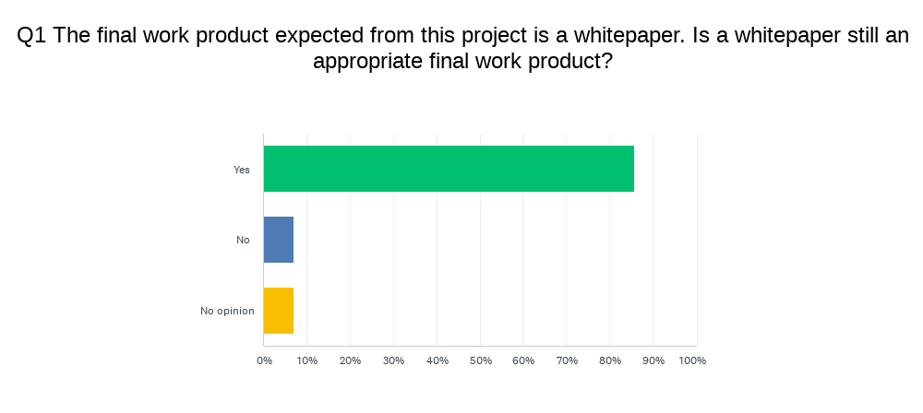

Slide 5
Q2: If no is your answer to Q1, please explain what final work product would be most appropriate.
Model language.

Slide 6
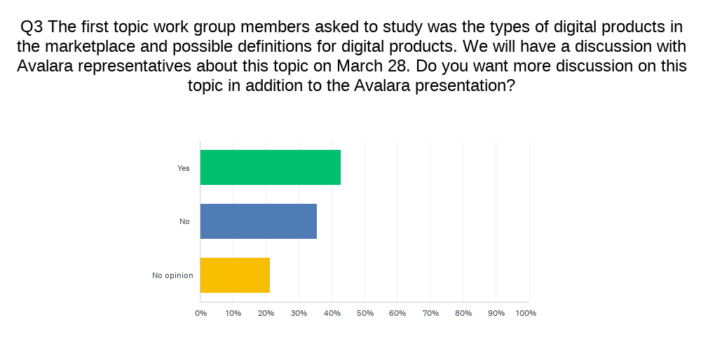

Slide 7
Q4: If yes is the answer to Q3, please explain what information would be helpful.
Unique digital goods that pose the most questions in terms of tax administration and/or audits.
Hard to say if the information from this one group will be enough.
To be clear, I don't think additional work directed solely at specific digital products is necessary right now, but further knowledge of specific products will be needed on occasion as our general work progresses.
Depends on what Avalara shares.
It would be most beneficial to hear from sellers of digital products. Avalara will be able to provide information they have obtained from their clients but having the industry assist would be more helpful.
The actual product, and after that is defined, what that means relative to the seller and purchaser.

Slide 8
Q5: what additional types of digital products would you like to learn more about?
Digital advertising/targeted advertising. Digital automated services via web based applications. Digital codes.
Crypto and anything "as a service.“
Cache (computing); we may need more of a reference for the rate at which technology is advancing in this field to indicate to the various legislators that a narrow, static definition may not be useful for any meaningful amount of time.
Want to understand all the different digital products out there.
Nothing right now.
What are all the types of digital products? Are we (as a group of tax administrators) sure we fully understand all the digital products being sold?
I'd like to see us explore the platform-as-a-service and infrastructure-as-a-service layers.
Unknown.

Slide 10
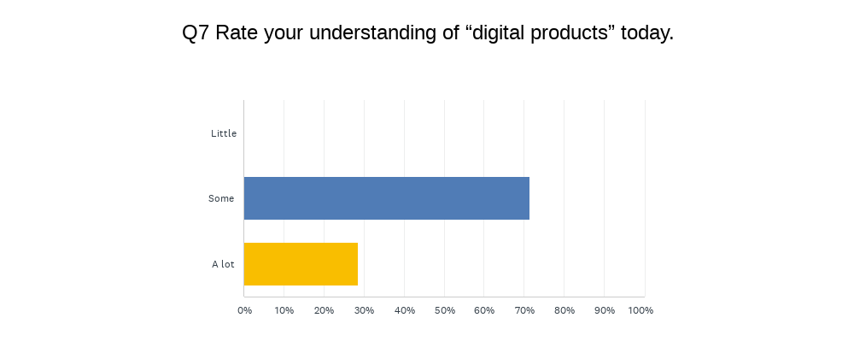

Slide 11
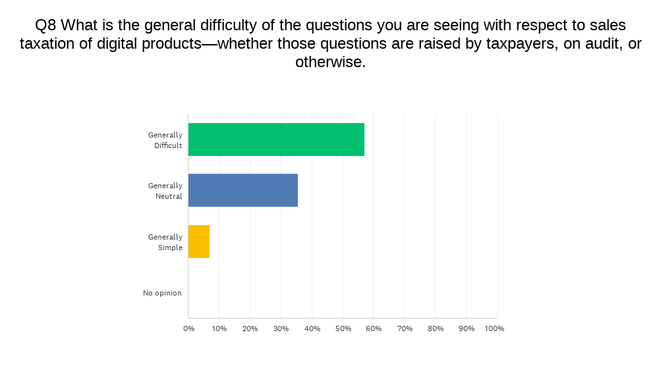

Slide 12
Q9: The Streamlined states have experience working on issues involving digital products and we are planning to have a presentation from Streamlined on that experience and what was learned. Since the work group has both Streamlined and non-Streamlined state members, please tell us what specific issues or questions you would like to see covered in that presentation, for example, definitions, exemptions, sourcing, bundling, other.
Bundling of digital goods with other taxable/nontaxable non-digital good items, sourcing of mixed transactions where you have digital goods and non-digital goods. A detailed approach on how vendors/Streamlined States can determine the separate products/services within a bundle.
All of that sounds good. I think discussion on future-proofing rules or statutes may be helpful, given how quickly technology changes.
As a Non-Streamlined state, the Streamlined definitions seem narrow and outdated, so I would like to know how they are actually working and how the states apply their existing laws to more modern products; are those products not taxable because they are not covered?

Slide 13
Q9: Responses Continued
Exemptions and sourcing.
Why did work on digital products stall out after the initial adoption of definitions? Is Streamlined planning to produce further guidance related to digital products sourcing? Why was the concept of multiple-points-of-use (MPU) sourcing abandoned by Streamlined? What substitute to MPU sourcing is Streamlined considering?
Definitions (2 responses).
I'd like to explore sourcing. I'd also like to explore how software taxes are being applied to software-enabled infrastructure such as cloud servers.
Definitions, exemptions, sourcing, bundling, and general approach to the taxation of digital products e.g., broad, narrow, or a combination of both.
How were those definitions developed? Why haven't they developed more definitions? Are they considering developing more definitions? What is the status of the digital products sourcing project they are working on?
Bundling, sourcing, multiple points of use.
Exemptions, sourcing, and delivery medium terminology/definitions.
I would like to know the Streamlined definitions for digital products, taxable goods, exemptions, etc.

Slide 14
Q10: When we finish studying digital products in the marketplace and definitions, what topic would you like to discuss next? You may want to refer to the project outline or suggest a topic not reflected in the outline.
Recommendations on how to best source the sales of digital products.
Sourcing.
Best practices for day-to-day administration and moving forward with either a broad or narrow definition both from the perspective of the state (do we need to retain technology experts) and educating taxpayers for voluntary compliance.
What does the business community consider to be a digital product versus a service?
The factors that a state should consider in determining its tax base.
Unknown.
Administration.

Slide 15
Q10: Responses Continued
I think it would be very helpful to have a more-detailed outline of the whitepaper, with discussions of each issue that outline the possible approaches and the pros & cons of each. Having concrete proposals in front of members will stimulate discussion. It is important that such descriptions be written as neutrally as possible, so as not to appear biased in favor of any option, to enable a neutral, productive, discussion of all options.
Apportionment with respect to product use.
It makes sense to move to item III, forms of taxation.
Not yet determined.
I think it is very important that, before we go too far into determining the appropriate digital product taxation rules, we contend with ITFA as that is a major barrier I have seen industry using to try and take down state digital taxation efforts. It would be null to define out a taxation regime if it is built on a pretext that can be easily fought or limited. In that same vein, I think policy review/analysis (like the kind discussed in questions 11 and 12) is vital before nailing down smaller technical pieces. We need to have a better understanding what different stances will effect in our tax landscape rather than an 'implement and see' approach. I think studying current state responses as well as some international landscape pieces will add leagues to the discussion.

Slide 16
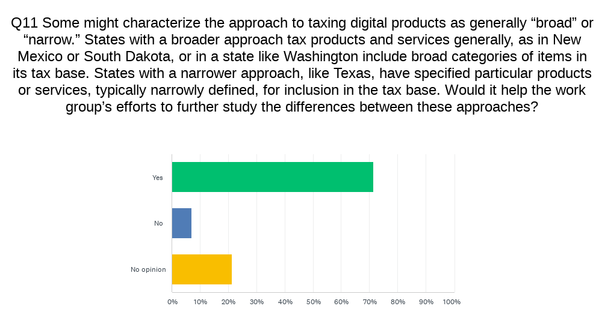

Slide 17
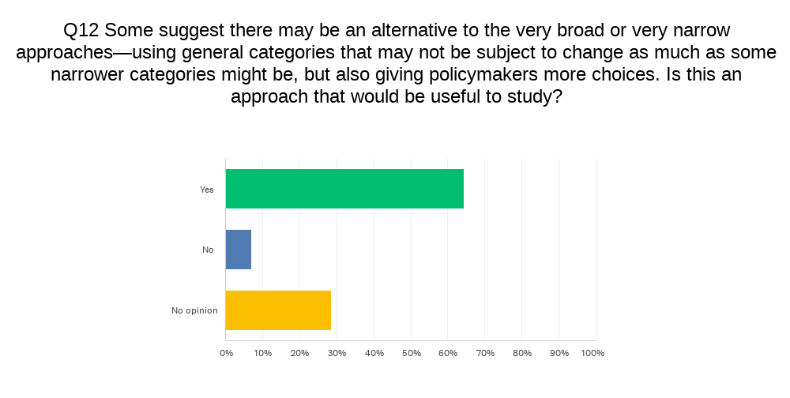

Slide 18
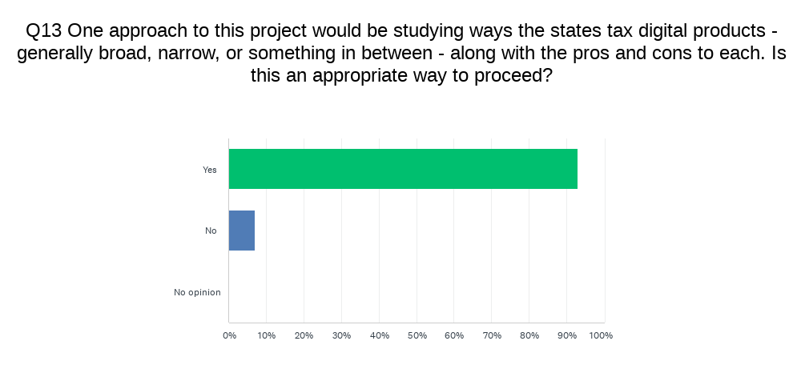

Slide 19
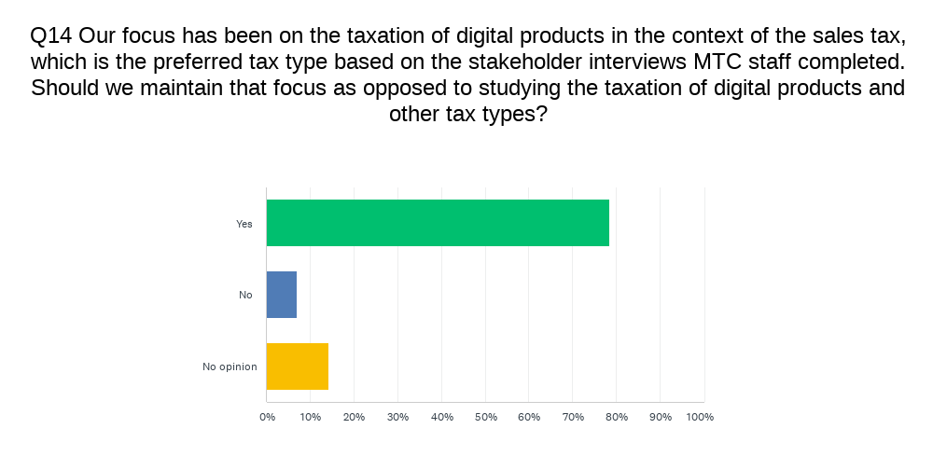

Slide 20
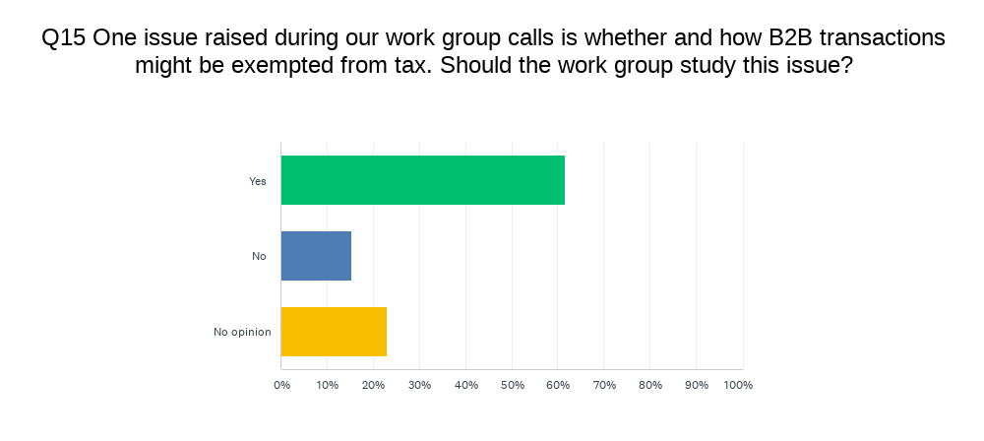

Slide 21
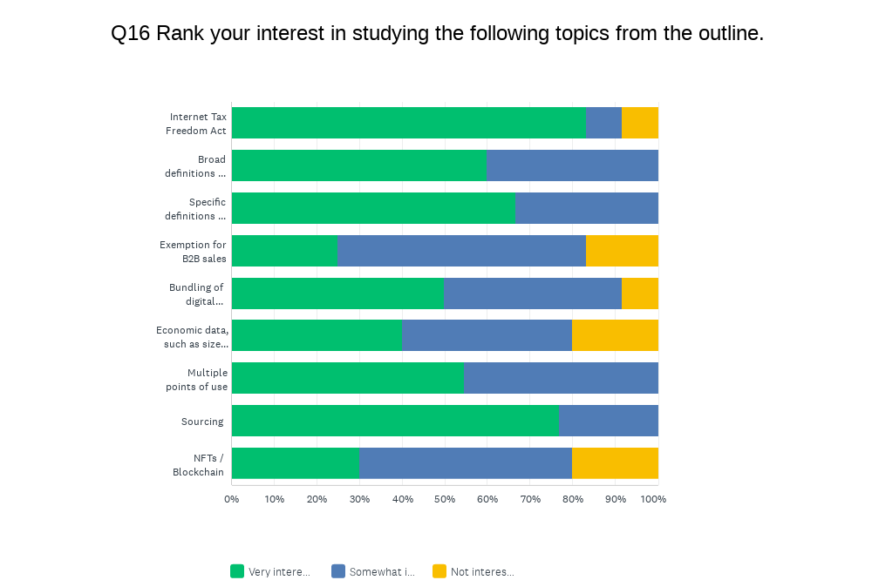

Slide 22
Q17: Please add any other comment or information you think would be helpful to the work group. Thank you for your time and participation.
Business seems opposed to broad definitions of digital products, but this universe is not more broad than TPP, which we have all worked with for years. Same with respect to B2B transactions, for states that don't already have them or only have a few, it does not seem that giving them more broadly to digital products is appropriate. In general, I thought the whitepaper for marketplaces was very good and useful and think a similar product for digital products would provide a good road map for the issues and options to be considered by states in working through the taxation of digital products.
I think that we are heading in the right direction and the push-back from representatives of the business community should be expected because they are looking out for the interests of their clients. Having said that, the success of the project will depend on our ability to maintain a neutral position while presenting member states and taxpayers alike with the opportunity to find a common/middle ground approach to address any concerns such as on the issue of acknowledging the contributions of and providing exemptions for B2B input to sales & use tax transactions which in my opinion should be at the discretion of each member state.
Because the categories of digital products is broad is not a reason not to develop a scheme to determine the taxation of them. All states tax TPP, which is the broadest category of them all.

Slide 23
Conclusions?
Questions?
Comments?
Next Steps?

