Slide 1
Sales Taxation of Digital Products
Sales Taxation of Digital Products Work Group Meeting
June 1, 2023
Jonathan W. White, Counsel

Slide 2
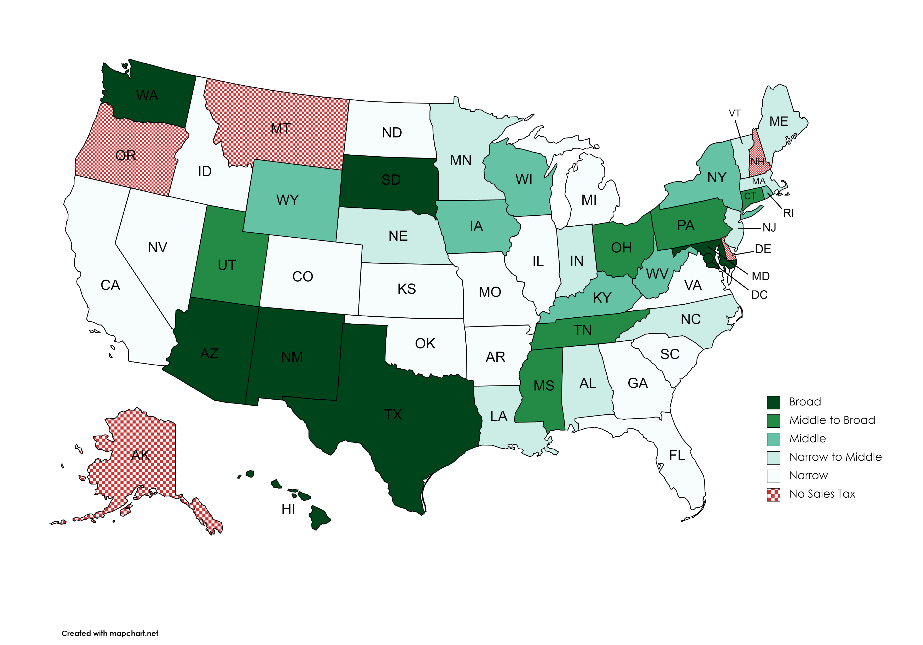
Breadth of States’ “Digital” Sales Tax Bases
Breadth of Digital Tax base:
Four Metrics
Taxation of prewritten software however delivered
Taxation on digital products
Breadth of digital services base
Breadth of cloud products base
“Cloud Products”
“…remote servers hosted on the internet to store, manage, and process data…”
Access is key.
Source: MTC staff research.
Source: MTC staff research.

Slide 3
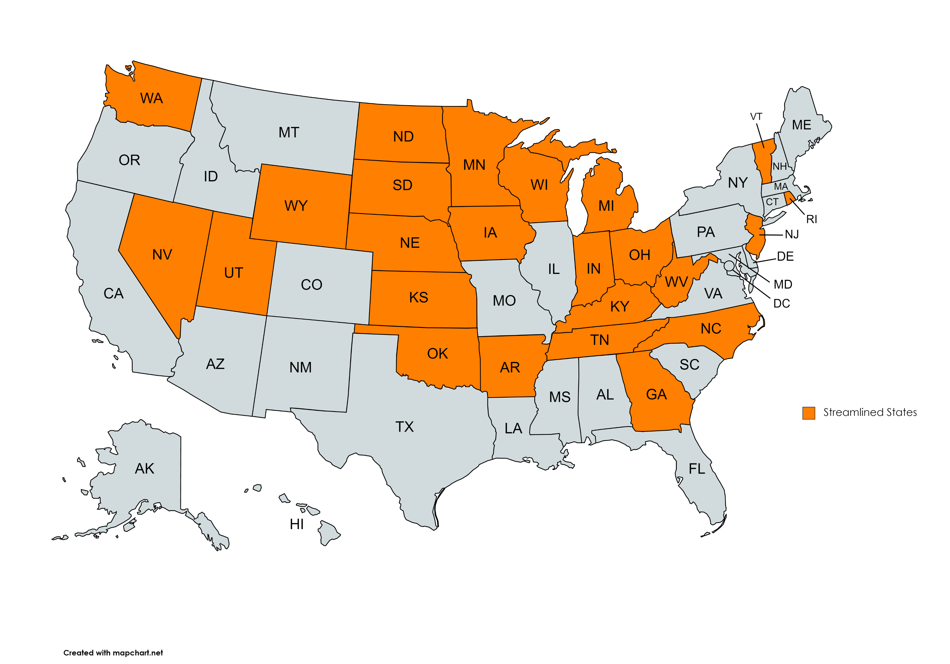
Streamlined States
Source: MTC staff research.

Slide 4
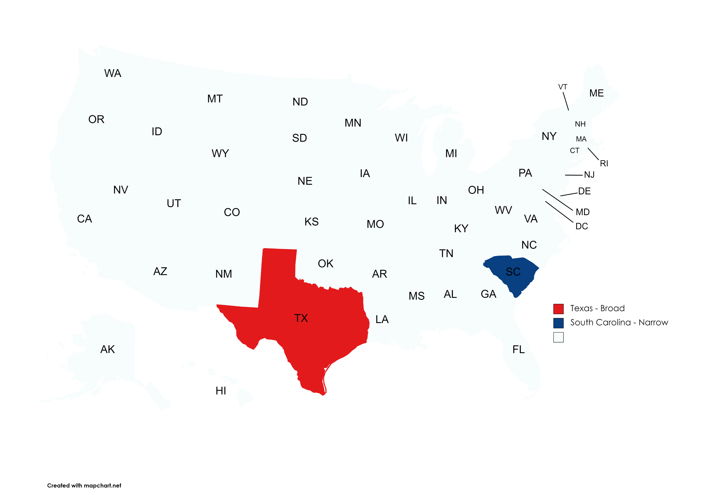
A Broad State and a Narrow State
Source: MTC staff research.

Slide 5
Curious Finding 1
The characterization of a single item can differ greatly across states, and for good reason: statute drafting decades ago.

Slide 6
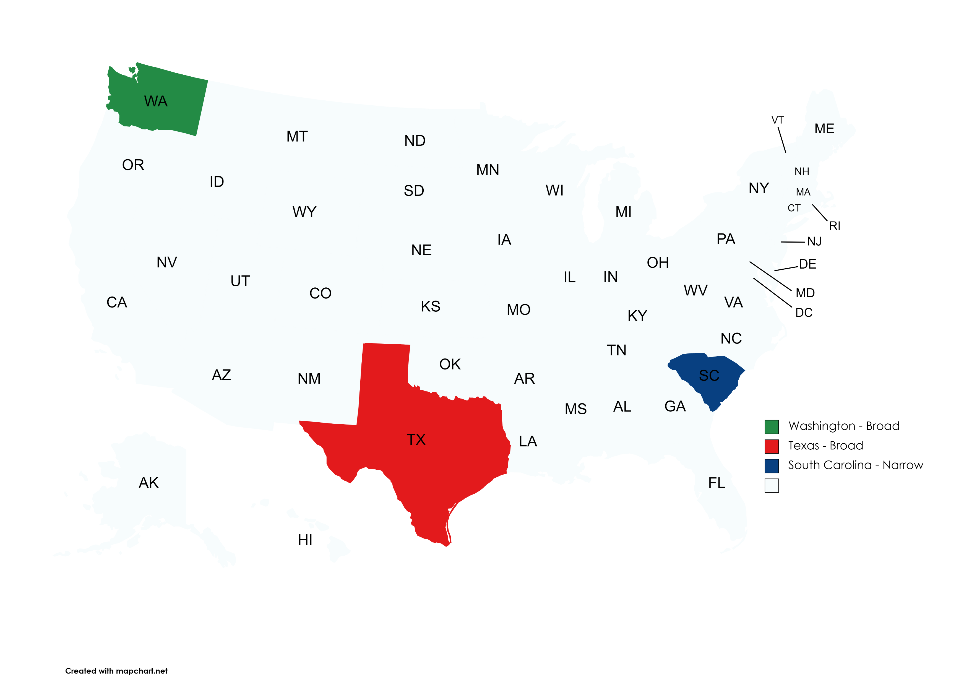
Another Broad State
Source: MTC staff research.
Source: MTC staff research.

Slide 7
Excerpt from Washington
Digital automated services means services transferred electronically that use one or more software applications but does not include services primarily (more than 50% based on time and costs) involving the application of human effort after the customer requests the service.
Digital automated service does not include data processing services.

Slide 8
Curious Finding 2
For sales tax, the characterization of an item is for determining taxability.
That characterization follows through to affect the sourcing and other decisions.

Slide 9
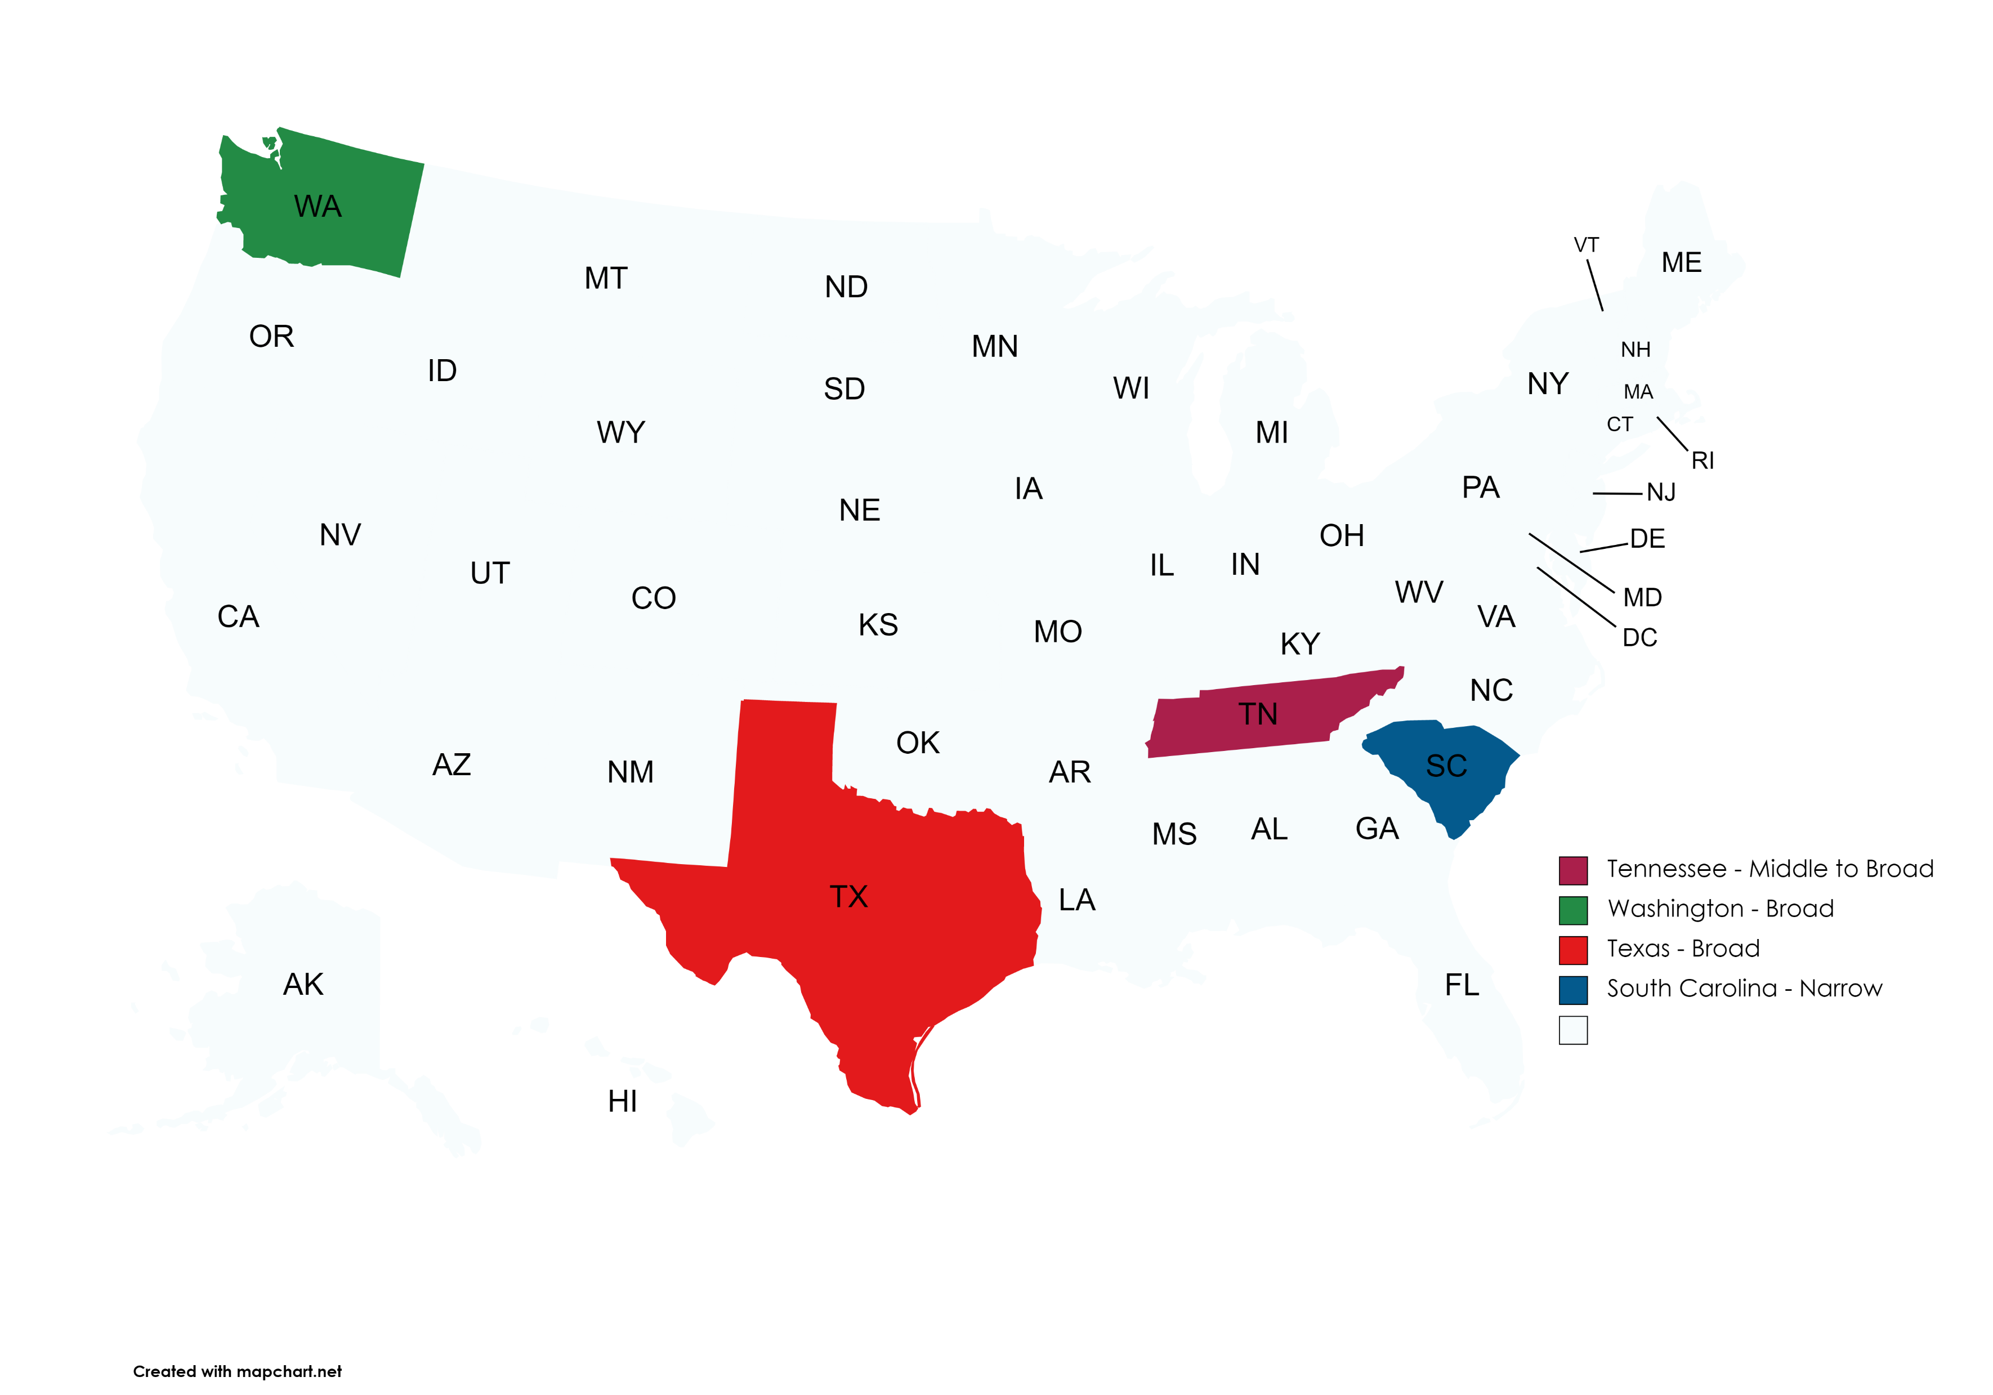
Another Broad State
Source: MTC staff research.
Source: MTC staff research.
Source: MTC staff research.
Source: MTC staff research.

Slide 10
Excerpt from Tennessee
Computer programming and code writing services, implementation, and consulting and professional services that include creating, designing, developing, fabricating, programming, or modifying taxable software are taxable even if separately stated.
Standalone installation of software is taxable if the software remains TPP after installation.

Slide 11
Curious Finding 3
The prewritten software experience is repeating itself.
Has the experience with prewritten software been satisfactory?
What lessons are there from the prewritten software experience?

Slide 12
Anything Else?
Washington’s Digital Automated Services.
Designed to capture products as yet unknown.
Streamlined’s Software Maintenance Contracts.
Specific, narrow definition that will only capture the original, specific target.
Texas’s Data Processing Services.
Could capture products other than the original, specific target.

Slide 13
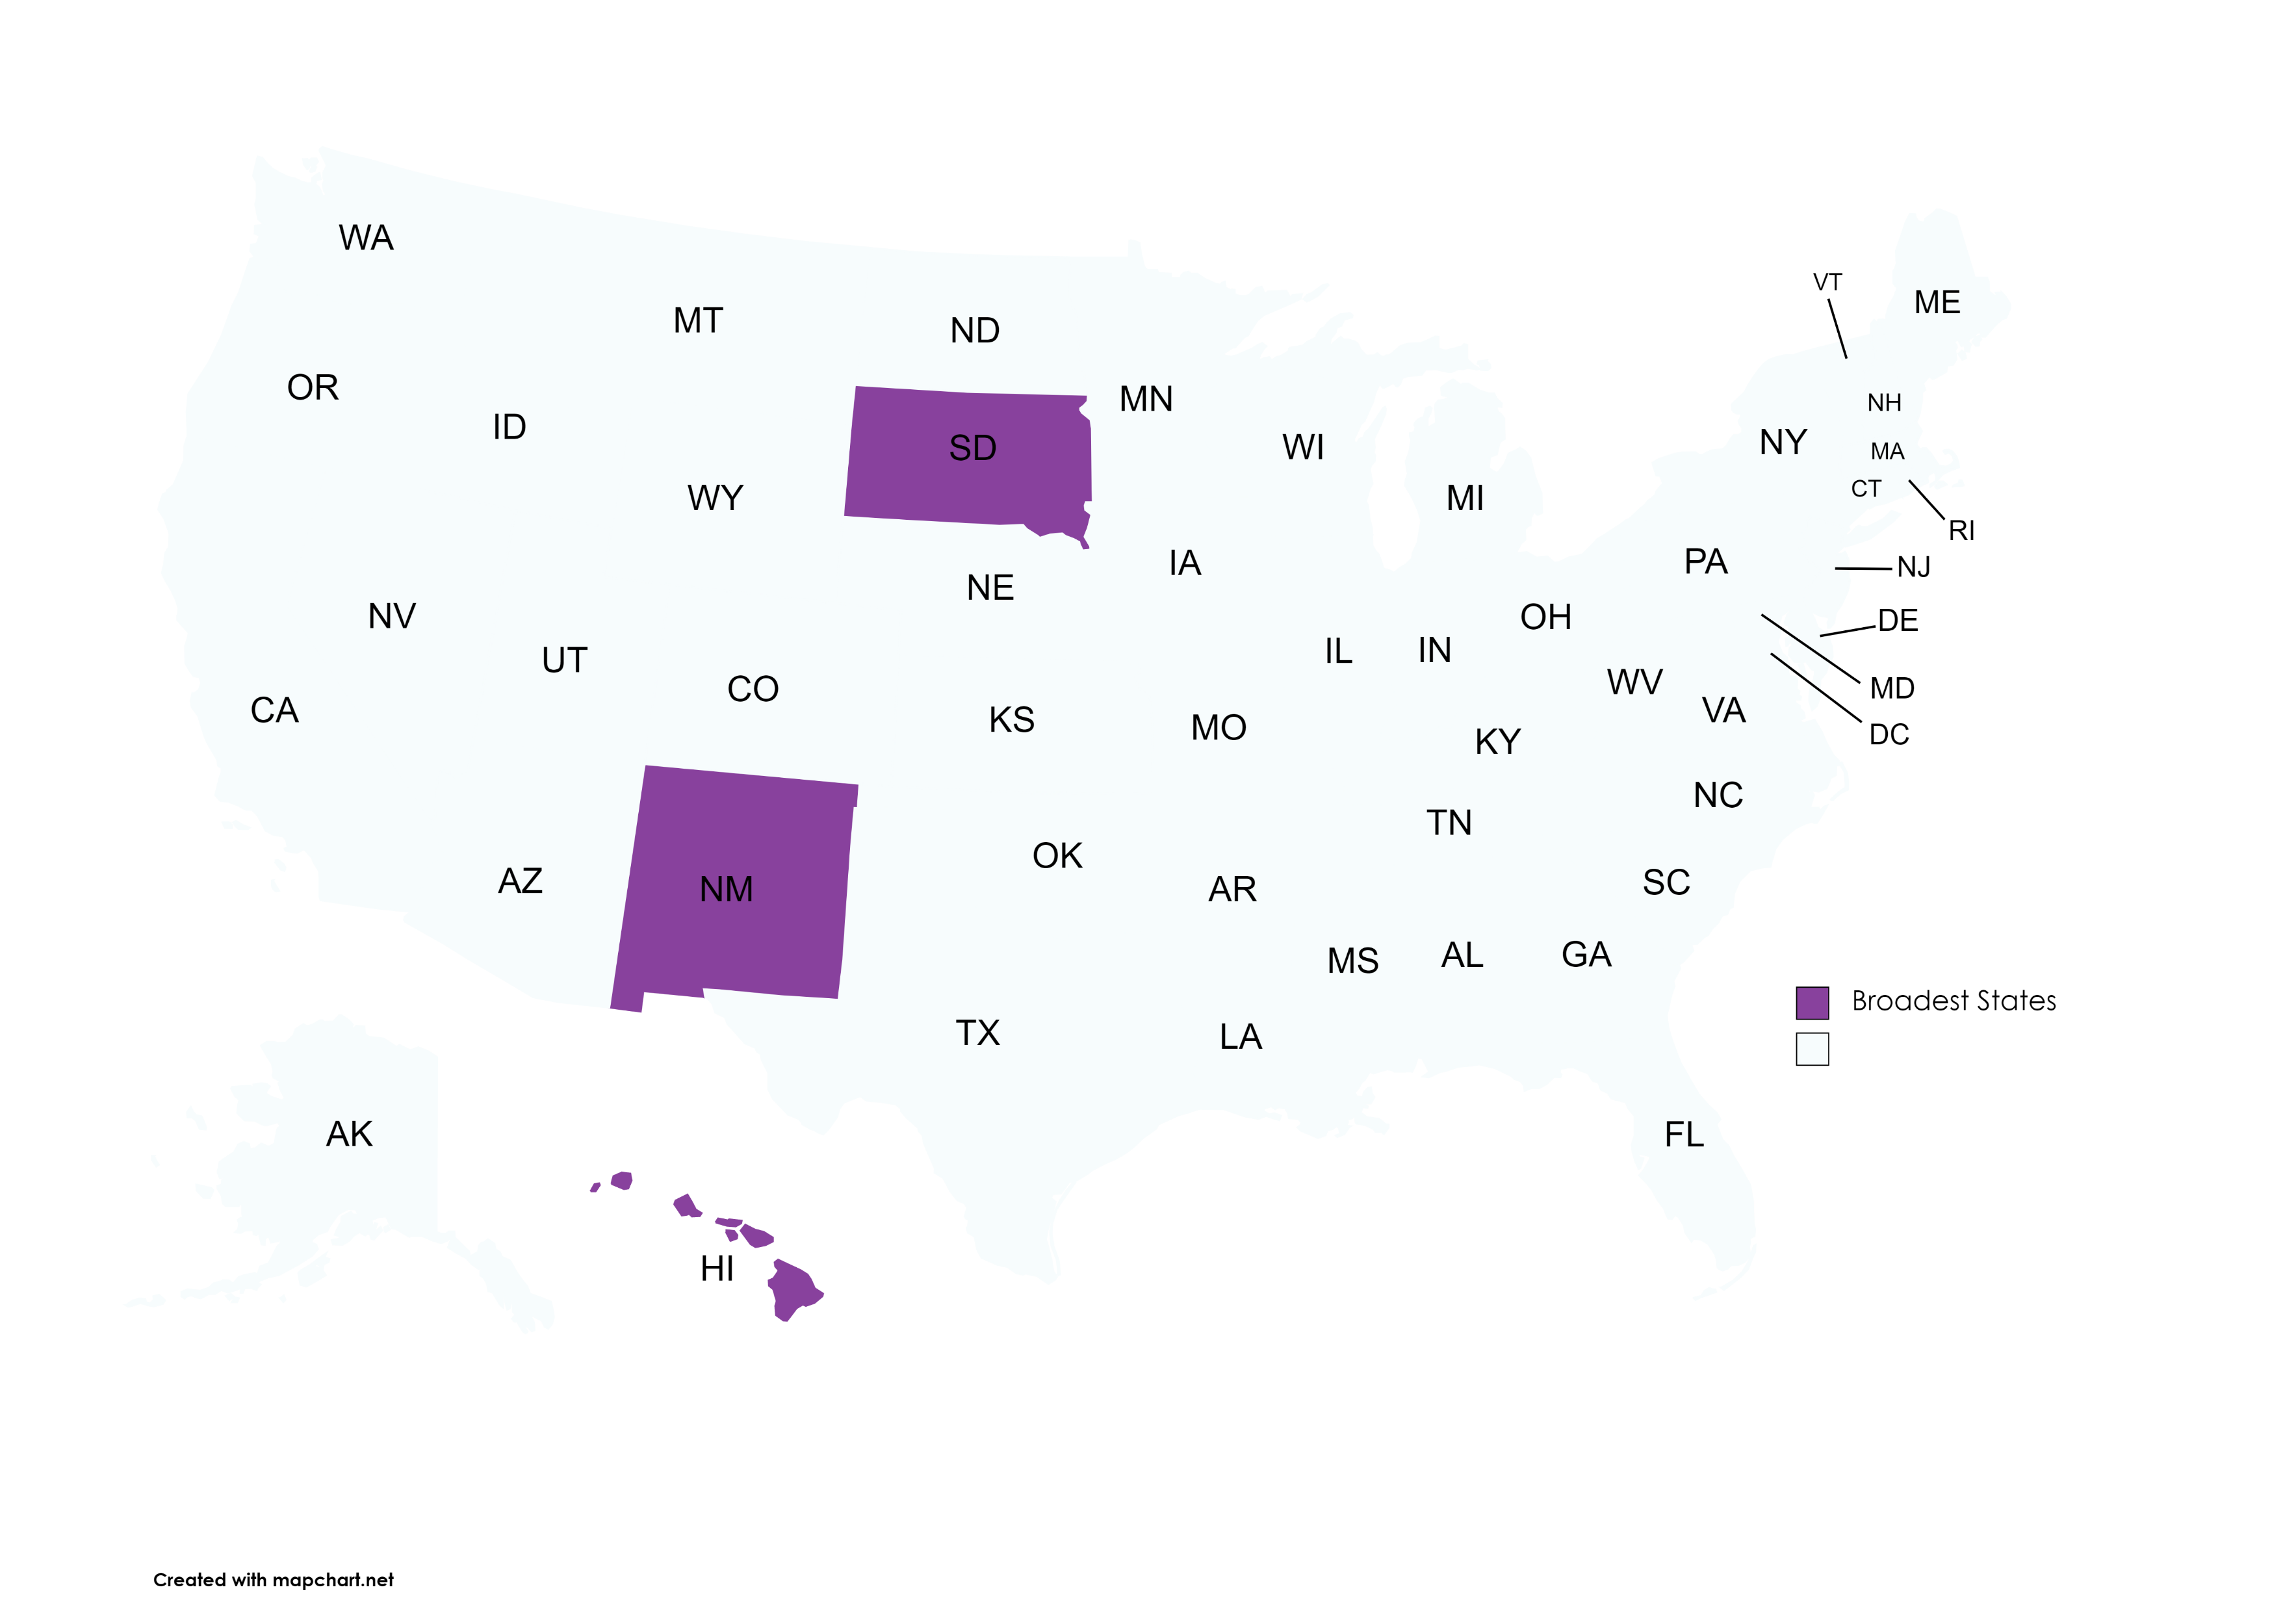
The Broadest States – In More than One Way
Source: MTC staff research.
Source: MTC staff research.
Source: MTC staff research.
Source: MTC staff research.
Source: MTC staff research

Slide 14
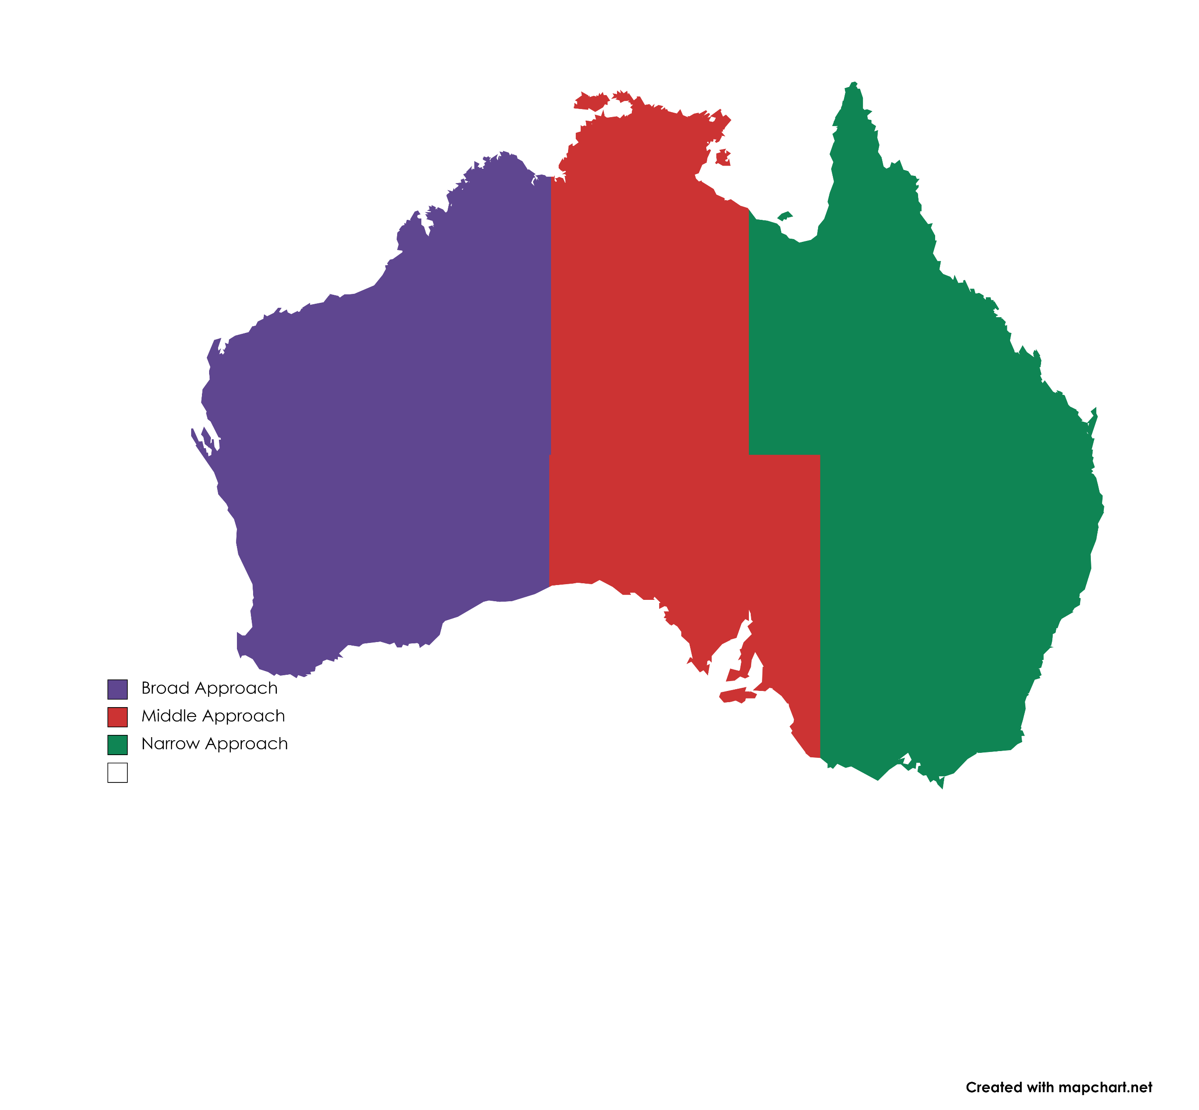
A 3-state Country
Broad Approach Characteristics:
Tax Base – typically broad
Imposition – broad but varied, may impose tax on gross income rather than transactions
Purpose-built modern definitions for modern products
More potential pyramiding
Broader, more complex business-to-business exemption(s)
Middle Approach Characteristics:
Tax Base – typically mixed
Imposition – “sales” of “tangible personal property”
Broad interpretation of tangible personal property
Limited set of taxed enumerated services
Narrow Approach Characteristics:
Tax Base – typically narrow
Imposition – “sales” of “tangible personal property”
Insistence on physical attributes to impose tax
Narrow definitions of enumerated services
Less overall pyramiding
Simpler, narrower business-to-business exemption(s)

Slide 15
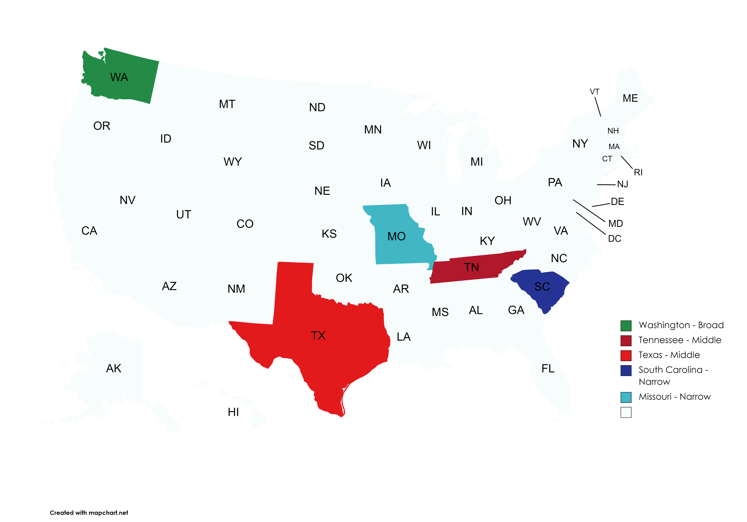
Two Narrow (APPROACH) States
Source: MTC staff research.
Source: MTC staff research.

Slide 16
Closing
Jonathan W. White
Counsel
jwhite@mtc.gov

