Slide 1
MTC Partnership Summit – Review of Recent Partnership Related State Tax Cases
May 2023

Slide 2
Notice – about The Summit and these materials
Many state tax agencies are dealing with difficult issues involved in the taxation of income from multistate partnerships—including tax reporting and administration, nexus and audit issues, technology support, employee training, and policy development. As states work to develop processes, procedures, and expertise in all these areas, we believe they would benefit from sharing their experiences with each other and that the staff of the Multistate Tax Commission would also benefit from information to help us better assist with state efforts—whether by providing technical research, training resources, coordination with the IRS or other groups, etc.
While the summit is open only to states and is a training and information sharing session under the MTC's Public Participation Policy, we advise the states not to share confidential taxpayer information in the context of the summit.
These materials were prepared by and belong to the Multistate Tax Commission. These materials are for discussion purposes only. They do not represent the official position of the MTC or any state.
These materials are copyrighted to the MTC and may contain proprietary or privileged information. The MTC reserves all rights to these materials and no person can reproduce or make any other use of the materials without the express permission of the MTC.

Slide 3
2009 Metropoul0s family trust v. Cal. Franchise Tax Board 294 Cal.Rptr.3d 557 (Cal. App. 2022)
NONRESIDENT
TRUSTS
The plaintiff trusts were nonresident shareholders in the S corporation Pabst Corporate Holdings, Inc. (Pabst).
In 2014, Pabst sold its wholly-owned subsidiary in a transaction treated as an asset sale under the Internal Revenue Code. The plaintiffs conceded that Pabst and its subsidiaries were a unitary business.
PABST S CORP.
PABST HOLDINGS, INC.
PABST
BREWING
FALSTAFF
BREWING

Slide 4
2009 Metropoul0s family trust v. Cal. Franchise Tax Board 294 Cal.Rptr.3d 557 (Cal. App. 2022)
The plaintiffs claimed that their share of gain from the sale of Pabst’s subsidiary should be sourced to their residence under the California personal income tax nonresident sourcing rules for the sale of an intangible.
California argued that the income should be apportioned at the S corporation level to California as business income from a unitary business. California further argued that “operation of the conduit rule meant that the trusts' income from the subsidiary's sale was business income because Pabst had characterized the income as apportionable business income on its tax return.”

Slide 5
2009 Metropoul0s family trust v. Cal. Franchise Tax Board 294 Cal.Rptr.3d 557 (Cal. App. 2022)
The Court ruled in favor of California, holding that the nonresident trust shareholders of Pabst are taxed on their pass-through pro rata share of the gain, which is business income sourced to California under UDITPA.
The Court reasoned: “because the gain from the asset sale of goodwill is undisputedly business income to Pabst, it remains business income for purposes of sourcing the trusts' pro rata share of that income.”
The Court also held that even if the intangible sourcing rules were applicable, the result would be the same because the goodwill had acquired a situs in California.
The case is final.
Link: https://law.justia.com/cases/california/court-of-appeal/2022/d078790.html

Slide 6
In the Matter of the Appeal of: L. Smith Dkt. No. 20036033 (Cal. Office of Tax Appeals, December 7, 2022)
NONRESIDENT
TAXPAYER
The nonresident taxpayer owned an indirect interest in a holding company taxed as a partnership (“Holdco”). Holdco owned a 50.50 percent direct membership interest in an Arizona LLC taxed as a partnership called Shell Vacations, LLC (“Shell”).
In 2012, Holdco sold its entire 50.50 percent (direct) membership interest in Shell to an unrelated third-party. The entire gain was from hot assets.
HOLDCO
Doing Business in
California
SHELL

Slide 7
In the Matter of the Appeal of: L. Smith Dkt. No. 20036033 (Cal. Office of Tax Appeals, December 7, 2022)
The taxpayer argued that Holdco’s sale of its interest in Shell was the sale of an intangible and that the resulting gain should be sourced to residence.
The Franchise Tax Board argued that the gain was apportionable income that retained its character as the California source income flowed up.

Slide 8
In the Matter of the Appeal of: L. Smith Dkt. No. 20036033 (Cal. Office of Tax Appeals, December 7, 2022)
The Office of Tax Appeals ruled in favor of the Franchise Tax Board, finding that Holdco and Shell were engaged in a unitary business such that Holdco’s gain should be treated as business income. The Office of Tax Appeals also found that the gain should be sourced to California using Holdco’s share of Shell’s apportionment factors.
The Office of Tax Appeals cited Metropoulos and noted that the taxpayer “improperly focuses the analysis on the gain at his level when it was actually generated at Holdco’s level.”
The case was not appealed.
Link: https://ota.ca.gov/wp-content/uploads/sites/54/2023/03/20036033-Smith-Opinion-120722wm.pdf?emrc=14ab16

Slide 9
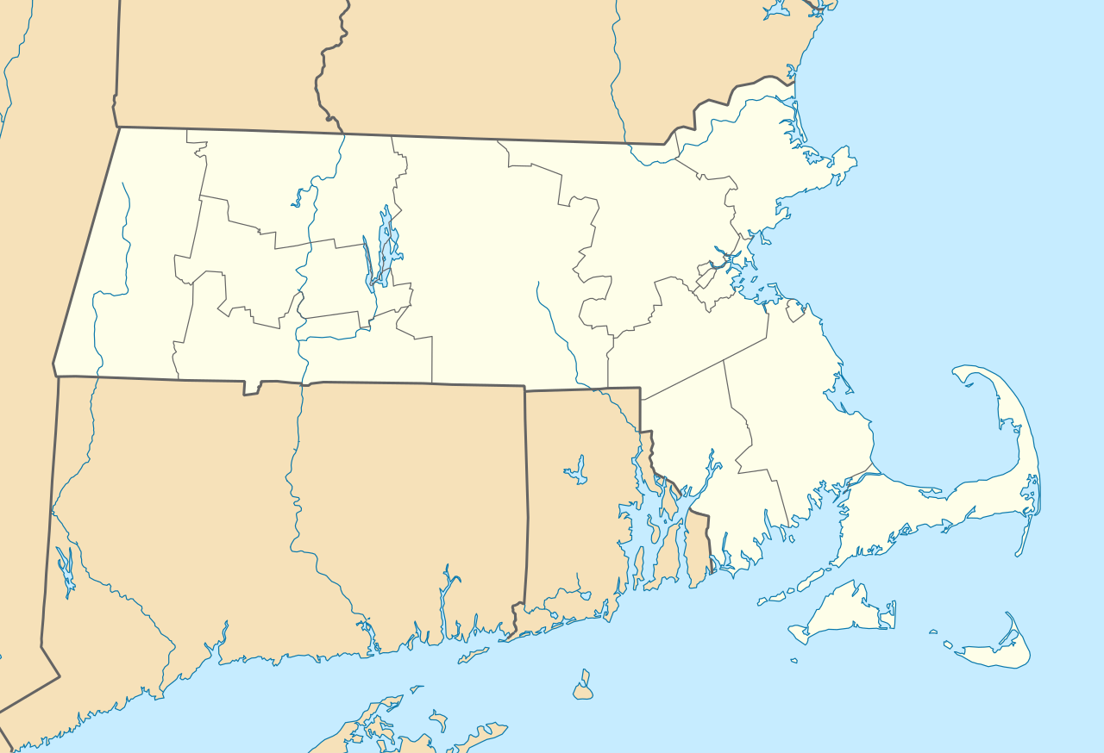
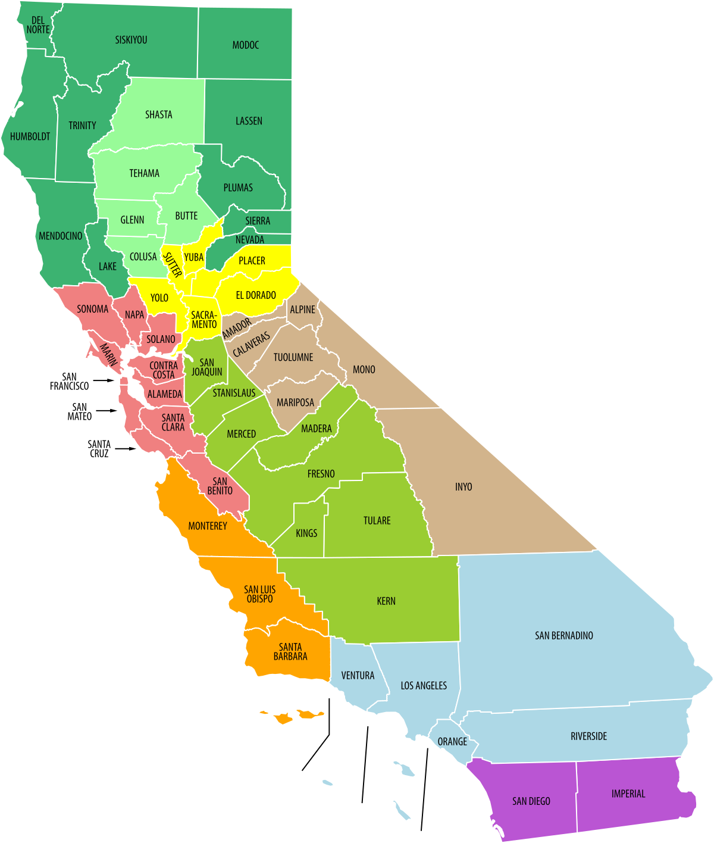
In the Matter of the Appeal of: Buehler Dkt. No. 21067960 (Cal. Office of Tax Appeals, February 28, 2023)
This case involved a California resident taxpayer that was a managing member in an LLC (taxed partnership) – the LLC had offices in California, Massachusetts, and New York.
A third party purchased the manager’s 23.123 percent LLC membership interest in a sale. The transaction was not treated as a sale of assets.
The taxpayers apportioned 50 percent of the gain to Massachusetts and claimed a California other state tax credit for the income taxes paid to Massachusetts on this gain.
This Photo by Unknown Author is licensed under CC BY-SA
This Photo by Unknown Author is licensed under CC BY-SA

Slide 10
In the Matter of the Appeal of: Buehler Dkt. No. 21067960 (Cal. Office of Tax Appeals, February 28, 2023)
The Franchise Tax Board denied the taxpayers’ credit, arguing that the gain should be sourced to California using California’s nonresident sourcing rules for the sale of an intangible.
The taxpayers argued that the interest had acquired a business situs in Massachusetts and that there was a unitary business.

Slide 11
In the Matter of the Appeal of Buehler Dkt. No. 21067960 (Cal. Office of Tax Appeals, February 28, 2023)
The California Office of Tax Appeals agreed with the Franchise Tax Board that the membership interest had not acquired a business situs in Massachusetts, noting that the interest was not localized in Massachusetts. The Office of Tax Appeals also determined that the taxpayers had not presented any evidence that the managing member was operating a unitary business with the LLC.
The Office of Tax Appeals ruled in favor of the Franchise Tax Board on February 28, 2023. It is unknown whether this case will be appealed.
Link: https://ota.ca.gov/2023-franchise-income-tax-opinions/

Slide 12
Noell Indus., Inc. v. Idaho Tax Comm’n 470 P.3d 1176 (Idaho 2020)
MIKE NOELL
The taxpayer’s owner, Mike Noell, had originally been involved in the combat and tactical gear business through the taxpayer, but later transferred the assets of the taxpayer to an LLC. Noell Industries owned 78.54 % of the LLC. Mike Noell also served as president and CEO of the LLC but did not manage its daily operations.
The taxpayer corporation sold its interest in the LLC for a net gain and sourced the net gain to its Virginia commercial domicile.
Noell Industries, Inc. – VA Corp.
1993 - 2003
_______________________________
78.54 %
President/CEO
Blackhawk
Industries Products Group Unlimited, LLC – Doing Business in Idaho
2003-2010

Slide 13
Noell Indus., Inc. v. Idaho Tax Comm’n 470 P.3d 1176 (Idaho 2020)
The taxpayer argued that the net gain was nonbusiness income and that taxing the gain in Idaho would be unconstitutional.
Idaho argued that the net gain was apportionable business income to Idaho.

Slide 14
Noell Indus., Inc. v. Idaho Tax Comm’n 470 P.3d 1176 (Idaho 2020)
The Court found that the transactional test was not met because the taxpayer did not regularly engage in buying and selling subsidiaries. The Court concluded that the functional test was not met, stating that the LLC was only a passive investment that did not further the business of the taxpayer.
The Court held that there was not a unitary business noting that “[t]his high-level separation of the companies—combined with Noell Industries’ only role as a shell holding company—showcases substantial independence rather than the level interdependence required to manifest unity.” The Court also noted that Noell’s oversight of the LLC was not sufficient to be unitary.
Link: https://law.justia.com/cases/idaho/supreme-court-civil/2020/46941.html
The Court declined to follow a holding company case with the opposite result. See Blue Bell Creameries, LP v. Roberts, 333 S.W.3d 59 (Tenn. 2011).

Slide 15
Vas Holdings & Invs. LLC v. Commissioner, 186 N.E.3d 1240 (Mass. 2022)
The taxpayer, Vas Holdings & Investments LLC (“VASHI”), sold its fifty percent membership interest in Cloud5 LLC (“Cloud5”) for a gain. Cloud5 (a taxed partnership) had business activities taking place primarily in Massachusetts.
VASHI did not have a domicile, employees, operations, real property, or tangible property in Massachusetts. VASHI’s only material asset in Massachusetts was its fifty percent membership interest in Cloud5. VASHI was not involved in the operations of Cloud5. Massachusetts conceded that the gain would not be taxable under the unitary business principle.
The taxpayer argued that without a unitary business, Massachusetts did not have a basis for taxing the capital gain.
Massachusetts argued that it could constitutionally tax the gain using Cloud5’s apportionment factors because the gain reflected Cloud5’s growth in Massachusetts and VASHI had reaped the benefit of this growth.

Slide 16
Vas Holdings & Invs. LLC v. Commissioner 186 N.E.3d 1240 (Mass. 2022)
The Court ruled that the constitution did not require the application of the unitary business principle for Massachusetts to tax the gain.
The Court found that there was a constitutional basis to tax the gain based upon Cloud5’s nexus in Massachusetts.
The Court agreed with Massachusetts “that the protections, opportunities, and benefits provided by the Commonwealth to Cloud5, suffice to meet the constitutional requirement of a nexus between the Commonwealth and VASHI; and, because the tax imposed by the Commonwealth reflects the apportionment formula of Cloud5, the tax is circumscribed to capture the value of those protections and benefits.”
However, the Court ultimately ruled in favor of the taxpayer, holding that there was not a statutory basis to tax the gain.
Link: https://casetext.com/case/vas-holdings-invs-v-commr-of-revenue

Slide 17
Cities Management, Inc. v. Commissioner of Revenue Dkt. No. 9484 (Mn. T.C. December 20, 2022)
The taxpayer is a Minnesota S corporation that was involved in the community association management business in Minnesota and Wisconsin.
The taxpayer’s two shareholders sold their stock in an IRC § 338(h)(10) deemed asset sale.
The majority shareholder was a nonresident, and her portion of the gain from the sale of goodwill was reported by the taxpayer as nonbusiness income.
The Commissioner made a nonresident withholding assessment, arguing that the gain should be treated as business income.

Slide 18
Cities Management, Inc. v. Commissioner of Revenue Dkt. No. 9484 (Mn. T.C. December 20, 2022)
The Court analyzed the applicable Minnesota statutory provisions and case law. The Court held that the gain from the sale of goodwill was apportionable business income, noting that “there is no dispute that the goodwill at issue was an integral asset of the taxpayer’s unitary business.”
The Court also noted that the value of the goodwill was based, in part, on the success of the taxpayer’s business which included Minnesota sales.
The Court granted the Department’s motion for summary judgment on December 20, 2022. This case has been appealed to the Minnesota Supreme Court.
Link to Tax Court Opinion: https://mn.gov/tax-court-stat/published%20orders/2022/Cities%20Management%20v%20COR%2012-20-22.pdf

Slide 19
Goldman Sachs Petershill Fund Offshore Holdings (Delaware) Corp. v New York City Tax Appeals Tribunal 204 A.D.3d 469 (N.Y. App. Div. 2022)
A taxpayer sold its minority membership interest in Claren Road Asset Management, LLC — a limited liability company taxed as a partnership and conducting business in New York city.
The taxpayer did not have any other presence in the city.
The taxpayer argued that New York was impermissibly taxing income attributable to activities conducted outside its border.
The taxpayer contended that the capital gain was earned outside of the city because the activities related to its investment in Claren were performed in London.

Slide 20
Goldman Sachs Petershill Fund Offshore Holdings (Delaware) Corp. v New York City Tax Appeals Tribunal 204 A.D.3d 469 (N.Y. App. Div. 2022)
The Court ruled that Claren’s activities in the city were sufficient to provide nexus between the taxpayer's capital gain and the city.
The Court based its analysis on Matter of Allied-Signal Inc. v Commissioner of Fin., 588 N.E.2d 731 (N.Y. 1991), noting that “[i]n Allied-Signal, the Court of Appeals held that for tax purposes it did not matter whether the taxpayer was present or domiciled in the City because the business activities conducted in the City by the entity in which the taxpayer had invested provided a nexus between the taxpayer's capital gain and the City, even in the absence of a unitary relationship between the corporations.”
Link: https://casetext.com/case/goldman-sachs-petershill-fund-offshore-holdings-delaware-corp-v-nyc-tax-appeals-tribunal

Slide 21
Utah state tax commission case Appeal No. 16-1358 (January 27, 2022)
TAXPAYER
The taxpayer was a C corporation investment entity that received a pass-through share of gain from the sale of partnership units (arising from an acquisition of Company 1 by another company).
The taxpayer reported the gain as nonapportionable, nonbusiness income on its Utah return.
INVESTMENT
ENTITY 1 - LP
INVESTMENT
ENTITY 2 - LP
COMPANY 1
PARTNERSHIP
DOING BUSINESS IN UTAH

Slide 22
Utah state tax commission case Appeal No. 16-1358 (January 27, 2022)
The taxpayer argued that Utah could not tax the gain because there was not a unitary relationship between the taxpayer and the partnership.
Utah argued that the gain was taxable business income in Utah meeting the functional test which resulted from the flow up of the gain, and that unitary combination only applied in the corporate context.

Slide 23
Utah state tax commission case Appeal No. 16-1358 (January 27, 2022)
The Commission agreed that the gain was business income to the taxpayer, noting that the “[t]axpayer’s trade or business was to purchase an interest, through various partnerships, in COMPANY-1, and then hold it in anticipation of selling it for a profit.”
However, the Commission, relying on Meadwestvaco, found that Utah could not constitutionally tax the gain because there was not a unitary relationship with functional integration, centralized management, and economies of scale.
Link: https://tax.utah.gov/commission/decision/16-1358.pdf

Slide 24
Ohio cases – not “recent” but often cited
Corrigan v. Testa, 73 N.E.3d 381 ( Ohio 2016) – held that the state may not tax a nonresident’s capital gain income from the sale of an in-state pass-through entity, because the activity at issue was the nonresident’s transfer of intangible property rather than Ohio business activity. Since the transfer of the intangible property occurred outside of Ohio, the Court held that the taxation of the gain violated Due Process. The nonresident was a member on the board with a 79.29 percent membership interest.
Link: https://www.supremecourt.ohio.gov/rod/docs/pdf/0/2016/2016-Ohio-2805.pdf

Slide 25
Ohio cases – not “recent” but often cited
T. Ryan Legg Irrevocable Tr. v. Testa, 75 N.E.3d 184 (Ohio 2016)(cert. denied) This case involved the taxation of gain from the sale of a nonresident trust’s stock in an Ohio pass-through entity. The Court did not find any constitutional violation because of the trust grantor’s own contacts with Ohio and the pass-through entity. The Court noted “unlike Corrigan, Legg (trust grantor) was a founder and manager of the business of the pass-through entity—a material distinction, see Corrigan at ¶ 68 (finding the tax unconstitutional as applied to Corrigan "in light of the absence of any assertion or finding that Corrigan's own activities amounted to a unitary business with that of Mansfield Plumbing”).
Link: https://www.supremecourt.ohio.gov/rod/docs/pdf/0/2016/2016-Ohio-8418.pdf

Slide 26
Questions/Comments/other cases?
Jenn Stosberg
MTC COUNSEL
jstosberg@mtc.gov

