Slide 1
Survey of Sales Taxation of Digital Products
Uniformity Committee Meeting
April 25, 2023 – Long Beach, California
Jonathan W. White, Counsel

Slide 2
Disclaimer
I am speaking for myself.
My comments do not necessarily represent the views of my employer.
Nothing in this presentation should be considered legal advice.

Slide 3
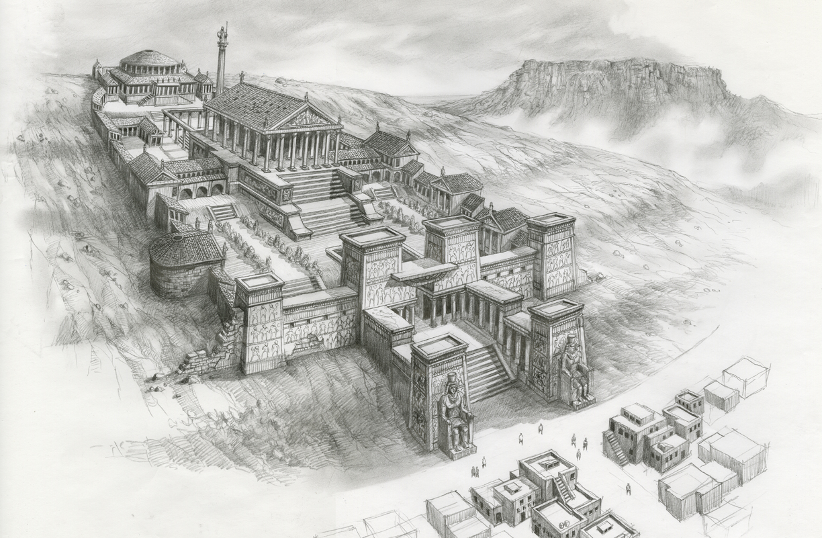
How it Started
This Photo by Unknown Author is licensed under CC BY-SA

Slide 4
How it’s Going
This Photo by Unknown Author is licensed under CC BY-SA

Slide 5
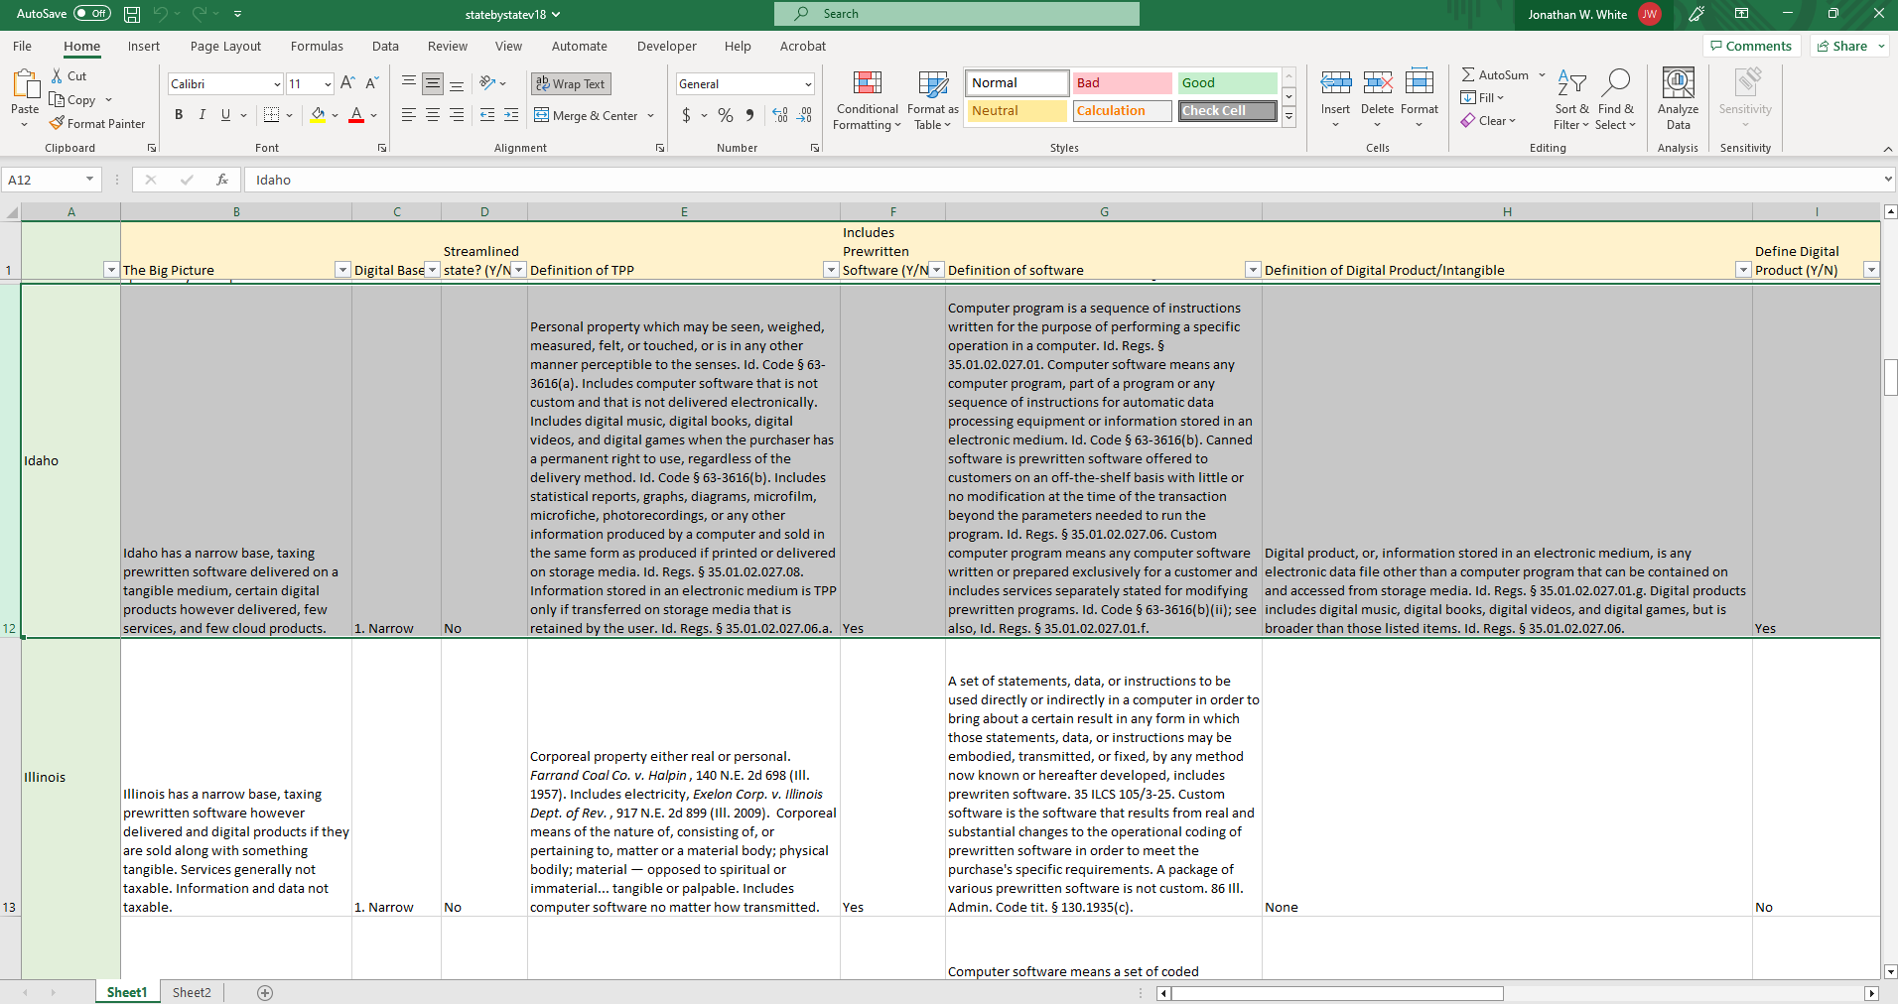
How it’s Going

Slide 6
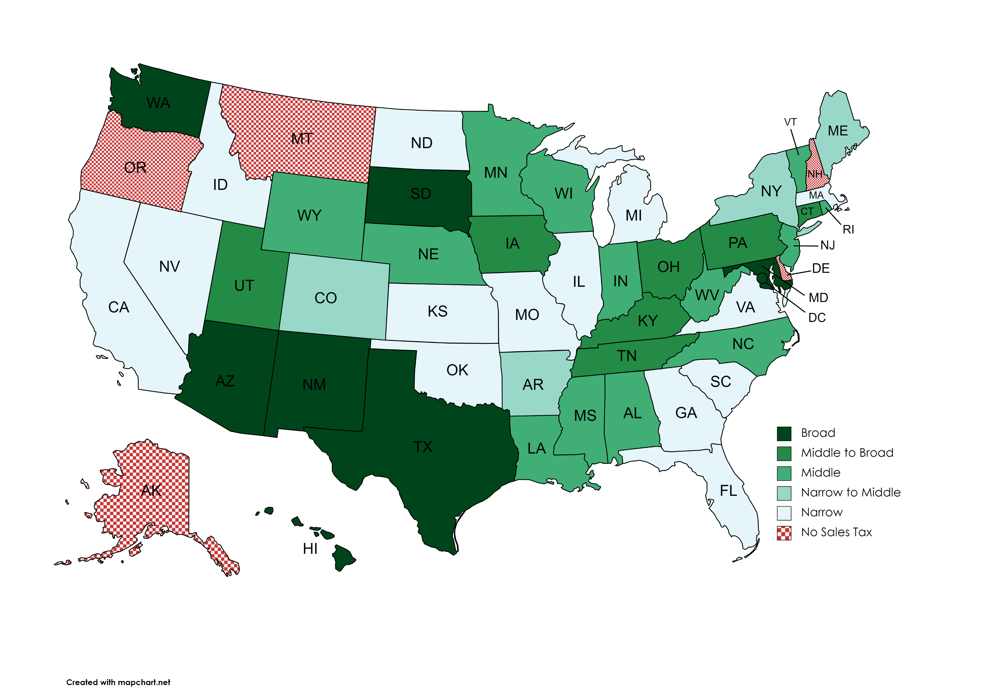
States’ “Digital” Sales Tax Bases
Source: MTC staff research.

Slide 7
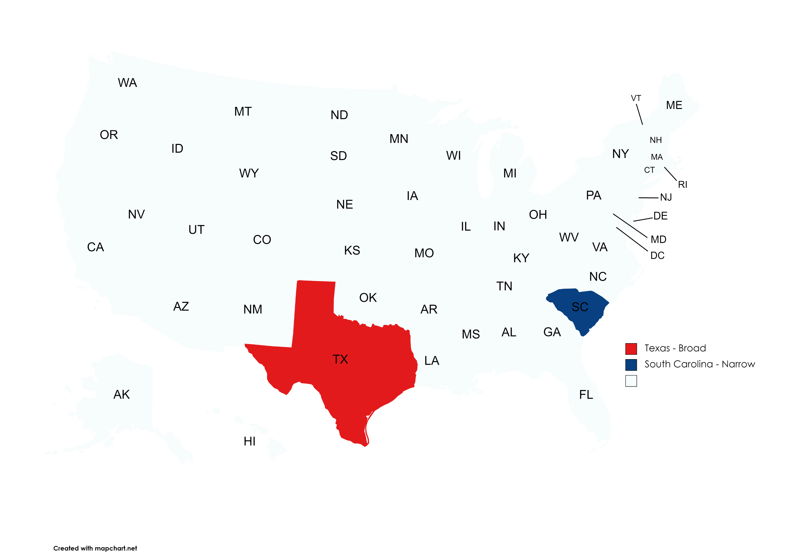
A Broad State and a Narrow State
Source: MTC staff research.

Slide 8
Curious Finding 1
The bases differ, big surprise.
The basic characterization of single items differ greatly across states, and for good reason: statute drafting decades ago.

Slide 9
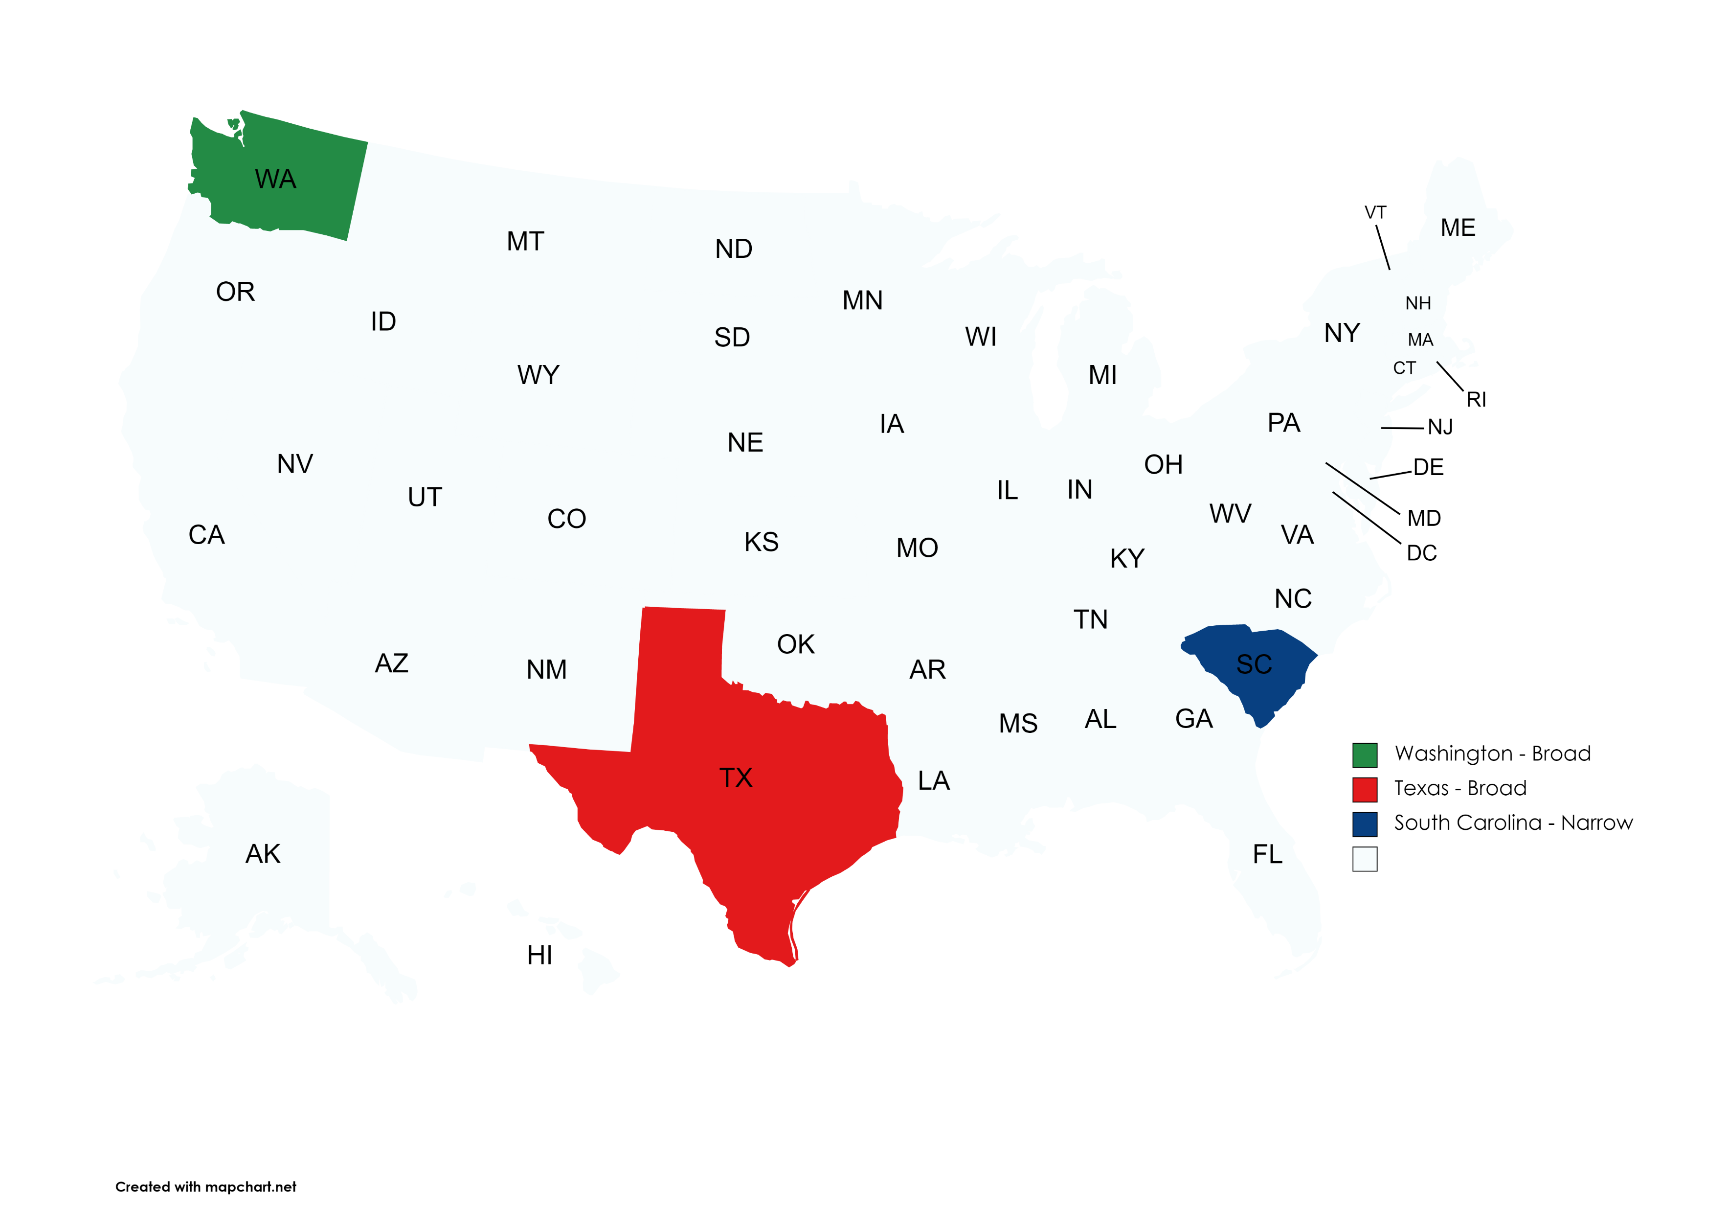
Another Broad State
Source: MTC staff research.
Source: MTC staff research.

Slide 10
Excerpt from Washington
Digital automated services means services transferred electronically that use one or more software applications but does not include services primarily (more than 50% based on time and costs) involving the application of human effort after the customer requests the service.
Digital automated service does not include data processing services.

Slide 11
Curious Finding 2
For sales tax, the characterization of an item is for squeezing it into or out of the tax base.
That characterization follows through to affect the sourcing decisions.

Slide 12
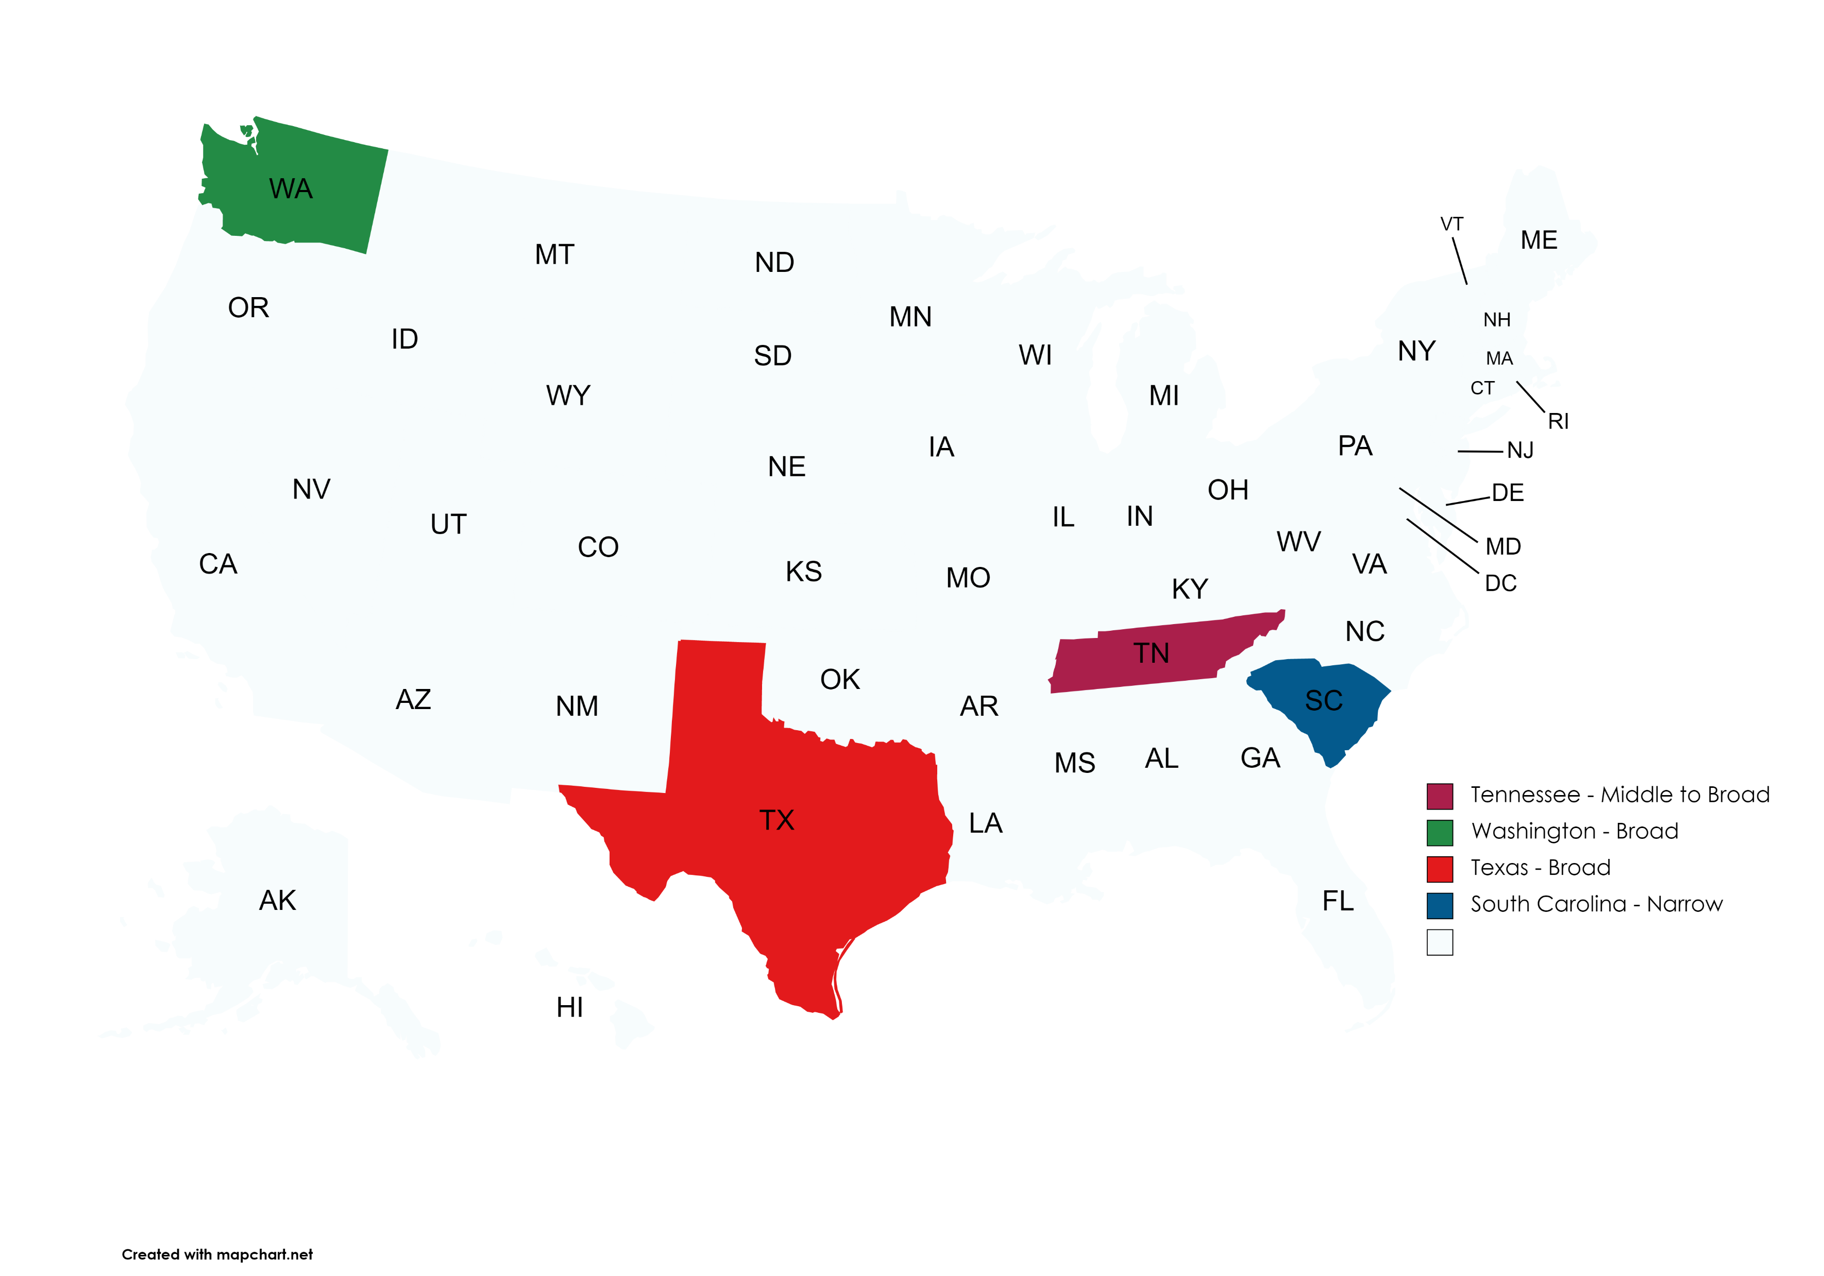
Another Broad State
Source: MTC staff research.
Source: MTC staff research.
Source: MTC staff research.
Source: MTC staff research.

Slide 13
Excerpt from Tennessee
Computer programming and code writing services, implementation, and consulting and professional services that include creating, designing, developing, fabricating, programming, or modifying taxable software are taxable even if separately stated.
Standalone installation of software is taxable if the software remains TPP after installation.

Slide 14
Curious Finding 3
The prewritten software script is repeating itself.
Is this the way?
This Photo by Unknown Author is licensed under CC BY-NC-ND

Slide 15
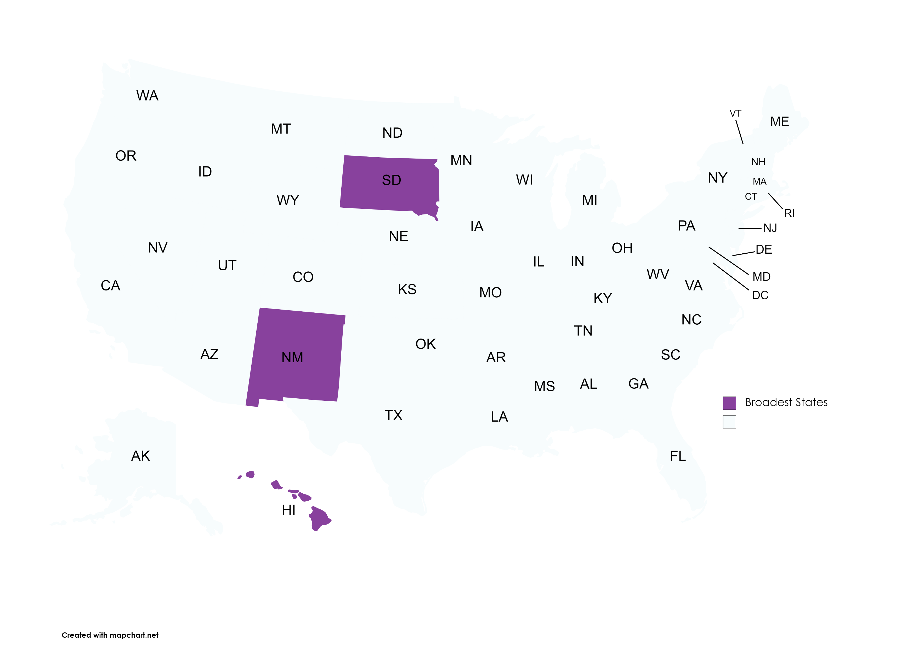
The Broadest States – Just for Fun
Source: MTC staff research.
Source: MTC staff research.
Source: MTC staff research.
Source: MTC staff research.
Source: MTC staff research

Slide 16
Closing
Jonathan W. White
Counsel
jwhite@mtc.gov

