Slide 1
Streamlined Sales Tax and Digital Products
Background and general information and specific topics related to Mtc digital products survey

Slide 2
Agenda
Background
Streamlined digital products framework
Sourcing
Exemptions
Bundled transactions
Multiple points of use
MTC whitepaper

Slide 3
What is Streamlined Sales Tax (SST)?
Effort by State and Local Governments and Business Community
Focus is on:
Simplification
Uniformity
Removing burdens
State sovereignty
Recent efforts have focused significantly on removing taxpayer burdens through the use of disclosed practices.

Slide 4
What is SST? - Streamlined’s Goals
Create a simpler system for administering the various state and local sales taxes
01
At least make processes uniform if they cannot be made simple
02
Balance the interests of a state’s sovereignty with the interests of simplicity and uniformity
03
Leverage the use of technology to ease the retailer’s tax collection and reporting
04
Notes:
Craig

Slide 5
Why Did SST Start?
1967 case of National Bellas Hess v. Illinois
1992 case of Quill Corp. v. North Dakota
States do not have the authority to require sales tax collection by out-of-state retailers with no physical presence in a state
Burdens imposed by States constituted an “undue burden on interstate commerce” and a violation of the Commerce Clause of U.S. Constitution
Notes:
Craig

Slide 6
Who’s Involved?
States
Initially - All with a sales tax except CO involved in developing the SSUTA
Voluntary Participation
23 Full member states
1 Associate member state
Local Governments
Business Community
Businesses
Tax Practitioners
Business Associations

Slide 7
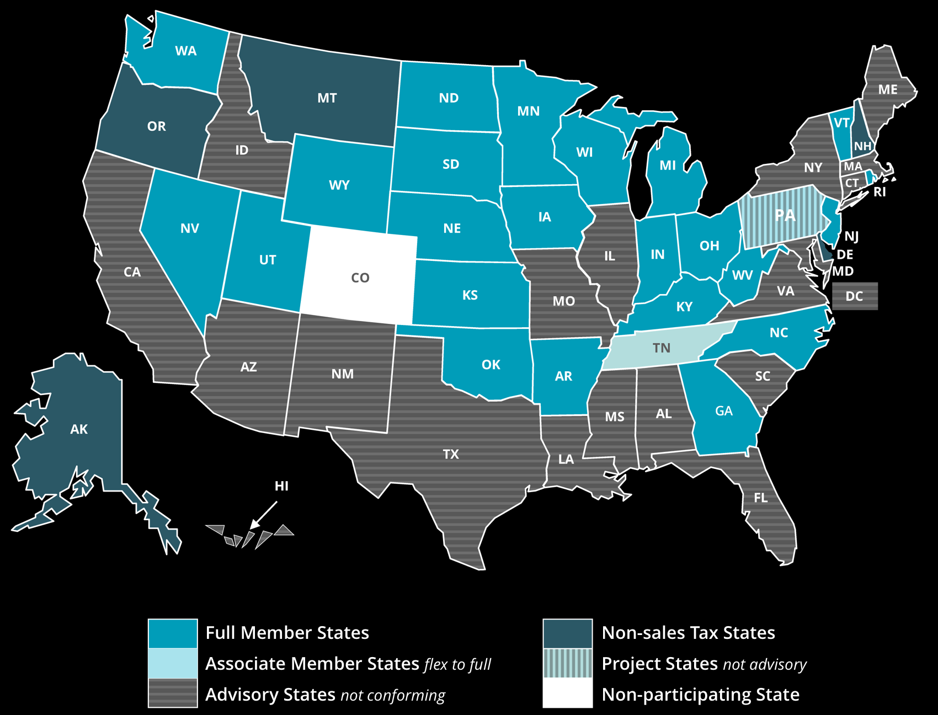
SST STATE MEMBERSHIP STATUS 04-01-2023

Slide 8
What Do We Do?
“Assist states as they administer a simpler and more uniform sales and use tax system.”
Simplify and modernize sales and use tax administration in order to substantially reduce the burden of tax compliance.
Improve sales and use tax administration systems for all sellers and for all types of commerce.

Slide 9
Background: Ideas on How to Reduce Some of the Burdens
One level of tax administration per state …no locally administered sales taxes
Set-up a central registration system
Have one rule that establishes who has the right to tax a transaction
Have fewer tax rates within each state and locality

Slide 10
Background: Ideas on How to Reduce Some of the Burdens
Have the same state and local tax bases
Have common definitions for the same product
Do not make the retailer liable when a buyer lies or fails to provide proof of an exempt sale
Have states disclose how certain items are treated

Slide 11
Results: Streamlined Sales and Use Tax Agreement (SSUTA)
SSUTA effective October 1, 2005
Current membership (4/1/2023)
23 Full members:
Arkansas, Georgia, Kansas, Kentucky, Indiana, Iowa, Michigan, Minnesota, Nebraska, New Jersey, Nevada, North Carolina, North Dakota, Ohio, Oklahoma, Rhode Island, South Dakota, Utah, Vermont, Washington, West Virginia, Wisconsin, Wyoming
1 Associate member:
Tennessee

Slide 12
Key Features of SSUTA
State level administration of local sales and use taxes
Common state and local tax bases within a state
One-stop central registration system
Uniform simplified electronic return (SER)
Rate and boundary databases
Taxability matrix

Slide 13
Key Features of SSUTA
Liability relief provisions
Certified Service Providers (CSPs)
Uniform definitions
Uniform destination-based sourcing rules for goods and services
Simplified exemption administration
Uniform administrative provisions, e.g., bundled transactions

Slide 14
Digital Goods
Comments from MTC Survey:
As a Non-Streamlined state, the Streamlined definitions seem narrow and outdated, so I would like to know how they are actually working and how the states apply their existing laws to more modern products; are those products not taxable because they are not covered?
All of that sounds good. I think discussion on future-proofing rules or statutes may be helpful, given how quickly technology changes.
Why did work on digital products stall out after the initial adoption of definitions? Is Streamlined planning to produce further guidance related to digital products sourcing? How were those definitions developed? Why haven't they developed more definitions? Are they considering developing more definitions?

Slide 15
Definitions - Digital Goods
Developing Definitions in SSUTA – incrementalist approach
Existing state definitions
Federal definitions
Industry standard definitions
Business community experts

Slide 16
Digital Goods
Definitions:
Not included in “ancillary services,” “computer software,” “telecommunications services,” or “tangible personal property”
Specific Digital Products
Digital Audio-Visual Works
Digital Audio Works
Digital Books
Digital Codes
Other Products Transferred Electronically
“If a state imposes a sales or use tax on products “transferred electronically” separately from its imposition of tax on “tangible personal property”, that state will not be required to use” any specific Streamlined digital products definition.

Slide 17
Digital Goods
Specific Criteria
End Users
Only imposed on “end users” unless the statute specifically imposes and separately enumerates the tax on someone who is not an end user
Permanent or less than permanent use
Only on permanent use unless statute specifically imposes and separately enumerates on less than permanent use
Continued payments
Only on sales that are not conditioned on continued payment unless statute specifically imposes and separately enumerates on sales conditioned on continued payments

Slide 18
Digital Goods
Additional Criteria
Digital codes
Same treatment of product to which code relates
Code can be obtained by any means (i.e., email, tangible form (song code))
Other products transferred electronically
Products outside “specified digital goods”
“Additional digital goods” – as defined by state
(a) “Additional digital goods" means all of the following, if they are transferred electronically:
1. Greeting cards.
2. Finished artwork.
3. Periodicals.
4. Video or electronic games.
5. Newspapers or other news or information products.
(b) For purposes of this subchapter, the sale, license, lease, or rental of or the storage, use, or other consumption of a digital code is treated the same as the sale, license, lease, or rental of or the storage, use, or other consumption of any additional digital goods for which the digital code relates.
Subscription to products
Can treat differently than products with no subscription

Slide 19
Digital Goods
Washington’s experience
Streamlined adopted the current digital products provisions prior to 2008
2008 digital products study
Comprehensive digital products legislation
Streamlined compliant; captures the Streamlined uniform definitions for specified digital goods and incorporates the other specific additional criteria required
Recognizes the digital space will expand and evolve over time and so leverages the SSUTA’s flexibility with respect to imposing tax on other products transferred electronically, i.e., WA enacted broader definitions for “digital goods” and “digital automated services” to capture the expansion
Other member states
Member states seeking to apply their existing laws or adopt specific new impositions to more modern products are free to do so, but there are no uniform applicable uninform definitions
The Streamlined provisions have held up well-over time, however, because of the incrementalist approach taken vis a vis specified digital products definitions, the definitions do not capture many new and emerging products
Specific state policies, politics, and fiscal needs will determine whether a state prefers a broad or narrow approach to taxation

Slide 20
Sourcing and Multiple Points of Use
Comments from MTC Survey related to Sourcing and MPU:
I'd like to explore sourcing.
What is the status of the digital products sourcing project they are working on?
Why was the concept of multiple-points-of-use (MPU) sourcing abandoned by Streamlined? What substitute to MPU sourcing is Streamlined considering?
Notes:
Tim

Slide 21
Key Features – Uniform Sourcing Rules
Sourcing Rules – SSUTA Sections 309, 310, 310.1, 311, 313, 313.1 and 314
Destination-based sourcing hierarchy
Options origin sourcing for intrastate transactions only
Rules apply regardless of characterization of product (TPP, service, digital good)
Only apply with respect to seller’s obligation to pay or collect
Do not affect purchaser’s obligation based on where product is used
Notes:
Tim

Slide 22
Key Features – Uniform Sourcing Rules
General Rules – Retail Sales – SSUTA Section 310.A
Destination-based sourcing hierarchy for retail sales
1. Business location of seller
2. Location where receipt (takes possession of goods or makes first use of services) by purchaser occurs known to the seller
3. Address available from purchaser’s books and records
4. Address obtained during consummation of sale
5. Location from which:
TPP shipped;
Digital good or computer software was first available for transmission; or
Service was provided

Slide 23
Key Features – Uniform Sourcing Rules
Simple example
Joe purchases a digital visual audio work (movie) from Seller. Seller electronically transfers the movie file to Joe’s email address. Seller likely does not know where Joes received the movie file, and will likely source the sale to the purchaser’s address as reflected in Seller’s books and records or obtained at the consummation of sale
Current challenge
Seller does not know and has no business reason to obtain the information or location of receipt of the product to complete the sale
Business practices and customer friction
Emerging products and forms of payment (i.e., nonfungible tokens and crypto currency)
Streamlined workgroup regarding seller use of address, 9-digit zip code, and 5- digit zip code

Slide 24
Key Features – Uniform Sourcing Rules
SST Sourcing Workgroup
Local Sales Tax Revenues
Origin Sourcing – Foreign Sellers
Business Advisory Council Principles
Class Action and Qui Tam Lawsuits

Slide 25
Multiple-Points-of-Use
Section 312 of the SSUTA – Repealed December 2006
Notwithstanding the provisions of Section 310, a business purchaser that is not a holder of a direct pay permit that knows at the time of its purchase of a digital good, computer software, or a service that the digital good, computer software, or service will be concurrently available for use in more than one jurisdiction shall deliver to the seller in conjunction with its purchase an exemption certificate claiming multiple points of use…
Upon receipt of an exemption certificate claiming multiple points of use, the seller is relieved of all obligation to collect, pay, or remit the applicable tax and the purchaser shall be obligated to collect, pay, or remit the applicable tax on a direct pay basis…
A purchaser delivering an exemption certificate claiming multiple points of use may use any reasonable, but consistent and uniform, method of apportionment that is supported by the purchaser's books and records as they exist at the time the transaction is reported for sales or use tax purposes…
Notes:
Craig

Slide 26
Multiple-Points-of-Use
Section 312 of the SSUTA – Repealed December 2006
At time of repeal – various specific rules adopted
Developed and adopted as a compromise
Rule 309.2 – Sourcing Prewritten Computer Software
Rule 309.3 – Sourcing Computer-Related Services
Rule 309.4 – Sourcing Computer Software Maintenance Contracts
Rule 309.5 – Sourcing Software Term License Subscriptions
Notes:
Craig

Slide 27
Exemption Administration
Exempt same as TPP
Internet Tax Freedom Act (tangible v. digital form)
Exempt same items whether in tangible or digital form
Example: The sales price from the sale of and the storage, use, or other consumption of specified digital goods or additional digital goods, if the sale of and the storage, use, or other consumption of such goods sold in a tangible form is exempt from, or not subject to, taxation under this subchapter.
Notes:
Craig

Slide 28
Bundled Transactions
Comments from MTC Survey:
Bundling of digital goods with other taxable/nontaxable non-digital good items, sourcing of mixed transactions where you have digital goods and non-digital goods. A detailed approach on how vendors/Streamlined States can determine the separate products/services within a bundle.
Notes:
Tim

Slide 29
Bundled Transactions
SSUTA Section 330 and Rule 330
General Rules
Sale of two or more products (except real property or services to real property)
Products are otherwise distinct and identifiable
Packaging not included
Product provided free of charge
Items in definition of “sales price” (delivery charges, services necessary to complete the sale, etc.)
Sold for one nonitemized price
States can tax or exempt bundled transactions
Treat different bundles differently
Notes:
Tim

Slide 30
Bundled Transactions
SSUTA Section 330 and Rule 330
Does not include:
Sales of products where the price varies based on selection by purchaser of products included
TPP and service if TPP essential to the use of the service
Two services if one service is essential to use or receipt of other service
Transactions if taxable products de minimis
10% or less of sales price or purchase price
50% if food, drugs, DME MEE, OTC drugs, prosthetic devices
Unbundling (limited options)
Telecom, ancillary, internet access or audio or video programming
Notes:
Tim

Slide 31
Bundled Transactions
SSUTA Section 330 and Rule 330
Unbundling transactions
Telecom, ancillary, internet access or audio or video programming
All taxable unless:
Provider can verify nontaxable products
Reasonable and verifiable standards
Books and records kept in ordinary course of business
If products taxed at different rates:
All taxed at highest rate unless:
Provider can verify price attributable to products at lower rate
Reasonable and verifiable standards
Books and records kept in ordinary course of business
Notes:
Craig
Option of Seller to unbundle – state and consumer can’t force unbundling

Slide 32
The Future
The MTC whitepaper represents a unique opportunity for Streamlined to participate and share its experience in this area and to work with the larger tax community in promoting continued sound tax policy development. For example…
Contributing material on Streamlined’s digital products framework for consideration as part of the MTC whitepaper
Exploring opportunities to develop additional voluntary definitions consistent with the Streamlined incrementalist approach
Benefits
Time-tested digital products framework
Compliments the broader imposition approach discussed at the MTC, providing state policy makers more option to make informed decisions
Streamlined participation entails collaboration with additional state administrators, legislators, and members of the business community
Notes:
Tim/Craig

Slide 33
QUESTIONS?

Slide 34
Streamlined Sales Tax Governing Board STAFF
Craig Johnson, Executive Director SST
Jody Bartels, IT Director
Christie Comanita, Research & State Compliance Director
Jim Romano, IT Technology and Programming Specialist
Bobbie Stellner, Administrative Operations Manager/Executive Assistant
Notes:
Craig

