Slide 1
State Taxation of Partnerships
January 18, 2022

Slide 2
White Paper Preliminary Outline
Survey of Available Industry Data
(What do entities that might be “investment partnerships” look like?)
General Categories and Descriptions
Private Equity and Hedge Funds
Other Entities
IRS, SEC, and Other Data on Such Entities
Size, Assets, Ownership, Activities, Etc.
Survey of State Tax Rules
(How do states define and treat investment partnerships?)
Definitions – Assets and Income
Other Qualifications or Limitations
Sourcing of Income –
Differences by Type (if any)
Differences by General or Limited Partner (if any)
Other Issues
Analysis of State Rules
Future Evolution and Projected Industry Changes

Slide 3
Last Call
Investment partnerships – defined broadly – account for a majority of all partnership income
The vast majority of this income is portfolio income - interest, dividends, and capital gains
Investment partnerships are lightly regulated and not publicly traded
Include private equity funds, venture capital funds, hedge funds, etc.
Limited partners include other investment partnerships, individuals, corporations, tax exempt entities & governments, and foreign persons

Slide 4
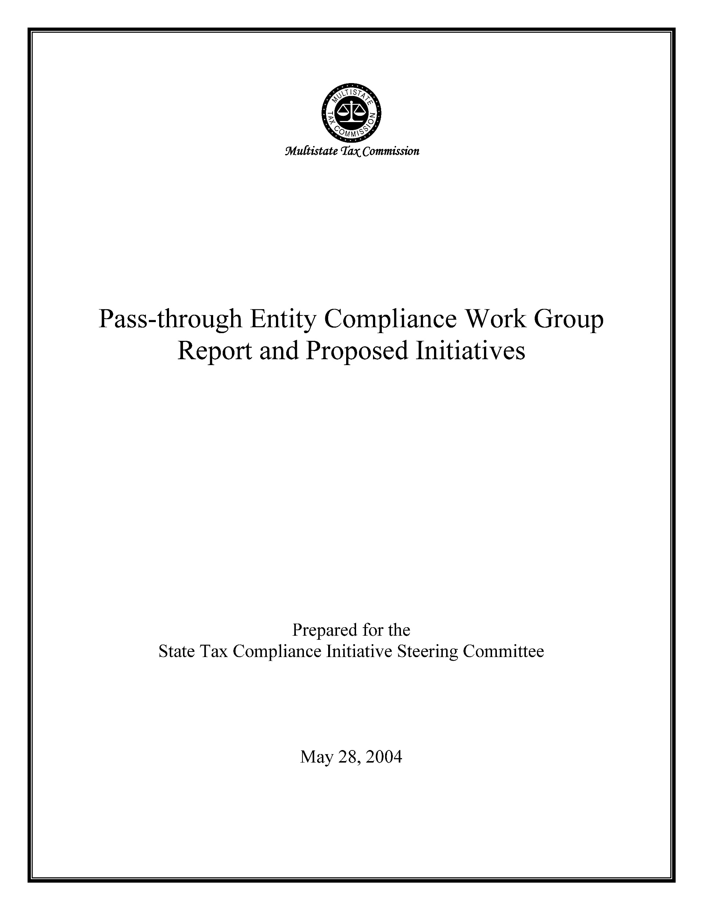
This is not the first foray into the partnership area by the MTC . . .

Slide 5
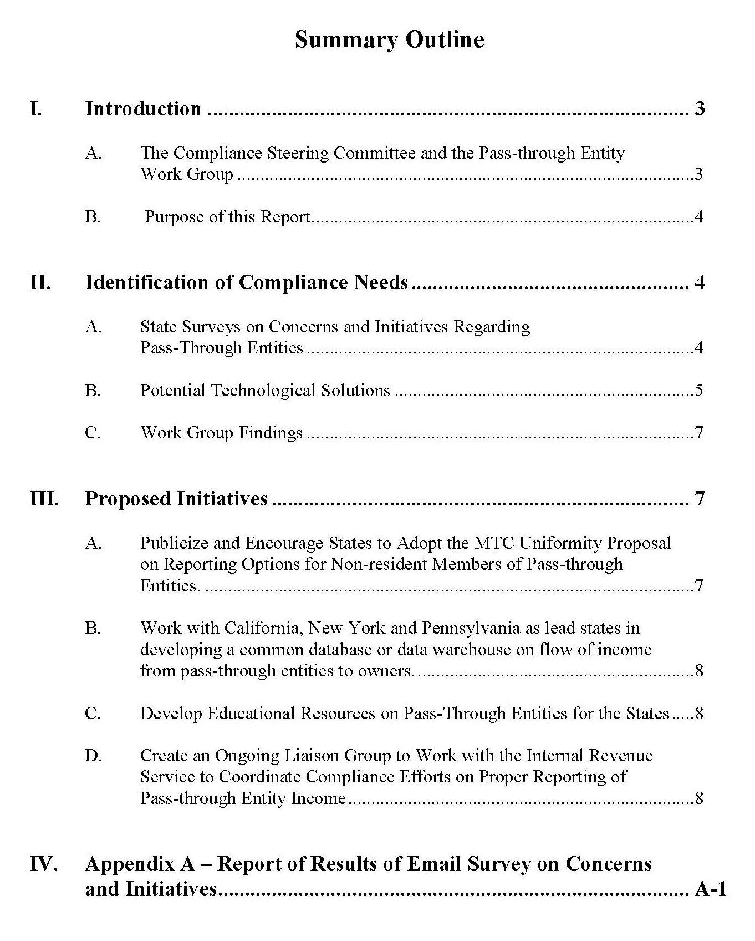

Slide 6
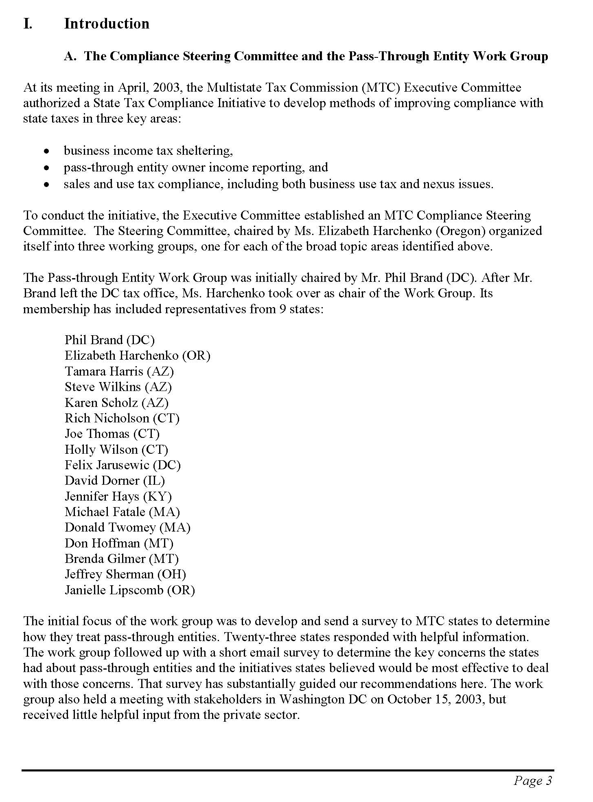
Some things don’t change . . .

Slide 7
Results of Survey –
from the 2004 Report

Slide 8
Emerging picture . . .
(Subject to Change)

Slide 9
Context – Default Partnership Rules
Becoming clearer -
States assert nexus over out-of-state partners (even limited minority partners)
Majority sourcing rules (distributive share) – whether limited or minority –
Individual partners – based on partnership factors
Corporate partners – based on partnership plus partner factors
Withholding, composite returns, and PTE taxes are accepted means of taxation

Slide 10
Exception – Investment Partnerships
Majority sourcing rule – (for state in which the IP offices are located)
Limited partners
Individual – to state of residence
Corporate – to domicile or apportioned using corporate factors alone
Rationale
Some states suggest nexus over limited partners is lacking or they are not “engaging in business” in the state where the IP is located
Some states suggest the income is “nonbusiness” income
Other - policy

Slide 11
Variations
Definitions of investment partnerships
Other rules for qualifying as an IP
Treatment of corporate partners
Treatment of general (managing) partners

Slide 12
Still Somewhat Murky
What does the IP rule mean for credits for taxes paid?
What about the state where the IP’s investments are located?

Slide 13
Where to draw the line -
Formal
Informal
Management & Structure
Unrelated
Closely Held
Relationship of Investors
Passive
Active
Relationship with Investees
Many
Few
Number of Investments

Slide 14
Example:
IP
Non-IP
OP

Slide 15
Update on Partnership Training
Coming soon . . .

