Slide 1
State Taxation of Partnerships
August 31, 2021

Slide 2
Project Plan
The project work group has outlined a general approach to the project:
Identify and generally describe a comprehensive list of potential issues.
Note the important relationships between those issues.
Select a particular issue and develop generally recommended practices or positions.
Repeat step 3 until all major issues have been addressed and reconcile any differences.
Agree on overall set of recommended practices/positions for all issues.
Begin creating draft models, etc., to carry out the recommended practices/positions.

Slide 3
Roadmap
17 Aug.
ISSUE OUTLINE General Approach Terms Operating Income -Nexus & Federal Conformity
31 Aug.
ISSUE OUTLINE Operating Income -Federal Conformity cont’d & Sourcing
14 Sep.
ISSUE OUTLINE Operating Income Sourcing cont’d & Credits
28 Sep.
ISSUE OUTLINE Sale of Partnership Interest Nexus & Conformity
12 Oct.
ISSUE OUTLINE Sale of Partnership Interest Sourcing & Credits
26 Oct.
ISSUE OUTLINE Administrative & Enforcement

Slide 4
Updates – To Outline of August 10, 2021
Before each meeting – any input/updates to the sections discussed previously will be highlighted in yellow
See August 26, 2021 outline
First page – describes the functionality of the outline in Word
Particularly Federal Conformity starting at p. 11.
2.2.2. Conformity Implications and Questions

Slide 5
Today
Conformity Implications & Questions
Sourcing of Partnership Income

Slide 6
Conformity Implications & Questions

Slide 7
2.2.2 Conformity Implications & Questions
This section focusses on conformity to Subchapter K in particular.
Conformity to the federal passthrough approach has a number of implications that it appears most states have not fully considered or addressed.

Slide 8
2.2.2 Conformity Implications & Questions
2.2.2.1. Guaranteed Payments to Partners Treated as Deductible Expense
Implications:
Certain payments to partners are treated not as an allocation of partnership income (distributive share) but as a partnership expense.
This includes payments to partners that are tiered partners.
Questions:
2.2.2.1.2 Should guaranteed payments be sourced separately from distributive shares?
2.2.2.1.3. Should guaranteed payments be subject to state anti-income shifting or other limitations?

Slide 9
2.2.2 Conformity Implications & Questions
2.2.2.2. Special Allocations Allowed
Implications:
Distributive shares do not always match partnership interests and may not be the same for all partnership items of income, gain, loss, and expense.
IRC has extensive rules intended to limit abusive tax planning.
Questions:
2.2.2.2.2. Are there circumstances in which special allocations should be sourced differently than allocations made in accordance with the partners’ interest in the partnership?
2.2.2.2.3. Are there circumstances in which special allocations would have substantial economic effect for federal purposes but arguably not for state purposes and, if so, may states apply the same limitations as under federal rules?

Slide 10
2.2.2 Conformity Implications & Questions
2.2.2.3. Built-In Gain or Loss on Contributed Property Allocated Back to Contributing Partner
Implications:
Partners can make tax-free contributions of property with built-in gain/loss.
To avoid shifting tax consequences between partners, these gains/losses are generally allocable back to the contributing partner when the property is later exchanged.
Question:
2.2.2.3.2. Should these built-in gains and losses be sourced differently by the affected partner?

Slide 11
2.2.2 Conformity Implications & Questions
2.2.2.4. Partners May Offset Income and Loss from Different Partnerships or Other Sources
Implication:
The effects of this at the state level are unclear.
Question:
2.2.2.4.2. Are there cases involving related-company income or gains and losses where states may need to limit partners ability to offset those items.

Slide 12
2.2.2 Conformity Implications & Questions
2.2.2.5. Conformity to Federal Anti-Abuse Rules (Generally)
Implication:
The general flexibility of the federal pass-through system has led to abuse and, as a response, the IRC, including Subchapter K, now contains a number of anti-abuse provisions.
Questions:
2.2.2.5.2. As in other areas, the intersection of state and federal tax rules may create a number of questions as to how federal rules, like these anti-abuse rules, will apply at the state level, including:
Questions concerning whether federal statutory and regulatory rules created for one set of circumstances will apply in analogous circumstances involving state taxes.
Questions concerning how conflicts between state and federal tax rules should be resolved.
Questions concerning the extent to which federal tax principles should be employed in interpreting state tax statutes tied to federal statutes.

Slide 13
2.2.2 Conformity Implications & Questions
2.2.2.6. Other General Federal Anti-Abuse Rules
Implication:
Because of the use of partnerships for abusive tax planning – the IRS has often cited partnership structures or transactions that will not be respected.
Question:
2.2.2.6.2. Question: Can such federal rules be used to address potential state tax avoidance strategies?
NOTE: MTC has a disclosure model that would apply partnerships.

Slide 14
2.2.3. State Approaches to Intercompany Transactions
(Including Transfer Pricing and Add-Back Statutes, and Other State Anti-Abuse Provisions)
Examples that affect state tax owed
Use of IRC Sec. 482
Use of State Add-Back Statutes

Slide 15
Sourcing of Partnership Income

Slide 16
Sourcing of Partnership Income
2.3.1 - Situs Based and Apportionment Based Sourcing
2.3.2 - Differences Between Corporate and Individual Partners
2.3.3 - Methods of Sourcing Partnership Income - Generally
2.3.4 - Effect of Tiered Partnership Structures on Sourcing
2.3.5 - Example – Differences in Results Between Methods Used
2.3.6 - Sourcing Methods – Constitutional Requirements
2.3.7 - Sourcing Methods – Policy and Other Considerations
2.3.8 - Application of UDITPA

Slide 17
Terms: Situs-Based and Apportionment-Based Sourcing
Situs-Based Sourcing
Refers to sourcing income to a particular geographic location.
Apportionment-Based Sourcing
Refers to sourcing income using a formula based on certain factors so that the income may be divided between multiple locations.

Slide 18
Differences Between Corporate and Individual Partners
States typically tax corporate income based on the source of the income.
States typically use a hybrid method to tax income of individual partners.
Unlike corporate partners, individual partners do not have their own apportionment factors.

Slide 19
Methods of Sourcing Partnership Income
Situs-based sourcing – using partnership information.
Situs-based sourcing – using partner information.
Apportionment-based sourcing – using partnership information.
Apportionment-based sourcing – using corporate partner information.
Apportionment-based sourcing – using a combination of the partnership and corporate partner’s apportionment factors.

Slide 20
Effect of Tiered Partnership Structures on Sourcing
Lower-tier passthrough sourcing
Upper-tier sourcing
Combination sourcing

Slide 21
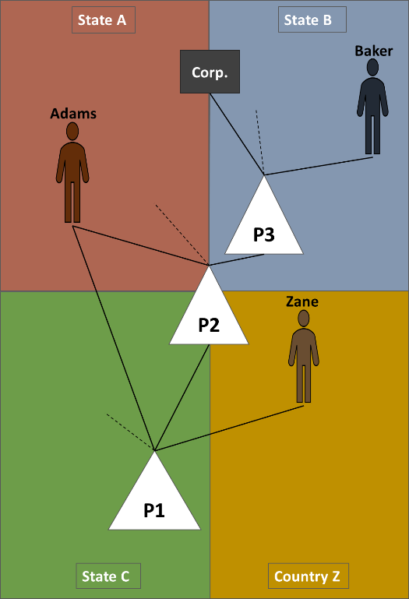
Example – differences in results between methods used
Assume that P1 has an amount of income that will be allocated to its partners (and their partners) through the structure shown in the diagram

Slide 22
Situs-based sourcing
The income might be sourced to a situs (including domicile or residence). But the result will differ depending on which of the methods is used:
Situs determined at the recognizing partnership level (P1), with that sourcing information passed through to each of the taxpayer partners.
Situs determined at the partner level

Slide 23
Apportionment-based sourcing
P1 Direct/Indirect | Adams | Baker | Zane | Corp | P2 | P3 | Other | Total
Direct Shares P1 | 40.00% |  | 10.00% |  | 40.00% |  | 10.00% | 100.00%
Direct Shares P2 | 40.00% |  |  |  |  | 40.00% | 20.00% | 100.00%
Direct Shares P3 |  | 50.00% |  | 40.00% |  |  | 10.00% | 100.00%
Indirect Shares P1 | 16.00% | 8.00% |  | 6.40% |  |  | 9.60%
Total | 56.00% | 8.00% | 10.00% | 6.40% |  |  | 19.60% | 100.00%
For this purpose, assume the various partners direct and indirect shares of the P1 income are as follows:

Slide 24
Assume that each of the jurisdictions about have single sales-factor apportionment. Also assume we are looking for the amount of the P1 income that would be apportioned to state C.
Sales & Sales Factors | State A | State B | State C | Country Z | Total
P1 Sales |  |  | $1,000 |  | $1,000
Factor | 0% | 0% | 100% | 0% | 100%
P2 Sales | $500 | $500 | $500 | $500 | $2,000
Factor | 25% | 25% | 25% | 25% | 100%
P2 Share of P1 | $0 | $0 | $400 | $0 | $400
P2 Plus Share of P1 | $500 | $500 | $900 | $500 | $2,400
Factor | 21% | 21% | 38% | 21% | 100%
P3 Sales |  | $4,000 |  |  | $4,000
Factor | 0% | 100% | 0% | 0% | 100%
P3 Indirect Share of P1 | $0 | $0 | $160 | $0 | $160
P3 Share of P2 & P1 | $200 | $200 | $360 | $200 | $960
P3 Plus Indirect Share of P1 | $0 | $4,000 | $160 | $0 | $4,160
Factor | 0% | 96% | 4% | 0% | 100%
P3 Plus Share of P2 & P1 | $200 | $4,200 | $360 | $200 | $4,960
Factor | 4% | 85% | 7% | 4% | 100%
Corp Sales | $5,000 | $5,000 |  |  | $10,000
Factor | 50% | 50% | 0% | 0% | 100%
Corp Indirect Share of P1 | $0 | $0 | $64 | $0 | $64
Corp Indirect Share of P2 & P1 | $80 | $80 | $144 | $80 | $384
Corp Share of P3, P2 & P1 | $80 | $1,680 | $144 | $80 | $1,984
Corp Plus Indirect Share of P1 | $5,000 | $5,000 | $64 | $0 | $10,064
Factor | 50% | 50% | 1% | 0% | 100%
Corp Plus Indirect Share of P2 & P1 | $5,080 | $5,080 | $144 | $80 | $10,384
Factor | 49% | 49% | 1% | 1% | 100%
Corp Plus Share of P3, P2 & P1 | $5,080 | $6,680 | $144 | $80 | $11,984
Factor | 42% | 56% | 1% | 1% | 100%

Slide 25
Next Steps
We will continue to flesh out the outline and identify questions and issues.
Send anything you think we should include or anything we’ve missed and we’ll incorporate it.
Next meeting:
Finish sourcing of operating income
Discuss credits for taxes paid (residents)

