Slide 1
The Rise of Pass-through Businesses
Notes:
1

Slide 2
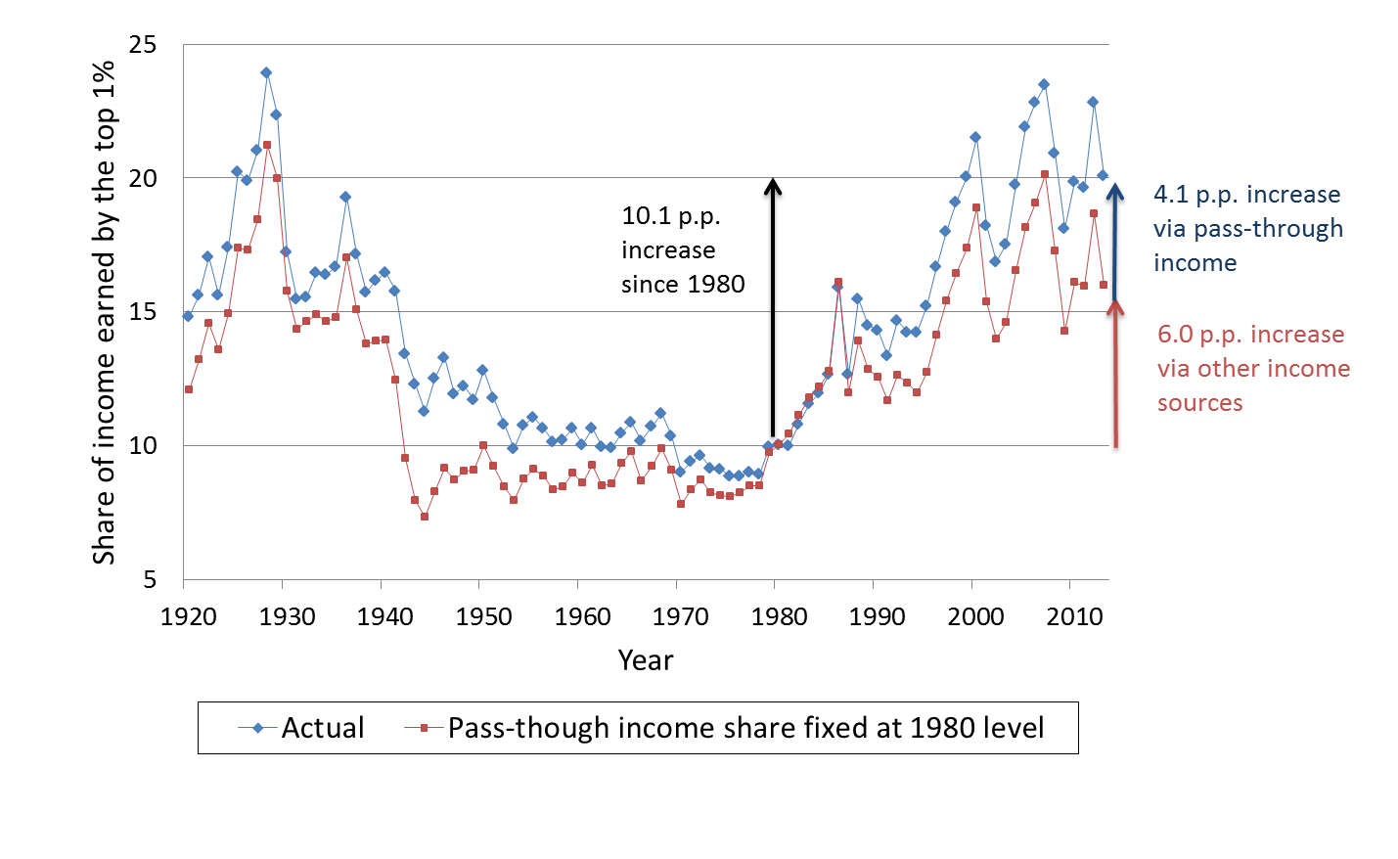
Pass-through Income and the 1% Income Share
Notes:
2

Slide 3
Why C-Corporation?
A Firm’s choice of business structure is likely a function of both tax and non-tax concerns.
C-Corporations:
Double Taxation
Limited liability
“Broad access to Capital Markets”
Deferral
Pre-1986 the Preferred Mechanism for Tax Avoiders

Slide 4
Why Pass-through Business?
Sole Proprietorships
Single Layer of Tax but must include Self-Employment Contribution Act (SECA) taxes
Filed on 1040 Schedule C
S-Corporations (“subchapter S entities”)
Limited Liability
Subject to Closely Held Rules
Some income avoids SECA taxes
Partnerships
Limited Liability
Some income avoids SECA taxes
Flexibility in Distribution/Form

Slide 5
Why Pass-through Business?
Sole Props
‘Single Operator’
Simplest Form
‘Out of Garage’ or Gig Worker
Receive Direct Payments or 1099s (information Returns)
Report Earnings on 1040 Schedule C
Fill out Schedule SE

Slide 6
Why Pass-through Business?
S-Corporation
Individual Shareholders only (certain trusts/estates)
‘100’ or less Shareholders
One Class of Stock (Pro Rata)
Income Retains Flavor
The Reasonable Compensation Problem
Owner-Shareholders are required to pay Wages
Remaining Earnings are not subject to SECA
No Strict Rule on ‘How Much’

Slide 7
Why Pass-through Business?
Partnership
Must have one ‘taxable’ partner
Most Complicated Form
Sophisticated Filers
Partners Receive Payments via K-1 (information Return)
Report Earnings on 1040 Schedule E (individual)
Fill out Schedule SE (individual)
Fill out 1120 (corporate)
Income retains ‘flavor’

Slide 8
Who Owns a Business?
C-Corporation
“Everyone”- Mutual Funds, Trusts, Pensions, etc
$1031.0B net income
Sole Proprietors
In 2011, 23.4 million returns that filed a schedule C
$282.6B net income
S-Corporations
7.2 million K-1 net incomes from the 4.5 million S-corps to 4.8 million individuals
$375.4B net income
Partnership
25.5 million K-1s from the 3.6 million Partnerships
$580.9B net income

Slide 9
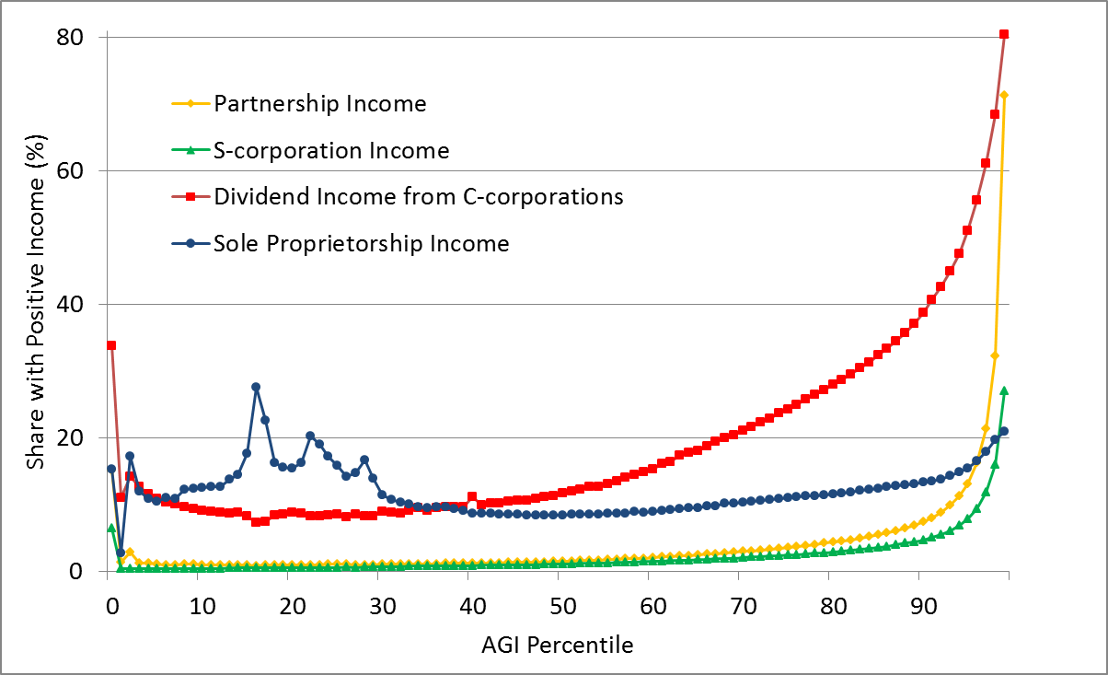
Business Participation Rates by AGI Percentile
Notes:
9

Slide 10
Who Owns a Business?
Partnerships continued
Partners can be one of many entity types including other partnerships
Distributions of income need not be pro-rata
We have K-1s for 97.7% of partnerships
The K-1s we use account for over 98% of income

Slide 11
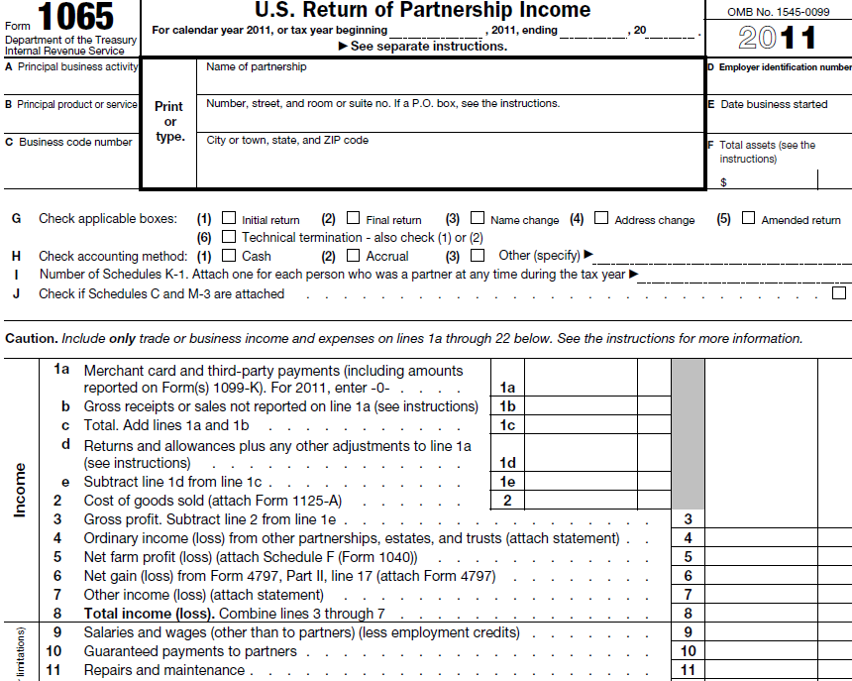
Partnerships file a business income tax return…
Notes:
11

Slide 12
…which lists allocations only by partner type…
Notes:
12

Slide 13
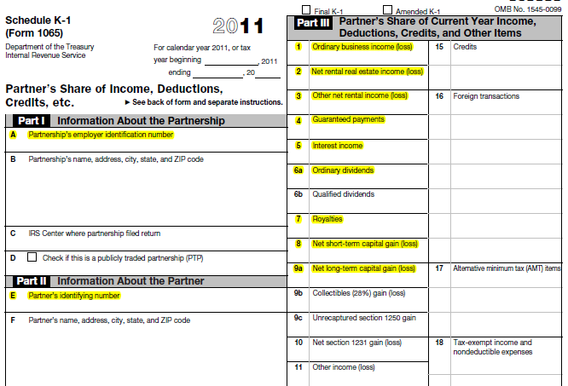
…but are reflected in K-1s (issued per partner)
Notes:
13

Slide 14
Who Owns Partnerships?
Number of K-1s by Type of Partner

Slide 15
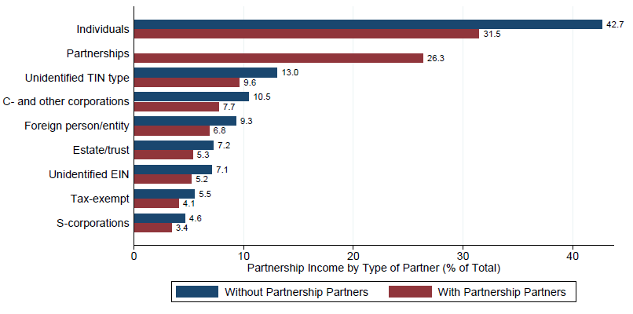
Who Owns Partnerships?
Income Shares by Type of Partner

Slide 16
Calculation of Average Tax Rates
We calculate tax rates for every business. These are average rates determined by dividing tax paid by taxable income.
For C-corporations, we divide the reported tax paid on the Form 1120 by taxable income. We also impute the tax from the second layer of tax levied on the owner’s dividends and capital gains.
For Sole Proprietors, we recalculate what tax would have been due on the Form 1040 if the taxpayer’s Schedule C income was zero and then divide this change in tax due by the amount of Schedule C income.
S-Corporations and Partnerships require a calculation at the owner level and then an aggregation weighted by the income flows to determine the tax paid on the business’s income.

Slide 17
Partnership Chains
Partnerships can be partners in other partnerships. We use the K-1s to trace income through the chain of partnerships.
We recursively solve from the non-partnership owner back through the chain to where the business activity occurred.
B
C
1040/1120
1040/1120
A
1040/1120
1040/1120

Slide 18
Partnership Chains
Partnerships can be partners in other partnerships. We use the K-1s to trace income through the chain of partnerships.
We recursively solve from the non-partnership owner back through the chain to where the business activity occurred.
Not all structures are solvable via this method.
D
E
1040/1120
1040/1120
F
1040/1120
1040/1120

Slide 19
Many Partnerships Are Opaque
In many cases we can not directly link the business activity of partnership to the ultimate owner.
We can not match 2.4 million K-1s to a tax return for the partner.
These K-1s account for 20% of partnership income.
We assign a tax rate for all of these partners.
And after recursively tracing the income through the chains of partnerships there are 22,417 partnerships out of the 3.6 million that are without definitive linkages between firm and all owners.
These partnerships issue 9.6 million K-1s (out of 25.5 million).
They account for approximately $100 billion in income.
The average tax rate on this income is 8.8%.

Slide 20
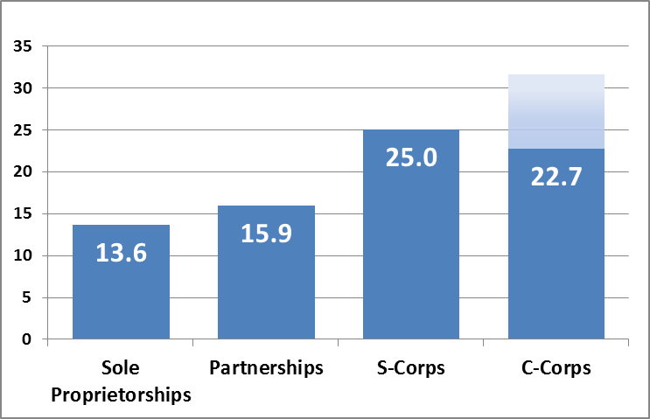
Average Tax Rate by Entity Type
Notes:
20

Slide 21
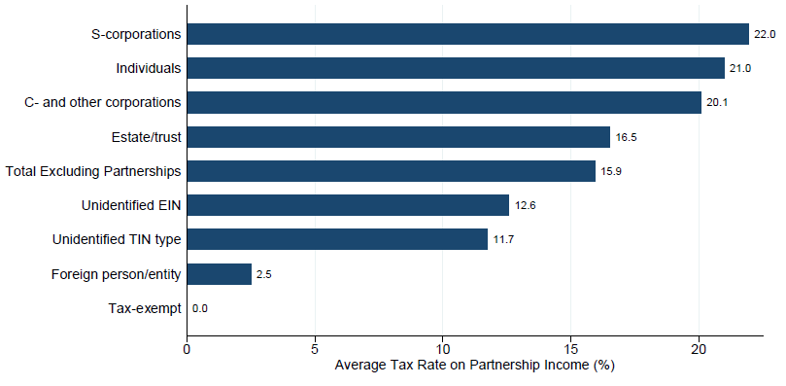
Average Tax Rates on Partnership Income
Notes:
21

Slide 22
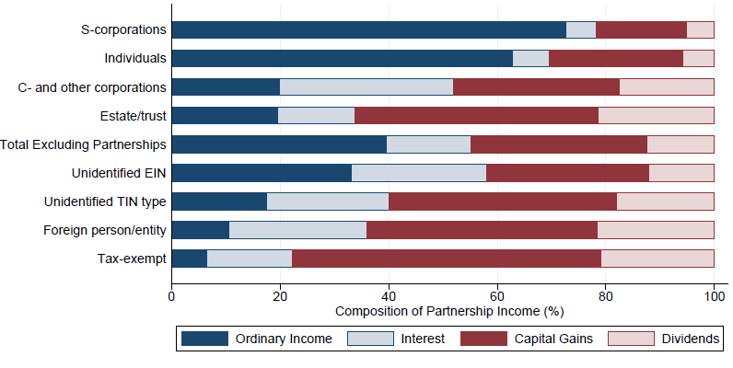
Partnership Income Type by Partner Type
Notes:
22

Slide 23
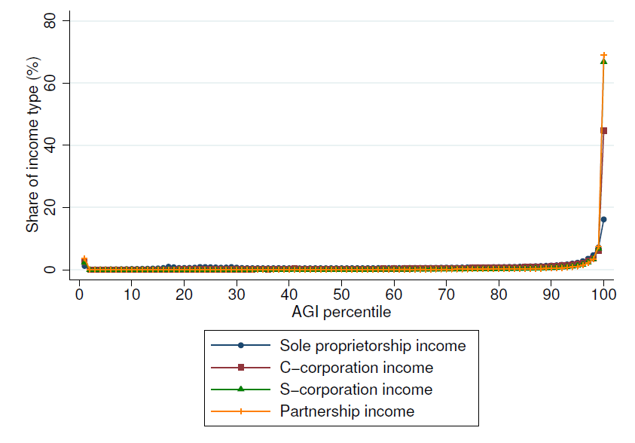
Business Income Shares by AGI

Slide 24
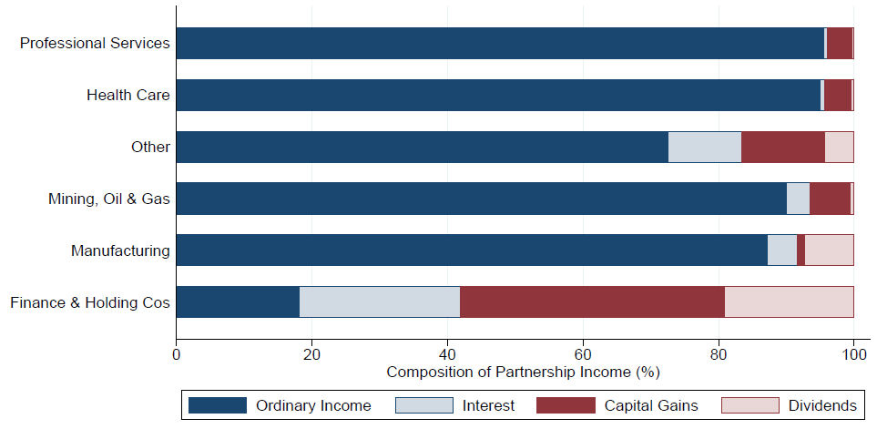
Partnership Income Type by Industry

Slide 25
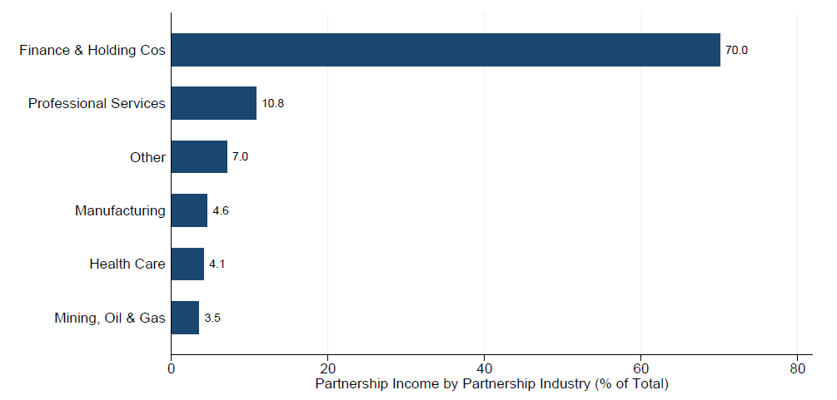
Distribution of Partnership Income by Industry

Slide 26
Check Point
The Rise of Pass-throughs: U.S. business activity is migrating from corporations to pass-throughs.
Who Owns Partnerships?
About half of partnership income taxed on individual returns.
At least 15% to foreign or tax exempt entities with little tax.
At least 10% to C-corporations.
Remaining ownership is opaque.
How Much Tax Do They Pay?
In 2011 the average tax rate on pass-through income was 19%.
Implication: The rise of pass-throughs has lowered the average tax rate on business income and as a result tax receipts are lower than they would otherwise be.
Notes:
26

Slide 27
Flexibility of Income
Intertemporal Shift
Capital Gains
Base Shift
Choice of Entity
Flavor Shift
Capital vs. Labor
Combination
Notes:
27

Slide 28
Ease of Conversion
Check-the-Box rules allow Pass-Throughs to choose taxation under the corporate system.
Corporate Taxation is simpler than Partnership
Conversion to C-corporation is largely costless
Conversion to Pass-Through is *not* costless
Notes:
28

Slide 29
Tax Rate Comparison of Business Types
Tax wedge between the corporate and individual tax base is:
W = Τ_{net corp} - Τ_{ind}
Where:
Τ_{net corp} = Τ_{corp} + (1 – Τ_{corp} ) · ( α · Τ_{div} + ( 1- α ) · β · Τ_{cg} )
α = share of corporate income paid out as dividends
β = a measure of the benefits of capital gains deferral
Notes:
29

Slide 30
Tax Rate Comparison of Business Types
Table 1: Top Statutory Tax Rates in 2017 and 2018
 | 0% Retained
 | 2017 |  | 2018
Type of Tax | C-corporation | Pass-through | C-corporation | Pass-through | with 20% Deduction
Entity Tax | 35.0% | 0.0% | 21.0% | 0.0% | 0.0%
Individual Tax | 20.0% | 39.6% | 20.0% | 37.0% | 29.6%
Net Investment Income Tax | 3.8% | 3.8% | 3.8% | 3.8% | 3.8%
Net Rate | 50.5% | 43.4% | 39.8% | 40.8% | 33.4%
Rate Differential |  | 7.1 |  | -1.0 | 6.4
 | 100% Retained
 | 2017 |  | 2018
Entity Tax | 35.0% | 0.0% | 21.0% | 0.0% | 0.0%
Individual Tax | 0.0% | 39.6% | 0.0% | 37.0% | 29.6%
Net Investment Income Tax | 0.0% | 3.8% | 0.0% | 3.8% | 3.8%
Net Rate | 35.0% | 43.4% | 21.0% | 40.8% | 33.4%
Rate Differential |  | -8.4 |  | -19.8 | -12.4
Notes:
30

Slide 31
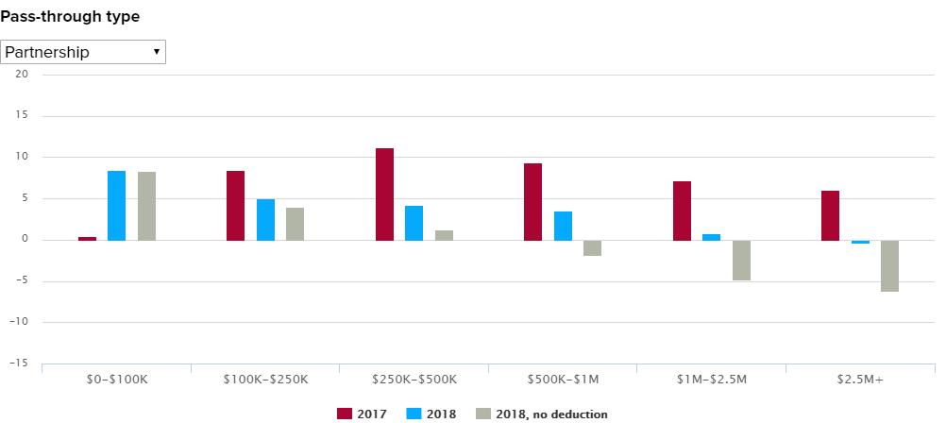
Tax Rate Comparison 52% Retained
Notes:
31

Slide 32
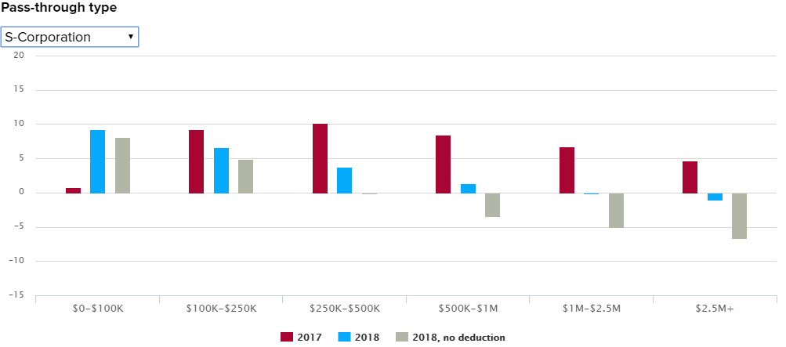
Tax Rate Comparison 52% Retained
Notes:
32

Slide 33
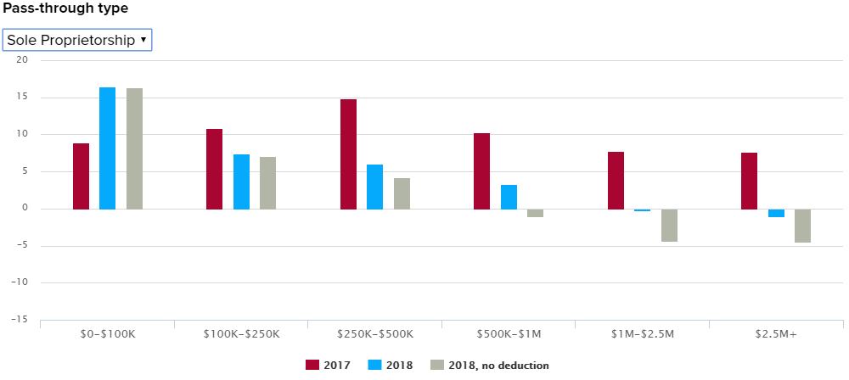
Tax Rate Comparison 52% Retained
Notes:
33

Slide 34
Observations from TCJA
Not Everyone Optimizes Their Tax Position
77% of Beneficiaries had AGI > $500K
17.5% of Ordinary Pass-Through Business
Notes:
34

Slide 35
Pass-Through Policies on the Hill
SECA/NIIT Conformity
Wealth Taxation
Mark-to-Market
Treatment at Death
Centimillionaire Tax
Notes:
35

Slide 36
SECA Conformity
Proposed by Obama (restrictively)
Internal to OTA since 2007ish
Keys:
Reasonable Compensation (Gingrich-Edwards)
Active/Passive designation for NIIT
Loophole
Confuses Capital/Labor
‘Hurts’ Small Business
Not necessarily general revenue
Notes:
36

Slide 37
Centimillionaire Tax
“Minimum Tax” on Wealthiest
20% Effective Tax Rate
Includes unrealized gains
Not subject to Tax if “Illiquid”
i.e. Private Wealth is 80% of wealth
More Pass-Throughs?
Notes:
37

Slide 38
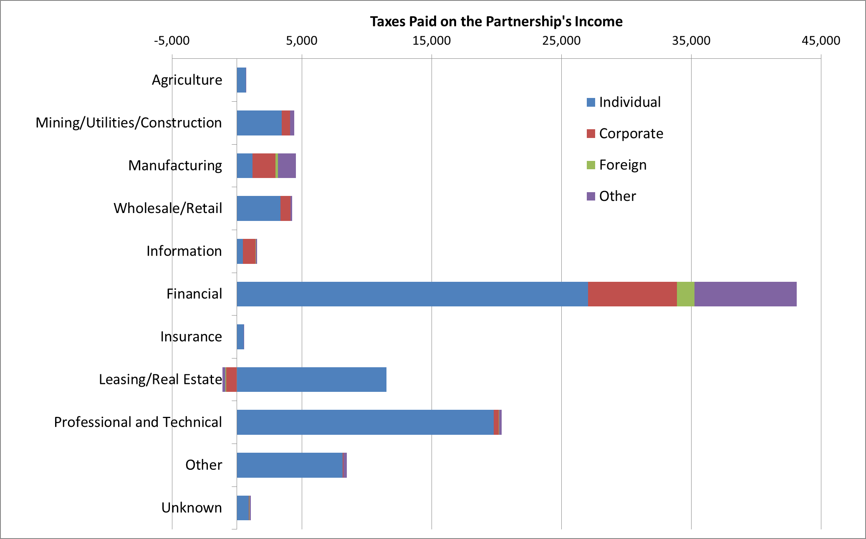
Tax on Partnership Income by Industry

Slide 39
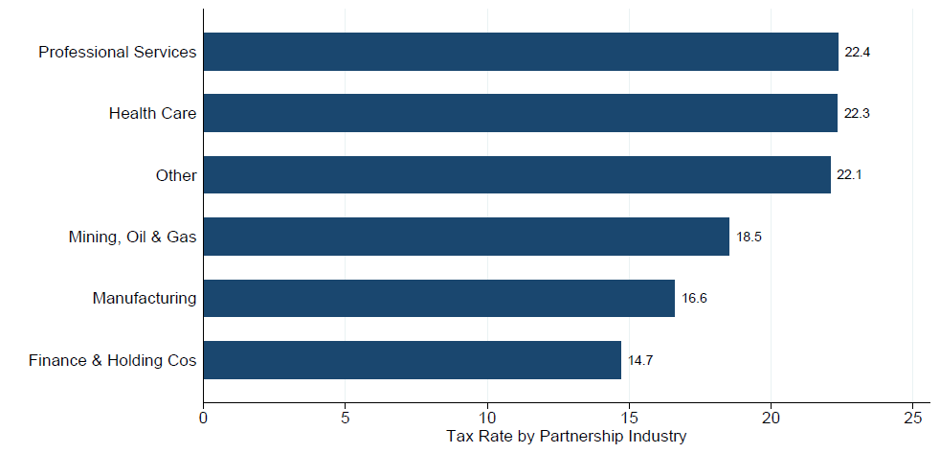
Partnership Income Tax Rates by Industry

Slide 40
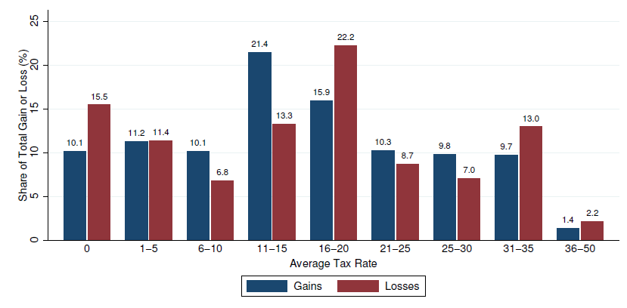
Gains and Losses by Tax Rate

