Slide 1
Interactive Slides Illustrating Basic Federal Partnership Audit Process & Major Effects Under Existing State Law Including Important Issues Not Addressed
Prepared by MTC Staff – April 2017
Based on Proposed IRS Regulations
(For Review and Discussion Purposes Only)

Slide 2
Information & Instructions
YOU MUST BE IN SLIDE SHOW MODE TO USE INTERACTIVE FEATURES OF THIS SLIDE DECK
In Powerpoint, activate slide show mode by going to the “Slide Show” tab on the main menu
Select “From Current Slide”
In the slide show, page forward to the slide following this one
Click on any icon on that page to go to the slide that provides more detail (a random click will take you to the next slide in the deck)
Click “back to home page” on any slide to return
(You can also scroll through the slides)
The icons represent important issues, in the process, not addressed under existing state law

Slide 3
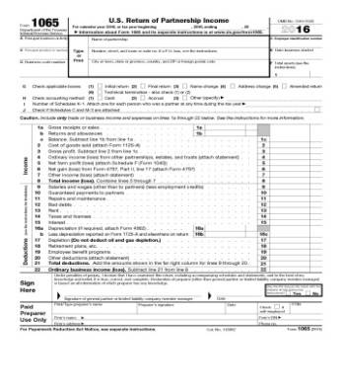
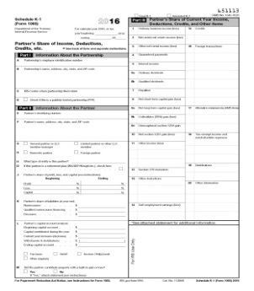
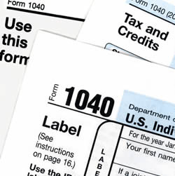
Phase I – Partnership Audit
Proposed Partnership Adjustment
Phase II – Modification Period
Final Partnership Adjustment
Phase III – Partnership Pays or Pushes Out

Slide 4
Phase I: Partnership Audit
IRS audits at partnership level –
Large partnerships with more than 100 partners or non-taxpayer partners
Small partnerships not electing out
For the typical audit year (“reviewed year”) which will be 2-3 years in the past when the audit begins
BACK TO HOME PAGE

Slide 5
Phase I: Partnership Audit
The partnership audit may affect all partners including both direct and indirect taxpayer-partners
The audit will broadly encompass all issues affected by the reporting of partnership items of income and transactions
Every partnership must designate a partnership representative (PR)
BACK TO HOME PAGE

Slide 6
Phase I: Partnership Audit
The IRS will do the audit through the partnership representative (PR) and the partnership’s accountants/practitioners, etc.
Does not need to be an individual or a partner
Must be a U.S. person
If the partnership does not have a qualified PR, the IRS may appoint one
BACK TO HOME PAGE

Slide 7
Phase I: Partnership Audit
Role of the PR is governed by federal law and the partnership agreement –
Under federal law –PR will make binding decisions for the partners and the partnership with respect to the audit
Under the partnership agreement - the partners may direct the PR’s decisions but the agreement cannot conflict with the PR role under federal law
BACK TO HOME PAGE

Slide 8
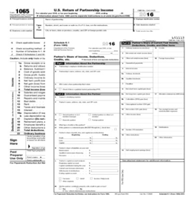
Phase I: Partnership Audit
General scope of the federal audit –
The audit will cover the partnership return (1065) and the allocation of partnership items made on the K-1s to all partners (but not allocations at upper or lower partnership tiers)
The IRS will typically be auditing one year – but the adjustments may affect subsequent years as well and these effects will be taken into account
BACK TO HOME PAGE

Slide 9
Phase I: Partnership Audit
Under proposed regulations, adjustments will be determined and imputed underpayments will be calculated as follows:
Related adjustments will be grouped
Adjustments within groupings will be netted
Netted adjustments will form the basis for two types of imputed underpayments of concern to states –
General imputed underpayment (affecting all partners) – of which there will be only one
Specific imputed adjustments (affecting only some partners) – of which there could be more than one
BACK TO HOME PAGE

Slide 10
Phase I: Partnership Audit
Final audit report reviewed by PR –
As part of the audit process, the IRS will provide the proposed adjustments to the PR and may agree to review certain information prior to the issuance of the notice of proposed partnership adjustment (PPA) in an effort to resolve issues in an expedited fashion
However, once the PPA is issued, the modification procedures (discussed next) are the partnership’s only formal route to request changes to an imputed underpayment set forth in the PPA
BACK TO HOME PAGE

Slide 11
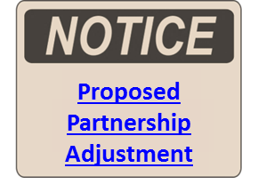
Phase I: Partnership Audit
IRS will issue a notice of proposed partnership adjustment (PPA) computed, generally, as follows:
Net adjustments to partnership items having a positive affect on tax due PLUS
Positive re-allocations to partners (not net of negative re-allocations) TIMES
Highest tax rate
BACK TO HOME PAGE

Slide 12
Phase II: Modification Period
The IRS provides a 270-day modification period –
Period may be extended by IRS
Purpose of the period is to allow the PR to obtain all information necessary for any modifications to the PPA
BACK TO HOME PAGE

Slide 13
Phase II: Modification Period
Partners may choose to “pay up” –
By amending their reviewed (audit) year returns, as well as subsequent returns affected by adjustments, and pay the tax on the adjustments if SOL is still open
If SOL is not open –
A partner may extend the SOL and file an amended return
A partner may enter into a closing agreement and pay, without filing an amended returns
No requirement for all partners to amend – BUT – if there is to be a modification of the partnership liability for a re-allocation adjustment – then all partners affected by that re-allocation must file
It does not appear partners can challenge the adjustments if they file amended returns
BACK TO HOME PAGE

Slide 14
Phase II: Modification Period
State effects under existing law if amended federal returns are filed -
If partners file amended federal returns – state amended returns will also be required
But there will not be an amended federal partnership return (1065) or an amended K-1 – instead – the partners would base their federal amended returns on the PPA and supporting audit adjustment information
There may be no requirement to file an amended composite return
BACK TO HOME PAGE

Slide 15
Phase II: Modification Period
Important issues not addressed under existing state law – Amended Returns Filed –
What happens if a composite return was filed originally and a partner wants to amend
Some partners may file amended returns reducing tax owed (for example – where there are re-allocated amounts) – resulting in refunds which may or may not be allowed
States may also want a closing-agreement procedure, similar to the IRS
BACK TO HOME PAGE

Slide 16
Phase II: Modification Period
IRS will modify the PPA based primarily on two kinds of information provided by the PR:
Information that one or more partners have filed amended returns, taken all adjustments into account for all affected years (which may include years subsequent to the reviewed year) and have paid the tax due
If the adjustments are re-allocations of partnership items, all affected partners must have filed amended returns
Information on partner tax rates or tax exempt status
BACK TO HOME PAGE

Slide 17
Phase III: Partnership Pays or Pushes Out
The IRS will issue a modified final partnership adjustment (FPA) to the partnership –
The FPA is computed in a similar fashion to the proposed partnership adjustment
This FPA is the partnership-level liability that would have to be paid if the partnership does not “push out” the adjustments to the partners
BACK TO HOME PAGE

Slide 18
Phase III: Partnership Pays or Pushes Out
Important issues not addressed under existing state law – Modifications –
The modifications made by the IRS will not take into effect whether or not partners filed amended state returns and paid state tax, or proved that partners had lower state rates or are exempt from state taxes
Therefore – the partnership may not be entitled to modification at the state level
BACK TO HOME PAGE

Slide 19
Phase III: Partnership Pays or Pushes Out
At this point, the PR has several decisions to make:
Whether to pay the FPA without contesting it
Whether to elect to push-out the adjustments without contesting them
Whether to contest the FPA (or some part) without electing to push out adjustments
Whether to contest the FPA (or some part) and push out the adjustments
BACK TO HOME PAGE

Slide 20
Phase III: Partnership Pays or Pushes Out
Partnership pays –
If the PR decides not to elect to push out the adjustments, the partnership will have to pay the FPA
Practitioners and taxpayers worry that it is not clear how this tax should be viewed – whether it is, in effect, tax owed by some or all of the taxable partners but paid by the partnership
BACK TO HOME PAGE

Slide 21
Phase III: Partnership Pays or Pushes Out
Important issues not addressed under existing state law – Partnership Pays –
If states are also going to allow the partnership to pay the liability they will have to be able to compute that liability (with appropriate modifications for state purposes)
Also states will have to be able to apportion the liability
States would need to clarify what the payment constitutes—whether it is a payment on behalf of some or all partners for their state taxes, etc.
BACK TO HOME PAGE

Slide 22
Phase III: Partnership Pays or Pushes Out
Partnership elects to push out adjustments –
If the PR elects to have the partnership push out the adjustments to the reviewed-year partners, then the partnership will have to provide the affected partners (and the IRS) information returns –
Containing necessary information to compute the tax for all affected years (including years subsequent to the reviewed year, if necessary)
So that it can be reported and paid on their current (adjustment) year returns
Partnership is then relieved of liability
BACK TO HOME PAGE

Slide 23
Phase III: Partnership Pays or Pushes Out
State effects under existing law, depending on how federal adjustments are required to be reported –
It is possible that at least some states would include the pushed-out adjustments in computing state tax owed for resident partners in the adjustment year (under their conformity statutes)
In that case, would a state into which a partner had moved since the reviewed year tax the adjustments?
BACK TO HOME PAGE

Slide 24
Phase III: Partnership Pays or Pushes Out
Important issues not addressed under existing state law – Push-Out –
If states allow the same kind of push-out treatment, they will need the partnership to provide additional information to the partners
Nonresident partners will need apportionment information for the reviewed year
If partners are not affected (because they filed amended federal returns or for some other reason) states will need this information so as to verify that the push-out for state purposes is proper
BACK TO HOME PAGE

Slide 25
Phase III: Partnership Pays or Pushes Out
PR contests the FPA adjustments –
PR may contest the adjustment whether or not the push-out election is made
Partnership must pay the FPA as a deposit in order to contest any adjustments, but can defer pushing out those adjustments until there is a final determination
Partnership and all affected partners will be represented by the PR who will make all decisions (presumably, assisted by counsel)
A final determination occurs when the matter is resolved without the option for further appeal
BACK TO HOME PAGE

Slide 26
Phase III: Partnership Pays or Pushes Out
Important issues not addressed under existing state law – PR Contests FPA –
Will the state also require some sort of deposit in order to protect its interest
Can the partnership contest the state-level liability if it does not contest the federal liability
BACK TO HOME PAGE

Slide 27
Phase III: Partnership Pays or Pushes Out
Related federal issues –
In addition to the tax – the IRS will assess penalties and interest and require payment of those amounts
The IRS will also limit the issues that can be raised by the partnership in contesting the FPA or any adjustments
Presumably, a final determination may affect intervening years
BACK TO HOME PAGE

Slide 28
Phase III: Partnership Pays or Pushes Out
Important issues not addressed under existing state law – Related Issues –
How will of penalties and interest be calculated
If the state allows the partnership to pay the liability
If the state follows the push out and reporting of adjustments on adjustment year returns
How will statute of limitations apply
What is the affect on composite returns filed in the reviewed year
BACK TO HOME PAGE

